Slide 1


Funding at the National Science Foundation: Strategies and Recent Developments
February 2021
Directorate for Social, Behavioral & Economic Sciences
Toby Parcel, Ph.D.
Formerly SES/SBE/Sociology
Notes:
Credit: NSF/Nicolle Rager Fuller Glad to be here today; I was prohibited from giving this type of talk to you while I was at NSF out of fairness; but these slides have, with adaptation, been used in outreach in multiple venues. Thanks for attending and especially thanks to those of you who have served on any NSF panels lately and those of you who have provided ad hoc reviews. We couldn’t do it without you!

Slide 2
Background and Topics for Today NSF and SBE as Organizations Preparing Proposals Cross-Disciplinary Programs at NSF Challenges and Opportunities

Slide 3
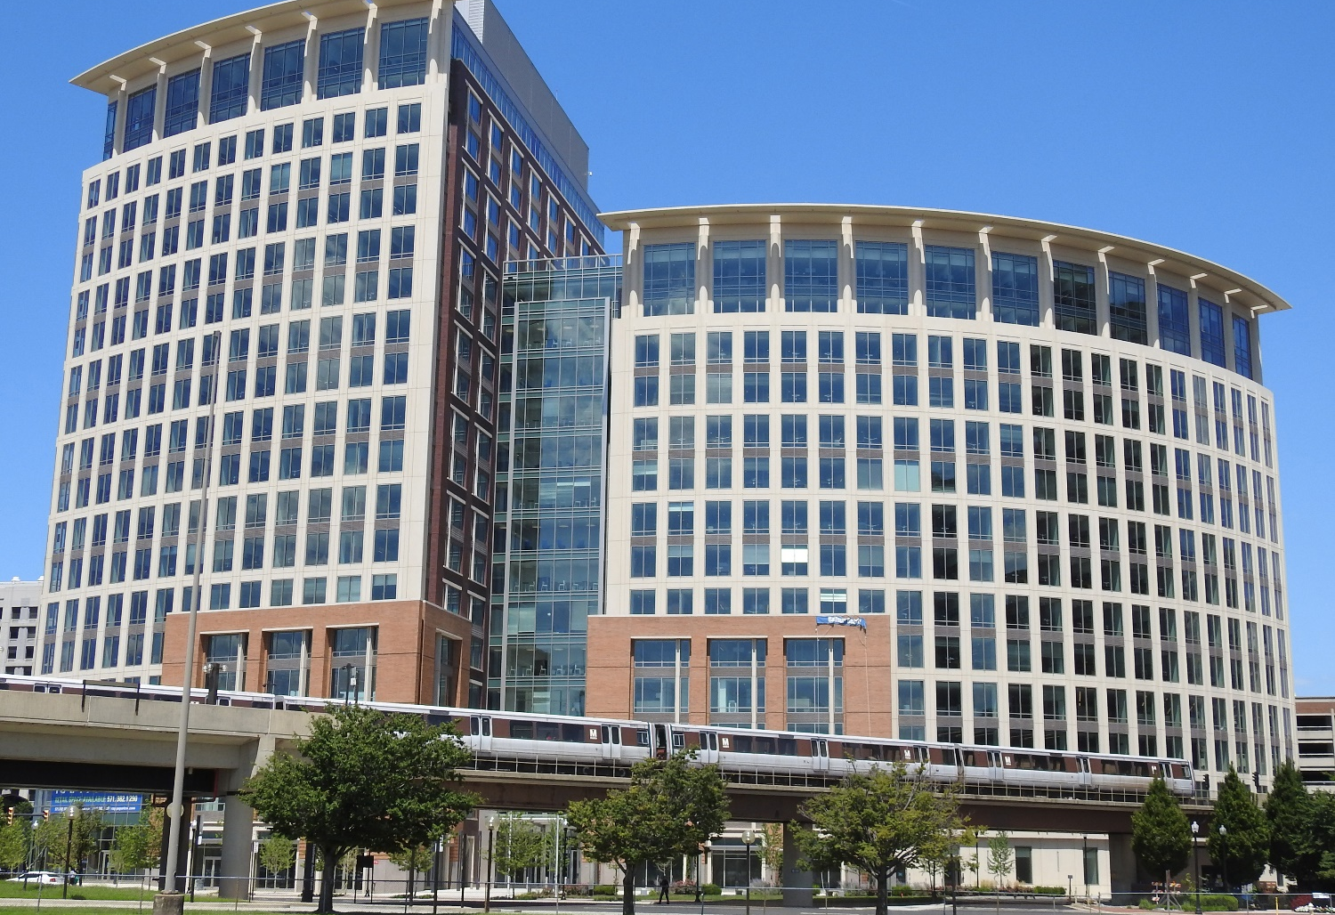
National Science Foundation (NSF)
Independent federal agency created in 1950
NSF Mission
To promote the progress of science;
To advance the national health, prosperity, and welfare;
To secure the national defense
Notes:
NSF is an independent federal agency created by Congress in 1950 "to promote the progress of science; to advance the national health, prosperity, and welfare; to secure the national defense…"
Annual budget of about $8.0 billion – funds approximately 20 percent of all federally supported basic research conducted by America’s colleges and universities
Most of the funds support peer reviewed grants to individuals or small groups of investigators – currently about 11,000 new awards per year, with an average duration of three years
NSF also provides funding for research centers, instruments, surveys and facilities

Slide 4
The National Science Foundation
Is a science funding and management agency
Budget of $8.5B in FY21, 2.5% increase over FY20; $8.3 billion in FY20, 2.5% increase over FY19
Currently about 10,000 new awards per year with an average duration of 2.6 years
Notes:
Budget increases have not gone to regular programs; they have gone to interdisciplinary/cross disciplinary, Big Ideas.

Slide 5
NSF Funds All Fields of Science & Engineering
Biological Sciences
Education & Human Resources
Social, Behavioral & Economic Sciences (SBE)
International Science and Engineering
Engineering
Mathematical & Physical Sciences
Computer & Information Science & Engineering
Geosciences (including Polar Programs)
Integrative Activities
Notes:
SBE is considered STEM at NSF

Slide 6
Your Life. Our Work. SBE.
Social, behavioral and economic (SBE) sciences advance scientific knowledge about people and society. This knowledge furthers NSF's mission to advance U.S. health, prosperity, welfare, and defense — it is critical for the country's well-being.
SBE sciences explore human behavior and social organizations. They look at how economic, political, environmental, social, and cultural forces affect the lives of people from birth to old age — and how people in turn shape those forces.
Notes:
Promote the understanding of people and their lives by supporting research that:
Reveals basic facets of human behavior and
Helps provide answers to important societal questions and problems
Work with other disciplines to ensure that basic research and solutions to problems build upon the best multidisciplinary science
Provide mission-critical statistical information about science and engineering in the U.S. and the world

Slide 7
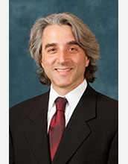



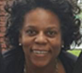
Directorate for Social, Behavioral and Economic Sciences
Arthur “Skip” Lupia
Assistant Director
Kellina Craig-Henderson
Deputy Assistant Director
Behavioral and Cognitive Sciences
Social and Economic Sciences
National Center for Science and Engineering Statistics
Office of Multidisciplinary Activities
Marc Sebrechts
Division Director
Research Experiences for Undergraduates Sites
SBE Postdoctoral Research Fellowships
Science of Science : Discovery, Communication and Impact
Daniel Goroff
Division Director
Emilda Rivers
Division Director
Archaeology and Archaeometry
Biological Anthropology
Cultural Anthropology
Human-Environment and Geographical Sciences
Cognitive Neuroscience
Developmental Sciences
Linguistics
Perception, Action and Cognition
Science of Learning and Augmented Intelligence
Social Psychology
Human Networks and Data Science
Economics
Accountable Institutions and Behavior
Security and Preparedness
Sociology
Decision, Risk and Management Sciences
Law and Science
Methodology, Measurement and Statistics
Science of Organizations
Science and Technology Studies
Secure & Trustworthy Cyberspace
Ethical and Responsible Research
Statistical information about science and engineering in the U.S. and the world
The nation’s investment in R&D
Education and workforce info of scientists and engineers
Developing indicators of the nation’s competitiveness and innovation capacity
Notes:
$244 million annual budget (FY 2018 Enacted) $279M BY 2020; SBE probably spent more than that by the end of FY20.
SBE Supports Basic Research on People and Society
Human behavior
Social organizations
Social, economic, political, cultural, and environmental forces
Patterns of stability & change
Individual, group, organizational
Birth to advanced ages
How people in turn shape those forces to promote the progress of science and to advance the national health, prosperity, and welfare

Slide 8
Broadening Participation (BP) Opportunities
NSF is committed to diversity and furthering BP of underrepresented groups in STEM
Two Social Science-focused opportunities (SBE directorate)
SBE Science of Broadening Participation (SBP)
Uses the theories and methods of the social sciences to better understand the factors that affect our ability to expand participation in education, the workforce, and society generally, and other sectors. This is about the science of BP; important for social scientists.
Submit to regular program, preface title with SBP:
Build and Broaden Dear Colleague Letter (DCL)
Foster partnerships and build research collaborations among institutions that include at least one Minority-Serving Institution (MSI)
FY2020: conferences; FY2021: larger projects to build MSI infrastructure.
Notes:
Also note that as an organization, NSF is very committed to diversity; the new Director, Dr. Panch, has a task force on diversity. When we were in the building, we could see the commitment to diversity in terms of personnel—race, ethnicity, gender, veteran status, religion and many other social dimensions. Geographic diversity, R1 vs. non-R1. Harder to see on Zoom, but not impossible.

Slide 9
BP Opportunities
Two NSF-wide opportunities
ADVANCE
Grants to enhance the systemic factors that support gender equity and inclusion and to mitigate the systemic factors that create inequities in the academic profession and workplaces
Letter of Intent (LOI) due 11/3/20, Preliminary proposal due 4/22/21
NSF INCLUDES
Alliance award: supports new Alliance that employs collaborative infrastructure to address a critical BP challenge in STEM at scale
LOI due 10/5/20, Full proposal due 1/26/21

Slide 10

Behavioral and Cognitive Sciences (BCS) Division
Supports research to develop and advance scientific knowledge on:
Perception and cognition
Development
Neural Bases of Behavior
Language
Social behavior
Culture
Interactions between human societies and the physical environment
Marc Sebrechts
BCS Division Director

Slide 11
Archaeology and Archaeometry
Funds research that furthers anthropologically relevant archaeological knowledge.
While within the broad range of “archaeology” the focus is on projects judged to be significant from an anthropological perspective.
Program sets no priorities based on time period, geographic region or specific research topic.
The Program administers “senior” archaeology, archaeometry, doctoral dissertation and “high risk” competitions.
Program Director: John Yellen (jyellen@nsf.gov)

Slide 12
Biological Anthropology
Supports basic research in areas related to human evolution and contemporary human biological variation.
Research areas supported include, but are not limited to:
human genetic variation
human and nonhuman primate ecology and adaptability
human osteology and bone biology
human and nonhuman primate paleontology
functional anatomy
primate socioecology
Program Directors: Rebecca Ferrell (rferrell@nsf.gov) and Siobhan Mattison (smattiso@nsf.gov)

Slide 13
Cultural Anthropology
Supports fundamental, systematic anthropological research and training to increase understanding of the causes, consequences, and complexities of human social and cultural variability
The overarching research goals should be to produce empirically grounded findings that will be generalizable beyond particular case studies and contribute to building a more robust anthropological science of human society and culture.
Program Directors: Jeffrey Mantz (jmantz@nsf.gov) & Siobhan Mattison (smattiso@nsf.gov)

Slide 14
Cognitive Neuroscience
Funds highly innovative proposals that use brain-based measurements in order to advance our understanding of the neural systems that mediate cognitive processes.
Human cognitive science encompasses a wide range of topics, including attention, learning, memory, decision-making, language, social cognition, and emotions.
Proposals will be considered that investigate a particular cognitive process using human brain data.
Program Director: Jonathan Fritz (jfritz@nsf.gov)

Slide 15
Developmental Sciences (DS)
Supports basic research that increases our understanding of cognitive, linguistic, social, emotional, cultural, motor, and biological processes related to human development across the lifespan.
Supports work with any appropriate population for the topics of interest, including infants, children, adolescents, adults, and non-human animals
The program also supports research investigating factors that affect developmental change including family, peers, school, community, culture, media, physical, genetic, and epigenetic influences.
Program Director: Peter Vishton (pvishton@nsf.gov)

Slide 16
Science of Learning and Augmented Intelligence
Aims to develop basic theoretical insights and fundamental knowledge about learning principles, processes and mechanisms of learning, and about augmented intelligence – how human cognitive function can be augmented through interactions with others, contextual variations, and technological advances.
Supports research addressing learning in a wide range of domains at one or more levels of analysis including: molecular/cellular mechanisms; brain systems; cognitive, affective, and behavioral processes; and social/cultural influences.
Supports a variety of methods including: experiments, field studies, surveys, computational modeling, and artificial intelligence/machine learning methods.
Program Director: Soo-Siang Lim (slim@nsf.gov)

Slide 17
Perception, Action & Cognition (PAC)
Funds theoretically motivated research aimed at understanding a wide array of basic perceptual, motor, and cognitive processes and their interactions
The program welcomes perspectives such as individual differences, symbolic and neural-inspired computation, ecological approaches, genetics and epigenetics, nonlinear dynamics and complex systems, experimentation, and modeling
Program Directors: Betty Tuller (btuller@nsf.gov) &
Michael Hout (mhout@nsf.gov)

Slide 18
Social Psychology
Supports research and research infrastructure to advance basic knowledge in social psychology
Social Cognition
Attitudes
Social Influence
Stereotypes
Group Dynamics
Aggression
Close Relationships
Social Neuroscience
Emotions
Social Development
Learning
Helping
Health
Personality
Program Directors: Steven Breckler (sbreckle@nsf.gov)
Ximena Arriaga (xarriaga@nsf.gov)

Slide 19
Human-Environment and Geographical Sciences (HEGS)
Supports basic science research on topics across the full spectrum of geography (human <-> physical; cartography and GIS) and spatial sciences
Theoretically strong projects emphasizing spatial dynamics and analytics are especially welcome.
Regular Proposals
Doctoral Dissertation Proposals (accepted at any time).
HEGS Program Directors can be reached at: Scott Freundschuh (sfreunds@nsf.gov),Sharmistha Bagchi (shabagch@nsf.gov or gss-info@nsf.gov

Slide 20
Human Networks and Data Science
Human Networks and Data Science – Infrastructure (HNDS-I). Development of data resources and relevant analytic techniques that support fundamental SBE research in the context of human networks. For FY 2020, this replaces the previous Resource Implementations for Data Intensive Research in the Social, Behavioral and Economic Sciences (RIDIR) solicitation.
Human Networks and Data Science – Core Research (HNDS-R). Core research proposals use data science to generate novel understandings of human networks – particularly understandings that can improve the outcomes of significant societal opportunities and challenges. Research could include a range of network concepts (networks of neurons, networks of individuals, networks of languages, networks of cultures, etc.) conducted as part of large data collections using rigorous and responsible analyses.
Program Directors:
Trisha Van Zandt (pvanzand@nsf.gov) and Tyler S. Kendall (tkendall@nsf.gov)

Slide 21
Social and Economic Sciences (SES) Division
Seeks to enhance our understanding of human, social and organizational behavior by supporting disciplinary and interdisciplinary research that advances knowledge in the social and economic sciences, and by building social science infrastructure
Daniel Goroff
SES Division Director

Slide 22
Economics
Supports theoretical and empirical research that improves understanding of institutions and processes of economics
Emphasizes and fund rigorous research in economics
Only Federal government program with broad mandate to maintain and strengthen basic economic science.
Transformative/innovative are two operative words
Funds research in all sub-fields of economics
Strongly support inter-disciplinary research---across SBE and across the Foundation
Program Directors: Nancy Lutz (nlutz@nsf.gov); Kwabena Gyimah-Frempong (kgyimahb@nsf.gov), & Senay Agca (sagca@nsf.gov)

Slide 23
Sociology
Supports theoretically-grounded research on systematic patterns of social relationships examining the causes and consequences of human behavior, social structure and social change, from micro to macro levels of interaction.
Topics include, but are not limited to:
Stratification, labor markets, mobility, social change, environment
Organizations, networks, economic and workplace change
Crime, delinquency, social organization and social control
Race, ethnicity, social identity/interactions, culture, education
Family, gender, population, migration, immigration
Social movements, political processes, globalization and more
Supports research that uses the full range of social science methods.
Program Directors: Melanie Hughes (mehughes@nsf.gov) &
Joseph Whitmeyer (jwhitmey@nsf.gov)

Slide 24
Accountable Institutions and Behavior (AIB)
Supports basic scientific research that advances knowledge and understanding of attitudes, behavior and institutions connected to public policy and public services.
Substantive areas include, but are not limited to:
Individual and group decision-making
Political institutions
Attitude and preference formation and expression
Electoral processes and voting
Public administration and public policy
Can focus on a single case, or can be comparative, either over time or cross-sectionally
Program Director: Janet Leighley (jleighle@nsf.gov)

Slide 25
Supports basic scientific research that advances knowledge and understanding of issues broadly related to global and national security.
Substantive areas include, but are not limited to:
International relations
Comparative politics
International and comparative political economy
Conflict processes and peace science
Program Directors: Paul Huth (phuth@nsf.gov) and Lee Walker (lwalker@nsf.gov)
Security and Preparedness (SAP)

Slide 26
Decision, Risk, and Management Sciences (DRMS)
Supports research that explores fundamental issues in judgment and decision making, risk analysis, management science, and organizational behavior
Research must be relevant to an operational or applied context, grounded in theory, and based on empirical observation or subject to empirical validation
Program Directors:
Robert O’Connor (roconnor@nsf.gov) & Claudia Gonzalez-Vallejo (clagonza@nsf.gov)

Slide 27
Science and Technology Studies (STS)
STS supports research that that uses historical, philosophical, and social scientific methods to investigate the intellectual, material, and social facets of the STEM disciplines, including medicine.
It encompasses a broad spectrum of STS topics including interdisciplinary studies of ethics, equity, governance, and policy issues closely related to STEM.
Proposed projects should provide new, important scientific insights into STEM theory or practice, or into the adoption, use, or diffusion of technology.
It should bring to light underlying assumptions, practices, methods, values, or goals of science, engineering, or technology.
Program Directors: Frederick Kronz (fkronz@nsf.gov) & Wenda Bauchspies (wbauchsp@nsf.gov)

Slide 28
Law & Science (LS)
Funds research that:
addresses scientific studies of law and law-like systems of rules
advances scientific theory and understanding of the connections between law or legal processes and human behavior
Fields of study include many disciplines, and often address problems including, though not limited to:
Crime, Violence and Punishment
Economic Issues
Governance
Legal Decision Making
Legal Mobilization and Conceptions of Justice
Litigation and the Legal Profession
Regulation and Facilitation of Biotechnology (.e.g., gene editing, gene testing, synthetic biology) and Other Emerging Sciences and Technologies
Program Directors: Mark Hurwitz (mhurwitz@nsf.gov) & Reggie Sheehan (rsheehan@nsf.gov)

Slide 29
Methodology, Measurement and Statistics (MMS)
MMS is an interdisciplinary program that supports the development of innovative analytical and statistical methods and models for the SBE sciences.
MMS seeks proposals that are methodologically innovative, grounded in theory, and have potential utility for multiple fields within the social and behavioral sciences. Successful proposals often integrate across the following areas:
The development, application, and extension of formal models and methodology for social, behavioral, and economic research, including methods for improving measurement. The proposed research must show promise for having value for multiple fields in the social, behavioral, and economic sciences.
The development of formal models that cross traditional disciplinary boundaries, including research on statistical methodology or statistical modeling. The proposed research must show promise for having value for multiple social and behavioral science fields.
Research on methodological aspects of new or existing procedures for data collection, including
methodological advances for survey research;
research to evaluate or compare existing databases and data collection procedures; and
research on methodological issues related to the use and analysis of new sources of data for the social, behavioral, and economic sciences.
Infrastructure projects that facilitate the research activities of the MMS community.
Program Director: Cheryl L Eavey (ceavey@nsf.gov)

Slide 30
Science of Organizations (SoO)
Funds basic research that yields a scientific evidence base for improving the design and emergence, development and deployment, and management and ultimate effectiveness of organizations of all kinds
Intellectual perspectives may involve (but are not limited to) organizational theory, behavior, sociology or economics, business policy and strategy, communication sciences, entrepreneurship, human resource management, information sciences, managerial and organizational cognition, operations management, public administration, social or industrial psychology, and technology and innovation management
Program Director: Tara Behrend (tsbehren@nsf.gov)

Slide 31
REU and RUI
REU sites and REU Supplements engage undergraduates in areas of research that NSF funds. These can be either REU sites, which are designed specifically for the REU program, or REU supplements, which are attached to ongoing NSF awards.
RUI Proposals need to come from predominantly undergraduate institutions.
Notes:
The Research Experiences for Undergraduates (REU) program supports active research participation by undergraduate students in any of the areas of research funded by the National Science Foundation. REU projects involve students in meaningful ways in ongoing research programs or in research projects specifically designed for the REU program. This solicitation features two mechanisms for support of student research: (1) REU Sites are based on independent proposals to initiate and conduct projects that engage a number of students in research. REU Sites may be based in a single discipline or academic department or may offer interdisciplinary or multi-department research opportunities with a coherent intellectual theme. Proposals with an international dimension are welcome. (2) REU Supplements may be included as a component of proposals for new or renewal NSF grants or cooperative agreements or may be requested for ongoing NSF-funded research projects. The Research in Undergraduate Institutions (RUI) and Research Opportunity Awards (ROA) funding opportunities support research by faculty members at predominantly undergraduate institutions (PUIs). RUI proposals support PUI faculty in research that engages them in their professional field(s), builds capacity for research at their home institution, and supports the integration of research and undergraduate education. ROAs similarly support PUI faculty research, but these awards typically allow faculty to work as visiting scientists at research-intensive organizations where they collaborate with other NSF-supported investigators.

Slide 32
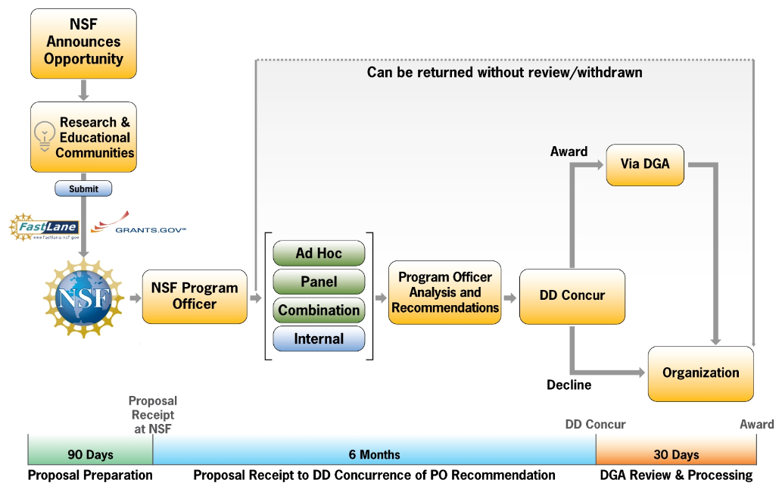
Standard Submission Process
* There are some exceptions to submission procedures (e.g., individual awards such as postdoctoral fellowships)

Slide 33
Navigating NSF Documents/ Websites
Notes:
This is important and you need to be willing to invest the time.

Slide 34
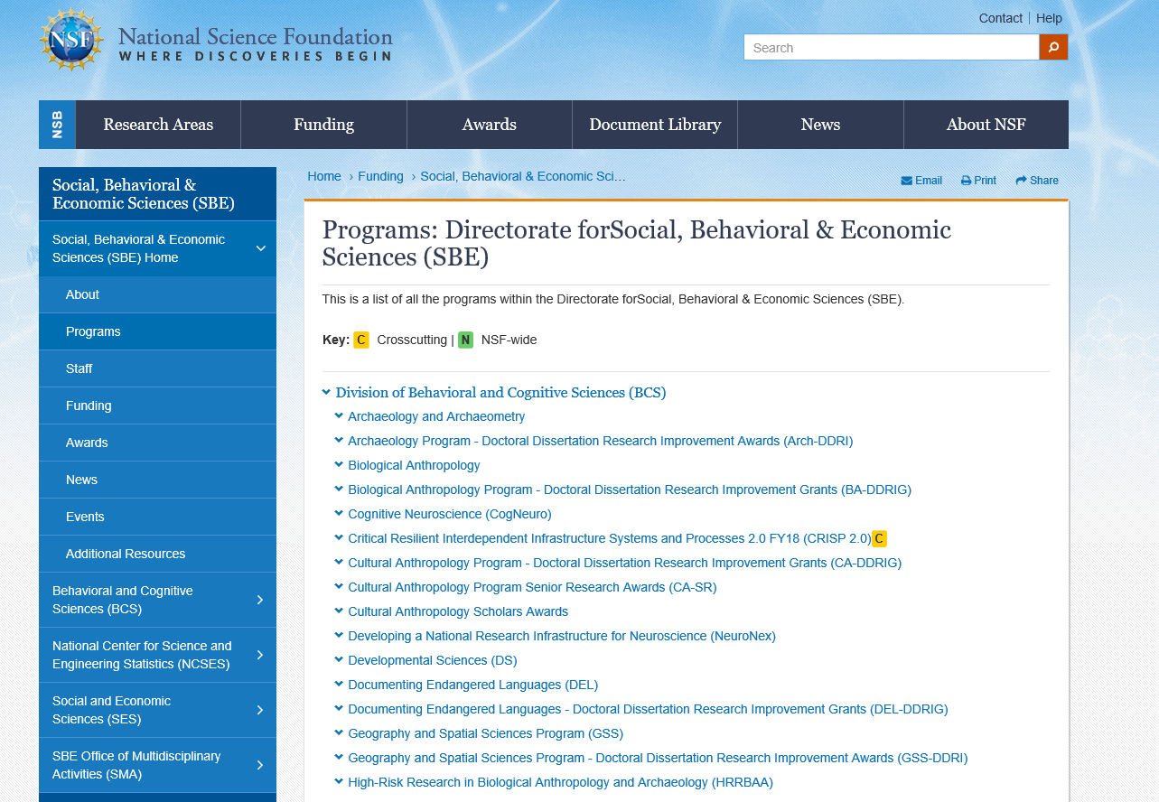
Review the SBE Programs Page: https://nsf.gov/funding/programs.jsp?org=SBE

Slide 35
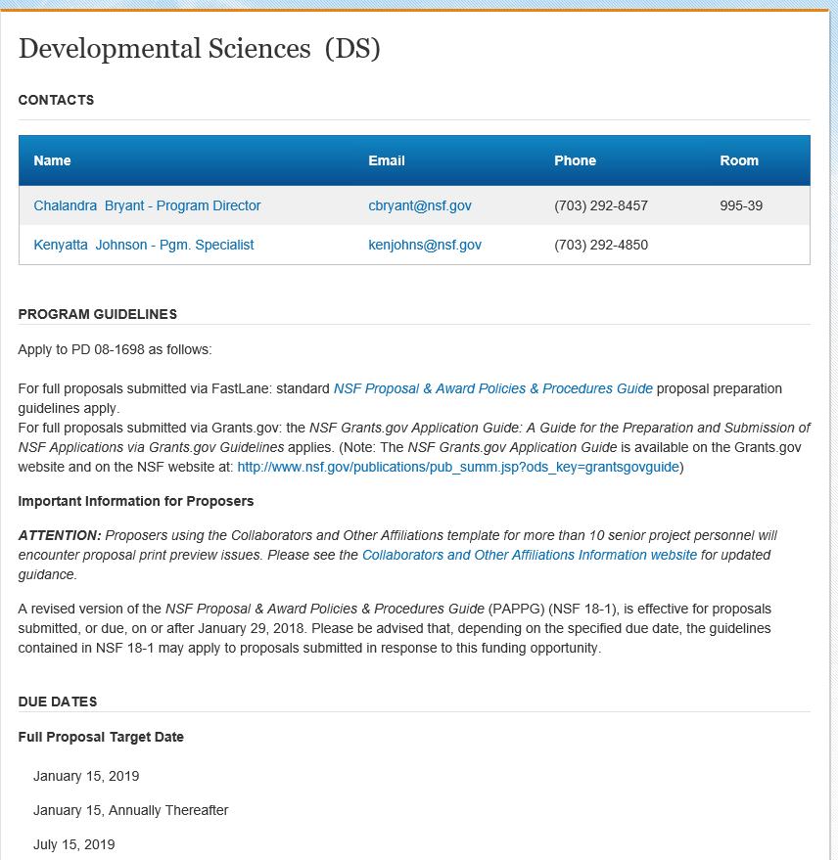
Find the Right Program (e.g., DS program webpage)
Who is the Program Director?
How do you contact the Program Director?
How do you apply?
Program Description vs. Solicitation
When do you apply?
Target date or deadline?

Slide 36
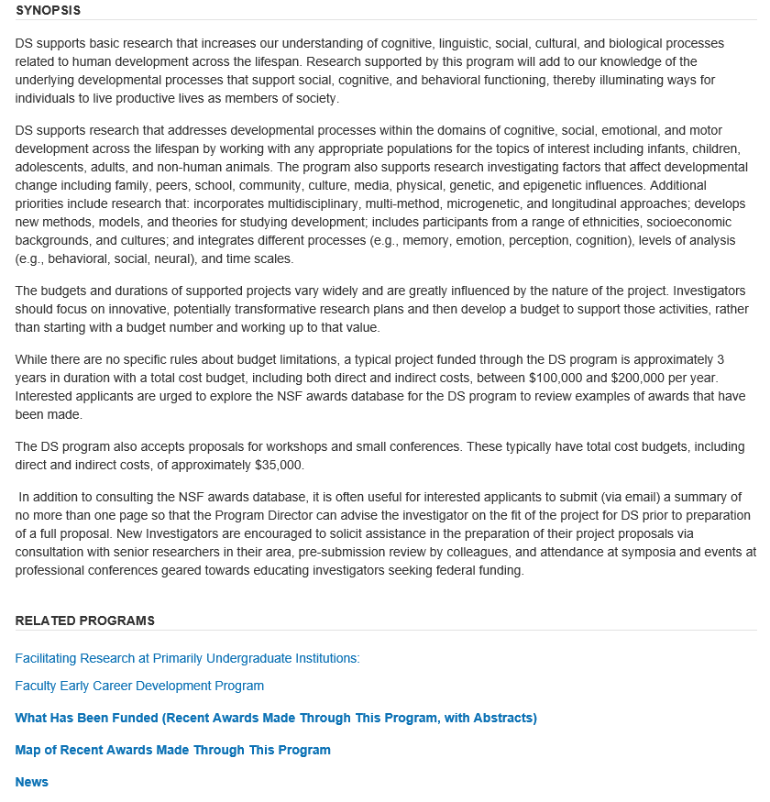
Find the right program: (scrolling down….)
How do I know if my research is relevant to a particular program?
Click this!

Slide 37
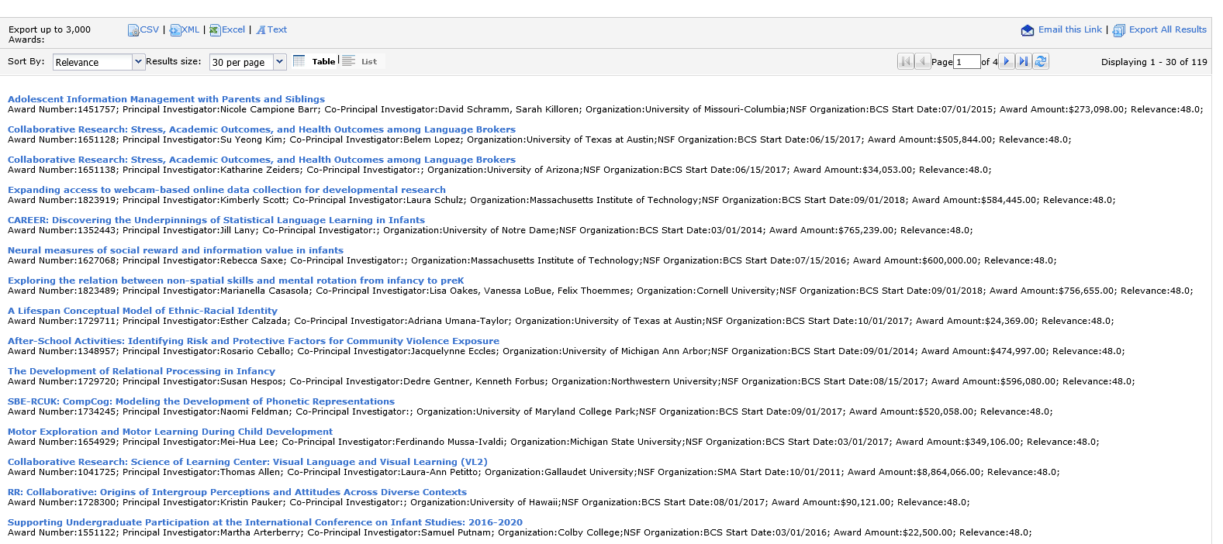
Find the Right Program: Awards recently made
What has been funded through a particular program?
Click on a title to get
the abstract
Notes:
How to read this website; dollar figures may not be for the entire grant if it is funded over time; award dollars differ from requested dollars.

Slide 38
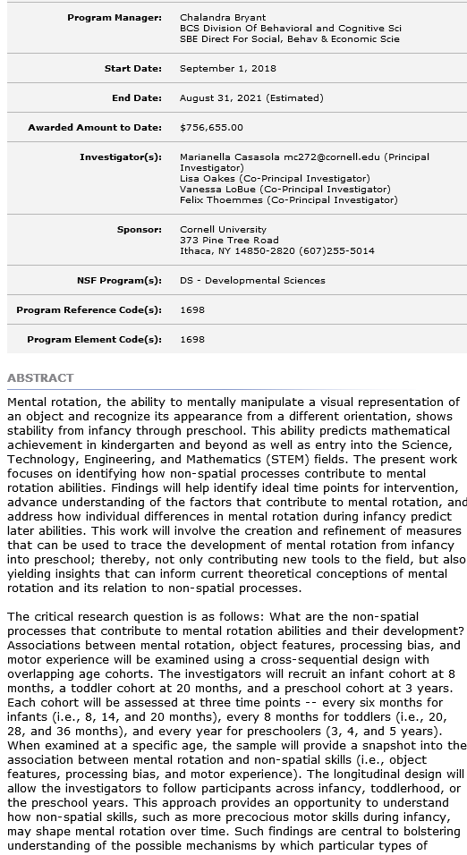
Find the Right Program: Abstracts of Awards Recently Made
Note:
Program Manager
Duration
Awarded amount
Co-funded?
Topic area
You can review the abstracts of awards made through a particular program.

Slide 39
Preparing your Proposal

Slide 40
Before you apply… READ!!!
Notes:
-Before you apply, make sure you have read the solicitation and are familiar with the NSF’s Proposal and Award Policies and Procedures Guide. In situations where the PAPPG and solicitation differ, follow the guidance in the solicitation. Missy’s office will guide you regarding PAPPG requirements.
-There are also FAQs on the program page
-The potential consequence of not following the guidelines in the solicitation is that your proposal is returned without review.

Slide 41
Next Steps
After you have narrowed down to programs that match your area of research and you have read the program page and (solicitation):
If you are unsure regarding whether your work fits a given program, reach out to that Program Director by EMAILING a 1-page summary of your planned research project (IM and BI). Get feedback about project fit with program goals
Email ALL relevant programs in a SINGLE email.
Request a phone meeting if the program is a good fit.
Make this request EARLY (well before the deadline/target date)
Follow-up if you have not heard back within 1- week
Ask about other relevant programs and initiatives
Notes:
-Work your way back approximately 6-9 months before the due date and contact the program officer
-Email is typically the best form of contact instead of a cold call. This gives the PO time to prepare for your call and dedicate specific time to discuss your proposal.

Slide 42
Intellectual Merit: the potential to advance knowledge
Will the proposed activity advance basic science, knowledge, and understanding within its own field or across different fields?
Is the project likely to be successful?
Qualifications of the proposer/ team
Sufficient access to resources
To what extent does the proposed activity explore creative and original concepts?
How well-conceived and organized is the proposed activity?
Notes:
Extremely Important. This is a major criterion for a successful project.

Slide 43
Broader Impacts: the potential to benefit society and contribute to the achievement of specific, desired societal outcomes
Demonstrate societal impacts with specificity
Disseminate results broadly to enhance scientific and technological understanding
Make data/findings available to others, where applicable/appropriate (public access)
Enhance the infrastructure for research and education, such as facilities, instrumentation, networks and partnerships
Broaden the participation of underrepresented groups (e.g., gender, ethnicity, disability, geographic, etc.)
Promote teaching, training and learning ETC!
Notes:
This is an evolving area. Can your project change lives?

Slide 44
Starting a Grant Submission: Your University Submits the Grant Proposal, Not You!
Start your budget and figure out the direct costs on the activities that you have planned.
Email your Sponsored Research Office
Get a Fastlane ID and log in and start on shorter, but required documents
Bring your budget draft to make sure that all necessary costs are included in calculations.
Find out what your campus requires for routing timelines and internal approvals are needed. Many campuses require grants to be signed off before the actual grant deadline. Plan for this time.
Be nice to your SRO

Slide 45
Common Pitfalls to Avoid
Overlooking key aspects of the program announcement/description and requirements
Lacking specificity about methods and/ or predictions, as appropriate
Underdeveloped or vague data analysis plan; failure to craft the 15 pages
Disconnect between framing/ motivation and proposed activity
Failing to establish feasibility; importance of pilot data
Not tailoring your proposal to the appropriate audience (disciplinary vs. multidisciplinary panel)
Notes:
Here is a good place to talk about pitfalls of a CAREER proposal. Discuss how different programs administer differently. Either up or down; no discretion on minimal level of funding. Challenging to write because there is an educational component that must be included. Concerns about qualitative proposals…..

Slide 46

Common Myths
NSF only funds scholars at elite institutions
NSF only funds “famous” academics
Once declined, always declined
Advisory committees make funding decisions

Slide 47
Your Proposal is Declined. What now?
Develop a thick skin.
Take time to digest the reviews and then get back up and plan to resubmit if you can address weaknesses noted in the reviews
Persistence can pay off!
Carefully consider how you will address all weaknesses (you don’t get extra space) or whether you need to reformulate the project
Schedule a time to talk to the program director (after you have had time to digest the reviews) to discuss the appropriateness and plans for resubmission
Notes:
How I handled it when I had a proposal initially declined.

Slide 48


Beyond the Standard Grant: NSF’s Cross-Disciplinary Programs
Considerable Funds Located in these Programs

Slide 49
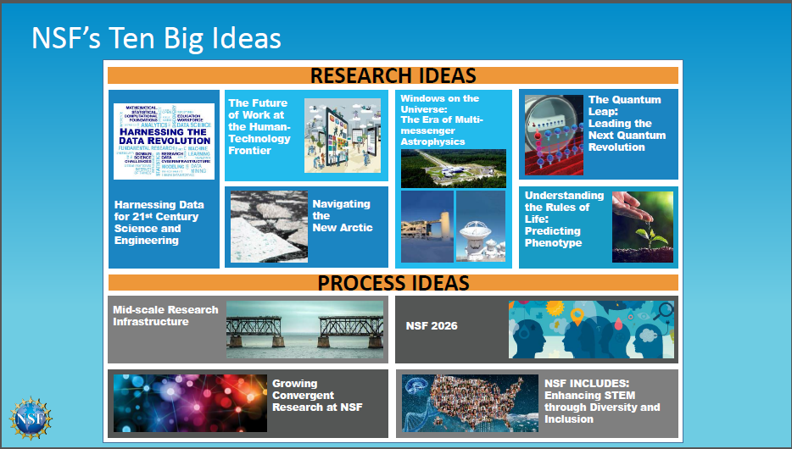

Slide 50
QUESTIONS????

Slide 51
Secure and Trustworthy Cyberspace (SaTC)
The goals of the SaTC program are aligned with the Federal Cybersecurity Research and Development Strategic Plan (RDSP) and the National Privacy Research Strategy (NPRS) to protect and preserve the growing social and economic benefits of cyber systems while ensuring security and privacy.
SBE program is interdisciplinary, with PIs from many fields. Research questions typically require empirical research with people, use behavioral data or large datasets, or involve examination of policies or systems with consequences for people, communities, and society.
Program Director: Sara Kiesler (skiesler@nsf.gov)

Slide 52
Supports planning grants and integrative research that pair advances in technological and social dimensions with meaningful community engagement.
S&CC Core: Neuroscience, sociology, psychology, economics, security, networking, data analytics, education and workforce, human technology interaction.
Topics: Water management, agriculture, food, public safety, transportation, energy, urban planning, infrastructure, health and wellbeing.
Program Director: Sara Kiesler (skiesler@nsf.gov)
Smart and Connected
Communities (S&CC)

Slide 53
Ethical and Responsible Research
Supports research advancing understanding of factors that promote ethical behavior among STEM researchers, and of approaches for cultivating cultures of ethical STEM within and across science and engineering fields.
Such factors include, but are not limited to:
Honor codes
Ethics training programs and interventions
Professional ethics codes & cultures within labs
Other research on creating and maintaining ethical STEM cultures
Emphasis on institutions serving under-represented groups
Program Directors: Wenda Bauchspies (wbauchsp@nsf.gov) &
Frederick Kronz (fkronz@nsf.gov)

Slide 54
Science of Science: Discovery, Communication, and Impact
Supports research designed to advance the scientific basis of science and innovation policy.
The program funds research to develop models, analytical tools, data and metrics that can be applied in the science policy decision-making process and concern the use and allocation of scarce scientific resources.
Program Director: Josh Trapani (jtrapani@nsf.gov)

Slide 55
Outline
Barriers to Opportunities for seeking NSF funding outside of the Sociology Program
Ten Big Ideas as Opportunities outside the Sociology Program
Insights from Sociology Colleagues

Slide 56
Barriers to Greater Participation
Habit; You don’t look beyond Sociology (Science of Organizations, Law and Science) to cross-directorate programs
You are not working in interdisciplinary teams required; it is time consuming to form them and the payoff is uncertain; communication within these teams is challenging
Much work is required: Studying websites, a long-term proposition

Slide 57
Barriers, continued
Titles of these opportunities may not convey important specifics making them a better or worse fit for you; these specific foci may change over time
These opportunities have their own solicitations, deadlines and requirements; these are distinct from Sociology requirements
Incentives are weak; interdisciplinary work not valued; seems too applied

Slide 58
Opportunities beyond the Sociology Program
These Cross-Directorate Programs have more money than we do in Sociology; they may have up to $30M per year
SBE intellectual perspectives are valued in these competitions, and we work to achieve that
Sometimes competition for these awards is modest

Slide 59
Growing Convergence Research:
Supports research projects inspired by societal and scientific grand challenges that warrant a sustained team effort which crosses NSF directorate and division boundaries and that are not currently supported by other NSF programs, initiatives or Big Ideas.
Particular interest is in problems that require the development of a larger research community that will extend beyond the project duration.
Successful teams may spend protracted time at the beginning of a project to develop effective ways of communicating across disciplines, supporting/training teams, and developing a common scientific vocabulary.

Slide 60
Growing Convergence Research: Award Mechanism and Funding
Grants, some of them Collaborative
Funding duration 2 + 3 years for successful projects
Initial funding for two years, up to 600k/year
Reverse site visit review towards the end of the second year
Successful teams will receive funding for an additional three years, up to 800k/year
Full proposal deadlines: February 3, 2020, 2021
Wide range of problems funded

Slide 61
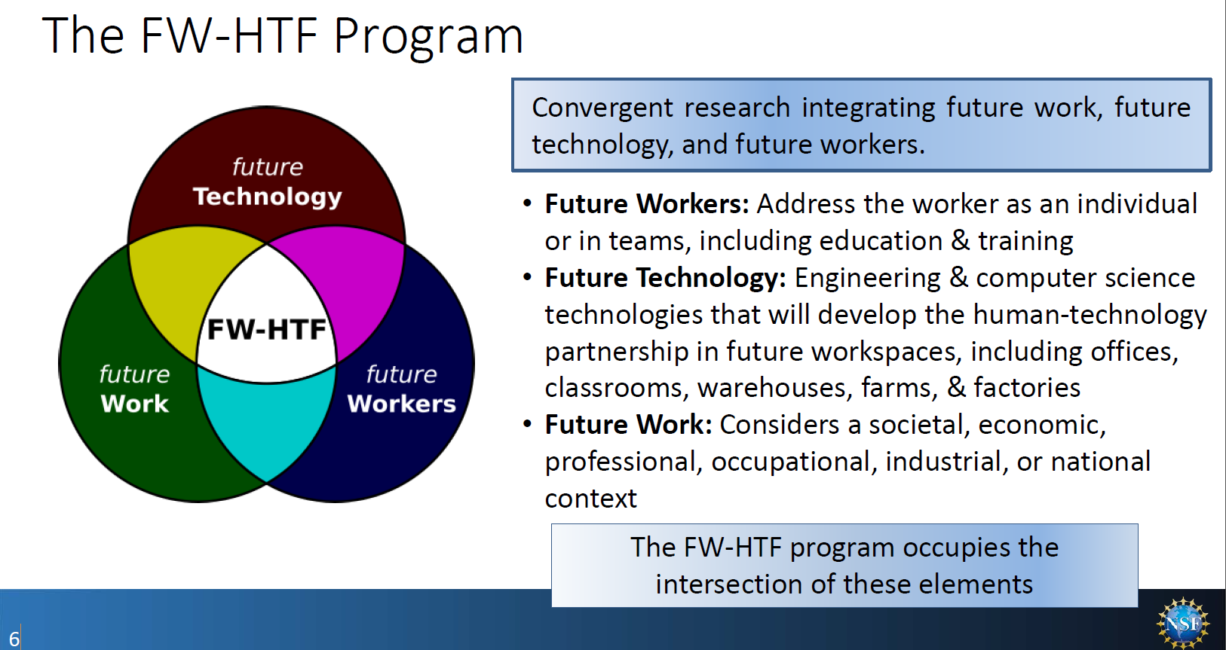
(Future of Work at the Human-Technology Frontier)

Slide 62
Future of Work at the Human-Technology Frontier:
Last year: Proposals due March 9, 2020;
Program Solicitation NSF 20-515; watch for new solicitations
Specific objectives
Facilitate convergent research from computer science, engineering, learning sciences, research on education and workforce training, and social, behavioral, and economic sciences
Encourage the development of a research community dedicated to designing intelligent technologies and work organization and modes
Advance design of intelligent work technologies that operate in harmony with human workers
Investigate potential risks arising from future work at the human-technology frontier
Three levels
Planning: 1 year, $150K
Medium: up to 3 years, up to $1.5 million
Large: up to 4 years, $1.5 m to $3 million

Slide 63
Infrastructure Competitions
Small: Human Networks and Data Science – Infrastructure (HNDS-I)
HNDS is new SBE program: full scope is still uncertain
This year’s HNDS-I Deadline: February 2020
For databases and analytic tools for using them
More than one SBE area of research, possibly beyond SBE
Evaluated also by technical (e.g., IT) reviewer
Medium: Major Research Instrumentation
Deadline: January
Track 1: Up to $1 million; Track 2: $1-4 million
For acquisition or development of a multi-user research instrument too costly and not appropriate for support through other NSF programs.
Cost-sharing required
Foundation-wide competition
Includes distributed/networked instruments and cyberinstrumentation
Notes:
https://www.nsf.gov/funding/pgm_summ.jsp?pims_id=5383

Slide 64
Infrastructure Competitions (cont.)
Large and Extra-Large: Midscale Research Infrastructure-1 and -2
One of NSF’s Big Ideas
For any combination of equipment, infrastructure, computational hardware and software, and necessary commissioning and human capital in support of implementation (or design).
MSRI-1 Track 1: Design, $600,000 up to $20 million
MSRI-1 Track 2: Implementation, $6 million up to $20 million
MSRI-2: $20 million to $70 million
Both MSRI-1 and MSRI-2 possible for 2021
Foundation-wide competition
Project Management component is crucial
Notes:
https://www.nsf.gov/funding/pgm_summ.jsp?pims_id=5383

Slide 65
NSF Convergence Accelerator
Multidisciplinary and
Involves partnerships involving at least two of: academia, industry, not-for-profits, government entities.
Aim is to produce deliverables.
Two years
Phase 1 (6-9 months) for $500K to $1 million
Phase 2 (up to 5 years) up to $5 million
Two tracks each year, some relevant to social scientists:
2019: Open Knowledge Network (Track A) and AI and Future Jobs (Track B)
2020: Quantum Technology (Track C) and AI-Driven Innovation (Track D)
See future solicitations
Notes:
On any of these, your partnerships must be in place before you apply and if you can show you have already worked together, all the better.

Slide 66
Proposal Tips
Adhere to the solicitation
Substance: Tick all the boxes! Be detailed, not vague.
Format: Don’t fail because of missing some technical requirement.
Be truly collaborative for collaborative solicitations
Program Officers don’t like a token social scientist or engineer or …
Good to partner with someone who has received NSF funding
Don’t worry about budget size, just don’t inflate
Don’t get discouraged

Slide 67
Additional comments from Guangqing Chi, Penn State: Experience on interdisciplinary grant proposals
1. CRISP
Topic: Population-Infrastructure Nexus
Team: 1 sociologist and 2 engineers
2. Robust & Reliable (DCL16-137)
Topic: Generalizability and Replicability of Twitter Data
Team: 1 sociologist, pol. scientist, 2 computer scientists
3. Navigating the New Arctic
Topic: Pursuing Opportunities for Long-term Arctic Resilience

Slide 68
Review panel experience: S&CC and ERC
No social science or social scientists on the team:
Disqualifying
Social science is not substantively, cohesively, or organically integrated into the proposal:
No chance

Slide 69
Reflections as a sociologist: Opportunities
Interdisciplinary research is exciting
Convergence
All easy problems have been solved. What’s left for us are difficult problems, which need interdisciplinary work.
Most big projects need social science
For Intellectual Merit
For Broader Impacts
To fulfill NSF requirements

Slide 70
Reflections as a sociologist: Challenges
Different fields speak different languages.
Different fields approach research differently.
Different norms in publication process/authorship.

Slide 71
Reflections as a sociologist: Challenges
Some non-social scientists think they know social science better than social scientists do.
And/or treat social science as an add-on (e.g. only for Broader Impacts, education, or workforce components).
Outcome? None of them got funded.

Slide 72
Strategies and tips for working with non-social scientists
A good collaboration with non-sociological scientist(s) takes time and patience, and more so for engineers and natural science collaborators.
A good non-social science collaborator appreciates social science: its science, its contribution, its approach, and its difference.
A good non-social science collaborator is willing to learn from you about social science.
Scenarios to avoid: a non-social scientist you do not know approaches you two weeks before the submission deadline, asking you to write some required components (e.g. education, workforce development).

Slide 73
Sociologists can and should lead interdisciplinary teams when appropriate
We care about people and society, so that we can make the project more relevant to the society.
We tend to be “nicer” and more respectful, which is important for cooperative team chemistry.
We tend to be more “open-minded” and appreciative of the diversity of science, an important character of interdisciplinary research.

Slide 74
Ways to participate in interdisciplinary projects
Take the lead
Take the role of co-PI or senior personnel
Actively seek non-social scientist collaborators. Engineers or natural scientists may also have difficulty in identifying social science collaborators and may appreciate it if you approached them.
When approached: be constructive in “teaching” them about social science, be comfortable to step out of your comfort zone (the boundary of sociology), and celebrate different collaboration styles.

Slide 75

Questions

