Slide 1
Proposal Development …Tips and Best Practices from Experts
December 5th and 12th, 2014
Conrad Monson
801-422-7722
conrad_monson@byu.edu

Slide 2
Workshop Objectives
Discuss the most effective ways to develop grant proposals from the creation of an idea to the preparation and submittal of a proposal
Notes:
My experience likely similar to yours? Have things changed in 30 yrs? Got PhD 30 yrs ago; helped a bit with major professors proposal; wrote my own proposal for last year of PhD funding after the NIH training grant ran out; wrote a proposal for National Research Council Sponsored Postdoc fellowship
No formal, classroom training on proposal writing

Slide 3
Workshop Schedule
Dec 5th
Introduction 9am
Proposal Development 9:15-11
Panel Discussion 11- noon
Dec 12th
Reconnoiter 9 am
Foundation Searching – Alan Moore 9:15-9:45
ORCA Processes – Debbie Silversmith 9:45-10:30
Break
Budgeting – Gary Arnoldson 10:35-11:15
IRB – Sandee Munoz 11:15-11:45
Review abstract/summary 11:45-noon
Wednesday, December 17, 2014 10-12noon 2212 HBLL
  How to use PIVOT to search for grants

Slide 4
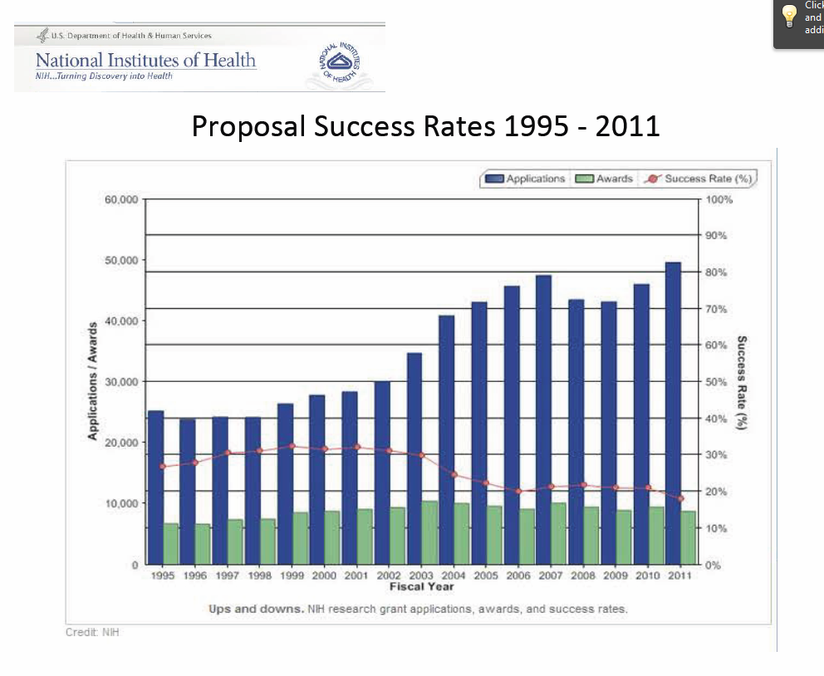
Even in Today’s Challenging Funding Environment…
NIH Proposal Success Rates 1995-2011
  There is a steady increase in proposal submission BUT also a steady decrease in proposal success rate
Future funding will be negatively impacted by sequestration and rising budget deficits
Bottom line – there will very likely be a continued decline in proposal success rates
Notes:
Proposal success rates now average just 15 to 30 per cent (in 2009, NIH averaged 8-10% on 1st submission 28% on 2nd; other agencies have similar success rates)
BYU rates tend to be just a bit higher

Slide 5
… There are Ways to be Successful
Use Best Practices
Pay attention to details
Be persistent
Notes:
Pay attention to details
Significant number of proposals are rejected by funding agencies without review because the proposer didn’t follow all the directions
Use Best Practices
Develop a fundable idea
Find funders
Use effective pre-proposal activities
Write compelling proposals
Be persistent
Themes throughout this presentation include – lots of pre-proposal activity; marketing throughout; pay attention to detail
At Dec 2013 NSF Days – be persistent; ~15% success for 1st time, ~50% 2nd time, 75% 3rd, assuming followed reviewer recommendations and did proper revisions
In 2009, NIH averaged 8-10% on 1st submission 28% on 2nd; other agencies have similar success rates

Slide 6
Agenda - Best Practices
Develop a Fundable Idea and Find Funders
Identify the Best Opportunities
Perform Pre-Proposal Activities
Prepare to Write
Write the Proposal
Final Thoughts
Resources

Slide 7
Develop a Fundable Idea and
Find Funders

Slide 8
Develop a Fundable Idea
Start by answering these key questions :
What are you passionate about in terms of research?
What is the problem (or need) and why is it important?
What data can you use to validate the importance of your proposed project?
How is existing knowledge or practice inadequate… what are the gaps?
Why is your idea better/unique/different??
What will it contribute and who will benefit from it?
Then refine the idea
(questions adapted from those developed by an NSF panel)
Notes:
Why is your idea better/unique/different?
Fresh idea that advances understanding, meets a societal need?
A refinement improving efficiency, lowering costs of goods, services?
A new paradigm that reshapes thinking or ways of doing thinking?

Slide 9
Refine Your Idea
Clearly identify the niche area into which your idea fits
Draft a short, well-crafted, logical description of your idea that answers Why, Who, What, How
Identify your strengths and weaknesses
Know your competition
If you answer the questions and follow the refining steps, you will have a fundable idea AND the foundation of a good proposal
Notes:
Clearly identify the niche area into which your idea fits
Identify long-term goals within niche area
Conceptualize research needed to attain long-term research goals
Identify next logical step in research continuum…your idea should be a logical next step
Draft a short, well-crafted, logical description of your idea (must answer Why, Who, What, How) and present it to colleagues for a critical review
Are they excited, show a keen interest in your idea?
Does it have scientific and technical merit?
Do you have the ability, capability and resources to pursue your idea?
At the right time, a description could be presented to a potential funder
Identify your strengths/weaknesses and those of your competitors -- how you will emphasize your strengths and mitigate your weaknesses. Do you know if your competitors will submit a proposal? Have you considered collaborating with a potential competitor?

Slide 10
Develop a Strategic Plan for Research Funding
Should be part of a Faculty Development Plan*
Make sure you have realistic funding objectives
Leverage any current funding (startup package?)
Develop research outreach
Incorporate research expectations from your department, college
Develop an approach that is systematic, deliberate, consistent
* The Faculty Center has lots of resources and training for faculty planning -- http://facultycenter.byu.edu/byu-faculty-development-series
Notes:
Most faculty know how to develop a strategic plan – the faculty center has resources to support these efforts. I want to highlight the elements of the plan that are peculiar to research funding
Realistic objectives means don’t write an NSF/NIH major proposal as soon as you start unless you have a tract record
Developing research outreach includes ensuring your research results can be disseminated in some way to the public at large (e.g., NSF Broader Impacts) through educational and other opportunities

Slide 11
Find Funders
If you have current funding, can you extend it?
Can you participate in someone else’s award?
Look at the funder acknowledgement in journal articles
Query colleagues
Find mentor(s)
Look for funders at conferences
Attend Agency funder’s conferences (e.g., NSF in March and Oct; NIH June)
Notes:
A study (find reference) identified mentoring as the number one key to success in proposal development
Query colleagues (current, classmates in graduate school, major professors)
Attended several funders conferences (NSF ones especially good) – hear about new programs, learn submittal process, get specific interests from directorates, meet with program officers (e.g., NSF encourage asking)

Slide 12
Find Funders (cont.)
Look for funder contacts within professional organizations
Participate in review panels
Could your idea attract Crowdfunding?
Can you obtain unused Government year end funds?
Contact Program Officers about funding … ask them to recommend other funding sources
Other possible funding sources (besides federal agencies)
  NGOs
  Associations
  Municipal, County, State Government
  Community Partnerships
  Foundations, Companies
Notes:
Review Panels - at Dec 2013 NSF Days, leader solicited business cards for potential reviewers. For NSF, don’t need a prior NSF grant, or even a PhD or university affiliation. Need expert. NSF needs about 50K reviewers per year

Slide 13
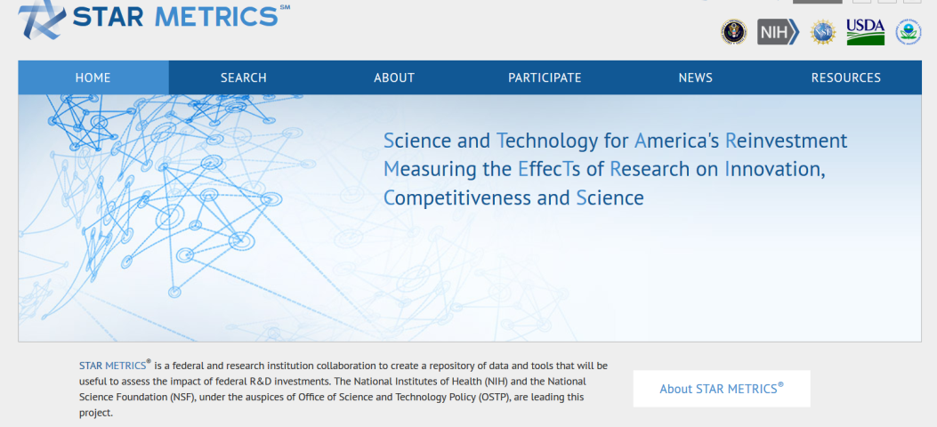
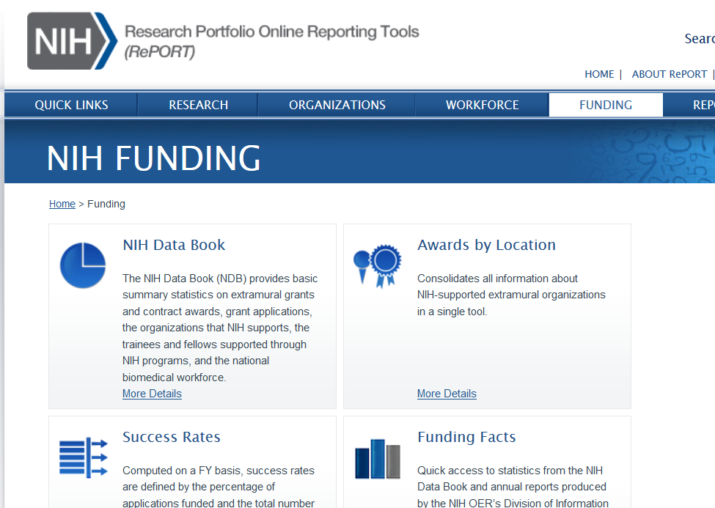
Find Funders
Online Search Tools
PIVOT
http://pivot.cos.com/funding_main
Foundation Center Online
Grants.gov
Other online tools
  Federal Register
  Grantsmanship Center
  Agency, Foundation,
  Company websites
  Google/Bing/Yahoo
  RePorter, Star Metrics
As one expert says - think big, think small, think in different ways to uncover funding opportunities
Notes:
PIVOT
Database of funding opportunities (~$33B and 26,000 opportunities), scholars (3 million) and software to match the two
Matches based on profile, your search terms, keywords
Manage and track opportunities including email alerts
To use PIVOT, go to PIVOT website http://pivot.cos.com, create an account and claim or create a prolific
Foundation Center Online
Database of 100,000 + foundations, corporate donors, and grantmaking public charities, 2.1 million grants, database search software
Matches based on search terms and keywords
Provides detailed information about non-profit foundations and corporations
Provides 990 tax form information and information about past awards
To use the Foundation Center online, go to http://fdncenter.org/ and login with username byuacadvp and password cougars2002
Perhaps most useful feature of PIVOT is the opportunity tracking that provides automated alerts when selected opportunities are updated
We will do a PIVOT tutorial later this morning and Trace Eddington from LDS-P will provide demonstrated Foundation Center online next week.
Are there a few who would like us to do a preliminary search for them and show it at next weeks class?

Slide 14
Select Funding Opportunities to Pursue
Evaluate candidate opportunities:
  Funder match
  You are eligible
  Sufficient funds available
  If foundation, ensure gives nationally and/or to Utah
  You have sufficient time, resources available
Focus on a limited number (3-6?) of good candidate funding opportunities for further development
  Avoid the shotgun approach… if I fire enough proposals at enough potential funders, something is going to hit
Do a “SWOT” Analysis
Identify the best opportunity(ies)
Contact the Program Officer
Notes:
Ties into Go No Go decision that will be talked about later
Evaluate candidate opportunities:
Your research objectives and funder needs match
You meet eligibility requirements
Funder has sufficient funds to give you a grant
If the funder is a foundation, the foundation gives nationally and/or to Utah
You have sufficient time to do both pre-proposal and proposal writing activities
Focus on a limited number (3-6?) of good candidate funding opportunities for further development
Avoid the shotgun approach… if I fire enough proposals at enough potential funders, something is going to hit
Do a “SWOT” Analysis on the funding opportunities

Slide 15
SWOT Analyses
S
Strengths
What are your strengths
What do you do better than others
What unique capabilities and resources do you possess
What do others perceive as your strengths?
W
Weaknesses
What are your weaknesses
What do competitors do better than you
What do others perceive as your weaknesses
Internal (attributes of your organization)
O
Opportunities
What trends or conditions may positively impact you
What opportunities are available to you
T
Threats
What trends or conditions may negatively impact you
What are your competitors doing that may impact you
Do you have solid financial support
What impact do weaknesses have on threats to you
External (attributes of your environment)
Positive (helps meet objectives)
Negative (detrimental to objectives)
SWOT analyses can identify strengths to highlight, weaknesses to mitigate, opportunities to capitalize on and threats to counter

Slide 16
SWOT Example
Utah State’s SWOT analyses determined that the University of Colorado would be a better partner than BYU on a 3-university NSF I CORPs Node proposal (U of U was the other partner)
Strengths – Colorado has largest venture capital investment in the region, as well as a great marketing campaign around its entrepreneurial/innovation activity
Weaknesses – BYU has limited federal research expenditures and impact growth potential
Opportunities – Piggyback on the national attention and momentum that Boulder has received due to its commitment to early-stage deals
Threat – The Univ. of Colorado is attracting a lot of interest through its commercialization and ecosystem development efforts
S
Strengths
Best available regional partner is Univ. of Utah (data)
Combines top efficiency/magnitude programs (BYU and Univ. of Utah)
Geographical proximity - knowledge spillover
Complimentary network of fields
Common ecosystem resources/characteristics
W
Weaknesses
Limited innovation/entrepreneurship interaction between institutions
Univ. of Utah had visible failure in the first round of I-Core
Univ. of Utah would most likely need to drive the initiative
BYU has limited federal research expenditures and impact growth potential
S
Strengths
Best available regional partner is Univ. of Utah (data)
Combines top efficiency/magnitude programs (BYU and Univ. of Utah)
Geographical proximity - knowledge spillover
Complimentary network of fields
Common ecosystem resources/characteristics
W
Weaknesses
Limited innovation/entrepreneurship interaction between institutions
Univ. of Utah had visible failure in the first round of I-Core
Univ. of Utah would most likely need to drive the initiative
BYU has limited federal research expenditures and impact growth potential
S
Strengths
Best available regional partner is Univ. of Utah (data)
Combines top efficiency/magnitude programs (BYU and Univ. of Utah)
Geographical proximity - knowledge spillover
Complimentary network of fields
Common ecosystem resources/characteristics
W
Weaknesses
Limited innovation/entrepreneurship interaction between institutions
Univ. of Utah had visible failure in the first round of I-Core
Univ. of Utah would most likely need to drive the initiative
BYU has limited federal research expenditures and impact growth potential
O
Opportunities
Utah is a leader in high-tech startup density and venture capital share growth in the region and nation
Signals a united front for the state of Utah and its commitment to entrepreneurship/innovation
Opportunity to showcase impact of USTAR/other state programs on commercialization
Regardless of outcome, these collaborations could greatly benefit Utah State
T
Threats
Los Angeles/San Diego is the strongest ecosystem available in the Pacific and Mountain Regions
A member of the I-Core Selection Committee has voiced their lack of support for the Univ. of Utah
The Univ. of Colorado is attracting a lot of interest through its commercialization and ecosystem development efforts
Utah is an extremely conservative state compared to Colorado and Washington/Oregon
O
Opportunities
Utah is a leader in high-tech startup density and venture capital share growth in the region and nation
Signals a united front for the state of Utah and its commitment to entrepreneurship/innovation
Opportunity to showcase impact of USTAR/other state programs on commercialization
Regardless of outcome, these collaborations could greatly benefit Utah State
T
Threats
Los Angeles/San Diego is the strongest ecosystem available in the Pacific and Mountain Regions
A member of the I-Core Selection Committee has voiced their lack of support for the Univ. of Utah
The Univ. of Colorado is attracting a lot of interest through its commercialization and ecosystem development efforts
Utah is an extremely conservative state compared to Colorado and Washington/Oregon
O
Opportunities
Utah is a leader in high-tech startup density and venture capital share growth in the region and nation
Signals a united front for the state of Utah and its commitment to entrepreneurship/innovation
Opportunity to showcase impact of USTAR/other state programs on commercialization
Regardless of outcome, these collaborations could greatly benefit Utah State
T
Threats
Los Angeles/San Diego is the strongest ecosystem available in the Pacific and Mountain Regions
A member of the I-Core Selection Committee has voiced their lack of support for the Univ. of Utah
The Univ. of Colorado is attracting a lot of interest through its commercialization and ecosystem development efforts
Utah is an extremely conservative state compared to Colorado and Washington/Oregon
Notes:
Lots of templates and procedures have been developed to do a SWOT analysis. Whether or not you use a formal procedure, you will likely do at least an informal SWOT – the key is to clearly identify SWOT elements so you can leverage the positives about your research situtation and mitigate the negatives

Slide 17
Effective Pre-Proposal Activities…
Now that you have a fundable Idea and a strategic plan, you have developed a short list of potential funders, done a SWOT analysis (formally or informally), identified the opportunity(ies) to pursue, you need to take additional preparation steps before you start writing
Notes:
There may be an irresistible urge to write – just say NO. The more time you put in pre-proposal activities, the greater your chances of success

Slide 18

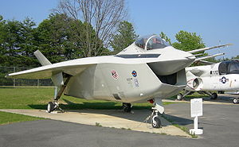
Market Your Ideas… Think Like a Marketer
Always see things from the customer’s point of view
A proposal is not about you or your needs, it is about the funder’s needs… you’re project should make the funder successful
You want an emotional response to your ideas from your potential funders… excitement, keen interest, compelling, “I’ve got to have it now” … not boredom, confusion, or even anger
Boeing’s UCAV, F-35 – the power of emotion in contract decisions
Ultimately, funding decisions are emotional decisions… make sure your proposal generates positive emotions
Notes:
“Marketing” should be done throughout your career… and the reality is that you are marketing yourself anyway all the time, whether you want to our not.
Think like a marketer and always see things from the customer’s point of view
“Marketers do one thing, and they do it very well. They see things from the prospect’s point of view. They lose their own ego, interests and desires, and they focus on the customer’s wants and desires (Morgan Giddings)”
A proposal is not about you or your needs, it is about the funder’s needs… you’re project should make the funder successful
You want an emotional response to your ideas from your potential funders… excitement, keen interest, compelling, “I’ve got to have it now” … not boredom, confusion, or even anger
Boeings UCAV contract with DARPA was an ~$150M competition with Northrop Grumman that was so close, Boeing won at least in part because the PM felt Boeing would do a better job - not on price, past performance, schedule … many of the elements that typically win a proposal. The emotional investment was so intense by Northrop Grumman, the customer told us during when NG was debriefed that was the first time in all his years of contracting, he had ever seen “grown men cry”.
Boeing management was so worried about the emotional response to its F-35 prototype – it looked so ugly, pilots might not want to fly it – that they hired high priced consultants to understand the emotional response to the aircraft and how to mitigate it.
Finally, marketing your ideas and proposal should be embedded in the complete proposal development process, from pre-proposal to proposal writing, described in the next sections.

Slide 19
Even “Objective” Review Panels Respond Emotionally
“The problem statement, such as it is, is too global, showing no relationship to reality with no potential solution being indicated or even possible.”
“This problem has been studied to death. I’m surprised the writer doesn’t know this.”
“It is almost impossible to understand what the author wants to study or what the main theme is. The problem is full of jargon and totally unclear as stated.”
“I cannot ascertain what approach the researcher will take in examining the problem as outlined.”
“The writer has a flair for the dramatic. The world will not collapse if we do not fund a study of students’ daydreams.”
(Actual comments made by NIH reviewers)
Notes:
Funding decisions are ultimately emotional decisions

Slide 20
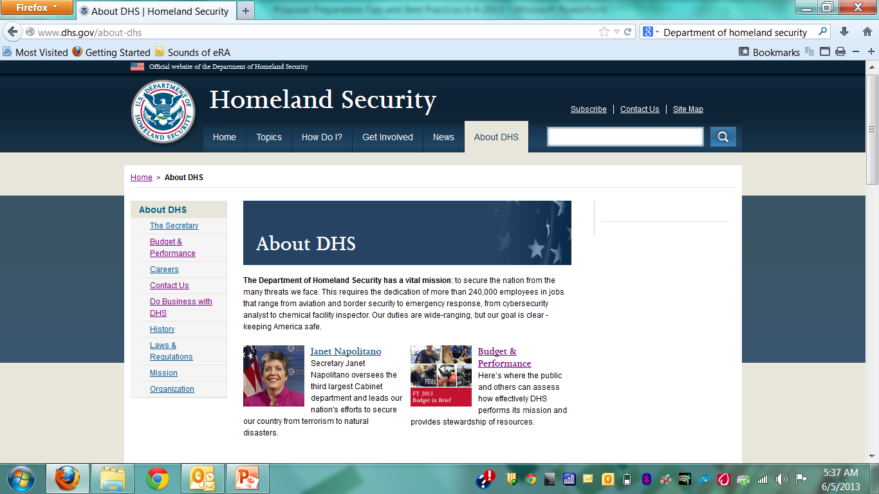
What Can Industry Teach About Effective Pre-Proposal Activities?
Use principles from a Business Acquisition Plan (BAP) as part of your pre-proposal activities. Highlights of a BAP include
Long term planning
  Includes lots of customer contact and marketing, marketing, marketing
  Create and execute real plans (technical, management, campaign)
Know about upcoming funding opportunities and funder objectives as they are being developed … can you shape the funders thinking, shape the RFP?
  Example
Create a win strategy that can include SWOT analyses, P_{win} calculations
Identify proposal resources well in advance of proposal writing
Notes:
The more time you spend in effective pre-proposal activities, the more likely you are to be successful in developing a proposal that will be funded. High Tech and other Industries that do a lot of research and development with a significant amount of funding from the federal government are expert at pre-proposal activities – in fact, their business depends upon the effectiveness of pre-proposal planning. Here are some methods they use

Slide 21
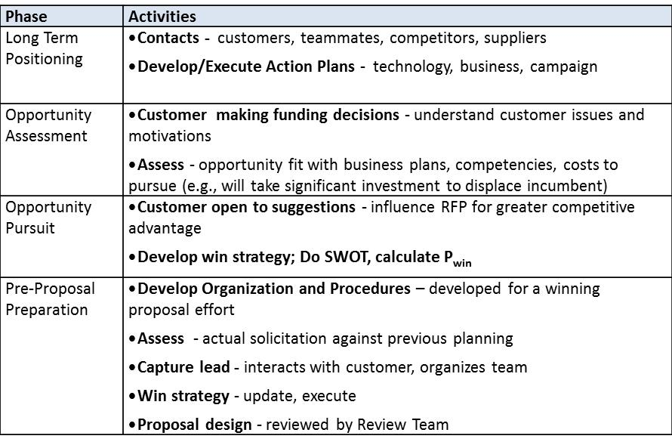
Example of a Business Acquisition Plan
This BAP is similar to one a large Aerospace company uses to secure R&D funding for small to large projects
One year or even longer
Modify a “BAP” to create a “Research Acquisition Plan”

Slide 22
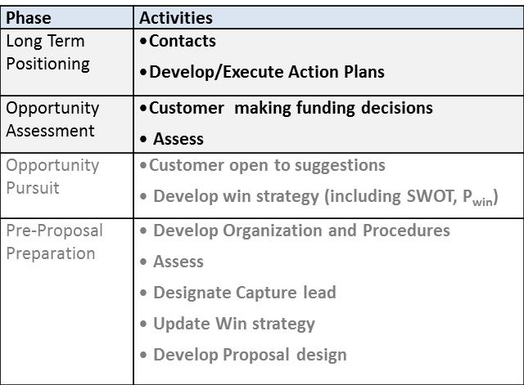
Business Acquisition Plan Details (1/3)
Long Term Positioning Phase
  Ideally, starts year(s) before an RFP is released
  Develop Contacts - customers, teammates, competitors, suppliers
  Develop/Execute Action Plans - technology, business, campaign
Opportunity Assessment Phase
  Customer is making funding decisions
    Understand customer issues and motivations
  Assess the opportunity
    Does it fit with business plans, competencies, pursuit resources?
    Are there sufficient resources and commitment to displace an incumbent?

Slide 23
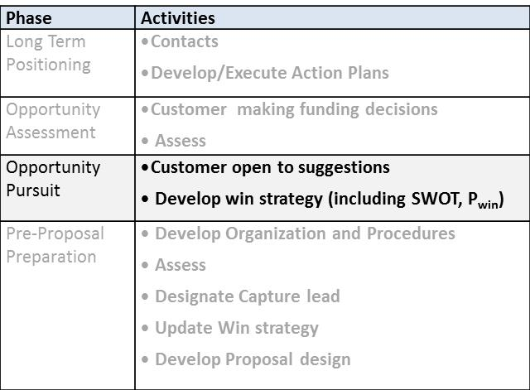
Business Acquisition Plan Details (2/3)
Opportunity Pursuit Phase
  Customer open to suggestions - influence RFP for greater competitive advantage
  Develop a win strategy
  Do SWOT analyses
  Calculate a P_{win}
  Likely a win if
  “We can give the customer an offer that speaks directly to and meets their wants and desires and we have a demonstrated track record of performance thereby earning the customer’s trust”

Slide 24
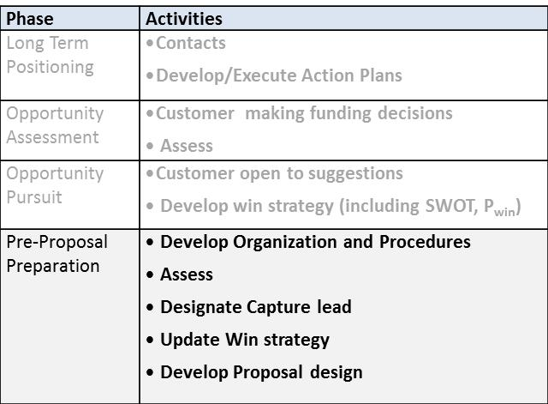
Business Acquisition Plan Details (3/3)
Pre-proposal Preparation Phase
  Develop Organization and Procedures – developed for a winning proposal effort
  Assess actual solicitation against previous planning
  Identify a Capture lead - interacts with customer, organizes team
  Develop and execute win strategy then update it as needed

Slide 25
Calculate a P_{win}
Develop criteria from the Solicitation
Evaluate criteria
  Assign “values” (including weightings)
  from Solicitation requirements
  Determine elements that make up
  criteria from SWOT, similar analyses,
  “Go-No Go” information
  For industry, typically need a P_{win} > 0.5
  and/or a P_{win} > competitors to proceed with proposal
  For academic research, competitor comparison may be less important (multiple awards, no defined product as an outcome)
An Example of One Way to Calculate P_{win}
Even a very subjective P_{win} has value; it can predict the strengths and potential weaknesses of a proposal

Slide 26
Prepare to Write…
You have a fundable idea, identified the best funding opportunity(ies), engaged in pre-proposal activities, now you prepare to write

Slide 27
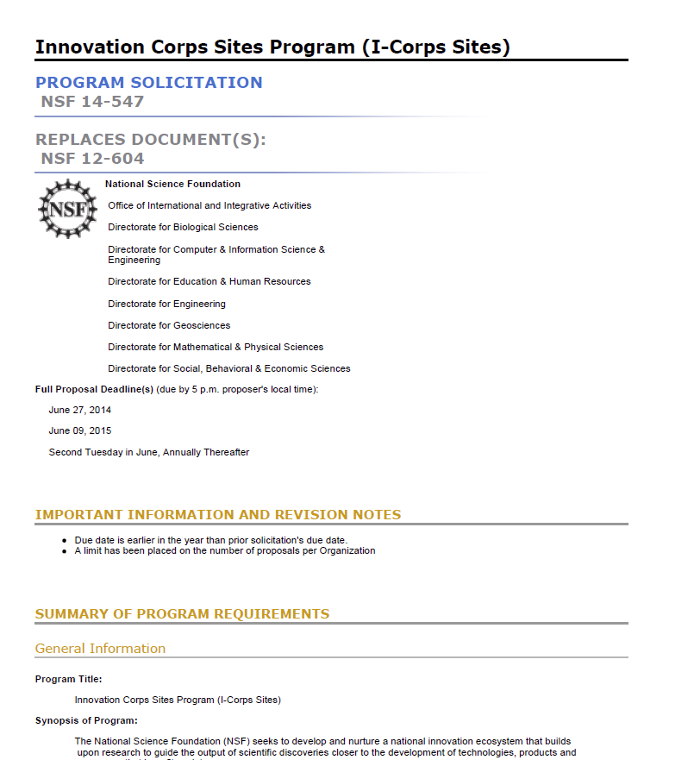
Thoroughly Decompose the Solicitation
Deadlines
Requirements, (technical, budget, management, “MIRs” etc.)
Proposal components
Unusual requirements
Procedures for submittal (including BYU/ORCA procedures)
Notes:
Deadlines for submitting questions to the program officer, submittal through BYU/ORCA, submittal to the funder
Most Important Requirements (technical, budget content)
Elements required of proposal (cover page, summary, etc.)
Unusual requirements
Procedures for submittal (including BYU/ORCA procedures
Requirements
Can be technical, budget, management
What isn’t said in the solicitation may be just as important as what is said
Must understand and answer the MIRs (most important requirements

Slide 28
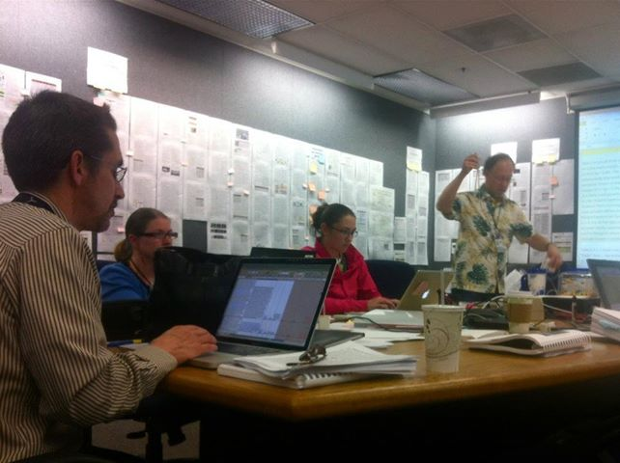
Develop a Plan for Managing the Proposal Effort … don’t “Ad Hoc” it
Conduct a Kickoff
Designate a preparation room/wall/area
Coordinate – with whom and when
Create a proposal development schedule
Create proposal themes
Determine how requirements will be addressed
Make writing assignments
Arrange proposal support
Arrange reviewers
Use Checklists (e.g., http://researchdevelopment.byu.edu/resources/proposal)
Proposal “War” Room (from NASA)
Careful planning should help you avoid common errors, ensure all requirements are met and the best possible proposal is submitted
Notes:
Kickoff with proposal team
Proposal preparation room/wall/area to post drafts, get timely, continuing reviews
Coordination with Department, College, ORCA
Schedule for proposal production – make sure sufficient time to submit to ORCA before deadline. Sometimes the SPO/ORCA can make a mistake and you need time to review what they are going to submit. At NSF Day Dec 2013, PM in Astronomy related an experience whereby the SPO changed collaborators to Co-Is and PI didn’t review before submittal. Good proposal; NSF had to reject because there was no information required for Co-Is (wouldn’t have been required of collaborators)
Writing assignments to team
Proposal support assignments
Reviewers identification and review schedule
Use Checklists - see example on the website

Slide 29
Write the Proposal…
Make it Competitive and Compelling
Use an Effective Proposal Structure
Start With An Outline
Write With the Correct Style and Voice
Use the Right Words
Create Effective Sentences and Phrases
Use Transitions
Use Emphasis, Figures and Tables
Address Aesthetic
Write for Reviewers

Slide 30
Make Your Proposal Competitive…
Significance
Approach
Likelihood of success
Knowledge and experience
Methodology
Project plan
Realistic amount of work
Sufficient detail
Cost effective
Notes:
Significance (important area of research)
Great idea(s) that address important problems in the field and are significant to relevant stakeholders
Original approach
Strong likelihood of success, i.e., will make a significant contribution to the field
Knowledge and experience in the discipline
Experience in essential methodology
Well developed, succinct, logical and focused project plan developed around the idea
Coherent narrative that integrates each component of the project
Realistic amount of work
Sufficient detail
Cost effective

Slide 31
… and Make It Compelling
Grabs the reader’s attention
Explains the benefits
Assures the funder of your capability
Describes a fully-aligned, justified budget
(From Giddings, Porter)
Notes:
Grabs the reader’s attention
Holds that attention long enough to explain the benefits of your offer
Explains how the benefits will be delivered
Assures the reviewer of your reliability/capability
Describes the costs of benefits to be delivered

Slide 32
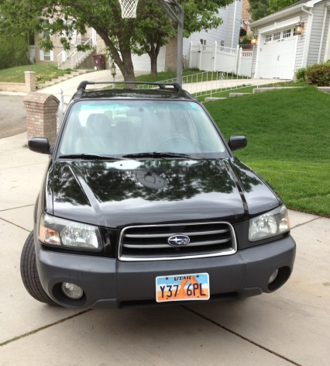
Start With an Effective Proposal Structure
Answer these questions and in this order
  Why is this of interest to the funder?
  Who is proposing the work and are they credible?
  What is the theory/model/hypothesis behind the proposal?
  How are you going to accomplish the research and spend funds?
Align elements (including budget) with goals and outcomes/objectives
“Tell a Story” with a good narrative woven throughout
Buying a car with why, who, what, how steps
(adapted From Giddings, Porter)
Notes:
Use Subaru car buying experience as an example of the importance of why, who, what, how and in that order.
It would seem ludicrous if I went to the dealer who followed these steps
Sign for this amount of money, then I will tell you what you can have, whether or not you need it or want it
The dealer should identify the why first (I wanted an all wheel drive car when I experienced commuting in a snow storm after having lived in CA for 23 yrs)
Once he understood the Why, then he needed to convince me that he was a credible dealer who had the car, the service record, warranty, etc. that would appeal to me (and keep me from going elsewhere – was there something about him that stood out?)
Show me what he had and that it exactly met my needs (what) at a price, warranty, delivery I could afford (the how)
Best car I ever had – I would go back to him again

Slide 33
Write The Proposal From An Outline
Outline the complete proposal
  Ensure all components are tied together
  Use as the basis for a smooth, end-to-end narrative
  Consistent with the RFP decomposition
Use themes and put in topic sentences
Show how requirements will be met
Review and re-iterate the outline… sequentially adding greater levels of detail will make the actual writing easier
Notes:
This is Outlining 101. The more experienced we get writing in a field, the more we tend to write without an outline. Example from HFE reports -- I found I was so familiar with the field and customer (DoD) and what the reports should be that I could easily generate R&D reports that were clear, had topic sentences for each paragraph, good transitions and narratives etc. without an outline. I could just start writing. Don’t fall into that trap when doing a proposal you must start with a good outline. When doing proposals at Rockwell, Boeing and Northrop Grumman, typically, we were not even allowed to write until different levels of outline were reviewed and refined so that there was a clear narrative, all MIRs were answered, themes were identified, etc.

Slide 34
Write Using “Proposal” Style
Academic Writing:
Proposal Writing:
Research-centered
Past oriented
Expository
Impersonal
Individualistic
Verbosity rewarded
Specialized terminology
Sponsor-centered
Future oriented
Persuasive
Personal
Team-oriented
Brevity rewarded
Accessible language
Academic Writing is the World of Ideas (thesis, theme, theory) Proposal Writing is the World of Action (project, activities, outcomes)
Notes:
Notice how proposal writing is consistent with Marketing

Slide 35
Write in Active, Not Passive Voice
Passive
Active
It has been demonstrated by research that…
The SAP program is being implemented by our department…
Following administration of the third dosage, measurements will be taken…
Research shows …
Our department launched SAP …
After dosage 3, we will measure…
Notes:
Again, marketing typically uses active voice

Slide 36
Use the Right Words
Write simply, but professionally
  Replace phrases with single words, e.g. “now” instead of “at this point in time”, “because” instead of “in light of the fact that“
Avoid jargon and acronyms (spell out first time and if not used for awhile)
Avoid equivocal language, such as "might, could, ought, may, should, hope, will consider, it appears“
Use concrete, "picture" language
Except when familiarity with technical terms must be shown, substitute everyday words for the more abstruse (e.g. "end" instead of "terminate"; "begin", not "institute")

Slide 37
Create Effective Sentences and Phrases
Be concise, but complete and always check grammar and spelling
Simplify sentences and vary their structure
  Break up sentences that go on and on BUT
  Keep an interesting rhythm of long and short; don't become too choppy, too staccato
Avoid tentative phrasing; replace with a positive statement
  e.g., “A general review of the literature indicates that this topic has likely not been previously investigated” could be “This topic has not been previously investigated”
Notes:
Rule of thumb I was taught, sentences should be no more than 20-25 words in length

Slide 38
Use Transitions
Use transitions between concepts, paragraphs, sections. Be generous with transitions … they help readers know where they have been and where they are going
Make transitions smoothly so readers aren’t lost at junctions. Proper sequencing, clear reference to earlier discussion, and constructive reasoning from such references join up with selective repetition of key phrases and words for easy shifts of perspective between sections, paragraphs and even sentences
Use forecasting and internal summaries to help readers know where they are and where they are going
Notes:
Pet peeve – often I have seen too little attention paid to transitions

Slide 39
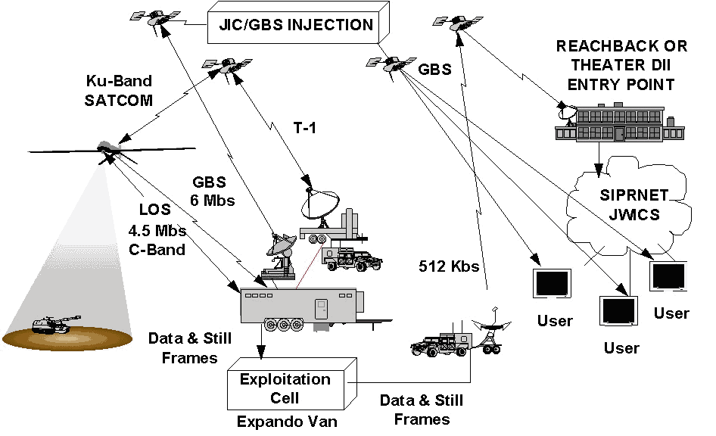
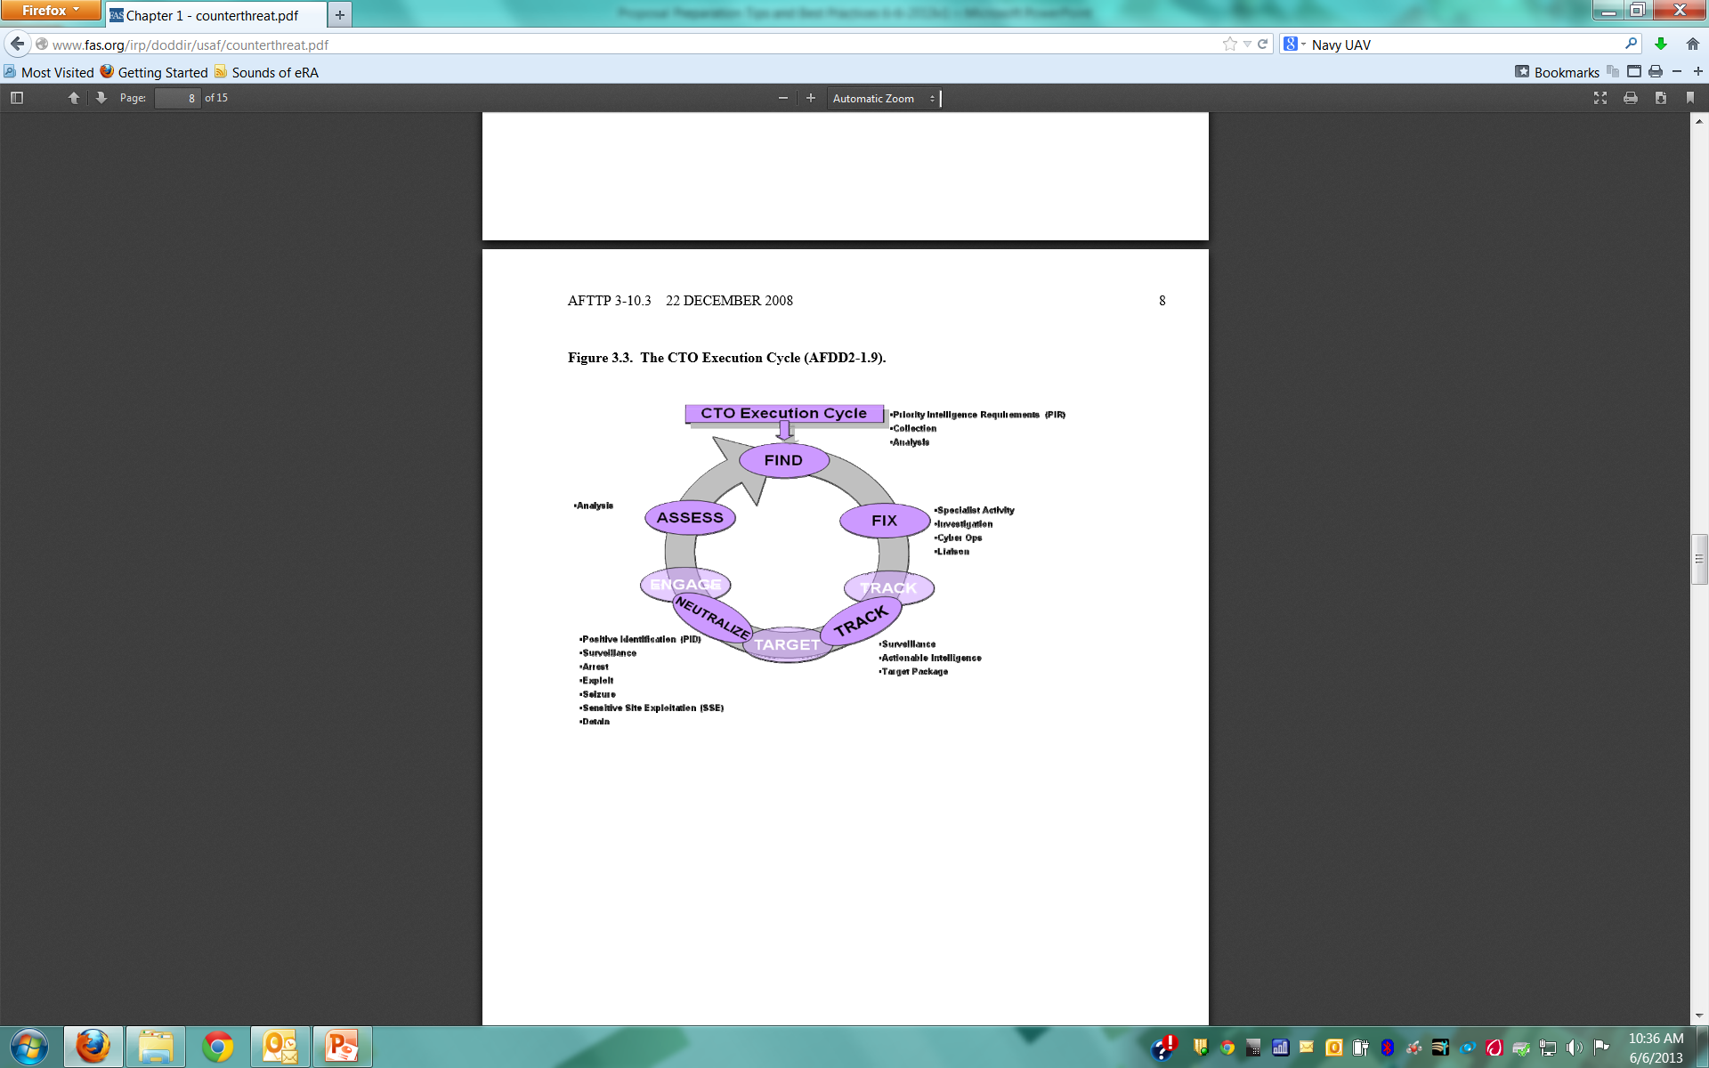
Use Emphasis, Figures and Tables
Reinforce your ideas with emphasis (bolding, italics, underlining… bolding best – but don’t overdue)
Use figures and tables appropriately
Use examples to support statements
Use level of detail appropriate for persuasion not for an expository peer reviewed journal article
Figures can summarize, even support the narrative, tell the story, support skimming
Throughout your writing, convey liveliness and enthusiasm… shows your commitment to the project
Notes:
Experience with Paul Osterbeck – I was in charge of developing a proposal for researching options for a Multi Role Unmanned aircraft operating off of a variety of naval vessels. I was assigned a “master proposal writer” to help me. He spent more than half the proposal writing time doing very careful figures and tables that told the whole story of the proposal while I was freaking out because there was no writing to review for what I thought was too a period in the proposal writing schedule. His approach was successful for our proposal and for others he wrote.
Proposal figures and tables are not typically the same as manuscript figures and tables. Be aware of the differences – simple, make the point clearly, support skim reading, etc.

Slide 40
Address Proposal Aesthetics
The proposal must be aesthetically appealing
  “Just as clothing is important in the business world for establishing initial impressions, so, too, is the appearance of your proposal as it reaches the reviewer's hands. The proposal should ‘look’ familiar to the reader. A familiar proposal is a friendly proposal (Jeremy and Lynn Miner).”
If allowed, match the funder’s publications style (same type size, style, layout, and headings as they do in their publications) …. Your proposal will look more credible
Use white spaces for visual relief and to frame the text (don’t go overboard)

Slide 41
Proposal Aesthetics (continued)
The proposal must support all types of reading (skim, search, critical)
  Bold Type to emphasize key words and ideas; avoid overemphasis
  Lists to quickly provide the message, convey chunks of information
  Ragged Right Margins for reading easier eye tracking from one line to the next
  Type Size that is at least a 12-point (smaller is difficult to read); make ideas fit, by tightening sentences, editing wordy phrases
  Type Style that unless otherwise specified, uses serif typefaces for text and sans serif typefaces for titles and headings. Serif type easier to read; sans serif makes titles and headings stand off from the body of the text.
Notes:
Bold Type easier to read than underlining, italics, or all capital letters as a means of creating emphasis. Use bold type to emphasize key words and ideas, but avoid overemphasis.
Lists. Lists help to get the message to the reader with a sense of immediacy, without being wordy. Furthermore, because lists are easy for readers to skim, they convey chunks of information quickly
Ragged Right Margins. A ragged right margin is easier to read than one that is right justified because the proportional spacing slows readability. It is easier for the reader's eye to track from
the end of one line to the beginning of the next line when the right-hand margins are jagged.
Type Size. Adjust your word processing program for a 12-point type style. Text smaller than 12-point becomes difficult to read and makes the reviewer’s job harder. Rather than reducing
type size to make all your ideas fit on the page, try tightening sentences and editing wordy phrases.
Type Style. If a type style is not specified in the application guidelines, consider using serif typefaces for the text of your proposal and sans serif typefaces for titles and headings. Serif type styles such as Times Roman and Courier have small strokes that finish off the main stroke of a letter and make it easier to read. Sans serif type styles such as Universal and Arial, which do not have the small finishing strokes, are ideal for titles and headings because they stand off from the body of the text. Avoid using ornate type styles, such as Cloister Black and Freestyle Script,which are hard to read and distract from the content of the proposal.
Adapted from A Guide to Proposal Planning and Writing by Jeremy T. Miner and Lynn E. Miner
Experts have suggested looking at Scientific American articles to get an idea of what in general a proposal should look like – don’t use the articles in the top, peer reviewed journals in your field as examples

Slide 42
Write for Reviewers
You Should
Pay attention to all the review criteria
Assume an uninformed but intelligent reviewer
Avoid insider jargon and acronyms
Consider the challenges facing reviewers
  Many proposals to review
  Limited Time for your proposal
  Different experiences in review process, veterans to novices
  Different levels of knowledge in proposal area
  With many proposals to review, looking for reasons to reject proposals
Your Proposal Must
Support each reading style; reviewers will use them all (skim, search, critical)
Get reviewers excited and interested starting from the title and first page
Make them an advocate for your proposal to their colleagues … likely only one will review the proposal all the way through
Not bore them, confuse or anger them… these emotions are the kiss of death

Slide 43
Academic Writing Sample
From a study on workplace aggression:
Taken together with the findings from the present study that (a) workplace aggression in the primary job was more closely associated with negative work experiences and (b) both situational and individual characteristics played a role in aggression in the secondary job, future research might benefit from a greater focus on the subjective salience of the job as a moderator of the relationship between workplace experiences and supervisor-targeted aggression. Indeed, despite the differential effects of situational and individual difference factors on aggression, it is notable that the individual difference factors exerted a consistent but relatively low-level effect on aggression across contexts, whereas the more salient situational experiences exerted context-specific effects.
Inness, M., Barling, J., & Turner, N. (2005). Understanding supervisor targeted aggression: A within-person, between-jobs design. Journal of Applied Psychology, 90, 4, 731-739.
Exciting? Interesting? Compelling?... not for a proposal!

Slide 44
Components of the Proposal
General Components
Effective Titles
Effective Abstracts/Summaries
Narrative Elements

Slide 45
General Components
Title
Project Summary/Executive Summary/Abstract
  Typically 1-2 page summary
  Some funders want specific content (e.g., intellectual merit, broader impacts for NSF)
Proposal Narrative/Project Description/Research Plan
  “Meat” of the proposal – what you are going to do and how
  Typical sections may include
    Introduction/Overview/Objectives/Rationale/Specific Aims/Significance
    Background/Lit Review/Stated of the Art; Preliminary Results/Studies
    Methodology/Technical Approach/Experimental Plan/Research Strategy
    Project Schedule/Milestones/Deliverables/Outcomes
    Management Approach
    Education/Broader Impacts/Diversity
(Proposal writing descriptions were adapted from a variety of sources, inlcuding Cronan and Deckard, “New Faculty Guide to Competing for Research Funding”, 2013 and from NSF TUES Webinar, 2013)

Slide 46
General Components (cont.)
References Cited/Bibliography
Facilities and Equipment
  Demonstrate you have the equipment and infrastructure to accomplish proposed project
Budget including Budget Narrative and Justification
  Budget to accomplish the work and why it is needed
Biographical Sketches
  Show you and your team can do the work, are credible
Other
  Cover page, Statement of Work, Public Health Relevance, Data Management Plan, Postdoc Mentoring Plan, Letters of Support/Collaboration/Reference as specified by funder
  ORCA, IRB form

Slide 47
Characteristics of Effective Titles
First thing the reviewer should read is an “eye-catching” title
Title should emphasize the payoff/benefit
Title must be understood by a broad spectrum of audiences, including the general public
Select words which accent the main category of the study, describe its distinctive features
State the major idea as quickly as possible, with the modifiers following, rather than preceding, the main category

Slide 48
Effective Titles (cont.)
Avoid fillers and non-communicating devices such as
  “A Study of... ”, “An Exploratory Study to Determine...”, “An Examination of...”, “A Method to Explore...” (unless the focus of your project is the methodology itself, rather than the results of using the methodology)
Study titles of other funded projects in your field to
  Get a sense of the type of research currently funded
  See how specifically other researchers describe their projects
  See the extent of precise technical language in your discipline
Avoid jargon or vogue words

Slide 49
Steps for Creating Effective Titles
List candidate words and standard abbreviations
Create approximately ten titles using combinations and permutations of the words and abbreviations
Ask colleagues and “laypersons” to identify the most informative and evocative of interest
Refine until you have an eye catching title
Example
  Rather than "Studies on the Development of Objective Techniques for Monitoring the Development of Visual Acuity in Infants“ how about "Visual Acuity in Infants” or "Visual Acuity in Infants: Objective Monitoring of its Development"

Slide 50
Effective Summary/Abstract
After the title, the next and perhaps only thing a reviewer reads is the abstract or summary
Written last, but read first by reviewers
  Provides first impression of your project but may also be the last impression for reviewers wanting to refresh their understanding after reading your proposal
Must be an intriguing “first advertisement”
  Compelling, interesting, exciting
Should reflect entire scope of project

Slide 51
Effective Abstract/Summary (cont.)
Summarizes project purpose, goals, research design, methods, significance
Must convey:
  What researcher intends to do
  Why it’s important
  Expected outcome(s)
  How work will be accomplished
Should be explicit (e.g., “The objective of this study is to …”)
Has to be well crafted and thoughtful, CONCISE and COMPLETE
“If I had more time, I would have written you a shorter letter (Mark Twain’s correspondence with a friend)”

Slide 52
Elements of the Narrative
Introduction (never generic; avoid too much explanation and quickly get to the kernel of your great idea)
  How is your idea different from others? What important problem will it solve? Why is it innovative and exciting?
Background and context (prior work, theoretical basis – reference the literature)
Justification and significance (importance, impact, need)
Ultimately, the introduction, background, justification provide the rationale to convince your reader that the proposal has placed the proposed work in the context of prior work and relevant theory and has identified a problem of significance with a proposed viable solution

Slide 53
Narrative Elements (cont.)
Goals and Expected Outcomes
  A Goal is a broad statement about what you hope to achieve or accomplish through the project… What are your intentions or ambitions in conducting the project?
  An Expected Outcome (or Objective) is a measurable result that is directly traceable to one or more project goals
Whereas Goals need to broadly written, even somewhat vague, Outcomes need to be SMART (Specific, Measurable, Attainable, Realistic, Timely)
(adapted from NSF definitions)

Slide 54
Narrative Elements (cont.)
Project Plans
  Implementation plan (how and when things are done)
    Strategies and activities to achieve goals, expected outcomes
    “Products” to be developed
    Equipment, materials and other required resources
    Summary of prototypes or pilots
    Timeline (Integrates, shows connections between project plans; overall flow of the project)
  Management plan (who, what and when of project activities)
    Show funds will be responsibly managed
    Show appropriate resources (people, equipment, space, time) are in place for success
  Other plans as required
Plans help the reviewer determine if the project is feasible… i.e., the applicant has intellectual capacity, disciplinary knowledge, strategies, means and resources to accomplish the goals

Slide 55
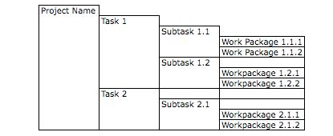
Budget
Credible, consistent with the scope of the project
Each item clearly explained and justified
Address prior funding when appropriate (emphasize the outcomes)
A good industry tool for developing a budget is to create a Work Breakdown Structure (WBS)
  Outline work to several different levels of detail and then put into the budget a rolled up version at a higher level
(From tutorialspoint.com}

Slide 56
Final Thoughts on Proposal Writing
Winning proposals have been polished repeatedly through writing and re-writing
  “Competitive ideas evolve and converge over time; they do not appear fully and perfectly formed by a narrative Genie (Cronan and Deckard, “New Faculty Guide to Competing for Research Funding”)”
Fight “Pride of Authorship”
Sell but don’t over promote your ideas
Get reviewers and proofreaders (with no stake in project?)
Allow time
Learn from rejection
Notes:
Must spend time, write, re-write, polish etc. How long do you spend getting manuscripts prepared for top journals? You should put at least as much time and effort into proposal writing

Slide 57
Summary
Marketing your ideas throughout the proposal development process is a fundamental key to success in funding capture
Pre-proposal planning and other pre-proposal activities (many of which faculty already do?) can improve the chance for success and make proposal writing easier
Attention to details in organizing and writing (including word selection, usage, titles, abstracts) can greatly improve a proposal’s P_{win}

Slide 58
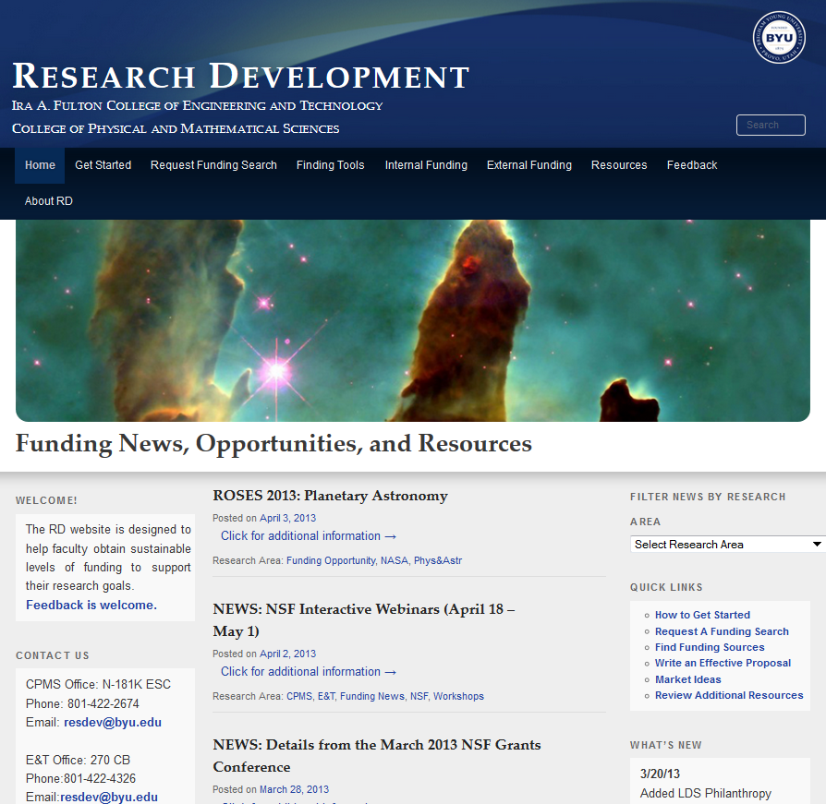
Research Development Website
Design
Information “dense”
Information accessible < 3 clicks
Checklists and guides
Pages
Home page
  Orient reader to website
  Funding news
  Quick links to other pages
Getting Started page
  Planning, finding, securing
  funding steps
Request a funding search
Tools funding searches
Internal and external funding sources
Resources
  Proposal planning/management
  Proposal preparation
  Sample proposals
  Marketing
http://researchdevelopment.byu.edu/

Slide 59
Sources for This Presentation
Robert Porter, What do Grant Reviewers Really Want, Journal of Research Administration, Vol. XXXVI, Issue 2, 2005.
Robert Porter, Coaching Researchers to Write Successful Grants, National Organization of Research Development Professionals (NORDP), May, 2013 conference. Really Want and
Morgan Giddings, Four Steps to Funding, How To Avoid Rejection and Get Your Proposal Funded on Your Next Try, 2012
Jeremy and Lynn Miner, A Guide to Proposal Planning and Writing
Grant Writing Institute
CapturePlanning.com
ORCA proposal writing guides and proposal forms
Instructional materials prepared by the National Council of University Research Administrators and the Society for Research Administrators, July 1995 (see facstaff.gpc.edu/~ebrown/infobr3.htm Georgia Perimeter College)
Tips and Practical Guidelines for Proposal Writers prepared by an NSF panel
NSF Panel on TUES proposal preparation
NSF Proposal Writing Exercises
The Grant Center, UNC. http://writingcenter.unc.edu/handouts/grant-proposals-or-give-me-the-money/
*A Guide to Proposal Planning and Writing by Jeremy T. Miner and Lynn E. Miner

Slide 60
Additional Resources for Proposal Preparation
Online
  Research Development website http://researchdevelopment.byu.edu/
  ORCA website http://orca.byu.edu/
  Faculty Center website http://facultycenter.byu.edu/node?destination=node
Human Resources
  Colleges of Engineering and Physical and Mathematical Sciences Research Development group
  ORCA
  Faculty Center
  Experienced faculty with success at proposal writing
  LDS-P
  BYU workshops
  Off campus workshops
Hardcopy
  Research Development Group loanable guides for NIH, NSF proposals
HBB Library

Slide 61
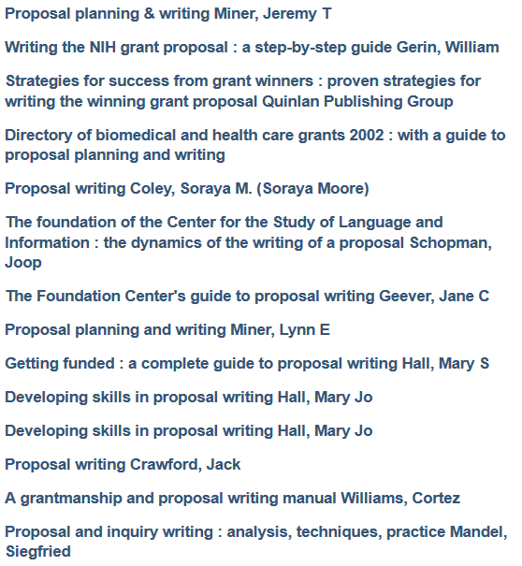
Sampling of Proposal Writing Books at the HBLL

Slide 62
Sample Search Strategy
Search Strategy for Dr. Matthew Memmott
Department of Chemical Engineering
350U CB
801-422-6237
memmott@byu.edu
Search Criteria
Overall Objective
Find funding to establish a research lab that studies nuclear fuels and reactors.
Near-Term Objective
Leverage the current DOE funding to obtain additional NEUP grants
Utilize the DOE funding, BYU start up funding and any additional funding opportunities that can be secured in the next few years to generate data that will help secure larger levels of funding that can support overall objectives
Current Funding Sources
Has $50K of DOE funding through Georgia Tech in collaboration with Westinghouse as part of the NEUPs (Nuclear Engineer University Programs)
Has submitted 2 pre-proposals for additional NEUP projects (should hear about these proposals by February of 2015
Received a start up package from BYU that will provide funding for a couple of graduate students for a year or so

Slide 63
Sample Search Strategy (cont.)
Background Information
As a professor in the Chemical Engineering department, Dr. Memmott is a trained chemical and nuclear engineer, with a focus on simulation, modeling, and design. He obtained his masters and doctoral degrees from the Massachusetts Institute of Technology (MIT) in Nuclear Science and Engineering. His research focused on the optimization of hydrogen production systems integrated with gas-cooled, fast-spectrum nuclear reactors and innovative fuel configurations and safety analyses for fast spectrum reactors.
Before coming to BYU, Dr. Memmott was employed for 5 years at Westinghouse Electric Company. As a senior engineer, he was involved with Westinghouse fuel cycle back-end research, and was the principal investigator for fast-spectrum reactor development. He also led the Westinghouse Small Modular Reactor (SMR) development team and worked on sodium fast reactors (SFR) concepts.
Dr. Memmott has developed several patents for varying aspects of nuclear reactor design and has been part of several research proposals that were part of Westinghouse’s Nuclear Engineering Program. His proposal writing for these efforts was limited.
Search Terms
· nuclear reactor simulation
· nuclear reactor modeling
· nuclear reactor design
· hydrogen production systems
· gas-cooled, fast-spectrum nuclear reactors
· fuel configurations and fast spectrum reactors
· safety and nuclear reactors
· small modular reactors
· sodium fast reactors

Slide 64
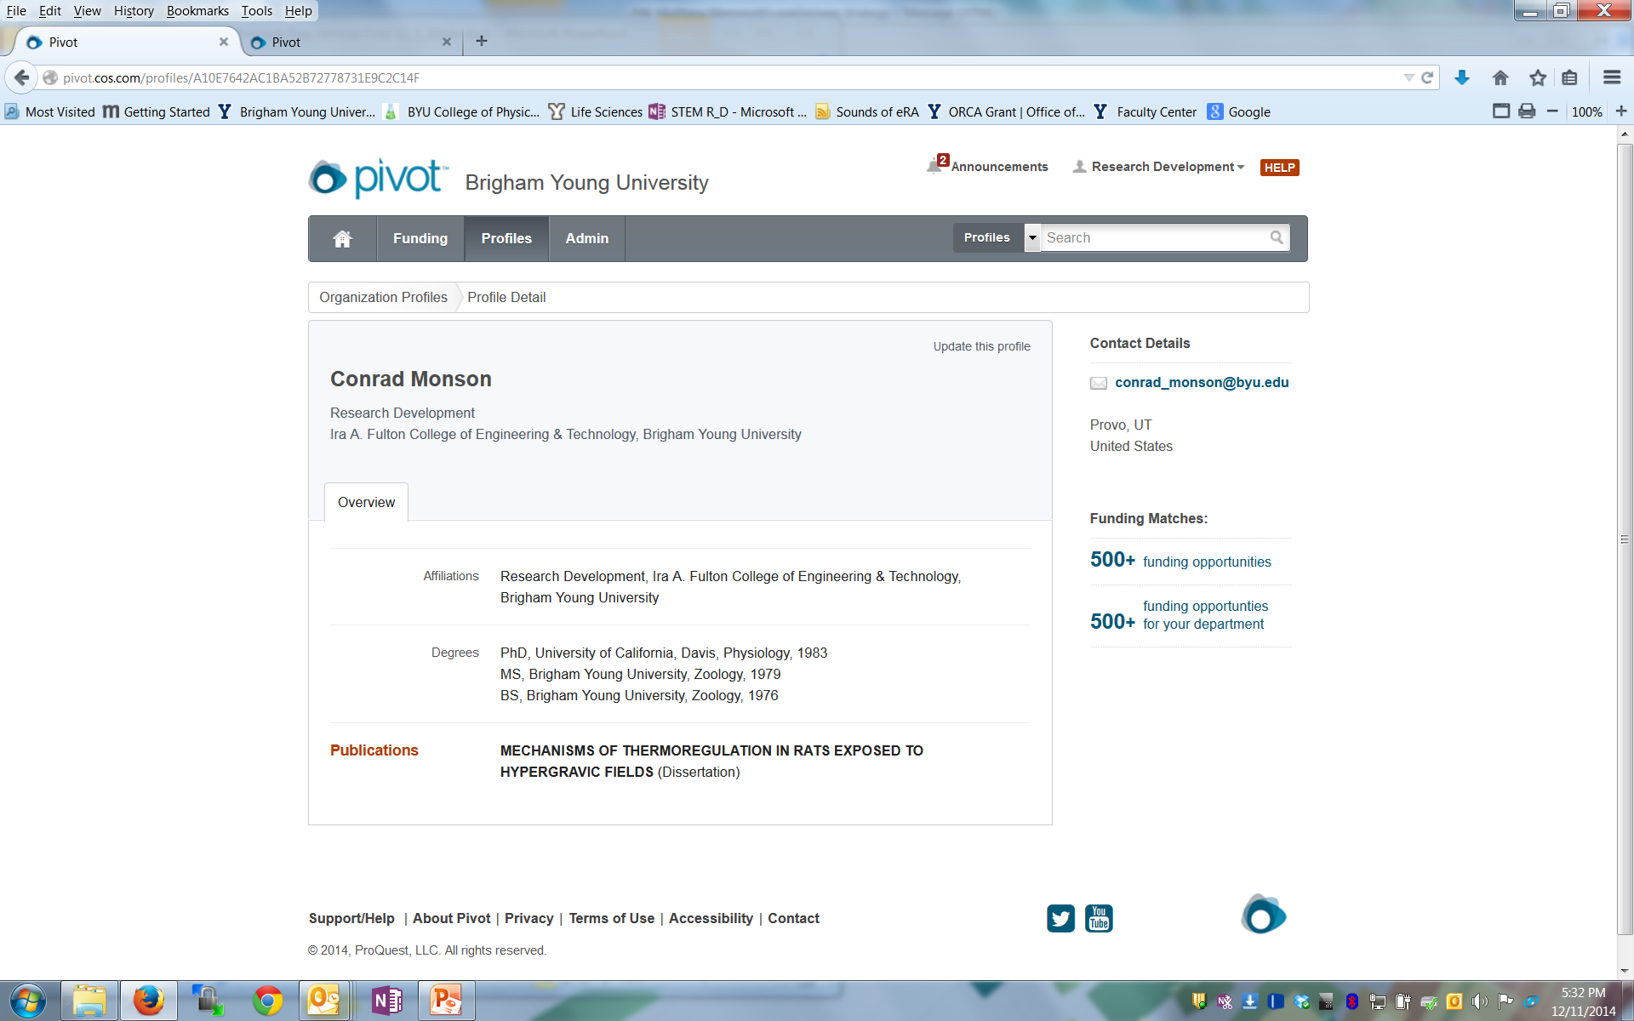
Very Simple Profile

Slide 65
Not So Good Abstract
Abstract from a study on workplace aggression:
Taken together with the findings from the present study that (a) workplace aggression in the primary job was more closely associated with negative work experiences and (b) both situational and individual characteristics played a role in aggression in the secondary job, future research might benefit from a greater focus on the subjective salience of the job as a moderator of the relationship between workplace experiences and supervisor-targeted aggression. Indeed, despite the differential effects of situational and individual difference factors on aggression, it is notable that the individual difference factors exerted a consistent but relatively low-level effect on aggression across contexts, whereas the more salient situational experiences exerted context-specific effects.
Exciting? Interesting? Compelling?...

Slide 66
Really Good Abstract
EFRI-ODISSEI: Uniting Principles of Folding and Compliant Mechanisms to Create Engineering Systems with Unprecedented Performance
PI: Larry L. Howell, Brigham Young University (BYU) Co-PIs: Spencer P. Magleby, Denise M. Halverson, David C. Morgan, Lisa C. Barrager (BYU) Senior Personnel: Paul L. Anderson (BYU); Consultant: Robert J. Lang (Independent artist)
Origami artists have spent millions of hours developing origami models under extreme self-imposed constraints (e.g. only paper, no cutting or gluing, one regular-shaped sheet). The resulting sophisticated motions suggest that it may be possible to design complex engineered systems from few components and processes. We hypothesize that compliant mechanism principles offer a way to translate origami discoveries beyond paper and across a wide spectrum of applications. This inspires the primary objective:
The objective of this research is to unite principles of origami and compliant mechanisms to enable the creation of engineered systems with unprecedented performance.
Intellectual Merit
The research creates design tools and methods that enable systems not previously possible (e.g. unprecedented compactness, weight, cost, integration of functions, elimination of assembly and interfaces, and unique coupled motions). During folding, origami models are compliant mechanisms because they achieve motion from folds and flexing panels rather than from traditional approaches using hinges and bearings. Combining the principles of origami and compliant mechanisms will enable applications such as highly compact mechanisms (e.g., medical implants, electronics equipment, and aerospace components), collapsible devices that are compact during transport and deployed at the location of operation (e.g., surgical devices, space mechanisms, and search and rescue systems), and applications with limited manufacturing processes available (e.g., microelectromechanical systems and cost-sensitive applications).

Slide 67
Compliant mechanism principles provide a means to translate origami discoveries into engineered systems that achieve desired behaviors. The objective will be accomplished via the following approach:
1. Overcome obstacles limiting origami principles from being widely applied to non-paper materials
2. Create design methods that unite origami and compliant mechanism principles
3. Employ the united principles to create engineered systems with unprecedented performance
4. Exhibit the relationship of origami art to engineering advances
The research progresses from the most straightforward (e.g. creating “surrogate folds” to replace origami creases in non-paper materials) to more complex approaches (e.g. translating origami tessellations to spatial compliant mechanism arrays), creating both an immediate impact and a foundation for future research and discoveries.
Deliverables include a library of surrogate folds, design methods and mathematical modeling approaches for creating origami-based compliant mechanisms, engineered systems that further national goals, student education, broadening participation results, and a world-class traveling museum exhibit with accompanying book and integrated outreach activities.
Broader Impacts
Education. Engineering, mathematics, and industrial design students will be intimately involved in all aspects of the research and the largest budget item is dedicated to their support.
Broadening participation. The broadening participation plan focuses on engaging and mentoring women students in all phases of the research. Two women co-PIs serve as role models, and freshmen mentorships, undergraduate and graduate women research assistantships, museum exhibit creation involvement, and outreach to younger students are tools that will be used to implement the plan.
Technology impact. The unification of principles of origami and compliant mechanisms will make possible engineered systems that are light weight, compact, low cost, and high precision. The approach is focused on tasks that result in systems that can enable the achievement of important national goals. Commercialization of the research will demonstrate its potential for real and significant economic impact.
Museum exhibit and outreach. An exhibit of origami art and its extension to engineering and mathematics will be developed for display and for traveling to museums nationally. This will include interactive activities for broader societal outreach.

Slide 69
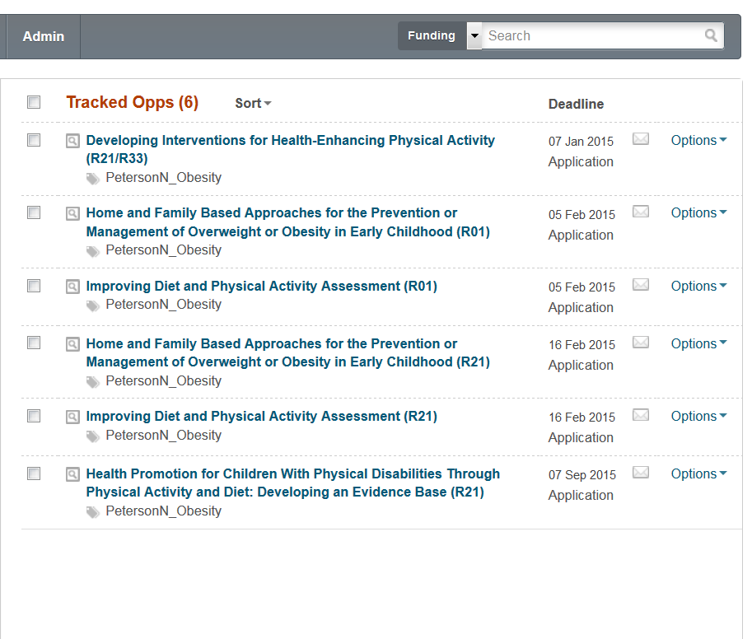
Neil Peterson Ops

