Slide 1
Grant Proposal Development Workshop Day 1
December 19, 2017

Slide 2


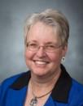
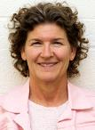
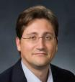
Research Development Support
Kristen Clarke Kellems
FHSS Research Development
934 SWKT
Tel: 801-422-8967
Email: fhssresdev@byu.edu
Conrad Monson
STEM Research Development
275 McDonald Building
Tel: 801-422-7722
Email: conrad_monson@byu.edu
Jaynie Mitchell
MSE Research Development
306C MCKB Tel: 801-422-3067
Email: Jaynie@byu.edu
Sarah Dorff
Research Development Administrator
269 McDonald Building
Tel: 801-422-0132
Email: resdev@byu.edu
Jon Balzotti
English Department Faculty College of Humanities
4127 JFSB
Tel: (801) 422-2440
jonathan_balzotti@byu.edu

Slide 3
Proposal Development Process
Good Ideas
Fundable Idea
Find Funder(s)
Pre-Proposal
Write the Proposal
Revise
Marketing
Rejected
Accepted AND Funded
Funder
Drafts
Submit (ORCA)
Peer Review
Edit
Research Development has tools and resources to help with the steps in this process

Slide 4
Agenda
Day 1, December 19th
Introduction/ Research Funding Environment (Conrad)
Finding Funding/IDR (Kristen)
Creating a Fundable Idea and SWOT (Jaynie)
Prewriting (Conrad)
Break 10:30 (10 min)
Describing Needs Statement/Writing a Persuasive Needs Statement ( (Kristen)
Proposal Elements (Conrad)
11:45-12:15 Lunch
Titles and Abstracts (Jaynie)
1:00 Faculty Panel and Q&A
Wrap up (Conrad)

Slide 5
Research Funding Environment

Slide 6
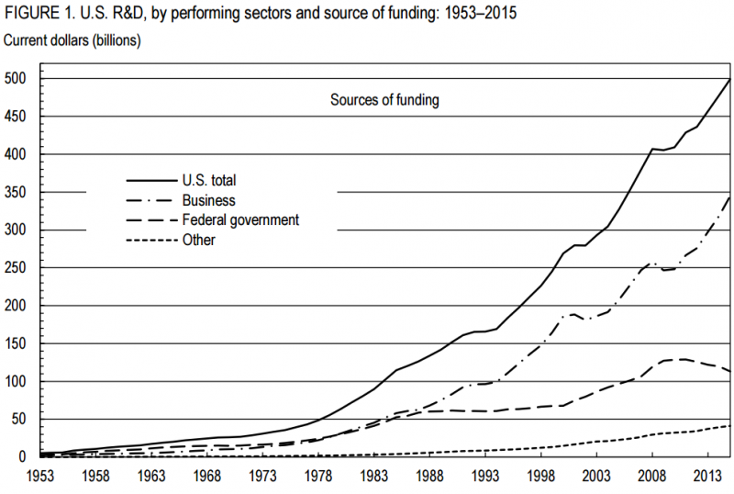
US R&D Funding
NSF, National Center for Science and Engineering Statistics, National Patterns of R&D Resources (annual series))

Slide 7
External Funding for University Research¹
In 2015, CPMS, FHSS, E&T, LS and MSE received 91% of BYU research funding; over 80% of that funding was from federal sources²
(Internal to a University)
¹NSF Higher Education R&D Survey. Data are the average of 2011, 2012, 2013
²ORCA Annual Report of Sponsored Research for 2015
Most of BYU research funding comes from federal sources

Slide 8
Finding Funding

Slide 9
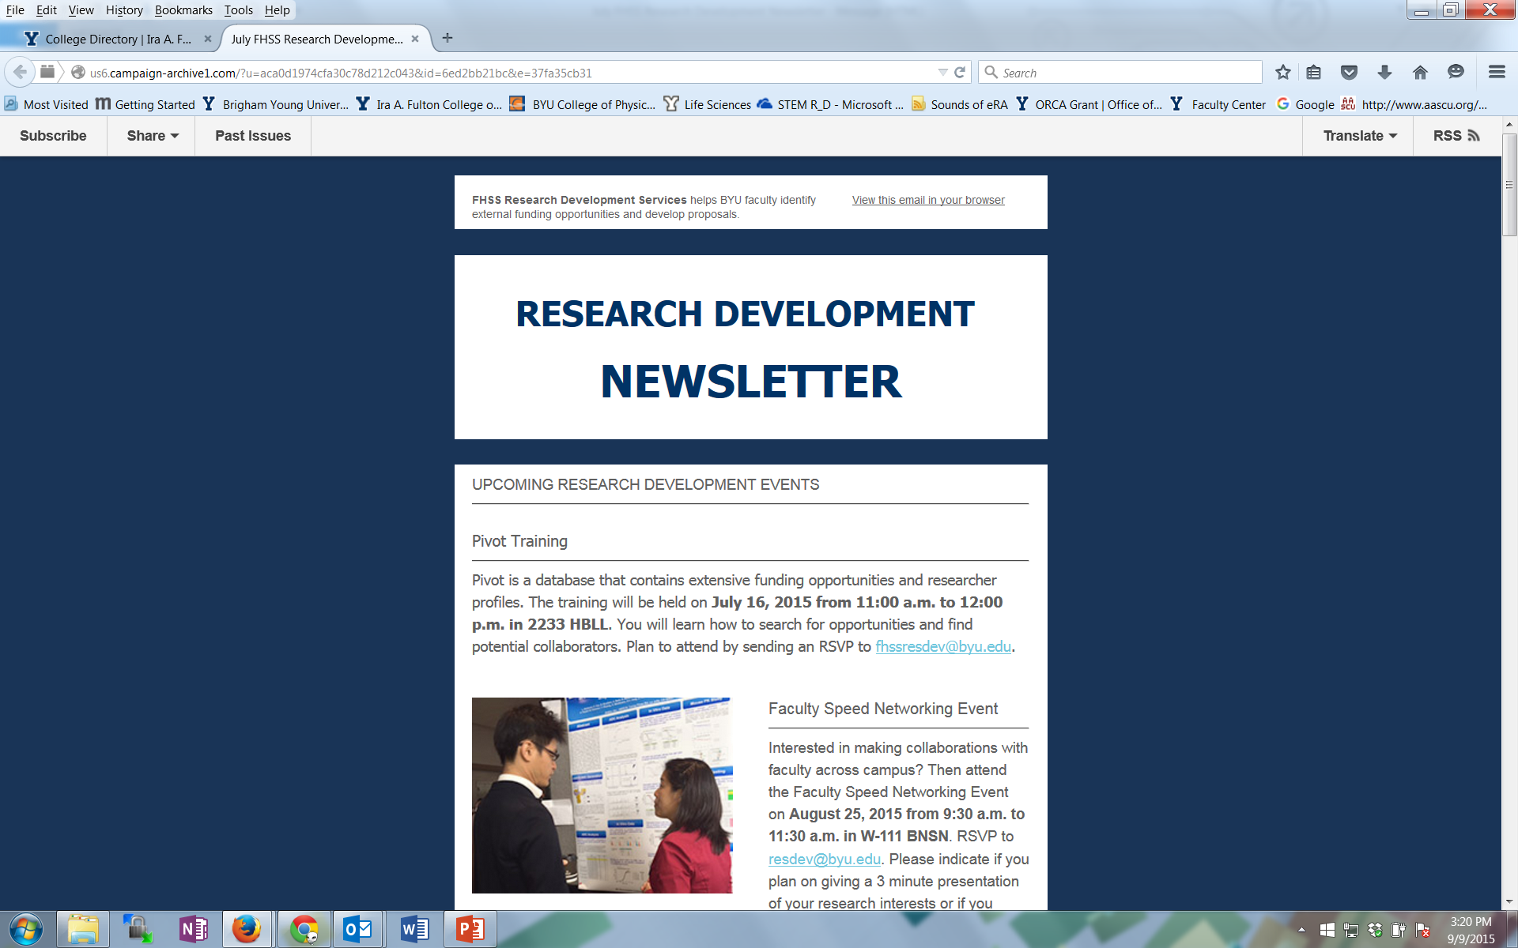
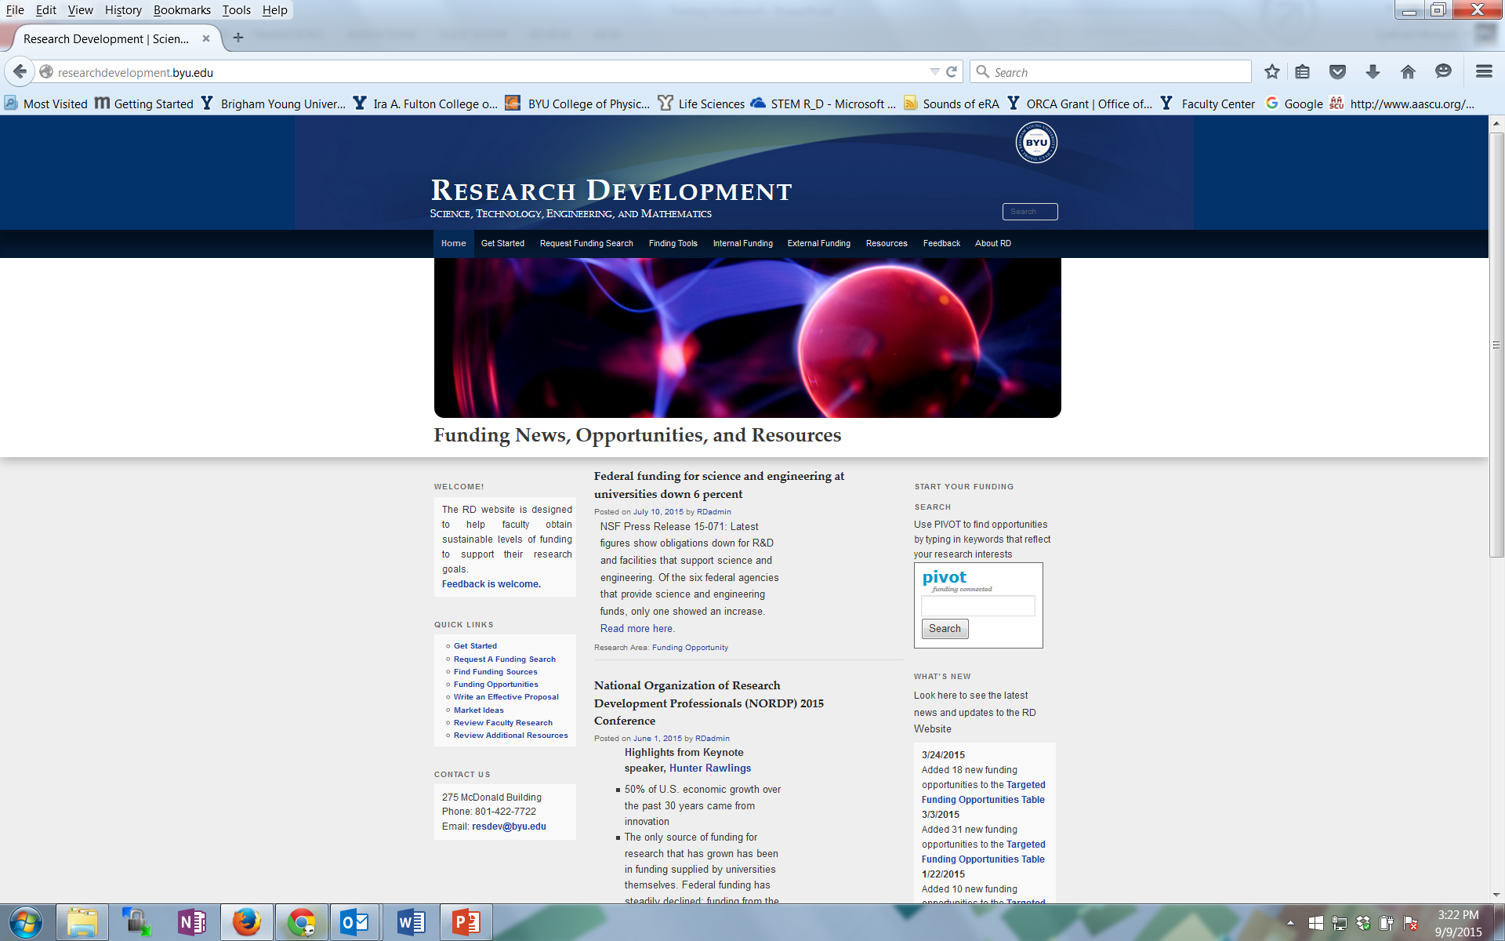
Research Development Support for Finding Funding and Writing Proposals
Newsletters from FHSS and STEM Research Development
Research Development website: researchdevelopment.byu.edu
Online funding searches
Conduct seminars about particular funders
Advocate research capabilities to funders
Attend funding conferences
Identify funding opportunity and help write the grant proposal

Slide 10
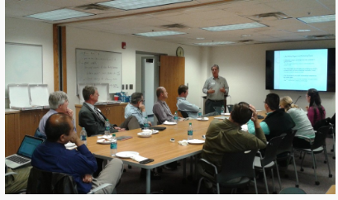
Facilitate Interdisciplinary Teaming
Focus on “Grand Challenges” described by NSF, NIH, NASA, other federal agencies
Current IDR Teams
Arctic Research (impacted by oil prices)
Brain group
Food, Energy, Water (NSF INFEWs and other opportunities)
Smart Cane for the Blind
Data
Diabetes
IDR Teams in work
Nutrition in public schools
Anything you may want to form a group about
Designated Area for IDR Teams
Reconfigurable
Large display screen with HDMI, Chromecast
Speaker phone
Whiteboards
Storage cabinets

Slide 11
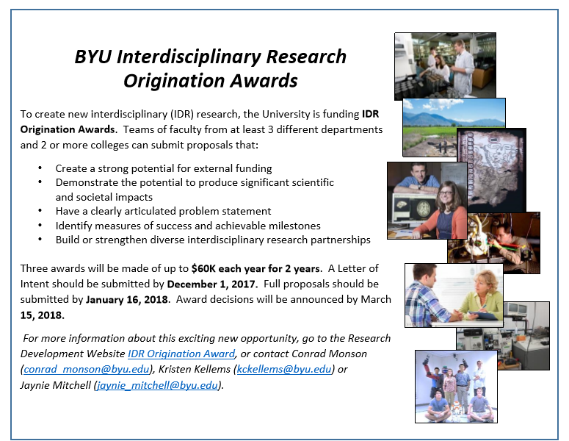

Slide 12
Develop a Fundable Idea

Slide 13


Ideas for Developing and Optimizing Your Research Proposal
Identify a relatively under-explored niche within the area of your broad research interest
Identify your long-term goal within the niche area
Search and critically analyze the literature that is pertinent to your research. Where are the knowledge gaps in your research or others?
From the literature, develop a list of key words that are pertinent to the area and the names of the investigators who have been active in the area during the last ten years
Assess your own ability to pursue the idea, including relevant expertise and resources
Who’s doing what in this field? Use information from funded grants to clearly identify the knowledge gap to improve your idea and research design
Determine which granting agencies are most appropriate to your idea, i.e., ones whose mission will be advanced by funding your idea (tie to their funding priorities)
Seek constructive criticism of your idea from knowledgeable colleagues and the funder’s program officer

Slide 14

Questions to Jump Start Your Proposal
The following questions are a good starting point for any grant proposal. You need a brief, convincing answer to each of them as a way of testing your readiness to start writing.
1. What is the problem (or need) and why is it important?
2. How is existing knowledge or practice inadequate?
3. Why is your solution/response better? How is it new, unique, different?
4. Who will benefit from it and how will it advance your field?

Slide 15
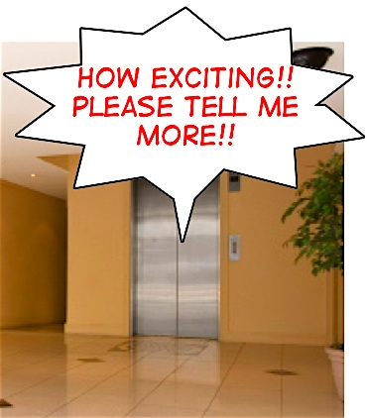
Goal: You want to obtain funding for a research project Preparation: You have 5 minutes to identify your problem and your proposed response on a 3x5 card 1. Divide into pairs 2. Present your fundable idea to your partner (the funder) for one minute 3. Partner response – one minute 4. Switch roles and repeat 5. Reconvene and debrief
Notes:
Rework exercise into “Elevator Speech”

Slide 16
With a Fundable Idea and Good Potential Funding Source(s) Perform SWOT Analyses
S
Strengths
What are your strengths
What do you do better than others
What unique capabilities and resources do you possess
What do others perceive as your strengths?
W
Weaknesses
What are your weaknesses
What do competitors do better than you
What do others perceive as your weaknesses
Internal (attributes of your organization)
O
Opportunities
What trends or conditions may positively impact you
What opportunities are available to you
T
Threats
What trends or conditions may negatively impact you
What are your competitors doing that may impact you
Do you have solid financial support
What impact do weaknesses have on threats to you
External (attributes of your environment)
Positive (helps meet objectives)
Negative (detrimental to objectives)
SWOT analyses can identify strengths to highlight, weaknesses to mitigate, opportunities to capitalize on and threats to counter

Slide 17
SWOT Example
Utah State’s SWOT analyses determined that the University of Colorado would be a better partner than BYU on a 3-university NSF I CORPs Node proposal (U of U was the other partner)
Strengths – Colorado has largest venture capital investment in the region, as well as a great marketing campaign around its entrepreneurial/innovation activity
Weaknesses – BYU has limited federal research expenditures and impact growth potential
Opportunities – Piggyback on the national attention and momentum that Boulder has received due to its commitment to early-stage deals
Threat – The Univ. of Colorado is attracting a lot of interest through its commercialization and ecosystem development efforts
S
Strengths
Best available regional partner is Univ. of Utah (data)
Combines top efficiency/magnitude programs (BYU and Univ. of Utah)
Geographical proximity - knowledge spillover
Complimentary network of fields
Common ecosystem resources/characteristics
W
Weaknesses
Limited innovation/entrepreneurship interaction between institutions
Univ. of Utah had visible failure in the first round of I-Core
Univ. of Utah would most likely need to drive the initiative
BYU has limited federal research expenditures and impact growth potential
S
Strengths
Best available regional partner is Univ. of Utah (data)
Combines top efficiency/magnitude programs (BYU and Univ. of Utah)
Geographical proximity - knowledge spillover
Complimentary network of fields
Common ecosystem resources/characteristics
W
Weaknesses
Limited innovation/entrepreneurship interaction between institutions
Univ. of Utah had visible failure in the first round of I-Core
Univ. of Utah would most likely need to drive the initiative
BYU has limited federal research expenditures and impact growth potential
S
Strengths
Best available regional partner is Univ. of Utah (data)
Combines top efficiency/magnitude programs (BYU and Univ. of Utah)
Geographical proximity - knowledge spillover
Complimentary network of fields
Common ecosystem resources/characteristics
W
Weaknesses
Limited innovation/entrepreneurship interaction between institutions
Univ. of Utah had visible failure in the first round of I-Core
Univ. of Utah would most likely need to drive the initiative
BYU has limited federal research expenditures and impact growth potential
O
Opportunities
Utah is a leader in high-tech startup density and venture capital share growth in the region and nation
Signals a united front for the state of Utah and its commitment to entrepreneurship/innovation
Opportunity to showcase impact of USTAR/other state programs on commercialization
Regardless of outcome, these collaborations could greatly benefit Utah State
T
Threats
Los Angeles/San Diego is the strongest ecosystem available in the Pacific and Mountain Regions
A member of the I-Core Selection Committee has voiced their lack of support for the Univ. of Utah
The Univ. of Colorado is attracting a lot of interest through its commercialization and ecosystem development efforts
Utah is an extremely conservative state compared to Colorado and Washington/Oregon
O
Opportunities
Utah is a leader in high-tech startup density and venture capital share growth in the region and nation
Signals a united front for the state of Utah and its commitment to entrepreneurship/innovation
Opportunity to showcase impact of USTAR/other state programs on commercialization
Regardless of outcome, these collaborations could greatly benefit Utah State
T
Threats
Los Angeles/San Diego is the strongest ecosystem available in the Pacific and Mountain Regions
A member of the I-Core Selection Committee has voiced their lack of support for the Univ. of Utah
The Univ. of Colorado is attracting a lot of interest through its commercialization and ecosystem development efforts
Utah is an extremely conservative state compared to Colorado and Washington/Oregon
O
Opportunities
Utah is a leader in high-tech startup density and venture capital share growth in the region and nation
Signals a united front for the state of Utah and its commitment to entrepreneurship/innovation
Opportunity to showcase impact of USTAR/other state programs on commercialization
Regardless of outcome, these collaborations could greatly benefit Utah State
T
Threats
Los Angeles/San Diego is the strongest ecosystem available in the Pacific and Mountain Regions
A member of the I-Core Selection Committee has voiced their lack of support for the Univ. of Utah
The Univ. of Colorado is attracting a lot of interest through its commercialization and ecosystem development efforts
Utah is an extremely conservative state compared to Colorado and Washington/Oregon
Notes:
Lots of templates and procedures have been developed to do a SWOT analysis. Whether or not you use a formal procedure, you will likely do at least an informal SWOT – the key is to clearly identify SWOT elements so you can leverage the positives about your research situtation and mitigate the negatives

Slide 19
Prewriting

Slide 20
Prewriting Activities: Thoroughly Decompose the Solicitation
Deadlines
Requirements, (technical, budget, management, “MIRs” etc.)
Proposal components
Unusual requirements
Procedures for submittal (including BYU/ORCA procedures)
Review Criteria
Notes:
Deadlines for submitting questions to the program officer, submittal through BYU/ORCA, submittal to the funder
Most Important Requirements (technical, budget content)
Elements required of proposal (cover page, summary, etc.)
Unusual requirements
Procedures for submittal (including BYU/ORCA procedures
Requirements
Can be technical, budget, management
What isn’t said in the solicitation may be just as important as what is said
Must understand and answer the MIRs (most important requirements

Slide 21
RFP Elements
General Information – Background, Goal, Mission
Eligibility
Required Sections
Document Format including font size, line spacing
Page Count
Submittal Process and Deadlines
Proposal Preparation Instructions
Merit Review Criteria

Slide 22
Sample of a Proposal Development Checklist
Contact Information and required proposal sections
Proposal writing tasks, deadlines, authors
Requirements and how they will be met
Themes
Proposal actions
Review criteria
From checklist posted on the RD Website http://researchdevelopment.byu.edu/resources/proposal

Slide 23
beginning independent career
outstanding researchers committed to teaching, learning, dissemination in a broader context to large audience
integration of research and education
mission, goals, resources of institution
foundation for lifetime of integration
be creative; many different approaches to integration
can’t apply for PECASE; make sure you meet criteria

Slide 24
Write for Reviewers
You Should
Pay attention to all the review criteria
Assume an uninformed but intelligent reviewer
Avoid insider jargon and acronyms
Consider the challenges facing reviewers
Many proposals to review
Limited Time for your proposal
Different experiences in review process, veterans to novices
Different levels of knowledge in proposal area
With many proposals to review, looking for reasons to reject proposals
Your Proposal Must
Support each reading style; reviewers will use them all (skim, search, critical)
Get reviewers excited and interested starting from the title and first page
Make them an advocate for your proposal to their colleagues … likely only one will review the proposal all the way through
Excite, not bore, confuse or anger reviewers… negative emotions are the kiss of death

Slide 25
Review Process and Panels
NIH
https://www.youtube.com/watch?v=fBDxI6l4dOA&feature=youtu.be
NSF
https://www.youtube.com/watch?v=WMoGdIFgy5o

Slide 26
Contacting Funding Officers
Do your homework – don’t ask questions that are answered in the RFP or other provided documents
Understand the mission and priorities of the funder
Be familiar with restrictions that might eliminate your organization
Know the minimum and maximum amounts typically awarded and the total amount of funding available
Review recent awards: what portion of the grants went to previous grantees
Write a short description of your project (white paper)
Email the description to the officer. Questions you could ask: What would you recommend to improve my chances for favorable review? What is anticipated success rate? What are some common reasons for proposal rejections? Listen carefully to read between the lines.
Follow up with a short thank you, summary of key points, cv with photo
Let the PO know you are willing to serve on a review panel
Adapted from Can We Talk? Contacting Grant Program Officers by Robert Porter, 2009

Slide 27
Writing A Persuasive Needs Statement

Slide 28
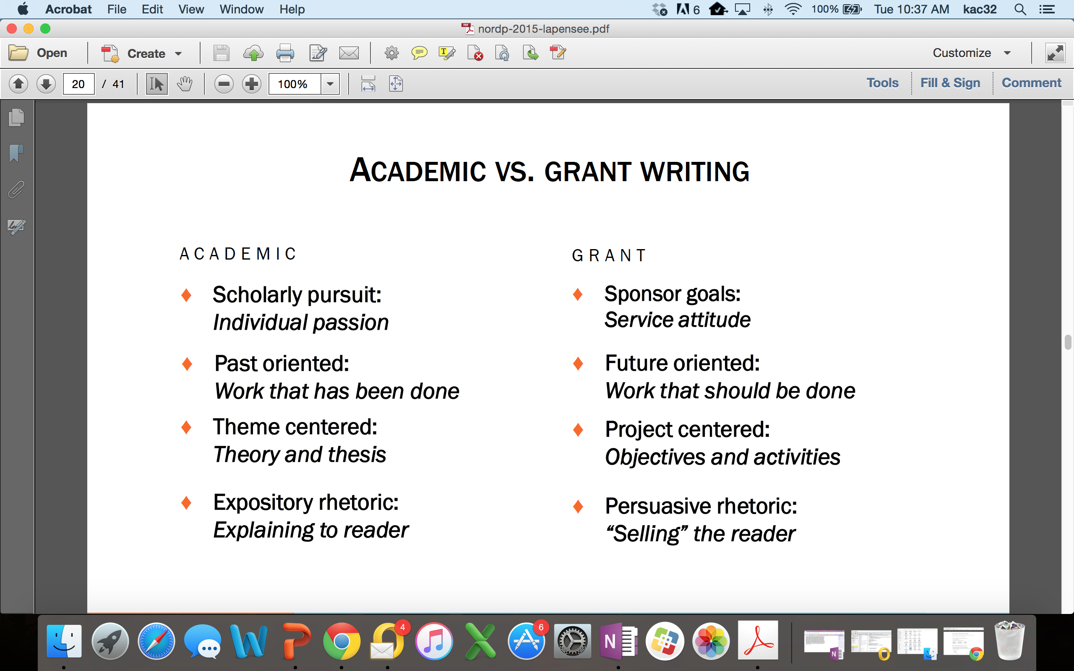
Academic vs Grant Proposal Writing

Slide 29




The Baseline Logic
Baseline Logic is the foundation for your readers’ (and your) understanding of a proposal
Because of the mis-alignment between (a) the college’s operating and delivery systems and (b) the needs of the college’s students and employers and community it serves,…
…we will develop and implement a comprehensive strategy for integrating current institutional initiatives into Engineering & Technology Division’s educational offerings.
Current Situation
Desired Result
S₂
S₁
As a result, BYU will be more responsive to the rapidly changing requirements of students, employers, and the community, offering higher quality educational services in less time and at a lower cost.
B
Benefits
90% of proposals have serious flaws in their baseline logic
(Baseline logic and generic slots descriptions adapted from Jon Balzotti’s presentations)

Slide 30
The Needs Statement Creates the Basis of Your Proposal: It has 3 parts
Description of the problem
Plan for solving the problem
Request for support (aka, “instrumental purpose”)
Example Instrumental Purpose
“United Methodist Church of Ames requests $20,000 from the Community Project Awards to fund an aftercare/tutoring program for at-risk K-6th graders in the Ames school systems.”

Slide 31
Need Statements: 3 parts
Description of the problem
Plan for solving the problem
Request for support (aka, “instrumental purpose”)
Problem statements explain:
Context of the problem
Define the problem so that other people can understand it, identify with it, and recognize it’s important
Be specific about what larger societal problem your proposed project contributes to solving
Justification for addressing the problem
Scope: How large is the problem? How many people affected by it?
Justification: Why do we need to spend the money and resources to solve this problem now? (Urgency)
Specific aspect of problem being addressed
If you are working on trying to solve a complex societal problem, you will not try and solve the entire problem, but rather an aspect of the problem

Slide 32
Expand Need Statement
Statistics:
Your own data
Info from external sources
Examples:
Anecdotes
Real-life examples
Quotes
Tips:
Use data that best supports the case your are building
Give the reader hope

Slide 33
Describe the Problem: Rhetorical Appeals
Aristotle wrote that there are three types of rhetorical appeals. They are:
A rational appeal (logos), citing facts, figures, and statistics to build your case; using deductive reasoning and inductive examples to support your claims
An emotional appeal (pathos), using case studies or examples which arouse the readers’ emotions and stimulate their desire to help
An appeal to the character and credibility (ethos) of you and your research team
The type of appeal you will use in your proposal depends on what type of sponsor you are writing for
If you are writing to a federal funding agency, you will concentrate on appeals to logos (facts, figures, and statistics) and ethos (the credibility and experience of your PI and research team members)
Smaller foundations prefer pathos (emotions)

Slide 34
Describe the Problem: Example
According to the Children’s Report card, approximately 10,753 were physically, mentally, or sexually abused. Children of color, especially Hispanics, are at considerably greater risk of being abused. According to the Department of Health and Human Services, Hispanic children are four times more likely to become victims of child abuse than Caucasian children.
This appeal to logos incorporates the context of the problem, the justification and scope
Certain aspects of Hispanic culture may create risk factors. Many Hispanic people leave their home countries to improve their quality of life, yet in the United States encounter poor education, unemployment and lack of affordable housing. While parents are working, relatives or friends who also live in the household often care for the children. Circumstances like these often leave Hispanic children more prone to abuse. Therefore, programs and interventions tailored specifically for Hispanics are needed to help prevent child abuse and successfully identify and refer victims to treatment.
This paragraph gives the aspect of the problem being solved
CENTRO believes that there is a need to educate the Hispanic community about child abuse in order to prevent abuse and identify and treat victims. CENTRO understands the cultural needs of the Hispanic community and has been serving the twin cities for 28 years.
This is an appeal to ethos—why this organization is qualified to solve this problem

Slide 35
Need Statements: 3 parts
Description of the problem
Plan for solving the problem
Request for support (aka, “instrumental purpose”)
Methods sections contain:
Approach taken to solve the problem
Convince your reader that the problem is solvable
Show how one consequence will lead to another until your solution is effected, or you can use analogies or precedent (i.e. how other similar research proposals have been successful elsewhere)
List of activities

Slide 36
Need Statements: 3 parts
Description of the problem
Plan for solving the problem
Request for support (aka, “instrumental purpose”)
Support sections contain:
Actions you want the sponsor to take immediately
Resources you want the sponsor to commit

Slide 37
Plan for Solving the Problem and Requesting Support: Example
CENTRO seeks to empower and support the Hispanic community by eliminating barriers to self-sufficiency. CENTRO believes that cultivating strong and healthy children who are free of abuse is one step to cultural self-sufficiency. For these reasons, we are undertaking a program to train parents and teachers to recognize the signs of abuse and refer abused children to treatment.
This training program will involve developing training materials and training trainers in the community to conduct free training sessions. We are seeking funding to train these trainers and develop a training video. Therefore, we are requesting $6,700 in support from your organization.

Slide 38
Developing the Proposal Elements From the Needs Statement

Slide 39


Proposal Elements are Created From the Needs Statement
The Needs Statement thoroughly develops and describes the problem you are addressing including context and justification … develops the Situation Slot, S₁
Describes Methods at a high level; informs Qualifications and Benefits
Provides the basis for the Budget you need
Needs Statement Components
1. Story (Problem)/S₁
2. Plan for solving (Problem)/S₁
3. Request for support
The 6 Generic Proposal “Slots” (tied to baseline logic)
Achieved Objective(s)
S
Methods
S
2
Situation
1
B
Qualifications
Benefits
Budget

Slide 40


The Six Generic Proposal Slots Answer the Funder’s Major Question
Q: Is your project worthy of funding?
A
meets the
:
Yes
requirement
for success
Q
:
Why?
We
We Are
We Have
We Have
The
There will
Understand
Clear On
The Right
The Right
Budget
be
the
Your
Qualifi-
is
Substantial
Situation
Objectives
Methods
cations
Justifiable
Benefits

Slide 41
Contents of the Generic Proposal Slots
Situation: This is our understanding of the problem.
Objectives: Given that problem, these are our objectives for solving (or realizing) it.
Methods: Given those objectives, these are the methods we will use to achieve them.
Qualifications: Given those methods, these are our qualifications for performing them.
Budget: Given those qualifications and methods, this is how much the project will cost.
Benefits: Given our efforts and funders support, these are the benefits or value you will receive.

Slide 42
Proposal Slots Map to Typical Proposal Sections
The generic slots map directly to proposal sections or provide content to support proposal sections identified by a funder
The Generic Proposal Slots
Typical Proposal Sections
Introduction/Background/Justification and Scope
Situation: This is our understanding of the problem.
Objectives: Given that problem, these are our objectives for solving (or realizing) it.
Introduction/Background/Justification and Scope/Specific Aims
Methods: Given those objectives, these are the methods we will use to achieve them.
Work Plan/Methods/Approach/Data Management Plans
Qualifications: Given those methods, these are our qualifications for performing them.
Qualifications
Budget: Given those qualifications and methods, this is how much the project will cost.
Budget/Budget Justification/Project Costs
Benefits: Given our efforts and funders support, these are the benefits or value you will receive.
Benefits/Significance
Content Supports
Titles/Abstract/Summary/Intellectual Merit/Broader Impacts/Previous Work/Biosketches
CVs/Other Resources and Support

Slide 43
Writing an Effective Title and Abstract

Slide 44
The Title and Abstract: Two Critical Parts of Your Proposal
For readers who are not the primary or secondary reviewers of your proposal, time is so short that the title and abstract are likely the only portions that they read carefully
Title/Abstract used to make the initial determination of whether a project is eligible for, or worthy of, further consideration
One foundation executive says that in nine out of ten cases, she reads only the executive summary before deciding whether or not to reject a proposal
Both public and private funders often copy proposals’ abstract/title and circulate them separately to key funding officials who want to see a digest of all incoming projects
The audience that reads the title/abstract may include members of Congress who fund the sponsoring agency, and voters who elected those officials. They will determine the project’s value based on the abstract/title.

Slide 45
Writing the Title
Do
Don’t
Describe the purpose of the project; use funder friendly keywords
Don’t discount the funder criteria
Use active, forward thinking verbs (predicting, mobilizing, empowering, revolutionary)
Use the name of the funder in the project title
Keep the title short; find out which research themes are mission-relevant
Don’t begin with “A Project To…”
Use imagination and flair; be original and relevant
Select a title that is likely to be used by others
Study titles of other funded projects in your field
Choose a title that might be funny/negative if seen out of context
Create at least ten titles using a combination of different words and abbreviations
Use jargon and filler words

Slide 46
Examples of Successful Titles
Paving Academic Pathways for Student Success. Funded by the U.S. Department of Education
Religion and the Rule of Law in Vietnam and Laos. Funded by the John Templeton Foundation
Teachers for a New Tomorrow: Engineering Education Pioneers and Trajectories of Impact. Funded by the National Science Foundation
A New Approach for the Development of Novel Antipsychotic Drug. Funded by the National Institutes of Health
Workplace Myth-Building: Rhetorical Strategies in Leadership and Decision-Making. Funded by the C.R. Anderson Research Foundation
Strategies to Optimize Art Services for Maternal and Child Health; The MCH-Art Study. Funded by the National Institutes of Health
EFRI-ODISSEI: Uniting Principles of Folding and Compliant Mechanisms to Create Engineering Systems with Unprecedented Performance. Funded by the National Science Foundation
The Brain on Breakfast: The Impact of Breakfast in the Classroom on Cognitive Performance

Slide 47
Activity
Write at least five titles for your research project. Get feedback from a partner on what works or doesn’t work about these titles.

Slide 48
The Abstract/Executive Summary
The abstract is an abbreviated version of your proposal—functions as the synopsis of your entire grant application
Write it before you begin the other sections of your proposal to function as a guiding narrative; then revise it (many times) after the rest of your proposal is written
Summarizes project purpose, goals, research design, methods, significance
Has to be well crafted and thoughtful, CONCISE and COMPLETE

Slide 49
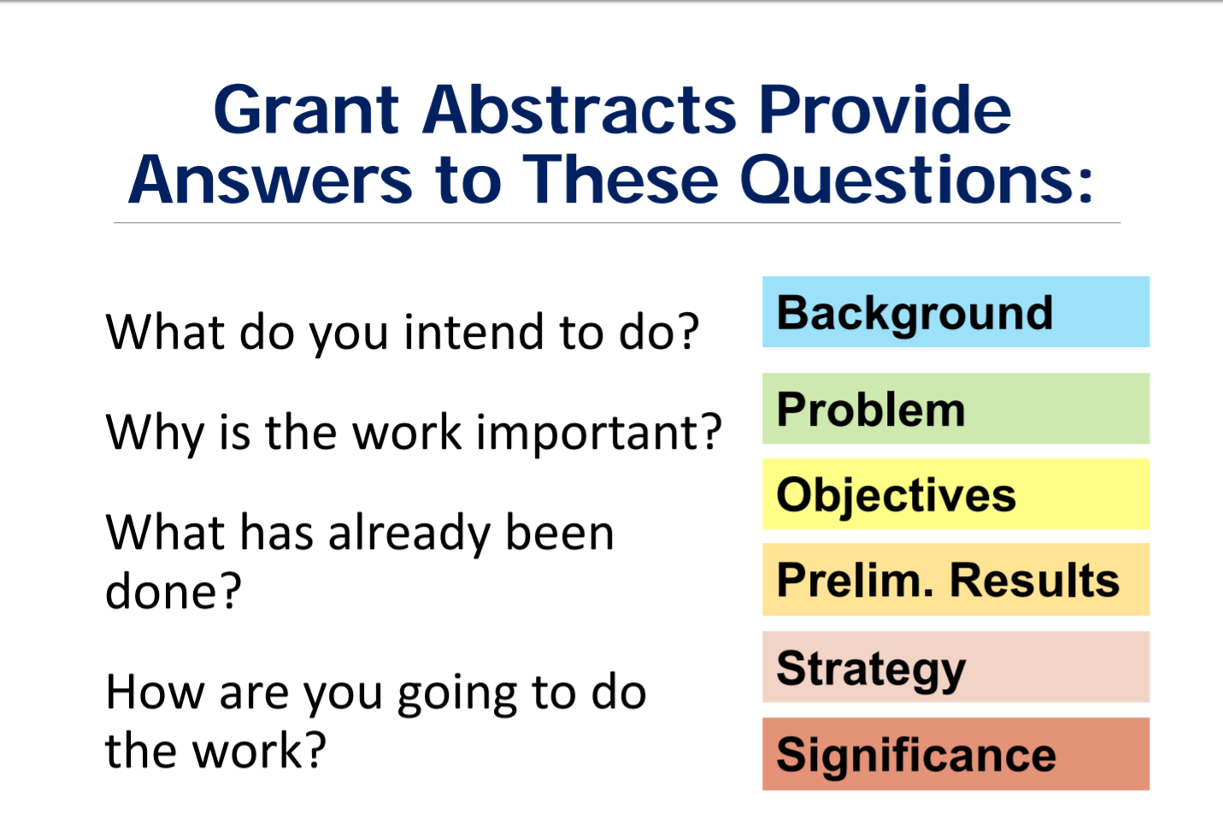

Slide 50
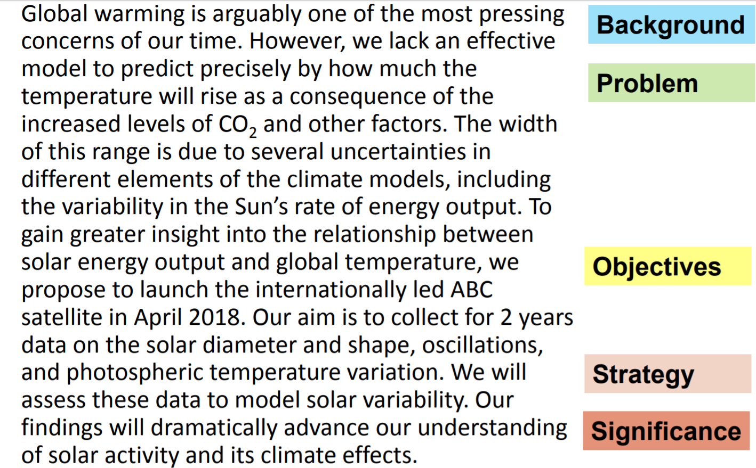
Writing the Abstract: Example

Slide 51
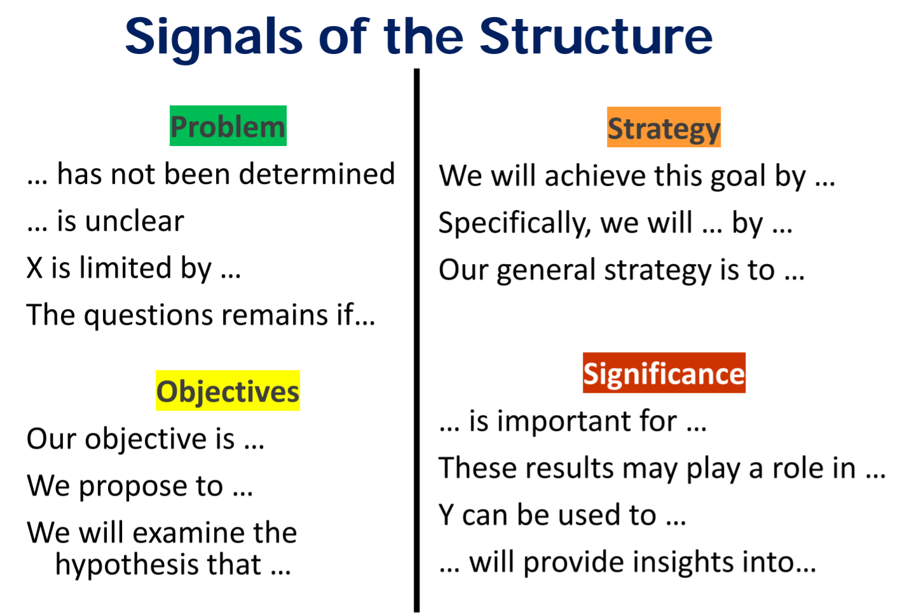
Source: Kallestinova, Elena, PhD. How to Write a Compelling Grant Abstract_July2017.pdf, Yale Center for Teaching and Learning

Slide 52
Faculty Panel

Slide 53
Panelists
Scott Sommerfeldt is in Physics and Astronomy. Most recently he was Dean of the College of Physical and Mathematical Sciences. His research interests include active and passive noise control and energy-based acoustics. He has been key to growing and expanding the interdisciplinary Acoustic Research Group at BYU which is recognized both nationally and internationally. He has had research funding from a variety of resources including corporate funding.
Mikle South is in Psychology and Neuroscience at Brigham Young University. He conducts research on emotion regulation and decision making, especially in autism spectrum disorders (ASD). Mikle has received internal funding for his research from different colleges and from ORCA. He has received external funding from NIH including a post-doc fellowship and service awards and from the European Union. Mikle also received the COFUND Senior International Fellowship to Durham University UK sponsored by the EU.
Heather Leary is Instructional Psychology & Technology at Brigham Young University. Before coming to BYU, she was a postdoc at the University of Colorado Boulder and designed online curricula for Brigham Young University-Idaho. Her research interests include professional learning for K12 and higher education teachers, design-based implementation research, research-practice partnerships, problem-based learning, STEAM, 21st century skills, open educational resources, self-directed learning, and technology integration.

Slide 54
Wrap Up
Homework
Review handouts
Before next session write a needs statement that includes a title
bring a hard copy with you on Dec 20th
Day 2 Dec 20th, 9am-2pm
Review Needs Statement and discuss
Proposal Elements, Aesthetics, Marketing
Editing and Rewriting
ORCA, IRB, IAUCU, IBT

Slide 55
Grant Proposal Development Resources

Slide 56
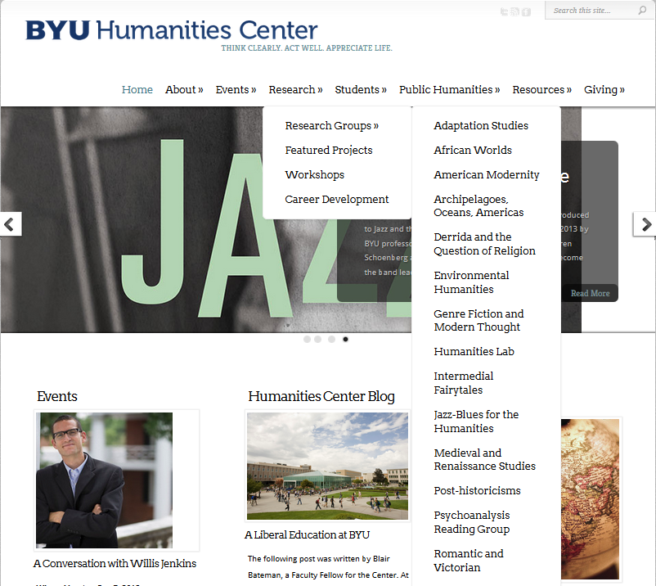
Research Resources in Humanities
http://humanitiescenter.byu.edu/services/external-grants/
http://humanitiescenter.byu.edu/research/workshops/

Slide 57
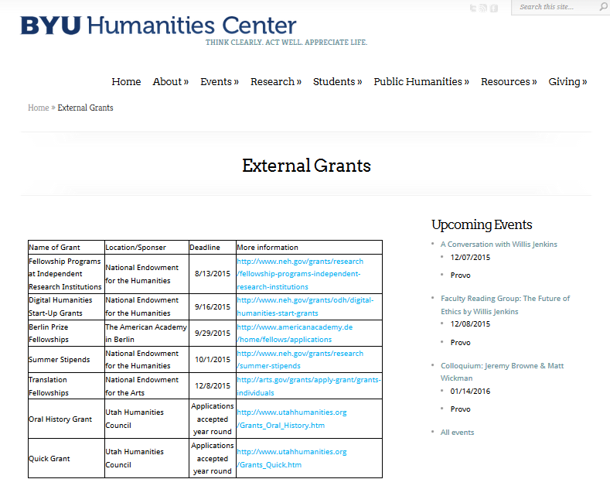
Research Resources in Humanities (cont.)
Grant proposal writing specialist – Jon Balzotti in the English Department,

Slide 58
Proposal Writing Sources
Robert Porter, What do Grant Reviewers Really Want, Journal of Research Administration, Vol. XXXVI, Issue 2, 2005.
Robert Porter, Coaching Researchers to Write Successful Grants, National Organization of Research Development Professionals (NORDP), May, 2013 conference. Really Want and
Morgan Giddings, Four Steps to Funding, How To Avoid Rejection and Get Your Proposal Funded on Your Next Try, 2012
Jeremy and Lynn Miner, A Guide to Proposal Planning and Writing
Grant Writing Institute
CapturePlanning.com
ORCA proposal writing guides and proposal forms
Instructional materials prepared by the National Council of University Research Administrators and the Society for Research Administrators, July 1995 (see facstaff.gpc.edu/~ebrown/infobr3.htm Georgia Perimeter College)
Tips and Practical Guidelines for Proposal Writers prepared by an NSF panel
NSF Panel on TUES proposal preparation
NSF Proposal Writing Exercises
The Grant Center, UNC. http://writingcenter.unc.edu/handouts/grant-proposals-or-give-me-the-money/
*A Guide to Proposal Planning and Writing by Jeremy T. Miner and Lynn E. Miner

Slide 59
Additional Resources
Online
Research Development website http://researchdevelopment.byu.edu/
ORCA website http://orca.byu.edu/
Faculty Center website http://facultycenter.byu.edu/node?destination=node
Human Resources
STEM and FHSS Research Development
ORCA
Faculty Center
Experienced faculty with success at proposal writing
LDS-P
BYU workshops
Off campus workshops
Hardcopy
Research Development Group loanable guides for NIH, NSF proposals
HBL Library

Slide 60
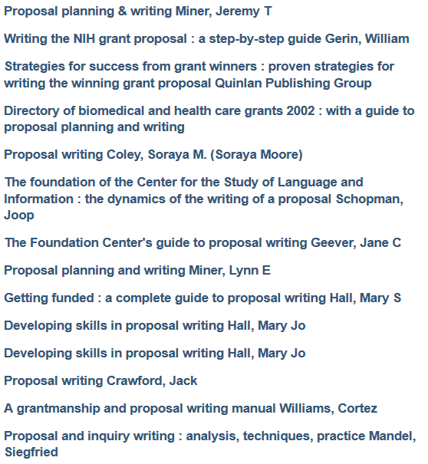
Sampling of Proposal Writing Books at the HBLL

Slide 61
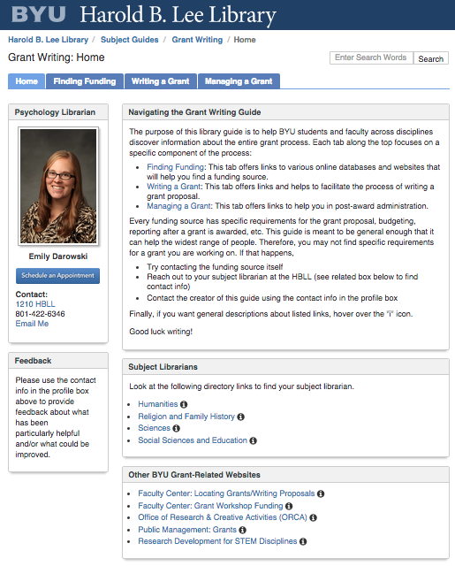
Additional Library Support

