Slide 1
Grant Proposal Development Workshop Day 2
December 20, 2017

Slide 2
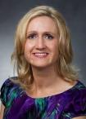
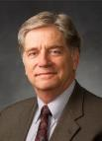
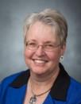
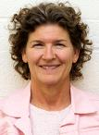
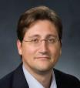
Research Development Support
Kristen Clarke Kellems
FHSS Research Development
934 SWKT
Tel: 801-422-8967
Email: fhssresdev@byu.edu
Conrad Monson
STEM Research Development
275 McDonald Building
Tel: 801-422-7722
Email: conrad_monson@byu.edu
Jaynie Mitchell
MSE Research Development
306C MCKB Tel: 801-422-3067
Email: Jaynie@byu.edu
Sarah Dorff
Research Development Administrator
269 McDonald Building
Tel: 801-422-0132
Email: resdev@byu.edu
Jon Balzotti
English Department Faculty College of Humanities
4127 JFSB
Tel: (801) 422-2440
jonathan_balzotti@byu.edu

Slide 3
Agenda
Day 2, December 20th
Recap of Day 1 9:00-9:10 (Kristen)
Group Review Needs Statements/Review 9:10-10:10 (Kristen)
Themes 10:10-10:20(Conrad)
10:20-10:30 Break
Methodology and Qualifications 10:30-11:00 (Conrad)
Budget and Benefits 11:00-11:30 (Jaynie)
Role of LDS-P and other potential funding sources 11:30-12:00 (Taunja Baxter) (30 min)
12:00-12:30 Lunch
Editing and Rewriting 12:30-1:00 (Kristen)
Aesthetics and Marketing 1:00-1:10 (Conrad)
ORCA 1:10-1:50 (Debbie Silversmith)
Wrap Up 1:50-2:00 (Kristen)

Slide 4
Recap Day 1
Creating a Fundable Idea
Finding Funding
Prewriting
Writing a Persuasive Needs Statement
Proposal Elements
Titles
Faculty Panel and Q&A

Slide 5
Needs Statement Review Groups

Slide 6
Proposal Themes
The
Highlighted Essential
Messages that
Express the character of your
Story
Themes Are . . .
Developed from the RFP decomposition and from your needs statement
Address the funders “hot buttons” (e.g., Most Important Requirements)
Address evaluation criteria
A“…system of threads that weave, communicate, and align your messages with the funder’s desires…” throughout the proposal
What are the themes we have tried to emphasize in our workshop?

Slide 7
Themes from the RFP Example
FEWS Team
Key Requirements
World renown team developing water resource monitoring and management software – World Wide Water
Potential international partners
Experts in identifying pollutants from water runoff
Behavioral scientists who study water management policy at local levels
A geographic location that includes water resource management challenges, that could be a study area
FEWS system includes physical, natural, biological, social/ behavioral, cyber elements
Availability of Nitrogen, Phosphorus, Water is critical
Themes
We have the best qualified team with a unique approach that addresses all the FEWS system elements
No one else has our tools or the capabilities to integrate all of the FEWS elements into a cost-effective, field-deployable system
Our system is low risk - world wide water software system is in use today; we are experts in Ni, Ph, Water availability; we have developed the sensors; we have experience in integrating software and hardware elements into a viable system
Topic 2 most relevant – develop new, field-deployable sensing modalities

Slide 8
Expanding on the Proposal Elements

Slide 9


Proposal Elements are Created From the Needs Statement
The Needs Statement thoroughly develops and describes the problem you are addressing including context and justification … develops the Situation Slot, S₁
Describes Methods at a high level; informs Qualifications and Benefits
Provides the basis for the Budget you need
Needs Statement Components
1. Story (Problem)/S₁
2. Plan for solving (Problem)/S₁
3. Request for support
The 6 Generic Proposal “Slots” (tied to baseline logic)
Achieved Objective(s)
S
Methods
S
2
Situation
1
B
Qualifications
Benefits
Budget

Slide 10
Methods and Qualifications
Situation: This is our understanding of the problem.
Objectives: Given that problem, these are our objectives for solving (or realizing) it.
Methods: Given those objectives, these are the methods we will use to achieve them.
Qualifications: Given those methods, these are our qualifications for performing them.
Budget: Given those qualifications and methods, this is how much the project will cost.
Benefits: Given our efforts and funders support, these are the benefits or value you will receive.

Slide 11
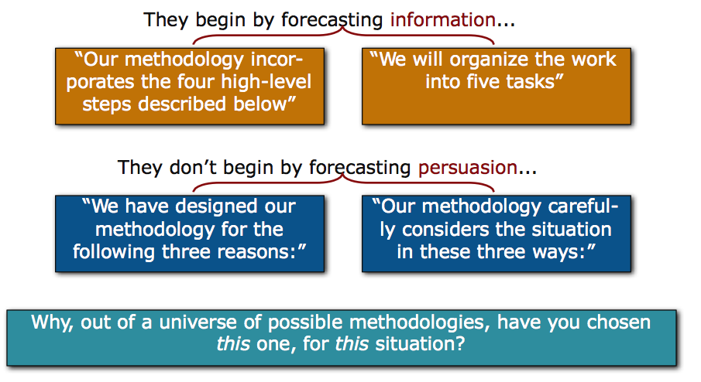
Methods
Lacking persuasion, methods sections often begin by first explaining “How” rather than “Why”

Slide 12
Methods
Evaluation
Broad statement about what you hope to accomplish
Goal
Objective
Objective
Objective
Measurable result directly traceable to one or more goals
Tasks
Tasks
Tasks
What you will do to meet the objectives
Outcome
Outcome
Outcome
What result do you expect
Evaluation and Evaluators

Slide 13
Methods Example¹
(Revolutionary) Relationship Building Dinner Party
10 Important Guests Attend
Dirt-free House
Three Course Dinner
Task 3. Provide Meal 3a. Create menu
3b. Review recipes
3c. Buy food
3d. Cook food
3e. Serve meal
3f. Clean up
Task 1. Invite Guests
1a. Identify 12 Guests
1b. Identify email addresses
1c. Send invitations
Task 2. Clean House 2a. Dust
2b. Vacuum
2c. Polish Floors
2d. Clean Toilets
100% dirt free
80% will attend
100% compliments
Strengthened Relationships¹
¹How to get tenure if you are an English professor

Slide 14
Exercise: Draft a methods description that addresses “Why” not just “How”

Slide 15
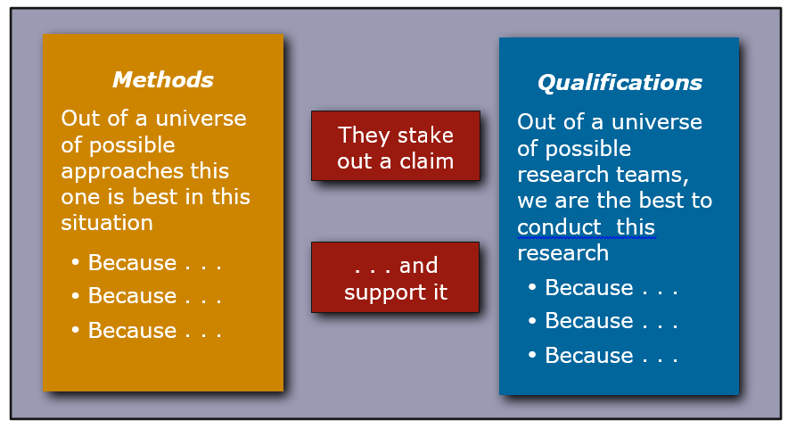
Methods Lead to Qualifications

Slide 16
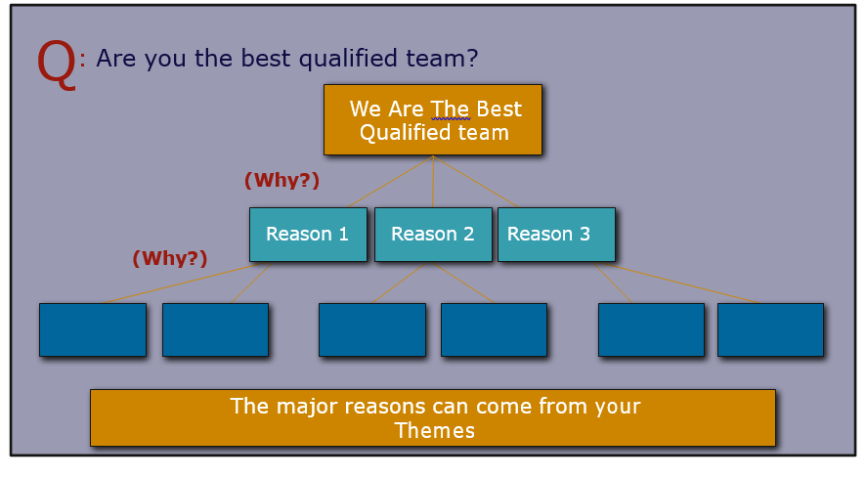
The Qualifications Provides Reasons for “Why Us”

Slide 17
Exercise: Draft a qualification section that ties to methods

Slide 18
Budget and Benefits
Situation: This is our understanding of the problem.
Objectives: Given that problem, these are our objectives for solving (or realizing) it.
Methods: Given those objectives, these are the methods we will use to achieve them.
Qualifications: Given those methods, these are our qualifications for performing them.
Budget: Given those qualifications and methods, this is how much the project will cost.
Benefits: Given our efforts and funders support, these are the benefits or value you will receive.

Slide 19
Budget
Credible, consistent with the scope of the project
Each item clearly explained and justified
Address prior funding when appropriate (emphasize the outcomes)
A good industry tool for developing a budget is to create a Work Breakdown Structure (WBS)
Describe work in tasks and subtasks at several different levels of detail and then put into the budget a rolled up version at a higher level
Project Name
Task 1
Subtask 1.1
Subtask 1.2
Workpackage 1
Subtask 1.3
Subtask 2.1
Task 2
Workpackage 2
Subtask 2.2

Slide 20
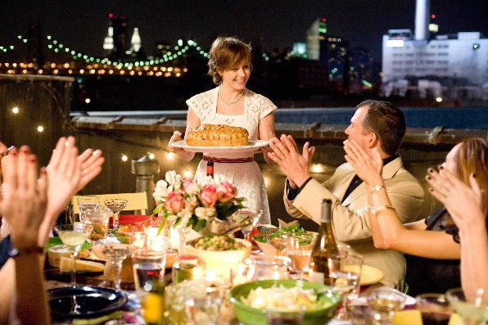
Dinner Party WBS
Project Relationship Building Dinner Party
Task 3 Provide Dinner
Subtask 3a
Create menu
Subtask 3b
Get recipes
Subtask 3c
Buy food
Subtask 3c
Cook food
Subtask 3d
Serve meal
Subtask 3e
Clean up
Work Package for Task 3
Develop menu: 1 hr
Review cook books and find recipes: 2 hrs
Travel to 3 stores to purchase food: 6 hrs
Prepare salad: 1 hr
Cook main course: 5 hrs
Cook dessert: 3 hrs
Serve food: 2 hr
Clean up: 4 hrs
Total Hours: 24 hrs
Cost:
Food: Vegetables = $30
Meat = $60
Cake Ingredients = $20
Labor: 12 hrs Cook at $50/hr = $600
12 hrs Asst Cook $10/hr = $120 Total = $720
Justification: Past experience cooking dinner

Slide 21
Budget Narrative
NSF Career Grant
The NSF budget narrative is an excellent place to continue “selling” your project, by pointing out the various strengths of faculty and resources, and the well-planned proposal through the suitable allocation of funds over the project period.
Source: osp.utah.edu/_doc/nsf-budget-justification.doc

Slide 22
Benefits
In the baseline logic (captured in the Needs Statement) which expresses a “value proposition”
S₁ S₂ B
In the Abstract. Introduction/ Background section or other funder-specified sections (e.g., Summary, Justification, Benefits)
To answer these challenges, we have designed an approach to meeting [[objectives]]. As a result of achieving these objectives, there will be [[benefits]]
Content from the Benefits Slot exists throughout the proposal
Benefit(s) should be one of your themes
Address the different types of benefits
Immediate, a direct result of your research
Long-term, how your research moves your field forward
Remember… the benefits address the funders needs and mission

Slide 23
LDS Philanthropies (LDSP)
We are a department under the
Presiding Bishopric.
We correlate charitable giving within all church charities and institutions of higher education.
Notes:
We provide donor management for all church areas including the church’s higher education institutions and church departments like Family Search, Self-Reliance services, etc. We don’t handle any tithing and fast offerings. Each college has a DL assigned, and most of them are right on campus.

Slide 24
Summary of how LDSP helps
Relationships with prospects/funders
Tools to help with finding funding
Foundation proposal correlation
Help with proposal writing/editing
“No Overhead” (costs in budget)
Notes:
I can help as time permits. First come, first serve. Preferable first you take the first pass at writing as you know your project best.

Slide 25
THE PROCESS OF FUNDRAISING WITH FOUNDATIONS
(1) FINDING POTENTIAL FOUNDATIONS
(2) CULTIVATION AND GRANT-WRITING
(3) FOLLOW-UP

Slide 26
THE PROCESS OF FUNDRAISING WITH FOUNDATIONS
(1) FINDING POTENTIAL FOUNDATIONS
Foundation Directory
fconline.foundationcenter.org
Username: byuacadvp
Password: cougars2002
Notes:
Kristen and Conrad offer a whole class on this tool.

Slide 27
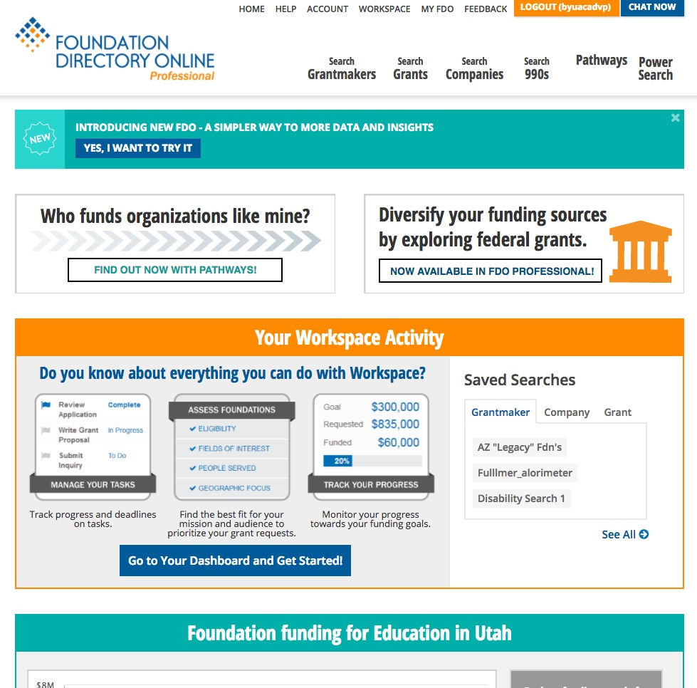
Notes:
Grantmakers, grants, and 990 are the searches I find most useful. I prefer Grantmakers.

Slide 28
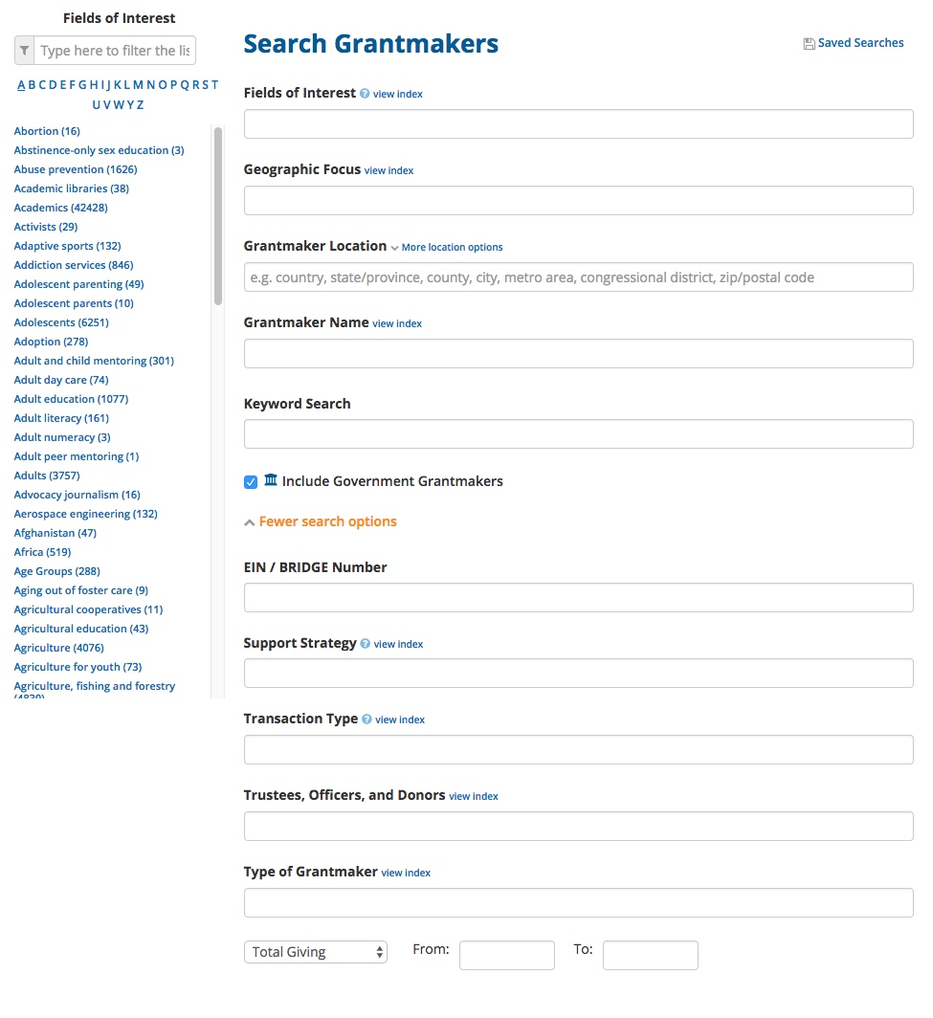
Notes:
Go over fields.

Slide 29
Notes:
I prefer to search narrow to broad.

Slide 30
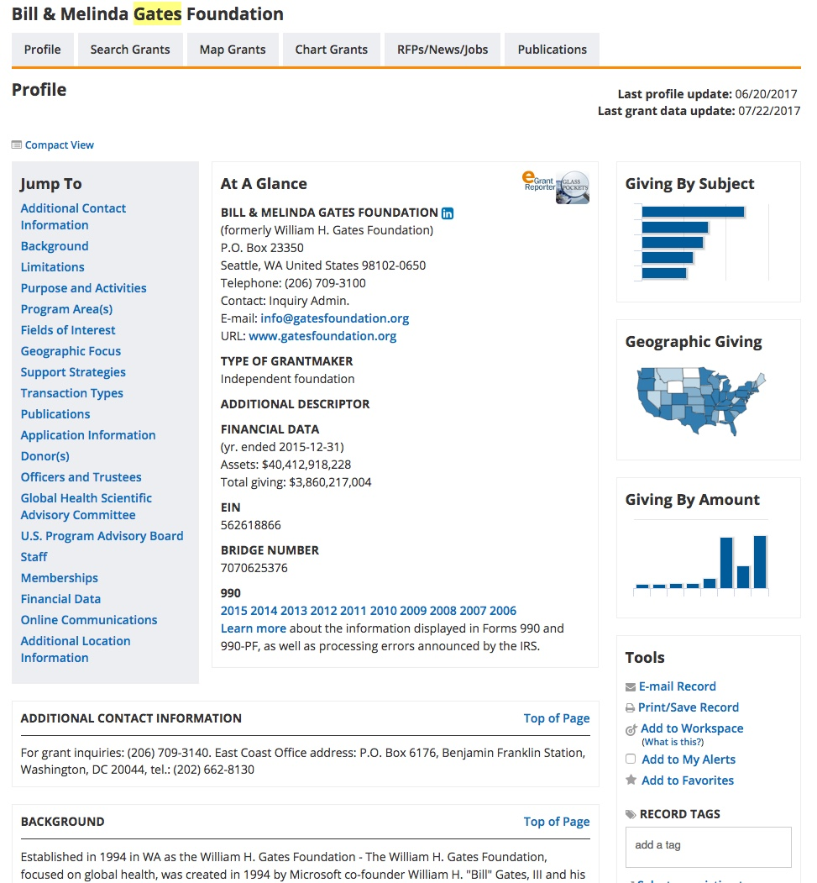
Notes:
Talk about “jump to” area; then graphics. Then 990s. 990s available through GuideStar and other sources.

Slide 31
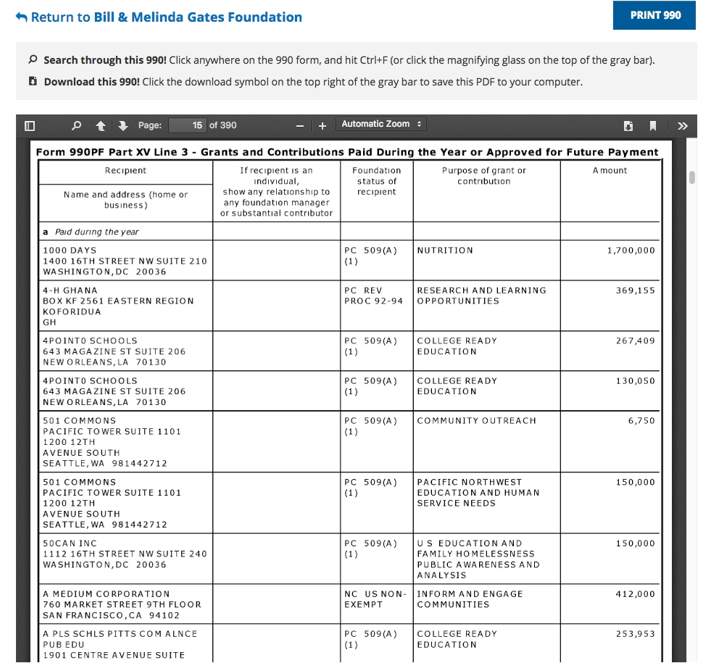
Notes:
Could find this information through Grant search

Slide 32
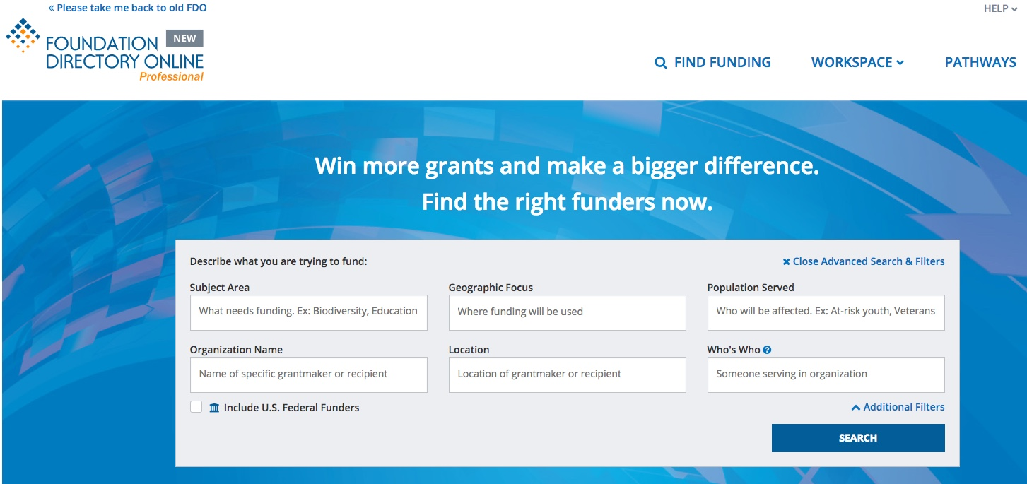

Slide 33
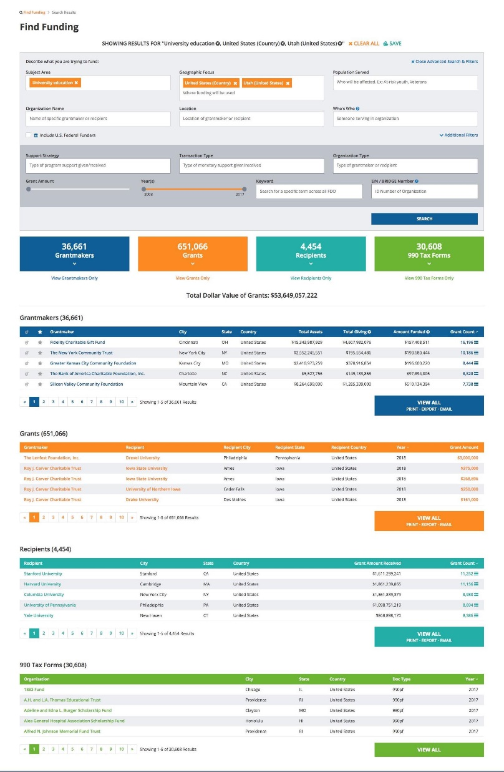

Slide 34
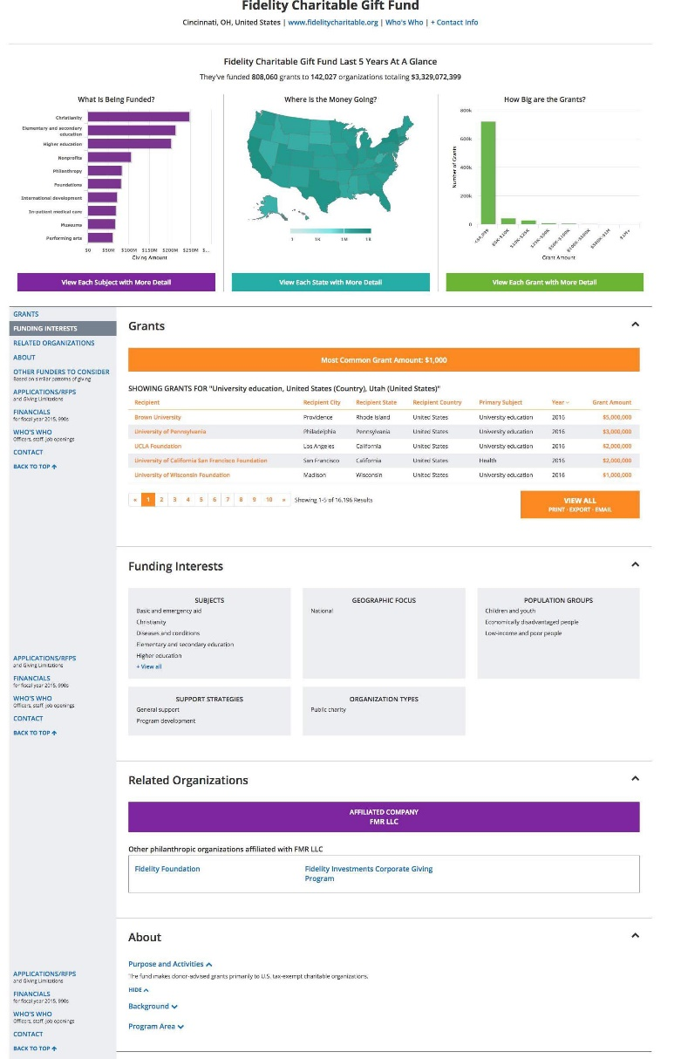
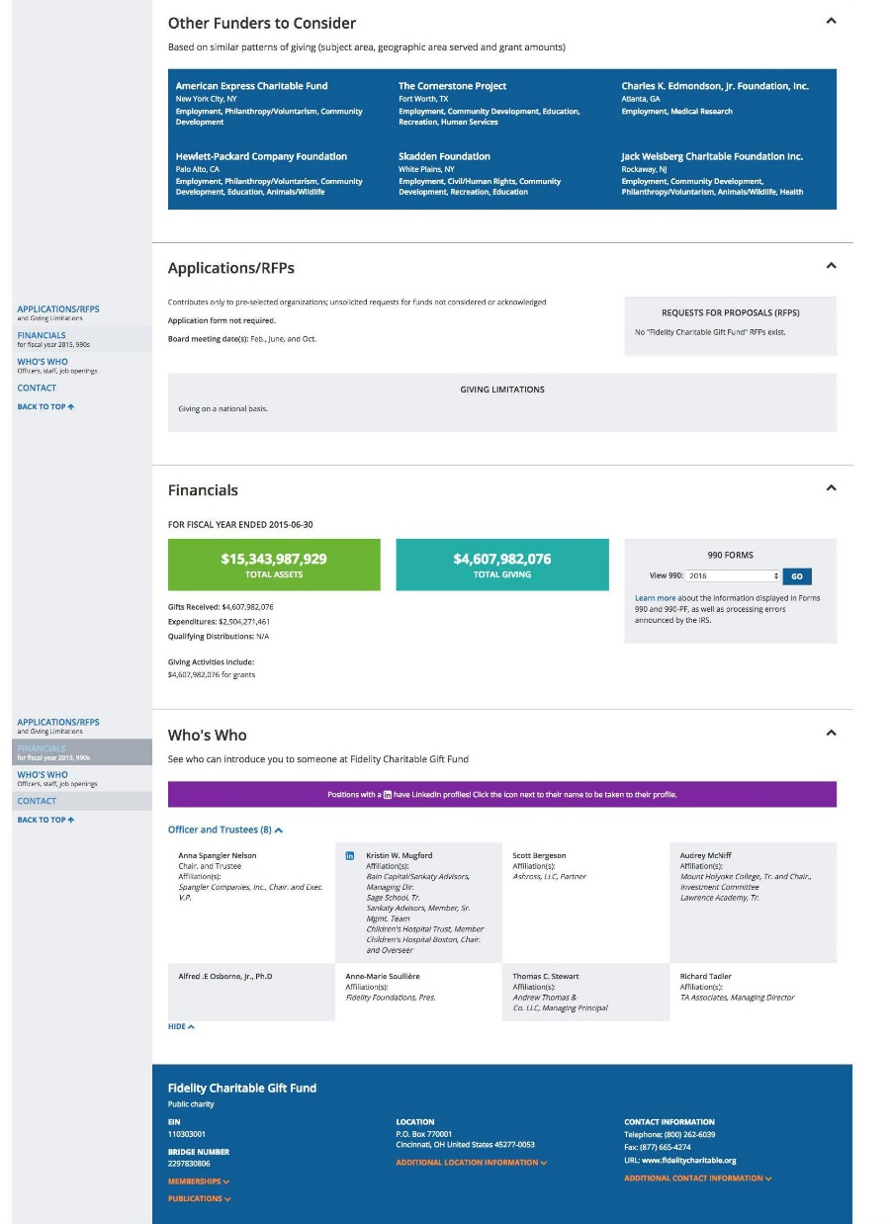

Slide 35
THE PROCESS OF FUNDRAISING WITH FOUNDATIONS
(1) FINDING POTENTIAL FOUNDATIONS
Foundation Directory
Philanthropy News Digest
Login screen from Foundation Center
or
philanthropynewsdigest.org/rfps
Notes:
Another product from Foundation Center; This lists RFPs (request for proposals)

Slide 36
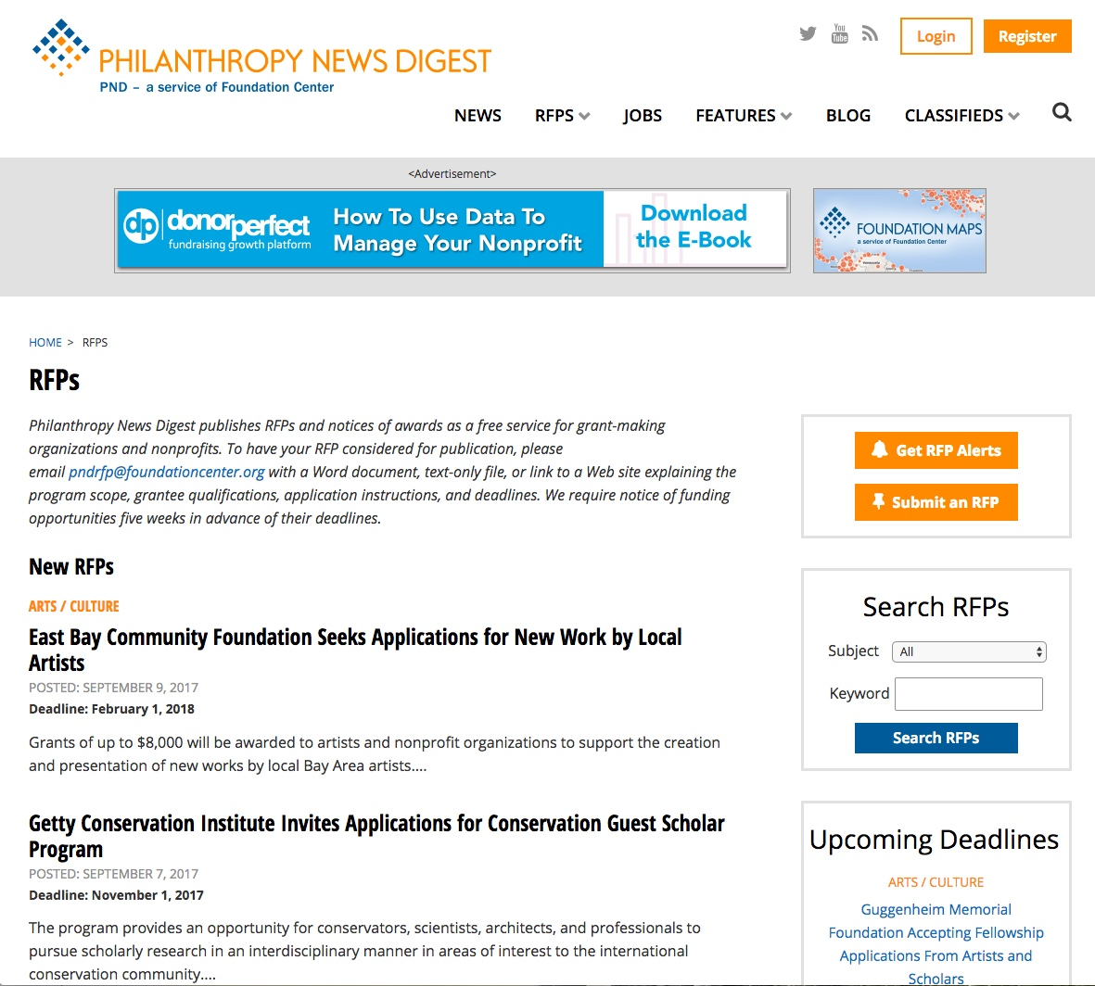
Notes:
Gives new RFPs.

Slide 37
Notes:
Can be searched by subject and keyword. Can have them send you a newsletter or alerts when new RFPs are shared.

Slide 38
RFP Subjects
Aging
Agriculture / Food
Animal Welfare
Arts / Culture
Athletics / Sports
Children / Youth
Civil / Human Rights
Community Improvement /
Development
Education
Environment
Health
Higher Education
Human Services
Journalism / Media
Medical Research
Philanthropy / Volunteerism
Public Affairs
Religion
Science / Technology
Women / Girls

Slide 39
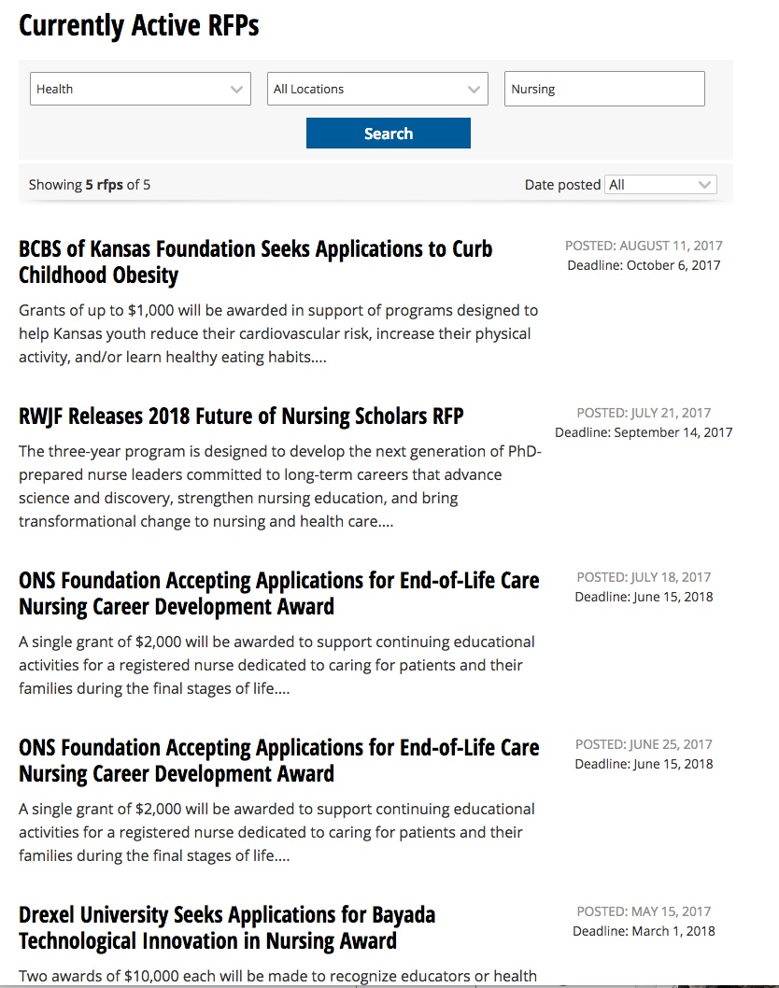
Notes:
This is a subject and keyword search.

Slide 40
THE PROCESS OF FUNDRAISING WITH FOUNDATIONS
(1) FINDING POTENTIAL FOUNDATIONS
Foundation Directory
Philanthropy News Digest
Foundation Search
Notes:
Similar information to Foundation Directory. I am only one with access to this.

Slide 41
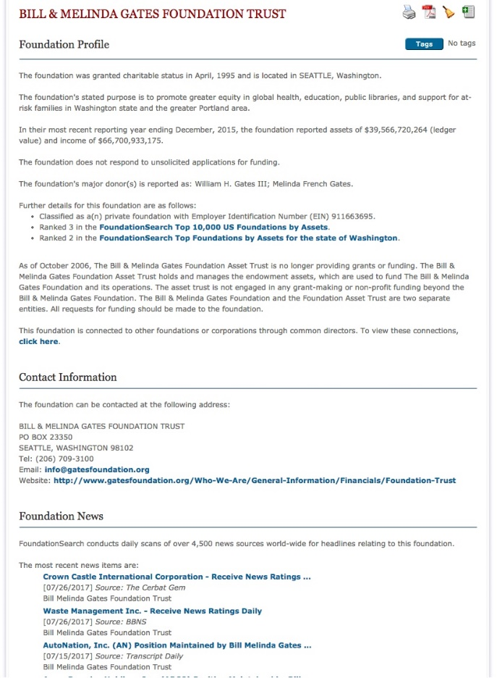
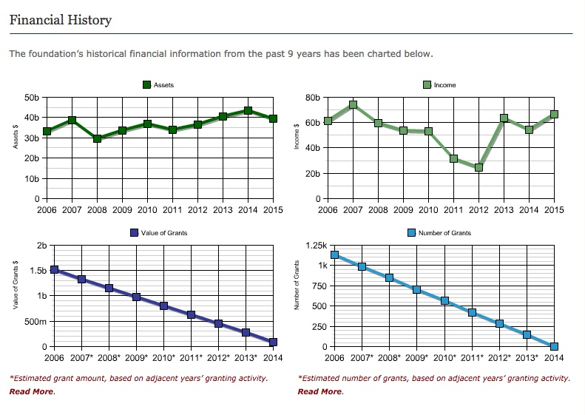
Foundation Search
Notes:
Examples of what you get there.

Slide 42
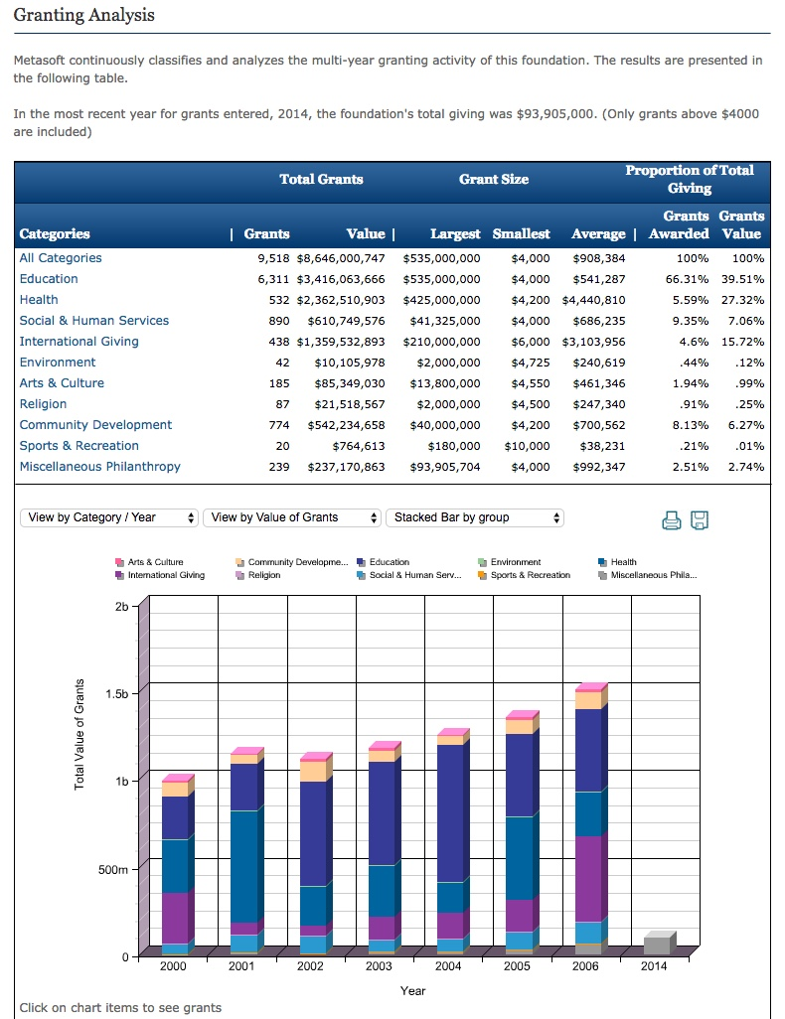
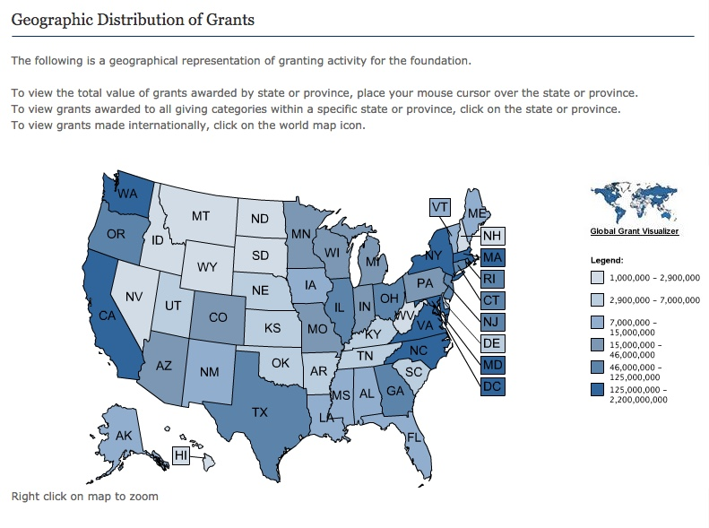
Notes:
These are two areas I find especially useful.

Slide 43
THE PROCESS OF FUNDRAISING WITH FOUNDATIONS
(1) FINDING POTENTIAL FOUNDATIONS
Foundation Directory
Philanthropy News Digest
Foundation Search
Web/Colleagues
Notes:
Mention Chronicle of Philanthropy

Slide 45
THE PROCESS OF FUNDRAISING WITH FOUNDATIONS
(2) CULTIVATION AND GRANT-WRITING
LDSP level of involvement depends upon your needs
Letter of Inquiry - Letter of Intent - Phone call – Proposal - Proof your proposal

Slide 46
THE PROCESS OF FUNDRAISING WITH FOUNDATIONS
(3) FOLLOW-UP
Getting feedback from the foundation after proposal approval or denial
Dispersing feedback to all involved parties
Foundations require an annual report on how the money was spent

Slide 47
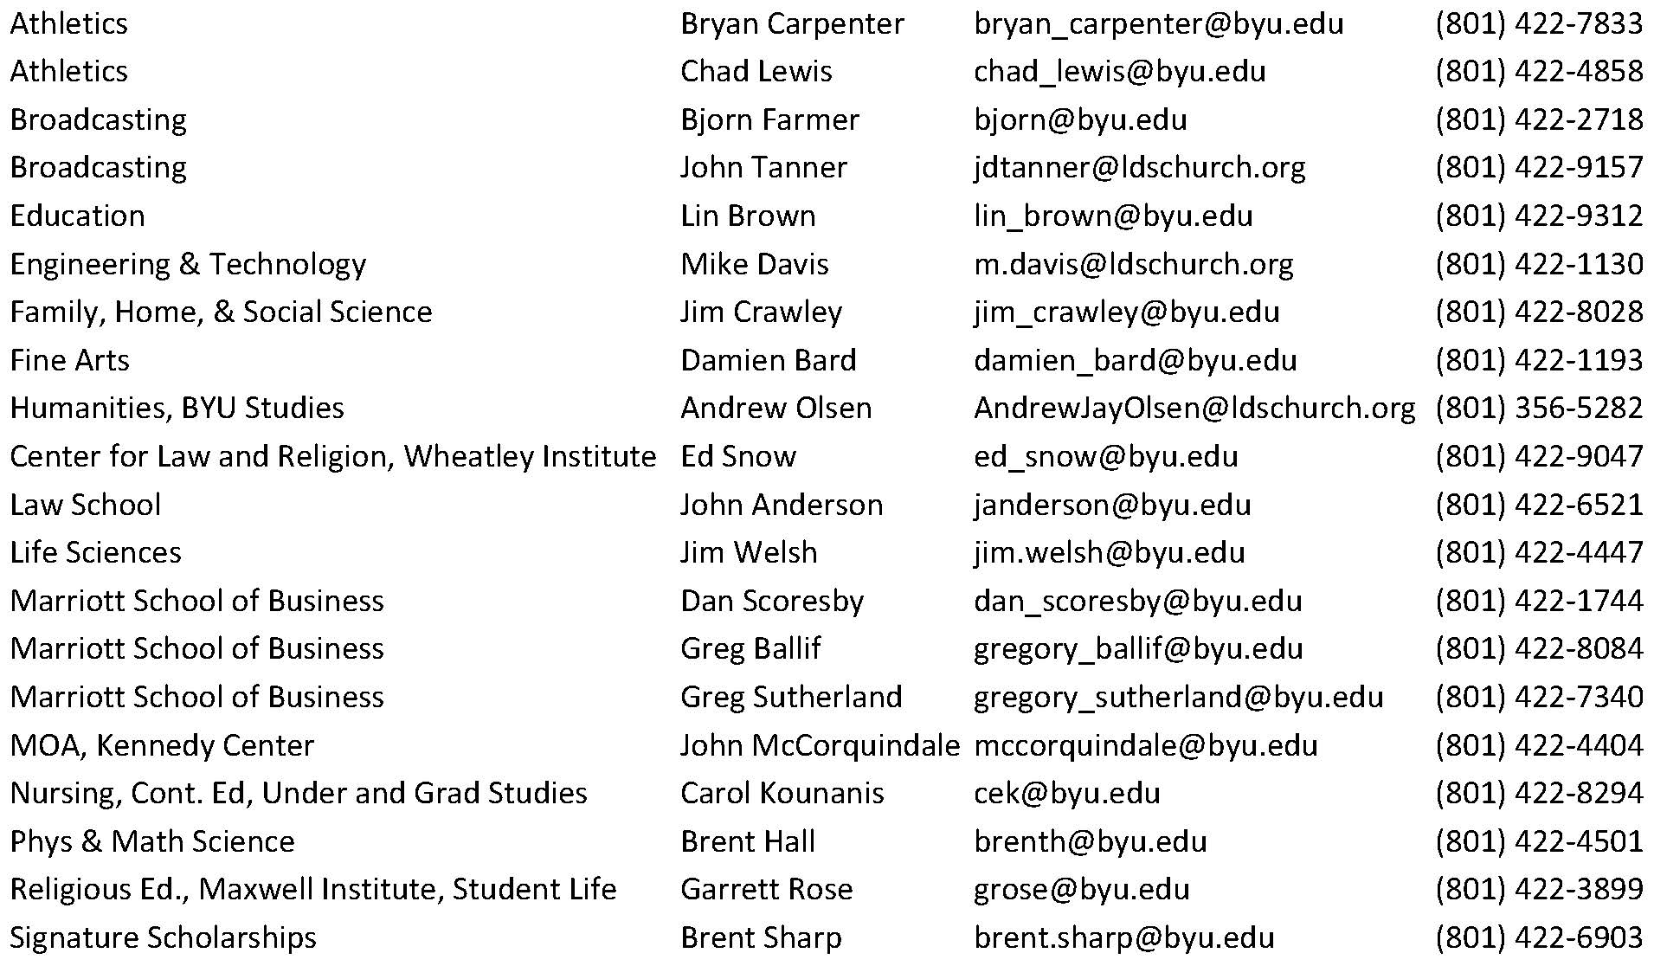
LDSP Donor Liaisons

Slide 48
LDSP or ORCA
Use the ORCA office if your funding source:
is a government entity
requires specific deliverables or sponsor input
requires detailed financial reporting
obligates the university to any terms or conditions
When in doubt, call ORCA at 422-3841 or Kristen / Conrad
Notes:
LDSP doesn’t handle any government grants. (Click twice after.) Conrad and Kristen can help with finding gov sources.

Slide 49
Things to Note
Meet with Department Chair, Donor Liaison, and/or Dean
Discuss department and college priorities
Do you have a “champion” at the foundation?
Annual Audited Financial Report limitations at BYU
Notes:
Internal and External Matchmaker.

Slide 50
Foundations are interested in their giving priorities. You must position your work in a way that clearly aligns with and advances a foundation's established goals.

Slide 51
COMMUNICATION
When should you contact LDSP?
Before approaching a foundation, please contact your college assigned Donor Liaison or call Taunja Baxter to check the status of a foundation.

Slide 52
Taunja Baxter
Grant Writer, LDS Philanthropies
1450 N. University Ave
(w) 801-356-5289 | (c) 801-420-4919
taunja.baxter@ldschurch.org
www.ldsp.org

Slide 53
Editing and Rewriting

Slide 54
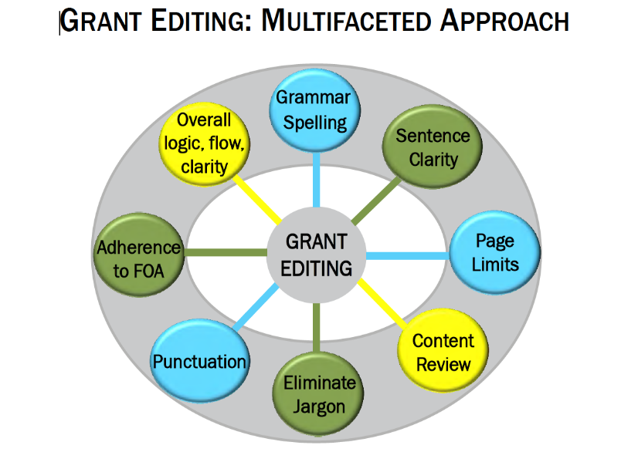
Editing and Rewriting

Slide 55
Project Summary #1: The Basketball Project at the Meridian Mews Center
We are really excited about the Basketball Project for 25 boys ages 13 to 16 who live in North Meridian Mews. The program will be sponsored by our organization, the Meridian Mews Center. This Center’s neighborhood is downtown Metro City, Indiana. The kids who will take part in the project are badly behaved and have acted out in school. Well-qualified instructors will teach the kids basketball skills and also how to dress for success. They will receive different types of counseling also and gift certificates from Ace Sport Supplies will be given out to the kids on the winning team in the basketball competition.
The Basketball Project will take place after school and on weekends and the boys will behave better as a result of being in the program. The Basketball Project will run from September 1, 2016 to June 30, 2017, and activities will be held at the Meridian Mews Center and the YMCA. We are asking for $10,000 to help cover the expenses for this excellent program that we’re running with the help of Meridian University and the YMCA.
There are many staff members who will make sure the kids get solid instruction. We are hoping that the kids who join our project will stay in school longer and behave much better. They will probably enjoy the trips we’ll take to basketball games and we’re looking forward to having guest speakers.
From “The Only Grant Writing Book You’ll Ever Need” by Ellen Karsh and Arlen Sue Fox

Slide 56
From “The Only Grant Writing Book You’ll Ever Need” by Ellen Karsh and Arlen Sue Fox
Editing and Rewriting
Do
Write as you should speak
Present strong credentials, facts, and statistics
Use a grammar book, thesaurus, and dictionary
Don’t
Use slang or imprecise or insensitive language
Don’t exaggerate
Include value judgments, political views, or a sense of humor
Use too many adjectives
Use too many abbreviations or acronyms
Use the active voice
Back up your claims

Slide 57
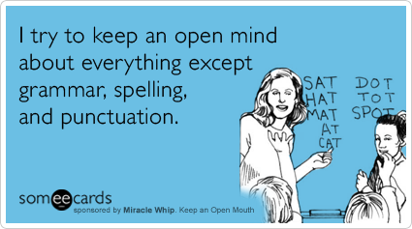
Do: Use a grammar book, thesaurus, and dictionary
Grammar tips
Common style guides: Chicago Manual of Style; MLA Style Manual and Guide to Scholarly Publishing; Scientific Style and Format: CBE Manual
Punctuation tips
Punctuation helps to reveal the structure of a sentence (structural meaning), and thus to clarify meaning (rhetorical meaning).
Spelling Tips
When in doubt, use a dictionary
Remember that spellcheckers:
Do not distinguish between homophones (principal and principle).
Do not account for spellings determined by usage (resume and résumé).
May allow variant spellings (catalog and catalogue) in the same document.
Do not highlight a misspelled word if the misspelling is itself a word (from and form).

Slide 58
Do: Use the Active Voice
In grant proposals, the active voice keeps you honest and clear. Which statement in each pair is more straightforward and gives the most detailed information?
Students will be recruited to participate in the Meridian Mews Center’s Activities.
The Meridian Mews Center’s outreach workers will recruit children to participate in the Center’s Activities.
Change these sentences to active voice:
The creation of a database is being considered, but no estimate has been made in regard to the potential of its usefulness.
Revised: We are considering whether we should create a database, but we have not yet evaluated how useful it would be.
Look at your needs statements. Are there sentences where the passive voice should be revised?

Slide 59
Do: Provide Old Information Before New Information
Principle of Cohesion: Old to New
Begin sentences with information familiar to your readers.
End sentences with information readers cannot anticipate.
Example: Center staff will recruit 25 boys between the ages of 13 and 16 who live in the North Meridian Mews neighborhood of downtown Metro City, Indiana. The recruited teens–identified by families, teachers, counselors, and others–will have demonstrated acting-out and behavior problems.
Writers often refer to something in a previous sentence with words such as this, these, that, those, another, such, second, or more. When you use any of those signals, try to put them at or close to the beginning of the sentence:
How to calculate credits for classes taken in a community college is another issue that we must consider.
Another issue that we must consider is how to calculate credits for classes taken in a community college.

Slide 60
Do: End Your Sentences and Paragraphs With Emphasis
We call the most emphatic part of a sentence STRESS.
If you end a sentence on words that carry little meaning, your sentence will seem to end weakly. Compare these sentences:
They will receive different types of counseling also and gift certificates from Ace Sport Supplies will be given out to the kids on the winning team in the basketball competition.
Activities will include basketball instruction; team competition; dress-for-success lessons by the coaching staff and trips to professional and college basketball games. Participants will also be offered one-on-one counseling sessions with a licensed therapist.
Just as we look at the first few words of a sentence for point of view, we look to the last few words for emphasis. You can revise a sentence to emphasize particular words that you want readers to hear stressed and thereby note as particularly significant.

Slide 61
Do: Be Concise
Principle 1: Delete meaningless words
kind of virtually
individual particular
really generally
given practically
Principle 2: Delete words that repeat the meaning of other words
full and complete true and accurate
hopes and desires each and every
first and foremost hope and trust
Principle 3: Delete words implied by other words
serious crisis untimely death
important essentials true facts
final outcome advance planning
Principle 4: Replace a phrase with a word
Instead of— Try—
in close proximity near, nearby, close
is cognizant of is aware of, knows
Principle 5: Change negatives to affirmatives
not different similar
not the same different
not allow prevent
not notice overlook
Principle 6: Delete useless adjectives and adverbs
Many writers can’t resist adding useless adjectives and adverbs. Try deleting every adverb and every adjective before a noun, then restore only those that readers need to understand the passage.

Slide 62
Do: Back up your claims
Unproved, unexplained statements thrown into a proposal hurt your credibility with grant reviewers. Compare these two statements:
Everyone in the community thinks the Meridian Mews Center runs educational and enjoyable programs.
According to surveys that were conducted in two community churches and two schools, 60 percent of residents of Meridian Hills Mews think the programs offered at the Meridian Mews Center are educational and enjoyable
The police are excited about the Meridian Mews Center’s activities.
According to interviews with police officers in the Meridian Mews precinct conducted by program staff, 20 of the 25 officers questioned feel that the Center’s programs encourage children to stay out of trouble.
Offer proof for your proclamations.

Slide 63
Project Summary #2: The Basketball Project at the Meridian Mews Center
The Meridian Mews Center is requesting $10,000 for a basketball and mentoring project designed to engage troubled youth and lead to their improved behavior in and out of school. Center staff will recruit 25 boys between the ages of 13 and 16 who live in the North Meridian Mews neighborhood of downtown Metro City, Indiana. The recruited teens–identified by families, teachers, counselors, and others–will have demonstrated acting-out and behavior problems.
The overall goal is to increase the likelihood that the teenagers who participate in the activities will stay in school longer and become productive members of the North Meridian Mews community.
Specific objectives include improved basketball skills and teamwork, and knowledge of how to create a positive appearance through dress; these skills in turn will improve self-esteem and reduce acting-out behavior.
Activities will include basketball instruction; team competition; dress-for-success lessons by the coaching staff and trips to professional and college basketball games. Participants will also be offered one-on-one counseling sessions with a licensed therapist. The program will operate twice a week after school from September 1, 2016 to June 30, 2017. Activities will be held at the Meridian Mews Center, Meridian University, and the YMCA. Staff will include basketball coaches, a psychologist from Meridian University, and a social worker and recreation specialist from the Meridian Mews Center.

Slide 64
Aesthetics and Marketing

Slide 65
Proposal Aesthetics
The proposal must be aesthetically appealing
“Just as clothing is important in the business world for establishing initial impressions, so, too, is the appearance of your proposal as it reaches the reviewer's hands. The proposal should ‘look’ familiar to the reader. A familiar proposal is a friendly proposal (Jeremy and Lynn Miner).”
If allowed, match the funder’s publications style (same type size, style, layout, and headings as they do in their publications) …. Your proposal will look more credible and familiar
Use white spaces for visual relief and to frame the text (don’t go overboard)
The proposal should support all types of reading (skim, search, critical)

Slide 66
Proposal Aesthetics (cont.)
Use at least a 12-point Type Size (smaller is difficult to read)… make ideas fit by tightening sentences, editing wordy phrases etc. not by changing font size
Unless otherwise specified, uses Serif typefaces for text and Sans Serif typefaces for titles and headings. Serif type easier to read; sans serif makes titles and headings stand apart from the text
Use Bold Type to emphasize key words and ideas; avoid overemphasis
If allowed, format with Ragged Right Margins; makes reading easier because it is easier for your eye to track from one line to the next
Notes:
Bold Type easier to read than underlining, italics, or all capital letters as a means of creating emphasis. Use bold type to emphasize key words and ideas, but avoid overemphasis.
Lists. Lists help to get the message to the reader with a sense of immediacy, without being wordy. Furthermore, because lists are easy for readers to skim, they convey chunks of information quickly
Ragged Right Margins. A ragged right margin is easier to read than one that is right justified because the proportional spacing slows readability. It is easier for the reader's eye to track from
the end of one line to the beginning of the next line when the right-hand margins are jagged.
Type Size. Adjust your word processing program for a 12-point type style. Text smaller than 12-point becomes difficult to read and makes the reviewer’s job harder. Rather than reducing
type size to make all your ideas fit on the page, try tightening sentences and editing wordy phrases.
Type Style. If a type style is not specified in the application guidelines, consider using serif typefaces for the text of your proposal and sans serif typefaces for titles and headings. Serif type styles such as Times Roman and Courier have small strokes that finish off the main stroke of a letter and make it easier to read. Sans serif type styles such as Universal and Arial, which do not have the small finishing strokes, are ideal for titles and headings because they stand off from the body of the text. Avoid using ornate type styles, such as Cloister Black and Freestyle Script,which are hard to read and distract from the content of the proposal.
Adapted from A Guide to Proposal Planning and Writing by Jeremy T. Miner and Lynn E. Miner
Experts have suggested looking at Scientific American articles to get an idea of what in general a proposal should look like – don’t use the articles in the top, peer reviewed journals in your field as examples

Slide 67
Proposal Aesthetics (cont.)
Before creating figures and tables, put yourself in the position of the reader…what would you want to know?
Ask yourself
What do you want to say and why does it matter?
To whom do you want to say it?
How do you say it?
Create figures and tables that are easy to read and that
Support the narrative, help tell the story
Summarizes technical details
Support the different reading styles, particularly skimming
Create Lists to quickly provide the message, convey chunks of information
With lists, figures and tables, use level of detail appropriate for persuasion not for an expository peer reviewed journal article
Notes:
Experience with Paul Osterbeck – I was in charge of developing a proposal for researching options for a Multi Role Unmanned aircraft operating off of a variety of naval vessels. I was assigned a “master proposal writer” to help me. He spent more than half the proposal writing time doing very careful figures and tables that told the whole story of the proposal while I was freaking out because there was no writing to review for what I thought was too a period in the proposal writing schedule. His approach was successful for our proposal and for others he wrote.
Proposal figures and tables are not typically the same as manuscript figures and tables. Be aware of the differences – simple, make the point clearly, support skim reading, etc.

Slide 68
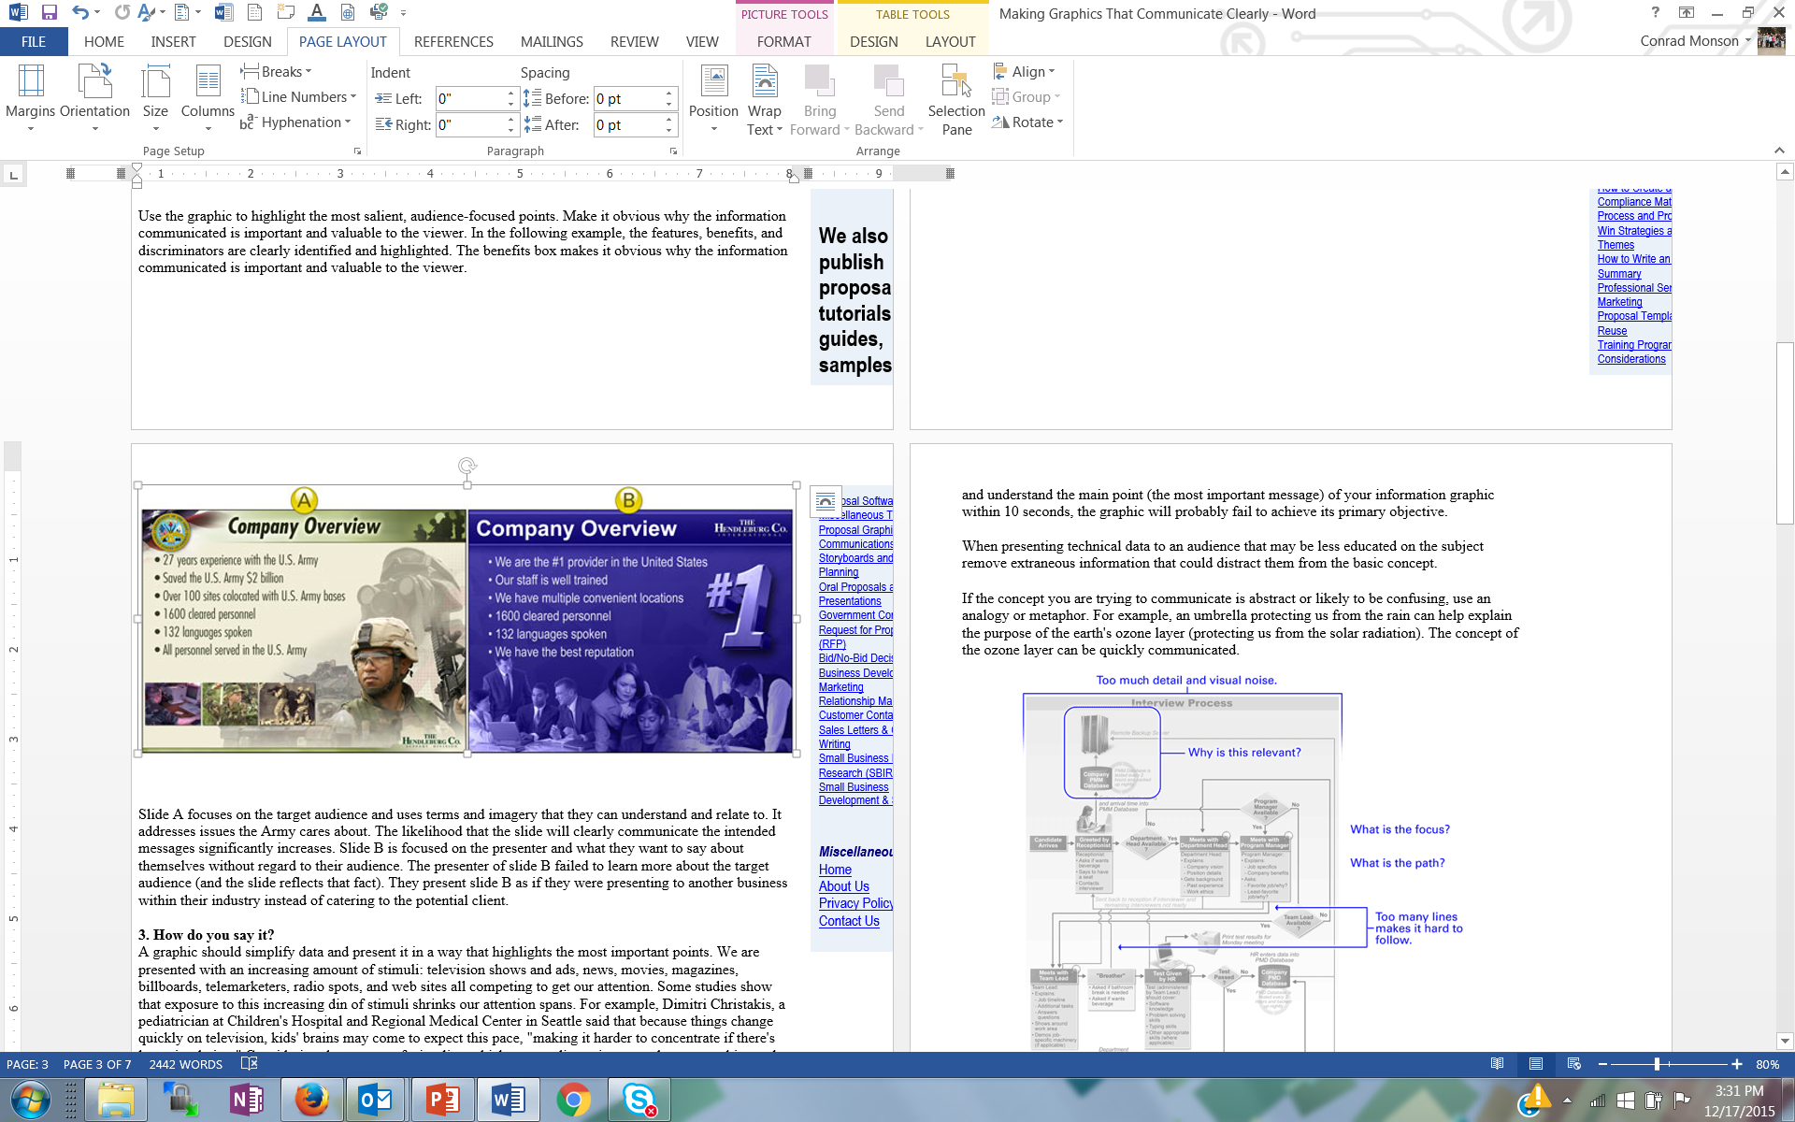
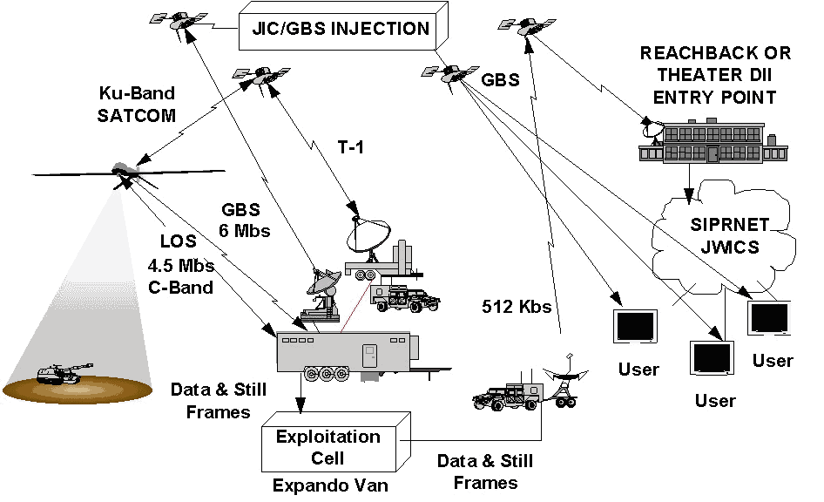
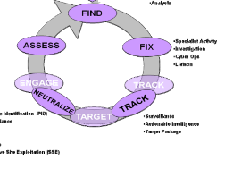
Figure Examples
Primary Intelligence Requirements -Collection -Analysis
-Specialist activity -Investigation
-Cyber Ops
-Liaison
-Identification
-Surveillance -Actionable intelligence
-Target package
Both of these figures are about a company proposing a project to the Army… which is more appealing to an Army proposal reviewer?
Both of these figures are about a C4ISR system… one is better for a technical report, the other for a proposal
Notes:
Experience with Paul Osterbeck – I was in charge of developing a proposal for researching options for a Multi Role Unmanned aircraft operating off of a variety of naval vessels. I was assigned a “master proposal writer” to help me. He spent more than half the proposal writing time doing very careful figures and tables that told the whole story of the proposal while I was freaking out because there was no writing to review for what I thought was too a period in the proposal writing schedule. His approach was successful for our proposal and for others he wrote.
Proposal figures and tables are not typically the same as manuscript figures and tables. Be aware of the differences – simple, make the point clearly, support skim reading, etc.

Slide 69
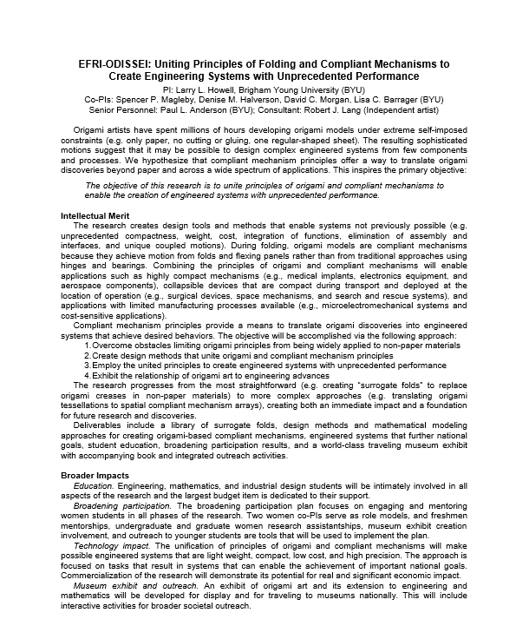
A Proposal Summary With Good Aesthetics

Slide 70
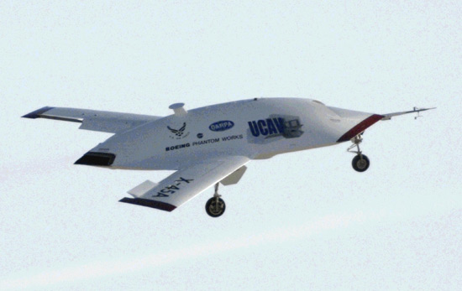
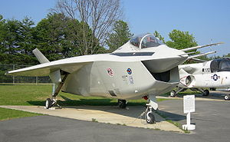
Marketing is Ongoing
Should begin with the first funding officer contacts well before a proposal is submitted Treat customer contacts including white papers, LOIs, etc. as marketing opportunities
Writing should be clear and effective using a persuasive writing style Make sure your title and abstract/summary standout
The best marketing creates an emotional response to your ideas and proposals… excitement, keen interest, compelling, “I’ve got to have it now” … not boredom, confusion, or even anger
Marketing doesn’t end with the proposal submittal You could be contacting the funding officer for a re-submittal if your proposal is rejected and additional funds are available after an initial award
UCAV
UCAV
F-35
Notes:
“Marketing” should be done throughout your career… and the reality is that you are marketing yourself anyway all the time, whether you want to our not.
Think like a marketer and always see things from the customer’s point of view “Marketers do one thing, and they do it very well. They see things from the prospect’s point of view. They lose their own ego, interests and desires, and they focus on the customer’s wants and desires (Morgan Giddings)”
A proposal is not about you or your needs, it is about the funder’s needs… you’re project should make the funder successful
You want an emotional response to your ideas from your potential funders… excitement, keen interest, compelling, “I’ve got to have it now” … not boredom, confusion, or even anger
Boeings UCAV contract with DARPA was an ~$150M competition with Northrop Grumman that was so close, Boeing won at least in part because the PM felt Boeing would do a better job - not on price, past performance, schedule … many of the elements that typically win a proposal. The emotional investment was so intense by Northrop Grumman, the customer told us during when NG was debriefed that was the first time in all his years of contracting, he had ever seen “grown men cry”.
Boeing management was so worried about the emotional response to its F-35 prototype – it looked so ugly, pilots might not want to fly it – that they hired high priced consultants to understand the emotional response to the aircraft and how to mitigate it.
Finally, marketing your ideas and proposal should be embedded in the complete proposal development process, from pre-proposal to proposal writing, described in the next sections.

Slide 71
Proposal Preparation and Submittal Process (ORCA)

Slide 72
ORCA Proposal Preparation & Submittal Process
Susie Quartey, Research Administrator
December 20, 2017

Slide 73
ORCA Personnel
Gene Larson, Director
Debbie Silversmith, Associate Director
ORCA student grants, MEGs
Sandee Aina, IRB Administrator
Susie Quartey, Research Administrator
IBC Administrator
Jason Jay, Research Administrator
IACUC Administrator
Rachel Teki, Administrative Assistant
Rachel Uryan, IACUC, IBC, & ORCA grants Assistant

Slide 74
ORCA Functions
Proposal Approvals and Submission
Letters of Commitment / Certifications / Subrecipient Commitment Forms
Contract Negotiations
Non-disclosure Agreements / Confidentiality Agreements / Material Transfer Agreements
Misc. required forms (i.e. proof of insurance, worker’s comp, etc.)
Award Processing / Issuing Subcontracts
Contractual support throughout the life of an award

Slide 75
Compliance Committees
IBC – Institutional Biosafety Committee, Biohazardous Chemical Research
Every other month: ibc@byu.edu
IRB – Institutional Review Board ,Human Subjects Research
Monthly: irb@byu.edu Many federal changes; check website frequently and pay close attention to email messages related to IRB
IACUC – Institutional Animal Care and Use Committee, Animal Research
Monthly, iacuc@byu.edu
Approval from federally mandated compliance committees is required for ALL research on campus, not just those with federal funding
Approved protocols must be in place before research can begin
External research funding unavailable to spend until approved protocol is in place; no R# issued

Slide 76
Proposal/Award Obligations
All proposals should come through ORCA before submission:
Proposals commit the University
Terms and conditions need review & authorization
Cost sharing/matching needs approval
Problems are much easier to fix at the proposal stage than after submission or an award is received
NSF: Fastlane
NIH: Assist
Other Govt: Workspace
Foundations: Sponsor systems

Slide 77
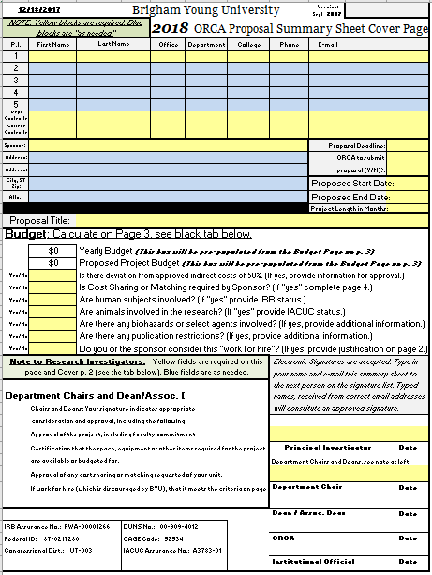
ORCA Proposal Sheet Changes
Benefit Rates change every year
“Faculty Detail” tab
Calculates and carries to budget page
**Recorded as Effort—12.5% = 1 month summer salary
Up-to-date forms found at orca.byu.edu
Notes:
Full salary, 8 month base, regardless of whether they have an 8 month, 10 month, etc., contract

Slide 78
F&A/Indirect Costs & Matching
Facilities & Administration (F & A) / Overhead
Operations and Maintenance, phones, copying, ILL, etc.
Building and Equipment Depreciation
General Administration (HR, payroll)
Department Administration
Sponsored Projects Administration
Library
Student Services
MATCHING/COST SHARING
Only include if required by sponsor
If it is proposed, we are obligated to track and report it

Slide 79

Grants.gov: WORKSPACE
PURPOSE: Enhance grants.gov functionality and streamline participant collaboration and delegation, from form access to submission
TIMELINE
Current system retires Dec. 31, 2017
Required starting Jan. 1, 2018
iMedRIS IBC Dec. 20, 2017, IRB & IACUC Feb, 2018
KUALI at BYU ** Jan. 2019

Slide 80


ORCA’s Role in Grants.gov: WORKSPACE
ACTIONS
Faculty request access from their ORCA Research Administrator AFTER they have created an institutional login, connected to BYU
Access requests accommodated now
Last-minute requests risk missing deadlines
ORCA completes final review and submits Grant Proposals through WORKSPACE
PI submits 5-7 working days prior to grant deadline

Slide 81

Benefits of Workspace
Multiple users work concurrently on application forms
Reuse previously submitted Workspace forms for future opportunities
Immediate validation, errors corrected before submission, minimizes rejection rate
Seamless integration between online web forms and offline PDF forms
Collaborate with Users External to Your Organization
Changes to Opportunity Package are reflected
in Workspace

Slide 82
Submission Deadlines
ORCA needs the signed summary sheets, budget justification, budget in sponsor’s format, project summary, and completed proposal 3 – 5 days before the submission due date (WORKSPACE proposals needed 5 – 7 business days)
Research Administrator reviews, suggests changes, secures signature from AAVP
ORCA or PI submits (depending on sponsor)
If PI submits, ORCA/University approval still required prior to submission
Contact ORCA early and often!

Slide 83
Your Formula for Success
Write Proposal
Obtain University Approval (via ORCA)
Submit Proposal
APPROVED
Declined

Slide 84
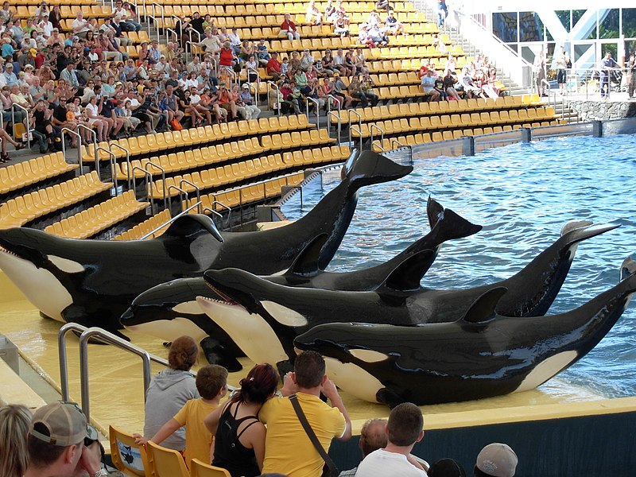
Contact us with questions!
Team ORCA http://orca.byu.edu
Gene Larson
Marriott School of Bus, Law School, School of Fine Arts & Comm, Religious Ed, Maxwell Inst, & Nursing
Debbie Silversmith
Fulton School of Eng/Tech
Susie Quartey
McKay School of Ed, Humanities, Phys & Math
Jason Jay
FHSS, Life Sciences
Sandee Aina
All things IRB
https://commons.wikimedia.org/wiki/File:Orcas_at_Loro_Parque_08.JPG

Slide 85
Wrap Up
Good Ideas
Fundable Idea
Find Funder(s)
Pre-Proposal
Write the Proposal
Revise
Marketing
Rejected
Accepted AND Funded
Funder
Drafts
Submit (ORCA)
Peer Review
Edit
Research Development has tools and resources to help with most of the steps in this process

Slide 86
Final Thoughts on Proposal Writing
Winning proposals have been polished repeatedly through writing and re-writing
“Competitive ideas evolve and converge over time; they do not appear fully and perfectly formed by a narrative Genie (Cronan and Deckard, New Faculty Guide to Competing for Research Funding)”
Fight “Pride of Authorship”
Sell but don’t over promote your ideas
Get reviewers and proofreaders (with no stake in project?)
Allow time

Slide 87
Upcoming Events
January 25th, NSF CAREER Awards Seminar; 12:00-1:00 p.m. 270 MB
February 6th, Carter Cornwall/NIH Funding Seminar; 12:00-1:00 p.m.; one-on-ones afterwards
February 13th , Lisa Troyer/Department of Defense Minerva Institute Funding Seminar; 12:00-1:00 p.m.; one-on-ones afterwards
Late February/Early March, Steve Taulbee/Army Research Labs; 12:00-1:00 p.m.; one-on-ones afterwards
March 8th, 13st, 15th, and 22nd Graduate Student Proposal Development Series; 12-1
March 29th, Sophia Yang/Fulbright Scholar and Fulbright Student Presentations from CIS staff
April 5th, Department of Education Funding Seminar 12:00-1:00 p.m.
May 14th-17th, Spring Bootcamp; 9-2 in 270 MB
June 5th, 6th, and 7Th, Graduate Student Grant Writing Bootcamp
Late August, Research Networking

