Slide 1
Grant Proposal Development Workshop
December 9, 2016

Slide 2

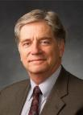
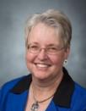
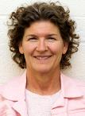
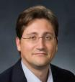
Research Development Support
Kristen Clarke Kellems
FHSS Research Development
934 SWKT
Tel: 801-422-8967
Email: fhssresdev@byu.edu
Conrad Monson
STEM Research
Development
275 McDonald Building
Tel: 801-422-7722
Email: conrad_monson@byu.edu
Jaynie Mitchell
MSE Research Development
306C MCKB
Tel: 801-422-3067
Email: Jaynie@byu.edu
Sarah Dorff
Research Development Administrator
269 McDonald Building
Tel: 801-422-0132
Email: resdev@byu.edu
Jon Balzotti
English Department Faculty
College of Humanities
4127 JFSB
Tel: (801) 422-2440
jonathan_balzotti@byu.edu

Slide 3
Proposal Development Process
Good Ideas
Fundable Idea
Find Funder(s)
Pre-Proposal
Write the Proposal
Revise
Marketing
Rejected
Accepted AND Funded
Funder
Drafts
Submit (ORCA)
Peer Review
Edit
Research Development has tools and resources to help with the steps in this process

Slide 4
Agenda
Day 1, December 9th
Introduction
Research Funding Environment (Conrad)
Creating a Fundable Idea (Conrad)
Finding Funding (Jaynie)
Role of LDS-P and other potential funding sources (Taunja Baxter)
Break
Prewriting (Conrad)
Writing a Persuasive Needs Statement (Kristen)
Proposal Elements (Conrad)
11:45-12:30 Write; have Lunch
Titles and Abstracts (Kristen)
Faculty Panel and Q&A
Wrap up

Slide 5
Research Funding Environment

Slide 6
2015 Federal Spending For Academic Research
$62.6B Total
From National Science Foundation, National Center for Science and Engineering Statistics, Survey of Federal Funds for Research and Development, FYs 2013–15.

Slide 7
Private Funding Awarded by Project Type
Private industry contributes close to 70% of the over $400B in yearly US R&D funding
(from “Getting Funded: The Complete Guide to Writing Grant Proposals” and NSF Science and Engineering Indicators)

Slide 8
External Funding for University Research¹
In 2015, CPMS, FHSS, E&T, LS and MSE received 91% of BYU research funding; over 80% of that funding was from federal sources²
(Internal to a University)
¹NSF Higher Education R&D Survey. Data are the average of 2011, 2012, 2013
²ORCA Annual Report of Sponsored Research for 2015
Most of BYU research funding comes from federal sources

Slide 9
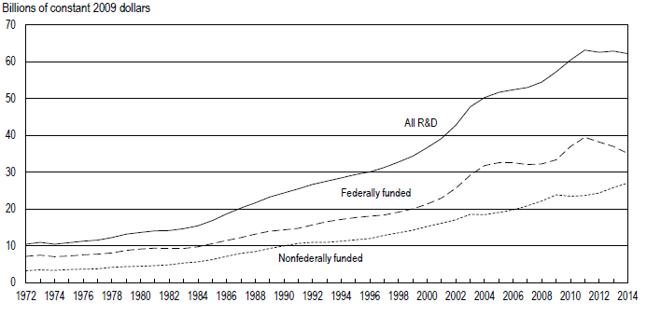
Research Funding Acquisition Challenges
Nationally, there has been a decrease in research funding
  External funding from federal sources is
  declining
    The longest decline in federal finding has occurred in the last few years
However, even in today’s challenging funding environment, there are ways to be successful
  Pay attention to details
  Use best practices to write compelling proposals
  Be persistent
University Research and Development Funding in the US¹
¹From “Universities Report Continuing Decline in Federal R&D Funding in FY 2014” InfoBriefs | NSF 16-302 | November 17, 2015
²ORCA Annual Report of Sponsored Research for 2015

Slide 10
Develop a Fundable Idea

Slide 11

Developing Good Ideas
The process starts with being knowledgeable,
thoughtful, creative, open to new ideas
(and prayerful throughout)
Think in Question format
  Write out every interesting question that you
  can think of related to your area of interest
Think in Experiment/Research Approach format
  What research would you do, information would you collect, interviews would you conduct regardless of money, time, expertise or equipment?
Think in Hypothesis format
  Write out as many untested hypotheses as you can related to your area of interest
Keep an ongoing log of your ideas
Let the ideas incubate and try the process again (and again)
(Adapted from “Grantsmanship Workshop, How to Develop a Fundable Research Proposal” Tammy Bray, PhD, Dean, College of Health and Human Sciences Oregon State University)

Slide 12
Additional Ideas for Developing and Optimizing Your Research Idea
Identify a relatively under-explored niche within the area of your broad research interest
  Identify your long-term goal within the niche area
Conceptualize a step-by-step continuum of research that you have just formulated
  Identify the next logical step that needs to be taken along the continuum of research that you have just formulated.
Search and critically analyze the literature that is pertinent to the step you want to take
While searching and analyzing the literature, develop a list of key words that are pertinent to the area and the names of the investigators who have been active in the area during the last ten years
Asses your own ability to pursue the idea, including relevant expertise and resources
Assess your competition
Use information from funded grants to improve your idea and research design
Determine which granting agencies are most appropriate to your idea, i.e., ones whose mission will be advanced by funding your idea (tie to grand challenges?)
Seek constructive criticism of your idea from knowledgeable colleagues
(This list was generated from various sources)

Slide 13
Exercise: You want to obtain funding for a project—So What?
1. Divide into teams
2. Present your fundable idea to your team
3. Team response - So What?
4. Justify your idea
5. Reconvene and debrief

Slide 14
Finding Funding

Slide 15
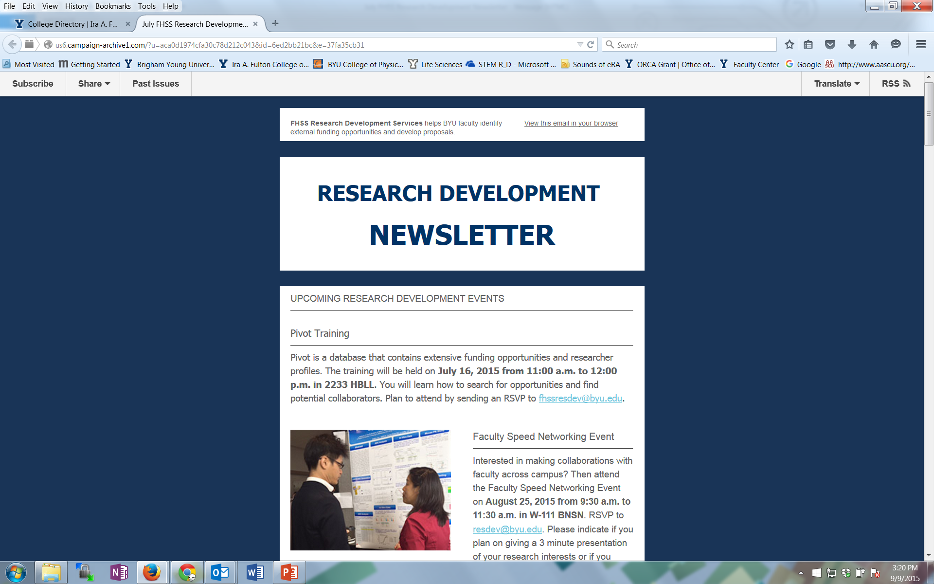
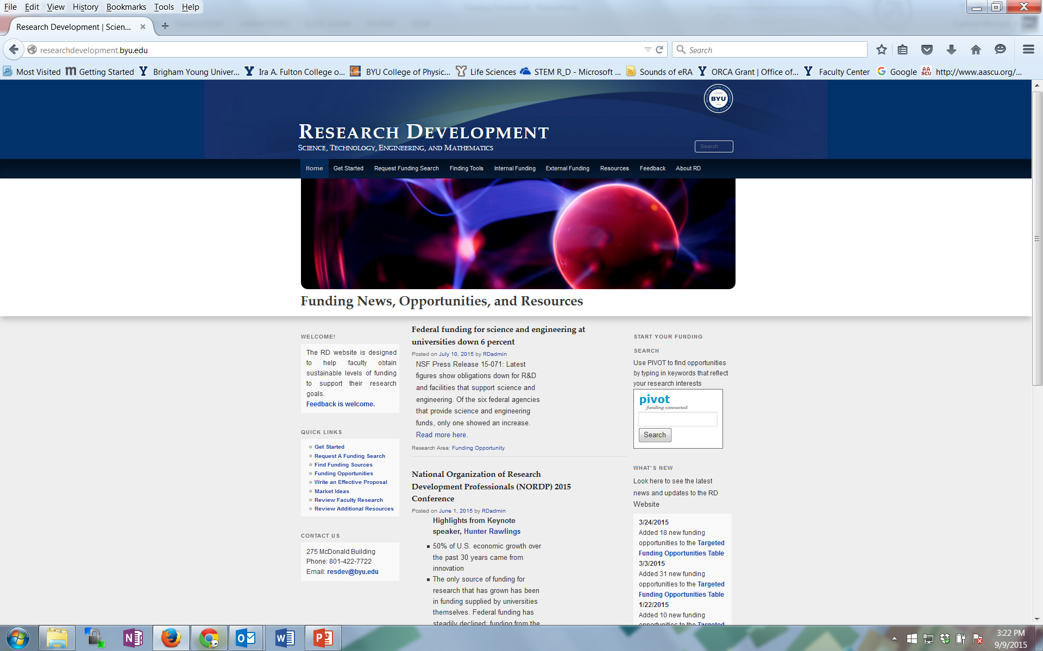
Research Development Support for Finding Funding and Writing Proposals
Newsletters from FHSS and STEM Research Development
Research Development website: researchdevelopment.byu.edu
Online funding searches
Conduct seminars about particular funders
Advocate research capabilities to funders
Attend funding conferences
Identify funding opportunity and help write the grant proposal

Slide 16
Finding External Funding By Casting A Wide Net
Look for funder contacts within professional societies
  National Geographic
  American Psychological Association
Attend funding conferences (e.g., NSF, NIH)
Search journal article acknowledgements
Participate in proposal review panels
Look for funding opportunities from unused Government year end funds
Contact potential Program Officers about funding and ask them to recommend funding sources
Search a wide range of possible funding sources
  Federal Government
  Associations, Foundations, Companies
  Municipal, County, State Government, Community Partnerships
  “Alternative” sources of funding (e.g., Crowdfunding, Benefunder, Nine Sigma funding)
Notes:
Review Panels - at Dec 2013 NSF Days, leader solicited business cards for potential reviewers. For NSF, don’t need a prior NSF grant, or even a PhD or university affiliation. Need expert. NSF needs about 50K reviewers per year

Slide 17
Use Online Tools to Find Funding
PIVOT (BYU has a subscription) http://pivot.cos.com
Foundation Center Online (BYU has a subscription) http://fdncenter.org/
login username byuacadvp and password cougars2002
Foundation and company websites
Grants.gov (free; register) http://grants.gov/
Agency websites
University-affiliated Humanities centers
The Catalog of Federal Domestic Assistance (CFDA) (free) www.cfda.gov
Other online tools
  Federal Register http://www.gpoaccess.gov/fr/
  Grantsmanship Center http://www.tgci.com/
  Fundsnet service http://fundsnetservices.com
  GrantsNet http://www.grantsnet.com
  Guidestar http://www.guidestar.org
  Google/Bing/Yahoo
As one expert put it - think big, think small, think in different ways to uncover funding opportunities… in other words, cast a wide net
Notes:
Perhaps most useful feature of PIVOT is the opportunity tracking that provides automated alerts when selected opportunities are updated
We will do a PIVOT tutorial later this morning and Trace Eddington from LDS-P will provide demonstrated Foundation Center online next week.
Are there a few who would like us to do a preliminary search for them and show it at next weeks class?

Slide 18
Discussion: Your experiences with finding funding

Slide 19
LDS Philanthropies (LDSP)
We are a department under the
Presiding Bishopric.
We correlate charitable giving within all church charities and institutions of higher education.
Notes:
We provide donor management for all church areas including the church’s higher education institutions and church departments like Family Search, Self-Reliance services, etc. We don’t handle any tithing and fast offerings. Each college has a DL assigned, and most of them are right on campus.

Slide 20
LDSP or ORCA
Use the ORCA office if your funding source:
  is a government entity
  requires specific deliverables or sponsor input
  requires detailed financial reporting
  obligates the university to any terms or conditions
When in doubt, call ORCA at 422-3841 or Kristen / Conrad
Notes:
LDSP doesn’t handle any government grants. (Click twice after.) Conrad and Kristen can help with finding gov sources.

Slide 21
Summary of how LDSP helps:
Tools to help with finding funding
Foundation proposal correlation
Relationships with prospects/funders
Help with proposal writing/editing
“No Overhead” (costs in budget)
Notes:
I can help as time permits. First come, first serve. Preferable first you take the first pass at writing as you know your project best.

Slide 22
Important Details
Meet with Department Chair, Donor Liaison, and/or Dean
  Discuss department and college priorities
  Do you have a “champion” at the foundation?
Annual Audited Financial Report limitations at BYU
Notes:
Internal and External Matchmaker.

Slide 23
THE PROCESS OF
FUNDRAISING WITH FOUNDATIONS
(1) FINDING POTENTIAL FOUNDATIONS
(2) CULTIVATION AND GRANT-WRITING
(3) FOLLOW-UP

Slide 24
THE PROCESS OF
FUNDRAISING WITH FOUNDATIONS
FINDING POTENTIAL FOUNDATIONS
Foundation Directory - fconline.foundationcenter.org
Notes:
Kristen and Conrad offer a whole class on this tool.

Slide 25
Foundation Directory

Slide 26
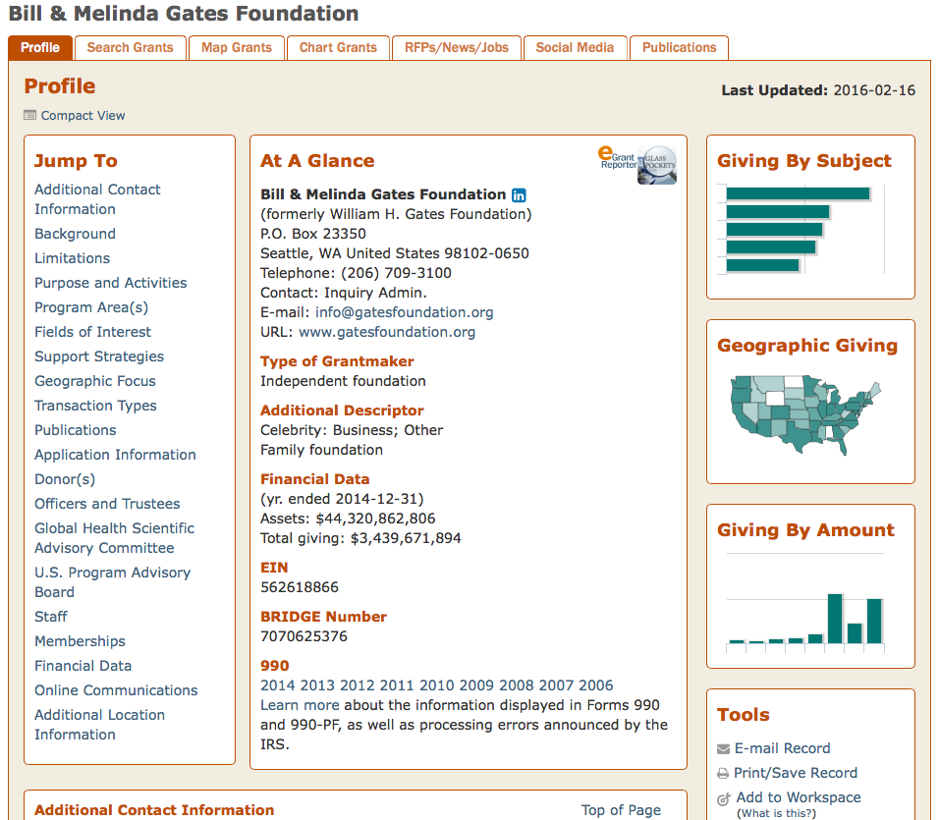
Notes:
Has started getting some graphical info: chart of giving by subject, amount or a map of geographic giving

Slide 27
THE PROCESS OF
FUNDRAISING WITH FOUNDATIONS
FINDING POTENTIAL FOUNDATIONS
Foundation Directory - fconline.foundationcenter.org
Foundation Search
Notes:
I can run this for you. Similar information to Foundation Directory.

Slide 28
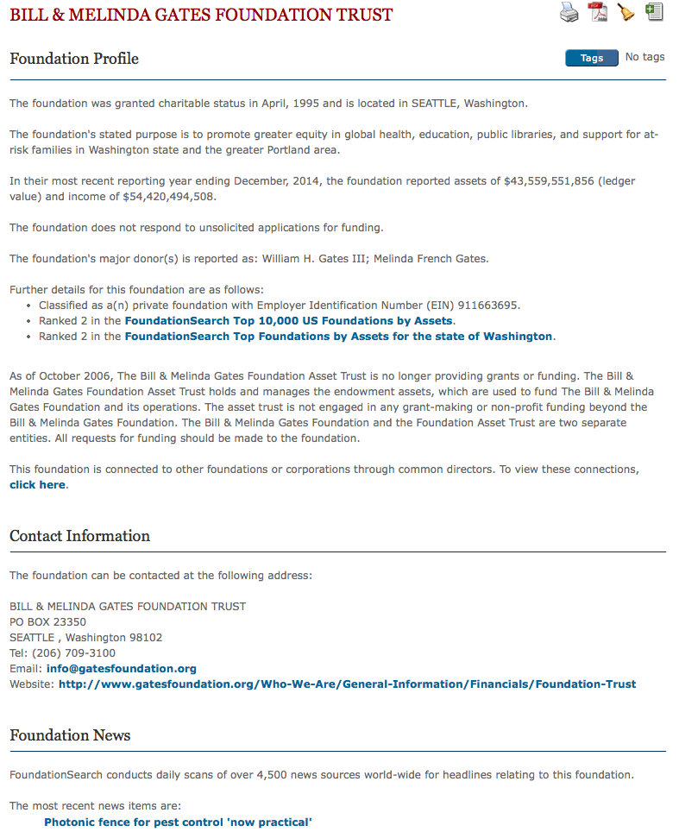
Foundation Search

Slide 29
Notes:
Graphics are more useful that Foundation Directory

Slide 31
THE PROCESS OF
FUNDRAISING WITH FOUNDATIONS
FINDING POTENTIAL FOUNDATIONS
Foundation Directory - fconline.foundationcenter.org
Foundation Search
Philanthropy News Digest – RFPs

Slide 32
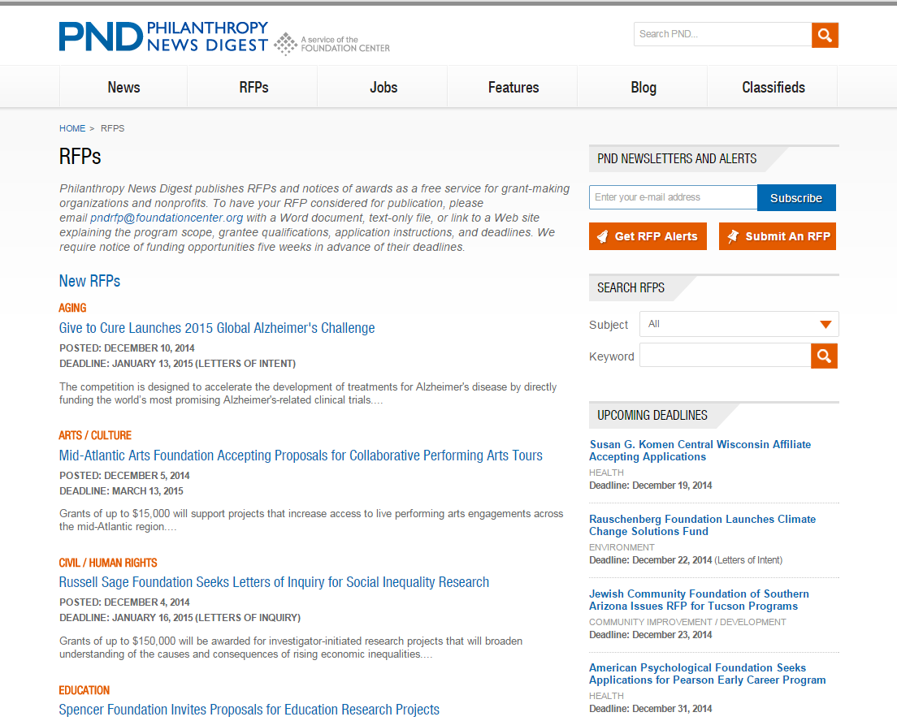
Philanthropy News Digest RFPs
Notes:
New RFPs

Slide 33
Philanthropy News Digest – RFPs
philanthropynewsdigest.org
Aging
Agriculture / Food
Animal Welfare
Arts / Culture
Athletics / Sports
Children / Youth
Civil / Human Rights
Community Improvement / Development
Education
Environment
Health
Higher Education
Human Services
Journalism / Media
Medical Research
Philanthropy / Volunteerism
Public Affairs
Religion
Science / Technology
Women / Girls

Slide 34
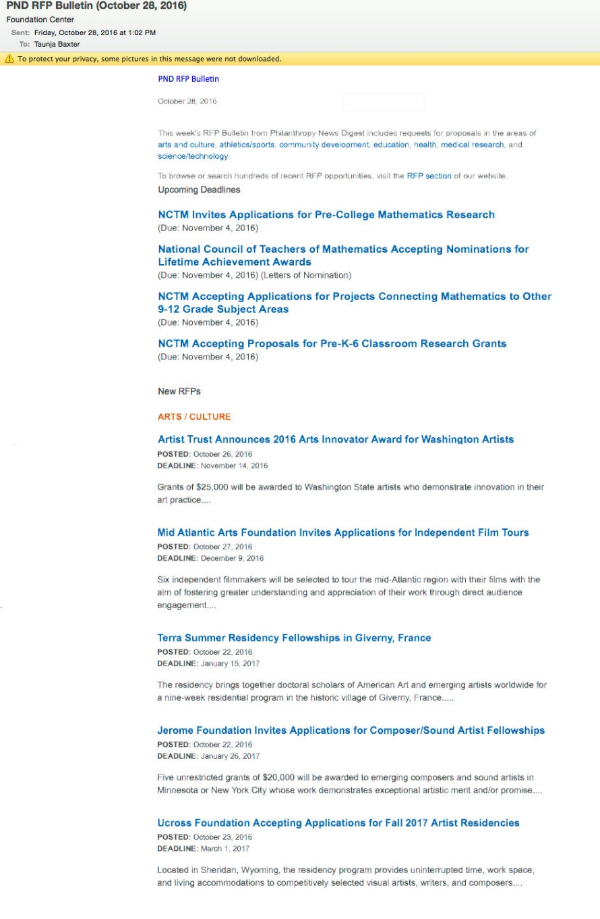
Philanthropy News Digest – RFP Bulletin

Slide 35
THE PROCESS OF
FUNDRAISING WITH FOUNDATIONS
FINDING POTENTIAL FOUNDATIONS
Foundation Directory - fconline.foundationcenter.org
Foundation Search
Philanthropy News Digest – RFPs
Web
Notes:
Of course, web searches.

Slide 36
Web Searches

Slide 37
THE PROCESS OF
FUNDRAISING WITH FOUNDATIONS
(2) CULTIVATION AND GRANT-WRITING
LDSP level of involvement depends upon your needs
Letter of Inquiry - Letter of Intent - Phone call – Proposal - Proof your proposal

Slide 38
THE PROCESS OF
FUNDRAISING WITH FOUNDATIONS
(3) FOLLOW-UP
Getting feedback from the foundation after proposal approval or denial
Dispersing feedback to all involved parties
Foundations require an annual report on how the money was spent

Slide 39
LDSP Donor Liaisons

Slide 40
COMMUNICATION
When should you contact LDSP?
Before approaching a foundation, please contact your college assigned Donor Liaison or call Taunja Baxter to check the status of a foundation.

Slide 41
Foundations are interested in their giving priorities.
You must position your work in a way that clearly aligns with and advances a foundation's established goals.

Slide 42
Taunja Baxter
Grant Writer, LDS Philanthropies
1450 N. University Ave
(w) 801-356-5289 | (c) 801-420-4919
taunja.baxter@ldschurch.org
www.ldsp.org

Slide 43
Prewriting

Slide 44
With a Fundable Idea and Good Potential Funding Source(s) Perform SWOT Analyses
S
Strengths
What are your strengths
What do you do better than others
What unique capabilities and resources do you possess
What do others perceive as your strengths?
W
Weaknesses
What are your weaknesses
What do competitors do better than you
What do others perceive as your weaknesses
Internal (attributes of your organization)
O
Opportunities
What trends or conditions may positively impact you
What opportunities are available to you
T
Threats
What trends or conditions may negatively impact you
What are your competitors doing that may impact you
Do you have solid financial support
What impact do weaknesses have on threats to you
External (attributes of your environment)
Positive (helps meet objectives)
Negative (detrimental to objectives)
SWOT analyses can identify strengths to highlight, weaknesses to mitigate, opportunities to capitalize on and threats to counter

Slide 45
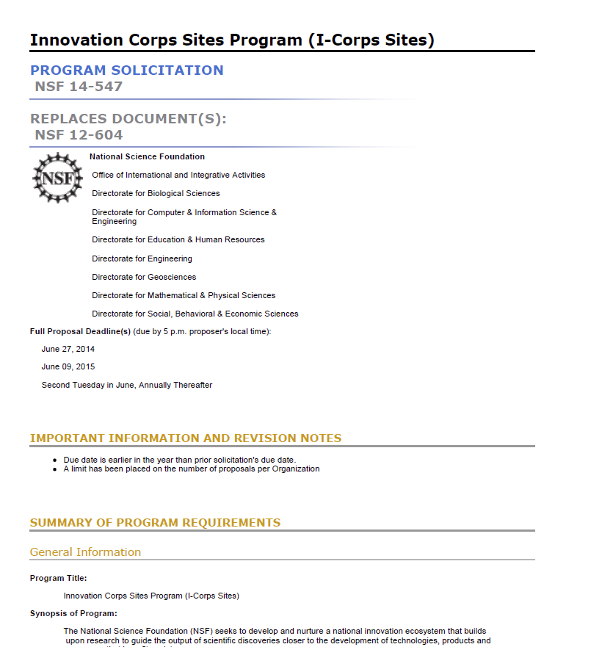
Prewriting Activities: Thoroughly Decompose the Solicitation
Deadlines
Requirements, (technical, budget, management, “MIRs” etc.)
Proposal components
Unusual requirements
Procedures for submittal (including BYU/ORCA procedures)
Review Criteria
Notes:
Deadlines for submitting questions to the program officer, submittal through BYU/ORCA, submittal to the funder
Most Important Requirements (technical, budget content)
Elements required of proposal (cover page, summary, etc.)
Unusual requirements
Procedures for submittal (including BYU/ORCA procedures
Requirements
Can be technical, budget, management
What isn’t said in the solicitation may be just as important as what is said
Must understand and answer the MIRs (most important requirements

Slide 46
Prewriting Activities: Create a checklist
Make a checklist for what you need to accomplish:
  Approval from your department chair and research dean
  Contacted ORCA about compliance issues (human subject and animal research, using recombinant DNA, etc.)
  Read all of the forms and instructions provided by the funder and pay close attention to those regarding length of each section, overall number of pages, required content, attachments, etc.
  Identify all the sections that will need input from the other sources
  Let those who must submit content as early as possible (letters of support) along with the guidelines and suggestions of what to write
  Develop an outline that includes the major points (and is based on the RFP’s review criteria)

Slide 47
Sample of a Proposal Development Checklist
Contact Information and
required proposal sections
Proposal writing tasks, deadlines, authors
Requirements and how they will be met
Themes
Proposal actions
Review criteria
From checklist posted on the RD Website http://researchdevelopment.byu.edu/resources/proposal

Slide 48
Prepare a Proposal Development Timeline
Month | Activity
1 | Identify the problem. Analyze your ability to successfully pursue the idea.
2 | Identify a project director and others who will be involved in planning/writing the proposal. Conduct a needs assessment. Identify prior work/related activities of other universities. Develop a case for how your work differs from/compliments others. Identify funders and get administrative buy-in.
3 | Begin cultivating potential funding sources. Ensure university can meet compliance obligations.
From “Getting Funded: The Complete Guide to Writing Grant Proposals” by Susan Howlett

Slide 49
Proposal Development Timeline (cont.)
Month | Activity
4 | Develop the first draft of the proposal and seek feedback from colleagues who have previously received funds from this source
5 | Modify the proposal using input received during previous months. Complete the final version and translate it into the formats required by the funders. Submit the proposal for internal reviews. Submit the proposal to the funder.
6-9 | Verify receipt of the proposal by the funders and find out when a decision is likely to be made. Stand by while funders conduct their initial review and request more information.
10-11 | Receive approval or rejection. In either case, obtain reviewers comments.
12 | Receive authorization to expend funds. Start the project.

Slide 50
Create an Outline From an RFP
Organize proposal sections according to the funder’s guidelines
  If the sponsor’s materials provide an outline structure, incorporate the review criteria into the structure. Use the sponsor’s terminology, especially in the headings/subheadings to make it easier for reviewers.
Outline the complete proposal
  Ensure all components are tied together
  Use as the basis for a smooth, end-to-end narrative
  Consistent with the RFP decomposition
  Show how requirements will be met
Include instructions and review criteria
  As you are reading the FOA and creating headings/subheadings, include information on the review criteria and scoring system. This helps you address that information in each area
Review and re-iterate the outline… sequentially adding greater levels of detail will make the actual writing easier
From “Grant Seeking in Higher Education” by The University of Missouri Grant Writing Network

Slide 51
How to Use Review Criteria As Part of the Proposal Decomposition
Pay attention to all the review criteria
Assume a non-expert but intelligent reviewer
Avoid insider jargon and acronyms
Know the different types of reviewers:
  Critical reviewers: Those who read every word on every page; assigned to write the most comprehensive review and lead the review panel’s discussion about a proposal (sometimes called primary reviewers).
  Search readers: Read enough to get the main points of the proposal but not every word (looking for responses to the review criteria).
  Skimmers: Looking for important points but not reading the proposal in depth.
Consider the challenges facing reviewers
  Many proposals to review
  Limited Time for your proposal
  Different experiences in review process, veterans to novices
  Different levels of knowledge in proposal area
  With many proposals to review, looking for reasons to reject proposals

Slide 52
Decompose an RFP
What are critical needs?
What are the themes?
What are the reviewers asking for (both directly and indirectly)?

Slide 53
RFP
Example

Slide 54
Decomposed RFP Example
Requirements |  | How will this requirement be met?
GENERAL - The FEWS focus for this year "...advance a new understanding of the role of the chemistry of nitrogen, phosphorous, and water in the nexus of food, energy and water systems, "INFEWS: N/P/H2O." The goals of this new focus are: "the production and use of fertilizers for food production" "detection, seperation, and reclamation/recycling of nitrogen- and phosphorus-containing species in and from complex aqueous enivornments"
More specifically, in FY 2017, the topics of interest in INFEWS: N/P/H2O include innovative, fundamental research to:
(1) advance catalytic methods for the reduction of dinitrogen to ammonia that permit reductions in the energy requirements for fertilizer production; | What are the catalytic methods you will use
(2) develop new sensing modalities that will lead to field-deployable, inexpensive, and environmentally and energetically sustainable sensors for real-time monitoring of nitrogen- or phosphorus-containing species as they move, via agricultural run-off, to other water systems; and | What are the new sensing modalities you will develop
(3) develop methods for the selective and efficient detection, sequestration/separation, and recycling of nitrogen and phosphorous species from water (For proposals submitted to CHE, proposals should focus on gaining an understanding of the supramolecular recognition and binding of environmentally-relevant nitrogen- and phosphoruscontaining species.); and | What methods for N and P detection, sequestartion/separation and recycling will you develop
(4) develop new materials to optimize the availability of N and control the utilization of P while managing effluents within the context of sustainable energy and preservation of our natural resources | What new materials to optimize the availability of N and control the utilization of P will you develop
"There is a critical need for research that enables new means of adapting to future challenges" (when it comes to stresses on the food, energy, and water systems) | How will your research enable new means of adapting to future challenges
"The FEW (food, energy, water) systems must be defined broadly, incorporating"
"physical processes" | How will your research address the synergy of these components within the context of sustainability and how will it create new knowledge and technologies to address scarcity and variability
"biological processes"
"natural processes"
"social/behavioral processes"
"and cyber elements"
"It is the synergy among these components, in the context of sustainability, that will open innovative science and engineering pathways to produce new knowledge and novel technologies to solve the challenges of scarcity and variability"
Predicted water shortages "necessitate scientific and technological innovations that will address global problems that center on fresh water" | Will your research address global problems centering on fresh water?
“The most competitive proposals will address how the project conceptually advances innovations at the nexus of the food, energy, and water systems and sustainability of the proposed solution, i.e., the monetary and energetic costs for translation and scale-up.” | Will your project sustainability advance FEWS … what are the monetary and energy costs for translation and scale-up
Since these are global issues, “proposals including international collaboration are encouraged when those efforts enhance the merit of the proposed work.”​ | What international collaborations will be part of the project

Slide 55
Writing A Persuasive Needs Statement

Slide 56
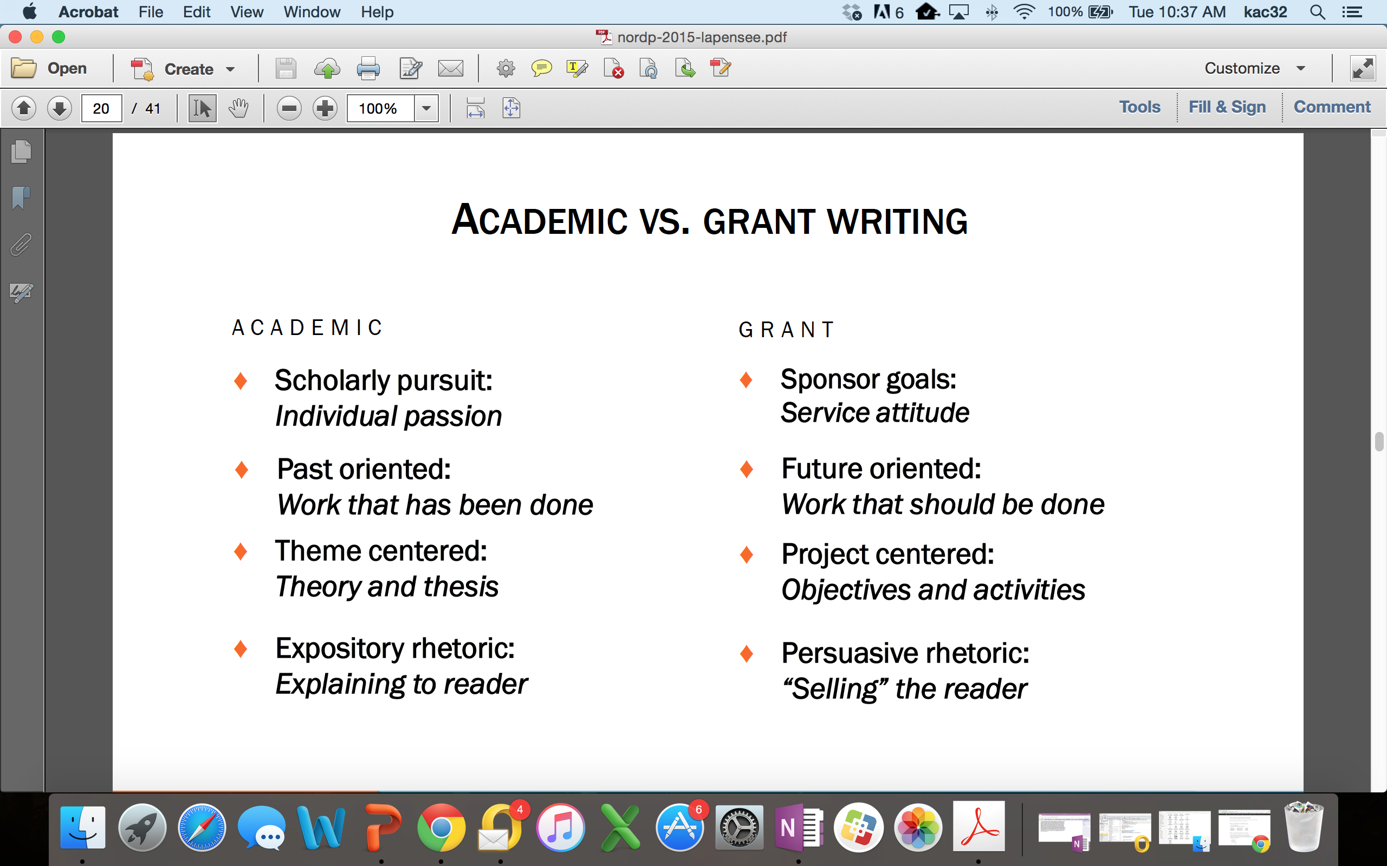
Academic vs Grant Proposal Writing

Slide 57




The Baseline Logic
Baseline Logic is the foundation for your readers’ (and your) understanding of a proposal
Because of the mis-alignment between (a) the college’s operating and delivery systems and (b) the needs of the college’s students and employers and community it serves,…
…we will develop and implement a comprehensive strategy for integrating current institutional initiatives into Engineering & Technology Division’s educational offerings.
Current Situation
Desired Result
S₂
S₁
As a result, BYU will be more responsive to the rapidly changing requirements of students, employers, and the community, offering higher quality educational services in less time and at a lower cost.
B
Benefits
90% of proposals have serious flaws in their baseline logic
(Baseline logic and generic slots descriptions adapted from Jon Balzotti’s presentations)

Slide 58
The Needs Statement Creates the Basis of Your Proposal
Component
1. Story (Problem)/S₁ | Describe the problem: (1) context of the problem, (2) justification for addressing the problem, (3) specific aspect of problem being addressed. (Causes and Effects) Statistics: -Your own data -Info from external sources Examples: -Anecdotes -Real-life examples -Quotes
2. Plan for solving (Problem) S₁ | Method section contains the approach taken to solve the problem and list of activities/tasks.
3. Request for support | The instrumental purpose statement contains actions you want the sponsor to take immediately and resources you want the sponsor to commit.

Slide 59
S1 Situation for the Needs Statement: Describe the problem
Describe the context of the problem
  Define the problem so that other people can understand it, identify with it, and recognize it’s important
  Be specific about what larger societal problem your proposed project contributes to solving
Describe the scope of the problem and the justification for solving it
  Scope: How large is the problem? How many people affected by it?
  Justification: Why do we need to spend the money and resources to solve this problem now? (Urgency)
Describe the aspect of the problem you’re trying to solve
  If you are working on trying to solve a complex societal problem, you will not try and solve the entire problem, but rather an aspect of the problem

Slide 60
Describe the Problem: Rhetorical Appeals
Aristotle wrote that there are three types of rhetorical appeals. They are:
  A rational appeal (logos), citing facts, figures, and statistics to build your case; using deductive reasoning and inductive examples to support your claims
  An emotional appeal (pathos), using case studies or examples which arouse the readers’ emotions and stimulate their desire to help
  An appeal to the character and credibility (ethos) of you and your research team
The type of appeal you will use in your proposal depends on what type of sponsor you are writing for
  If you are writing to a federal funding agency, you will concentrate on appeals to logos (facts, figures, and statistics) and ethos (the credibility and experience of your PI and research team members)
  Smaller foundations prefer pathos (emotions)

Slide 61
Describe the Problem: Example
According to the Children’s Report card, approximately 10,753 were physically, mentally, or sexually abused. Children of color, especially Hispanics, are at considerably greater risk of being abused. According to the Department of Health and Human Services, Hispanic children are four times more likely to become victims of child abuse than Caucasian children.
    This appeal to logos incorporates the context of the problem, the justification and scope
Certain aspects of Hispanic culture may create risk factors. Many Hispanic people leave their home countries to improve their quality of life, yet in the United States encounter poor education, unemployment and lack of affordable housing. While parents are working, relatives or friends who also live in the household often care for the children. Circumstances like these often leave Hispanic children more prone to abuse. Therefore, programs and interventions tailored specifically for Hispanics are needed to help prevent child abuse and successfully identify and refer victims to treatment.
    This paragraph gives the aspect of the problem being solved
CENTRO believes that there is a need to educate the Hispanic community about child abuse in order to prevent abuse and identify and treat victims. CENTRO understands the cultural needs of the Hispanic community and has been serving the twin cities for 28 years.
    This is an appeal to ethos—why this organization is qualified to solve this problem

Slide 62
The Needs Statement Creates the Basis of Your Proposal
Component
1. Story (Problem)/S₁ | Describe the problem: (1) context of the problem, (2) justification for addressing the problem, (3) specific aspect of problem being addressed. (Causes and Effects) Statistics: -Your own data -Info from external sources Examples: -Anecdotes -Real-life examples -Quotes
2. Plan for solving (Problem) S₁ | Method section contains the approach taken to solve the problem and list of activities/tasks.
3. Request for support | The instrumental purpose statement contains actions you want the sponsor to take immediately and resources you want the sponsor to commit.

Slide 63
Needs Statement: Plan for Solving the Problem and Request for Support
Plan for solving the problem (S1)
  Convince your reader that the problem is solvable
  Show how one consequence will lead to another until your solution is effected, or you can use analogies or precedent (i.e. how other similar research proposals have been successful elsewhere)
Justifying your solution
  Actions you want the sponsor to immediately take and resources you want it to commit
  Be specific about what the money will be used for and why it is necessary.
  State what will happen if the project isn’t funded; what happens after funding ends

Slide 64
Plan for Solving the Problem and Requesting Support: Example
CENTRO seeks to empower and support the Hispanic community by eliminating barriers to self-suffiency. CENTRO believes that cultivating strong and healthy children who are free of abuse is one step to cultural self-sufficiency. For these reasons, we are undertaking a program to train parents and teachers to recognize the signs of abuse and refer abused children to treatment.
This training program will involve developing training materials and training trainers in the community to conduct free training sessions. We are seeking funding to train these trainers and develop a training video. Therefore, we are requesting $6,700 in support from your organization.

Slide 65
Practice Identifying the 3 Components of a Needs Statement
The Minneapolis Police Department Community Crime Prevention/SAFE (CCP/SAFE) Unit works with the community on teaching crime prevention. Because of the ethnic and racial diversity in Minneapolis, CCP/SAFE has made resources materials in seven different languages. The deaf community is also defined by language and culture, but it has not had the attention directed at bridging the communication gap that exists between the police and the deaf community that other groups have had.
We believe that information and education will result in safety awareness and empowerment within the deaf community. By providing 12 workshops that present material suggested by the deaf community, we will effectively begin to narrow the gap between the police and the deaf community.

Slide 66
Developing the Proposal Elements From the Needs Statement

Slide 67


Proposal Elements are Created From the Needs Statement
The Needs Statement thoroughly develops and describes the problem you are addressing including context and justification … develops the Situation Slot, S₁
Describes Methods at a high level; informs Qualifications and Benefits
Provides the basis for the Budget you need
Needs Statement Components
1. Story (Problem)/S₁
2. Plan for solving (Problem)/S₁
3. Request for support
The 6 Generic Proposal Slots (tied to baseline logic)
Achieved Objective(s)
S
Methods
2
S
Situation
1
B
Qualifications
Benefits
Budget

Slide 68


The Six Generic Proposal Slots Answer the Funder’s Major Question
Q: Is your project worthy of funding?
A
meets the
:
Yes
requirement
for success
Q
:
Why?
We
We Are
We Have
We Have
The
There will
Understand
Clear On
The Right
The Right
Budget
be
the
Your
Qualifi-
is
Substantial
Situation
Objectives
Methods
cations
Justifiable
Benefits

Slide 69
Contents of the Generic Proposal Slots
Situation: This is our understanding of the problem.
Objectives: Given that problem, these are our objectives for solving (or realizing) it.
Methods: Given those objectives, these are the methods we will use to achieve them.
Qualifications: Given those methods, these are our qualifications for performing them.
Budget: Given those qualifications and methods, this is how much the project will cost.
Benefits: Given our efforts and funders support, these are the benefits or value you will receive.

Slide 70
Proposal Slots Map to Typical Proposal Sections
The generic slots map directly to proposal sections or provide content to support proposal sections identified by a funder
The Generic Proposal Slots
Typical Proposal Sections
Introduction/Background/Justification and Scope
Situation: This is our understanding of the problem.
Objectives: Given that problem, these are our objectives for solving (or realizing) it.
Introduction/Background/Justification and Scope/Specific Aims
Methods: Given those objectives, these are the methods we will use to achieve them.
Work Plan/Methods/Approach/Data Management Plans
Qualifications: Given those methods, these are our qualifications for performing them.
Qualifications
Budget: Given those qualifications and methods, this is how much the project will cost.
Budget/Budget Justification/Project Costs
Benefits: Given our efforts and funders support, these are the benefits or value you will receive.
Benefits/Significance
Content Supports
Titles/Abstract/Summary/Intellectual Merit/Broader Impacts/Previous Work/Biosketches
CVs/Other Resources and Support

Slide 71
Writing an Effective Title and Abstract

Slide 72
The Title and Abstract: Two Critical Parts of Your Proposal
For readers who are not the primary or secondary reviewers of your proposal, time is so short that the title and abstract are likely the only portions that they read carefully
Title/Abstract used to make the initial determination of whether a project is eligible for, or worthy of, further consideration
  One foundation executive says that in nine out of ten cases, she reads only the executive summary before deciding whether or not to reject a proposal
Both public and private funders often copy proposals’ abstract/title and circulate them separately to key funding officials who want to see a digest of all incoming projects
The audience that reads the title/abstract may include members of Congress who fund the sponsoring agency, and voters who elected those officials. They will determine the project’s value based on the abstract/title.

Slide 73
Writing the Title
Do
Don’t
Describe the purpose of the project; use funder friendly keywords
Don’t discount the funder criteria
Use active, forward thinking verbs (predicting, mobilizing, empowering, revolutionary)
Use the name of the funder in the project title
Keep the title short; find out which research themes are mission-relevant
Don’t begin with “A Project To…”
Use imagination and flair; be original and relevant
Select a title that is likely to be used by others
Study titles of other funded projects in your field
Choose a title that might be funny/negative if seen out of context
Create at least ten titles using a combination of different words and abbreviations
Use jargon and filler words

Slide 74
Examples of Successful Titles
Paving Academic Pathways for Student Success. Funded by the U.S. Department of Education
Religion and the Rule of Law in Vietnam and Laos. Funded by the John Templeton Foundation
Teachers for a New Tomorrow: Engineering Education Pioneers and Trajectories of Impact. Funded by the National Science Foundation
A New Approach for the Development of Novel Antipsychotic Drug. Funded by the National Institutes of Health
Workplace Myth-Building: Rhetorical Strategies in Leadership and Decision-Making. Funded by the C.R. Anderson Research Foundation
Strategies to Optimize Art Services for Maternal and Child Health; The MCH-Art Study. Funded by the National Institutes of Health
EFRI-ODISSEI: Uniting Principles of Folding and Compliant Mechanisms to Create Engineering Systems with Unprecedented Performance. Funded by the National Science Foundation
The Brain on Breakfast: The Impact of Breakfast in the Classroom on Cognitive Performance

Slide 75
Activity
Write at least five titles for your research project. Get feedback from a partner on what works or doesn’t work about these titles.

Slide 76
The Abstract/Executive Summary
The abstract is an abbreviated version of your proposal—functions as the synopsis of your entire grant application
Write it before you begin the other sections of your proposal to function as a guiding narrative; then revise it (many times) after the rest of your proposal is written
Summarizes project purpose, goals, research design, methods, significance
Has to be well crafted and thoughtful, CONCISE and COMPLETE

Slide 77
Writing the Abstract
The abstract should contain:
  Why the project is needed (what is the problem that the project aims to solve). Include:
    Provocative statistics
    Illustrative narratives
    Compelling examples that show the reader the seriousness of the problem you are addressing or the consequences of not funding your proposal
  Who will do the work
  What will be done
  When will the activities be accomplished
  How will the results be evaluated and disseminated

Slide 78
Writing the Abstract: Showing why the project is needed
Which example is more effective at showing why the project is needed:
We posit that estrogens improve over-nutrition and/or angiotensin II (Ang-II)-induced INS resistance in skeletal muscle and cardiovascular tissue via decreased SK1-mediated Ser (P) of IRSs.
More than 17 million Americans suffer from type 2 diabetes, the seventh leading cause of death, with premenopausal obese and diabetic women at particular risk. Preliminary data from our laboratory show that in different animal models of obesity, female rodents are protected when compared with same strain male rodents. We posit that estrogens improve over-nutrition and/or angiotensin II (Ang II)-induced INS resistance in skeletal muscle and cardiovascular tissue via decreased SK1-mediated SER (P) of IRS.

Slide 79
Activity
As a group we will go through a couple of different examples of abstracts

Slide 80
Faculty Panel

Slide 81
Panelists
David Long is a professor in Electrical and Computer Engineering. He came to BYU after working for NASA's Jet Propulsion Laboratory. His expertise is in Earth microwave remote sensing including the development of a variety of advanced microwave remote sensing instruments, techniques, and applications, including the development of mesoscale models of oceanic winds for use in model-based wind retrieval (estimation) algorithms from scatterometer data, resolution enhancement algorithms, sampling theory, cryosphere studies, as well as innovative synthetic aperture radar (SAR) and scatterometer systems. David has had over 26 years of research funding and is the former Associate Dean for Research in Engineering.
Mikle South is an Associate Professor of Psychology and Neuroscience at Brigham Young University. He conducts research on emotion regulation and decision making, especially in autism spectrum disorders (ASD). Mikle has received internal funding for his research from different colleges and from ORCA. He has received external funding from NIH including a post-doc fellowship and service awards and from the European Union.
Paul Caldarella is an Associate Professor in the Department of Counseling Psychology and Special Education. He is the director of BYU’s Positive Behavior Support Initiative. He is a licensed psychologist and teaches graduate courses primarily in the area of school psychology. His research studies positive behavior support and social emotional learning interventions in public schools, as well as screening and targeted interventions for at-risk students. Paul has received outside funding for his research, most recently with an NIH award

Slide 82
Wrap Up
Homework
  Review handouts
  Before next session write a needs statement that includes a title
    send us the needs statement by Dec 15th so we can print copies or bring a hard copy with you on Dec 16th
Next Week – Dec 16, 9am-2pm
  Review Needs Statement and discuss
  Proposal Elements, Aestethics, Marketing
  Editing and Rewriting
  ORCA, IRB, IAUCU, IBT

Slide 83
Grant Proposal Development Resources

Slide 84
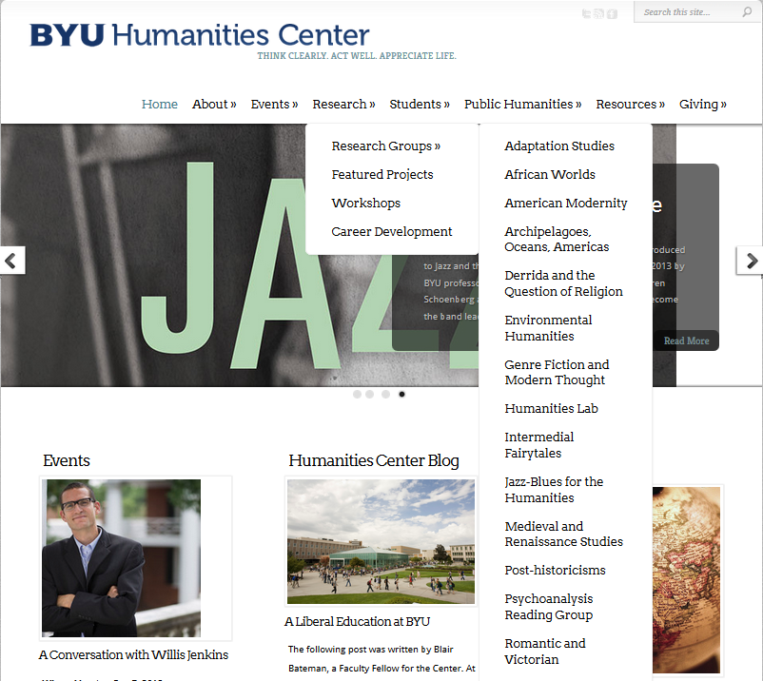
Research Resources in Humanities
http://humanitiescenter.byu.edu/services/external-grants/
http://humanitiescenter.byu.edu/research/workshops/

Slide 85
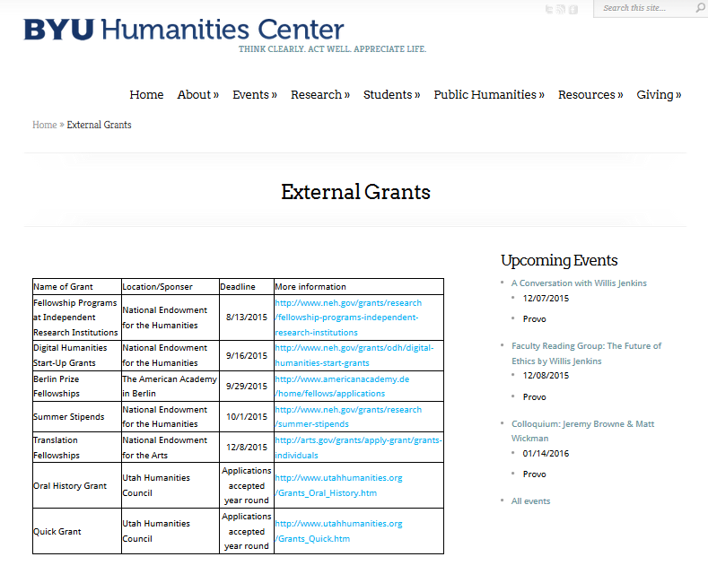
Research Resources in Humanities (cont.)
Grant proposal writing specialist – Jon Balzotti in the English Department,

Slide 86
Proposal Writing Sources
Robert Porter, What do Grant Reviewers Really Want, Journal of Research Administration, Vol. XXXVI, Issue 2, 2005.
Robert Porter, Coaching Researchers to Write Successful Grants, National Organization of Research Development Professionals (NORDP), May, 2013 conference. Really Want and
Morgan Giddings, Four Steps to Funding, How To Avoid Rejection and Get Your Proposal Funded on Your Next Try, 2012
Jeremy and Lynn Miner, A Guide to Proposal Planning and Writing
Grant Writing Institute
CapturePlanning.com
ORCA proposal writing guides and proposal forms
Instructional materials prepared by the National Council of University Research Administrators and the Society for Research Administrators, July 1995 (see facstaff.gpc.edu/~ebrown/infobr3.htm Georgia Perimeter College)
Tips and Practical Guidelines for Proposal Writers prepared by an NSF panel
NSF Panel on TUES proposal preparation
NSF Proposal Writing Exercises
The Grant Center, UNC. http://writingcenter.unc.edu/handouts/grant-proposals-or-give-me-the-money/
*A Guide to Proposal Planning and Writing by Jeremy T. Miner and Lynn E. Miner

Slide 87
Additional Resources
Online
  Research Development website http://researchdevelopment.byu.edu/
  ORCA website http://orca.byu.edu/
  Faculty Center website http://facultycenter.byu.edu/node?destination=node
Human Resources
  STEM and FHSS Research Development
  ORCA
  Faculty Center
  Experienced faculty with success at proposal writing
  LDS-P
  BYU workshops
  Off campus workshops
Hardcopy
  Research Development Group loanable guides for NIH, NSF proposals
HBL Library

Slide 88
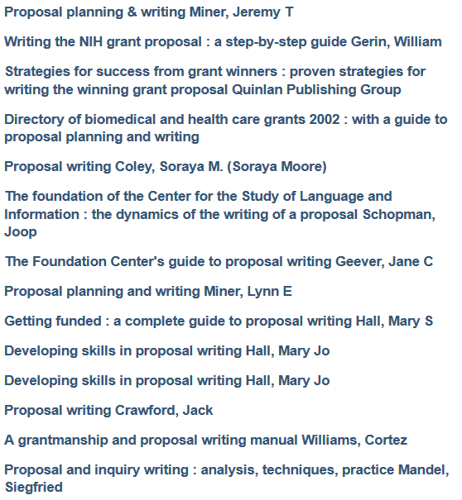
Sampling of Proposal Writing Books at the HBLL

Slide 89
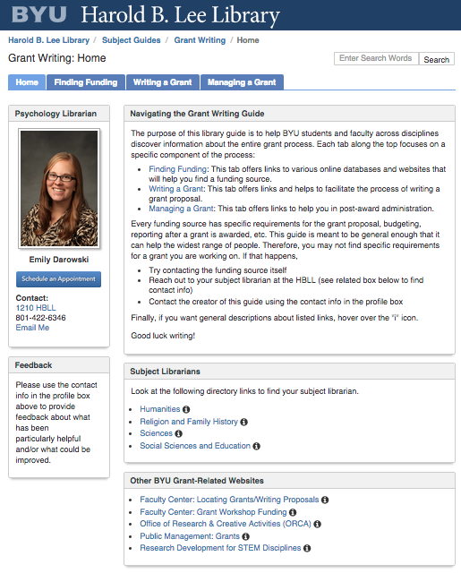
Additional Library Support

