Slide 1
Grant Proposal Development Workshop
Day 2
December 16, 2016

Slide 2
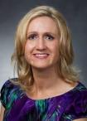
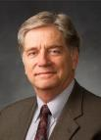
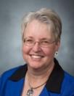
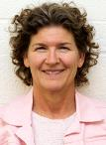
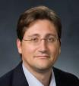
Research Development Support
Kristen Clarke Kellems
FHSS Research Development
934 SWKT
Tel: 801-422-8967
Email: fhssresdev@byu.edu
Conrad Monson
STEM Research
Development
275 McDonald Building
Tel: 801-422-7722
Email: conrad_monson@byu.edu
Jaynie Mitchell
MSE Research Development
306C MCKB
Tel: 801-422-3067
Email: Jaynie@byu.edu
Sarah Dorff
Research Development Administrator
269 McDonald Building
Tel: 801-422-0132
Email: resdev@byu.edu
Jon Balzotti
English Department Faculty
College of Humanities
4127 JFSB
Tel: (801) 422-2440
jonathan_balzotti@byu.edu

Slide 3
Agenda
Day 2, December 16th
Recap of Day 1 (Kristen)
Group Review Needs Statements (Kristen)
Review Discussion (Kristen)
Themes (Conrad)
10:30 Break
Methodology and Qualifications (Kristen)
Benefits and Budget(Conrad)
Editing and Rewriting (Kristen)
Review Process (video) (Conrad)
12:00-12:30 Lunch
Aesthetics and Marketing (Conrad)
ORCA (Debbie Silversmith)
Wrap Up (Kristen)

Slide 4
Recap Day 1
Creating a Fundable Idea
Finding Funding
Role of LDS-P
Prewriting
Writing a Persuasive Needs Statement
Proposal Elements
Titles and Abstracts
Faculty Panel and Q&A

Slide 5
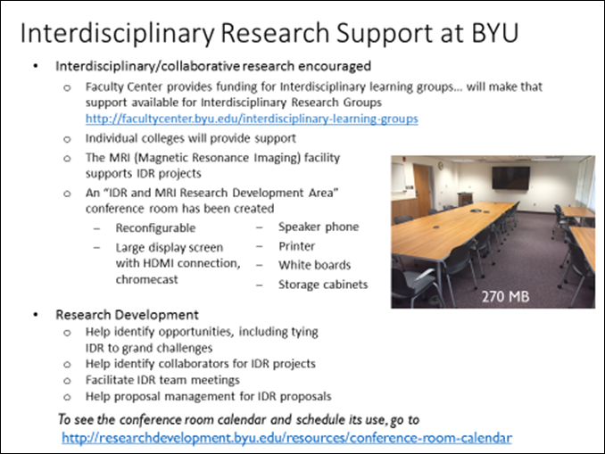

Teaming
Research Development facilitates teaming, including collaborative research discussions, proposal development, proposal reviews, research networking
Facilitate Research Topic Discussions
  FEWS (Food, Energy, Water System)
  Brain
  Diabetes
  Dementia
Facilitate proposal reviews by peers
  Ongoing NIH Specific Aims review run by Bill Pitt in Chemical Engineering
  Hosted NSF Summary reviews
  Support MMBio team proposal reviews
Sponsor Annual Research (Speed) Networking Event
      About 30 faculty present research
      to each other and to 30-40 other faculty
      Learn about campus-wide research; develop collaboration opportunities
  Big Data
  Smart Cane for the Blind
  Arctic Research
Conference Room for Collaborative and Interdisciplinary Research Development

Slide 6
Needs Statement Review Groups

Slide 7
Proposal Themes
The
Highlighted Essential
Messages that
Express the character of your
Story
Themes Are . . .
Developed from the RFP decomposition and from your needs statement
  Address the funders “hot buttons” (e.g., Most Important Requirements)
  Address evaluation criteria
A“…system of threads that weave, communicate, and align your messages with the funder’s desires…” throughout the proposal
What are the themes we have tried to emphasize in our workshop?

Slide 8
Themes from the RFP Example
FEWS Team
Key Requirements
World renown team developing
water resource monitoring and management software – World Wide Water
Potential international partners
Experts in identifying pollutants from water runoff
Behavioral scientists who study water management policy at local levels
A geographic location that includes water resource management challenges, that could be a study area
FEWS system includes physical, natural, biological, social/ behavioral, cyber elements
Availability of Nitrogen, Phosphorus, Water is critical
Themes
We have the best qualified team with a unique approach that addresses all the FEWS system elements
No one else has our tools or the capabilities to integrate all of the FEWS elements into a cost-effective, field-deployable system
Our system is low risk - world wide water software system is in use today; we are experts in Ni, Ph, Water availability; we have developed the sensors; we have experience in integrating software and hardware elements into a viable system
Topic 2 most relevant – develop new, field-deployable sensing modalities

Slide 9
Developing the Proposal Elements

Slide 10


Proposal Elements are Created From the Needs Statement
The Needs Statement thoroughly develops and describes the problem you are addressing including context and justification … develops the Situation Slot, S₁
Describes Methods at a high level; informs Qualifications and Benefits
Provides the basis for the Budget you need
Needs Statement Components
1. Story (Problem)/S₁
2. Plan for solving (Problem)/S₁
3. Request for support
The 6 Generic Proposal Slots (tied to baseline logic)
Achieved Objective(s)
S
Methods
2
S
Situation
1
B
Qualifications
Benefits
Budget

Slide 11
Methods and Qualifications
Situation: This is our understanding of the problem.
Objectives: Given that problem, these are our objectives for solving (or realizing) it.
Methods: Given those objectives, these are the methods we will use to achieve them.
Qualifications: Given those methods, these are our qualifications for performing them.
Budget: Given those qualifications and methods, this is how much the project will cost.
Benefits: Given our efforts and funders support, these are the benefits or value you will receive.

Slide 12
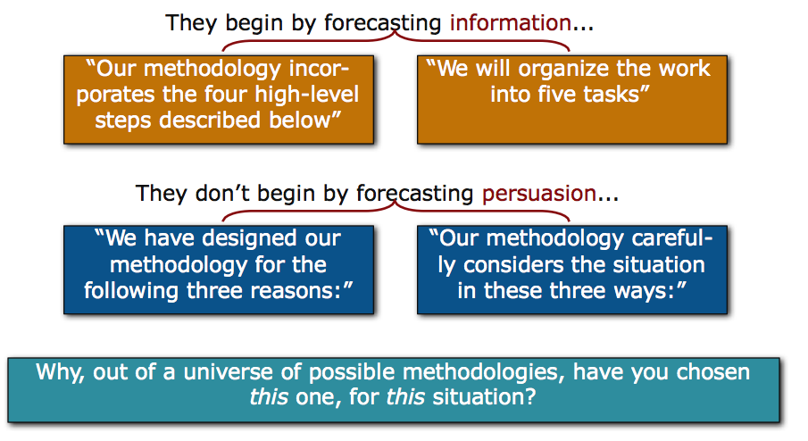
Methods
Lacking persuasion, methods sections often begin by first explaining “How” rather than “Why”

Slide 13
Methods
Evaluation
Broad statement about what you hope to accomplish
Goal
Objective
Objective
Objective
Measurable result directly traceable to one or more goals
Tasks
Tasks
Tasks
What you will do to meet the objectives
Outcome
Outcome
Outcome
What result do you expect
Evaluation and Evaluators

Slide 14
Methods Example¹
(Revolutionary) Relationship Building Dinner Party
10 Important Guests Attend
Dirt-free House
Three Course Dinner
Task 3. Provide Meal 3a. Create menu
3b. Review recipes
3c. Buy food
3d. Cook food
3e. Serve meal
3f. Clean up
Task 1. Invite Guests
1a. Identify 12 Guests
1b. Identify email addresses
1c. Send invitations
Task 2. Clean House
2a. Dust
2b. Vacuum
2c. Polish Floors
2d. Clean Toilets
100% dirt free
80% will attend
100% compliments
Strengthened Relationships¹
¹How to get tenure if you are an English professor

Slide 15
Exercise: Draft a methods description that addresses “Why” not just “How”

Slide 16
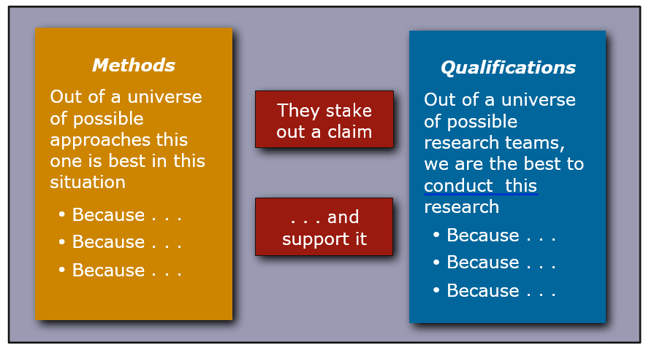
Methods Lead to Qualifications

Slide 17
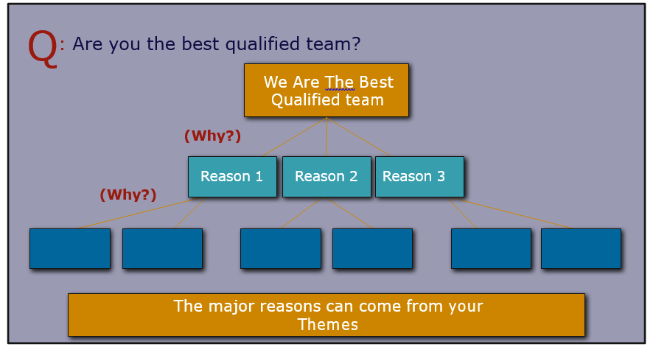
The Qualifications Provides Reasons for “Why Us”

Slide 18
Budget and Benefits
Situation: This is our understanding of the problem.
Objectives: Given that problem, these are our objectives for solving (or realizing) it.
Methods: Given those objectives, these are the methods we will use to achieve them.
Qualifications: Given those methods, these are our qualifications for performing them.
Budget: Given those qualifications and methods, this is how much the project will cost.
Benefits: Given our efforts and funders support, these are the benefits or value you will receive.

Slide 19
Budget
Credible, consistent with the scope of the project
Each item clearly explained and justified
Address prior funding when appropriate (emphasize the outcomes)
A good industry tool for developing a budget is to create a Work Breakdown Structure (WBS)
  Describe work in tasks and subtasks at several different levels of detail and then put into the budget a rolled up version at a higher level
Project Name
Task 1
Subtask 1.1
Subtask 1.2
Workpackage 1
Subtask 1.3
Subtask 2.1
Task 2
Workpackage 2
Subtask 2.2

Slide 20

Dinner Party WBS
Project
Relationship Building Dinner Party
Task 3
Provide Dinner
Subtask 3a
Create menu
Subtask 3b
Get recipes
Subtask 3c
Buy food
Subtask 3c
Cook food
Subtask 3d
Serve meal
Subtask 3e
Clean up
Work Package for Task 3
Develop menu: 1 hr
Review cook books and find recipes: 2 hrs
Travel to 3 stores to purchase food: 6 hrs
Prepare salad: 1 hr
Cook main course: 5 hrs
Cook dessert: 3 hrs
Serve food: 2 hr
Clean up: 4 hrs
Total Hours: 24 hrs
Cost:
Food: Vegetables = $30
Meat = $60
Cake Ingredients = $20
Labor: 12 hrs Cook at $50/hr = $600
12 hrs Asst Cook $10/hr = $120
Total = $720
Justification: Past experience cooking dinner

Slide 21
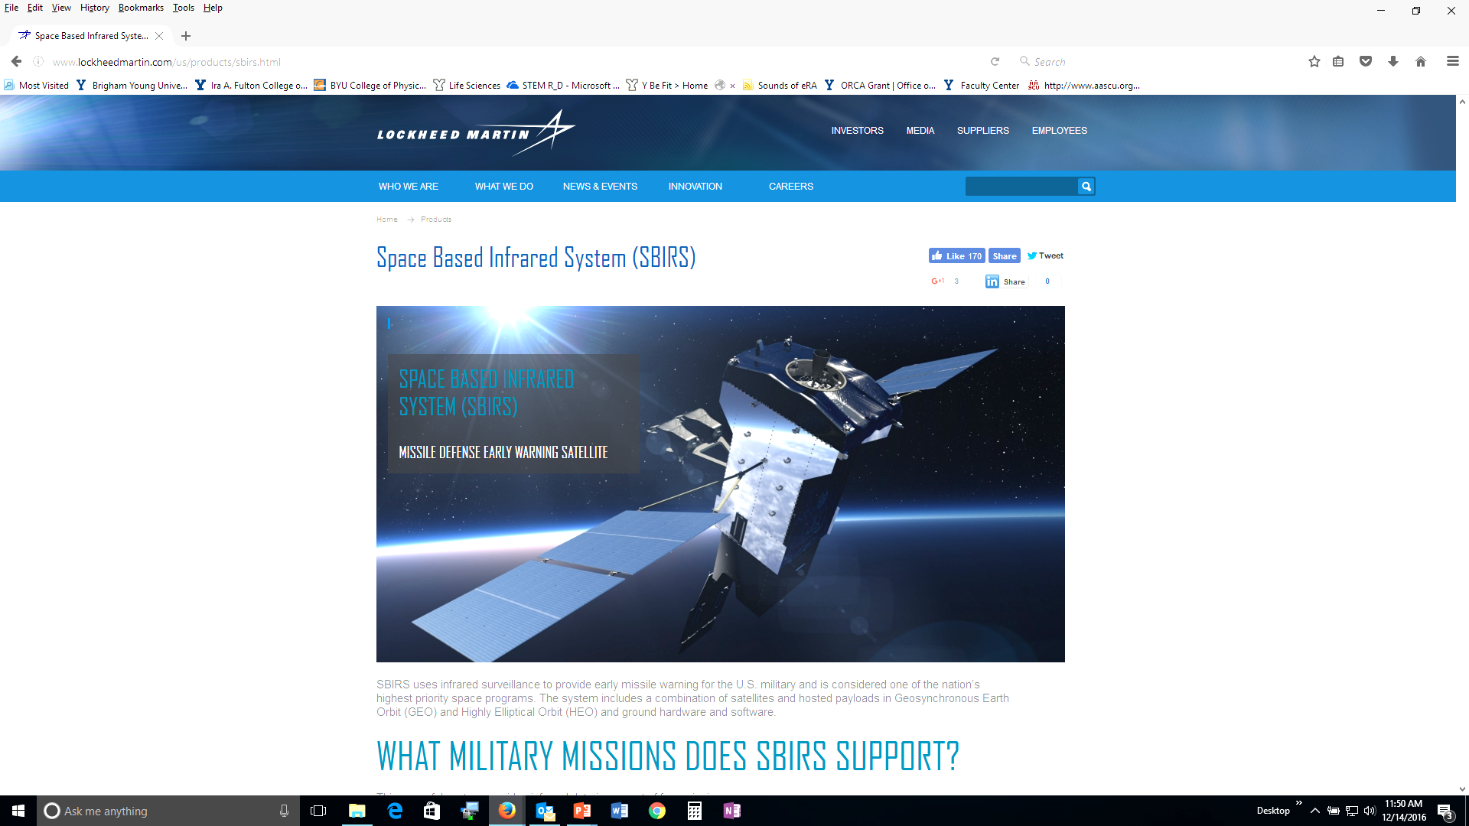
Space-based Infrared Satellite System
Ground Station WBS
Project
Develop Human-Computer Interfaces for new SBIRS ground station operators
Task 1
Design displays for the A Operator
Subtask 1a
Identify operator tasks
Subtask 1b
Prototype static displays
Subtask 1c
Conduct operator evaluations
Subtask 1c
Develop report
Subtask 1d
Design review
Work Package for Task 1
Review ops manual and mil standards 1472C, 46855B; 12 hrs
Interview 3 “A” operators; 12 hrs
Statically prototype 1 main display, 5 subdisplays; 40 hrs
Conduct operator evaluations; 16 hrs
Prepare evaluation report; 40 hrs
Support design review; 40 hrs
Total Hours: 160
Cost: 80 hrs E1 at $150/hr = $12,000
80 hrs E4 at $165/hr = $13,200 Total = $25,400
Justification: Computer display development from previous SBIRS program; engineering judgement; need for experienced E4 to supervise E1
For Proposal
Task 1 – 160 hrs for new engineer (E1) and more experienced engineer (E4) to prototype static displays, perform evaluations and report results

Slide 22
Benefits
In the baseline logic (captured in the Needs Statement) which expresses a “value proposition”
S₁ S₂ B
In the Abstract. Introduction/ Background section or other funder-specified sections (e.g., Summary, Justification, Benefits)
To answer these challenges, we have designed an approach to meeting [[objectives]]. As a result of achieving these objectives, there will be [[benefits]]
Content from the Benefits Slot exists throughout the proposal
  Benefit(s) should be one of your themes
Address the different types of benefits
  Immediate, a direct result of your research
  Long-term, how your research moves your field forward
Remember… the benefits address the funders needs and mission

Slide 23
Editing and Rewriting

Slide 24
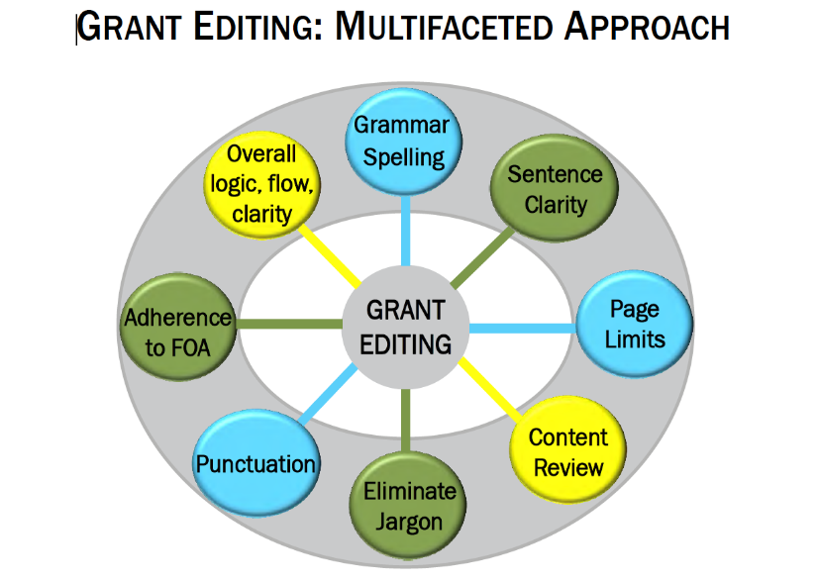
Editing and Rewriting

Slide 25
Project Summary #1: The Basketball Project at the Meridian Mews Center
We are really excited about the Basketball Project for 25 boys ages 13 to 16 who live in North Meridian Mews. The program will be sponsored by our organization, the Meridian Mews Center. This Center’s neighborhood is downtown Metro City, Indiana. The kids who will take part in the project are badly behaved and have acted out in school. Well-qualified instructors will teach the kids basketball skills and also how to dress for success. They will receive different types of counseling also and gift certificates from Ace Sport Supplies will be given out to the kids on the winning team in the basketball competition.
The Basketball Project will take place after school and on weekends and the boys will behave better as a result of being in the program. The Basketball Project will run from September 1, 2016 to June 30, 2017, and activities will be held at the Meridian Mews Center and the YMCA. We are asking for $10,000 to help cover the expenses for this excellent program that we’re running with the help of Meridian University and the YMCA.
There are many staff members who will make sure the kids get solid instruction. We are hoping that the kids who join our project will stay in school longer and behave much better. They will probably enjoy the trips we’ll take to basketball games and we’re looking forward to having guest speakers.
From “The Only Grant Writing Book You’ll Ever Need” by Ellen Karsh and Arlen Sue Fox

Slide 26
From “The Only Grant Writing Book You’ll Ever Need” by Ellen Karsh and Arlen Sue Fox
Editing and Rewriting
Do
Write as you should speak
Present strong credentials, facts, and statistics
Use a grammar book, thesaurus, and dictionary
Don’t
Use slang or imprecise or insensitive language
Don’t exaggerate
Include value judgments, political views, or a sense of humor
Use too many adjectives
Use too many abbreviations or acronyms
Use the active voice
Back up your claims

Slide 27
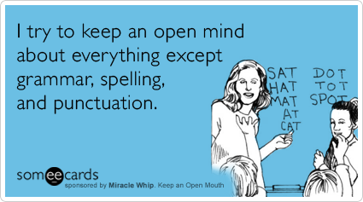
Do: Use a grammar book, thesaurus, and dictionary
Grammar tips
  Common style guides: Chicago Manual of Style; MLA Style Manual and Guide to Scholarly Publishing; Scientific Style and Format: CBE Manual
Punctuation tips
  Punctuation helps to reveal the structure of a sentence (structural meaning), and thus to clarify meaning (rhetorical meaning).
Spelling Tips
  When in doubt, use a dictionary
  Remember that spellcheckers:
    Do not distinguish between homophones (principal and principle).
    Do not account for spellings determined by usage (resume and résumé).
    May allow variant spellings (catalog and catalogue) in the same document.
    Do not highlight a misspelled word if the misspelling is itself a word (from and form).

Slide 28
Do: Use the Active Voice
In grant proposals, the active voice keeps you honest and clear. Which statement in each pair is more straightforward and gives the most detailed information?
  Students will be recruited to participate in the Meridian Mews Center’s Activities.
  The Meridian Mews Center’s outreach workers will recruit children to participate in the Center’s Activities.
Change these sentences to active voice:
  The creation of a database is being considered, but no estimate has been made in regard to the potential of its usefulness.
  Revised: We are considering whether we should create a database, but we have not yet evaluated how useful it would be.
Look at your needs statements. Are there sentences where the passive voice should be revised?

Slide 29
Do: Provide Old Information Before New Information
Principle of Cohesion: Old to New
  Begin sentences with information familiar to your readers.
  End sentences with information readers cannot anticipate.
  Example: Center staff will recruit 25 boys between the ages of 13 and 16 who live in the North Meridian Mews neighborhood of downtown Metro City, Indiana. The recruited teens–identified by families, teachers, counselors, and others–will have demonstrated acting-out and behavior problems.
  Writers often refer to something in a previous sentence with words such as this, these, that, those, another, such, second, or more. When you use any of those signals, try to put them at or close to the beginning of the sentence:
      How to calculate credits for classes taken in a community college is another issue that we must consider.
      Another issue that we must consider is how to calculate credits for classes taken in a community college.

Slide 30
Do: End Your Sentences and Paragraphs With Emphasis
We call the most emphatic part of a sentence STRESS.
If you end a sentence on words that carry little meaning, your sentence will seem to end weakly. Compare these sentences:
  They will receive different types of counseling also and gift certificates from Ace Sport Supplies will be given out to the kids on the winning team in the basketball competition.
  Activities will include basketball instruction; team competition; dress-for-success lessons by the coaching staff and trips to professional and college basketball games. Participants will also be offered one-on-one counseling sessions with a licensed therapist.
Just as we look at the first few words of a sentence for point of view, we look to the last few words for emphasis. You can revise a sentence to emphasize particular words that you want readers to hear stressed and thereby note as particularly significant.

Slide 31
Do: Be Concise
Principle 1: Delete meaningless words
    kind of virtually actually
    individual particular basically
    really generally certain
    given various practically
Principle 2: Delete words that repeat the meaning of other words
full and complete true and accurate
hopes and desires each and every
first and foremost hope and trust
Principle 3: Delete words implied by other words
serious crisis untimely death
terrible tragedy future plans
important essentials true facts
final outcome advance planning

Slide 32
Do: Be Concise (cont)
Principle 4: Replace a phrase with a word
  Instead of— Try—
    in close proximity near, nearby, close
    is cognizant of is aware of, knows
    in conjunction with with
    are desirous of want
Principle 5: Change negatives to affirmatives
  not different similar
    not the same different
    not allow prevent
    not notice overlook
Principle 6: Delete useless adjectives and adverbs
  Many writers can’t resist adding useless adjectives and adverbs. Try deleting every adverb and every adjective before a noun, then restore only those that readers need to understand the passage.

Slide 33
Don’t: Use too many adjectives or adverbs
When too many adjectives are tacked on to a noun, verb, or phrase, the reader is likely to see them as just the opinion of the proposal writer rather than documented facts. How do these two sentences differ:
  The Meridian Mews Center runs high-quality, exhilarating, well-regarded programs for poor, disadvantaged, disabled children.
  The Meridian Mews Center runs four programs that have been cited for excellence by the National After-School and Weekend Program Society. Attendance at all four programs is over 90 percent. During the last year, parents have written more than 50 letters to the executive director praising the programs.
The first statement is just…words. It doesn’t say anything that has meaning.

Slide 34
Don’t: Use Acronyms or Abbreviations
Compare these two sentences:
  The Department of Health (DOH) has a staff of 450 physicians, nurses, and nonmedical personnel. Starting on January 4, 2016, DOH will begin offering free tuberculosis screening for children at the Meridian Mews Center.
  The Meridian Mew Center has collaborated for the last eight years with professors from the PE Department at MU. DOH has a branch at MU and also works closely with the IT Department and the local Y.
Rule: The term represented by an acronym should be spelled out over and over—unless you have just explained it in the same paragraph (or within a couple of paragraphs).

Slide 35
Do: Back up your claims
Unproved, unexplained statements thrown into a proposal hurt your credibility with grant reviewers. Compare these two statements:
  Everyone in the community thinks the Meridian Mews Center runs educational and enjoyable programs.
  According to surveys that were conducted in two community churches and two schools, 60 percent of residents of Meridian Hills Mews think the programs offered at the Meridian Mews Center are educational and enjoyable
  The police are excited about the Meridian Mews Center’s activities.
  According to interviews with police officers in the Meridian Mews precinct conducted by program staff, 20 of the 25 officers questioned feel that the Center’s programs encourage children to stay out of trouble.
Offer proof for your proclamations.

Slide 36
Project Summary #2: The Basketball Project at the Meridian Mews Center
The Meridian Mews Center is requesting $10,000 for a basketball and mentoring project designed to engage troubled youth and lead to their improved behavior in and out of school. Center staff will recruit 25 boys between the ages of 13 and 16 who live in the North Meridian Mews neighborhood of downtown Metro City, Indiana. The recruited teens–identified by families, teachers, counselors, and others–will have demonstrated acting-out and behavior problems.
The overall goal is to increase the likelihood that the teenagers who participate in the activities will stay in school longer and become productive members of the North Meridian Mews community.
Specific objectives include improved basketball skills and teamwork, and knowledge of how to create a positive appearance through dress; these skills in turn will improve self-esteem and reduce acting-out behavior.
Activities will include basketball instruction; team competition; dress-for-success lessons by the coaching staff and trips to professional and college basketball games. Participants will also be offered one-on-one counseling sessions with a licensed therapist. The program will operate twice a week after school from September 1, 2016 to June 30, 2017. Activities will be held at the Meridian Mews Center, Meridian University, and the YMCA. Staff will include basketball coaches, a psychologist from Meridian University, and a social worker and recreation specialist from the Meridian Mews Center.

Slide 37
Write for Reviewers

Slide 38
Write for Reviewers
You Should
Pay attention to all the review criteria
Assume an uninformed but intelligent reviewer
Avoid insider jargon and acronyms
Consider the challenges facing reviewers
  Many proposals to review
  Limited Time for your proposal
  Different experiences in review process, veterans to novices
  Different levels of knowledge in proposal area
  With many proposals to review, looking for reasons to reject proposals
Your Proposal Must
Support each reading style; reviewers will use them all (skim, search, critical)
Get reviewers excited and interested starting from the title and first page
Make them an advocate for your proposal to their colleagues … likely only one will review the proposal all the way through
Excite, not bore, confuse or anger reviewers… negative emotions are the kiss of death

Slide 39
When Your Proposal Is Rejected
Every successful proposal writer has been rejected
  Re-submission success rates are relatively high (up to 50% for 2nd and 75% for 3rd time submission to some NSF directorates)
Clearly understand reasons for rejection (may need Program Officer clarification)
  NIH study of 609 reject proposals shows most common reasons for rejection
    Approach - 73%
    Problem - 58%
    Investigator - 55%
Can you address each reviewers comments with new, relevant information (and without being hostile)?
Will your revised proposal address every requirement, be more understandable and more compelling?
If revisions are too extensive, you should submit a new proposal
  NIH carefully monitors new applications to be sure they are not rejected proposals that have just been re-titled
Adapted from NIH RO1 Grant Application Mentor from the Principal Investigators Association

Slide 40
Summary
Take a break between editing and writing; edit first for spelling, punctuation, and grammar then for content
  Use dictionaries, style manuals
When editing for content: be clear and graceful
  Use active voice
  Use old to new transitions
  Place emphasis in the correct place
  Tie all the sentences in a passage together
  Delete meaningless and repetitive words
Write for reviewers
  Pay attention to all the review criteria
  Assume an uninformed but intelligent reviewer
  Avoid insider jargon and acronyms
  Get reviewers excited and interested starting from the title and first page
  Make reviewers advocate for your proposal to their colleagues
Remember that every successful proposal writer has been rejected
  Keep trying: revise and resubmit or write a new proposal

Slide 41
Aesthetics and Marketing

Slide 42
Proposal Aesthetics
The proposal must be aesthetically appealing
“Just as clothing is important in the business world for establishing initial impressions, so, too, is the appearance of your proposal as it reaches the reviewer's hands. The proposal should ‘look’ familiar to the reader. A familiar proposal is a friendly proposal (Jeremy and Lynn Miner).”
If allowed, match the funder’s publications style (same type size, style, layout, and headings as they do in their publications) …. Your proposal will look more credible and familiar
Use white spaces for visual relief and to frame the text (don’t go overboard)
The proposal should support all types of reading (skim, search, critical)

Slide 43
Proposal Aesthetics (cont.)
Use at least a 12-point Type Size (smaller is difficult to read)… make ideas fit by tightening sentences, editing wordy phrases etc. not by changing font size
Unless otherwise specified, uses Serif typefaces for text and Sans Serif typefaces for titles and headings. Serif type easier to read; sans serif makes titles and headings stand apart from the text
Use Bold Type to emphasize key words and ideas; avoid overemphasis
If allowed, format with Ragged Right Margins; makes reading easier because it is easier for your eye to track from one line to the next
Notes:
Bold Type easier to read than underlining, italics, or all capital letters as a means of creating emphasis. Use bold type to emphasize key words and ideas, but avoid overemphasis.
Lists. Lists help to get the message to the reader with a sense of immediacy, without being wordy. Furthermore, because lists are easy for readers to skim, they convey chunks of information quickly
Ragged Right Margins. A ragged right margin is easier to read than one that is right justified because the proportional spacing slows readability. It is easier for the reader's eye to track from
the end of one line to the beginning of the next line when the right-hand margins are jagged.
Type Size. Adjust your word processing program for a 12-point type style. Text smaller than 12-point becomes difficult to read and makes the reviewer’s job harder. Rather than reducing
type size to make all your ideas fit on the page, try tightening sentences and editing wordy phrases.
Type Style. If a type style is not specified in the application guidelines, consider using serif typefaces for the text of your proposal and sans serif typefaces for titles and headings. Serif type styles such as Times Roman and Courier have small strokes that finish off the main stroke of a letter and make it easier to read. Sans serif type styles such as Universal and Arial, which do not have the small finishing strokes, are ideal for titles and headings because they stand off from the body of the text. Avoid using ornate type styles, such as Cloister Black and Freestyle Script,which are hard to read and distract from the content of the proposal.
Adapted from A Guide to Proposal Planning and Writing by Jeremy T. Miner and Lynn E. Miner
Experts have suggested looking at Scientific American articles to get an idea of what in general a proposal should look like – don’t use the articles in the top, peer reviewed journals in your field as examples

Slide 44
Proposal Aesthetics (cont.)
Before creating figures and tables, put yourself in the position of the reader…what would you want to know?
Ask yourself
  What do you want to say and why does it matter?
  To whom do you want to say it?
  How do you say it?
Create figures and tables that are easy to read and that
  Support the narrative, help tell the story
  Summarizes technical details
  Support the different reading styles, particularly skimming
Create Lists to quickly provide the message, convey chunks of information
With lists, figures and tables, use level of detail appropriate for persuasion not for an expository peer reviewed journal article
Notes:
Experience with Paul Osterbeck – I was in charge of developing a proposal for researching options for a Multi Role Unmanned aircraft operating off of a variety of naval vessels. I was assigned a “master proposal writer” to help me. He spent more than half the proposal writing time doing very careful figures and tables that told the whole story of the proposal while I was freaking out because there was no writing to review for what I thought was too a period in the proposal writing schedule. His approach was successful for our proposal and for others he wrote.
Proposal figures and tables are not typically the same as manuscript figures and tables. Be aware of the differences – simple, make the point clearly, support skim reading, etc.

Slide 45
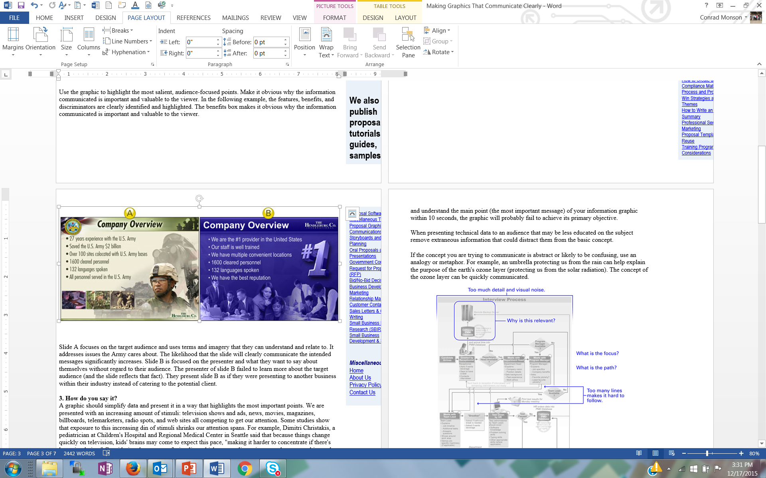
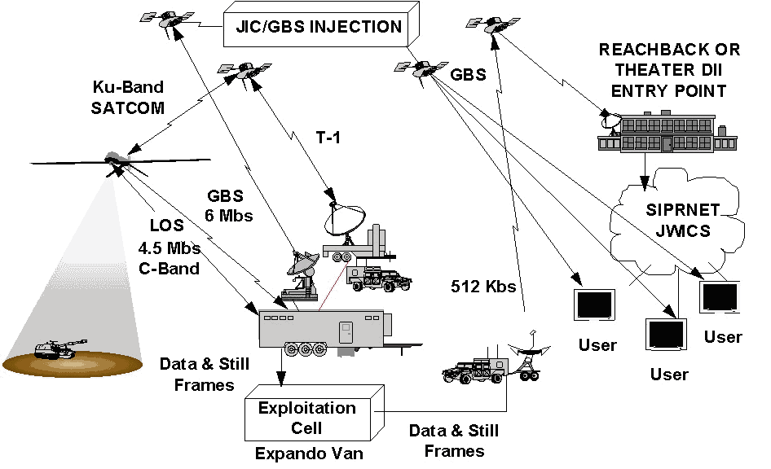
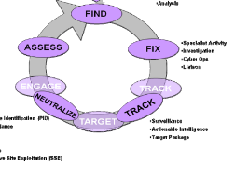
Figure Examples
Primary Intelligence Requirements
-Collection
-Analysis
-Specialist activity
-Investigation
-Cyber Ops
-Liaison
-Identification
-Surveillance
-Actionable intelligence
-Target package
Both of these figures are about a company proposing a project to the Army… which is more appealing to an Army proposal reviewer?
Both of these figures are about a C4ISR system… one is better for a technical report, the other for a proposal
Notes:
Experience with Paul Osterbeck – I was in charge of developing a proposal for researching options for a Multi Role Unmanned aircraft operating off of a variety of naval vessels. I was assigned a “master proposal writer” to help me. He spent more than half the proposal writing time doing very careful figures and tables that told the whole story of the proposal while I was freaking out because there was no writing to review for what I thought was too a period in the proposal writing schedule. His approach was successful for our proposal and for others he wrote.
Proposal figures and tables are not typically the same as manuscript figures and tables. Be aware of the differences – simple, make the point clearly, support skim reading, etc.

Slide 46
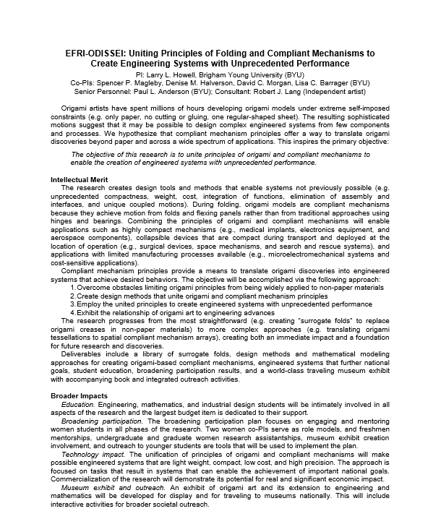
A Proposal Summary With Good Aesthetics

Slide 47
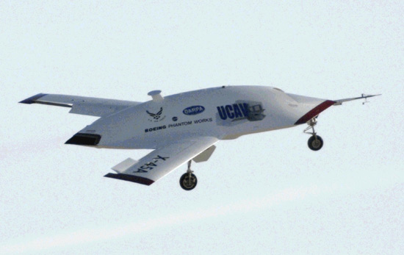
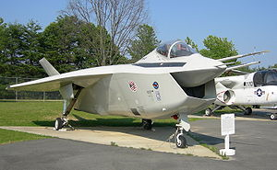
Marketing is Ongoing
Should begin with the first funding officer contacts well before a proposal is submitted
Treat customer contacts including white papers, LOIs, etc. as marketing opportunities
Writing should be clear and effective using a persuasive writing style
Make sure your title and abstract/summary standout
The best marketing creates an emotional response to your ideas and proposals… excitement, keen interest, compelling, “I’ve got to have it now” … not boredom, confusion, or even anger
Marketing doesn’t end with the proposal submittal
You could be contacting the funding officer for a re-submittal if your proposal is rejected and additional funds are available after an initial award
UCAV
UCAV
F-35
Notes:
“Marketing” should be done throughout your career… and the reality is that you are marketing yourself anyway all the time, whether you want to our not.
Think like a marketer and always see things from the customer’s point of view
“Marketers do one thing, and they do it very well. They see things from the prospect’s point of view. They lose their own ego, interests and desires, and they focus on the customer’s wants and desires (Morgan Giddings)”
A proposal is not about you or your needs, it is about the funder’s needs… you’re project should make the funder successful
You want an emotional response to your ideas from your potential funders… excitement, keen interest, compelling, “I’ve got to have it now” … not boredom, confusion, or even anger
Boeings UCAV contract with DARPA was an ~$150M competition with Northrop Grumman that was so close, Boeing won at least in part because the PM felt Boeing would do a better job - not on price, past performance, schedule … many of the elements that typically win a proposal. The emotional investment was so intense by Northrop Grumman, the customer told us during when NG was debriefed that was the first time in all his years of contracting, he had ever seen “grown men cry”.
Boeing management was so worried about the emotional response to its F-35 prototype – it looked so ugly, pilots might not want to fly it – that they hired high priced consultants to understand the emotional response to the aircraft and how to mitigate it.
Finally, marketing your ideas and proposal should be embedded in the complete proposal development process, from pre-proposal to proposal writing, described in the next sections.

Slide 48
Contacting Funding Officers
Do your homework – don’t ask questions that are answered in the RFP or other provided documents
Understand the mission and priorities of the funder
Be familiar with restrictions that might eliminate your organization
Know the minimum and maximum amounts typically awarded and the total amount of funding available
Review recent awards: what portion of the grants went to previous grantees
Write a short description of your project (white paper)
Email the description to the officer. Questions you could ask: What would you recommend to improve my chances for favorable review? What is anticipated success rate? What are some common reasons for proposal rejections? Listen carefully to read between the lines.
Follow up with a short thank you, summary of key points, cv with photo
Let the PO know you are willing to serve on a review panel
Adapted from Can We Talk? Contacting Grant Program Officers by Robert Porter, 2009

Slide 49
Video NIH Review Panel
https://www.youtube.com/watch?v=fBDxI6l4dOA&feature=youtu.be

Slide 50
Proposal Preparation and Submittal Process (ORCA)

Slide 51
ORCA
Gary Reynolds, Director
Law School / Library / Religion / Maxwell Institute / Fine Arts & Communication / Marriott School of Management
Gene Larson, Associate Director
Life Sciences / Nursing / Family Home & Social Sciences / Mentoring (ORCA and MEG grants) /
Institutional Animal Care and Use Committee (IACUC)
^{Sandee Aina,} ^{IRB Administrator}
Human Subjects Compliance Committee (IRB)
Debbie Silversmith, Research Administrator
Fulton School of Engineering & Technology
Marilyn Webb, Research Administrator
McKay School of Education / Humanities / Physical & Mathematical Sciences/ Bio Safety Committee (IBC)
Notes:
ORCA is here to protect you, your research, and BYU.
Each college is assigned to an administrator to work with their Grants and Contracts.
BYU receives around 30 Million in research awards each year. To date this year we are at….

Slide 52
How can ORCA help?
Proposal Approvals and Submission
Letters of Commitment / Certifications / Subrecipient Commitment Forms
Contract Negotiations
Non-disclosure Agreements / Confidentiality Agreements / Material Transfer Agreements
Misc. required forms (i.e. proof of insurance, worker’s comp, etc.)
Award Processing / Issuing Subcontracts
Contractual support throughout the life of an award
Notes:
We help you work through the BYU processes in addition to the sponsors’.
Contract Negotiations – Government contracts often include clauses that do not apply to universities or clauses we cannot agree to.
Industry Contracts – Often there are issues with Intellectual Property wording, ORCA is here to work those issues out for you.
Anything that binds the university, needs to be negotiated by ORCA. When collaborating with other institutions or discussing your research with industry sponsors, when the discussion turns to things like waived indirect costs or intellectual properties, or a gift vs sponsored research, it’s time to get ORCA in on the conversation.

Slide 53
Your Formula for Success:
Approved Declined
Write Proposal
Obtain University Approval (via ORCA)
Submit Proposal
Notes:
ORCA helps with the last two steps. Unfortunately we don’t have the man power to help write proposals, but if you have questions about the solicitation, we are happy to look at it.
I do skim all sections of each proposal and make suggested spelling or grammatical edits, or suggestions on formatting, if I happen to see anything that needs fixing. I typically spend the most time looking at the promised deliverables, how students will be utilized, the budget and budget justification.

Slide 54
University Approvals
All proposals should come through ORCA before submission because:
  Proposals commit the University
  Terms and conditions need review
  Cost sharing/matching needs approval
  Problems are much easier to fix at the proposal stage than after an award has been made
Notes:
Many agencies (NSF, NIH, DOE) require proposal submission through an institution’s sponsored projects office, which is ORCA. But some smaller government agencies, foundations or industry sponsors do not. For those, most often the PI simply emails the proposal. These all need approval before submission.
Pre-proposals do not need to come through ORCA, only when the full proposal (and budget) is requested.
Terms and Conditions - Sometimes an RFP includes the award terms and conditions and there is a statement like “if your proposal is awarded you agree to the following terms …” – So we are committed to those terms at the proposal stage.
Cost Sharing – we need to make sure that everyone is on board with what the University will be providing.
Problems – if there are problems, most often they are on the budget, but sometimes there are issues elsewhere.

Slide 55
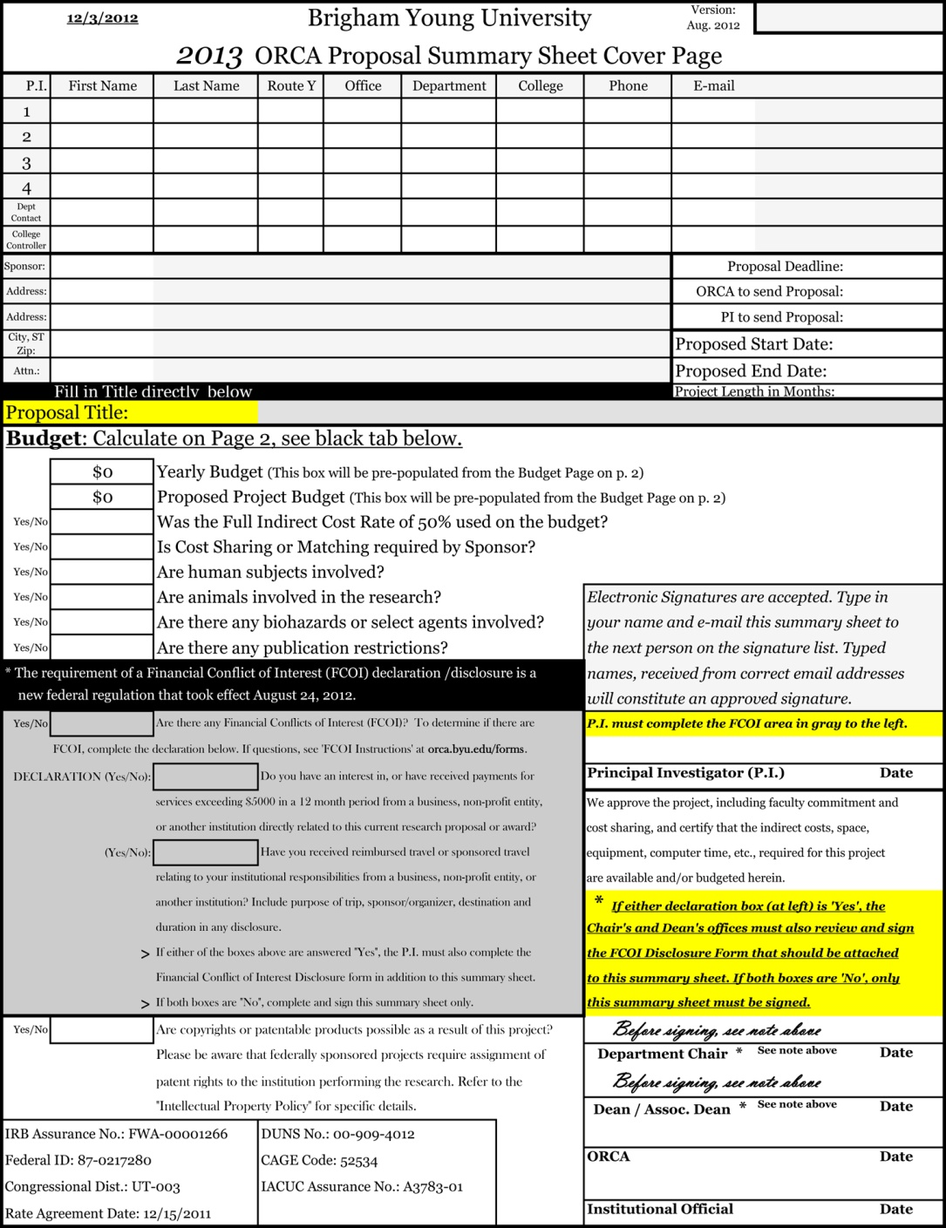
BYU Proposal
Summary Sheet
Notes:
PIs listed – all those that need to receive credit on the Funding Activity Report. Do not put PIs at other institutions.
Proposal Deadline – make sure the correct date is listed, this is what I use when prioritizing my workload and to make sure your proposal is submitted on time.
Indirect costs – current rate is 50% (lower rates are only allowed if sponsor has a policy that does not allow the full indirect costs, usually stated in the RFP/solicitation)
FCOI questions – Travel $ just from this sponsor

Slide 56
F&A (Facilities and Administrative Costs/Indirect Costs)
Operations and Maintenance
Building and Equipment Depreciation
General Administration (HR, payroll)
Department Administration
Sponsored Projects Administration
Library
Student Services
Notes:
Recalculated every five years through a thorough review and audited every year by the Federal Government as part of the Uniform Guidence Annual Audit.
This covers costs borne by the University that cannot be itemized as a direct cost can be. This includes utilities, building, Payroll/Accounting and Administrative services, etc.

Slide 57
Matching / Cost Sharing
Only include if required by sponsor
If we propose it, we are obligated to track it, and usually report it.

Slide 58
ORCA Resources
ORCA Website: www.orca.byu.edu
Sponsored Research Handbook
Proposal Templates/Examples (i.e. Data Management Plan)
Funding Opportunity Searches Available/Subscriptions
Sponsor registrations
Notes:
ORCA Website – Forms, Funding Opportunities
Sponsor Registrations – For anything where the University needs to be registered, ORCA takes care of that. With NIH and NSF individuals do need an account set up – contact ORCA to do that.

Slide 59
Deadlines
ORCA needs the signed summary sheet and proposal 3-5 days before the due date
  Administrator does review, suggests any changes, sends to Alan Harker for approval.
  ORCA or PI submits (depending on sponsor)
Notes:
Whether ORCA submits your proposal or not, we are here to help with all research proposals.

Slide 60
Compliance Committees
IBC – Institutional Biosafety Committee
IRB - Institutional Review Board for Human Subjects
IACUC - Institutional Animal Care and Use Committee
These are federally mandated committees and compliance is required for all research on campus, not just that with federal funding.
Approved protocols must be in place before research may begin.
External research funding will not be available to spend until an approved protocol is in place.

Slide 61
IBC
Research involving Recombinant DNA, Biological Toxins and Microorganisms
The committee meets quarterly. Turn applications in by the 20th of the previous month to get on the agenda.
Approved applications are good for 3 years. You will be contacted about renewal.

Slide 62
IRB
Full Board Meetings held monthly – submit application by the 20th of the previous month to make sure your research gets on the agenda (if full board is needed)
Electronic copy from faculty’s email address, hard copy from students
Collaborative IRB Training Initiative (CITI) is required for all researchers and research personnel – at time of application
Please contact the IRB to come present at your classes or faculty meetings - IRB.byu.edu

Slide 63
IACUC
All research involving live animals must be approved by the IACUC Electronic copy from faculty’s email address, hard copy from students
Meetings are held monthly. Protocol Applications must be submitted by the 10th of the month to be on the agenda for the next meeting, held the first week of the following month.
iacuc-secretary@byu.edu, 422-3022

Slide 64
Contact ORCA early and often!
Questions?

Slide 65
Submission Demonstration

Slide 66
Wrap Up
Good Ideas
Fundable Idea
Find Funder(s)
Pre-Proposal
Write the Proposal
Revise
Marketing
Rejected
Accepted AND Funded
Funder
Drafts
Submit (ORCA)
Peer Review
Edit
Research Development has tools and resources to help with most of the steps in this process

Slide 67
Final Thoughts on Proposal Writing
Winning proposals have been polished repeatedly through writing and re-writing
  “Competitive ideas evolve and converge over time; they do not appear fully and perfectly formed by a narrative Genie (Cronan and Deckard, New Faculty Guide to Competing for Research Funding)”
Fight “Pride of Authorship”
Sell but don’t over promote your ideas
Get reviewers and proofreaders (with no stake in project?)
Allow time

Slide 68
Upcoming Events
  January 26th, Carter Cornwall/NIH Funding Seminar; 12:00-1:00 p.m. 270 MB; one-on-ones afterwards
  February 9th, Department of Defense Funding Seminar (tentative Ivy Estabrooke); 12:00-1:00 p.m.
  February 14th, 21st, and 28th Graduate Student Proposal Development Series; 12-1
  February 16th, Graduate Student Pivot Training
  March 9th, Faculty Pivot/FDO Training
  March 16th, International Funding Seminar; 12:00-1:00 p.m. 270 MB
  March 23rd, Fulbright Scholar and Fulbright Student Presentations from CIS staff
  April 20th, NSF Funding Seminar 12:00-1:00 p.m.
  May 15th-18th, Spring Bootcamp; 9-2 in 270 MB
  Late August, Research Networking

