Slide 1
Grant Proposal Development Workshop Day 1
December 12, 2018

Slide 2
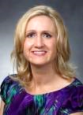
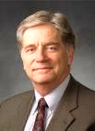
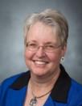
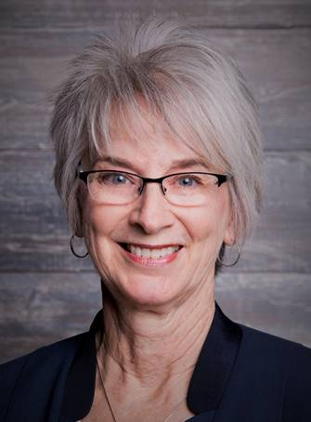
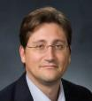
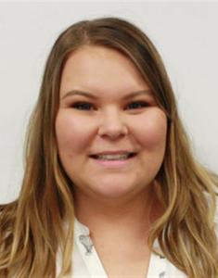
Research Development Support
Kristen Clarke Kellems
FHSS Research Development
934 SWKT
Tel: 801-422-8967
Email: fhssresdev@byu.edu
Conrad Monson
STEM Research Development
275 McDonald Building
Tel: 801-422-7722
Email: conrad_monson@byu.edu
Jaynie Mitchell
MSE Research Development
306C MCKB Tel: 801-422-3067
Email: Jaynie@byu.edu
Karen Hill
BYU Law Grants and Partnerships Manager 445 JRCB
Tel: 801-422-2684
Email: hillk@byu.edu
Jon Balzotti
English Department Faculty College of Humanities
4127 JFSB
Tel: (801) 422-2440
jonathan_balzotti@byu.edu
Kaylie Winterton
Research Development Administrator
269 McDonald Building
Tel: 801-422-0132
Email: rdadmin@byu.edu

Slide 3
Proposal Development Process
Good Ideas
Fundable Idea
Find Funder(s)
Pre-Proposal
Write the Proposal
Revise
Marketing
Rejected
Accepted AND Funded
Funder
Drafts
Submit (ORCA)
Peer Review
Edit
Research Development has tools and resources to help with the steps in this process

Slide 4
Agenda Day 1
Introduction/Research Funding Environment (Conrad)
Find Funding/IDR (Kristen, Jaynie)
Develop a Fundable Idea (Jaynie)
Break 10:15
Prewriting (Conrad)
Write a Persuasive Needs Statement (Kristen)
12:00-12:30 Lunch
Titles and Abstracts (Kristen)
Faculty Panel Discussion
Wrap up (Kristen)

Slide 5
Research Funding Environment

Slide 6
External Funding for University Research¹
In 2015, CPMS, FHSS, E&T, LS and MSE received 91% of BYU research funding; over 80% of that funding was from federal sources²
(Internal to a University)
¹NSF Higher Education R&D Survey. Data are the average of 2011, 2012, 2013
²ORCA Annual Report of Sponsored Research for 2015
Most of BYU research funding comes from federal sources

Slide 7
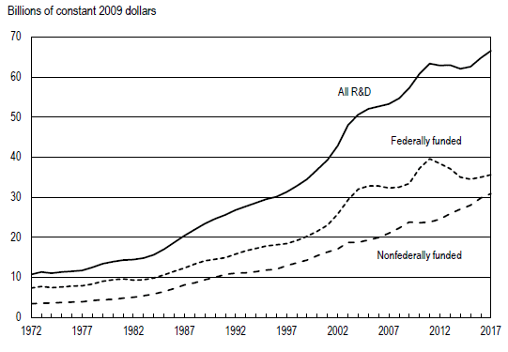
US R&D Funding For Academia
Higher education R&D expenditures, by source of funds: FYs 1972–2017
SOURCE: National Science Foundation, National Center for Science and Engineering Statistics, Higher Education Research and Development Survey.
Notes:
R&D Expenditures, by Source of Funding
When adjusted for inflation, federal funding for higher education R&D increased 1.7% between FY 2016 and FY 2017 (figure 1). Funding from nonfederal sources also increased from FY 2016, rising 3.7% in constant dollars. The overall share of higher education R&D supported by federal government funding in FY 2017 (53.5%) was nearly the same as in FY 2016 (54.0%) and the lowest share since the survey began in 1953. Federal funding in current dollars increased from $38.8 billion in FY 2016 to $40.3 billion in FY 2017.

Slide 8
Finding Funding

Slide 9
Dec 18th, 270 MB Information Seminar about 2019 IDR Origination Awards.

Slide 10
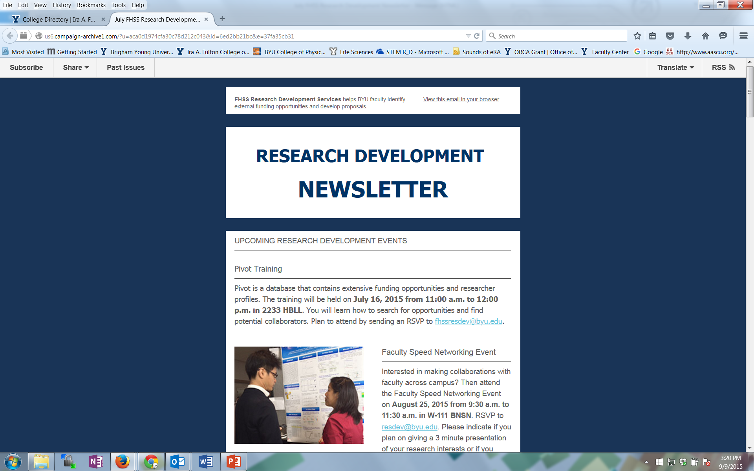
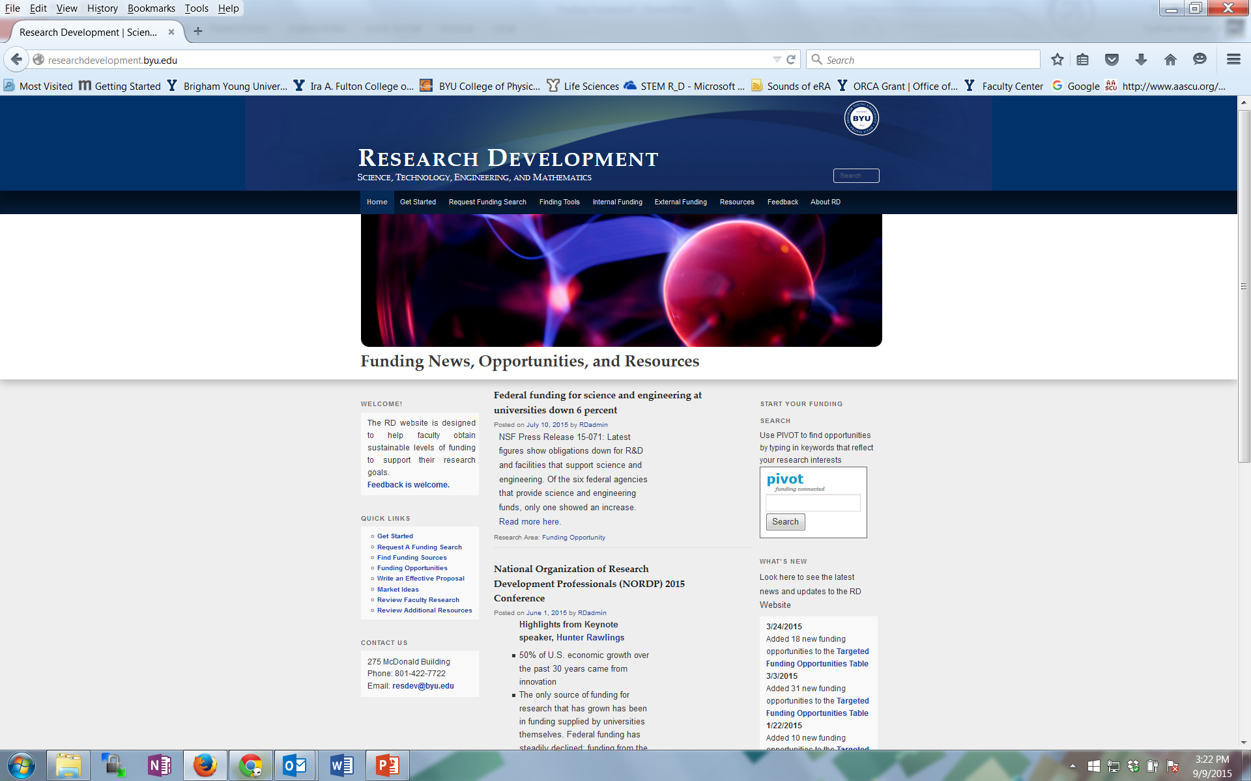
Research Development Support for Finding Funding and Writing Proposals
Newsletters from FHSS and STEM Research Development
Research Development website: researchdevelopment.byu.edu
Online funding searches
Conduct seminars about particular funders
Advocate research capabilities to funders
Attend funding conferences
Identify funding opportunity and help write the grant proposal

Slide 11
Team Exercise – Find Funding Opportunity
Objective – as a team, use Pivot to find and decompose a funding opportunity
Each teams has a set of tasks to complete; when you are finished, bring your answers to the “keeper of the box”
Notes:
Skills Participants will develop: Objectives [[suggest change this to objectives. I am not sure these “skills” will be all that impressive to faculty]]
Locate the Pivot search window at researchdevelopment.byu.edu
Perform a basic search for a specific topic
Identify where information is located on a funder’s website
Pull important details from the information
Search the website for prior funded projects or review process details

Slide 12
Develop a Fundable Idea

Slide 13
Fundable Ideas Start With Good Ideas
How do you develop good ideas?
Be knowledgeable, thoughtful, creative, open
And not just because we are at BYU…. be prayerful
Think in Question/Experiment/Hypothesis format
Keep an ongoing log of your ideas
Let the ideas incubate and try the process again
Seek constructive criticism of your idea
(Adapted from “Grantsmanship Workshop, How to Develop a Fundable Research Proposal” Tammy Bray, PhD, Dean, College of Health and Human Sciences Oregon State University)

Slide 14
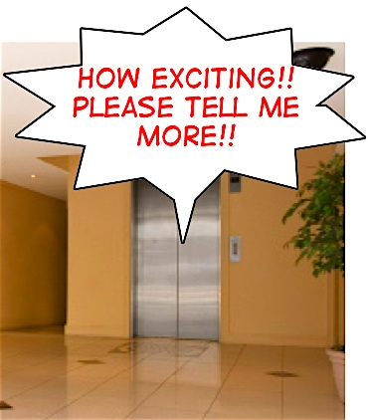
Exercise – Spend 5 minutes identifying your good idea and write it on a 3x5 card Divide into pairs and share
Notes:
Rework exercise into “Elevator Speech”

Slide 15


Convert a Good Idea Into a Fundable Idea
Identify a relatively under-explored niche
Search and critically analyze the pertinent literature
Develop a list of relevant key words and investigators
Assess your own ability to pursue the idea
Identify knowledge gaps
Determine granting agencies most appropriate to fund your idea
Those whose mission and funding priorities will be advanced by funding your idea
Seek constructive criticism of your idea from knowledgeable colleagues and the funder’s program officer

Slide 16
Prewriting

Slide 17
Prewriting Activities: Thoroughly Decompose the Solicitation*
Deadlines
Requirements, (technical, budget, management, “MIRs” or Most Important Requirements, etc.)
Proposal components
Unusual requirements
Procedures for submittal (aligned with BYU/ORCA procedures?)
Review Criteria
*Request for Proposal (RFP), Request for Application (RFA), Broad Agency Announcement (BAA), Funding Opportunity Announcement (FOA), also Program Description, Program Announcement, Program Solicitation, Dear Colleague Letter
Notes:
Deadlines for submitting questions to the program officer, submittal through BYU/ORCA, submittal to the funder
Most Important Requirements (technical, budget content)
Elements required of proposal (cover page, summary, etc.)
Unusual requirements
Procedures for submittal (including BYU/ORCA procedures
Requirements
Can be technical, budget, management
What isn’t said in the solicitation may be just as important as what is said
Must understand and answer the MIRs (most important requirements

Slide 18
Sample of a Proposal Development Checklist
Contact information and required proposal sections
Deadlines
Proposal preparation instructions – font, page count, etc.
Proposal writing tasks, deadlines, authors
Requirements and how they will be met
Themes
Proposal actions
Review criteria
Submittal process
From checklist posted on the RD Website http://researchdevelopment.byu.edu/resources/proposal

Slide 19
beginning independent career
outstanding researchers committed to teaching, learning, dissemination in a broader context to large audience; want underrepresented
contact program officer
integration of research and education
mission, goals, resources of institution
foundation for lifetime of integration
be creative; many different approaches to integration
can’t apply for PECASE; make sure you meet criteria

Slide 20
Writing A Persuasive Needs Statement

Slide 21
Academic vs Grant Proposal Writing
ACADEMIC
Scholarly pursuit: Individual passion
Past oriented: Work that has been done
Theme centered: Theory and thesis
Expository rhetoric: Explaining to reader
PROPOSAL
Sponsor goals: Service attitude
Future oriented: Work that should be done
Project centered: Objectives and activities
Persuasive rhetoric: “Selling” the reader

Slide 22
The Baseline Logic
Baseline Logic is the foundation for your readers’ (and your) understanding of a proposal
Lack of cybersecurity graduates
Current Situation
Desired Result
S₂
Increased number of cybersecurity graduates
S₁
B
Benefits
Cybersecurity jobs filled by qualified cybersecurity graduates
90% of proposals have serious flaws in their baseline logic
(Baseline logic and generic slots descriptions adapted from Jon Balzotti’s presentations)

Slide 23
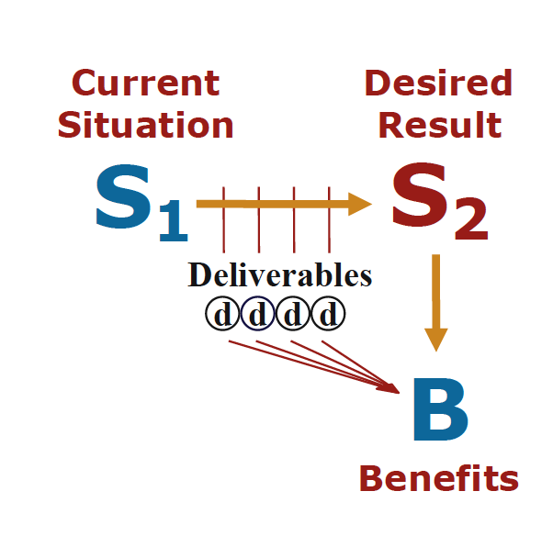
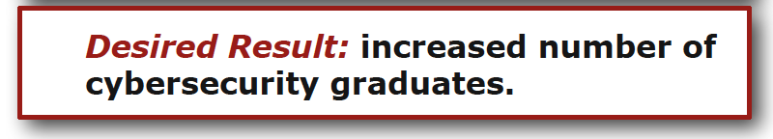
The Baseline Logic defines three outputs for ensuring reliable communication
Desired Result: the outcome of the
project or its phases: insight, a
product, and/or new knowledge.

Slide 24

The Baseline Logic defines three outputs for ensuring reliable communication
Deliverables: the outputs produced during the transition from S1 to S2

Slide 25
The Baseline Logic defines three outputs for ensuring reliable communication
Benefits: the good things that accrue after the desired result is achieved

Slide 26
The Need Statement Creates the Basis of Your Proposal: It has 3 parts
Description of the problem
Plan for solving the problem
Request for support

Slide 27
Need Statements: 3 parts
Description of the problem
Plan for solving the problem
Request for support (aka, “instrumental purpose”)
Problem statements explain:
Context of the problem
Define the problem so that other people can understand it, identify with it, and recognize it’s important
Be specific about what larger societal problem your proposed project contributes to solving
Justification for addressing the problem
Scope: How large is the problem? How many people affected by it?
Justification: Why do we need to spend the money and resources to solve this problem now? (Urgency)
Specific aspect of problem being addressed
If you are working on trying to solve a complex societal problem, you will not try and solve the entire problem, but rather an aspect of the problem

Slide 28
Tell A Story (Create a Narrative)
Statistics:
Your own data
Info from external sources
Examples:
Anecdotes
Real-life examples
Quotes
Tips:
Use data that best supports the case your are building
Give the reader hope

Slide 29
Describe the Problem: Example
According to the Children’s Report card, approximately 10,753 were physically, mentally, or sexually abused. Children of color, especially Hispanics, are at considerably greater risk of being abused. According to the Department of Health and Human Services, Hispanic children are four times more likely to become victims of child abuse than Caucasian children.
Description of the context of the problem, the justification and scope
Certain aspects of Hispanic culture may create risk factors. Many Hispanic people leave their home countries to improve their quality of life, yet in the United States encounter poor education, unemployment and lack of affordable housing. While parents are working, relatives or friends who also live in the household often care for the children. Circumstances like these often leave Hispanic children more prone to abuse. Therefore, programs and interventions tailored specifically for Hispanics are needed to help prevent child abuse and successfully identify and refer victims to treatment.
This paragraph gives the aspect of the problem being solved
CENTRO believes that there is a need to educate the Hispanic community about child abuse in order to prevent abuse and identify and treat victims. CENTRO understands the cultural needs of the Hispanic community and has been serving the twin cities for 28 years.
Justification for why this organization is qualified to solve this particular aspect of the problem

Slide 30
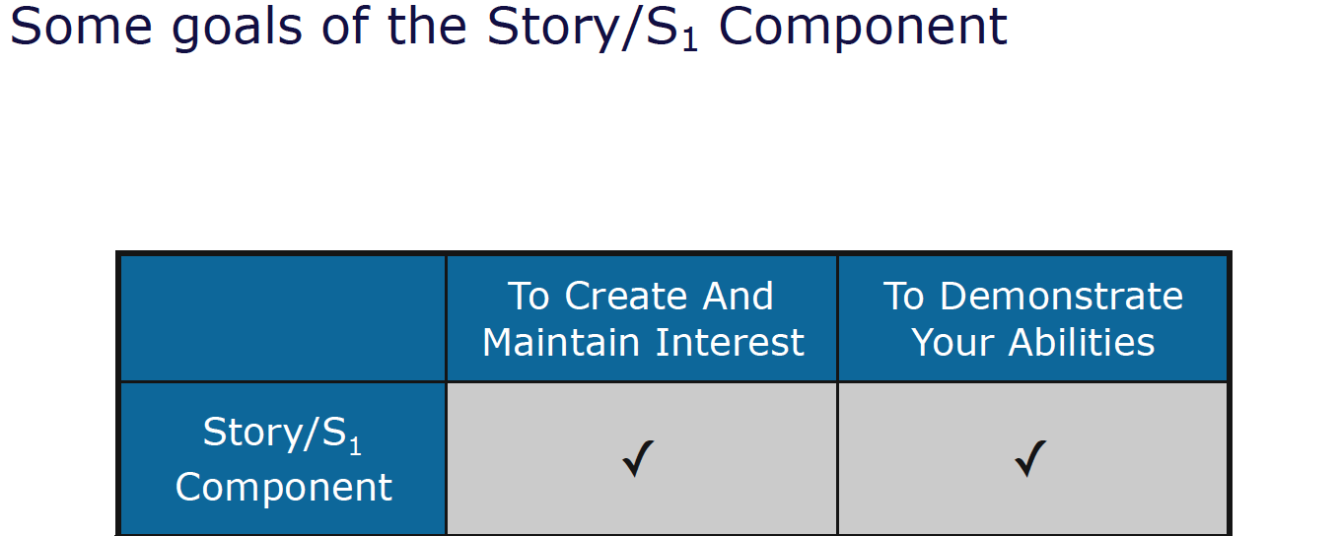
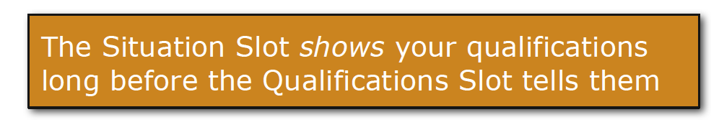
Goals of the Story/S1 Component

Slide 31
Need Statements: 3 parts
Description of the problem
Plan for solving the problem
Request for support (aka, “instrumental purpose”)
Methods sections contain:
Approach taken to solve the problem
Convince your reader that the problem is solvable
Show how one consequence will lead to another until your solution is effected, or you can use analogies or precedent (i.e. how other similar research proposals have been successful elsewhere)
List of activities

Slide 32
Need Statements: 3 parts
Description of the problem
Plan for solving the problem
Request for support
Support sections contain:
Actions you want the sponsor to take immediately
Resources you want the sponsor to commit

Slide 33
Plan for Solving the Problem and Requesting Support: Example
CENTRO seeks to empower and support the Hispanic community by eliminating barriers to self-sufficiency. CENTRO believes that cultivating strong and healthy children who are free of abuse is one step to cultural self-sufficiency. For these reasons, we are undertaking a program to train parents and teachers to recognize the signs of abuse and refer abused children to treatment.
This training program will involve developing training materials and training trainers in the community to conduct free training sessions. We are seeking funding develop a training video which will be used to train parents and teachers to recognize the signs of abuse and how to access treatment. Therefore, we are requesting $6,700 in support from your organization.
Funding CENTRO’s training program will result in parents and teachers who are able to recognize signs of child abuse in Latino/a children and refer abused children to treatment. This type of training program will lead to fewer abused Hispanic children and a more self-sufficient Hispanic community.

Slide 34
Writing an Effective Title and Abstract

Slide 35
The Title and Abstract: Two Critical Parts of Your Proposal
For readers who are not the primary or secondary reviewers of your proposal, time is so short that the title and abstract are likely the only portions that they read carefully
Title/Abstract used to make the initial determination of whether a project is eligible for, or worthy of, further consideration
One foundation executive says that in nine out of ten cases, she reads only the executive summary before deciding whether or not to reject a proposal
Both public and private funders often copy proposals’ abstract/title and circulate them separately to key funding officials who want to see a digest of all incoming projects
The audience that reads the title/abstract may include members of Congress who fund the sponsoring agency, and voters who elected those officials. They will determine the project’s value based on the abstract/title.

Slide 36
Writing the Title
Do
Don’t
Describe the purpose of the project; use funder friendly keywords
Discount the funder criteria
Use active, forward thinking verbs (predicting, mobilizing, empowering, revolutionary)
Use the name of the funder in the project title
Keep the title short; find out which research themes are mission-relevant
Begin with “A Project To…”
Use imagination and flair; be original and relevant
Select a title that is likely to be used by others
Study titles of other funded projects in your field
Choose a title that might be funny/negative if seen out of context
Create at least ten titles using a combination of different words and abbreviations
Use jargon and filler words

Slide 37
Examples of Successful Titles
Paving Academic Pathways for Student Success. Funded by the U.S. Department of Education
Religion and the Rule of Law in Vietnam and Laos. Funded by the John Templeton Foundation
Teachers for a New Tomorrow: Engineering Education Pioneers and Trajectories of Impact. Funded by the National Science Foundation
A New Approach for the Development of Novel Antipsychotic Drug. Funded by the National Institutes of Health
Workplace Myth-Building: Rhetorical Strategies in Leadership and Decision-Making. Funded by the C.R. Anderson Research Foundation
Strategies to Optimize Art Services for Maternal and Child Health; The MCH-Art Study. Funded by the National Institutes of Health
EFRI-ODISSEI: Uniting Principles of Folding and Compliant Mechanisms to Create Engineering Systems with Unprecedented Performance. Funded by the National Science Foundation
The Brain on Breakfast: The Impact of Breakfast in the Classroom on Cognitive Performance

Slide 38
Activity
Write at least five titles for your research project. Get feedback from a partner on what works or doesn’t work about these titles.

Slide 39
The Abstract/Executive Summary
The abstract is an abbreviated version of your proposal—functions as the synopsis of your entire grant application
Write it before you begin the other sections of your proposal to function as a guiding narrative; then revise it (many times) after the rest of your proposal is written
Summarizes project purpose, goals, research design, methods, significance
Has to be well-crafted and thoughtful, CONCISE and COMPLETE

Slide 40
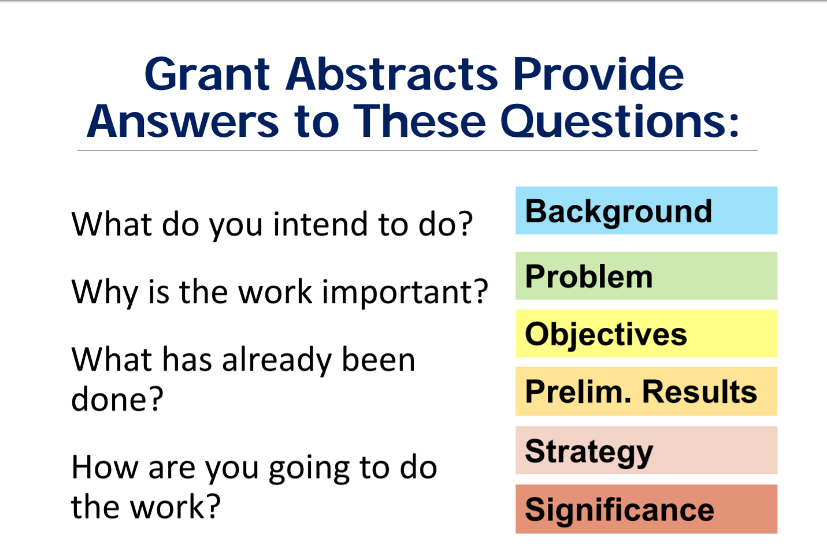

Slide 41
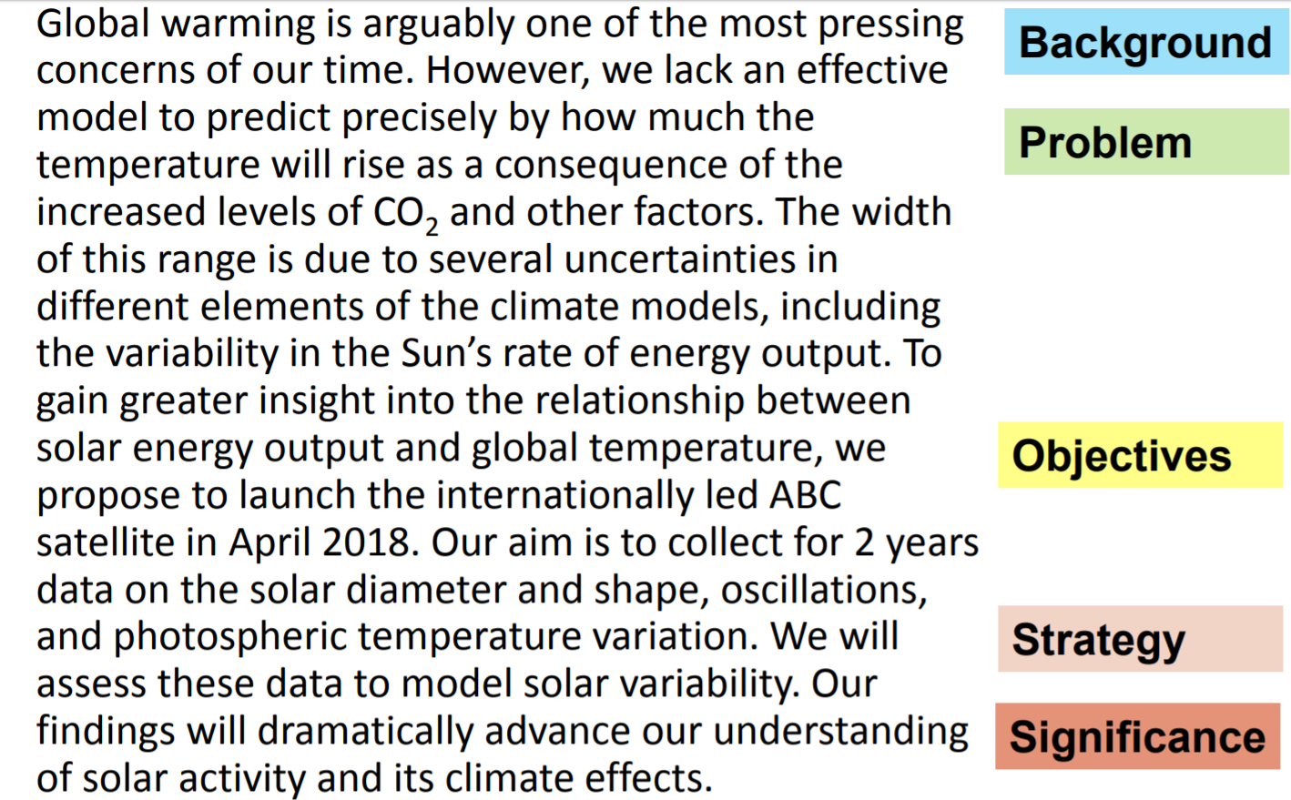
Writing the Abstract: Example

Slide 42
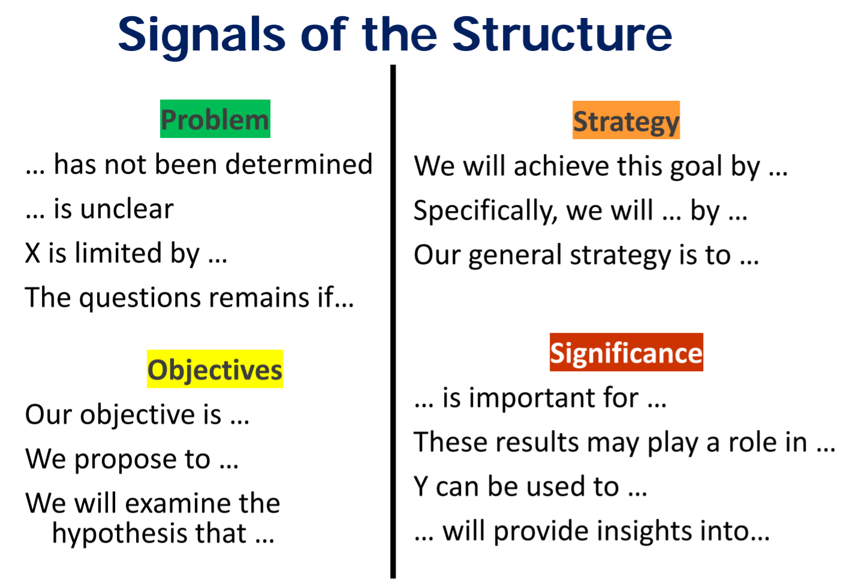
Source: Kallestinova, Elena, PhD. How to Write a Compelling Grant Abstract_July2017.pdf, Yale Center for Teaching and Learning

Slide 43
Faculty Panel Discussion

Slide 44
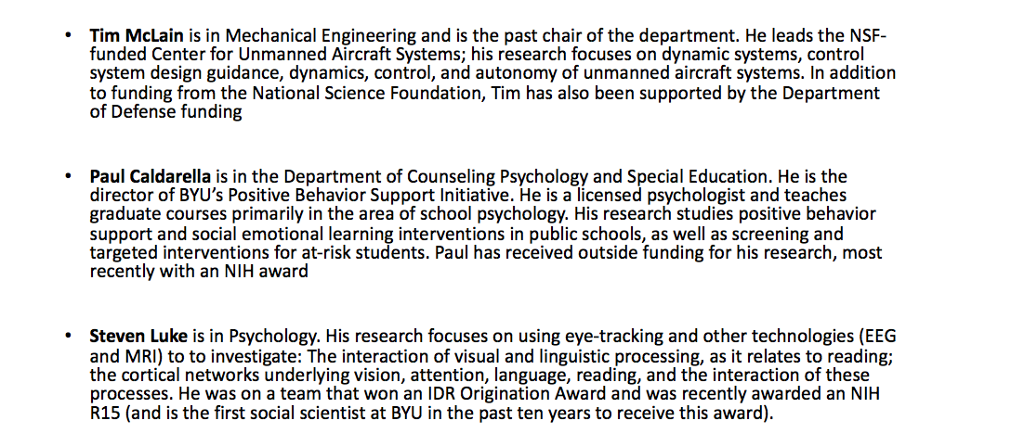
Panelists

Slide 45
Notes from Panel Discussion
Tim McLain
23 years; 1999 had written proposals but hadn't been funded; went to Ohio and started working on unmanned aircraft; was finally able to get funding
DOD funding
Basic research offices
AFOSR (Air Force), ARO (Army), ONR (Navy)
50% of funding goes to universities
Research Labs
15% to universities
DARPA
10% to universities
BAA's
Single investigator efforts
$100k-$200k
Special funding initiatives
Teaming efforts
$1.5 million per year; teams from 2-4 universities
Instrumentation--DURIP
$50k-$1m
Young investigator
AF, Army, Navy, DTRA, DARPA
50k to $170 k
SBIR/STTR
Insights
DOD program officers have a lot more latitude to fund what they want provided that the peer review group gives positive feedback
MUST have personal relationship
BAA are super broad
MUST have additional information from the program officer or you will not be funded
These are a synopsis of what they're looking for but not what they want to buy
Labs don't have excess money
But they do fund sabbaticals and summer research opportunities
Combined with some BYU funds--won't lose money and may come out with a little bit of extra change
Advice
Meet with PO and come with a white paper; find out who they work with and then you go work with them; make new research contracts; know what they want
Add value to the PO's program
They are in a situation where they have to be supportive of the war fighter
Create a video that shows how the research that is being done helps the mission of the DOD
Sometimes will depend on the PO--some might have a different agenda from different program officers
Conrad: We have a lot of success with DOD; translate your need statement to a white paper

Slide 46
Notes from Panel Discussion
Paul
Has had several grants
First exposure to grants was in graduate school--helped to write grants at Utah State
Was a practicing psychologist
Was approached by someone to run a grant; then began to write grants on his own--was able to be funded
Funded through school district
Funded through Department of Justice
Approached by a faculty member at the University of Kansas looking for a collaborator
Collaborative relationships are really important
Writing proposals with a team is valuable
Get editing and review from a team
Be willing to get a lot of feedback and to incorporate that feedback
Can attend professional organization and funding conferences to learn how to do it
Department of Ed likes to do multi-state projects; nice to network with these people to get funding
Internal money versus external money
External money is a rigorous process--lets you do cutting edge stuff; higher quality publishable material
There are some negatives--working with ORCA and more red tape but worth it to get good publications
Will run into tricky issues after you are funded
He got a grant but didn't have any office space--had to approach the dean to make sure he could secure office space
Working with collaborators means that everyone wins--has had a lot of success being a subcontractor
Questions from participants
Are there opportunities for those in health care fields to apply for funding
Tim: reads a lot of DOD BAA--sees a lot of calls that are about emergency health care (battlefield injuries, PTSD
Strategies for writing with collaborators
Paul: each collaborator is assigned a specific section or area--writes in that area and will review the sections that the other collaborators that have written; share the document through Drive or Dropbox; will also involve graduate students in finding literature reviews etc.
Steven Luke
Recent external funding recipient from NIH R15
Advice
Stick with what you know
There are lots of needs out there--make sure that you are able to do what you are proposing to do. Look for opportunities to fit your skill set
Proposal that he was funded for, written multiple drafts of for internal funding, for a dissertation--had distilled it down into basic research questions
Knew what he was trying to accomplish
R15 was a good mechanism for BYU
Purpose of this grant is to help train undergrads to become scientists--something that BYU does very well
Research proposal is important; also care very much about what the impacts are and what the benefits will be
Put a lot a time and thoughts into other parts of the components
Work with the Research Development to say things in the right way and in the right structure
Reviewers want to see what they expect to see where they expect to see it
Get lots of feedback
Contact the PO--send them the project summary; got direct and explicit feedback
Be lucky :)
Paul Caldarella
Has had several grants
First exposure to grants was in graduate school--helped to write grants at Utah State
Was a practicing psychologist
Was approached by someone to run a grant; then began to write grants on his own--was able to be funded
Funded through school district
Funded through Department of Justice
Approached by a faculty member at the University of Kansas looking for a collaborator
Collaborative relationships are really important
Writing proposals with a team is valuable
Get editing and review from a team
Be willing to get a lot of feedback and to incorporate that feedback
Can attend professional organization and funding conferences to learn how to do it
Department of Ed likes to do multi-state projects; nice to network with these people to get funding
Internal money versus external money
External money is a rigorous process--lets you do cutting edge stuff; higher quality publishable material
There are some negatives--working with ORCA and more red tape but worth it to get good publications
Will run into tricky issues after you are funded
He got a grant but didn't have any office space--had to approach the dean to make sure he could secure office space
Working with collaborators means that everyone wins--has had a lot of success being a subcontractor
Questions from participants
Are there opportunities for those in health care fields to apply for funding
Tim: reads a lot of DOD BAA--sees a lot of calls that are about emergency health care (battlefield injuries, PTSD
Strategies for writing with collaborators
Paul: each collaborator is assigned a specific section or area--writes in that area and will review the sections that the other collaborators that have written; share the document through Drive or Dropbox; will also involve graduate students in finding literature reviews etc.

Slide 47
Some Insights on Obtaining DoD Funding
Tim McLain
Department of Mechanical Engineering

Slide 48
Funding Organizations
Basic research offices
AFOSR (Air Force), ARO (Army), ONR (Navy/Marines)
Research Labs
AFRL, ARL, NRL, and others
DARPA
Technology innovation, applied in near term
Others
DTRA, MDO, OSD, etc.

Slide 49
Types of DoD funding
6.1 – basic research
50% to universities
6.2 – applied research
15% to universities
6.3 – advanced technology development
10% to universities
6.2 and 6.3 money for universities usually goes to UARC’s that can handle requirements (deadlines, security, reporting)
BYU professor could be a collaborator on 6.2/6.3 effort
6.1 efforts usually managed by basic research offices
6.2/6.3 efforts usually managed out of labs

Slide 50
Funding Opportunities
Single investigator efforts – BAA’s
$100K to $200K per year, 3 years
Special funding initiatives
Teaming efforts – MURI
$1.5M per year, 5 years, 2-4 universities
Instrumentation – DURIP
$50K to $1M
Young Investigator
AF, Army, Navy, DTRA, DARPA
$50K to $170K per year
SBIR/STTR
Require collaboration with a small company
Applied
Potentially higher hit rate
Phase I, Phase II

Slide 51
Some Key Insights
While peer review is utilized, DoD PO’s have far greater latitude than NSF PO’s
Relationships and face-to-face interactions are critical
BAA’s are broad descriptions of research areas
Responding to the BAA without additional inside information is hopeless endeavor
Labs often don’t have excess money
Visiting scientist opportunities (sabbatical, summer)
They know problems of interest
They review proposals
Know the customer, know what they are buying!

Slide 52
My Advice
Find the right contact (PO)
Look through the BAA’s
Who is funding your peers?
Visit the program officer
Come prepared to discuss your ideas
Learn about their specific interests
Find out who they work with in the labs (AFRL, ARL, NRL, ...)
Spend a summer or two in DoD research lab -- Get out of Provo!
Make new research contacts
Learn about their technical challenges
Distinguish yourself from your competitors
If you are funded, add value to the PO’s program

Slide 53
Go for it!
We expect the natural unfolding of knowledge to occur as a result of scholarship, but there will always be that added dimension which the Lord can provide when we are qualified to receive and he chooses to speak.”
Spencer W. Kimball

Slide 54
Wrap Up

Slide 55
Wrap Up
Homework
Review handouts
Before next session write a 2 page need statement that includes a title
bring a hard copy with you on Dec 13th or email to Kaylie Winterton kaylie.winterton@byu.edu
Day 2 Dec 13th , 9am-2pm
Review Needs Statement
Proposal Elements
Editing and Rewriting
Aesthetics, Marketing

Slide 56
Grant Proposal Development Resources

Slide 57
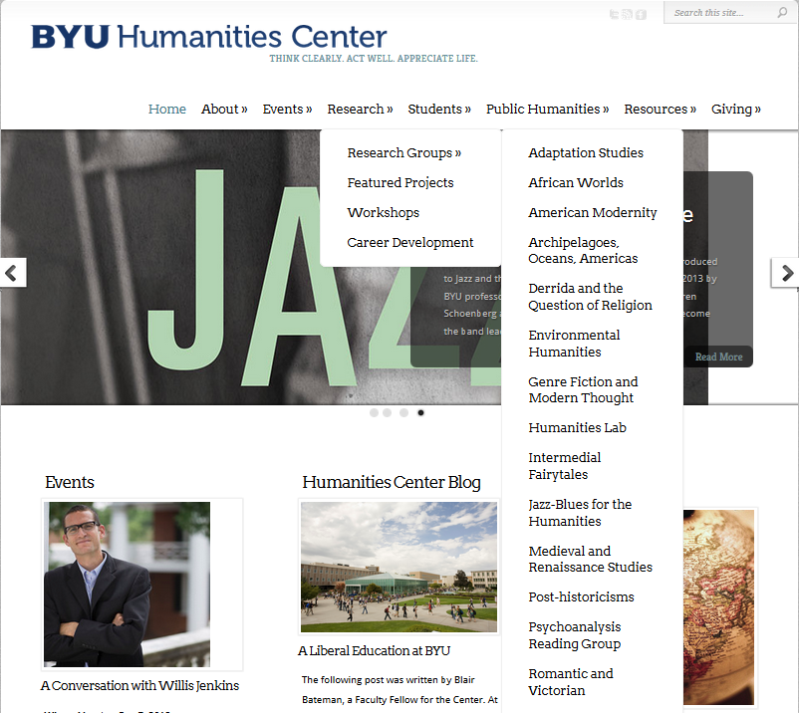
Research Resources in Humanities
http://humanitiescenter.byu.edu/services/external-grants/
http://humanitiescenter.byu.edu/research/workshops/

Slide 58
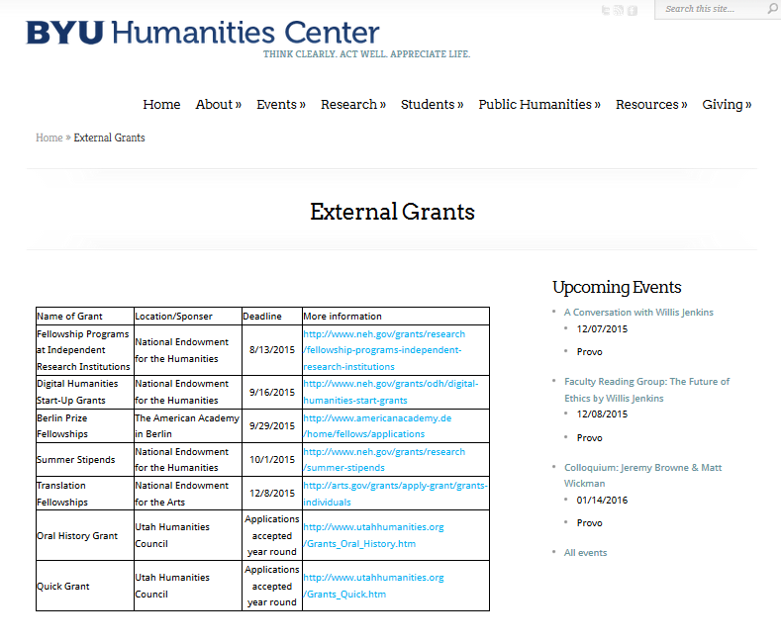
Research Resources in Humanities (cont.)
Grant proposal writing specialist – Jon Balzotti in the English Department,

Slide 59
Proposal Writing Sources
Robert Porter, What do Grant Reviewers Really Want, Journal of Research Administration, Vol. XXXVI, Issue 2, 2005.
Robert Porter, Coaching Researchers to Write Successful Grants, National Organization of Research Development Professionals (NORDP), May, 2013 conference. Really Want and
Morgan Giddings, Four Steps to Funding, How To Avoid Rejection and Get Your Proposal Funded on Your Next Try, 2012
Jeremy and Lynn Miner, A Guide to Proposal Planning and Writing
Grant Writing Institute
CapturePlanning.com
ORCA proposal writing guides and proposal forms
Instructional materials prepared by the National Council of University Research Administrators and the Society for Research Administrators, July 1995 (see facstaff.gpc.edu/~ebrown/infobr3.htm Georgia Perimeter College)
Tips and Practical Guidelines for Proposal Writers prepared by an NSF panel
NSF Panel on TUES proposal preparation
NSF Proposal Writing Exercises
The Grant Center, UNC. http://writingcenter.unc.edu/handouts/grant-proposals-or-give-me-the-money/
*A Guide to Proposal Planning and Writing by Jeremy T. Miner and Lynn E. Miner

Slide 60
Additional Resources
Online
Research Development website http://researchdevelopment.byu.edu/
ORCA website http://orca.byu.edu/
Faculty Center website http://facultycenter.byu.edu/node?destination=node
Review Process and Panels NIH https://www.youtube.com/watch?v=fBDxI6l4dOA&feature=youtu.be NSF https://www.youtube.com/watch?v=WMoGdIFgy5o
Human Resources
ORCA
Faculty Center
Experienced faculty with success at proposal writing
BYU workshops
Off campus workshops
Hardcopy
Research Development loanable guides for NIH, NSF proposals
HBL Library

Slide 61
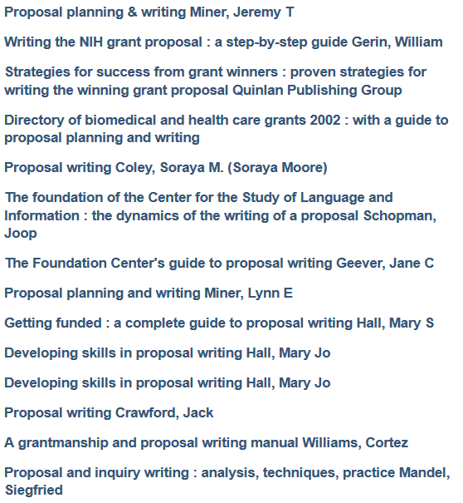
Sampling of Proposal Writing Books at the HBLL

Slide 62
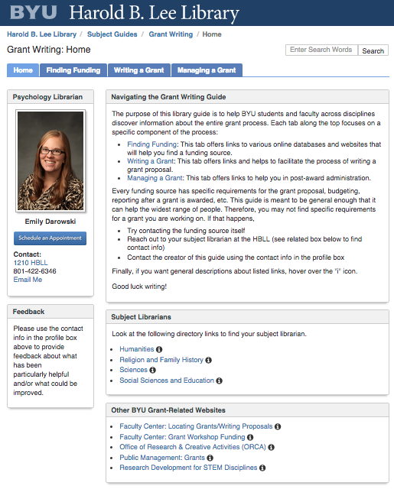
Additional Library Support

