Slide 1
Grant Proposal Development Workshop Day 2
December 13, 2018

Slide 2
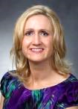

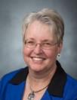
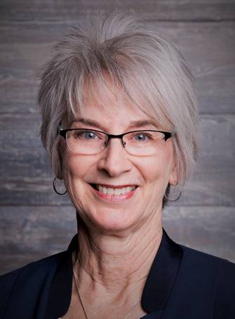
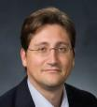
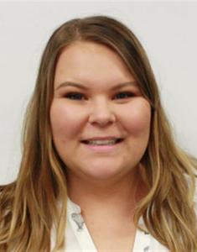
Research Development Support
Kristen Clarke Kellems
FHSS Research
Development
934 SWKT
Tel: 801-422-8967
Email: fhssresdev@byu.edu
Conrad Monson
STEM Research
Development
275 McDonald Building
Tel: 801-422-7722
Email: conrad_monson@byu.edu
Jaynie Mitchell
MSE Research
Development
306C MCKB
Tel: 801-422-3067
Email: Jaynie@byu.edu
Karen Hill
BYU Law Grants and Partnerships
Manager
445 JRCB
Tel: 801-422-2684
Email: hillk@byu.edu
Jon Balzotti
English Department Faculty
College of Humanities
4127 JFSB
Tel: (801) 422-2440
jonathan_balzotti@byu.edu
Kaylie Winterton
Research Development
Administrator
269 McDonald Building
Tel: 801-422-0132
Email: rdadmin@byu.edu

Slide 3
Recap Day 1
Finding Funding
Creating a Fundable Idea
Writing a Persuasive Needs Statement
Prewriting
Titles and Abstracts
Faculty Panel and Q&A

Slide 4
Agenda
Recap of Day 1 (Kristen)
Group Review Needs Statements (Kristen)
10:20-10:30 Break
Themes (Karen)
Proposal Elements (Conrad)
Methodology and Qualifications (Conrad)
12:00-12:30 Lunch
Budget and Benefits (Jaynie)
Editing and Rewriting (Kristen)
Aesthetics and Marketing (Conrad)
ORCA (Susie Quartey)
Wrap Up (Jaynie)

Slide 5
Needs Statement Review Groups

Slide 6
Proposal Elements

Slide 7


Proposal Elements are Created From the Need Statement
The Need Statement thoroughly develops and describes the problem you are addressing including context and justification … develops the Situation Slot, S₁
Describes Methods at a high level; informs Qualifications and Benefits
Provides the basis for the Budget you need
Need Statement Components
1. Story (Problem)/S₁
2. Plan for solving (Problem)/S₁
3. Request for support
The 6 Generic Proposal “Slots” (tied to baseline logic)
Achieved Objective(s)
S
Methods
S
2
Situation
1
B
Qualifications
Benefits
Budget

Slide 8
Themes

Slide 9
Proposal Themes
The
Highlighted Essential
Messages that
Express the character of your
Story
Themes Are . . .
Developed from the RFP decomposition and from your need statement
  Address the funders “hot buttons”
  Address evaluation criteria
A“…system of threads that weave, communicate, and align your messages with the funder’s desires…” throughout the proposal

Slide 10
outstanding researchers committed to teaching, learning, dissemination in a broader context to large audience

Slide 11
Methods and Qualifications
Situation: This is our understanding of the problem.
Objectives: Given that problem, these are our objectives for solving (or realizing) it.
Methods: Given those objectives, these are the methods we will use to achieve them.
Qualifications: Given those methods, these are our qualifications for performing them.
Budget: Given those qualifications and methods, this is how much the project will cost.
Benefits: Given our efforts and funders support, these are the benefits or value you will receive.

Slide 12
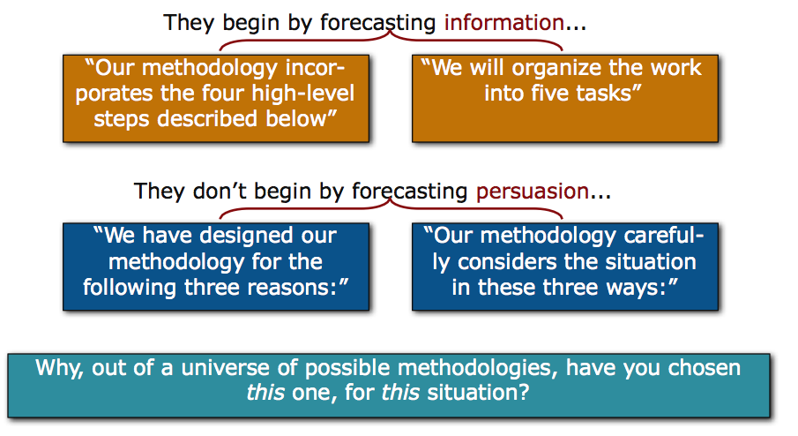
Methods
Lacking persuasion, methods sections often begin by first explaining “How” rather than “Why”

Slide 13
Methods
Evaluation
Broad statement about what you hope to accomplish
Goal
Objective
Objective
Objective
Measurable result directly traceable to one or more goals
Tasks
Tasks
Tasks
What you will do to meet the objectives
Outcome
Outcome
Outcome
What result do you expect
Evaluation and Evaluators

Slide 14
Exercise: Draft a methods description that addresses “Why” not just “How”

Slide 15
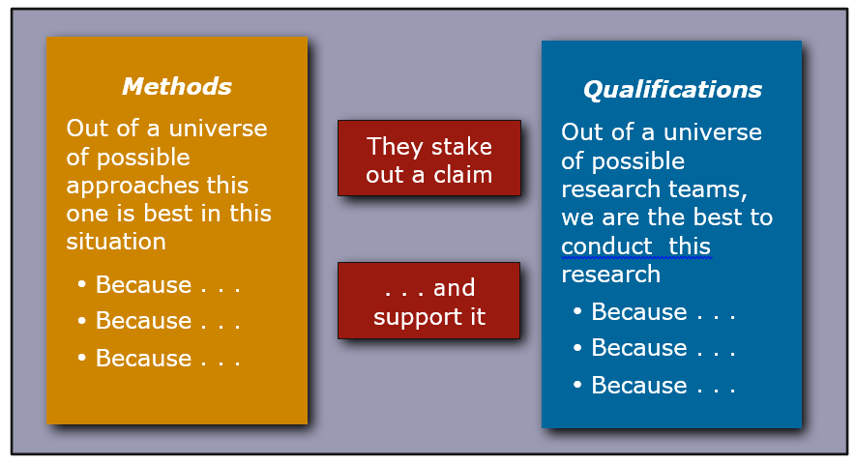
Methods Lead to Qualifications

Slide 16
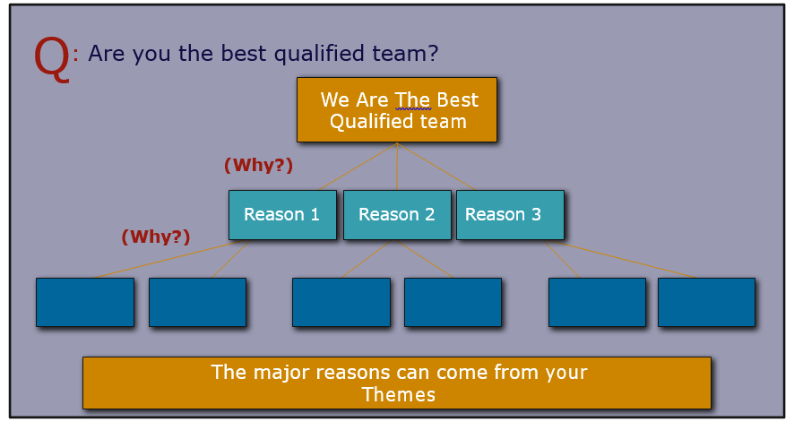
The Qualifications Provides Reasons for “Why Us”

Slide 17
Budget and Benefits
Situation: This is our understanding of the problem.
Objectives: Given that problem, these are our objectives for solving (or realizing) it.
Methods: Given those objectives, these are the methods we will use to achieve them.
Qualifications: Given those methods, these are our qualifications for performing them.
Budget: Given those qualifications and methods, this is how much the project will cost.
Benefits: Given our efforts and funders support, these are the benefits or value you will receive.

Slide 18

Budget Narrative
Credible and consistent with the scope of the project
Each item clearly explained and justified
Address prior funding when appropriate (emphasize past and future outcomes)
Include the Indirect Cost Rate (IDC) allowed by the funder. BYU’s rate is 50% unless specifically restricted in the RFA.

Slide 19
Budget Narrative (cont.)
Excellent place to continue “selling” your project
Point out the various strengths of faculty and resources over the project period
Tie allocations to your outcomes, including benefits to the target population and the funder
Source: osp.utah.edu/_doc/nsf-budget-justification.doc

Slide 20

Participant Costs:
List the stipend amount and type each participant will have – meet with your controller to conform to college and university guidelines.
List amount allotted for participant travel and explain the purpose of the travel.
List amount allotted for subsistence, which could be a food per diem. Specify the period you are providing assistance for subsistence in.
List any other expense associated for the participants, and how this is relevant and necessary to the project (e.g., supplies, printing of materials, etc.).
Where can you weave in your themes?

Slide 21

Equipment: (Items of durable value exceeding $5,000)
Focus on WHY and HOW:
List the equipment you are requesting for the project.
Include model no. and price quotes from a reputable source, listing name of source.
Detail how this item will be used to meet project outcomes.

Slide 22

Travel:
List total amount requested per year
Breakdown expenses, e.g., airfare, hotel, per diem, and mileage reimbursement by conference or travel required by the funder.
In projects with co-PI’s and research assistants, be sure to include who will travel and/or present.
Tie dissemination goals to your narrative.
Specify domestic or international travel – be reasonable.

Slide 23
Benefits
In the baseline logic (captured in the Need Statement) which expresses a “value proposition”
S₁ S₂ B
In the Abstract. Introduction/ Background section or other funder-specified sections (e.g., Summary, Justification, Benefits)
To answer these challenges, we have designed an approach to meeting [[objectives]]. As a result of achieving these objectives, there will be [[benefits]]
Content from the Benefits Slot exists throughout the proposal
  Benefit(s) should be one of your themes
Address the different types of benefits
  Immediate, a direct result of your research
  Long-term, how your research moves your field forward
Remember… the benefits address the funders needs and mission

Slide 24
Editing and Rewriting

Slide 25
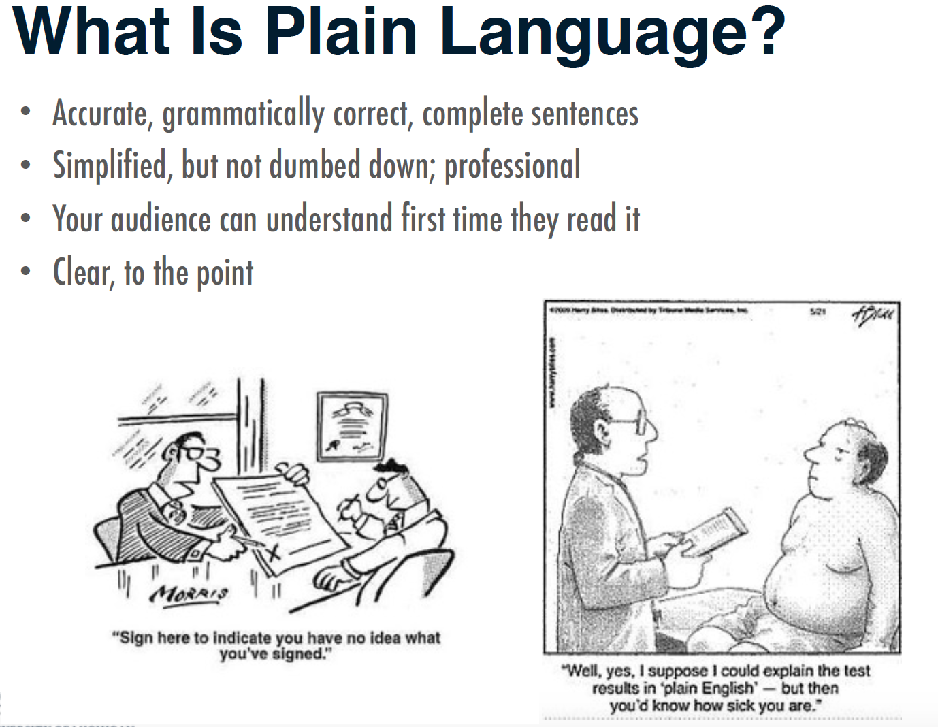
Write in Plain Language

Slide 26
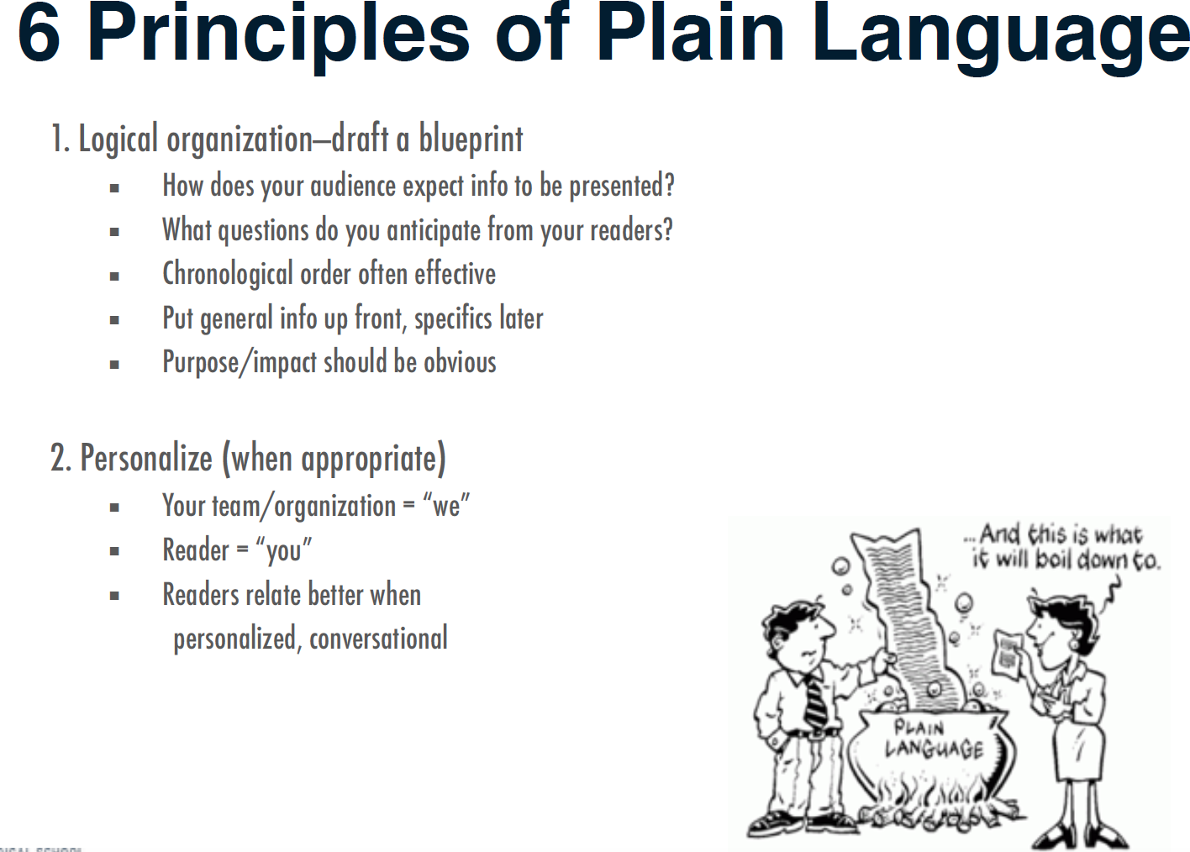

Slide 27
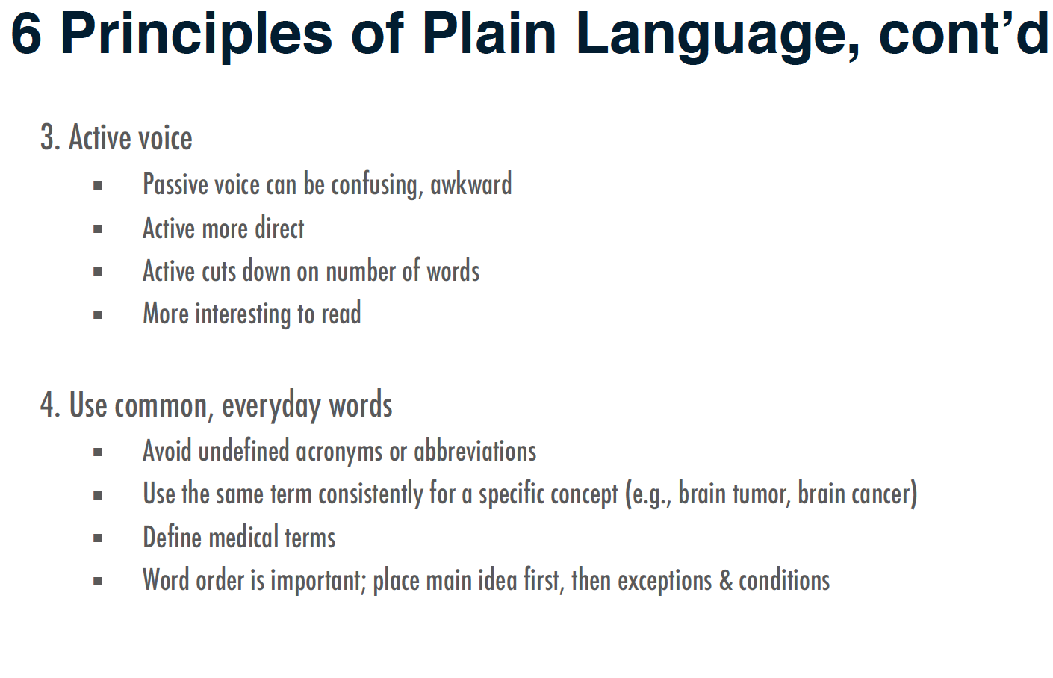

Slide 28
Active Voice Activity
Look at your need statement and replace passive voice with active voice

Slide 29
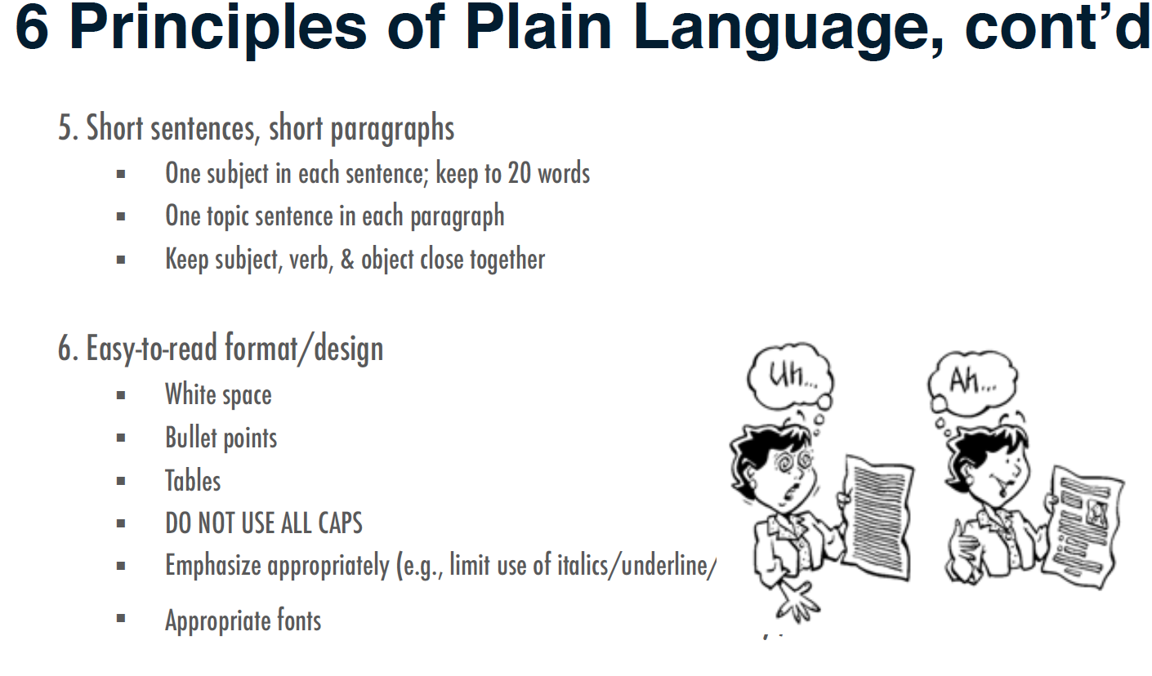

Slide 30
Be Concise
Delete meaningless words
    kind of virtually actually
    individual particular basically
    really generally certain
    given various practically
Delete words that repeat the meaning of other words
full and complete true and accurate
hopes and desires each and every
first and foremost hope and trust
Delete words implied by other words
serious crisis untimely death
terrible tragedy future plans
important essentials true facts
final outcome advance planning

Slide 31
Be Concise (cont.)
Replace a phrase with a word
  Instead of— Try—
    in close proximity near, nearby, close
    is cognizant of is aware of, knows
    in conjunction with with
    are desirous of want
Change negatives to affirmatives
  not different similar
    not the same different
    not allow prevent
    not notice overlook
Delete useless adjectives and adverbs
  Many writers can’t resist adding useless adjectives and adverbs. Try deleting every adverb and every adjective before a noun, then restore only those that readers need to understand the passage.

Slide 32
Concision Activity
Look at your need statement and remove redundant or unnecessary words

Slide 33
Provide Old Information Before New Information
Principle of Cohesion: Old to New
  Begin sentences with information familiar to your readers. Readers get that familiar information from two sources:
    First, they remember words from the sentences they just read.
    Second, readers bring to a sentence a general knowledge of its subject.
  End sentences with information readers cannot anticipate.
      Readers always prefer to read what’s easy before what’s hard, and what’s familiar is easier to understand than what’s new and complex.
  Writers often refer to something in a previous sentence with words such as this, these, that, those, another, such, second, or more. When you use any of those signals, try to put them at or close to the beginning of the sentence:
      How to calculate credits for classes taken in a community college is another issue that we must consider.
      Another issue that we must consider is how to calculate credits for classes taken in a community college.

Slide 34
End Your Sentences and Paragraphs With Emphasis
We call the most emphatic part of a sentence STRESS.
If you end a sentence on words that carry little meaning, your sentence will seem to end weakly. Just as we look at the first few words of a sentence for point of view, we look to the last few words for emphasis. You can revise a sentence to emphasize particular words that you want readers to hear stressed and thereby note as particularly significant.
Change the emphasis in the following sentences:
  The President’s tendency to rewrite the Constitution is the biggest danger to the nation, in my opinion.
  The nation is most threatened by the President’s tendency to rewrite the Constitution.
  A new political philosophy that could affect our society well into the twenty-first century may emerge from these studies.
  These studies may result in a new political philosophy that could affect our society well into the twenty-first century.

Slide 35
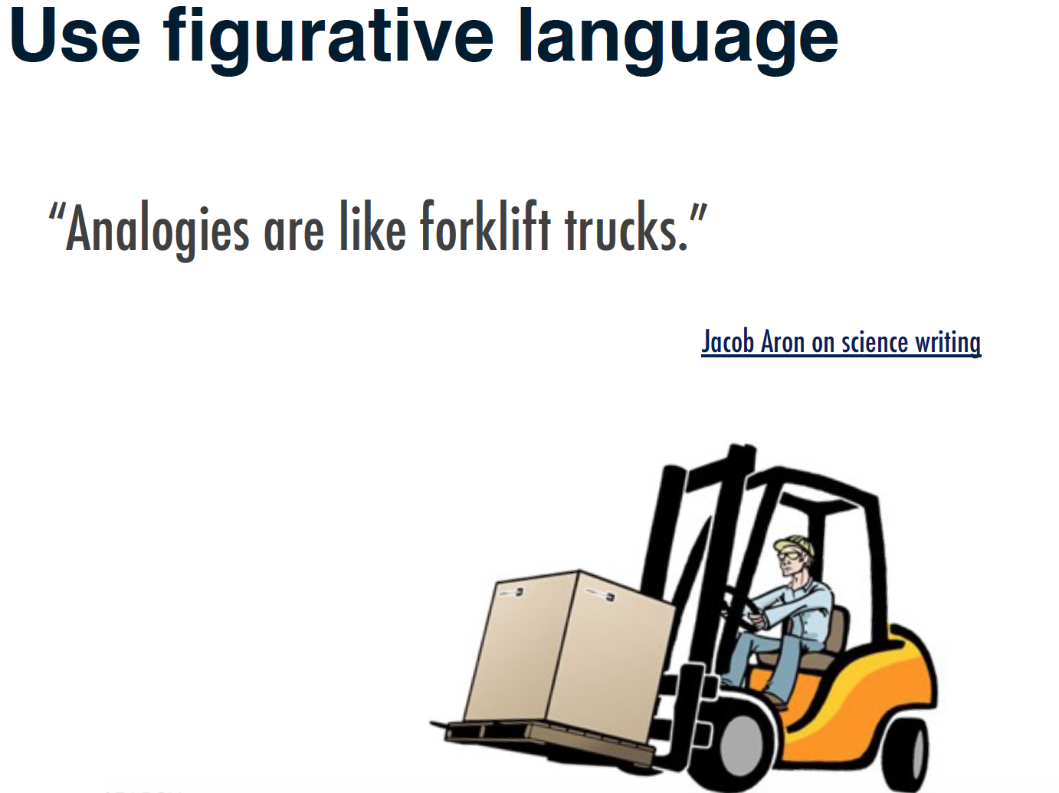

Slide 36
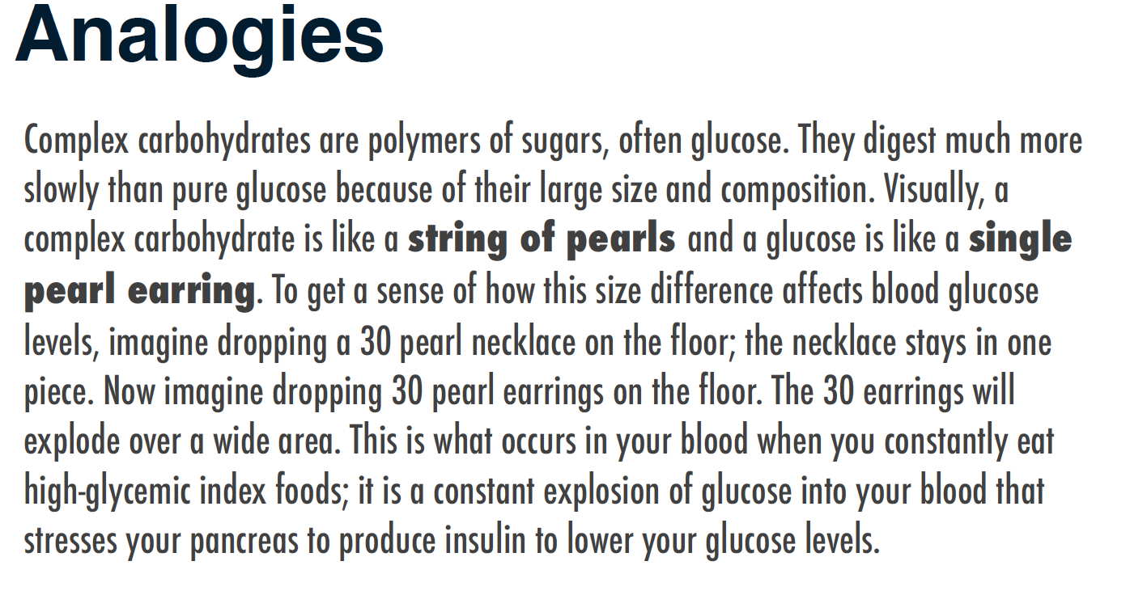
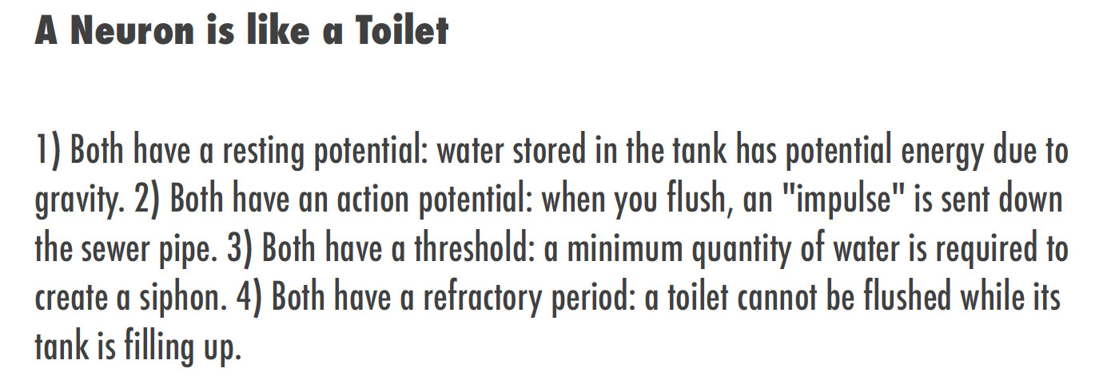

Slide 37
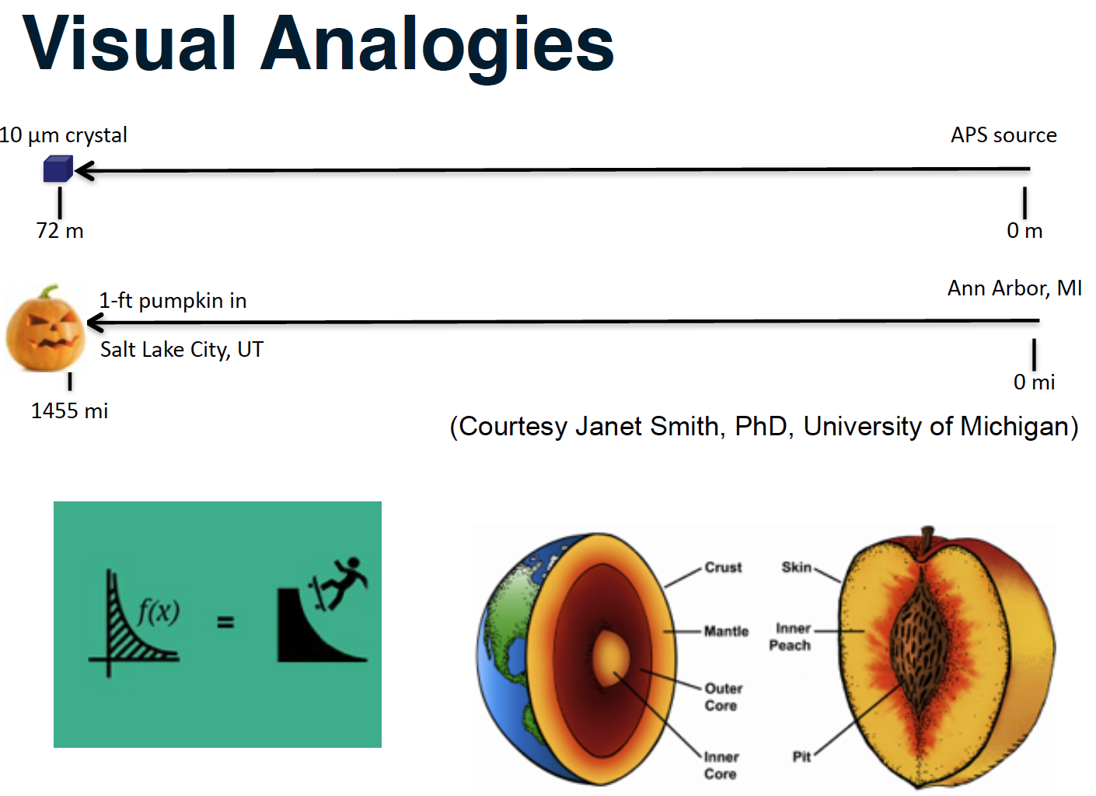

Slide 38
Aesthetics and Marketing

Slide 39
Proposal Aesthetics
The proposal must be aesthetically appealing
“Just as clothing is important in the business world for establishing initial impressions, so, too, is the appearance of your proposal as it reaches the reviewer's hands. The proposal should ‘look’ familiar to the reader. A familiar proposal is a friendly proposal (Jeremy and Lynn Miner).”
If allowed, match the funder’s publications style …. Your proposal will look more credible and familiar
Use white spaces for visual relief and to frame the text; bold text for emphasis (don’t go overboard); ragged right margins if allowed
Support all types of reading (skim, search, critical)
Type face should be no smaller than 12 pt.; Serif typefaces for text and Sans Serif typefaces for titles and headings

Slide 40
Proposal Aesthetics (cont.)
Before creating figures and tables, put yourself in the position of the reader…what would you want to know?
Create figures and tables that are easy to read, supports the narrative, summarizes technical details, supports the different reading styles, particularly skimming
Create lists to quickly provide the message, convey chunks of information
With lists, figures and tables, use level of detail appropriate for persuasion not for an expository peer reviewed journal article
Notes:
Experience with Paul Osterbeck – I was in charge of developing a proposal for researching options for a Multi Role Unmanned aircraft operating off of a variety of naval vessels. I was assigned a “master proposal writer” to help me. He spent more than half the proposal writing time doing very careful figures and tables that told the whole story of the proposal while I was freaking out because there was no writing to review for what I thought was too a period in the proposal writing schedule. His approach was successful for our proposal and for others he wrote.
Proposal figures and tables are not typically the same as manuscript figures and tables. Be aware of the differences – simple, make the point clearly, support skim reading, etc.

Slide 41
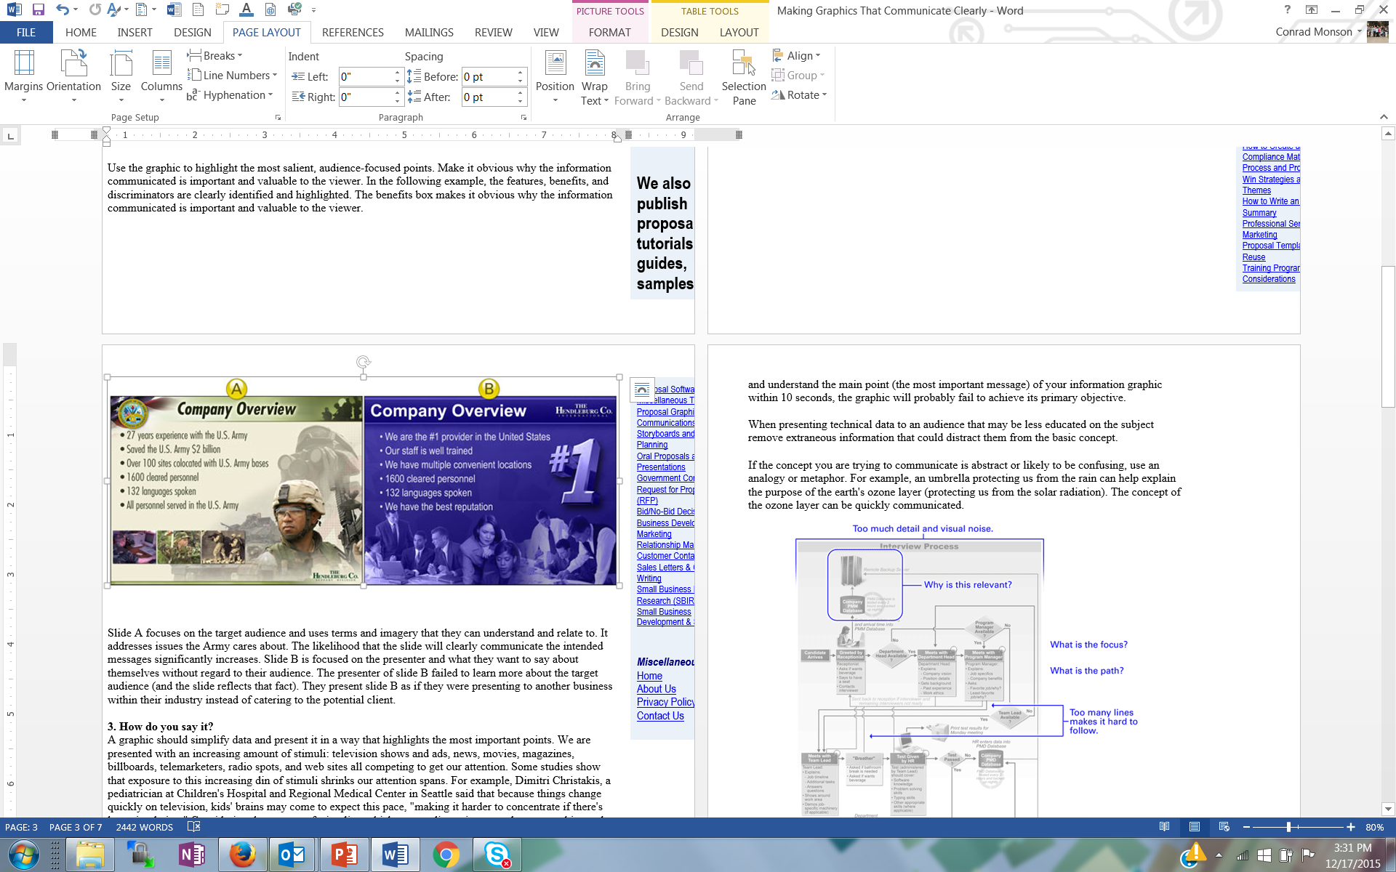
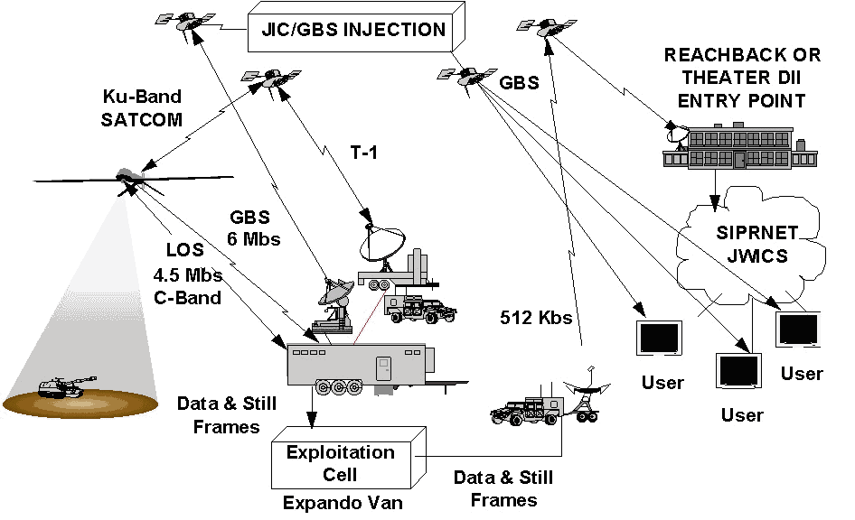
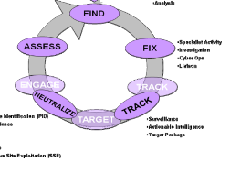
Figure Examples
Primary Intelligence Requirements
-Collection
-Analysis
-Specialist activity
-Investigation
-Cyber Ops
-Liaison
-Identification
-Surveillance
-Actionable intelligence
-Target package
Both of these figures are about a company proposing a project to the Army… which is more appealing to an Army proposal reviewer?
Both of these figures are about a C4ISR system… one is better for a technical report, the other for a proposal
Notes:
Experience with Paul Osterbeck – I was in charge of developing a proposal for researching options for a Multi Role Unmanned aircraft operating off of a variety of naval vessels. I was assigned a “master proposal writer” to help me. He spent more than half the proposal writing time doing very careful figures and tables that told the whole story of the proposal while I was freaking out because there was no writing to review for what I thought was too a period in the proposal writing schedule. His approach was successful for our proposal and for others he wrote.
Proposal figures and tables are not typically the same as manuscript figures and tables. Be aware of the differences – simple, make the point clearly, support skim reading, etc.

Slide 42
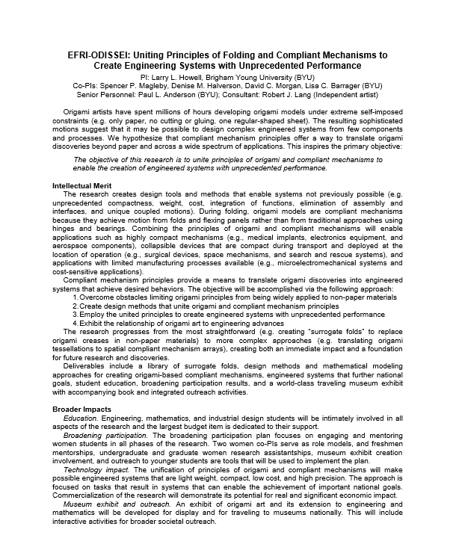
A Proposal Summary With Good Aesthetics

Slide 43
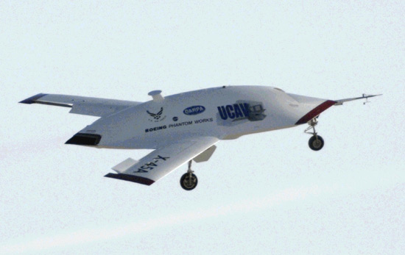
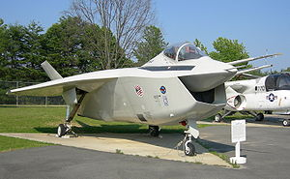
Marketing is Ongoing
Contact funding officer before submitting a proposal
  Can even start contact before an RFP is published – customer shaping
  Do your homework
    Understand mission, priorities, restrictions
    Know typical award size and amount of available funding
    Review recent awards
  Write a short description of your project based on a need statement
    Email the description program officer - ask about relevance
    Let the PO know you are willing to serve on a review panel
The best marketing creates an emotional response to your ideas and proposals… excitement, keen interest, compelling, “I’ve got to have it now” … not boredom, confusion, or even anger
Marketing doesn’t end with the proposal submittal
You could be contacting the funding officer for a re-submittal if your proposal is rejected and for additional funds that may be available after an initial award
UCAV
UCAV
F-35
Notes:
“Marketing” should be done throughout your career… and the reality is that you are marketing yourself anyway all the time, whether you want to our not.
Think like a marketer and always see things from the customer’s point of view
“Marketers do one thing, and they do it very well. They see things from the prospect’s point of view. They lose their own ego, interests and desires, and they focus on the customer’s wants and desires (Morgan Giddings)”
A proposal is not about you or your needs, it is about the funder’s needs… you’re project should make the funder successful
You want an emotional response to your ideas from your potential funders… excitement, keen interest, compelling, “I’ve got to have it now” … not boredom, confusion, or even anger
Boeings UCAV contract with DARPA was an ~$150M competition with Northrop Grumman that was so close, Boeing won at least in part because the PM felt Boeing would do a better job - not on price, past performance, schedule … many of the elements that typically win a proposal. The emotional investment was so intense by Northrop Grumman, the customer told us during when NG was debriefed that was the first time in all his years of contracting, he had ever seen “grown men cry”.
Boeing management was so worried about the emotional response to its F-35 prototype – it looked so ugly, pilots might not want to fly it – that they hired high priced consultants to understand the emotional response to the aircraft and how to mitigate it.
Finally, marketing your ideas and proposal should be embedded in the complete proposal development process, from pre-proposal to proposal writing, described in the next sections.

Slide 44
ORCA (Office of Research and Creative Activities)

Slide 45
ORCA Proposal Preparation & Submittal Process
Susie Quartey, Research Administrator
December 20, 2017

Slide 46
ORCA Personnel
Gene Larson, Director
Debbie Silversmith, Associate Director
  ORCA student grants, MEGs
Sandee Aina, IRB Administrator
Susie Quartey, Research Administrator
  IBC Administrator
Jason Jay, Research Administrator
  IACUC Administrator
Rachel Teki, Administrative Assistant
Rachel Uryan, IACUC, IBC, & ORCA grants Assistant

Slide 47
ORCA Functions
Proposal Approvals and Submission
Letters of Commitment / Certifications / Subrecipient Commitment Forms
Contract Negotiations
Non-disclosure Agreements / Confidentiality Agreements / Material Transfer Agreements
Misc. required forms (i.e. proof of insurance, worker’s comp, etc.)
Award Processing / Issuing Subcontracts
Contractual support throughout the life of an award

Slide 48
Compliance Committees
IBC – Institutional Biosafety Committee, Biohazardous Chemical Research
  Every other month: ibc@byu.edu
IRB – Institutional Review Board ,Human Subjects Research
  Monthly: irb@byu.edu Many federal changes; check website frequently and pay close attention to email messages related to IRB
IACUC – Institutional Animal Care and Use Committee, Animal Research
  Monthly, iacuc@byu.edu
Approval from federally mandated compliance committees is required for ALL research on campus, not just those with federal funding
Approved protocols must be in place before research can begin
External research funding unavailable to spend until approved protocol is in place; no R# issued

Slide 49
Proposal/Award Obligations
All proposals should come through ORCA before submission:
  Proposals commit the University
  Terms and conditions need review & authorization
  Cost sharing/matching needs approval
  Problems are much easier to fix at the proposal stage than after submission or an award is received
NSF: Fastlane
NIH: Assist
Other Govt: Workspace
Foundations: Sponsor systems

Slide 50
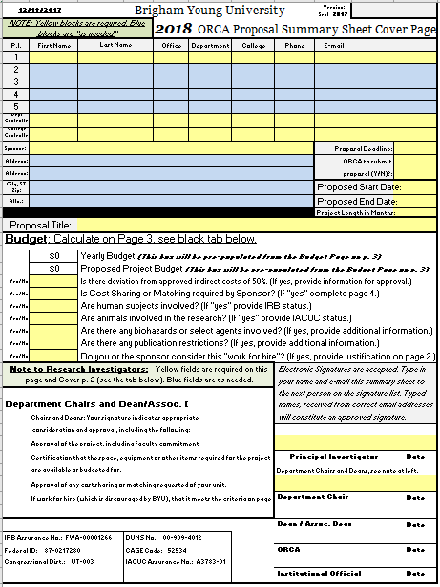
ORCA Proposal Sheet Changes
Benefit Rates change every year
“Faculty Detail” tab
  Calculates and carries to budget page
  **Recorded as Effort—12.5% = 1 month summer salary
Up-to-date forms found at orca.byu.edu
Notes:
Full salary, 8 month base, regardless of whether they have an 8 month, 10 month, etc., contract

Slide 51
F&A/Indirect Costs & Matching
Facilities & Administration (F & A) / Overhead
Operations and Maintenance, phones, copying, ILL, etc.
Building and Equipment Depreciation
General Administration (HR, payroll)
Department Administration
Sponsored Projects Administration
Library
Student Services
MATCHING/COST SHARING
Only include if required by sponsor
If it is proposed, we are obligated to track and report it

Slide 52

Grants.gov: WORKSPACE
PURPOSE: Enhance grants.gov functionality and streamline participant collaboration and delegation, from form access to submission
TIMELINE
Current system retires Dec. 31, 2017
Required starting Jan. 1, 2018
iMedRIS IBC Dec. 20, 2017, IRB & IACUC Feb, 2018
KUALI at BYU ** Jan. 2019

Slide 53


ORCA’s Role in
Grants.gov: WORKSPACE
ACTIONS
Faculty request access from their ORCA Research Administrator AFTER they have created an institutional login, connected to BYU
Access requests accommodated now
Last-minute requests risk missing deadlines
ORCA completes final review and submits Grant Proposals through WORKSPACE
PI submits 5-7 working days prior to grant deadline

Slide 54

Benefits of Workspace
Multiple users work concurrently on application forms
Reuse previously submitted Workspace forms for future opportunities
Immediate validation, errors corrected before submission, minimizes rejection rate
Seamless integration between online web forms and offline PDF forms
Collaborate with Users External to Your Organization
Changes to Opportunity Package are reflected
in Workspace

Slide 55
Submission Deadlines
ORCA needs the signed summary sheets, budget justification, budget in sponsor’s format, project summary, and completed proposal 3 – 5 days before the submission due date (WORKSPACE proposals needed 5 – 7 business days)
  Research Administrator reviews, suggests changes, secures signature from AAVP
  ORCA or PI submits (depending on sponsor)
    If PI submits, ORCA/University approval still required prior to submission
  Contact ORCA early and often!

Slide 56
Your Formula for Success
Write Proposal
Obtain University Approval (via ORCA)
Submit Proposal
APPROVED
Declined

Slide 57
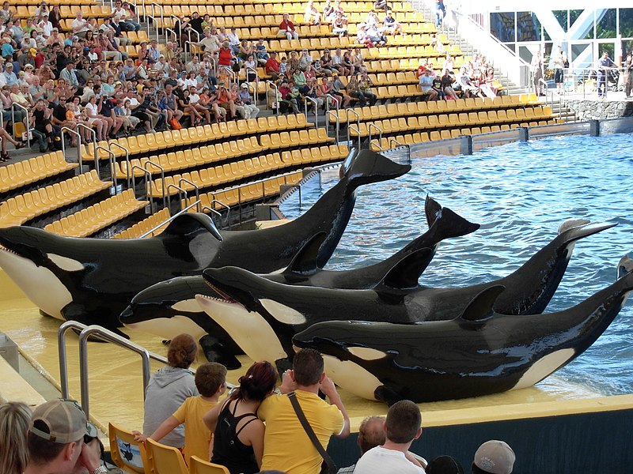
Contact us with questions!
Team ORCA http://orca.byu.edu
Gene Larson
  Marriott School of Bus, Law School, School of Fine Arts & Comm, Religious Ed, Maxwell Inst, & Nursing
Debbie Silversmith
  Fulton School of Eng/Tech
Susie Quartey
  McKay School of Ed, Humanities, Phys & Math
Jason Jay
  FHSS, Life Sciences
Sandee Aina
  All things IRB
https://commons.wikimedia.org/wiki/File:Orcas_at_Loro_Parque_08.JPG

Slide 58
Wrap Up
Good Ideas
Fundable Idea
Find Funder(s)
Pre-Proposal
Write the Proposal
Revise
Marketing
Rejected
Accepted AND Funded
Funder
Drafts
Submit (ORCA)
Peer Review
Edit
Research Development has tools and resources to help with most of the steps in this process

Slide 59
Consider What Makes Your Proposal Competitive…
Significance
  Great idea(s) that address important problems in the field and are significant to relevant stakeholders
Original approach
Succinct, logical and focused plan
  Coherent narrative that integrates each component of the project
Knowledge and experience in the discipline
Experience in essential methodology
Realistic amount of work
Sufficient detail
Cost effective
Strong likelihood of success

Slide 60
… and What Makes It Compelling
Grabs the reader’s attention
Holds that attention long enough to explain the benefits of your offer
Explains how the benefits will be delivered
Assures the reviewer of your reliability/capability
Describes the costs of benefits to be delivered
(From Giddings, Porter)

Slide 61
Final Thoughts on Proposal Writing
  “Competitive ideas evolve and converge over time; they do not appear fully and perfectly formed by a narrative Genie “
  (Cronan and Deckard, New Faculty Guide to Competing for Research Funding)”

Slide 62
Upcoming Events
January 31
Research Practice Partnerships Workshop– Bill Penuel (CU Boulder)
12:00-1:00 | 160-166 MCKB
February 4
Carter Cornwall– Writing NIH R01 Proposals
12:00-2:00 pm | 270 MB
February 13
NIH K/R-15 Awards
12:00-1:00 pm | 270 MB
March 13
NSF Seminar
12:00-1:00 pm | 270 MB
March 27
International Funding Seminar
12:00-1:00 pm | 270 MB
April 10
Outreach Seminar
12:00-1: 00 | 270 MB
May 6-7
Carter Cornwall Proposal Reviews
270 MB
May 9
Pivot training
12:00-1:00 pm | 2233 HBLL
May 13-16
Proposal Writing Bootcamp
9:00-2:00 | 270 MB
June 10-11
Grad Student Bootcamp
9:00-2:00 | 270 MB
*Dates may change - stay up to date at researchdevelopment.byu.edu

