Slide 1
Proposal Development “Bootcamp” Workshop May 14, 15, 21 and June 11, 2015
Conrad Monson, STEM Research Development conrad_monson@byu.edu
Jon Balzotti, English Department Faculty
jonathan_balzotti@byu.edu
Kristen Kellems, FHSS Research Development
kckellems@byu.edu

Slide 2
Workshop Objectives
Learn effective ways to generate winning proposals from the creation of an idea to the preparation and submittal of a proposal

Slide 3
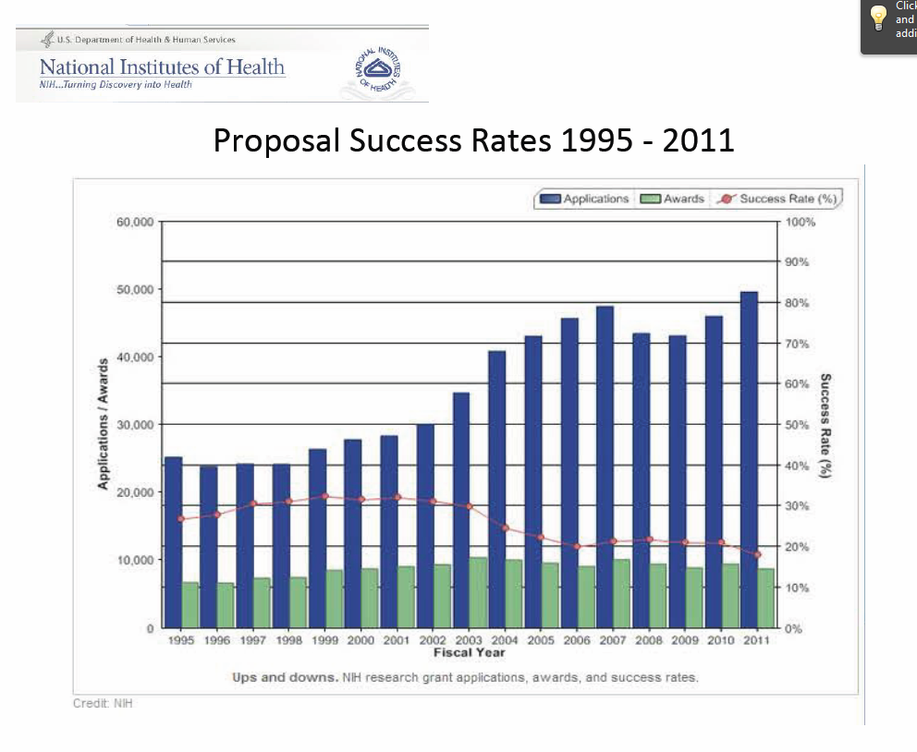
Even in Today’s Challenging Funding Environment…
NIH Proposal Success Rates 1995-2011
“Major U.S. Science Agencies Face Flat Prospects” (Science Insider, March 2014)
"The President’s FY15 budget does disappointingly little to close the nation’s innovation deficit…basic research funding declines in this budget” (AAU, 2014)
Steady increase in proposals with a steady decrease in proposal success rate

Slide 4
… There are Ways to be Successful
Pay attention to details
Significant number of proposals are rejected by funding agencies without review because the proposer didn’t follow all the directions
Use Best Practices
Develop a fundable idea
Find funders
Use effective pre-proposal activities
Write competitive and compelling proposals
Edit and revise
Be persistent
Notes:
Themes throughout this presentation include – lots of pre-proposal activity; marketing throughout; pay attention to detail; use effective proposal writing, editing and revising techniques
At Dec 2013 NSF Days – be persistent; ~15% success for 1st time, ~50% 2nd time, 75% 3rd, assuming followed reviewer recommendations and did proper revisions
In 2009, NIH averaged 8-10% on 1st submission 28% on 2nd; other agencies have similar success rates

Slide 5
Workshop Overview
Good Ideas
Fundable Idea
Find Funder(s)
Pre-Proposal
Write the Proposal
Needs Statements
Themes
Situation Slot
Objectives, Methods, Qualifications, Benefits
Document Design
Revise
Reject
Accepted AND Funded
Funder
Draft
Submit
Peer Review
Edit

Slide 6
Workshop Agenda – Thursday, May 14th
Conrad
Introductions
Overview of Workshop
Identify a Fundable Idea
Find Funders
Pre-proposal Activities
Lunch
Jon
Generic Structure of Proposals
Baseline Logic
The Six Generic Slots
Needs Statement

Slide 7
Workshop Agenda – Friday, May 15th
Jon
PIP (Themes)
Developing the Situation Slot
Objectives/Needs Statement
Methods, Qualifications, Benefits
Lunch
Jon
Faculty Sharing Experiences with Funders
Derek Hansen, NSF
Steven Charles, NIH
Scott Webber, NIH

Slide 8
Homework from 5/15
Refine Needs Statement – will have “a go around the room” sharing of our needs statements
Continue developing proposal
Goals
Objectives
Tasks, Methodologies
Think about Methods, Qualifications, Benefits – that will be discussed next week
Spend this week writing your proposal
Attend Pivot Training? May 20, 11 am 2233 HBLL
Plan for Speed Networking Aug 25th

Slide 9
Homework, 5/21
Write complete draft of proposal including: an eye-catching title, a one-page abstract and 5 pages for the proposal elements (i.e., the 6 generic slots). Paying attention to the review criteria (handout)
Bring 5 copies of your proposal to the June 11th meeting. If you wish Research Development to print the copies of the proposal for you, please email an electronic version of your proposal to Sarah (sarahdorff@byu.edu) by June 10th.
If you can not attend the June 11th meeting, but still would like to have your proposal reviewed, please email it to Kristen (fhssresdev@byu.edu) by June 10th, and she will bring it to the meeting to have it reviewed, or enable reviewers to edit the proposal electronically.
Indicate to Conrad conrad_monson@byu.edu by May 28th if you are going to participate in the “Extended” Bootcamp (need time to arrange)
Upcoming Events
Let Kristen know if you want to participate in the Fulbright Scholar Informational Seminar May 27, 2015 at 12:00 p.m. in 948 SWKT. RSVP to fhssresdev@byu.edu
Plan to participate in Speed Networking event, Aug 25th 9:30-11:30 (lunch to follow). Let Sarah know if you want to present or just attend

Slide 10
Workshop Agenda – Thursday, May 21st
Jon
Oral presentations of Needs Statement
Document Design
Elements of Style
Generating your first Draft
Lunch
Generating your first Draft (cont.)
Conrad
Peer Reviews
Peer Review Panel Demonstration
Larry Howell
Brad Bundy
Michael Jensen

Slide 11
Workshop Agenda – Thursday, June 11th
Kristen
Panel Reviews of Participant Proposals
Outbriefs from each Panel
Proposal Editing and Revising

Slide 12
Develop a Fundable Idea and Find Funders

Slide 13


Fundable Ideas Come from Good Ideas
How do you develop good ideas?
Be knowledgeable
Read extensively in your field
Leverage teaching… effective teaching helps you be knowledgeable
Be thoughtful
Devote time to just thinking
Be creative
Look for parallels with other fields
Be open
Share ideas with your colleagues
And not just because we are at BYU…. Be prayerful
(Adapted from “Grantsmanship Workshop, How to Develop a Fundable Research Proposal” Tammy Bray, PhD, Dean, College of Health and Human Sciences Oregon State University)

Slide 14
Developing Good Ideas (cont.)
Think in Question format
Think in Experiment format
Think in Hypothesis format
Keep an ongoing log of your ideas
Let the ideas incubate and try the process again

Slide 15
Convert a Good Idea Into a Fundable Idea
Answer key questions related to
Passion
Importance
Validation
Research gaps
Better/unique/different
Contributions and benefits
Then refine the idea
(Adapted from questions developed by an NSF panel)

Slide 16
Refine the Idea
Clearly identify the niche area into which your idea fits
Draft a short, well-crafted, logical description of research based on your idea
Present it to colleagues, potential funders
Assess competitors strengths and weaknesses (part of a SWOT analysis?)
Could a competitor be a collaborator?
If you follow the idea generation and refining steps, you will have a fundable idea AND the foundation of a good proposal
Notes:
Clearly identify the niche area into which your idea fits
Identify long-term goals within niche area
Conceptualize research needed to attain long-term research goals
Identify next logical step in research continuum…your idea should be a logical next step
Draft a short, well-crafted, logical description of your idea (must answer Why, Who, What, How) and present it to colleagues for a critical review
Are they excited, show a keen interest in your idea?
Does it have scientific and technical merit?
Do you have the ability, capability and resources to pursue your idea?
At the right time, a description could be presented to a potential funder
Identify your competitors and their strengths/weaknesses. Compare them with yours and determine how you will emphasize your strengths and mitigate your weaknesses. Do you know if your competitors will submit a proposal? Have you considered collaborating with a potential competitor?

Slide 17
Yamamoto Approach to Generating a Fundable Idea
Advisory committee
Is the question impactful in concept and/or practice and clearly articulated?
Are the experiments, even if bold and untested, technically feasible, and do they employ the most advanced approaches?
Would a collaborator add conceptual or technical breadth to the potential outcome?
Outcomes
Uncovers uncertainties and ambiguities
Resolves differences of opinion
Often stimulates improvements
Write the research proposal
Keith Yamamoto, Executive Vice Dean, UC San Francisco School of Medicine
Can you create your own “Advisory Group” with colleagues (or get department or research development to help facilitate their formation)?

Slide 18
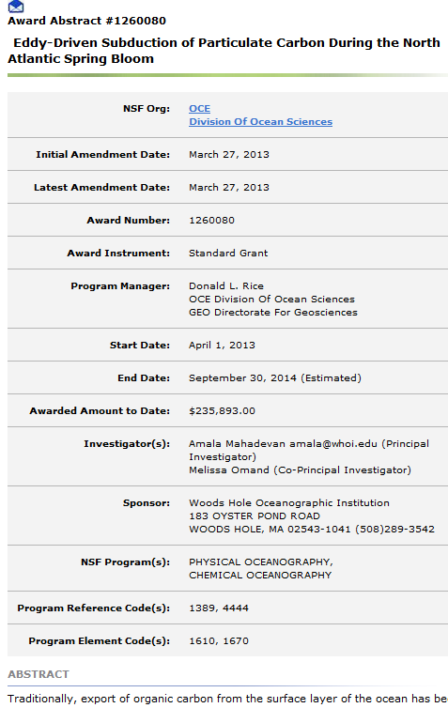
Find Funders
Be systematic and regular in searching
Strategy and plan
Use online alerts tools
Can you extend any current funding?
Can you be part of someone else’s funded project?
Query colleagues (current, classmates in graduate school, major professors) about funders
Find mentor(s)
Review funder acknowledgement in journal articles
A Science Article about Carbon cycling research acknowledged NSF award #1260080 as a source of funding; the NSF website provided detailed information about that award

Slide 19
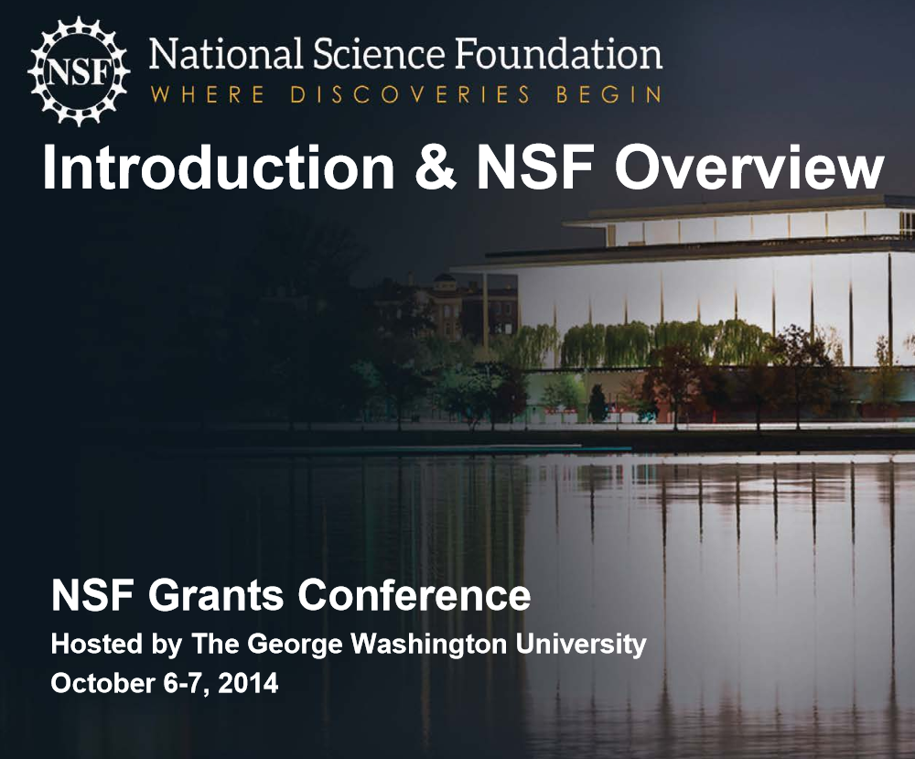
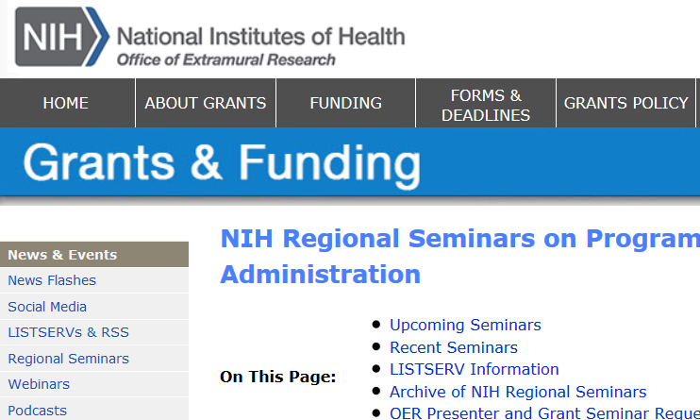
Find Funders (cont.)
Look for funder contacts within professional societies
Attend funding conferences
Participate in review panels
Look for funding opportunities provided by unused Government year end funds
Contact potential Program Officers about funding and ask them to recommend funding sources
Search a wide range of possible funding sources
Federal Government
Associations, Foundations, Companies
Municipal, County, State Government, Community Partnerships
“Alternative” sources of funding (e.g., Crowdfunding, Benefunder, Nine Sigma funding)
As one expert put it - think big, think small, think in different ways to uncover funding opportunities… in other words, cast a wide net
Notes:
Review Panels - at Dec 2013 NSF Days, leader solicited business cards for potential reviewers. For NSF, don’t need a prior NSF grant, or even a PhD or university affiliation. Need expert. NSF needs about 50K reviewers per year

Slide 20
Find Funders Online Search Tools
PIVOT (BYU has a subscription) http://pivot.cos.com
Foundation Center Online (BYU has a subscription) http://fdncenter.org/ login username byuacadvp and password cougars2002
Grants.gov (free; register) http://grants.gov/
The Catalog of Federal Domestic Assistance (CFDA) (free) www.cfda.gov
Other online tools
Federal Register http://www.gpoaccess.gov/fr/
Grantsmanship Center http://www.tgci.com/
Fundsnet service http://fundsnetservices.com
GrantsNet http://www.grantsnet.com
Guidestar http://www.guidestar.org
Agency, Foundation, Company websites
Google/Bing/Yahoo
Notes:
Perhaps most useful feature of PIVOT is the opportunity tracking that provides automated alerts when selected opportunities are updated
We will do a PIVOT tutorial later this morning and Trace Eddington from LDS-P will provide demonstrated Foundation Center online next week.
Are there a few who would like us to do a preliminary search for them and show it at next weeks class?

Slide 21
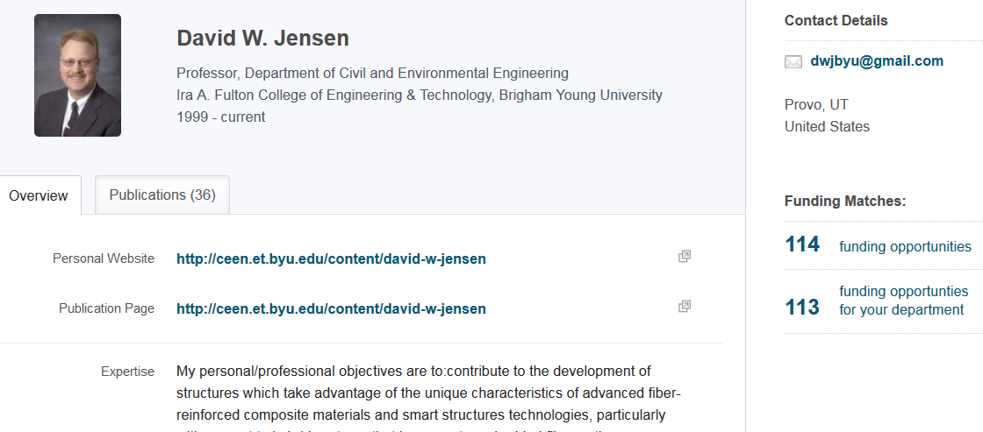
Funding Searches Using PIVOT Profile Matching
PIVOT matches funding opportunities to a profile
CV type information
Information from a research website
Publications (can view an abstract of all publications PIVOT has in your profile)
Grants
Patents
Professional affiliations, honors, awards
Will alert you to opportunities via an Advisor
Can find potential collaborators from opportunities in your profile
Updating your profile will provide better matches
To get started with Pivot, claim and update your profile

Slide 22
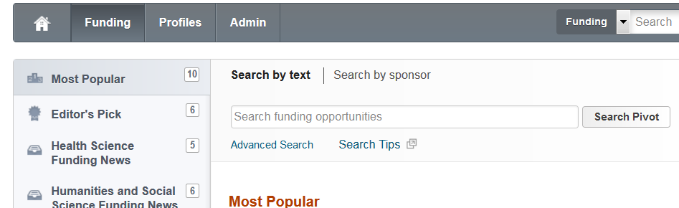
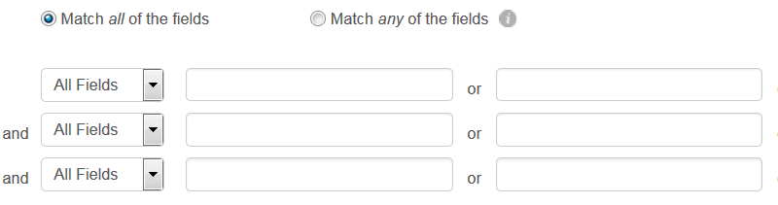
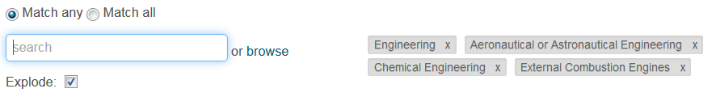
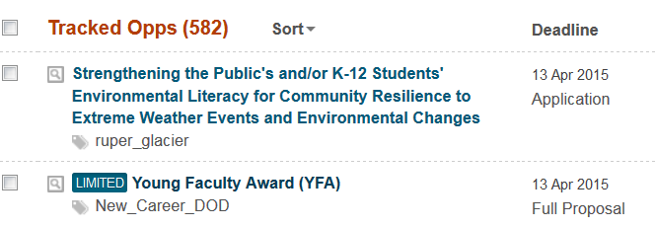
Funding Searches Using PIVOT General Searching
Search opportunities provided by PIVOT editors
What is popular
Editor’s picks
Health Science, Humanities and Social Sciences funding news
Search by entering terms in a text field
Search by sponsor
Search by single terms or multiple terms associated by AND or OR logic
Use keywords to search categories of opportunities
Save search results, track them and receive email alerts for particular opportunities of interest
To get started with Pivot, claim and update your profile. Attend regular Pivot training RD (next 5/20/2015, 11am, 2233 HBLL)

Slide 23
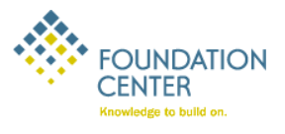
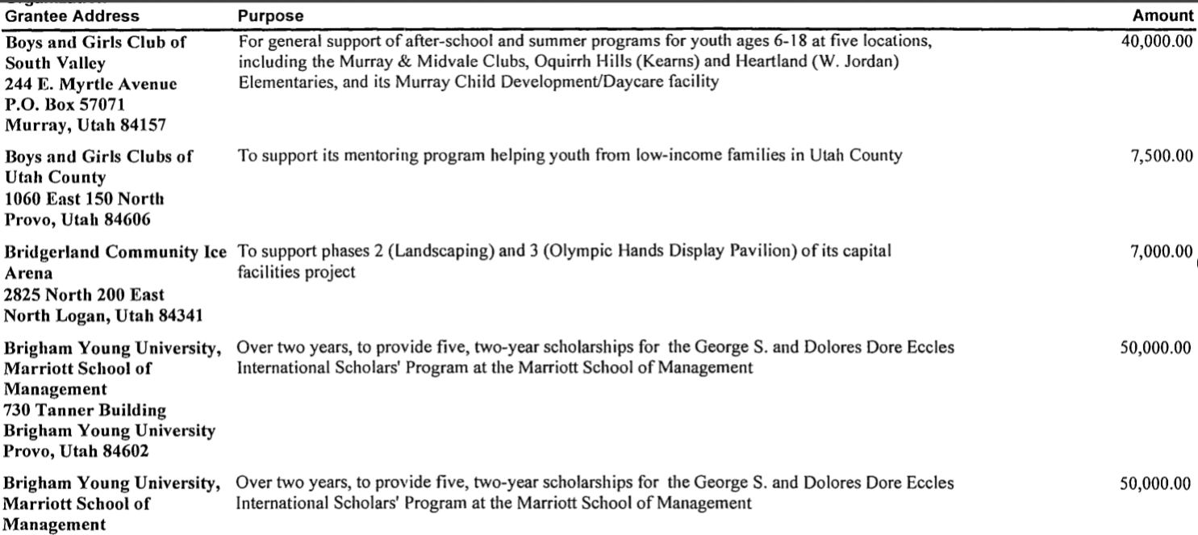
Funding Search Using the Foundation Center Database
Use keywords to search for
Foundations/Grantmakers
Companies
Individual Grants
Find information about particular funder
Areas of interest/mission
Contact information
Geographical area of interest
Whether or not can submit an unsolicited application
Find information about money that was distributed
Must distribute 5% of assets each year to remain a non-profit
Distributions described in 990 Tax Form
Part of the 2009 990 tax form for one of the Eccles foundations

Slide 24
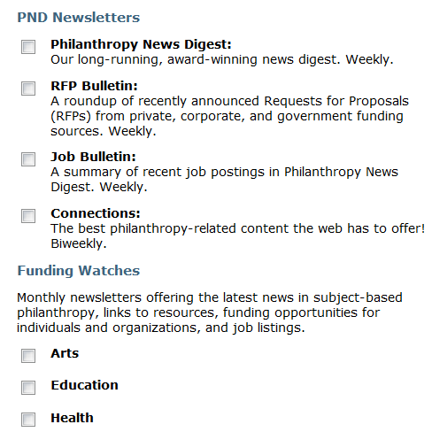
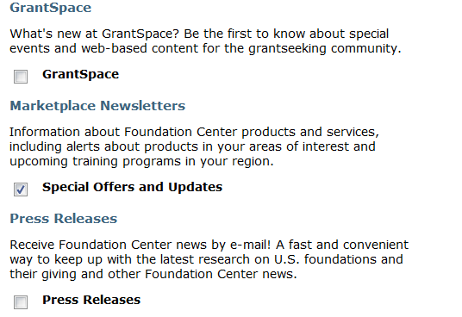
Additional Foundation Center Services That Aid Funding Searches

Slide 25
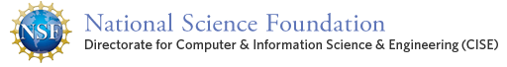
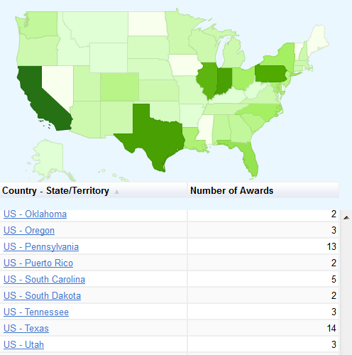
What to Know About Potential Funders
How much funding does a funder have?
How much do they usually distribute?
How many awards do they make?
What is their award rate?
Will they accept applications?
Clearly understand the funder’s research interests, goals, mission statement
See what they have funded in the past
Federal Agencies: often posted on their websites
Non-Profits: can be on their websites and must be on their 990 tax filings
Companies: harder to find; need websites, alumni, contacts to identify research problems they are trying to solve

Slide 26
Select Funding Opportunity(ies) to Pursue
Evaluate candidate opportunities
Your research objectives and funder needs match
You meet eligibility requirements
Funder has sufficient funds to give you a grant
If the funder is a foundation, the foundation gives nationally and/or to Utah
You have sufficient time to do both pre-proposal and proposal writing activities
You have the training to conduct the research (if not, you have collaborators who could)
Focus on one or a few candidate funding opportunities for further development
Avoid the shotgun approach… if I fire enough proposals at enough potential funders, something is going to hit
Perform SWOT analysis
Contact Program Officers
Notes:
Ties into Go No Go decision that will be talked about later

Slide 27
Perform SWOT Analyses
S
Strengths
What are your strengths
What do you do better than others
What unique capabilities and resources do you possess
What do others perceive as your strengths?
W
Weaknesses
What are your weaknesses
What do competitors do better than you
What do others perceive as your weaknesses
Internal (attributes of your organization)
O
Opportunities
What trends or conditions may positively impact you
What opportunities are available to you
T
Threats
What trends or conditions may negatively impact you
What are your competitors doing that may impact you
Do you have solid financial support
What impact do weaknesses have on threats to you
External (attributes of your environment)
Positive (helps meet objectives)
Negative (detrimental to objectives)
SWOT analyses can identify strengths to highlight, weaknesses to mitigate, opportunities to capitalize on and threats to counter

Slide 28
SWOT Example
Utah State’s SWOT analyses determined that the University of Colorado would be a better partner than BYU on a 3-university NSF I CORPs Node proposal (U of U was the other partner)
Strengths – Colorado has largest venture capital investment in the region, as well as a great marketing campaign around its entrepreneurial/innovation activity
Weaknesses – BYU has limited federal research expenditures and impact growth potential
Opportunities – Piggyback on the national attention and momentum that Boulder has received due to its commitment to early-stage deals
Threat – The Univ. of Colorado is attracting a lot of interest through its commercialization and ecosystem development efforts
S
Strengths
Best available regional partner is Univ. of Utah (data)
Combines top efficiency/magnitude programs (BYU and Univ. of Utah)
Geographical proximity - knowledge spillover
Complimentary network of fields
Common ecosystem resources/characteristics
W
Weaknesses
Limited innovation/entrepreneurship interaction between institutions
Univ. of Utah had visible failure in the first round of I-Core
Univ. of Utah would most likely need to drive the initiative
BYU has limited federal research expenditures and impact growth potential
S
Strengths
Best available regional partner is Univ. of Utah (data)
Combines top efficiency/magnitude programs (BYU and Univ. of Utah)
Geographical proximity - knowledge spillover
Complimentary network of fields
Common ecosystem resources/characteristics
W
Weaknesses
Limited innovation/entrepreneurship interaction between institutions
Univ. of Utah had visible failure in the first round of I-Core
Univ. of Utah would most likely need to drive the initiative
BYU has limited federal research expenditures and impact growth potential
S
Strengths
Best available regional partner is Univ. of Utah (data)
Combines top efficiency/magnitude programs (BYU and Univ. of Utah)
Geographical proximity - knowledge spillover
Complimentary network of fields
Common ecosystem resources/characteristics
W
Weaknesses
Limited innovation/entrepreneurship interaction between institutions
Univ. of Utah had visible failure in the first round of I-Core
Univ. of Utah would most likely need to drive the initiative
BYU has limited federal research expenditures and impact growth potential
O
Opportunities
Utah is a leader in high-tech startup density and venture capital share growth in the region and nation
Signals a united front for the state of Utah and its commitment to entrepreneurship/innovation
Opportunity to showcase impact of USTAR/other state programs on commercialization
Regardless of outcome, these collaborations could greatly benefit Utah State
T
Threats
Los Angeles/San Diego is the strongest ecosystem available in the Pacific and Mountain Regions
A member of the I-Core Selection Committee has voiced their lack of support for the Univ. of Utah
The Univ. of Colorado is attracting a lot of interest through its commercialization and ecosystem development efforts
Utah is an extremely conservative state compared to Colorado and Washington/Oregon
O
Opportunities
Utah is a leader in high-tech startup density and venture capital share growth in the region and nation
Signals a united front for the state of Utah and its commitment to entrepreneurship/innovation
Opportunity to showcase impact of USTAR/other state programs on commercialization
Regardless of outcome, these collaborations could greatly benefit Utah State
T
Threats
Los Angeles/San Diego is the strongest ecosystem available in the Pacific and Mountain Regions
A member of the I-Core Selection Committee has voiced their lack of support for the Univ. of Utah
The Univ. of Colorado is attracting a lot of interest through its commercialization and ecosystem development efforts
Utah is an extremely conservative state compared to Colorado and Washington/Oregon
O
Opportunities
Utah is a leader in high-tech startup density and venture capital share growth in the region and nation
Signals a united front for the state of Utah and its commitment to entrepreneurship/innovation
Opportunity to showcase impact of USTAR/other state programs on commercialization
Regardless of outcome, these collaborations could greatly benefit Utah State
T
Threats
Los Angeles/San Diego is the strongest ecosystem available in the Pacific and Mountain Regions
A member of the I-Core Selection Committee has voiced their lack of support for the Univ. of Utah
The Univ. of Colorado is attracting a lot of interest through its commercialization and ecosystem development efforts
Utah is an extremely conservative state compared to Colorado and Washington/Oregon
Notes:
Lots of templates and procedures have been developed to do a SWOT analysis. Whether or not you use a formal procedure, you will likely do at least an informal SWOT – the key is to clearly identify SWOT elements so you can leverage the positives about your research situtation and mitigate the negatives

Slide 29
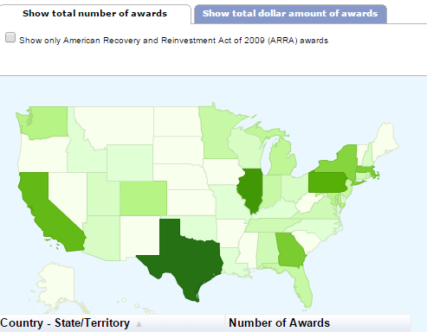
Contacting a Program Officer
Be respectful of PO’s time
Do your homework – don’t ask questions that are answered in RFP or other provided documents
Review recent awards
Write a pre-abstract
Email pre-abstract to program officer (PO) and ask if the proposed project aligns with the program.
If PO responds positively, schedule a call or in-person meeting
Ask: What would you recommend to improve my chances for favorable review? What is anticipated success rate? What are some common reasons for proposal rejections? Listen carefully to read between the lines.
Follow up with a short thank you, summary of key points, cv with photo
Let the PO know you are willing to serve on a review panel
(Adapted from Can We Talk? Contacting Grant Program Officers by Robert Porter, 2009)

Slide 30
Pre-Proposal Activities for a Targeted Funding Opportunity
Long Term Planning
Solicitation Decomposition
Proposal Development Plan
Market Your Ideas
Consider What Make Proposals Competitive AND Compelling

Slide 31
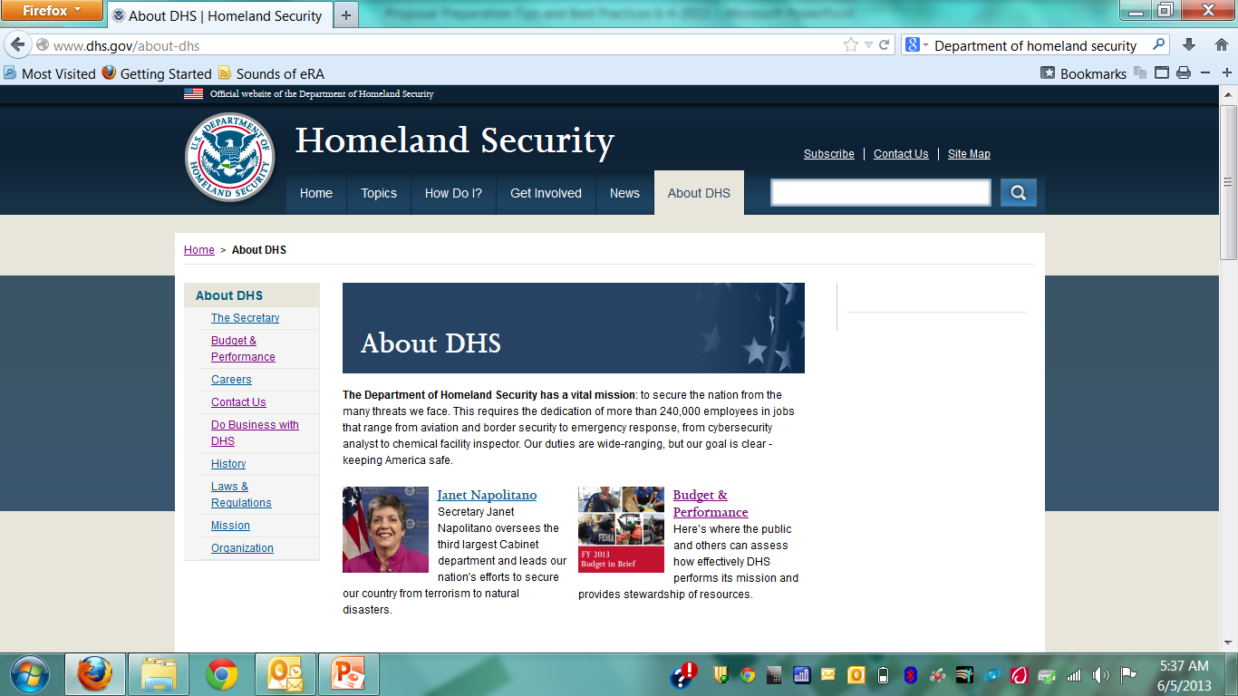
Take a Long-Term Approach
What can industry teach?
Develop a long-term research funding capture plan
Know about upcoming funding opportunities and funder objectives as they are being developed … can you shape the funders thinking, shape the RFP?
Example
Create a win strategy (and calculate a “P_{win}“?)
Well in advance of writing, identify proposal resources
Notes:
The more time you spend in effective pre-proposal activities, the more likely you are to be successful in developing a proposal that will be funded. High Tech and other Industries that do a lot of research and development with a significant amount of funding from the federal government are expert at pre-proposal activities – in fact, their business depends upon the effectiveness of pre-proposal planning. Here are some methods they use

Slide 32
Example of an Aerospace Company’s Business Acquisition Plan
Phase | Activities
Long Term Positioning | Contacts - customers, teammates, competitors, suppliers Develop/Execute Action Plans - technology, business, campaign
Opportunity Assessment | Customer making funding decisions - understand customer issues and motivations Assess - opportunity fit with business plans, competencies, costs to pursue (e.g., will take significant investment to displace incumbent)
Opportunity Pursuit | Customer open to suggestions - influence RFP for greater competitive advantage Develop win strategy; calculate P_{win} Likely a win if “we can give the customer an offer that speaks directly to and meets their wants and desires and we have a demonstrated track record of performance thereby earning the customer’s trust”
Pre-Proposal Preparation | Develop Organization and Procedures – developed for a winning proposal effort Assess - actual solicitation against previous planning Capture lead - interacts with customer, organizes team Win strategy - update, execute Proposal design - reviewed by Review Team
Typically 1 year or more
Notes:
A lot of planning including customer contact planning (contact plans) and assessment of effectiveness
The planning, contacting, technology development, typically become factors to determine a P_{win} … terms for customer knowledge (including numbers and types of contacts); competition assessments; technology maturity; time; preliminary development, past performance, etc. Without a P_{win} of 50%, likely wouldn’t submit a proposal

Slide 33
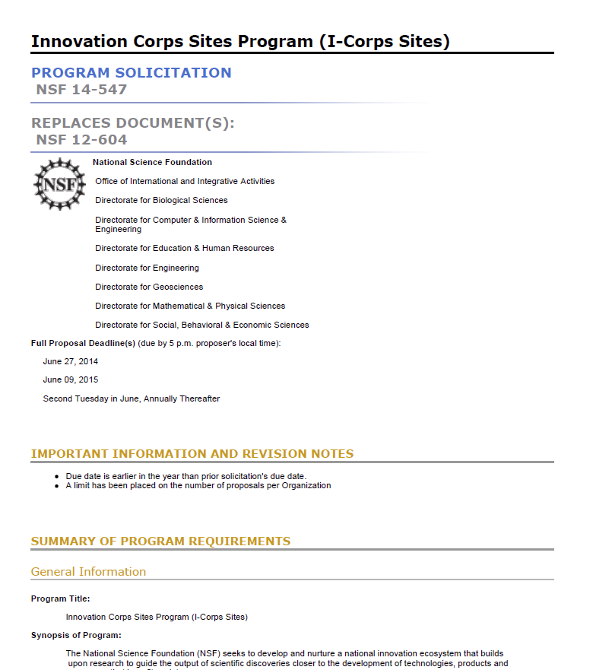
Thoroughly Decompose the Solicitation of a Targeted Opportunity
Deadlines
Requirements, (technical, budget, management, “MIRs” etc.)
Proposal components
Unusual requirements
Procedures for submittal (including BYU/ORCA procedures)
Notes:
Deadlines for submitting questions to the program officer, submittal through BYU/ORCA, submittal to the funder
Most Important Requirements (technical, budget content)
Elements required of proposal (cover page, summary, etc.)
Unusual requirements
Procedures for submittal (including BYU/ORCA procedures
Requirements
Can be technical, budget, management
What isn’t said in the solicitation may be just as important as what is said
Must understand and answer the MIRs (most important requirements

Slide 34
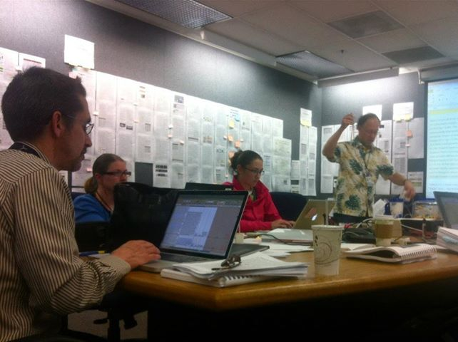
Create a Proposal Development Plan for the Targeted Funding Opportunity
Create a plan with checklists (e.g., http://researchdevelopment.byu.edu/resources/proposal)
Designate a preparation room/wall/area
Conduct a Kickoff
Coordinate – with whom and when
Create a proposal “production” schedule
Create proposal themes
Determine how requirements will be addressed
Make writing assignments
Arrange proposal development support
Arrange reviewers
Proposal “War” Room (from NASA)
Careful planning should help you avoid common errors, ensure all requirements are met and the best possible proposal is submitted
Notes:
Kickoff with proposal team
Proposal preparation room/wall/area to post drafts, get timely, continuing reviews
Coordination with Department, College, ORCA
Schedule for proposal production – make sure sufficient time to submit to ORCA before deadline. Sometimes the SPO/ORCA can make a mistake and you need time to review what they are going to submit. At NSF Day Dec 2013, PM in Astronomy related an experience whereby the SPO changed collaborators to Co-Is and PI didn’t review before submittal. Good proposal; NSF had to reject because there was no information required for Co-Is (wouldn’t have been required of collaborators)
Writing assignments to team
Proposal support assignments
Reviewers identification and review schedule
Use Checklists - see example on the website

Slide 35
Calculate a P_{win}
Develop Criteria from the Solicitation
Evaluate criteria
Assign “values” (including weightings) from Solicitation requirements
Determine elements that make up criteria from SWOT, similar analyses, “Go-No Go” information
For industry, typically need a P_{win} > 0.5 and/or a P_{win} > competitors to proceed with proposal
For academic research, competitor comparison may be less important (multiple awards, no defined product as an outcome)
An Example of One Way to Calculate P_{win}
Even a very subjective P_{win} has value; it can predict the strengths and potential weaknesses of a proposal

Slide 36

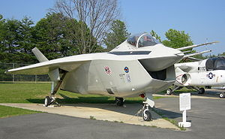
Market Your Ideas
Think like a marketer and always see things from the customer’s point of view
A proposal is not about you or your needs, it is about the funder’s needs… you’re project should make the funder successful
You want an emotional response to your ideas from your potential funders… excitement, keen interest, compelling, “I’ve got to have it now” … not boredom, confusion, or even anger
Boeing’s UCAV, F-35 – the power of emotion in contract decisions
Ultimately, funding decisions are emotional decisions… make sure your proposal generates positive emotions
Notes:
Think like a marketer and always see things from the customer’s point of view “Marketers do one thing, and they do it very well. They see things from the prospect’s point of view. They lose their own ego, interests and desires, and they focus on the customer’s wants and desires (Morgan Giddings)”
A proposal is not about you or your needs, it is about the funder’s needs… you’re project should make the funder successful
You want an emotional response to your ideas from your potential funders… excitement, keen interest, compelling, “I’ve got to have it now” … not boredom, confusion, or even anger
Boeings UCAV contract with DARPA was an ~$150M competition with Northrop Grumman that was so close, Boeing won at least in part because the PM felt Boeing would do a better job - not on price, past performance, schedule … many of the elements that typically win a proposal. The emotional investment was so intense by Northrop Grumman, the customer told us during when NG was debriefed that was the first time in all his years of contracting, he had ever seen “grown men cry”.
Boeing management was so worried about the emotional response to its F-35 prototype – it looked so ugly, pilots might not want to fly it – that they hired high priced consultants to understand the emotional response to the aircraft and how to mitigate it.
Finally, marketing your ideas and proposal should be embedded in the complete proposal development process, from pre-proposal to proposal writing, described in the next sections.
Characteristics of a
Successful Salesperson
•Makes a good first impression
•Is well-prepared
•Is credible
•Delivers a clear message
•Provides supporting documentation
•Has appropriate endorsements
•Has something special to offer
•Is persistent

Slide 37
Even “Objective” Review Panels Respond Emotionally
“The problem statement, such as it is, is too global, showing no relationship to reality with no potential solution being indicated or even possible.”
“This problem has been studied to death. I’m surprised the writer doesn’t know this.”
“It is almost impossible to understand what the author wants to study or what the main theme is. The problem is full of jargon and totally unclear as stated.”
“I cannot ascertain what approach the researcher will take in examining the problem as outlined.”
“The writer has a flair for the dramatic. The world will not collapse if we do not fund a study of students’ daydreams.”
(Actual comments made by NIH reviewers)
Notes:
Funding decisions are ultimately emotional decisions

Slide 38
Use the Title and Abstract As Marketing Tools
The title is the first thing a reviewer reads…it should catch the readers attentions
Emphasizes payoff/benefit
Is understood by a broad spectrum of audiences, including the general public
Uses words accenting the main category of the study and describing its distinctive features
States the major idea as quickly as possible, with the modifiers following, rather than preceding, the main idea
Avoids jargon or vogue words

Slide 39
Effective Titles (cont.)
Avoids fillers and non-communicating devices such as
“A Study of... ”, “An Exploratory Study to Determine...”, “An Examination of...”, “A Method to Explore...” (unless the focus of your project is the methodology itself, rather than the results of using the methodology)
Create effective titles by
Studying titles of other funded projects in your field to determine how projects are described including the extent of precise technical language
Identifying candidate words and abbreviations and combining them in different ways to create approximately ten titles
Ask colleagues and “laypersons” to identify the most informative and evocative of interest
Refine until it is “eye catching”
Example
Rather than "Studies on the Development of Objective Techniques for Monitoring the Development of Visual Acuity in Infants“ how about "Visual Acuity in Infants” or "Visual Acuity in Infants: Objective Monitoring of its Development"

Slide 40
Persuasive Summary/Abstract
After the title, the next and perhaps the only thing a reviewer reads is the abstract/summary
Usually written last, but read first by reviewers
Provides first impression of your project
May also be the last impression for reviewers wanting to refresh their understanding after reading your proposal
Must be compelling, interesting, exciting
Should reflect entire scope of project

Slide 41
Effective Abstract/Summary (cont.)
Summarizes project purpose, goals, research design, methods, significance
Must convey:
What researcher intends to do
Why it’s important
Expected outcome(s)
How work will be accomplished
Should be explicit (e.g., “The objective of this study is to …”) and use strong wording (e.g., “we will show the effects of…” and not “we intend to show…”)
Has to be well crafted and thoughtful, concise and complete
“If I had more time, I would have written you a shorter letter (Mark Twain’s correspondence with a friend)”

Slide 42
Make Your Proposal Competitive…
All of your pre-proposal activities from developing fundable ideas, planning and marketing can help you write a competitive proposal
Significant to relevant stakeholders
Original approach
Strong likelihood of success
Documents knowledge and experience in the relevant discipline
Logical, coherent project plan
Experience in essential methodology
Realistic amount of work
Sufficient detail
Cost effective
Notes:
Significance (important area of research)
Great idea(s) that address important problems in the field and are significant to relevant stakeholders
Original approach
Strong likelihood of success, i.e., will make a significant contribution to the field
Knowledge and experience in the discipline
Experience in essential methodology
Well developed, succinct, logical and focused project plan developed around the idea
Coherent narrative that integrates each component of the project
Realistic amount of work
Sufficient detail
Cost effective

Slide 43
… and Compelling
Grabs the reader’s attention
Explains the benefits
Assures the funder of your capability
Describes a fully-aligned, justified budget
(From Giddings, Porter)
Notes:
Grabs the reader’s attention
Holds that attention long enough to explain the benefits of your offer
Explains how the benefits will be delivered
Assures the reviewer of your reliability/capability
Describes the costs of benefits to be delivered

Slide 44
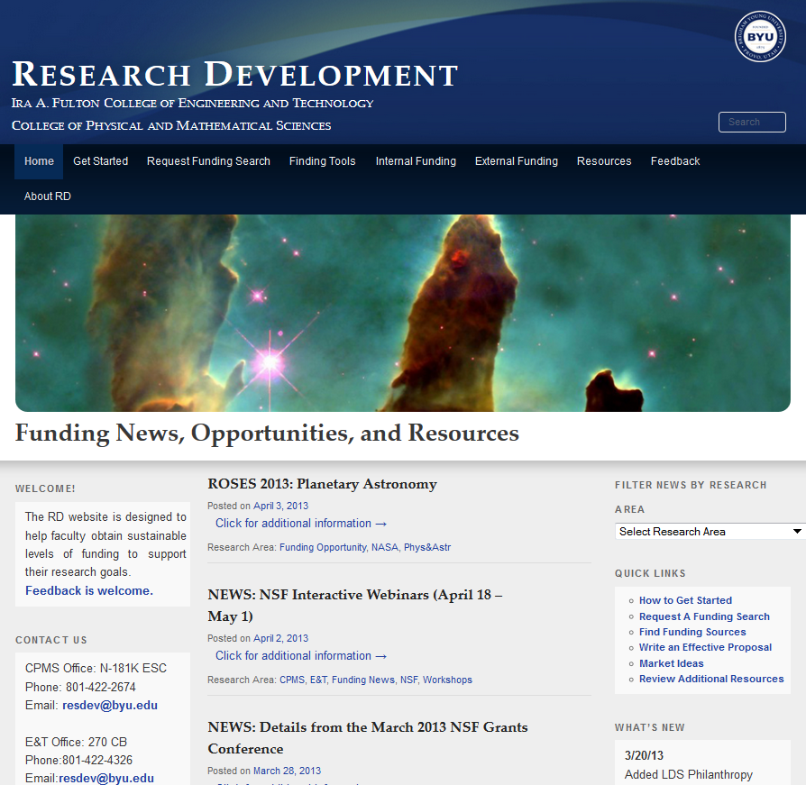
Research Development Website
Design
Information “dense”
Information accessible < 3 clicks
Checklists and guides
Pages
Home page
Orient reader to website
Funding news
Quick links to other pages
Getting Started page
Planning, finding, securing funding steps
Request a funding search
Tools funding searches
Internal and external funding sources
Resources
Proposal planning/management
Proposal preparation
Sample proposals
Marketing
http://researchdevelopment.byu.edu/

Slide 45
Sources for This Presentation
Robert Porter, What do Grant Reviewers Really Want, Journal of Research Administration, Vol. XXXVI, Issue 2, 2005.
Robert Porter, Coaching Researchers to Write Successful Grants, National Organization of Research Development Professionals (NORDP), May, 2013 conference. Really Want and
Morgan Giddings, Four Steps to Funding, How To Avoid Rejection and Get Your Proposal Funded on Your Next Try, 2012
Jeremy and Lynn Miner, A Guide to Proposal Planning and Writing
Grant Writing Institute
CapturePlanning.com
Instructional materials prepared by the National Council of University Research Administrators and the Society for Research Administrators, July 1995 (see facstaff.gpc.edu/~ebrown/infobr3.htm Georgia Perimeter College)
Tips and Practical Guidelines for Proposal Writers prepared by an NSF panel
NSF Panel on TUES proposal preparation
NSF Proposal Writing Exercises
The Grant Center, UNC. http://writingcenter.unc.edu/handouts/grant-proposals-or-give-me-the-money/

Slide 46
Additional Resources for Proposal Preparation
Online
Research Development website http://researchdevelopment.byu.edu/
ORCA website http://orca.byu.edu/
Faculty Center website http://facultycenter.byu.edu/node?destination=node
Human Resources
Colleges of Engineering, Physical and Mathematical Sciences and Life Sciences Research Development group
College of Family Health and Social Sciences Research Development Specialists
ORCA
Faculty Center
Experienced faculty with success at proposal writing
LDS-P
BYU workshops
Off campus workshops
Hardcopy
Research Development Group loanable guides for writing proposals to NIH, NSF other runders
HBB Library

Slide 47
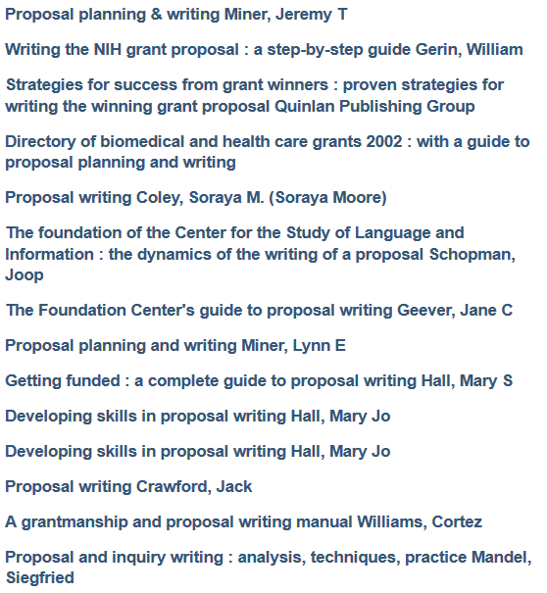
Sampling of Proposal Writing Books at the HBLL

