Slide 1
Proposal Review Panels – Improve Your Proposals by Understanding How Panels Review Them
May 21, 2015
Proposal Development Workshop

Slide 2
Agenda
Introduction
Proposal Review
Panelists Experiences
Questions

Slide 3
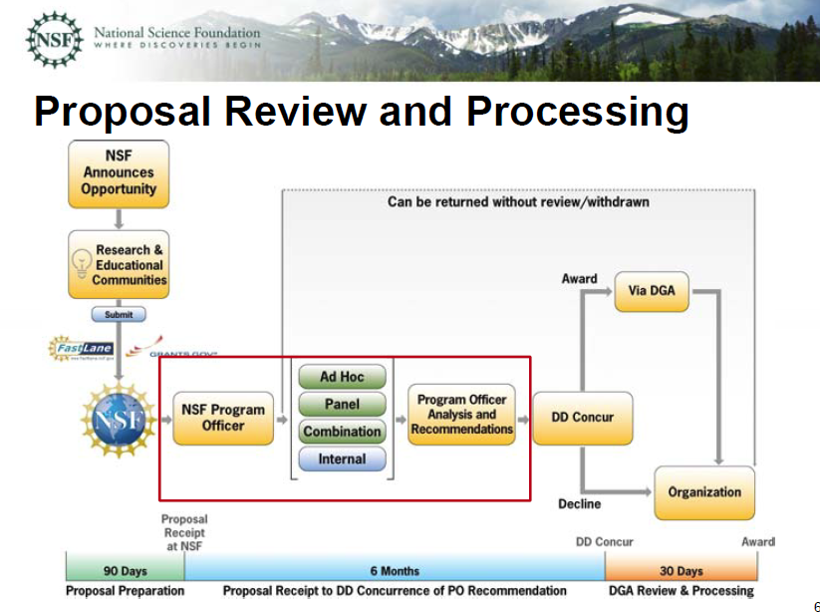

Slide 4
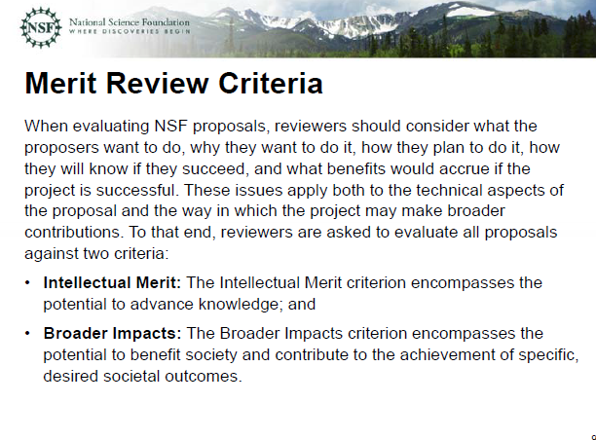

Slide 5
