Slide 1
Grant Proposal Development Bootcamp
May 15-18th , 2017

Slide 2
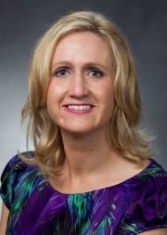
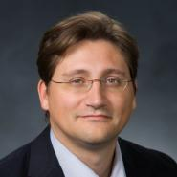
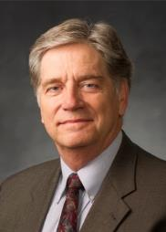
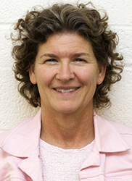
Research Development Support
Kristen Clarke Kellems
FHSS Research Development
934 SWKT
Tel: 801-422-8967
Email: fhssresdev@byu.edu
Jon Balzotti
English Department Faculty
College of Humanities
4127 JFSB
Tel: (801) 422-2440
jonathan_balzotti@byu.edu
Conrad Monson
STEM Research
Development
275 McDonald Building
Tel: 801-422-7722
Email: conrad_monson@byu.edu
Sarah Dorff
Research Development Administrator
269 McDonald Building
Tel: 801-422-0132
Email: resdev@byu.edu

Slide 3
Topics
Day 1
Baseline Logic and Six Generic Slots
Description of Needs Statement
Description of Background/Objectives Sections
Day 3
Creating a Value Proposition
Description of PIP and Benefits/Budget Sections
Day 4
Writing for Reviewers
Group Review
Writing and Editing
Titles and Abstracts
Marketing
Wrap Up
Day 2
Description of Methods/Qualifications Sections
Faculty Panel

Slide 4
Proposal Slots Map to Typical Proposal Sections
The generic slots map directly to proposal sections or provide content to support proposal sections identified by a funder
The Generic Proposal Slots
Typical Proposal Sections
Introduction/Background/Justification and Scope
Situation: This is our understanding of the problem.
Objectives: Given that problem, these are our objectives for solving (or realizing) it.
Introduction/Background/Justification and Scope/Specific Aims
Methods: Given those objectives, these are the methods we will use to achieve them.
Work Plan/Methods/Approach/Data Management Plans
Qualifications: Given those methods, these are our qualifications for performing them.
Qualifications
Budget: Given those qualifications and methods, this is how much the project will cost.
Budget/Budget Justification/Project Costs
Benefits: Given our efforts and funders support, these are the benefits or value you will receive.
Benefits/Significance
Content Supports
Titles/Abstract/Summary/Intellectual Merit/Broader Impacts/Previous Work/Biosketches
CVs/Other Resources and Support

Slide 5
Writing for Reviewers

Slide 6
All Funders Have A Review Process
If an organization offers grants, then they have a process for reviewing applications
They pick reviewers who:
Some level of expertise with the topic they are assigned to review
Are able to be impartial
Can work well in a group
Resolve conflicts of interest
Are given review criteria and instructions on how to evaluate applications
Examples of review criteria:
NIH (applicable to all applications): Significance, Investigators, Innovation, Approach, Environment
Fulbright: Applicant credentials; Suitability of applicants training, knowledge, skills and experience; Quality of proposed project; Applicants cultural adaptability and sensitivity; Projects projected impact and value of projected outcomes
Templeton Foundation (and other foundation funding): Review of initial letter--proposed project represents a realistic, strategic, and potentially successful opportunity to advance the philanthropic vision; Full proposal—completeness and accuracy (resolving questions about the project)
NSF: Intellectual merit, Broader impacts

Slide 7
Write for Reviewers
You Should
Pay attention to all the review criteria
Assume an uninformed but intelligent reviewer
Consider the challenges facing reviewers
  Many proposals to review
  Limited Time for your proposal
  Different experiences in review process, veterans to novices
  Different levels of knowledge in proposal area
  With many proposals to review, looking for reasons to reject proposals
Your Proposal Must
Support each reading style; reviewers will use them all (skim, search, critical)
Get reviewers excited and interested starting from the title and first page
Make them an advocate for your proposal to their colleagues … likely only one will review the proposal all the way through
Excite, not bore, confuse or anger reviewers… negative emotions are the kiss of death

Slide 8
Bad Proposal Example
Hypothesis: The goals of this proposal are to identify microRNAs (miRNAs) and elucidate gene networks that regulate limb regeneration. These studies will (1) identify miRNAs that contribute to the regulation of regenerative capacity; (2) identify miRNA-target mRNA pairs involved in limb regeneration; and (3) test selected microRNAs for their ability to promote regeneration.
Purpose: Elucidation of microRNA-dependent regulation during amphibian regeneration should identify key molecular components and regulatory steps that could potentially permit the therapeutic activation of regenerative processes in mammals.
  SA #1: Identification of microRNAs expressed in intact, regenerating, and non-regenerating limbs.
  SA #2: Characterization of miRNA-mRNA regulatory interactions
  SA #3: Functional analysis of selected miRNAs in limb regeneration
From “Grant Writing for Success: Top 10 Reviewer Concerns and Good/Bad Grants” by LeShawndra N. Price, NIH

Slide 9
Reviewer Comments
Unfocused screen for potential miRNAs that participate in limb regeneration.
The functional characterization is less focused and thus more uncertain in outcome. The potential unique assay offers a tantalizing opportunity, but it would be stronger if a more comprehensive analysis of all candidates were proposed.
The functional analysis is diffuse and overly ambitious. There is a major concern that the results will not lead forward to a more mechanistic understanding of limb regeneration.
Study in cells is very promising but extrapolation to limbs and tissues may be technically challenging.
Need discussion of controls/quantitative effects of method on normal regeneration.
The method of incorporating agents into specific tissues is a very new method. None of the PIs have used this method previously; preliminary experiments would strengthen the feasibility of this approach.
The PI is new to the regeneration field and has no funding or publication history in this area

Slide 10
Good Proposal Example
Hypothesis: Chronic drug exposure upregulates the expression of Factor X, which triggers and sustains the exocytotic trafficking and surface expression of functional Receptor A
Purpose: To investigate the molecular mechanisms for Factor X-induced Receptor A trafficking
  SA #1: Determine the signaling pathways mediating Factor X-induced Receptor A trafficking
  SA #2: Determine Factor X involvement in drug-induced Receptor A trafficking
  SA #3: Determine the synaptic sites of Receptor A trafficking and Receptor A-B interactions
  SA #4: Determine the behavioral significance of emergent Receptor A and behavioral Receptor A-B interactions

Slide 11
Reviewer Comments
Strengths are numerous and include novel and innovative hypotheses, sound experimental design using multidisciplinary approaches, a highly qualified investigator and research team, and a high likelihood of meaningful findings
Strengths include the significance of the central hypothesis, the well-designed experimental plan, supportive preliminary data ….
…the rationale for the studies are clearly delineated, appropriate controls are in place, scope of the studies is appropriate, and there is … complete discussion of possible limitations of some approaches and how findings will be interpreted

Slide 12
When Your Proposal Is Rejected
Every successful proposal writer has been rejected
  Re-submission success rates are relatively high (up to 50% for 2nd and 75% for 3rd time submission to some NSF directorates)
Clearly understand reasons for rejection (may need Program Officer clarification)
  NIH study of 609 reject proposals shows most common reasons for rejection
    Approach - 73%
    Problem - 58%
    Investigator - 55%
Can you address each reviewers comments with new, relevant information (and without being hostile)?
Will your revised proposal address every requirement, be more understandable and more compelling?
If revisions are too extensive, you should submit a new proposal
  NIH carefully monitors new applications to be sure they are not rejected proposals that have just been re-titled
Adapted from NIH RO1 Grant Application Mentor from the Principal Investigators Association

Slide 13
Group Review
Review Criteria Handout

Slide 14
Writing In Plain Language

Slide 15

From Jill Jividen, University of Michigan School of Medicine

Slide 16
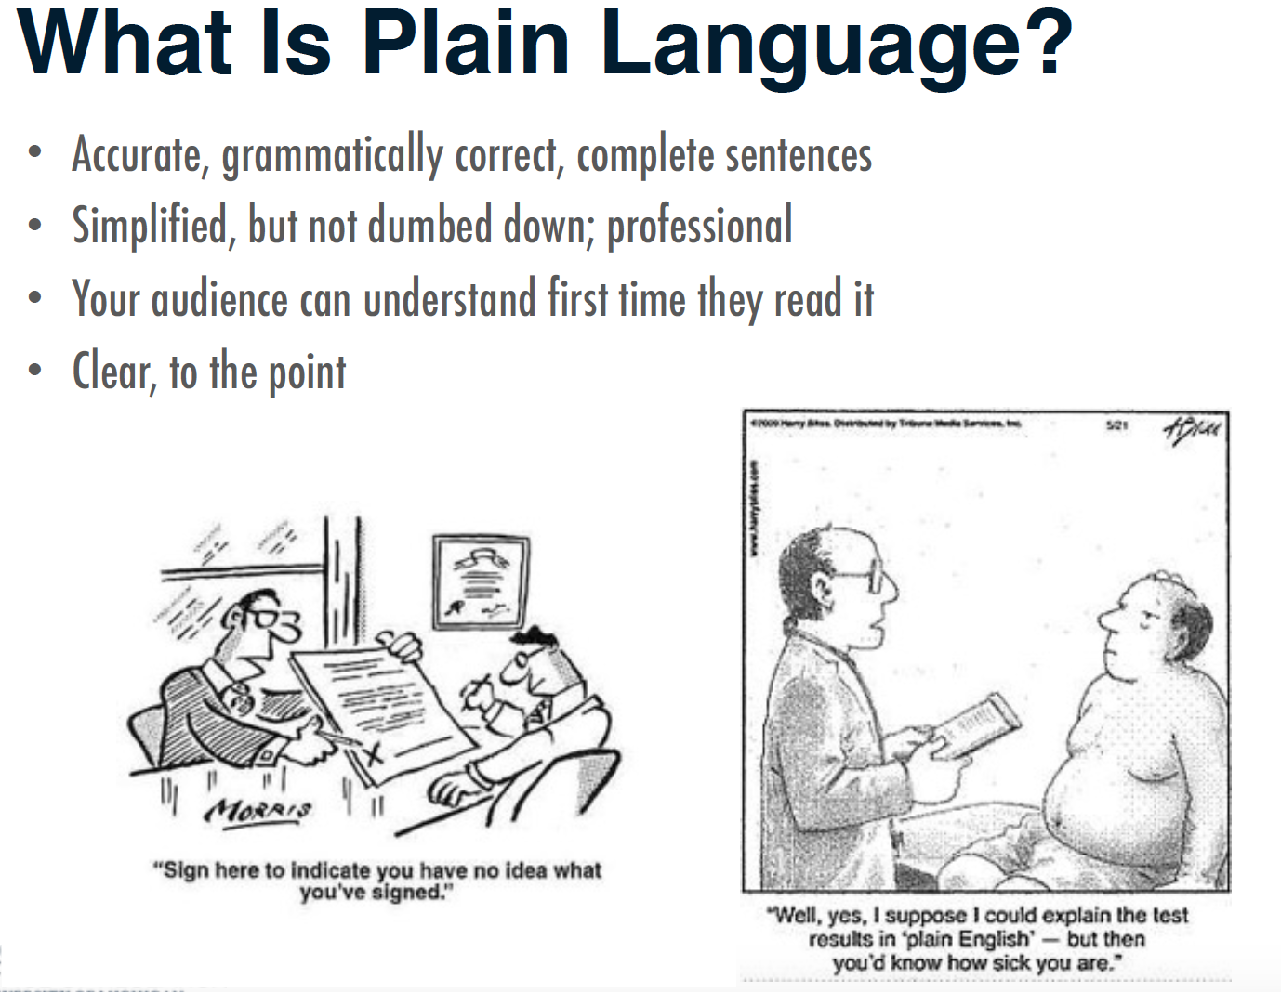

Slide 17
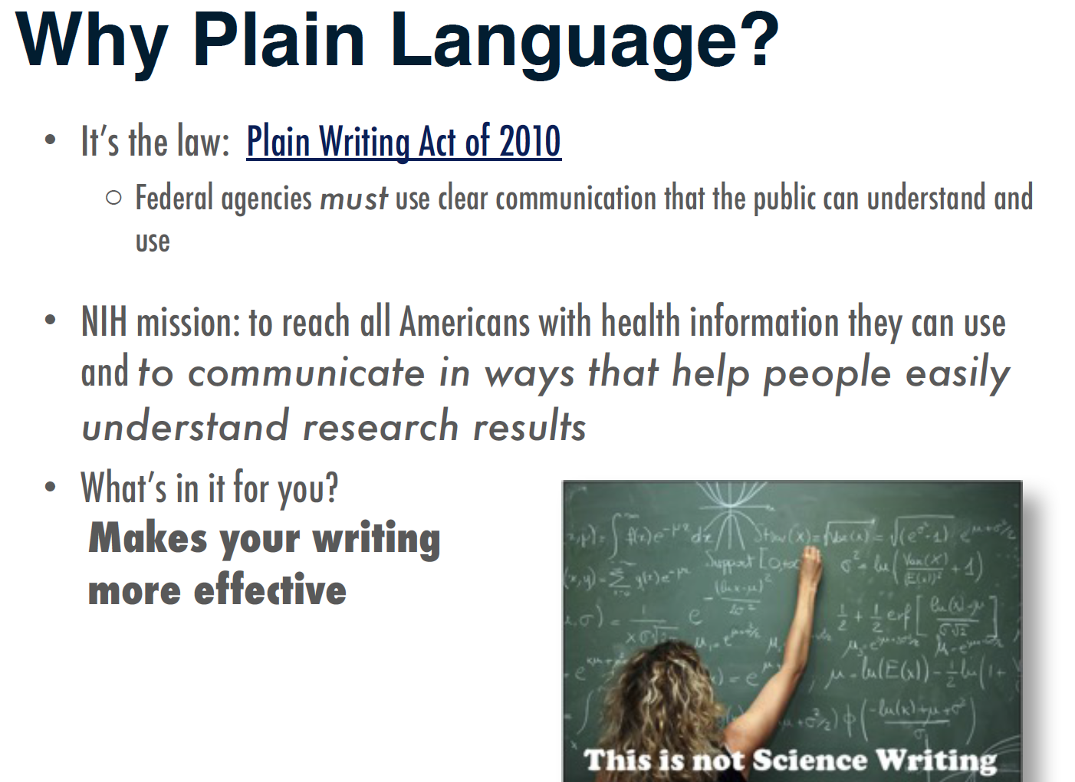

Slide 18
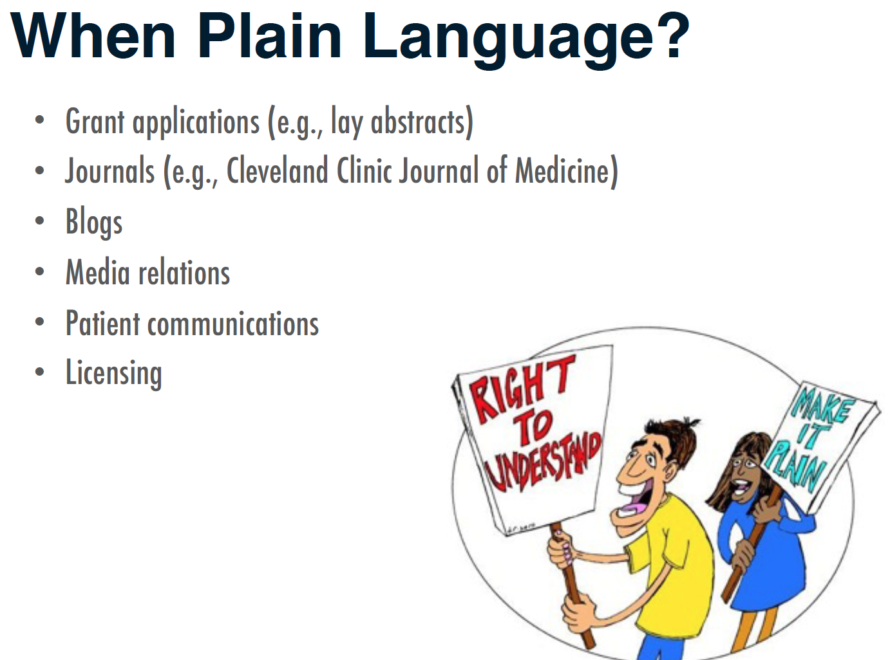

Slide 19
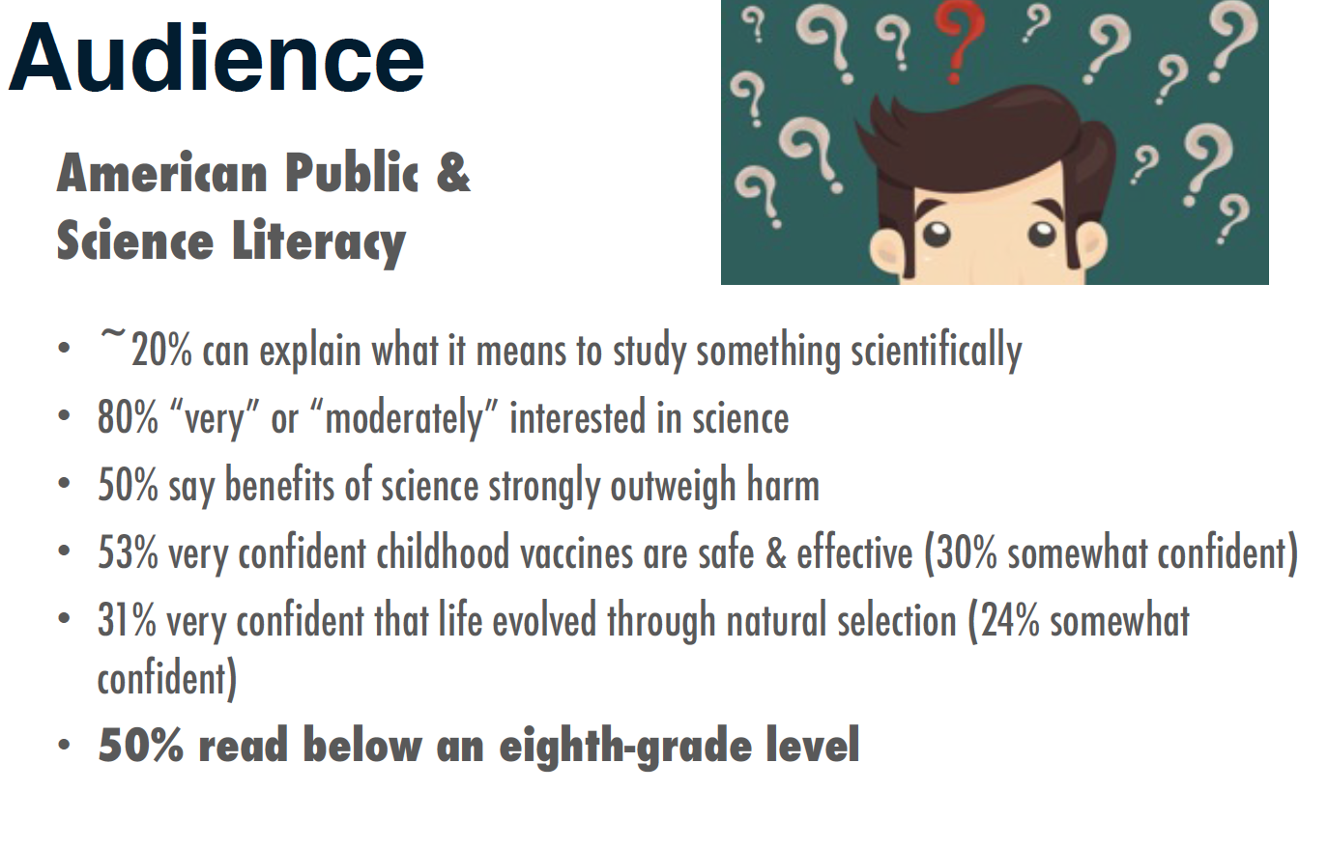

Slide 20
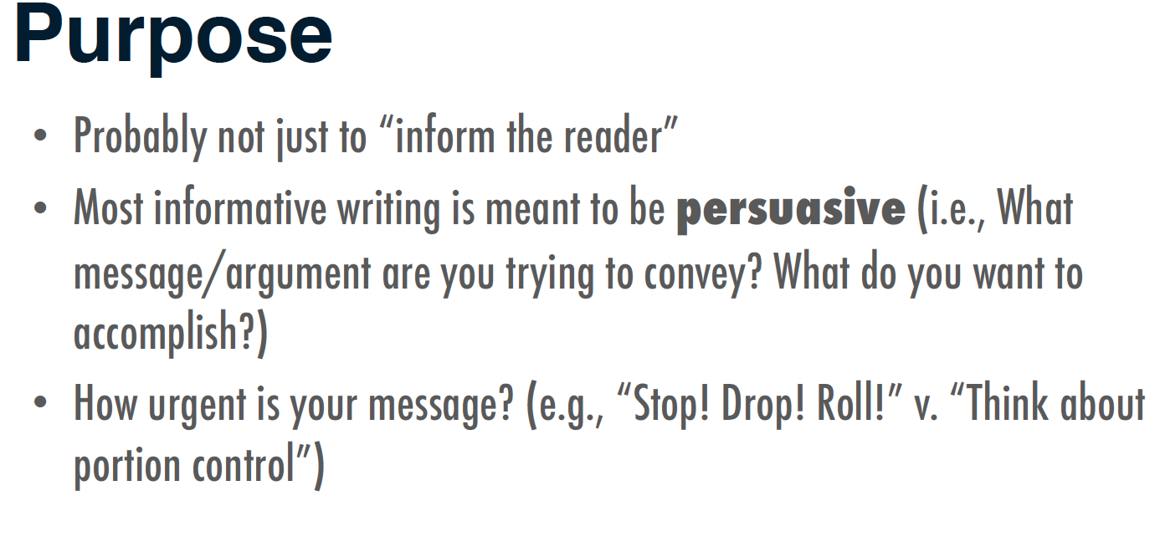

Slide 21
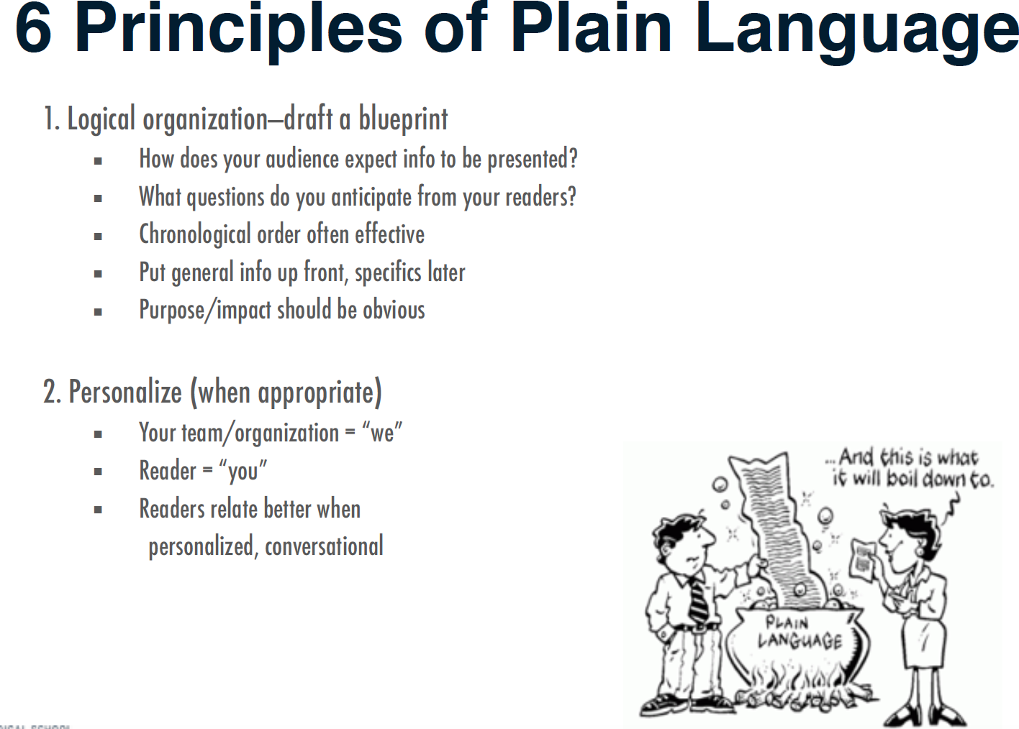

Slide 22
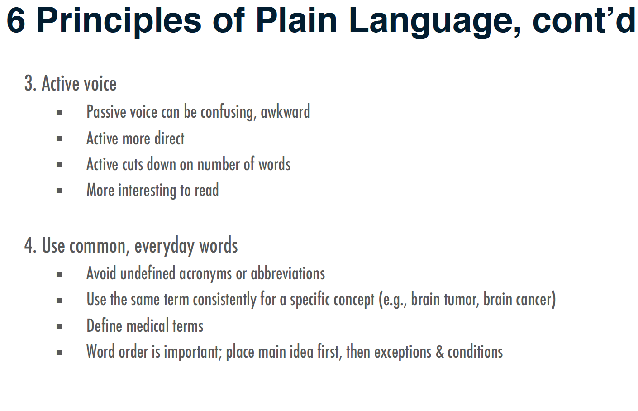

Slide 23
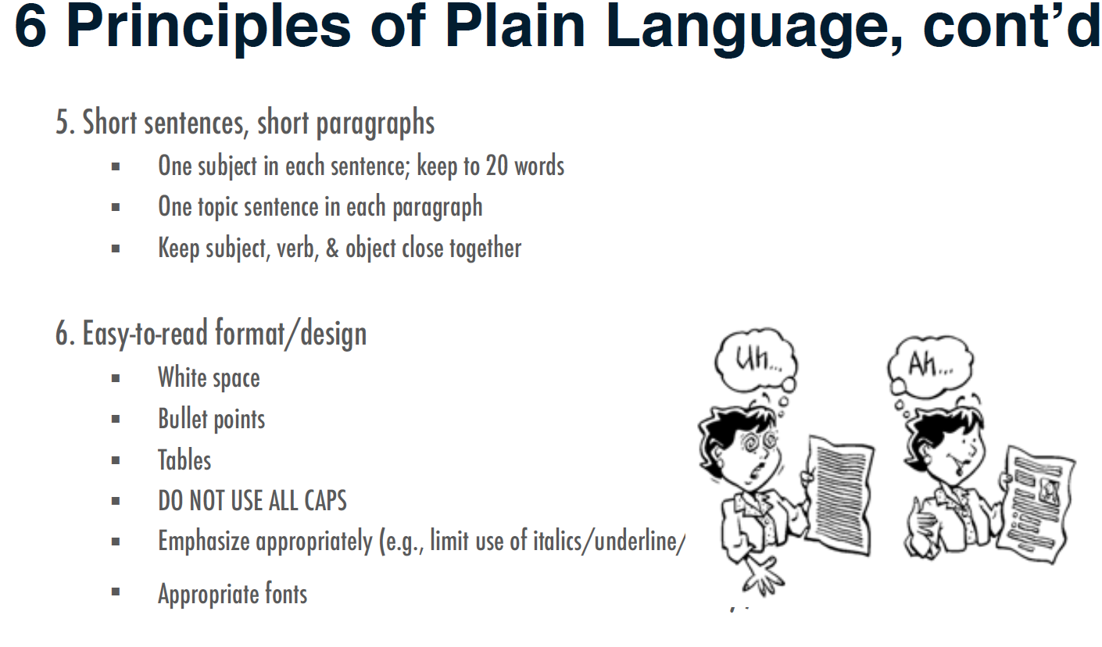

Slide 24
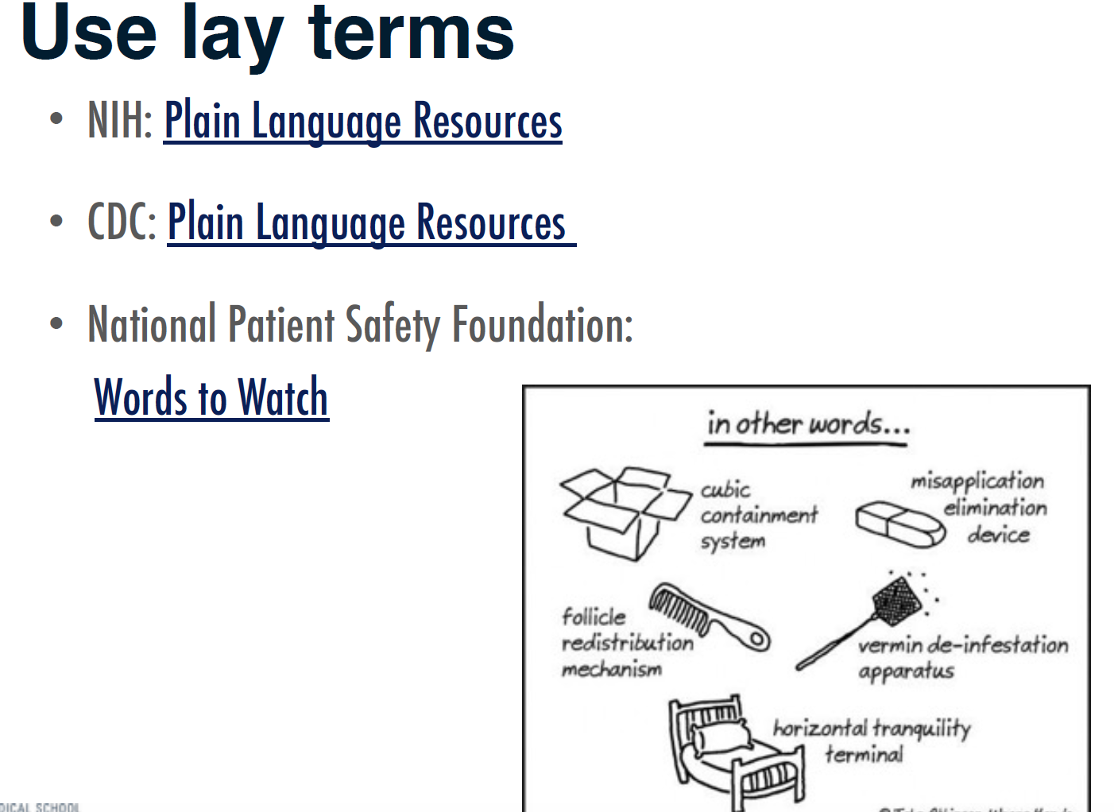

Slide 25
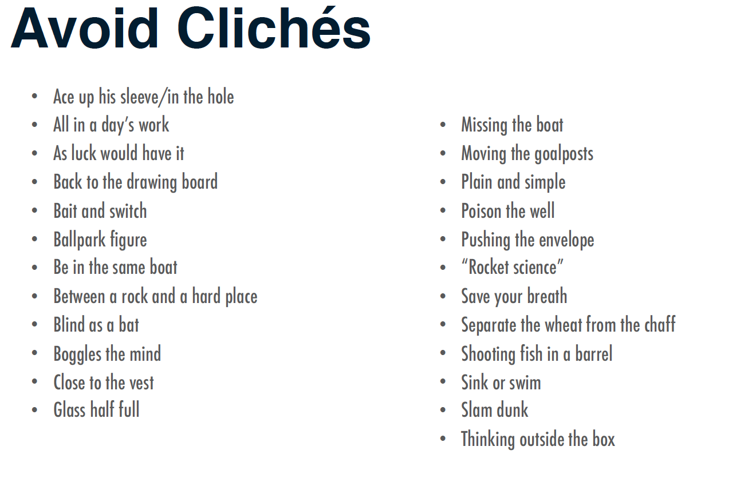

Slide 26
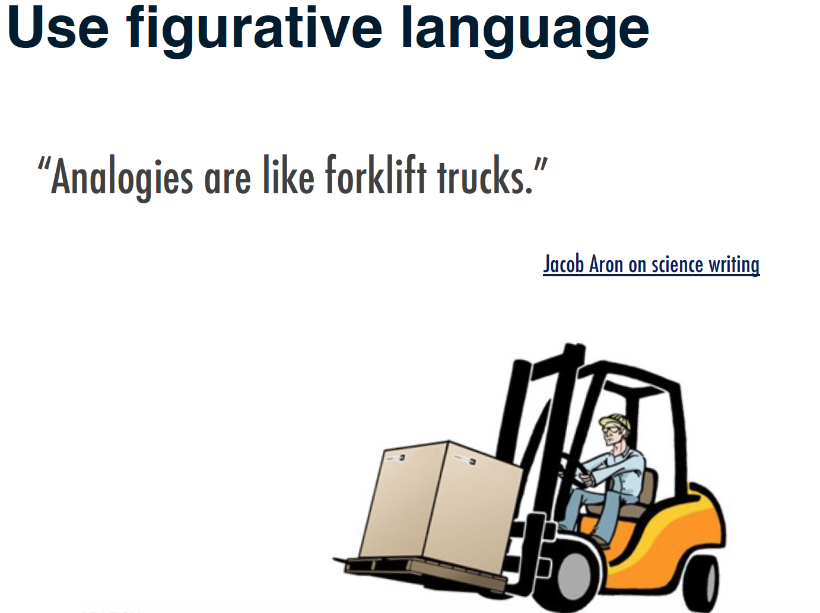

Slide 27
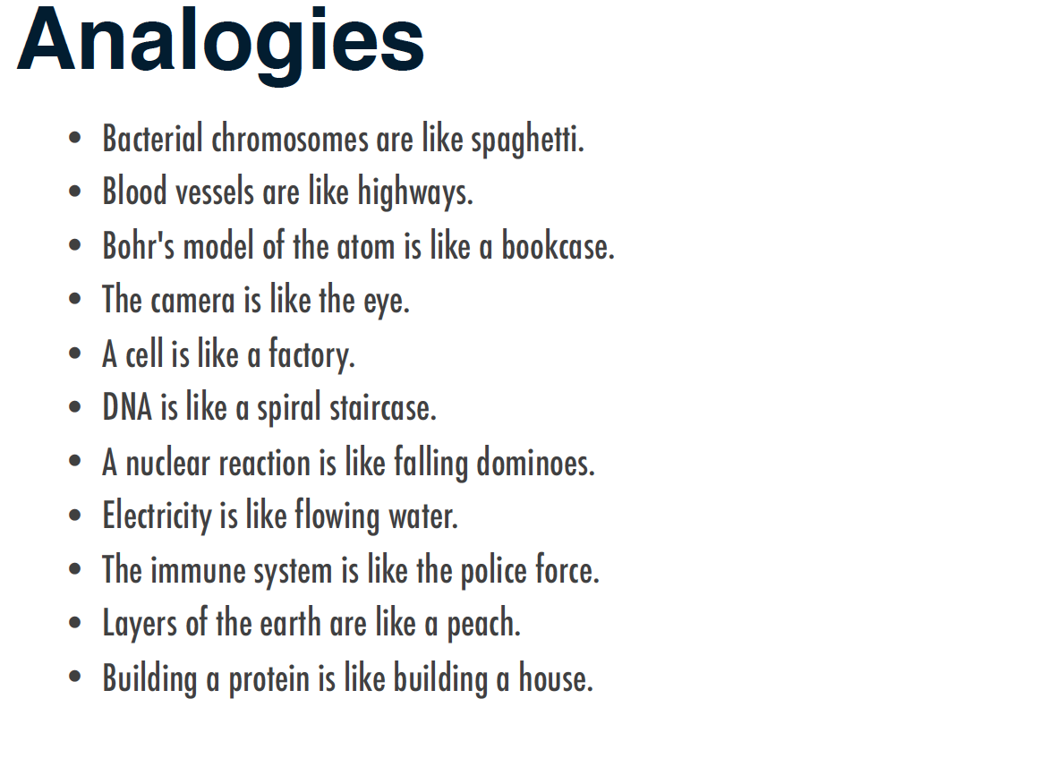

Slide 28
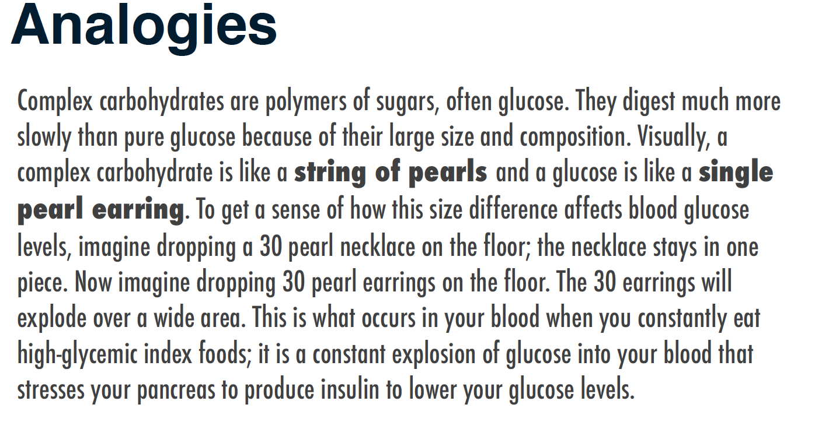
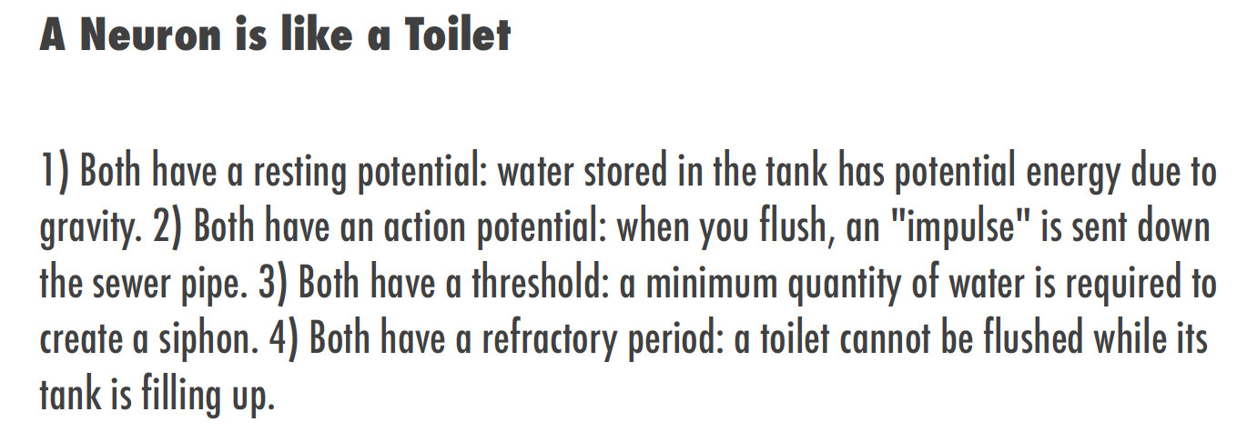

Slide 29
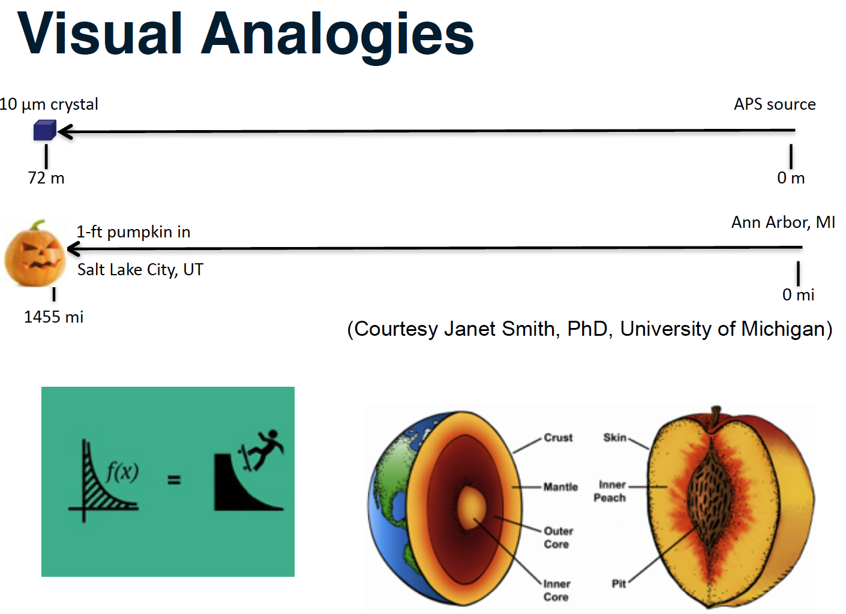

Slide 30
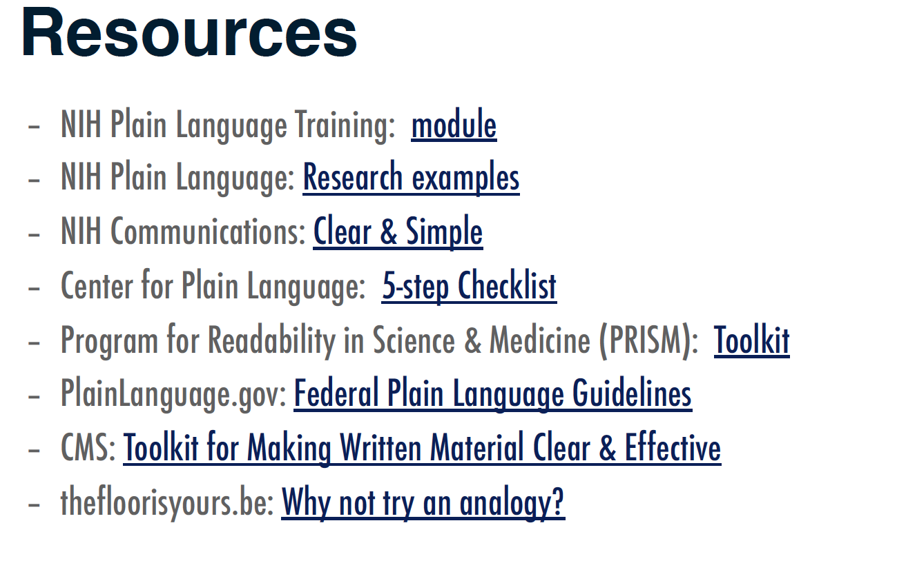

Slide 31
Editing and Rewriting

Slide 32
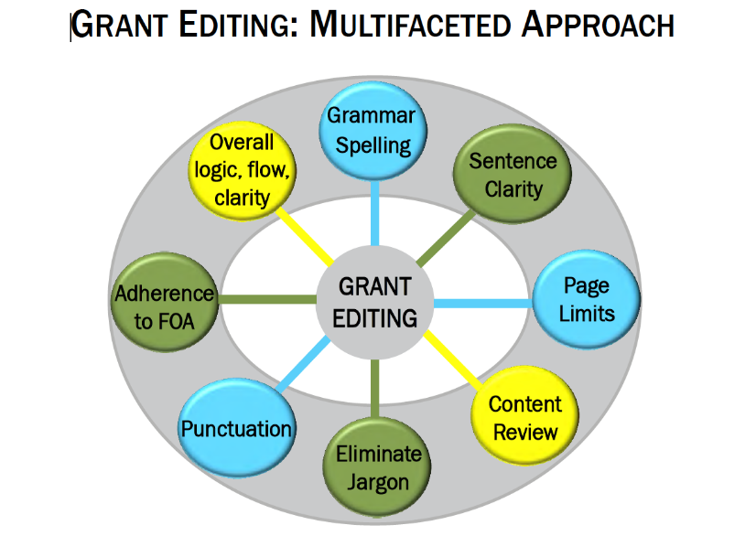
Editing and Rewriting

Slide 33
Common Mistakes in Grant Proposals
Statistics from editing 125 grants
Problems with page limits
  45% of grants require reduction in text to adhere to page limitations
Problems with the Specific Aims page
  83% of grants have some type of problem with:
    Illogical order
    Missing sections
    Lack of detail
    Too much detail
    No hypothesis
    Aims are too wordy
Problems with Approach/Methodology
  75% of grants need revisions to these sections because:
    There are insufficient details to understand the methods and/or data analysis
    Too technical–the broader goal is lost
    No techniques are referenced

Slide 34
Common Mistakes in Grant Proposals
Problems with sentence clarity
  100% of grants require rewriting of sentences to emphasize clarity and impact
Figures and Tables
  43% of grants have problems with figures/tables
  The most common problems are:
    A figure or table is needed but not included
    A figure or table is included but:
      The narrative does not include the figure/table
      The table/figure contains the wrong figures
      The table/figure describes data incorrectly
      The table/figure needs to be larger or have an accompanying legend
      Is not necessary
Expected Results
  Not addressed or insufficient
Potential Problems and Alternative Strategies
  Not addressed
  Identify potential problems but offer no alternative strategies
Future Direction
  Not addressed or insufficient

Slide 35
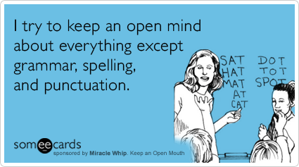
Use a grammar book, thesaurus, and dictionary
Grammar tips
  Common style guides: Chicago Manual of Style; MLA Style Manual and Guide to Scholarly Publishing; Scientific Style and Format: CBE Manual
Punctuation tips
  Punctuation helps to reveal the structure of a sentence (structural meaning), and thus to clarify meaning (rhetorical meaning).
Spelling Tips
  When in doubt, use a dictionary
  Remember that spellcheckers:
    Do not distinguish between homophones (principal and principle).
    Do not account for spellings determined by usage (resume and résumé).
    May allow variant spellings (catalog and catalogue) in the same document.
    Do not highlight a misspelled word if the misspelling is itself a word (from and form).

Slide 36
Use the Active Voice
In grant proposals, the active voice keeps you honest and clear.
  It is believed that a lack of understanding about the risks of alcohol is a cause of student bingeing.
  Revised: Researchers believe that students binge because they do not understand the risks of alcohol.
  The creation of a database is being considered, but no estimate has been made in regard to the potential of its usefulness.
  Revised: We are considering whether we should create a database, but we have not yet evaluated how useful it would be.

Slide 37
Provide Old Information Before New Information
Principle of Cohesion: Old to New
  Begin sentences with information familiar to your readers. Readers get that familiar information from two sources:
    First, they remember words from the sentences they just read.
    Second, readers bring to a sentence a general knowledge of its subject.
  End sentences with information readers cannot anticipate.
      Readers always prefer to read what’s easy before what’s hard, and what’s familiar is easier to understand than what’s new and complex.
  Writers often refer to something in a previous sentence with words such as this, these, that, those, another, such, second, or more. When you use any of those signals, try to put them at or close to the beginning of the sentence:
      How to calculate credits for classes taken in a community college is another issue that we must consider.
      Another issue that we must consider is how to calculate credits for classes taken in a community college.

Slide 38
End Your Sentences and Paragraphs With Emphasis
We call the most emphatic part of a sentence STRESS.
If you end a sentence on words that carry little meaning, your sentence will seem to end weakly. Just as we look at the first few words of a sentence for point of view, we look to the last few words for emphasis. You can revise a sentence to emphasize particular words that you want readers to hear stressed and thereby note as particularly significant.
Change the emphasis in the following sentences:
  The President’s tendency to rewrite the Constitution is the biggest danger to the nation, in my opinion.
  The nation is most threatened by the President’s tendency to rewrite the Constitution.
  A new political philosophy that could affect our society well into the twenty-first century may emerge from these studies.
  These studies may result in a new political philosophy that could affect our society well into the twenty-first century.

Slide 39
Do: Be Concise
Principle 1: Delete meaningless words
    kind of virtually actually
    individual particular basically
    really generally certain
    given various practically
Principle 2: Delete words that repeat the meaning of other words
full and complete true and accurate
hopes and desires each and every
first and foremost hope and trust
Principle 3: Delete words implied by other words
serious crisis untimely death
terrible tragedy future plans
important essentials true facts
final outcome advance planning

Slide 40
Do: Be Concise (cont.)
Principle 4: Replace a phrase with a word
  Instead of— Try—
    in close proximity near, nearby, close
    is cognizant of is aware of, knows
    in conjunction with with
    are desirous of want
Principle 5: Change negatives to affirmatives
  not different similar
    not the same different
    not allow prevent
    not notice overlook
Principle 6: Delete useless adjectives and adverbs
  Many writers can’t resist adding useless adjectives and adverbs. Try deleting every adverb and every adjective before a noun, then restore only those that readers need to understand the passage.

Slide 41
Project Summary #1: The Basketball Project at the Meridian Mews Center
We are really excited about the Basketball Project for 25 boys ages 13 to 16 who live in North Meridian Mews. The program will be sponsored by our organization, the Meridian Mews Center. This Center’s neighborhood is downtown Metro City, Indiana. The kids who will take part in the project are badly behaved and have acted out in school. Well-qualified instructors will teach the kids basketball skills and also how to dress for success. They will receive different types of counseling also and gift certificates from Ace Sport Supplies will be given out to the kids on the winning team in the basketball competition.
The Basketball Project will take place after school and on weekends and the boys will behave better as a result of being in the program. The Basketball Project will run from September 1, 2016 to June 30, 2017, and activities will be held at the Meridian Mews Center and the YMCA. We are asking for $10,000 to help cover the expenses for this excellent program that we’re running with the help of Meridian University and the YMCA.
There are many staff members who will make sure the kids get solid instruction. We are hoping that the kids who join our project will stay in school longer and behave much better. They will probably enjoy the trips we’ll take to basketball games and we’re looking forward to having guest speakers.
From “The Only Grant Writing Book You’ll Ever Need” by Ellen Karsh and Arlen Sue Fox

Slide 42
Project Summary #2: The Basketball Project at the Meridian Mews Center
The Meridian Mews Center is requesting $10,000 for a basketball and mentoring project designed to engage troubled youth and lead to their improved behavior in and out of school. Center staff will recruit 25 boys between the ages of 13 and 16 who live in the North Meridian Mews neighborhood of downtown Metro City, Indiana. Participants, identified by families, teachers, counselors, and others, will have demonstrated acting-out and behavior problems.
The overall goal is to increase the likelihood that the teenagers who participate in the activities will stay in school longer and become productive members of the North Meridian Mews community.
Specific objectives include improved basketball skills and teamwork, and knowledge of how to create a positive appearance through dress; these skills in turn will improve self-esteem and reduce acting-out behavior.
Activities will include basketball instruction; team competition; dress-for-success lessons by the coaching staff; one-on-one and group counseling, and trips to professional and college basketball games. The program will operate twice a week after school from September 1, 2016 to June 30, 2017. Activities will be held at the Meridian Mews Center, Meridian University, and the YMCA. Staff will include basketball coaches, a psychologist from Meridian University, and a social worker and recreation specialist from the Meridian Mews Center.

Slide 43
Handouts
Successful Letters of Inquiry
Successful Fulbright Project statements

Slide 44
Summary
Take a break between editing and writing; edit first for spelling, punctuation, and grammar then for content
  Use dictionaries, style manuals
When editing for content: be clear and graceful
  Use active voice
  Use old to new transitions
  Place emphasis in the correct place
  Tie all the sentences in a passage together
  Delete meaningless and repetitive words
Write for reviewers
  Pay attention to all the review criteria
  Assume an uninformed but intelligent reviewer
  Avoid insider jargon and acronyms
  Get reviewers excited and interested starting from the title and first page
  Make reviewers advocate for your proposal to their colleagues
Remember that every successful proposal writer has been rejected
  Keep trying: revise and resubmit or write a new proposal

Slide 45
Titles and Abstracts

Slide 46
Titles
The title is the first thing a reviewer reads…it should catch the readers attentions
  Emphasizes payoff/benefit
  Is understood by a broad spectrum of audiences, including the general public
  Uses words accenting the main category of the study and describing its distinctive features
  States the major idea as quickly as possible, with the modifiers following, rather than preceding, the main idea
  Avoids jargon, vogue
  Avoid filler words and non-communicating devices such as
  “A Study of... ”, “An Exploratory Study to Determine...”, “An Examination of...”, “A Method to Explore...” (unless the focus of your project is the methodology itself, rather than the results of using the methodology)

Slide 47
Summary/Abstract
After the title, the next and perhaps the only thing a reviewer reads is the abstract/summary
Usually written last, but read first by reviewers
  Provides first, and perhaps last or only impression of your project
Should reflect entire scope of project
Summarizes project purpose, goals, research design, methods, significance
Should be explicit (e.g., “The objective of this study is to …”) and use strong wording (e.g., “we will show the effects of…” and not “we intend to show…”)
Has to be well crafted, compelling, thoughtful, concise and complete

Slide 48
Proposal Aesthetics
The proposal must be aesthetically appealing
“Just as clothing is important in the business world for establishing initial impressions, so, too, is the appearance of your proposal as it reaches the reviewer's hands. The proposal should ‘look’ familiar to the reader. A familiar proposal is a friendly proposal (Jeremy and Lynn Miner).”
If allowed, match the funder’s publications style (same type size, style, layout, and headings as they do in their publications) …. Your proposal will look more credible and familiar
Use white spaces for visual relief and to frame the text (don’t go overboard)
The proposal should support all types of reading (skim, search, critical)

Slide 49
Proposal Aesthetics (cont.)
Use at least a 12-point Type Size (smaller is difficult to read)… make ideas fit by tightening sentences, editing wordy phrases etc. not by changing font size
Unless otherwise specified, uses Serif typefaces for text and Sans Serif typefaces for titles and headings. Serif type easier to read; sans serif makes titles and headings stand apart from the text
Use Bold Type to emphasize key words and ideas; avoid overemphasis
If allowed, format with Ragged Right Margins; makes reading easier because it is easier for your eye to track from one line to the next
Notes:
Bold Type easier to read than underlining, italics, or all capital letters as a means of creating emphasis. Use bold type to emphasize key words and ideas, but avoid overemphasis.
Lists. Lists help to get the message to the reader with a sense of immediacy, without being wordy. Furthermore, because lists are easy for readers to skim, they convey chunks of information quickly
Ragged Right Margins. A ragged right margin is easier to read than one that is right justified because the proportional spacing slows readability. It is easier for the reader's eye to track from
the end of one line to the beginning of the next line when the right-hand margins are jagged.
Type Size. Adjust your word processing program for a 12-point type style. Text smaller than 12-point becomes difficult to read and makes the reviewer’s job harder. Rather than reducing
type size to make all your ideas fit on the page, try tightening sentences and editing wordy phrases.
Type Style. If a type style is not specified in the application guidelines, consider using serif typefaces for the text of your proposal and sans serif typefaces for titles and headings. Serif type styles such as Times Roman and Courier have small strokes that finish off the main stroke of a letter and make it easier to read. Sans serif type styles such as Universal and Arial, which do not have the small finishing strokes, are ideal for titles and headings because they stand off from the body of the text. Avoid using ornate type styles, such as Cloister Black and Freestyle Script,which are hard to read and distract from the content of the proposal.
Adapted from A Guide to Proposal Planning and Writing by Jeremy T. Miner and Lynn E. Miner
Experts have suggested looking at Scientific American articles to get an idea of what in general a proposal should look like – don’t use the articles in the top, peer reviewed journals in your field as examples

Slide 50
Proposal Aesthetics (cont.)
Before creating figures and tables, put yourself in the position of the reader…what would you want to know?
Ask yourself
  What do you want to say and why does it matter?
  To whom do you want to say it?
  How do you say it?
Create figures and tables that are easy to read and that
  Support the narrative, help tell the story
  Summarizes technical details
  Support the different reading styles, particularly skimming
Create Lists to quickly provide the message, convey chunks of information
With lists, figures and tables, use level of detail appropriate for persuasion not for an expository peer reviewed journal article
Notes:
Experience with Paul Osterbeck – I was in charge of developing a proposal for researching options for a Multi Role Unmanned aircraft operating off of a variety of naval vessels. I was assigned a “master proposal writer” to help me. He spent more than half the proposal writing time doing very careful figures and tables that told the whole story of the proposal while I was freaking out because there was no writing to review for what I thought was too a period in the proposal writing schedule. His approach was successful for our proposal and for others he wrote.
Proposal figures and tables are not typically the same as manuscript figures and tables. Be aware of the differences – simple, make the point clearly, support skim reading, etc.

Slide 51
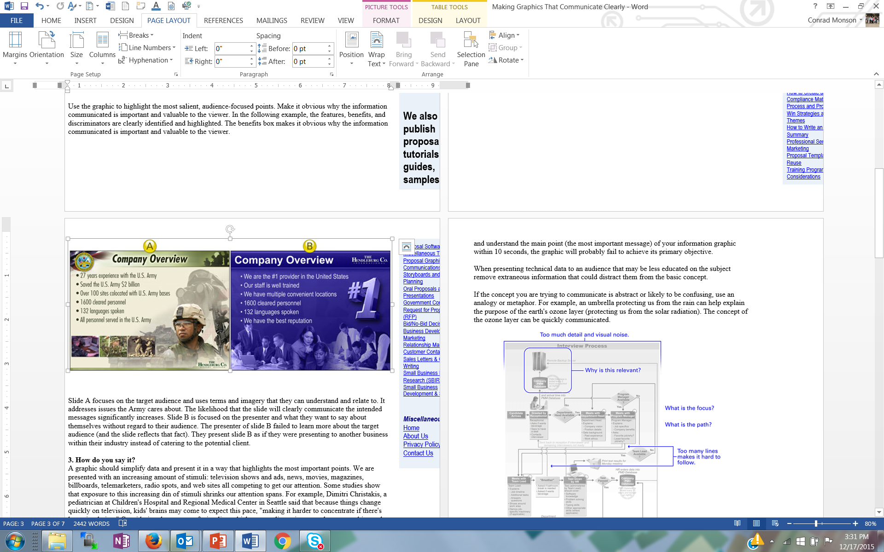
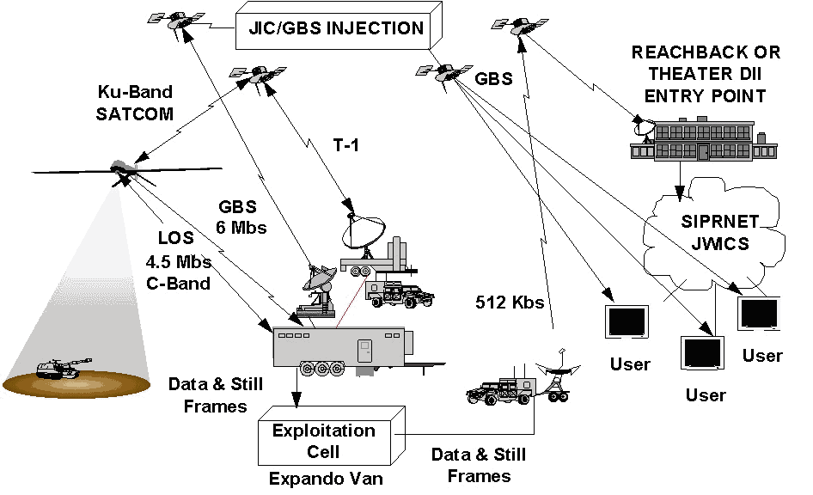
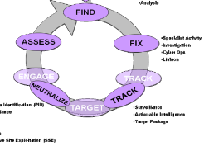
Figures Examples
Primary Intelligence Requirements
-Collection
-Analysis
-Specialist activity
-Investigation
-Cyber Ops
-Liaison
-Identification
-Surveillance
-Actionable intelligence
-Target package
Both of these figures are about a company proposing a project to the Army… which is more appealing to an Army proposal reviewer?
Both of these figures are about a C4ISR system… one is better for a technical report, the other for a proposal
Notes:
Experience with Paul Osterbeck – I was in charge of developing a proposal for researching options for a Multi Role Unmanned aircraft operating off of a variety of naval vessels. I was assigned a “master proposal writer” to help me. He spent more than half the proposal writing time doing very careful figures and tables that told the whole story of the proposal while I was freaking out because there was no writing to review for what I thought was too a period in the proposal writing schedule. His approach was successful for our proposal and for others he wrote.
Proposal figures and tables are not typically the same as manuscript figures and tables. Be aware of the differences – simple, make the point clearly, support skim reading, etc.

Slide 52
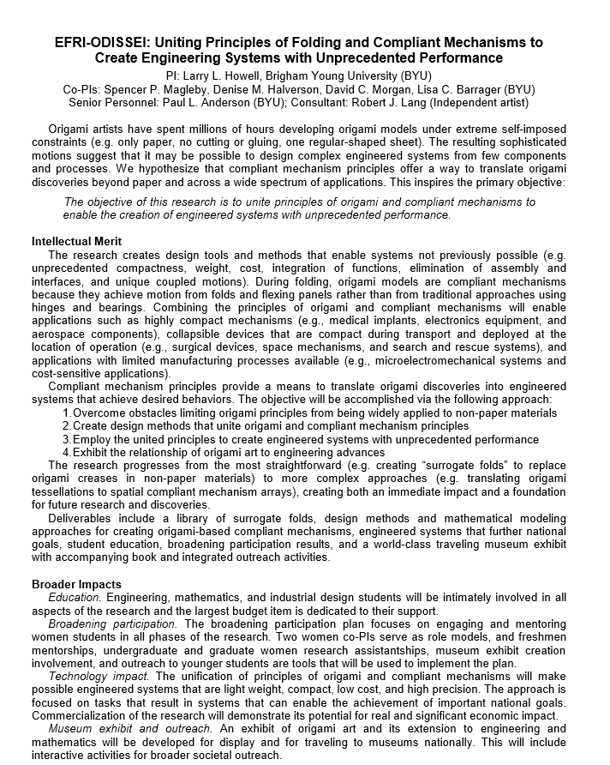

Slide 53
Marketing Your Proposal

Slide 54
Acquisition Planning… Key to Successful Marketing
Phase | Activities
Long Term Positioning | Contacts - customers, teammates, competitors, suppliers Develop/Execute Action Plans - technology, business, campaign
Opportunity Assessment | Customer making funding decisions - understand customer issues and motivations Assess - opportunity fit with business plans, competencies, costs to pursue (e.g., will take significant investment to displace incumbent)
Opportunity Pursuit | Customer open to suggestions - influence RFP for greater competitive advantage Develop win strategy; perform SWOT; calculate P_{win} Likely a win if “we can give the customer an offer that speaks directly to and meets their wants and desires and we have a demonstrated track record of performance thereby earning the customer’s trust”
Pre-Proposal Preparation | Develop Organization and Procedures – developed for a winning proposal effort Assess - actual solicitation against previous planning Capture lead - interacts with customer, organizes team Win strategy - update, execute Proposal design - reviewed by Review Team
Typically 1 year or more
Notes:
A lot of planning including customer contact planning (contact plans) and assessment of effectiveness
The planning, contacting, technology development, typically become factors to determine a P_{win} … terms for customer knowledge (including numbers and types of contacts); competition assessments; technology maturity; time; preliminary development, past performance, etc. Without a P_{win} of 50%, likely wouldn’t submit a proposal

Slide 55
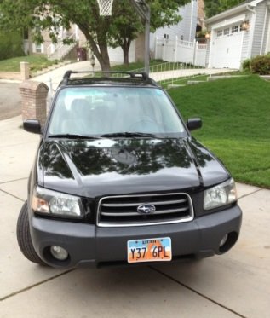
Market Your Ideas and Proposals… Think Like a Marketer
Always see things from the customer’s point of view
A proposal is not about you or your needs, it is about the funder’s needs… you’ re project should make the funder successful
Share the right information at the right time in the right order
  Why should I be interested in this?
  Are those proposing the work credible?
  What will be done and how much will it cost?
UCAV
Notes:
“Marketing” should be done throughout your career… and the reality is that you are marketing yourself anyway all the time, whether you want to our not.
Think like a marketer and always see things from the customer’s point of view
“Marketers do one thing, and they do it very well. They see things from the prospect’s point of view. They lose their own ego, interests and desires, and they focus on the customer’s wants and desires (Morgan Giddings)”
A proposal is not about you or your needs, it is about the funder’s needs… you’re project should make the funder successful
You want an emotional response to your ideas from your potential funders… excitement, keen interest, compelling, “I’ve got to have it now” … not boredom, confusion, or even anger
Boeings UCAV contract with DARPA was an ~$150M competition with Northrop Grumman that was so close, Boeing won at least in part because the PM felt Boeing would do a better job - not on price, past performance, schedule … many of the elements that typically win a proposal. The emotional investment was so intense by Northrop Grumman, the customer told us during when NG was debriefed that was the first time in all his years of contracting, he had ever seen “grown men cry”.
Boeing management was so worried about the emotional response to its F-35 prototype – it looked so ugly, pilots might not want to fly it – that they hired high priced consultants to understand the emotional response to the aircraft and how to mitigate it.
Finally, marketing your ideas and proposal should be embedded in the complete proposal development process, from pre-proposal to proposal writing, described in the next sections.

Slide 56

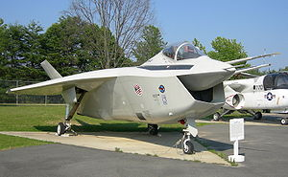
Marketing is Ongoing
Should begin with the first funding officer contacts well before a proposal is submitted
Treat customer contacts including white papers, LOIs, etc. as marketing opportunities
The best marketing creates an emotional response to your ideas and proposals… excitement, keen interest, compelling, “I’ve got to have it now” … not boredom, confusion, or even anger
Marketing doesn’t end with the proposal submittal
You could be contacting the funding officer for a re-submittal if your proposal is rejected and additional funds after an initial award
UCAV
F-35
Notes:
“Marketing” should be done throughout your career… and the reality is that you are marketing yourself anyway all the time, whether you want to our not.
Think like a marketer and always see things from the customer’s point of view
“Marketers do one thing, and they do it very well. They see things from the prospect’s point of view. They lose their own ego, interests and desires, and they focus on the customer’s wants and desires (Morgan Giddings)”
A proposal is not about you or your needs, it is about the funder’s needs… you’re project should make the funder successful
You want an emotional response to your ideas from your potential funders… excitement, keen interest, compelling, “I’ve got to have it now” … not boredom, confusion, or even anger
Boeings UCAV contract with DARPA was an ~$150M competition with Northrop Grumman that was so close, Boeing won at least in part because the PM felt Boeing would do a better job - not on price, past performance, schedule … many of the elements that typically win a proposal. The emotional investment was so intense by Northrop Grumman, the customer told us during when NG was debriefed that was the first time in all his years of contracting, he had ever seen “grown men cry”.
Boeing management was so worried about the emotional response to its F-35 prototype – it looked so ugly, pilots might not want to fly it – that they hired high priced consultants to understand the emotional response to the aircraft and how to mitigate it.
Finally, marketing your ideas and proposal should be embedded in the complete proposal development process, from pre-proposal to proposal writing, described in the next sections.

Slide 57
Proposal Development Process
Good Ideas
Fundable Idea
Find Funder(s)
Pre-Proposal
Write the Proposal
Revise
Marketing
Rejected
Accepted AND Funded
Funder
Drafts
Submit (ORCA)
Peer Review
Edit
Research Development has tools and resources to help with the steps in this process

Slide 58
Conclusion
The writing, editing, marketing approaches described over the past few days are proven practices for proposal success
Encourage lots of program officer contact and customer knowledge
Encourage lots of proposal review as part of the proposal maturation process

Slide 59
Next Steps
We will provide all the presentations and handouts
Please respond to survey from Faculty Center
One topic we didn’t cover – Tools for Finding Funding – could be a
lunchtime seminar if there is enough interest … let us know
For those who can commit to writing a complete proposal this
summer, we will support your proposal effort and convene an
“intensive” review panel of experienced proposal writers who
will thoroughly review your proposal… let us know

