Slide 1
Grant Proposal Development “Bootcamp” Followup
August 2, 2018

Slide 2
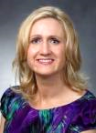

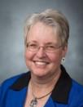
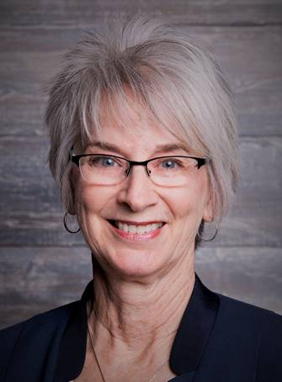
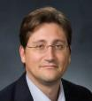
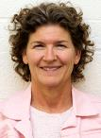
Research Development Support
Kristen Clarke Kellems
FHSS Research Development
934 SWKT
Tel: 801-422-8967
Email: fhssresdev@byu.edu
Conrad Monson
STEM Research Development
275 McDonald Building
Tel: 801-422-7722
Email: conrad_monson@byu.edu
Jaynie Mitchell
MSE Research Development
306C MCKB Tel: 801-422-3067
Email: Jaynie@byu.edu
Karen Hill
BYU Law Grants and Partnerships Manager 445 JRCB
Tel: 801-422-2684
Email: hillk@byu.edu
Jon Balzotti
English Department Faculty College of Humanities
4127 JFSB
Tel: (801) 422-2440
jonathan_balzotti@byu.edu
Sarah Dorff
Research Development Administrator
269 McDonald Building
Tel: 801-422-0132
Email: resdev@byu.edu

Slide 3
Proposal Development Process
Good Ideas
Fundable Idea
Find Funder(s)
Pre-Proposal
Write the Proposal
Revise
Marketing
Rejected
Accepted AND Funded
Funder
Drafts
Submit (ORCA)
Peer Review
Edit
Research Development has tools and resources to help with the steps in this process

Slide 4
Baseline Logic

Slide 5
Needs Statement Defines the Baseline Logic

Slide 6


Proposal Elements are Created From the Needs Statement
The Needs Statement thoroughly develops and describes the problem you are addressing including context and justification … develops the Situation Slot, S₁
Describes Methods at a high level; informs Qualifications and Benefits
Provides the basis for the Budget you need
Needs Statement Components
1. Story (Problem)/S₁
2. Plan for solving (Problem)/S₁
3. Request for support
The 6 Generic Proposal “Slots” (tied to baseline logic)
Achieved Objective(s)
S
Methods
S
2
Situation
1
B
Qualifications
Benefits
Budget

Slide 7
Proposal Slots Map to Typical Proposal Sections
The generic slots map directly to proposal sections or provide content to support proposal sections identified by a funder
The Generic Proposal Slots
Typical Proposal Sections
Introduction/Background/Justification and Scope
Situation: This is our understanding of the problem.
Objectives: Given that problem, these are our objectives for solving (or realizing) it.
Introduction/Background/Justification and Scope/Specific Aims
Methods: Given those objectives, these are the methods we will use to achieve them.
Work Plan/Methods/Approach/Data Management Plans
Qualifications: Given those methods, these are our qualifications for performing them.
Qualifications
Budget: Given those qualifications and methods, this is how much the project will cost.
Budget/Budget Justification/Project Costs
Benefits: Given our efforts and funders support, these are the benefits or value you will receive.
Benefits/Significance
Content Supports
Titles/Abstract/Summary/Intellectual Merit/Broader Impacts/Previous Work/Biosketches
CVs/Other Resources and Support

Slide 8
Topics
Write for reviewers
Write in plain language
Use active voice
Be concise
Avoid clichés, jargon
Proposal aesthetics
Marketing

Slide 9
Next Steps
What challenges are you having writing your proposals?
Did you write a Needs Statement?
Do you have proposals sections that can be reviewed now?
Do you need examples of successful proposals or proposal elements?
RD can support your proposal effort and convene an “intensive” review panel of experienced proposal writers who will thoroughly review your proposal
… or something else?

