Slide 1
ORCA Proposal Preparation & Submission Processes
Jason Jay, Research Administrator
December 13, 2019

Slide 2
ORCA Grants/Contracts Personnel
Gene Larson, Director
Business, Education, Fine Arts, Lee Library,
Law School, Religion
Debbie Silversmith, Associate Director
Engineering
Susie Quartey, Research Administrator
Physical & Mathematical Sciences
Jason Jay, Research Administrator
Family, Home, & Social Sciences; Humanities; Life Sciences; Nursing

Slide 3
ORCA Compliance Personnel
Gene Larson – IBC Administrator
Jason Jay – IACUC Administrator
Regina McCarthy – IBC & IACUC Secretary
Sandee Aina – Human Research Protection Program Manager (HRPP)
Wayne Larson – IRB Administrator
Stephanie Coyne – IRB Secretary

Slide 4
Compliance Committees
IBC – Institutional Biosafety Committee, Biohazardous Chemical Research
Every other month: ibc@byu.edu
IRB – Institutional Review Board, Human Subjects Research
Monthly: irb@byu.edu
IACUC – Institutional Animal Care and Use Committee, Animal Research
Monthly, iacuc@byu.edu
Notes:
Many federal changes; check website frequently and pay close attention to email messages related to IRB
Approval from federally mandated compliance committees is required for ALL research on campus, not just those with federal funding
Approved protocols must be in place before research can begin
External research funding unavailable to spend until approved protocol is in place; no R# issued

Slide 5
ORCA Functions
Proposal Approvals and Submission
Kuali and iRIS support
Letters of Commitment
Contract Negotiations
NDAs, CAs, MTAs
Misc. required forms
Award Processing / Issuing Subcontracts
Federal Compliance
Notes:
Certifications, Subrecipient Commitment Forms
Non-disclosure Agreements / Confidentiality Agreements / Material Transfer Agreements
MISC: Proof of insurance, worker’s comp, etc.)
Contractual support throughout the life of an award
Sponsored Projects Handbook to be updated in 2019

Slide 6
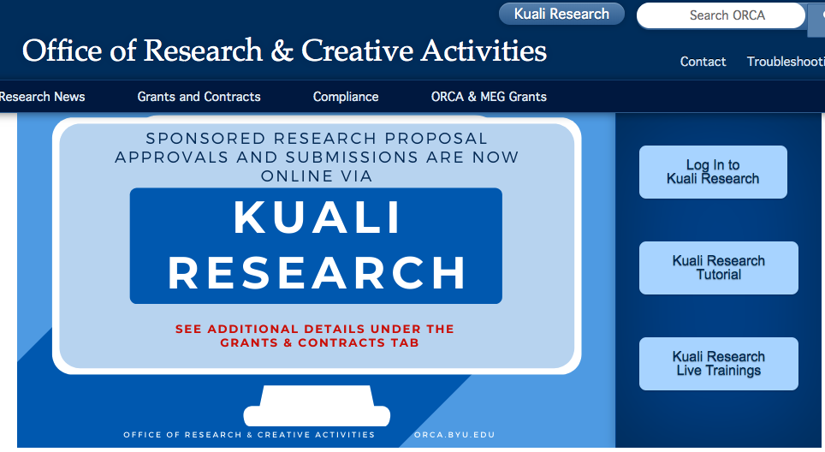
Proposal Submissions
All proposals to ORCA 5 business days before due date:
via Kuali Research - https://byures.kuali.co/
All internal approvals are now online via Kuali Research
Go to:
orca.byu.edu
Notes:
Proposals commit the University
Terms and conditions need review & authorization; fac do not have authorization to sign documents
Cost sharing/matching needs approval
Problems are much easier to fix at the proposal stage than after submission or an award is received

Slide 7
System to System (S2S) Proposals
All NIH, NSF (non-collaborative) and other grants.gov submitted proposals (i.e. DOE, USGS, EPA) are submitted System to System (S2S), meaning directly to the sponsor from Kuali Research.
All S2S proposals will be submitted 2 days before the sponsor due date.
NOTE: If there is a funding opportunity listed in grants.gov, the proposal will be submitted via S2S.
Notes:
Fringe rate changes every year
Full salary, 8 month base, regardless of whether they have an 8 month, 10 month, etc., contract

Slide 8
Non-System to System Proposals
All other proposals to sponsors that do not use grants.gov (i.e. Industry, Foundations, NASA, State/Local Government and other Federal sponsors that do not use grants.gov), are Non-System to System (Non-S2S) and will be submitted as directed by the sponsor.
NOTE: These proposals are still entered in Kuali for approval and tracking purposes.
Notes:
Facilities & Administration/Overhead/Indirect Costs: Operations and Maintenance, phones, copying, ILL, etc.
Building and Equipment Depreciation
General Administration (HR, payroll)
Department Administration
Sponsored Projects Administration
Library
Student Services
Matching/Cost Sharing: Only include if required by sponsor
If it is proposed, we are obligated to track and report it

Slide 9
Submission Requirements
PROPOSALS
Statement Of Work (SOW)
Budget entered in Kuali Research
Budget Justification
RESEARCH ADMINISTRATION
Review
Submit proposals
Notes:
Proposal Requirements needed 3 – 5 business days before submission deadline
Explain why—
ARO/SRO Access
ORCA vs PI Submission: If PI, ORCA/Univ approval required before submission

Slide 10
Your Formula for Success
Write Thorough Proposal
Utilize Available Resources
Obtain University Approval
Submit Proposal Early

Slide 11
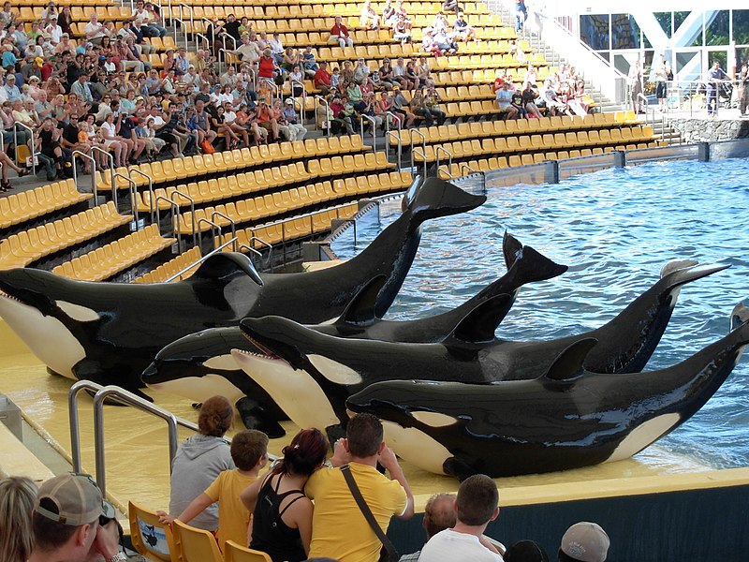
Contact us Early & Often!
Team ORCA http://orca.byu.edu
Kuali Research Live Trainings
Kuali Research Tutorial
Compliance Tutorials
https://commons.wikimedia.org/wiki/File:Orcas_at_Loro_Parque_08.JPG

