Slide 1
Writing Persuasive Grant Proposals
October 4, 2016

Slide 2


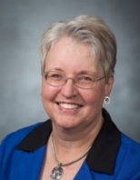
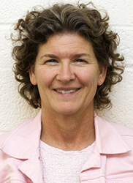
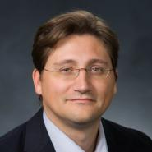
Research Development Support
Kristen Clarke Kellems
FHSS Research Development
934 SWKT
Tel: 801-422-8967
Email: fhssresdev@byu.edu
Conrad Monson
STEM Research
Development
275 McDonald Building
Tel: 801-422-7722
Email: conrad_monson@byu.edu
Jaynie Mitchell
MSE Research Development
306C MCKB
Tel: 801-422-3067
Email: Jaynie@byu.edu
Sarah Dorff
Research Development Administrator
269 McDonald Building
Tel: 801-422-0132
Email: resdev@byu.edu
Jon Balzotti
English Department Faculty
College of Humanities
4127 JFSB
Tel: (801) 422-2440
jonathan_balzotti@byu.edu

Slide 3
Agenda
Pre-Proposal Efforts that Build Persuasion
Effective Writing Techniques: Prewriting
Effective Writing Techniques: Persuasively Writing the Body of the Proposal
Proposal Titles and Abstracts
Summary

Slide 4
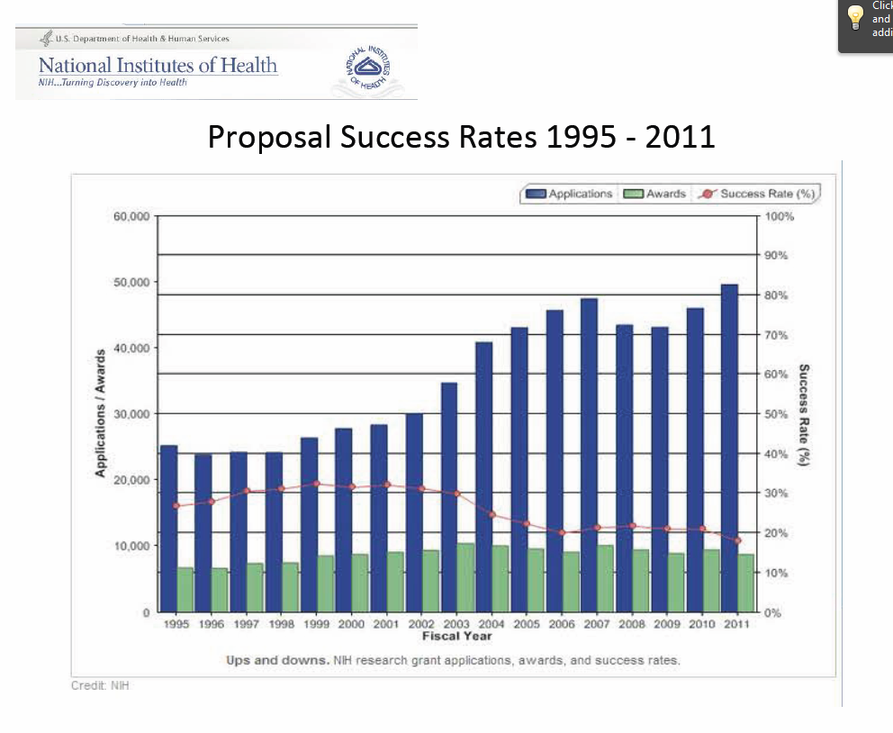
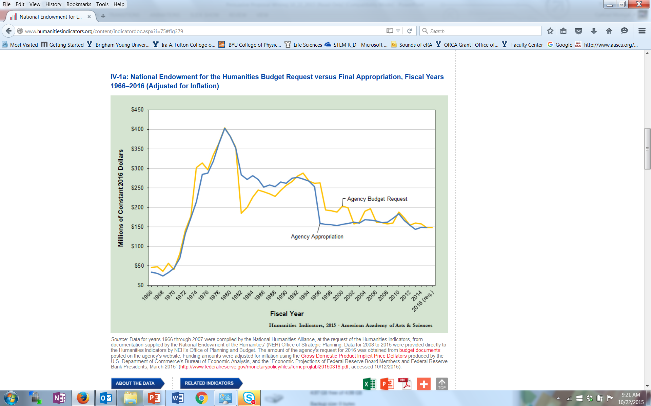
Even in Today’s Challenging Environment for Research Funding…
NIH Proposal Success Rates 1995-2011
  There is a steady increase in proposal submission BUT also a steady decrease in proposal success rate
Future funding will be negatively impacted by rising costs for research, national funding priorities and budget deficits
NEH Funding Levels 1966-2016
Notes:
Proposal success rates now average just 15 to 30 per cent (in 2009, NIH averaged 8-10% on 1st submission 28% on 2nd; other agencies have similar success rates)
BYU rates tend to be just a bit higher

Slide 5
… There are Ways to be Successful
Use best practices to write persuasive, compelling proposals
Know your funder and pay attention to RFP/FOA details
  Significant number of proposals (~60% for one NIH institute) are rejected without review because directions weren’t followed
Be persistent
  NSF ~15% success for 1st time, ~50% 2nd time, 75% 3rd, assuming followed reviewer recommendations and did proper revisions (Dec 2013 NSF Days )
Notes:
Pay attention to details
Significant number of proposals are rejected by funding agencies without review because the proposer didn’t follow all the directions
Use Best Practices
Develop a fundable idea
Find funders
Use effective pre-proposal activities
Write compelling proposals
Be persistent
Themes throughout this presentation include – lots of pre-proposal activity; marketing throughout; pay attention to detail
At Dec 2013 NSF Days – be persistent; ~15% success for 1st time, ~50% 2nd time, 75% 3rd, assuming followed reviewer recommendations and did proper revisions
In 2009, NIH averaged 8-10% on 1st submission 28% on 2nd; other agencies have similar success rates

Slide 6
Proposal Development Process
Good Ideas
Fundable Idea
Find Funder(s)
Pre-Proposal
Write the Proposal
Revise
Marketing
Rejected
Accepted AND Funded
Funder
Drafts
Submit (ORCA)
Peer Review
Edit

Slide 7
Pre-Proposal Efforts that Build Persuasion

Slide 8
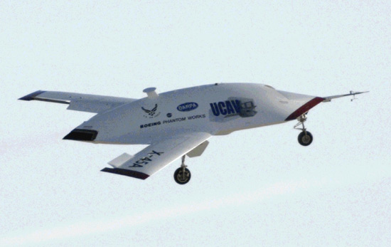
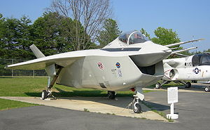
Marketing
Marketing throughout the proposal development process is one key to developing persuasive proposals
Always see things from the funder’s point of view
A proposal is not about you or your needs, it is about the funder’s needs… you’re project should make the funder successful
Share the right information at the right time in in the right order
You want an emotional response to your ideas from your potential funders… excitement, keen interest, compelling, “I’ve got to have it now” … not boredom, confusion, or even anger
UCAV
UCAV
F-35
Notes:
“Marketing” should be done throughout your career… and the reality is that you are marketing yourself anyway all the time, whether you want to our not.
Think like a marketer and always see things from the customer’s point of view
“Marketers do one thing, and they do it very well. They see things from the prospect’s point of view. They lose their own ego, interests and desires, and they focus on the customer’s wants and desires (Morgan Giddings)”
A proposal is not about you or your needs, it is about the funder’s needs… you’re project should make the funder successful
You want an emotional response to your ideas from your potential funders… excitement, keen interest, compelling, “I’ve got to have it now” … not boredom, confusion, or even anger
Boeings UCAV contract with DARPA was an ~$150M competition with Northrop Grumman that was so close, Boeing won at least in part because the PM felt Boeing would do a better job - not on price, past performance, schedule … many of the elements that typically win a proposal. The emotional investment was so intense by Northrop Grumman, the customer told us during when NG was debriefed that was the first time in all his years of contracting, he had ever seen “grown men cry”.
Boeing management was so worried about the emotional response to its F-35 prototype – it looked so ugly, pilots might not want to fly it – that they hired high priced consultants to understand the emotional response to the aircraft and how to mitigate it.
Finally, marketing your ideas and proposal should be embedded in the complete proposal development process, from pre-proposal to proposal writing, described in the next sections.

Slide 9
Pre-proposal Efforts That Support Persuasive Writing
Customer contacts and customer research prior to proposal writing generates information that is essential to persuasive writing
Phase | Activities
Long Term Positioning | Contacts - identify stakeholders, including program officers, customers, teammates, competitors, suppliers Develop/Execute Action Plans - technology, business, campaign
Opportunity Assessment | Customer making funding decisions - understand customer issues and motivations Assess - opportunity fit with business plans, competencies, costs to pursue (e.g., will take significant investment to displace incumbent)
Opportunity Pursuit | Customer open to suggestions - influence RFP for greater competitive advantage Develop win strategy; SWOT analyses; calculate P_{win} Likely a win if “we can give the customer an offer that speaks directly to and meets their wants and desires and we have a demonstrated track record of performance thereby earning the customer’s trust”
Pre-Proposal Preparation | Develop Organization and Procedures – developed for a winning proposal effort Assess - actual solicitation against previous planning Capture lead - interacts with customer, organizes team Win strategy - update, execute Proposal design - reviewed by Review Team
Typically 1 year or more
Modified Customer Acquisition Plan for an Aerospace company
Notes:
A lot of planning including customer contact planning (contact plans) and assessment of effectiveness
The planning, contacting, technology development, typically become factors to determine a P_{win} … terms for customer knowledge (including numbers and types of contacts); competition assessments; technology maturity; time; preliminary development, past performance, etc. Without a P_{win} of 50%, likely wouldn’t submit a proposal

Slide 10
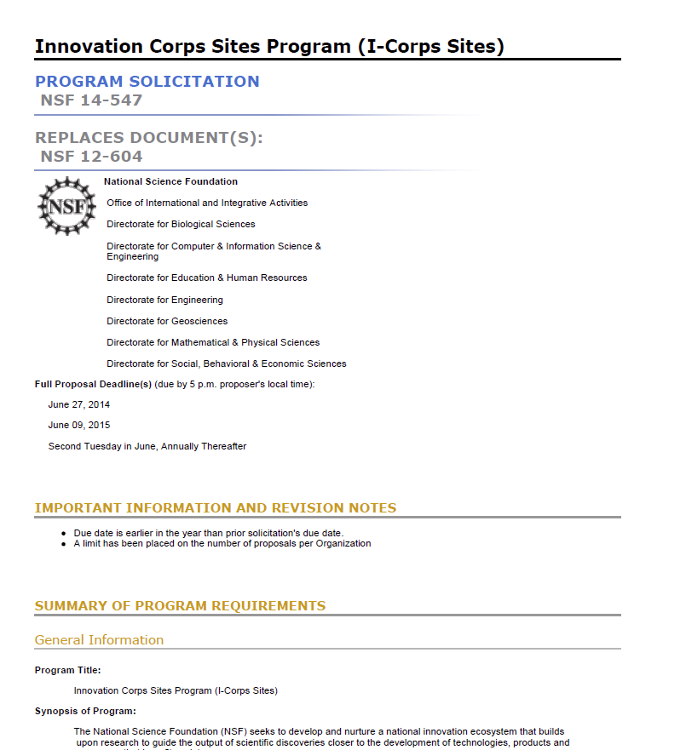
Pre-proposal Efforts (cont.)
Careful decomposition of the proposal solicitation including identifying “MIRs” can aid in persuasive writing
  Soliciation¹ Decomposition
  Deadlines
  Requirements
    Technical, budget, management, formatting
    Most Important Requirements, MIRs
Includes requirements not explicitly described that reflect customer goals, mission, experiences with past projects, etc.
  Proposal components
  Unusual requirements
  Procedures for submittal (including BYU/ORCA procedures)
¹Solicitations are called RFPs (Request for Proposal), RFA, (Request for Application), FOAs (Funding Opportunity Announcements), BAA (Broad Agency Announcement), Dear Colleague letters, etc.
Notes:
Deadlines for submitting questions to the program officer, submittal through BYU/ORCA, submittal to the funder
Most Important Requirements (technical, budget content)
Elements required of proposal (cover page, summary, etc.)
Unusual requirements
Procedures for submittal (including BYU/ORCA procedures
Requirements
Can be technical, budget, management
What isn’t said in the solicitation may be just as important as what is said
Must understand and answer the MIRs (most important requirements

Slide 11
Effective Writing Techniques: Prewriting

Slide 12
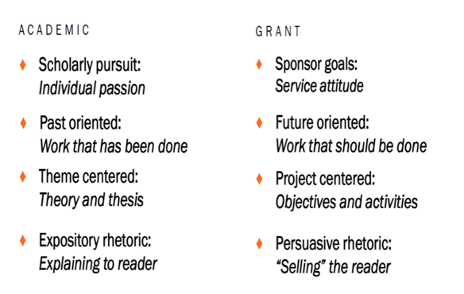
Academic vs. Grant Proposal Writing

Slide 13
Writing Persuasive Grant Proposals
Last session we talked about finding and approaching a funder. You have an FOA/RFP that fits your research and the funder’s goals. Now what?
Prewriting activities. Make a checklist for what you need to accomplish: (http://researchdevelopment.byu.edu/resources/proposal)
  Obtained approval from your department chair and research dean
  Contacted ORCA about compliance issues (for human subject research, etc.)
  Read all of the forms and instructions provided by the funder and paid close attention to those regarding length of each section, overall number of pages, required content, attachments, etc.
  Identified all the sections that will need input from the other sources
  Let those who must submit content as early as possible (letters of support) along with the guidelines and suggestions of what to write
  Developed an outline that includes the major points

Slide 14
Write The Proposal From An Outline
Outline the complete proposal
  Ensure all components are tied together
  Use as the basis for a smooth, end-to-end narrative
  Consistent with the RFP decomposition
Use themes and put in topic sentences
Show how requirements will be met
Review and re-iterate the outline… sequentially adding greater levels of detail will make the actual
writing easier
Notes:
This is Outlining 101. The more experienced we get writing in a field, the more we tend to write without an outline. Example from HFE reports -- I found I was so familiar with the field and customer (DoD) and what the reports should be that I could easily generate R&D reports that were clear, had topic sentences for each paragraph, good transitions and narratives etc. without an outline. I could just start writing. Don’t fall into that trap when doing a proposal you must start with a good outline. When doing proposals at Rockwell, Boeing and Northrop Grumman, typically, we were not even allowed to write until different levels of outline were reviewed and refined so that there was a clear narrative, all MIRs were answered, themes were identified, etc.

Slide 15
Prewriting: Prepare a Proposal Development Timeline
Month | Activity
1 | Identify the problem. Analyze your ability to successfully pursue the idea.
2 | Identify a project director and others who will be involved in planning/writing the proposal. Conduct a needs assessment. Identify prior work/related activities of other universities. Develop a case for how your work differs from/compliments others. Identify funders and get administrative buy-in.
3 | Begin cultivating potential funding sources. Ensure university can meet compliance obligations.
From “Grant Seeking in Higher Education” by Mary M. Licklider

Slide 16
Prewriting: Prepare a Proposal Development Timeline (cont.)
Month | Activity
4 | Develop the first draft of the proposal and seek feedback from colleagues who have previously received funds from this source
5 | Modify the proposal using input received during previous months. Complete the final version and translate it into the formats required by the funders. Submit the proposal for internal reviews. Submit the proposal to the funder.
6-9 | Verify receipt of the proposal by the funders and find out when a decision is likely to be made. Stand by while funders conduct their initial review and request more information.
10-11 | Receive approval or rejection. In either case, obtain reviewers comments.
12 | Receive authorization to expend funds. Start the project.

Slide 17
Effective Writing Techniques: Persuasive Writing

Slide 18




The Baseline Logic: The foundation for your readers’ (and your) understanding of your proposal¹
Because of the mis-alignment between (a) the college’s operating and delivery systems and (b) the needs of the college’s students and employers and community it serves,…
…we will develop and implement a comprehensive strategy for integrating current institutional initiatives into Engineering & Technology Division’s educational offerings.
Current Situation
Desired Result
S₂
S₁
As a result, BYU will be more responsive to the rapidly changing requirements of students, employers, and the community, offering higher quality educational services in less time and at a lower cost.
B
Benefits
90% of proposals have serious flaws in their baseline logic
¹Baseline logic and generic slots descriptions adapted from Jon Balzotti’s presentations

Slide 19


Your proposal’s content reflects the change process
Current Situation
Input = Your Role
Output = Desired Result/Benefits
Achieved Objective(s)
S
2
B
Methods
S
Situation
1
Qualifications
Benefits
Budget

Slide 20


The six generic structure slots answer the funder’s major question
Q: Is your project worthy of funding?
meets the requirement for success
A: Yes
Q: Why?
We Understand the Situation
We Are Clear On Your Objectives
We Have The Right Methods
We Have The Right Qualifi- cations
The Budget is Justifiable
There will be Substantial Benefits

Slide 21
Writing the Proposal: Identifying the Proposal Components
Situation: This is our understanding of the problem (or opportunity).
Objectives: Given that problem (or opportunity), these are our objectives for solving (or realizing) it.
Methods: Given those objectives, these are the methods we will use to achieve them.
Qualifications: Given those methods, these are our qualifications for performing them.
Budget: Given those qualifications and methods, this is how much you should plan to invest.
Benefits: Given our efforts and your investment, these are the benefits or value that be created for various stakeholders.

Slide 22
Generic Structure—Research Proposal
Situation: No one knows the extent of radon gas in Provo households
Objectives: To determine extent and communicate it to public
Methods: To make available and publicize availability of accurate, inexpensive testing devices; to analyze results
Qualifications: Distinguished inter-disciplinary university research team; necessary facilities
Budget: Narrative that justifies the expenses (indirect costs, lab costs, salaries etc.)
Benefits: Increased understanding of radon extent: a 1st step in recommending remedial actions

Slide 23
The needs statement can have three components
Component
1. Story (Problem)/S₁ | Describe the problem: (1) context of the problem, (2) justification for addressing the problem, (3) specific aspect of problem being addressed. (Causes and Effects) Statistics: -Your own data -Info from external sources Examples: -Anecdotes -Real-life examples -Quotes Give the reader hope!
2. Plan for solving (Problem) S₁ | Method section contains the approach taken to solve the problem and list of activities/tasks.
3. Request for support | The instrumental purpose statement contains actions you want the sponsor to take immediately and resources you want the sponsor to commit.

Slide 24
Showing a problem exists
Does this example state a problem?
  I am applying for this grant to complete a book manuscript on the successes and challenges African nurses experienced when delivering western biomedicine in South Africa’s rural Eastern Cape. The book, for which I have conducted most of the research already, will be of use in undergraduate and graduate courses and appeal to a general audience interested in the history of African women and health and healing.

Slide 25
Showing a problem exists (cont.)
From the 1960s to the 1980s, South Africa experienced years of intense political and social change. South African nurses—charged with administering western biomedicines to rural communities—navigated apartheid politics and ‘traditional’ healing techniques. These nurses played a central, though often unrecognized, role providing critical health services to their communities and influencing notions of health and healing. Their training, commitment, and acknowledgment of ‘traditional’ beliefs helped them succeed in providing health care despite a serious lack of equipment and personnel.
While these nurses wielded remarkable influence in the rural communities that they served, their individual stories, as well as an analysis of the interplay between biomedicine and ‘traditional’ healing beliefs, remains largely unexplored. I am applying for this grant to complete a book manuscript about the experiences of these nurses during this turbulent period of South African history.

Slide 26
Needs Statement: Solution and Justification for S1
Proposed solution to the problem
  Convince your reader that the problem is solvable
  Show how one consequence will lead to another until your solution is effected, or you can use analogies or precedent (i.e. how other similar research proposals have been successful elsewhere)
Justifying your solution
  Be specific about what the money will be used for and why it is necessary.
  State what will happen if the project isn’t funded; what happens after funding ends

Slide 27




Methodology: goals, objectives, and tasks
Goal
Objective
Objective
Objective
Tasks
Tasks
Tasks
Outcome
Outcome
Outcome
Evaluation

Slide 28





Methodology
Reduce Spread of HIV through education, testing, and support in six African- born communities residing in Marysville
Develop and deliver one cultural appropriate seminar designed for each community and three follow-up discussion sessions over a two year period
Make Orasure testing available to six immigrant communities over a two year period
Objective
Tasks
Tasks
Tasks
Outcome
Outcome
Outcome
Evaluation

Slide 29

Lacking persuasion, methods sections often begin by explaining “How” rather than “Why”
They begin by forecasting information...
“Our methodology incor- porates the four high-level steps described below”
“We will organize the work into five tasks”
They don’t begin by forecasting persuasion...
“We have designed our methodology for the following three reasons:”
“Our methodology careful- ly considers the situation in these three ways:”
Why, out of a universe of possible methodologies, have you chosen
this one, for this situation?

Slide 30

The Methods and Qualifications Slots are arguments
Methods
Out of a universe of possible approaches this one is best in this situation
Because . . .
Because . . .
Because . . .
Qualifications
Out of a universe of possible research teams, we are the best for this engagement
Because . . .
Because . . .
Because . . .
They stake out a claim
. . . and support it

Slide 31
Composing the Budget Slot
Budget: Given those qualifications and methods, this is how much you should plan to invest.
Benefits: Given our efforts and your investment, these are the benefits or value that you will receive (ROCI).

Slide 32
Composing the Benefits Slot
Benefits: Given our efforts and your investment, these are the benefits or value that you should expect.

Slide 33
Benefits
Benefits are important to a potential Funder | Yes | ❒ | No | ❒
Funders will buy in if they perceive that there will be substantial benefits to real people | Yes | ❒ | No | ❒
Funders might select one project over another because one communicates benefits more effectively | Yes | ❒ | No | ❒

Slide 34



The Benefits Slot exists throughout the proposal
In the baseline logic, which
expresses your value proposition
S₁ S₂ B
In the closing component of the background section
To answer these effects, we have designed an approach to [insert objectives]. As a result of achieving these objectives, there will be [insert 2-4 benefits].

Slide 35
Proposal Titles and Abstracts

Slide 36
Create Effective Titles to Help Market Proposals
First thing the reviewer should read is an “eye-catching” title
Title should emphasize the payoff/benefit
Title must be understood by a broad spectrum of audiences, including the general public
Select words which accent the main category of the study, describe its distinctive features
State the major idea as quickly as possible, with the modifiers following, rather than preceding, the main category
Avoid fillers and non-communicating devices such as
  “A Study of... ”, “An Exploratory Study to Determine...”, “An Examination of...”, “A Method to Explore...” (unless the focus of your project is the methodology itself, rather than the results of using the methodology)

Slide 37
Effective Titles (cont.)
Study titles of other funded projects in your field to
  Get a sense of the type of research currently funded
  See how specifically other researchers describe their projects
  See the extent of precise technical language in your discipline
Avoid jargon or slang words
List candidate words and standard abbreviations
Create approximately ten titles using combinations and permutations of the words and abbreviations
Ask colleagues and “laypersons” to identify the most informative and evocative of interest
Refine until you have an eye catching title

Slide 38
Create Persuasive Summaries and Abstracts
After the title, the next and perhaps only thing a reviewer reads is the abstract or summary
Written last, but read first by reviewers
Provides first impression of your project but may also be the last impression for reviewers wanting to refresh their understanding after reading your proposal
Must be an intriguing “first advertisement”
  Compelling, interesting, exciting
Should reflect entire scope of project

Slide 39
Persuasive Summaries and Abstracts (cont.)
Summarizes project purpose, goals, research design, methods, significance
Must convey:
  What researcher intends to do
  Why it’s important
  Expected outcome(s)
  How work will be accomplished
Should be explicit (e.g., “The objective of this study is to …”)
Has to be well crafted and thoughtful, CONCISE and COMPLETE
“If I had more time, I would have written you a shorter letter (Mark Twain’s correspondence with a friend)”

Slide 40
Summary
Pre-Proposal Efforts that Build Persuasion
  Marketing
  Customer Contact
  Carefully deconstructing the RFP
Effective Writing Techniques: Prewriting
  Outline
  Timeline
Effective Writing Techniques: Persuasively Writing the Body of the Proposal
Persuasive Proposal Titles and Abstracts

