Slide 1
Faculty Proposal Development Seminar:
Finding Funding and Developing a Fundable Idea
September 29, 2016

Slide 2


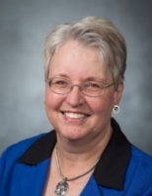
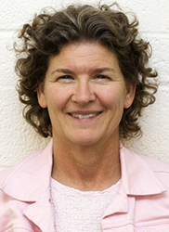
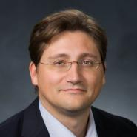
Research Development Support
Kristen Clarke Kellems
FHSS Research Development
934 SWKT
Tel: 801-422-8967
Email: fhssresdev@byu.edu
Conrad Monson
STEM Research
Development
275 McDonald Building
Tel: 801-422-7722
Email: conrad_monson@byu.edu
Jaynie Mitchell
MSE Research Development
306C MCKB
Tel: 801-422-3067
Email: Jaynie@byu.edu
Sarah Dorff
Research Development Administrator
269 McDonald Building
Tel: 801-422-0132
Email: resdev@byu.edu
Jon Balzotti
English Department Faculty
College of Humanities
4127 JFSB
Tel: (801) 422-2440
jonathan_balzotti@byu.edu

Slide 3
Agenda
Introduction
Understand Your Targeted Funder
Finding Funders/Online Tools
Develop a Fundable Idea
  SWOT analysis
  Faculty funding experiences: Rick Jellen
Contacting Funders
Wrap Up

Slide 4
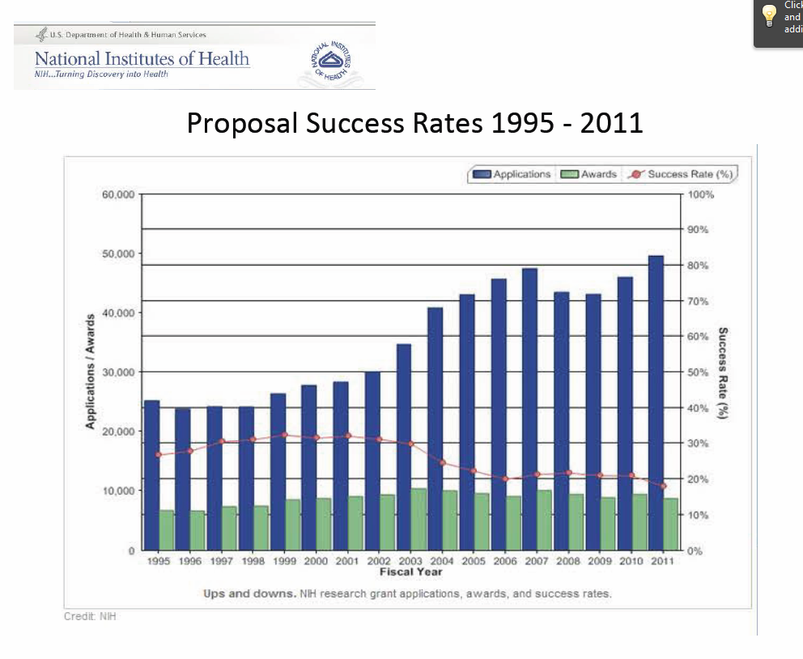
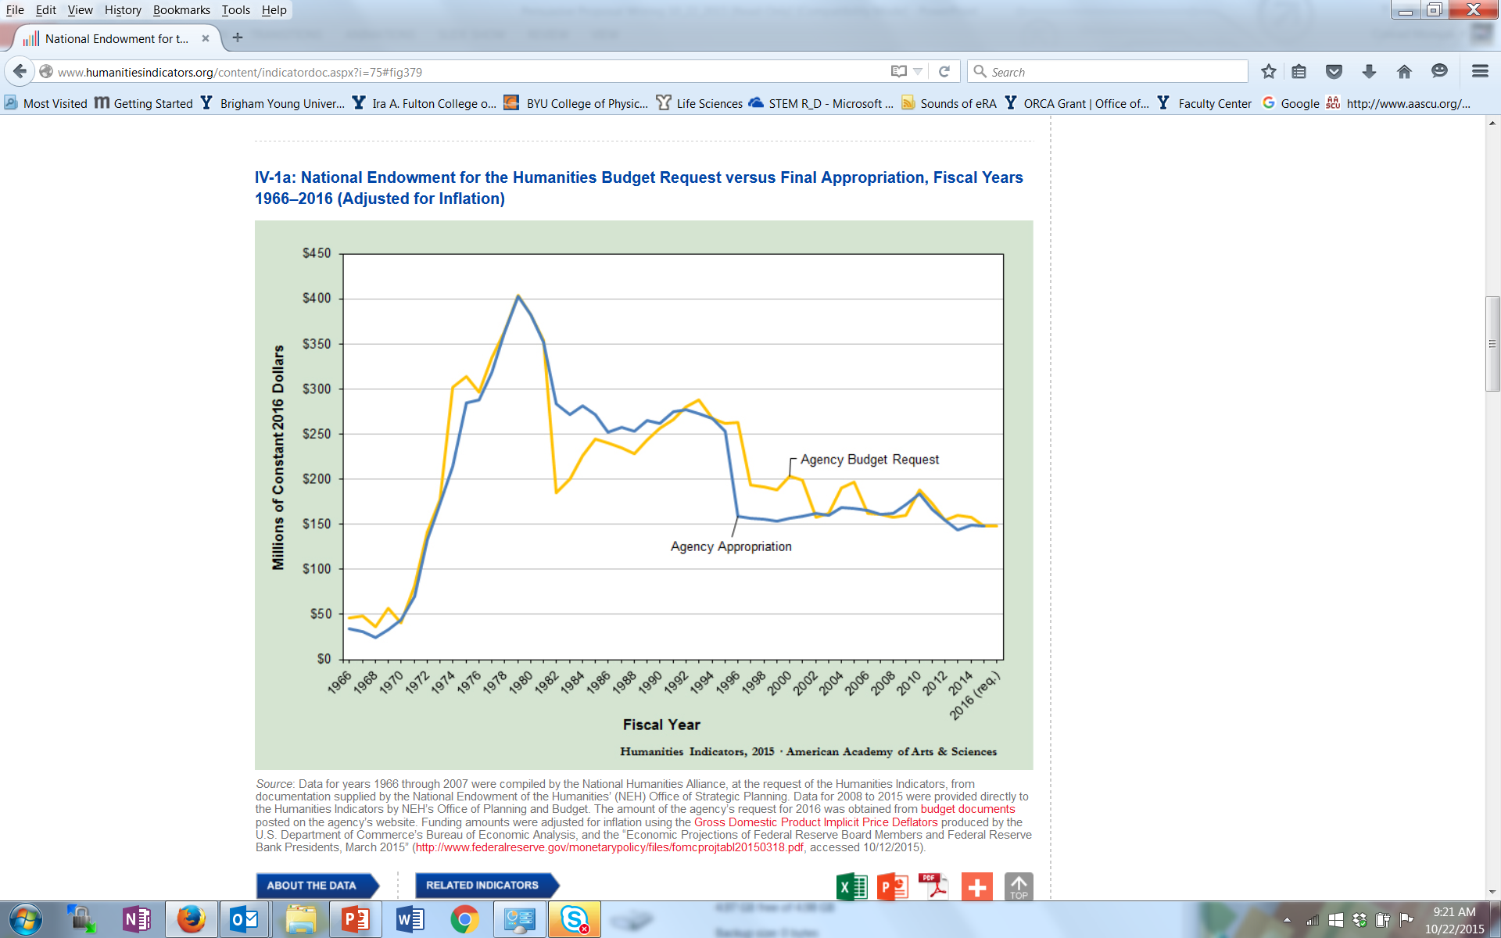
Even in Today’s Challenging Environment for Research Funding…
NIH Proposal Success Rates 1995-2011
  There is a steady increase in proposal submission BUT also a steady decrease in proposal success rate
Future funding will be negatively impacted by rising costs for research, national funding priorities and budget deficits
NEH Funding Levels 1966-2016
Notes:
Proposal success rates now average just 15 to 30 per cent (in 2009, NIH averaged 8-10% on 1st submission 28% on 2nd; other agencies have similar success rates)
BYU rates tend to be just a bit higher

Slide 5
… There are Ways to be Successful
Know your funder (what kind of projects they fund; how much money they give to research)
Find useful collaborative partners
Draft a short description of your project (elevator pitch) and use that to garner interest from project officers
Pay attention to the details
Use best practices to write compelling proposals
Be persistent
Notes:
Pay attention to details
Significant number of proposals are rejected by funding agencies without review because the proposer didn’t follow all the directions
Use Best Practices
Develop a fundable idea
Find funders
Use effective pre-proposal activities
Write compelling proposals
Be persistent
Themes throughout this presentation include – lots of pre-proposal activity; marketing throughout; pay attention to detail
At Dec 2013 NSF Days – be persistent; ~15% success for 1st time, ~50% 2nd time, 75% 3rd, assuming followed reviewer recommendations and did proper revisions
In 2009, NIH averaged 8-10% on 1st submission 28% on 2nd; other agencies have similar success rates

Slide 6
Proposal Development Process
Good Ideas
Fundable Idea
Find Funder(s)
Pre-Proposal
Marketing
Write the Proposal
Revise
Reject
Accepted AND Funded
Draft
Funder
Peer Review
Edit, Revise
Submit (ORCA)

Slide 7
Know Who Might Fund Your Research

Slide 8
External Funds for University Research¹
In 2015, CPMS, FHSS, E&T, LS and MSE received 91% of BYU research funding; over 80% of that funding was from federal sources²
(Internal to a University)
¹NSF Higher Education R&D Survey. Data are the average of 2011, 2012, 2013
²ORCA Annual Report of Sponsored Research for 2015
Most of BYU research funding comes from federal sources

Slide 9
Comparison of Public vs. Private Funding Sources
Public | Private
Federal government | Foundations
State government | Corporations
Local government (city, county, municipality) | Non-profits
Non-profits | Professional association
 | Trade associations
 | Unions/Service clubs
 | Special interest groups
 | Faith communities
Ways they differ:
  Where the money comes from and why they’re giving it away
  Who is involved in the decision-making process; how decisions are made
  How much money they will award
  How long they will fund a project
  How they want to initiate contact

Slide 10
Public Funding Sources: Advantages/Disadvantages
Advantages | Disadvantages
Large multiyear grants that can include operating costs | Complex applications and reporting requirements
Purpose set by legislation; transparent decision making | Proposals are longer and require assurances of nondiscrimination and fair practices
Aim is to effect significant groups in society | Many more organizational requirements once funds are received
Many funding opportunities available (grants, contracts, appropriations, dedicated funds) | Tend to favor proposals from established organizations
Prescribed processes and formats for proposals | May be reluctant to fund new or high-risk approaches
Funds available for a wider array of organizations (for-profit, nonprofit, etc.) | Higher cost to organization for securing funds and carrying out projects
Accountable to elected officials if bias suspected | Changing political trends affect security of some programs and continued availability of funds

Slide 11
2015 Federal Spending For Research
$62.6B Total
From National Science Foundation, National Center for Science and Engineering Statistics, Survey of Federal Funds for Research and Development, FYs 2013–15.

Slide 12
Private Funding Sources: Advantages/Disadvantages
Advantages | Disadvantages
Large and small grants | Average grant size is usually smaller
Guidelines determined by founder or board | Priorities can change rapidly making continued support harder to predict
Competition may be less intense | Grantseekers have limited influence on decision making process
Proposals usually less complex and lengthy | Information on policies and procedures can be harder to identify
Seldom have complex tracking and reporting requirements | May be unwilling to pay all project costs or indirect costs
Can help open the door to large public grants | Smaller staff size may limit opportunity for preliminary discussion or site visits
Can often provide forms of help other than just cash; may be better for local needs | May not explain a rejection, making it harder to compete more effectively next time

Slide 13
Private Funding Awarded by Project Type
Private industry contributes close to 70% of the over $400B in yearly US R&D funding
(from “Getting Funded: The Complete Guide to Writing Grant Proposals” and NSF Science and Engineering Indicators)

Slide 14
Methods to Find Funders:
Funding Search Tools

Slide 15
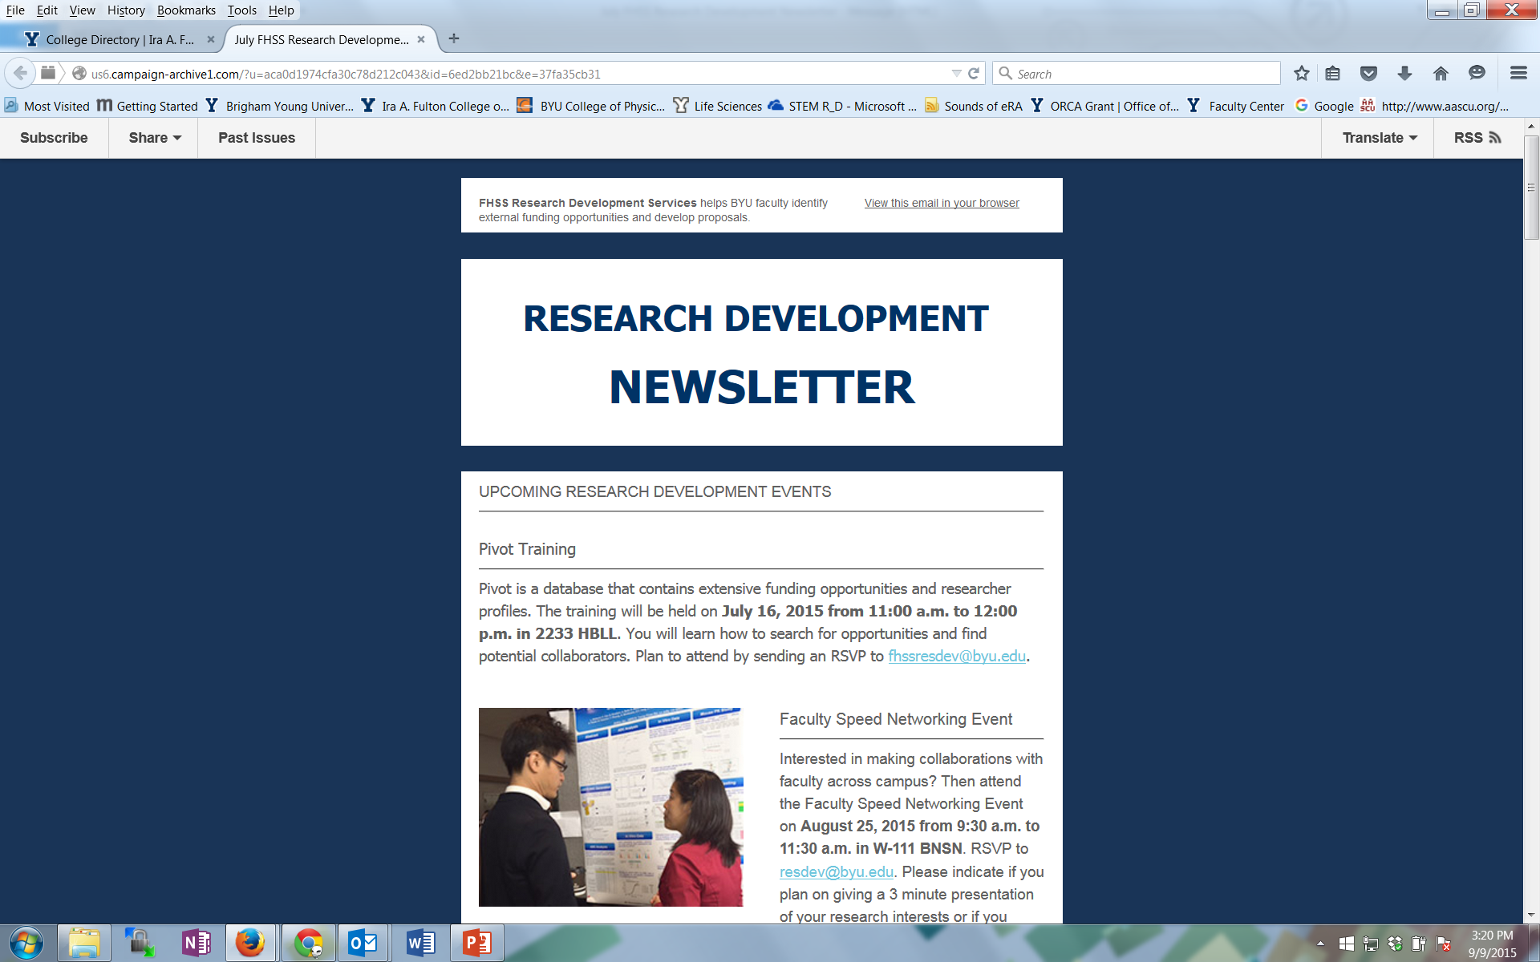
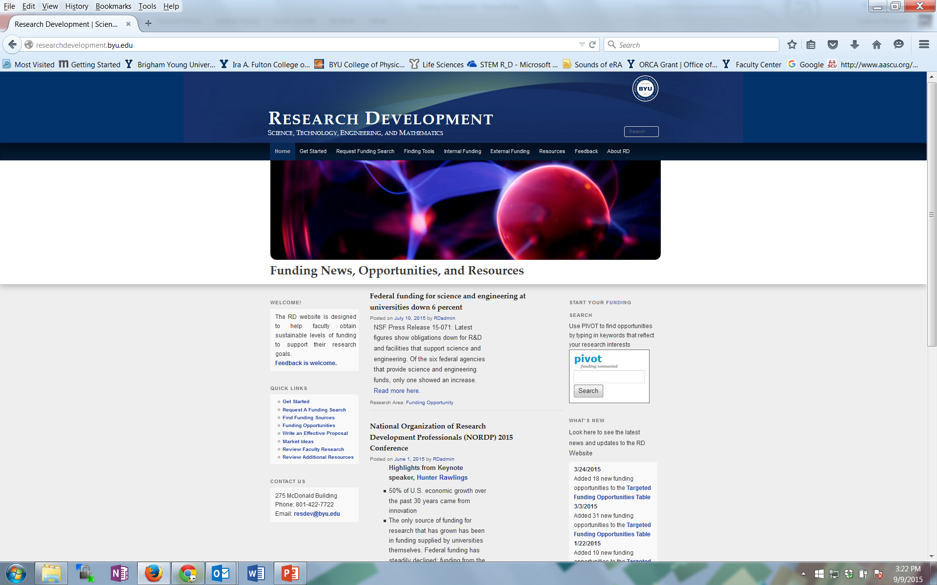
Research Development Support for Finding Funding and Writing Proposals
Newsletters from FHSS and STEM Research Development
Research Development website: researchdevelopment.byu.edu
Online funding searches
Conduct seminars about particular funders
Advocate research capabilities to funders
Attend funding conferences
Identify funding opportunity and help write the grant proposal

Slide 16

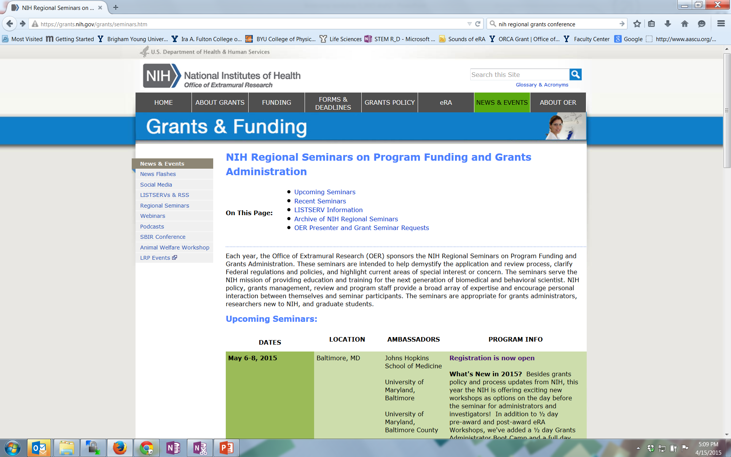
Find Funders
Look for funder contacts within professional societies
Attend funding conferences (e.g., NSF, NIH)
Search journal article acknowledgements
Participate in proposal review panels
Look for funding opportunities from unused Government year end funds
Contact potential Program Officers about funding and ask them to recommend funding sources
Search a wide range of possible funding sources
  Federal Government
  Associations, Foundations, Companies
  Municipal, County, State Government, Community Partnerships
  “Alternative” sources of funding (e.g., Crowdfunding, Benefunder, Nine Sigma funding)
As one expert put it - think big, think small, think in different ways to uncover funding opportunities… in other words, cast a wide net
Notes:
Review Panels - at Dec 2013 NSF Days, leader solicited business cards for potential reviewers. For NSF, don’t need a prior NSF grant, or even a PhD or university affiliation. Need expert. NSF needs about 50K reviewers per year

Slide 17
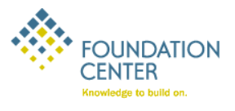
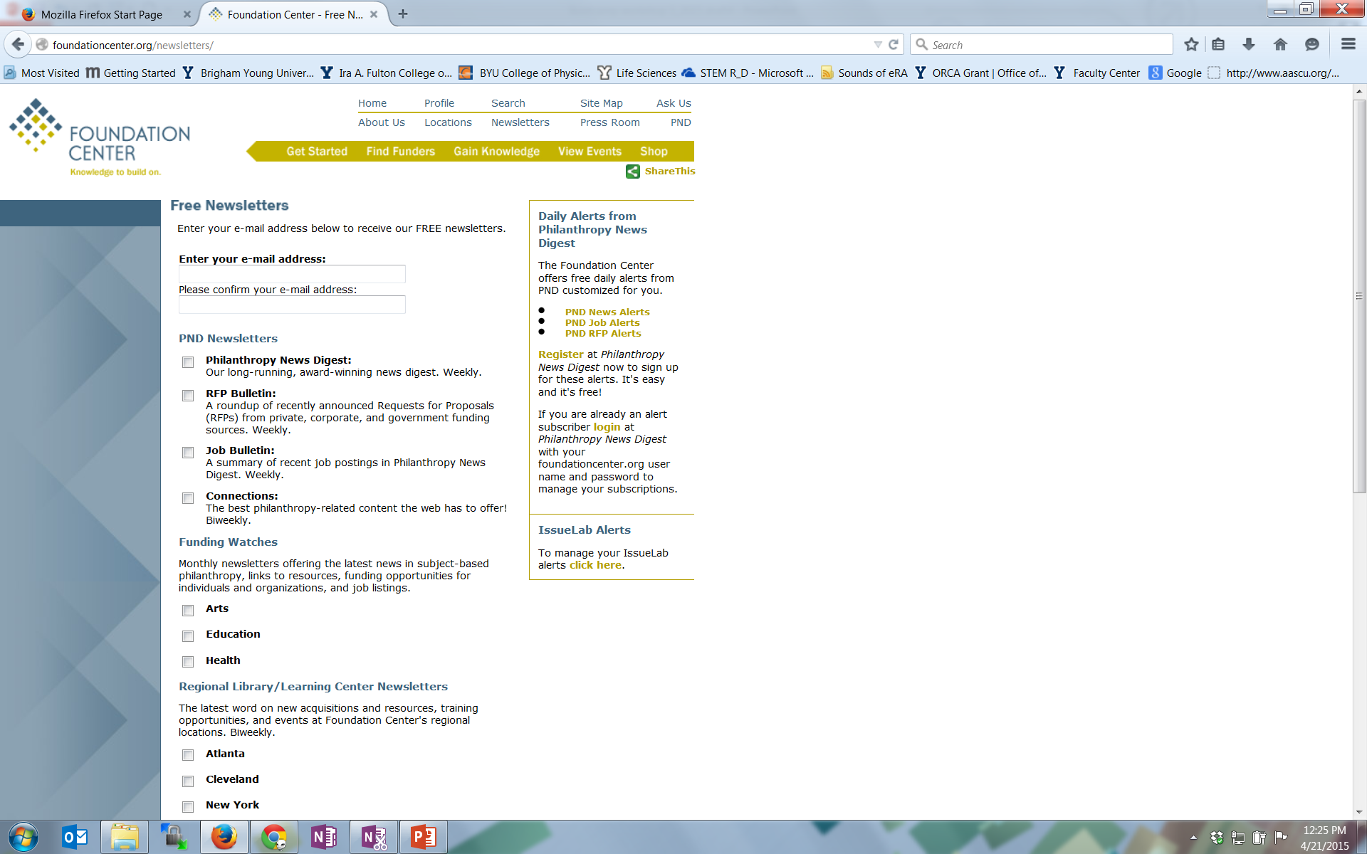
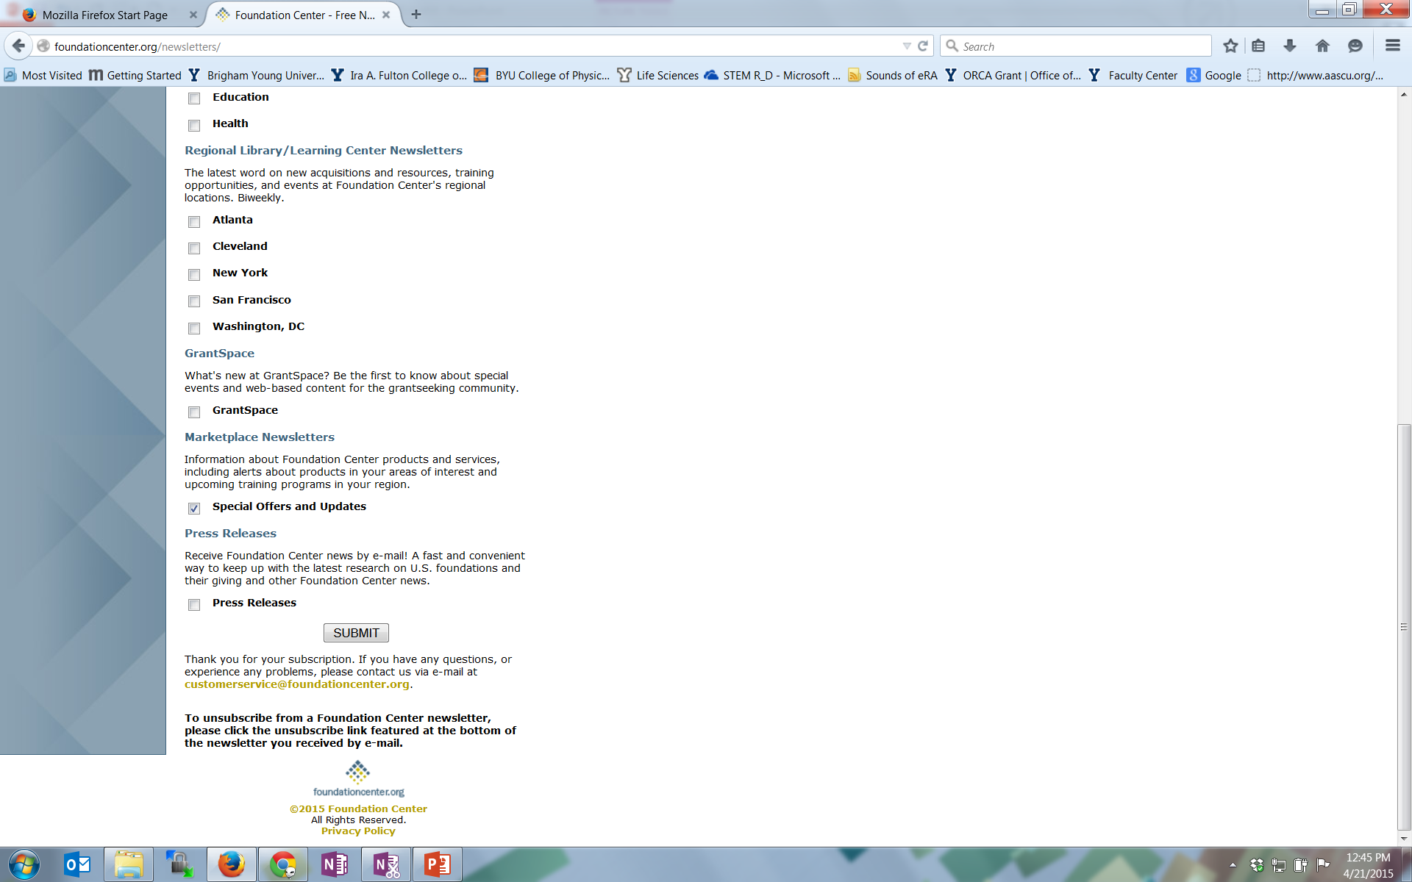
Additional Foundation Center Services That Aid Funding Searches

Slide 18
Find Funders (cont.)
Additional Online Search Tools
Grants.gov (free; register) http://grants.gov/
The Catalog of Federal Domestic Assistance (CFDA)
(free) www.cfda.gov
Other online tools
  Federal Register http://www.gpoaccess.gov/fr/
  Grantsmanship Center http://www.tgci.com/
  Fundsnet service http://fundsnetservices.com
  GrantsNet http://www.grantsnet.com
  Guidestar http://www.guidestar.org
  Agency, Foundation, Company websites
  Google/Bing/Yahoo
Notes:
Perhaps most useful feature of PIVOT is the opportunity tracking that provides automated alerts when selected opportunities are updated
We will do a PIVOT tutorial later this morning and Trace Eddington from LDS-P will provide demonstrated Foundation Center online next week.
Are there a few who would like us to do a preliminary search for them and show it at next weeks class?

Slide 19
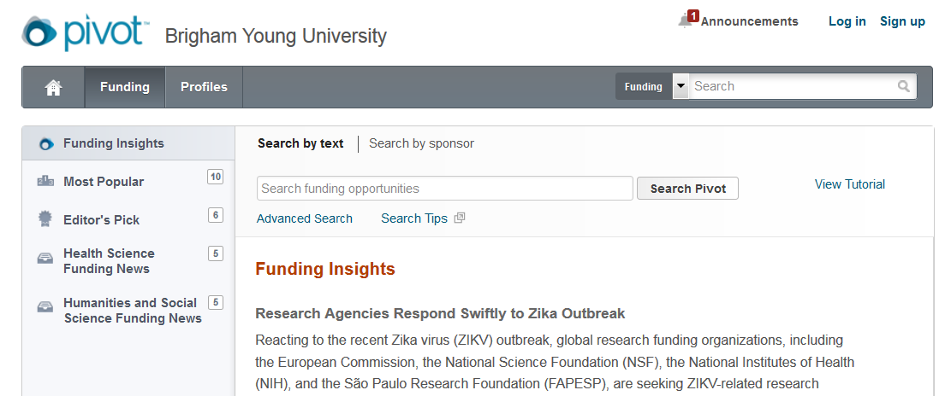
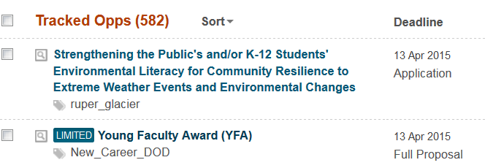
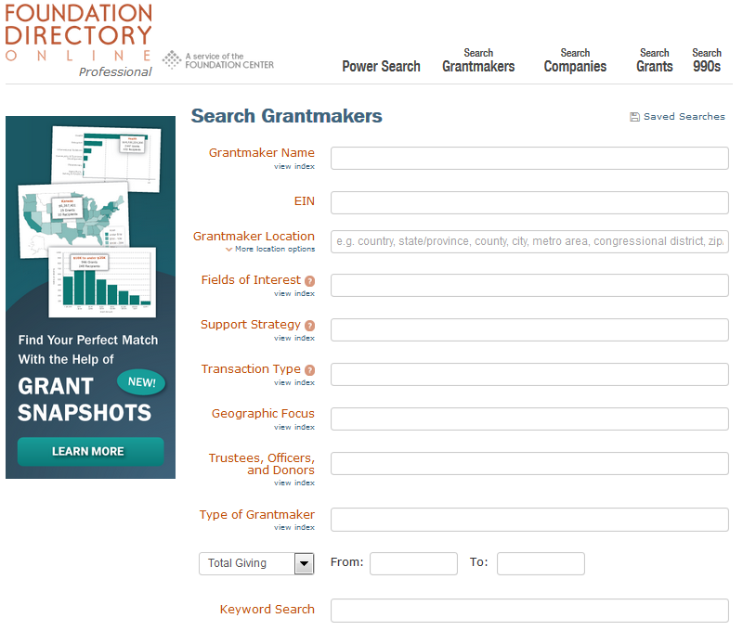
Find Funders
Online Search Tools
PIVOT (BYU has a subscription) http://pivot.cos.com
Database training: October 12
  Noon, 2231 HBLL
Foundation Center Online (BYU has a subscription)
http://fdncenter.org/ login username byuacadvp and
password cougars2002
Notes:
Perhaps most useful feature of PIVOT is the opportunity tracking that provides automated alerts when selected opportunities are updated
We will do a PIVOT tutorial later this morning and Trace Eddington from LDS-P will provide demonstrated Foundation Center online next week.
Are there a few who would like us to do a preliminary search for them and show it at next weeks class?

Slide 20
Develop a Fundable Idea

Slide 21
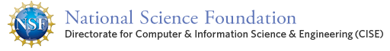
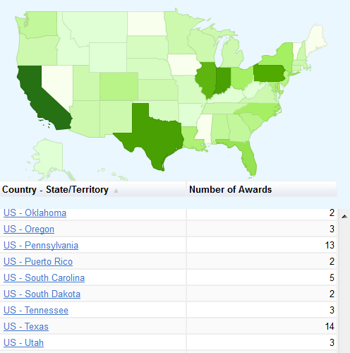
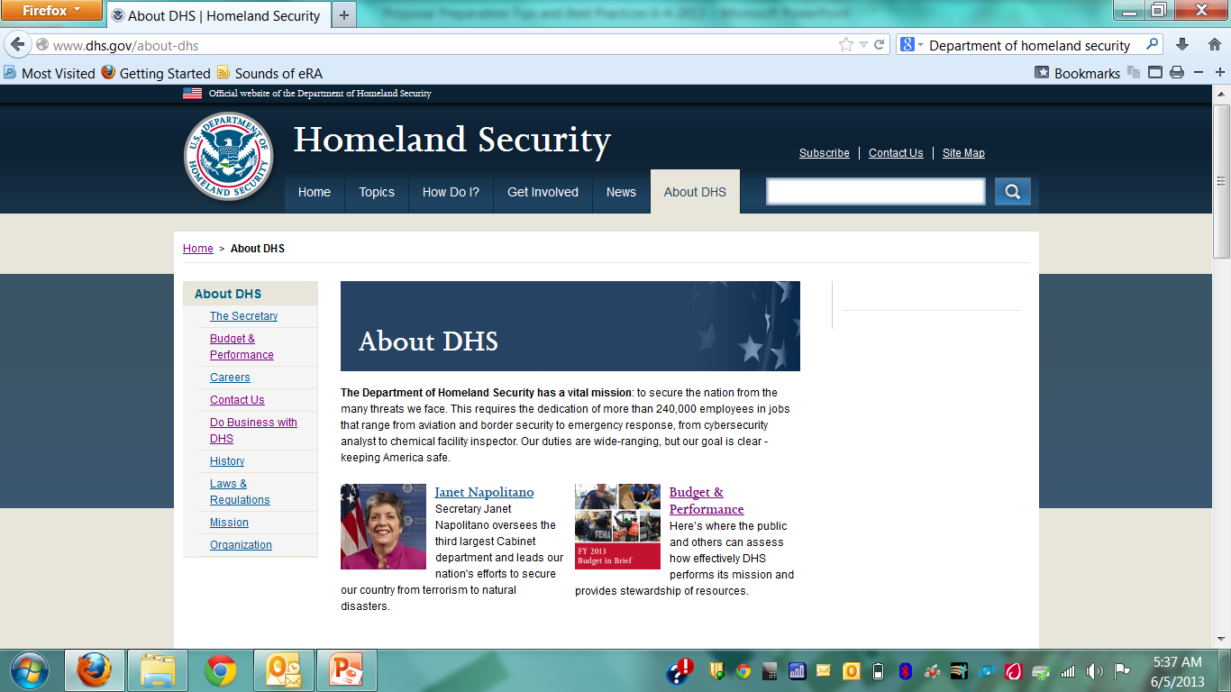
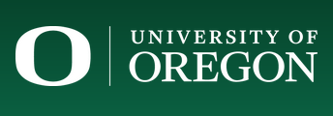
What Do You Need to Know About Potential Funders?
  Clearly understand the funder’s research interests, goals, mission statement – how well does your research fit?
  How much funding does a funder have and distribute?
How many awards does the funder make and what is the success rate?
Does the funder accept unsolicited proposals?
If a foundation – does it accept applications?
See what a funder has funded in the past
  Federal Agencies: often posted on their websites
  Non-Profits: can be on their websites and must be on their 990 tax filings
  Companies: research, websites, alumni, other contacts
Try to shape the funders thinking

Slide 22
With a Fundable Idea and Good Potential Funding Source(s) Perform SWOT Analyses
S
Strengths
What are your strengths
What do you do better than others
What unique capabilities and resources do you possess
What do others perceive as your strengths?
W
Weaknesses
What are your weaknesses
What do competitors do better than you
What do others perceive as your weaknesses
Internal (attributes of your organization)
O
Opportunities
What trends or conditions may positively impact you
What opportunities are available to you
T
Threats
What trends or conditions may negatively impact you
What are your competitors doing that may impact you
Do you have solid financial support
What impact do weaknesses have on threats to you
External (attributes of your environment)
Positive (helps meet objectives)
Negative (detrimental to objectives)
SWOT analyses can identify strengths to highlight, weaknesses to mitigate, opportunities to capitalize on and threats to counter

Slide 23
Developing a Fundable Idea: Faculty Experiences in Seeking and Securing Funding with Rick Jellen

Slide 24
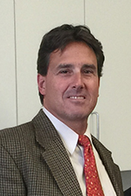
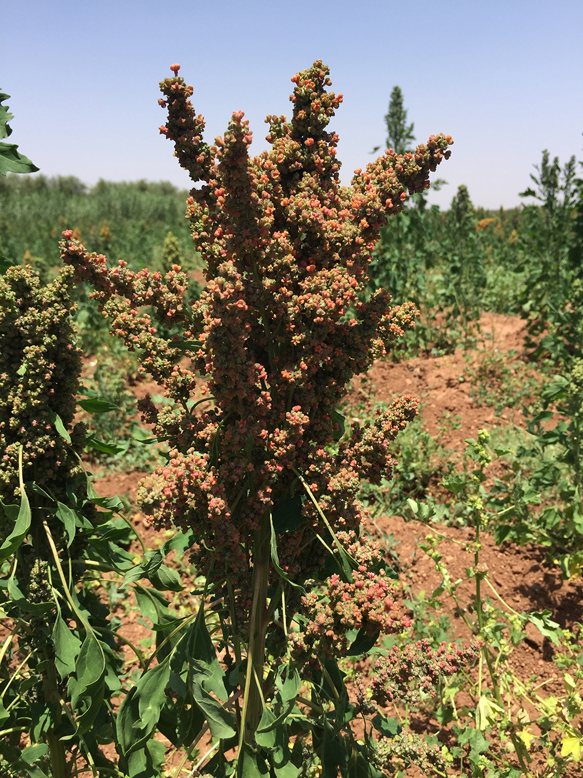
Rick Jellen is the Associate Dean for Research in
the College of Life Sciences
Rick studies the genetics of a group of native American crops in the goosefoot family (quinoa, amaranth, kiwicha, etc.) and also oats, along with their origins and relationships to their wild relatives
BS in agronomy from BYU and an MS and PhD in plant breeding from the University of Minnesota

Slide 25
Other Ways to Develop a Fundable Idea
Think in Question format
  Formally write out every interesting question that you can think of related to the area you are exploring
Think in Experiment/Research Approach format
  Write out every possible experiment you would like to do regardless of money, expertise or equipment
  If you aren’t conducting experiments, determine all possible ways of gathering information you need, interviews, who needs to be involved (schools? State Department?)
Think in Hypothesis format
  Formally write out as many untested hypotheses as you can related to the area of interest
Keep an ongoing log of your ideas
Let the ideas incubate and try the process again (and again)

Slide 26
Remember to Refine Your Idea
Clearly identify your niche
Determined if it addresses gaps in research
Sufficiently unique or different from other ideas
Analyze strengths and weaknesses of your idea and determine possible competitors/collaborators
Communicate your idea to others who can provide valuable feedback
  One example of Colleague communication – “Yamamoto Approach” that uses an Advisory committee to review ideas before a proposal can be written
    Is the question impactful and clearly articulated?
    Are the experiments technically feasible, most advanced approaches?
    Would a collaborator add conceptual or technical breadth to the potential outcome?
    Will outcomes uncover uncertainties and ambiguities, resolves differences of opinion?
    Approach typically stimulates improvements
Keith Yamamoto, Executive Vice Dean, UC San Francisco School of Medicine
Notes:
Clearly identify the niche area into which your idea fits
Identify long-term goals within niche area
Conceptualize research needed to attain long-term research goals
Identify next logical step in research continuum…your idea should be a logical next step
Draft a short, well-crafted, logical description of your idea (must answer Why, Who, What, How) and present it to colleagues for a critical review
Are they excited, show a keen interest in your idea?
Does it have scientific and technical merit?
Do you have the ability, capability and resources to pursue your idea?
At the right time, a description could be presented to a potential funder
Identify your competitors and their strengths/weaknesses. Compare them with yours and determine how you will emphasize your strengths and mitigate your weaknesses. Do you know if your competitors will submit a proposal? Have you considered collaborating with a potential competitor?

Slide 27
Refine the Idea (cont.)
Draft a short, well-crafted, logical description of research based on your idea
  Refined through colleague reviews/critiques (e.g., ongoing NIH, NSF summary reviews)
At the right time, present to potential funders before writing proposal
  Program Officer feedback can be invaluable and may direct you to a more appropriate funding source
If you follow the idea generation and refining steps, you will have a fundable idea AND the foundation of a good proposal
Notes:
Clearly identify the niche area into which your idea fits
Identify long-term goals within niche area
Conceptualize research needed to attain long-term research goals
Identify next logical step in research continuum…your idea should be a logical next step
Draft a short, well-crafted, logical description of your idea (must answer Why, Who, What, How) and present it to colleagues for a critical review
Are they excited, show a keen interest in your idea?
Does it have scientific and technical merit?
Do you have the ability, capability and resources to pursue your idea?
At the right time, a description could be presented to a potential funder
Identify your competitors and their strengths/weaknesses. Compare them with yours and determine how you will emphasize your strengths and mitigate your weaknesses. Do you know if your competitors will submit a proposal? Have you considered collaborating with a potential competitor?

Slide 28
Contacting Funding Officers

Slide 29
Contacting Funding Officers
Do your homework – don’t ask questions that are answered in RFP or other provided documents
Understand the mission and priorities of the funder
Be familiar with restrictions that might eliminate your organization
Know the minimum and maximum amounts typically awarded
Know the total amount of funding available
Review recent awards: what portion of the grants went to previous grantees
Write a short description of your project (white paper)
Email the description to the officer. Ask: What would you recommend to improve my chances for favorable review? What is anticipated success rate? What are some common reasons for proposal rejections? Listen carefully to read between the lines.
Follow up with a short thank you, summary of key points, cv with photo
Let the PO know you are willing to serve on a review panel
Adapted from Can We Talk? Contacting Grant Program Officers by Robert Porter, 2009

Slide 30
Wrap Up
Understand Your Targeted Funder
  Understand public and private funding
  Gain knowledge about funders
Finding Funders/Online Tools
  Search for funding in a variety of different ways—journal articles, databases, becoming a subawardee, etc.
  Make finding funding a regular part of your career – online tools with alerting features can help you be systematic and consistent in your finding efforts
Develop a Fundable Idea
  SWOT analysis
  Case studies
Contacting Funders
Work with Research Development!

