Slide 1
Academic Research Enhancement Award (AREA) Program
NIH Regional Seminar 2015
Michelle M. Timmerman, Ph.D.
Director, AREA Program
National Institutes of Health

Slide 2
Overview of AREA (R15) program
How R15s differ from other Rs
Changes, trends, and funding
Strategies for success
Institutional level
PI level
Ineligible list http://1.usa.gov/1z5GsIu

Slide 3

Goals of AREA program
Support small scale research projects
Expose students to research
Undergraduate (preferably) and/or graduate
Not high school
Not postdoc/residents/clinical fellows
Strengthen the research environment of educational institutions that have not been major recipients of NIH research grant funds

Slide 4
Key features
Project period is limited to 3 years
Direct cost limited to $300,000 over combined 3 years
Multiple PIs are allowed, if all eligible
Research Strategy limited to 12 pages
Grants are renewable
Preliminary data not required but can be provided

Slide 5
Application logistics
Funded through the R15 grant mechanism
Program Announcement (PA) Number: PA-13-313
Receipt dates
Standard application deadlines: February 25, June 25, and October 25
AIDS-related research deadlines: May 7, September 7, and January 7
All NIH ICs participate except FIC and NCATS
NIMHD joined Jan 2015
ASSIST (new!) or downloadable forms

Slide 6


















Who does what for R15s
Office of the Director
Director of AREA Program
Manage direction of AREA
NIA
NIAAA
NIAID
NIAMS
NCI
NICHD
NIDCD
NIDCR
NIDDK
NIDA
NIEHS
NEI
Awarding ICs (PO & GM):
Have funding authority
Awards R15
Make funding decisions
Manage & administer grant
NIGMS
NHLBI
NHGRI
NIMH
NINDS
NINR
NIMHD
NCCIH
FIC
NCATS
NLM
NIBIB
CC
CIT
CSR
CSR (SRO):
Review most R15
6
6

Slide 7
Assignments for R15
Institute/Center:
Funding consideration
Lifespan of award
e.g. AI (NIAID), AT (NCCIH)
Scientific Review Group
Standing committee/”standing study section”
e.g. AIP, VMD
Special Emphasis Panel/SEP
e.g. ZRG1 OTC-N 80, ZRG1 SBIB-D 57

Slide 8
Differences between R15 & other Rs
Unique review
Review criteria
Management of review
Unique application requirements
Eligibility
Institution
PI

Slide 9
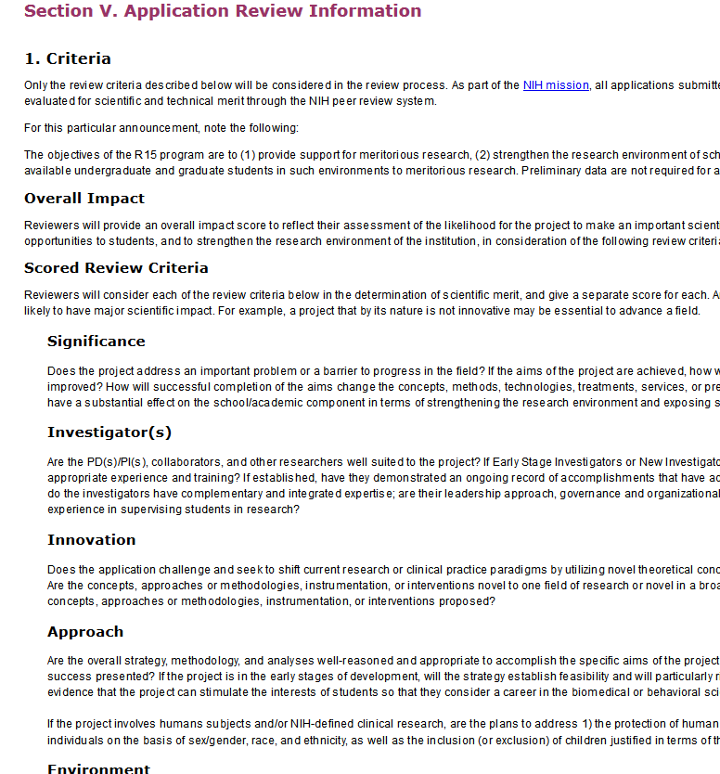
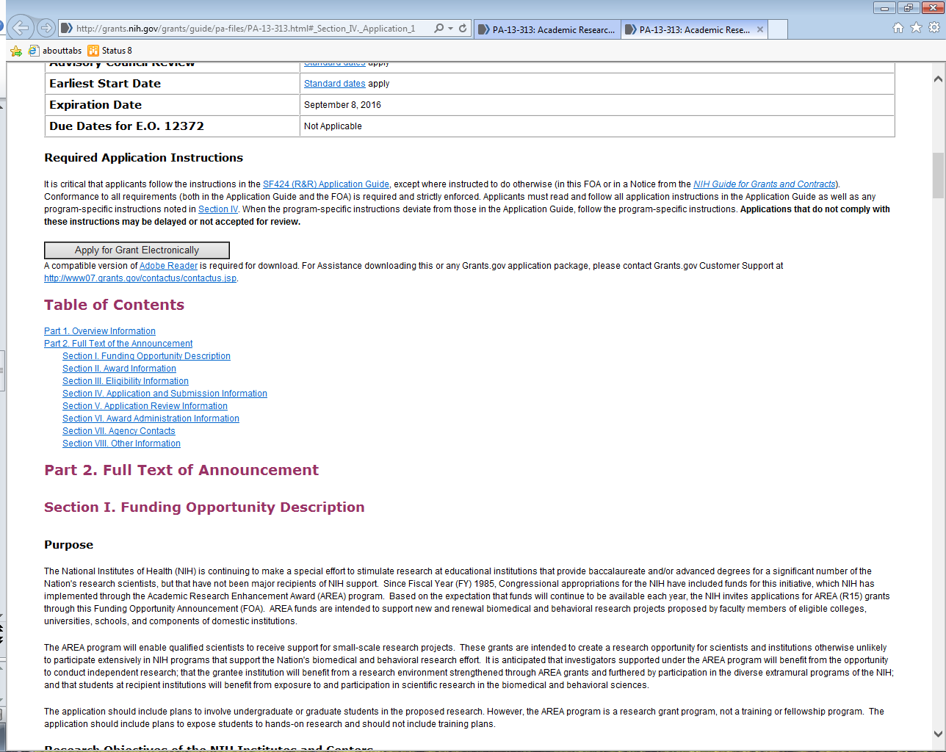
Where to find review criteria
Review criteria are in Part 2,
Section V, Part 1

Slide 10
Some review criteria are unique
PA-12-006 & PA-13-313
Significance
Strengthen research environment
Expose students to research
Investigator
Experience supervising students in research?
Approach
Can project stimulate students’ interest so they consider biomedical/behavioral science career?
Environment
Adequate institutional support & resources?
Well qualified students available?
Have or likely will students pursue biomedical/ behavioral science careers?

Slide 11
Overall impact
Important scientific contribution
Provide research opportunities for students
Strengthen research environment

Slide 12
R15 are clustered for review
Implemented in response to applicant feedback
In one time Special Emphasis Panel of R15
Panels are grouped by scientific topic
In study section with R01, R21, R03
Streamlined against R15 only
Reviewed sequentially, not mixed with other R
Based on logistics to get best review for each cycle’s applications
Can still request study section in Cover letter
Can list expertise needed to review app

Slide 13
Which should you request in your optional Cover Letter?
Knowing that R15s can be assigned to a SEP
Institute/Center
Review Group
Specific expertise
Specific Reviewers

Slide 14
What do you do?
You think your research fits well in NINR mission.
They funded 0/22 R15 in FY14 (0%).
But they funded 6/36 R15 in FY13 (16.7%)
It’s a stretch, but maybe Specific Aim 2Biii fits NIGMS mission.
They funded 69/328 R15 in FY14 (21%)
Notes:
Point is talk to IC contact and let science be the guide. Be particularly aware that with our small n, conclusions are difficult to draw. NINR’s success rate has been 0-18 in last ~5 years

Slide 15
Addition to PI biosketch
Summary of previous/current experience supervising students in research
Specify which pubs/patents involved students under their supervision

Slide 16
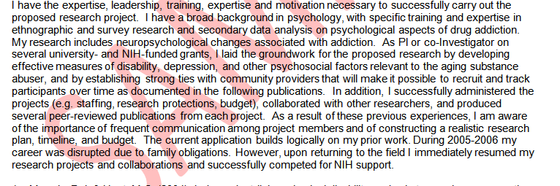
Don’t start your biosketch with:
“I have the expertise, leadership, training, expertise and motivation necessary to successfully carry out the proposed research project. I have a broad background in Topic A, with specific training and expertise in Sub-Topics B, C, and D.”

Slide 17
Additions to Budget
Must include undergraduate (preferably, if available) and/or graduate students
Specify which parts of research students will be involved in
List number & level (e.g., undergraduate, junior)
Multi year funded = 1 budget period of 3 years, not 3 budget periods of 1 year each
Example: 2 academic months + 3 summer month for each of 3 years = 6 academic months + 9 summer months for budget period

Slide 18
Additions to Facilities
For institution or qualifying School
Not PI’s experience
Profile of students
# who obtained Bachelor & went on to doctoral degree in health-related sciences in last 5 years
Special characteristics that make it appropriate for 3 goals of AREA
Impact of R15 on PI & institution
Any institutional support
Limited use of special facilities elsewhere

Slide 19
Answers to Common Profile Questions
Numbers and/or percentages OK
Must include information for Institution. Eligible HPS must include information for HPS.
Allowable to include information on Department
Ask admissions/alumni office for stats
Be upfront if you have only partial data
Not a diversity mechanism

Slide 20
Examples of institutional support
See PA-13-313 and
Equipment
Lab space
Release time
Matching funds
Items PI will not be charged for (e.g., no per diem for animals)
Pilot funds
Supply funds for student research
Stipends or housing for summer students
Travel grants

Slide 21
Eligibility
Eligibility
Institution
Principal Investigator
Eligibility = applicant institution and PI only
Eligibility ≠ collaborators

Slide 22
AOR certifies eligibility during submission
The list of NIH and other PHS agencies Assurances, Certifications, and other Policies is found in Supplemental Instructions Part III, Policies, Assurances, Definitions, and Other Information.
The applicant organization is responsible for verifying its eligibility and the accuracy, validity, and conformity with the most current institutional guidelines of all the administrative, fiscal, and scientific information in the application, including the Facilities and Administrative rate. Deliberate withholding, falsification, or misrepresentation of information could result in administrative actions, such as withdrawal of an application, suspension and/or termination of an award, debarment of individuals, as well as possible criminal penalties. The signer further certifies that the applicant organization will be accountable both for the appropriate use of any funds awarded and for the performance of the grant-supported project or activities resulting from this application. The grantee institution may be liable for the reimbursement of funds associated with any inappropriate or fraudulent conduct of the project activity.

Slide 23
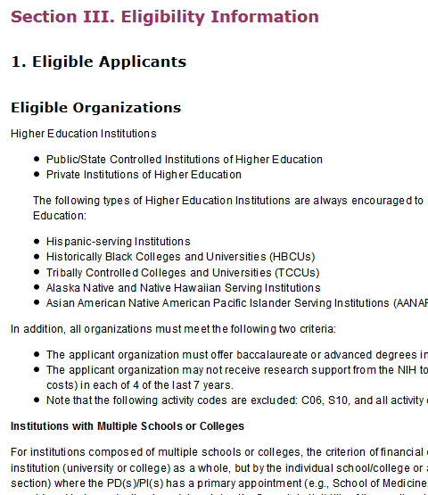
Where to find eligibility in the PA
R15-specific eligibility criteria are in
Part 2, Section III, Part 1

Slide 24
Institution eligibility
US institutions only
Baccalaureate or advanced degree in biomedical or behavioral science
Degree granting & accredited
Public or private non-profit
Receives less than $6 million per year in NIH support in 4 out of last 7 years
Everything except C06, S10, G series
Require institution receive grants in order to use products of C06, S10, Gs

Slide 25
Characteristics of eligible institutions and components
95% of eligible institutions & components never exceeded limit in any year (0/7)
93% would be still eligible if limit were halved
Average/median annual support < $1 million
96% would be eligible with $4.3 million limit (2003 + BRDPI)
42 institutions would not be eligible

Slide 26
There is no “eligible” list
Ineligible list is on AREA Program website
http://grants.nih.gov/grants/funding/area_ineligible.htm
“College” is called “School”
City listed does not necessarily mean that campus only
Name might not be what appears on your application
“Other Academic” = sum of everything that is not an R15-defined Health Professional School
Engineering + Education + Law + Arts & Sciences
Updated in April; university should check for PIs

Slide 27
PI eligibility
Primary appointment at eligible institution
Multiple PI OK if all eligible
R15 supports small scale projects
Eligible:
Also serve as consultant (e.g., Key Personnel) on another grant
Not Eligible:
Also serve as PI of other NIH research grants at time of award
Also serve as Multiple PI on another NIH research grant at time of award
Research is broadly defined

Slide 28
Second most common question
Can I have an ineligible collaborator?
At ineligible institution
At ineligible component on home campus or
At another site
or
PI of their own NIH research grant

Slide 29
Can I have an ineligible collaborator?
Eligibility answer: Yes
Merit answer: But
Majority of research should be directed by PI at grantee institution
Student profile & student inclusion are for applicant/eligible component
Consider the unique goals and criteria of the R15
No one can predict what level of involvement will be seen as counter to the R15 goals
Pre-PA-12-006, unique attributes not included in review criteria

Slide 30
Changes to R15 over time
Now considered career-sustaining, no longer stepping stone to R01
Renewable
Now clear incorporation of R15 goals in review criteria
Now softened language about expected scientific impact
Now softened language about expected impact from environment
Notes:
Will the scientific environment in which the work will be done contribute to the probability of success? Will the project benefit from unique features of the scientific environment, subject populations, or collaborative arrangements? Not in R15

Slide 31
After the award: Progress Report
RPPR due annually (same progress report as other NIH grants)
Must report students on R15 >1 person month (even if not paid)
Everyone must have Commons ID
One Commons ID per career

Slide 32
RPPR Section D - Participants
Must list students in Section D, not just mention in research update
Students who worked at least 1 person month per year even if unpaid must be listed
And must have Commons ID
They should complete Commons Person Profile
Crucial to tracking students and determining success of AREA program as a whole

Slide 33
Funding statistics FY11-14
NIH wide: ~1400-1600 applications, ~200-230 awards
# applications & awards vary widely among ICs, and not just by size of IC
Success rate ~14%
http://www.report.nih.gov/DisplayRePORT.aspx?rid=563

Slide 34
FY 14 Funding by Institute/Center (IC)
Institute/ Center | Applications reviewed | Applications funded | Success rate
NIAAA | 16 | 2 | 12.5%
NIA | 62 | 6 | 9.7%
NIAID | 179 | 28 | 15.6%
NIAMS | 51 | 7 | 13.7%
NCCAM/NCCIH | 30 | 4 | 13.3%
NCI | 228 | 23 | 10.1%
NIDA | 28 | 3 | 10.7%
NIDCD | 27 | 5 | 18.5%
NIDCR | 28 | 6 | 21.4%
NIDDK | 89 | 11 | 12.4%
NIBIB | 47 | 2 | 4.3%
NIEHS | 62 | 10 | 16.1%
NEI | 23 | 6 | 26.1%
NIGMS | 328 | 69 | 21.0%
NICHD | 158 | 18 | 11.4%
NHLBI | 111 | 8 | 7.2%
NHGRI | 0 | 0 | Indeterminate
NLM | 3 | 1 | 33.3%
NIMH | 47 | 8 | 17.0%
NINR | 22 | 0 | 0.0%
NINDS | 94 | 15 | 16.0%
FY Total | 1,633 | 232 | 14.2%

Slide 35
FY05-14 Funding trends
Notes:
Doubled award budget, more than doubled the total amount NIH awards for R15

Slide 36
Strategies for success
Institution
Investigator

Slide 37
Build a vital research environment
Understand the NIH extramural research program
Know guidelines, deadlines, submission & correction process, and review criteria
Create an environment in which grants office can succeed
Training
Protected time
Support to set expectations
Make a commitment to establishing an environment in which research can succeed
Start up packages for equipment and supplies
Pilot grants, student research grants
Credit for student involvement in research

Slide 38
…Build a research environment
Consider the importance of collaborative research in establishing a successful research environment
Do not pressure investigators to apply if their projects are not ready for peer review
Quality over quantity; submit best application
“Get some feedback from the reviewers”
Help investigators with the “Facilities and Other Resources” section of application
Profile of student body
Description of the institution and research environment
Letter of institutional commitment to research project
Maintain as resource & revise per Summary Statements

Slide 39
Strategies of Successful PIs
Include a collaborator or consultant if you don’t have the necessary expertise or resources
Understand the review criteria and the review criteria questions
Each question should be addressed in the application
In A1, respond thoroughly and diplomatically to all of the reviewer comments
AREA grant is research award, not training award
Focus on hands-on research not course work
Describe PI’s role in research & supervision

Slide 40
More Strategies of Successful PIs
Address the AREA-specific programmatic goals in the application; these are reflected in review criteria
Support meritorious research
Research should contribute to the field
Results should be publishable
Expose students to research
Profile of available and former students at the institution
Experience of the investigator in working with students
How students will be incorporated into the research project
How students will benefit from this research experience
Strengthen the research environment
The suitability of the institution for an award
The impact the AREA grant will have on the institution

Slide 41
Advice from PUI PIs
Research Strategy should address feasibility with your students
Involve first years & sophomores
Multi-semester commitment
Lab classes teach experimental design
Consider cultural exposure to major research institutions in lieu of summer REU
Assess what students need to participate
Help students plan workload realistically
Involve students in training new students
Consider a (part time/seasonal/dept) technician

Slide 42
What belongs in Research Strategy
How student will be supervised
How student will be taught to do the work
How student will be involved
Feasibility with respect to student investigators
Convey how project will stimulate students to consider NIH-related career
Describe student’s coursework
Describe student’s seminars, workshops, conferences
Describe PI’s teaching philosophy

Slide 43
There is no winning formula
No one can give specifics of what will score well
Do not treat a successful [or not] application as an iron-clad template [of what not to do]
How many students
How many papers
What % of a collaborator
What % of special facilities
What amount or type of institutional support
What type of environment

Slide 44
Resources
AREA Program Facebook page
Like us on Facebook
https://www.facebook.com/NIHAreaProgram
AREA Program FAQs
http://grants.nih.gov/grants/funding/area_faq.htm
AREA mailbox
R151@mail.nih.gov
Institute/Center contacts
http://grants.nih.gov/grants/guide/contacts/parent_R15.html
Strategic plans
http://report.nih.gov/strategicplans/

