Slide 1

Faculty Early Career Development (CAREER) Program (NSF 17-537)
Next Deadlines:
July 18, 2018 – BIO, CISE, EHR
• July 19, 2018 – ENG
July 20, 2018 – GEO, MPS, SBE Future Years:
Third Wed, Thursday, Friday of July
Sonia Esperança, Ph. D. –
GEO representative to the CAREER Coordinating Committee (CCC)
CAREER website: www.nsf.gov
(solicitation, FAQs, link to recent awards, Division Contacts)

Slide 2
Support for New Investigators
NSF supports new investigators (not previously
funded by NSF) in all of our programs
More than 1/3 of research proposals submitted to NSF are from new investigators (2/3 of CAREER proposals)
About 1/4 of research awards go to new investigators (1/2 of CAREER awards)
The Faculty Early Career Development Program (CAREER) - NSF-wide opportunity that offers the most prestigious awards in support of early-career faculty with potential to serve as academic role models in research and education, and to lead advances in the mission of their department/organization

Slide 3
CAREER Program
Emphasizes the importance NSF places on early development of academic careers in which the excitement of research is enhanced by inspired teaching and dissemination of new knowledge
Aims to provide stable support at a sufficient level and duration to enable awardees to develop careers not only as outstanding researchers but also as effective, committed educators
Aims to encourage faculty and academic institutions to value and support the integration of research and education, in which the process of discovery stimulates learning and assures that research findings are quickly and effectively communicated in a broader context and to a large audience

Slide 4
Investigator Eligibility Criteria
Hold a doctoral degree by proposal deadline
Be untenured and employed in a tenure-track (or tenure-track-equivalent) assistant professor position at an eligible institution as of October 1st following deadline
Be in a position with both research and educational responsibilities at an eligible institution
Have not previously received a CAREER award
Have not had more than two CAREER proposals reviewed previously

Slide 5
Tenure-Track Equivalency
For a position to be considered a tenure-track-equivalent position, it must
meet all of the following requirements:
the employee has a continuing appointment that is expected to last the five years of a CAREER grant;
the appointment has substantial research and educational
responsibilities; and
the proposed project relates to the employee's career goals and job responsibilities as well as to the mission of the department or organization.
Departmental Letter must affirm that the investigator's appointment is at an early-career level equivalent to pre- tenure status, and the Departmental Letter must clearly and convincingly demonstrate how the faculty member's appointment satisfies all the above requirements of tenure- track equivalency.

Slide 6
Institutional Eligibility
Academic institutions in the U.S. that award
degrees in fields supported by NSF
Non-profit, non-degree-granting organizations in the U.S. such as museums, observatories, or research labs (Note that eligibility requirements of the PI's position must be satisfied)
NSF encourages proposals from all institutional types, including Minority Serving and Primarily Undergraduate Institutions

Slide 7
CAREER or Regular proposal?
CAREER proposals are single-PI projects that include integrated research and education activities that are innovative and ambitious
CAREER proposals require a letter of support from the
Department Chair
The CAREER program’s aims are lofty – CAREER awards are a lot of work
Are you at the right stage in your career to undertake the commitments of a CAREER award?
Have you discussed your ideas with mentors / peers / program officers?
Have you demonstrated commitment to both research and education?

Slide 8
CAREER varies across NSF
CAREER proposals are submitted to, and reviewed by, one or more of the disciplinary research programs
Typical award sizes vary according to
Directorate/Division/Program
Expectations for scope of research and education activities vary with disciplinary community norms
Talk to Division Contact(s) for more information
(http://www.nsf.gov/crssprgm/career/contacts.jsp)
For interdisciplinary proposals, contact all
relevant Program Directors or Division Contacts
8

Slide 9
Merit Review varies across NSF
Ad hoc & Panel (review with other proposals under consideration by the disciplinary program):
most of GEO (AGS uses ad hoc only)
BIO and SBE
Primarily dedicated CAREER Panels :
ENG, CISE, EHR
MPS varies by Division:
AST : Panel only
CHE, DMR – Mix of ad hoc & panels
DMS – Mostly panel
➢
PHY – Mostly ad hoc
9

Slide 10
Number of CAREER Proposals
1400
1200
1000
800
600
400
200
0
CSE
GEO
2011
ENG
BIO
2014
EHR
MPS
2017
SBE
2010
2012
2013
2015
2016
2018

Slide 11
CAREER Funding Rate
35%
30%
25%
20%
15%
10%
5%
0%
CSE
GEO
2010 2011
ENG
2012 2013
BIO
EH&R
MPS
2016 2017
SBE
2014
2015

Slide 12
CAREER Proposal Ingredients
An integrated plan for research and education,
ambitious but feasible
Compelling argument that project will achieve effective integration of or synergy between research and education activities
Departmental Letter demonstrating commitment to
the career development of the investigator
Letters of Collaboration (not of support or endorsement) when appropriate
A budget that is consistent with the scope of the research and education activities

Slide 13
Integration of Research and Education
Think creatively about the reciprocal relationship between research and education activities and how they may inform each other in your career development
Plans should reflect your own disciplinary and educational interests and goals, as well as the needs and context of your organization
There are different expectations within different disciplinary fields – a wide range of research and education activities may be appropriate for the CAREER program
Some investigators may wish to pursue an additional activity such as entrepreneurship, industry partnerships, or policy that enhances their research and education plans
See the CAREER program solicitation for thought-provoking examples
Communicate with the CAREER contact(s) in the Division(s)
closest to your area of research to discuss expectations

Slide 14
Departmental Letter (2 pages)
Commitment to the PI’s proposed CAREER
research and education activities
Description of how the PI’s career goals and responsibilities mesh with that of the organization and department
Description of how the department will contribute to the professional development of the PI with mentoring and whatever is needed to further the PI’s efforts to integrate research and education
Statement indicating the PI’s eligibility for the
CAREER program

Slide 15
Letter(s) of Collaboration
Project Description or Facilities, Equipment, and Other Resources must document the nature of all project collaborations, such as:
Intellectual contributions to the project
Permission to access a site, use instrumentation or facility
Offer to furnish samples / materials for research
Logistical support / evaluation services
Mentoring of U.S. students at a foreign site, if applicable
Letter should consist of a single-sentence statement of
collaboration:
“If the proposal submitted by Dr. [name of the PI] entitled [proposal title] is selected for funding by the NSF, it is my intent to collaborate and/or commit resources as detailed in the Project Description.”
Must NOT recommend or endorse PI or project
15

Slide 16
CAREER Personnel and Budgets
Co-PIs on cover sheet are not allowed
Request for support of other senior personnel, consultants, or sub-awards is allowed, commensurate with a limited role in the project
International activities are encouraged and may be supported by the Office of International Science and Engineering (OISE)
Programs may support buy-out of academic year time for teaching-intensive institutions (check with your Program Officer)
Programs may prefer to make awards with budget close to the anticipated minimum size (check with
your Program Officer)
16

Slide 17
PECASE
(Presidential Early Career Award in Science and Engineering)
PECASE Eligibility: US Citizen or Permanent Resident
14 federal agencies nominate individuals for the PECASE recognition (more than 100 nominees in total annually)
20 nominees selected from recent CAREER awardees are put forward by NSF each year
Number of nominees per Directorate is based on number of CAREER awards made in the Directorate

Slide 18
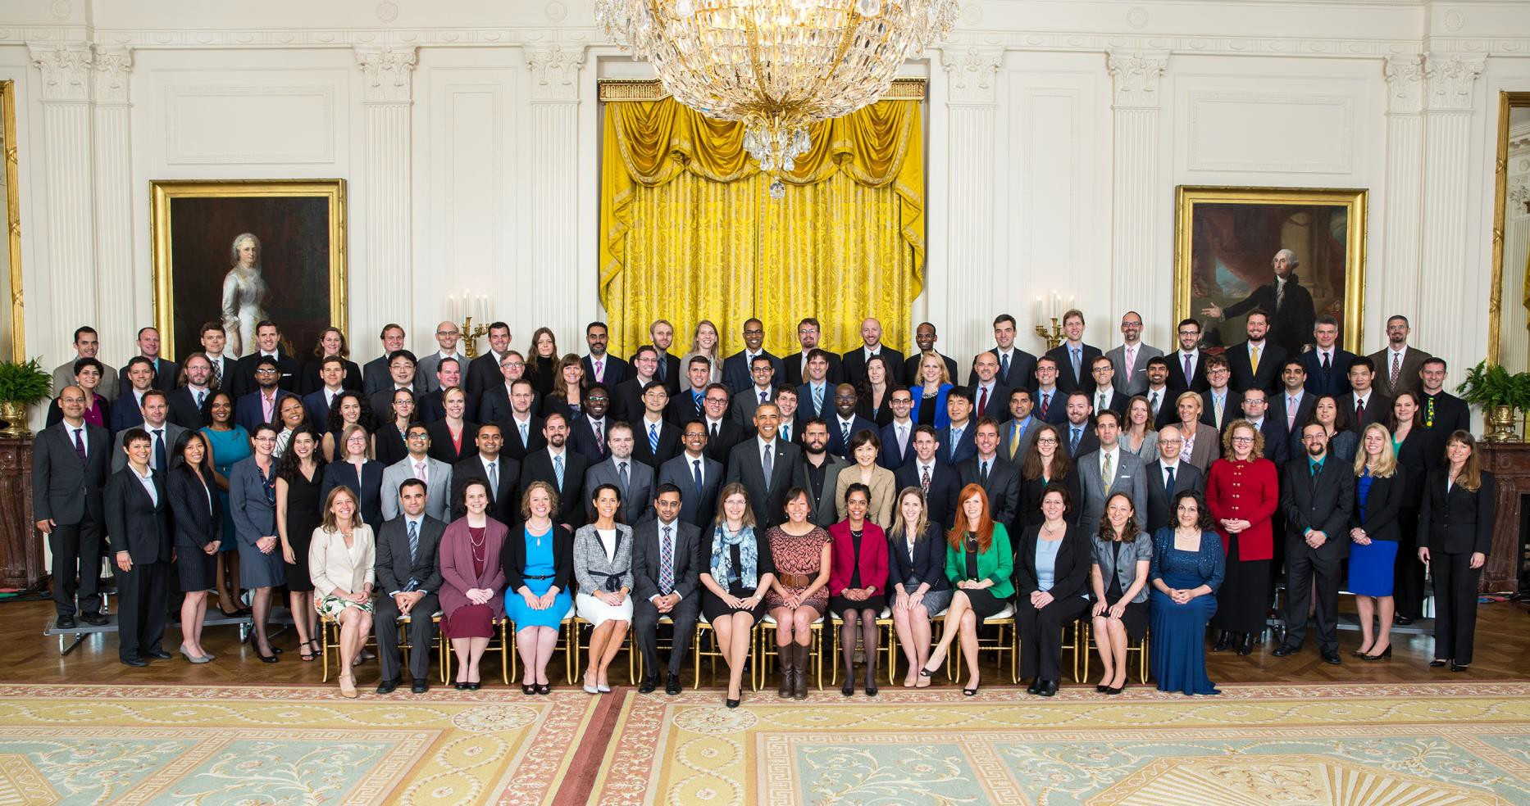
PECASE
(Presidential Early Career Award in Science and Engineering)
Official White House Photo by Lawrence Jackson – May 2016

Slide 19
QUESTIONS ?
CAREER website: www.nsf.gov
(solicitation, FAQs, link to recent awards, Division Contacts)

