Slide 1
UTAH’S TECHNOLOGY CATALYST: USTAR
IVY ESTABROOKE, PhD
EXECUTIVE DIRECTOR
UTAH SCIENCE TECHNOLOGY AND
RESEARCH INITIATIVE
iestabrooke@utah.gov

Slide 2


LONG TERM VISION FOR GROWTH
2006 established Utah Science, Technology and Research (USTAR) Initiative
State agency allows USTAR to fill gaps in the innovation ecosystem
Leverage the IP generated at the state universities into economic growth for the state
Build the technology ecosystem in the state

Slide 3
USTAR VISION AND MISSION
Utah Vision: Utah will lead the nation as the best performing economy, and be recognized as a premier global business destination
USTAR Vision: Build a robust innovation ecosystem in the State of Utah.
USTAR Mission: USTAR’s mission is to accelerate the commercialization of science and technology ideas generated from the private sector, entrepreneurial and university researchers in order to positively elevate tax revenue, employment and corporate retention in the State of Utah
Key USTAR Priorities:
1. Support technology entrepreneurs and innovators through training, funding, incubator
and accelerator programs
2. Broker technology transfer by connecting capital, management and industry
3. Address market gaps in Utah's technology ecosystem
4. Strengthen Utah research capacity
Notes:
USTAR supports the Governor’s economic vision for the state.
Vision is to build an innovation ecosystem for the state.
We conduct our mission through these four tasks listed here in priority order.
We seek to be a transparent organization that executes it’s mission using best practices and national standards.
For each of our programs we have administrative rules

Slide 4

BUILDING AN INNOVATION ECOSYSTEM

Slide 5
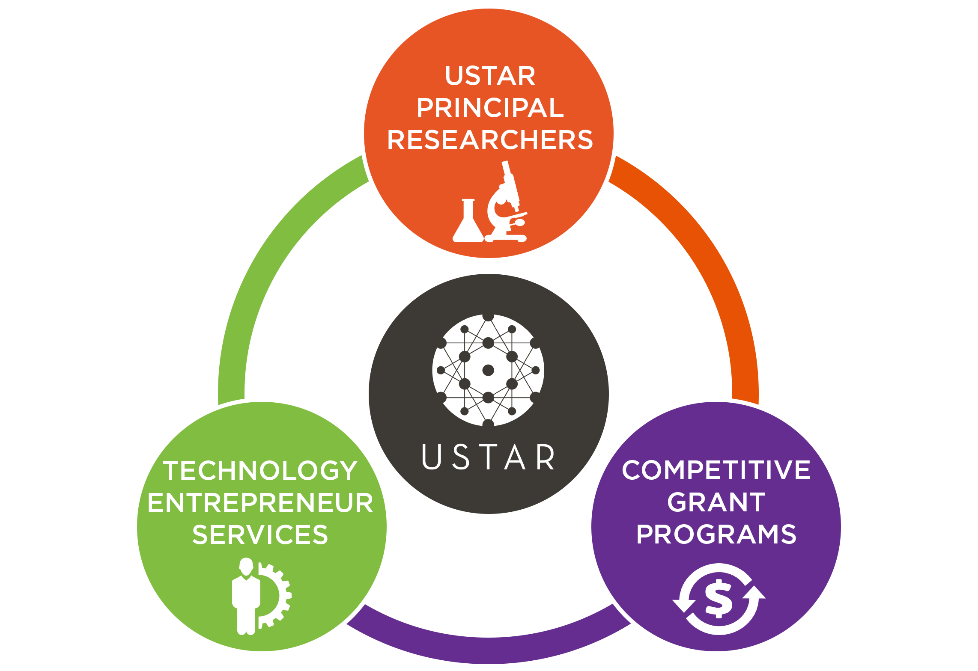
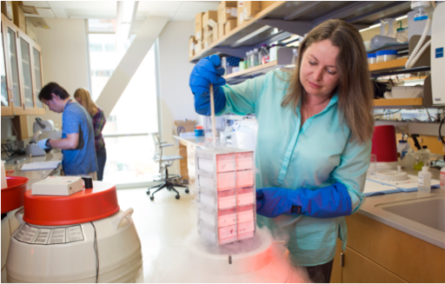
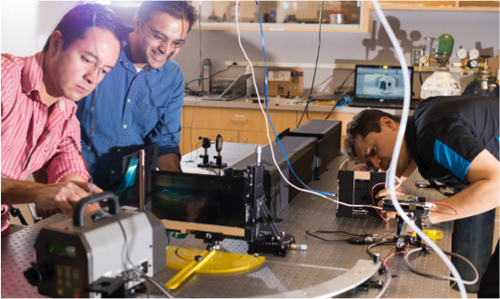
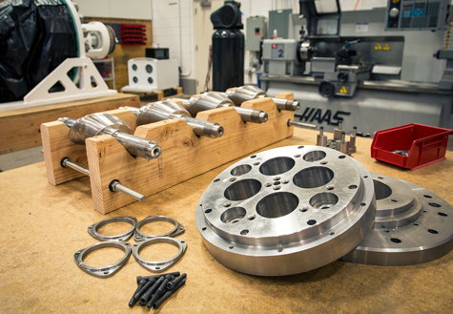
USTAR’S STATEWIDE PROGRAMS

Slide 6
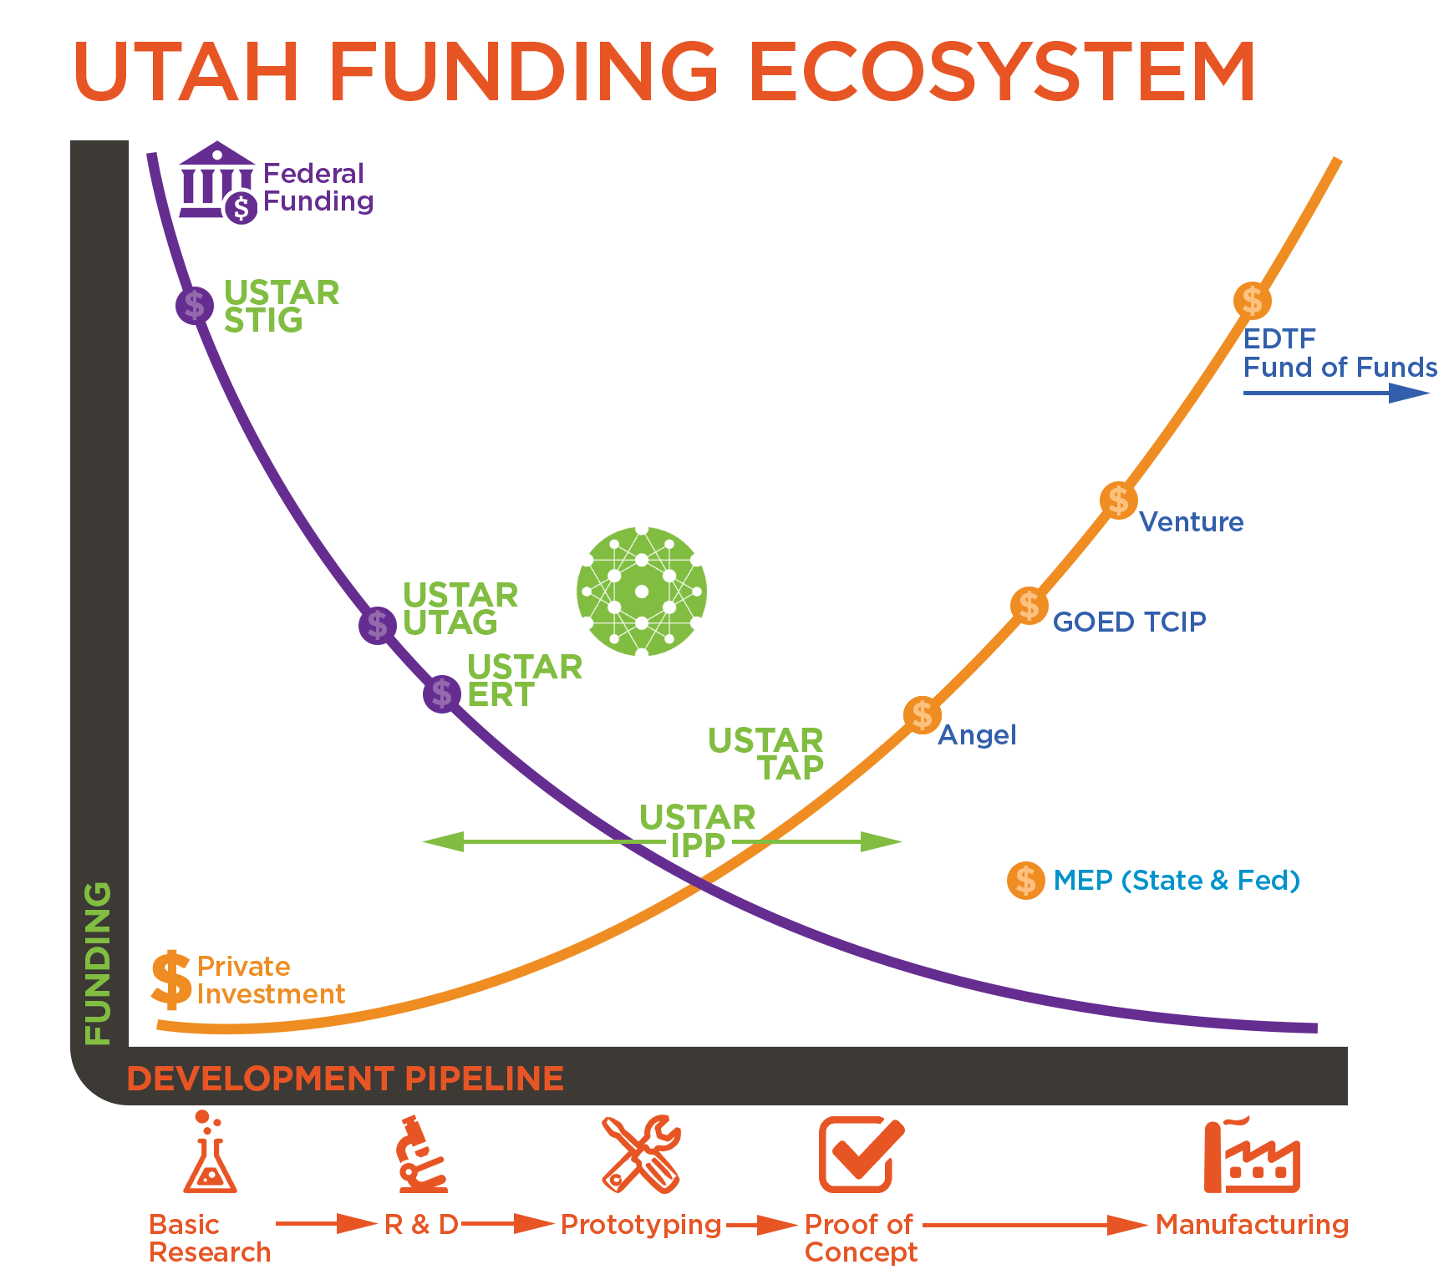
USTAR COMPETIITVE GRANT PROGRAMS TARGET THE VALLEY OF DEATH
Notes:
When one thinks about technology commercialization, a lot of Federal money going into research and a lot of private money going into product development
The valley of death in the high risk translational area
Other states have applied funds in a very targeted way to change university and private sector behavior

Slide 7
TARGETED TECHNOLOGY AREAS FY18
Automation and Robotics
  Hardware
  Internet of Things
  Smart Cities applications
Aerospace
Big Data & Cyber systems
  HealthIT
Energy & Clean Technologies
Life Science
  Agriculture
  Medical Device
  Pharma

Slide 8
UNIVERSITY TECHNOLOGY ACCELERATION GRANTS (UTAG)
Purpose: Accelerate the development of commercially viable technology development aligned to USTAR target technology areas
Mechanism: Twice annual call for proposals. Peer review process employed including technical and business reviewers. Provided as a grant through the Office of Sponsored Projects.
Eligibility:
  Technology Readiness Level of 3 or 4
  Researcher must be employed by a not-for-profit university in Utah
  Cannot have received funding from UTAG or ERT in the same fiscal year.
  Scope of project may not exceed 18 months

Slide 9
UTAG APPLICATION PROCESS
Letter of intent required that includes:
  Proposal title
  Technology sector
  Brief description of technology, unmet need and project deliverables (300 words)
  TRL and justification (300 words)
  Brief description of team (250 words)
  Estimated budget total
  Quad chart
Full application
  White paper
    Introduction, technical strategy, commercial market strategy, economic impact
  Key Personnel Biosketch
  Budget & Budget Narrative

Slide 10
FY18 DEADLINES
Mandatory Letter of Intent accepted between
  Accepted starting 11/2
  Must be received by 11/23 @ 5 PM Mountain Time
Full applications
  Accepted starting 11/30
  Due 12/29 @ 5 PM Mountain Time

Slide 11
FY17 DATA FROM UTAG
Total applications: ~150
Total awards: 27
Total funded: ~$4.9M over 2 FY
Range of grants: $30k - $1.6M

Slide 12
SCIENCE & TECHNOLOGY INITIATION GRANTS
  Purpose: Provides competitive funding for interdisciplinary and multidisciplinary teams for initial experimentation and data generation to compete for large federal R&D grants or industry contracts
Mechanism: Quarterly call for proposals. Peer review process employed including technical reviewers. Provided as a grant through the Office of Sponsored Projects
Eligibility:
  Researcher must be employed by a not-for-profit university in Utah
  Cannot already have funding for the research from another source; can’t be a continuation of a current line of research
  Must be targeting a specific grant or contract opportunity that would meet minimum funding levels

Slide 13
STIG APPLICATION PROCESS
White paper
  Introduction, technical strategy, grant target
Key Personnel Biosketch
Budget & Budget Narrative
NEXT REVIEW DATE: November 30, 2017

Slide 14
USTAR’S OTHER COMPETITIVE GRANTS
Technology Acceleration Program (TAP)
  Pre-seed fund for technology development
  Primarily start-up companies
Industry Partnerships Program (IPP)
  Address technology gaps for Utah industry
  Matching funds for research to address the gap
Notes:
Science & Technology Initiation Grant provides grants to university researchers to support the development of data, conduct proof of concept experiments or other precursor research activities required to pursue larger, commercially-oriented grants from a federal agency, grant making foundation, industry or related entity.
The goal of STIG is to increase the amount of external research funding received by Utah’s universities, promote interdisciplinary and cross-university collaboration and strengthen the research and development capacity at state Universities in commercially-oriented areas aligned to existing state industry sectors.

Slide 15
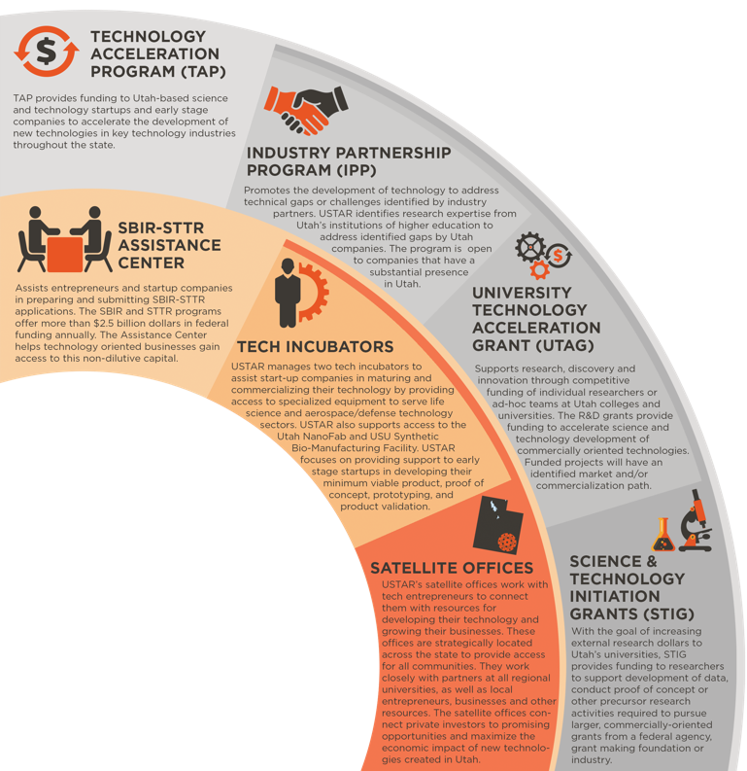
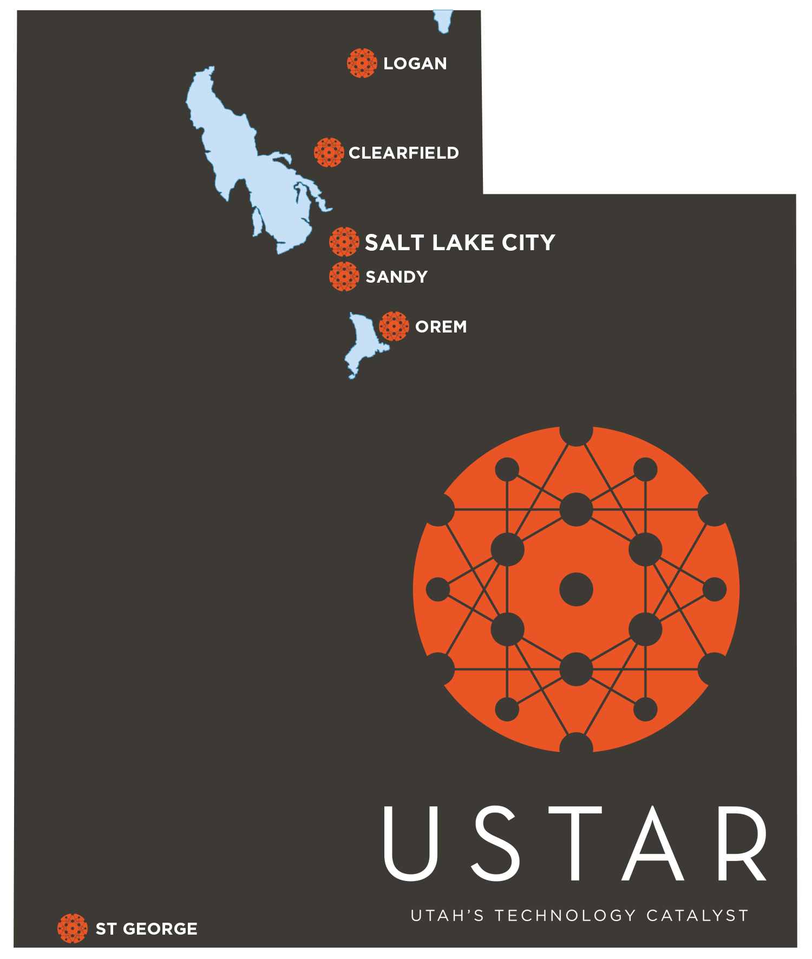
USTAR TECHNOLOGY ENTREPRENEURSHIP SERVICES
Notes:
USTAR’s Technology Entrepreneurship Services are designed to support technology commercialization activities across the state. TOIPs are regionally focused and provide support to community members and USTAR researchers with innovative technology ideas to establish spinout companies.
USTAR supports the pipeline of innovative technology ideas to establish new products and companies across the state. USTAR’s services provide resources at every step of the development pathway for university researchers and technology entrepreneurs. USTAR’s satellite offices work with tech entrepreneurs to connect them with resources for developing their technology and growing their businesses. The centers are strategically located across the state to provide access to all communities. They work closely with partners at all regional universities, as well as local entrepreneurs, businesses and other resources. The satellite offices connect private investors to promising opportunities and maximize the economic impact of new technologies created in Utah.

Slide 16

SBIR-STTR ASSISTANCE CENTER
USTAR’s SSAC is a statewide resource providing qualified Utah businesses assistance and insights into all the elements of the SBIR-STTR process. The SBIR and STTR programs are the largest source of seed funding with more than $2.5 billion dollars invested annually.
Working with USTAR’s SSAC, the chances of winning increase to more than 25% (the national average is 14-17%).
The SSAC offers assistance with:
Searching and matching your concept with agency solicitations
Finding a champion on the inside
Editing and writing assistance
Submission
Workshops and trainings
Registrations with agencies
Identifying gaps and solutions

Slide 17
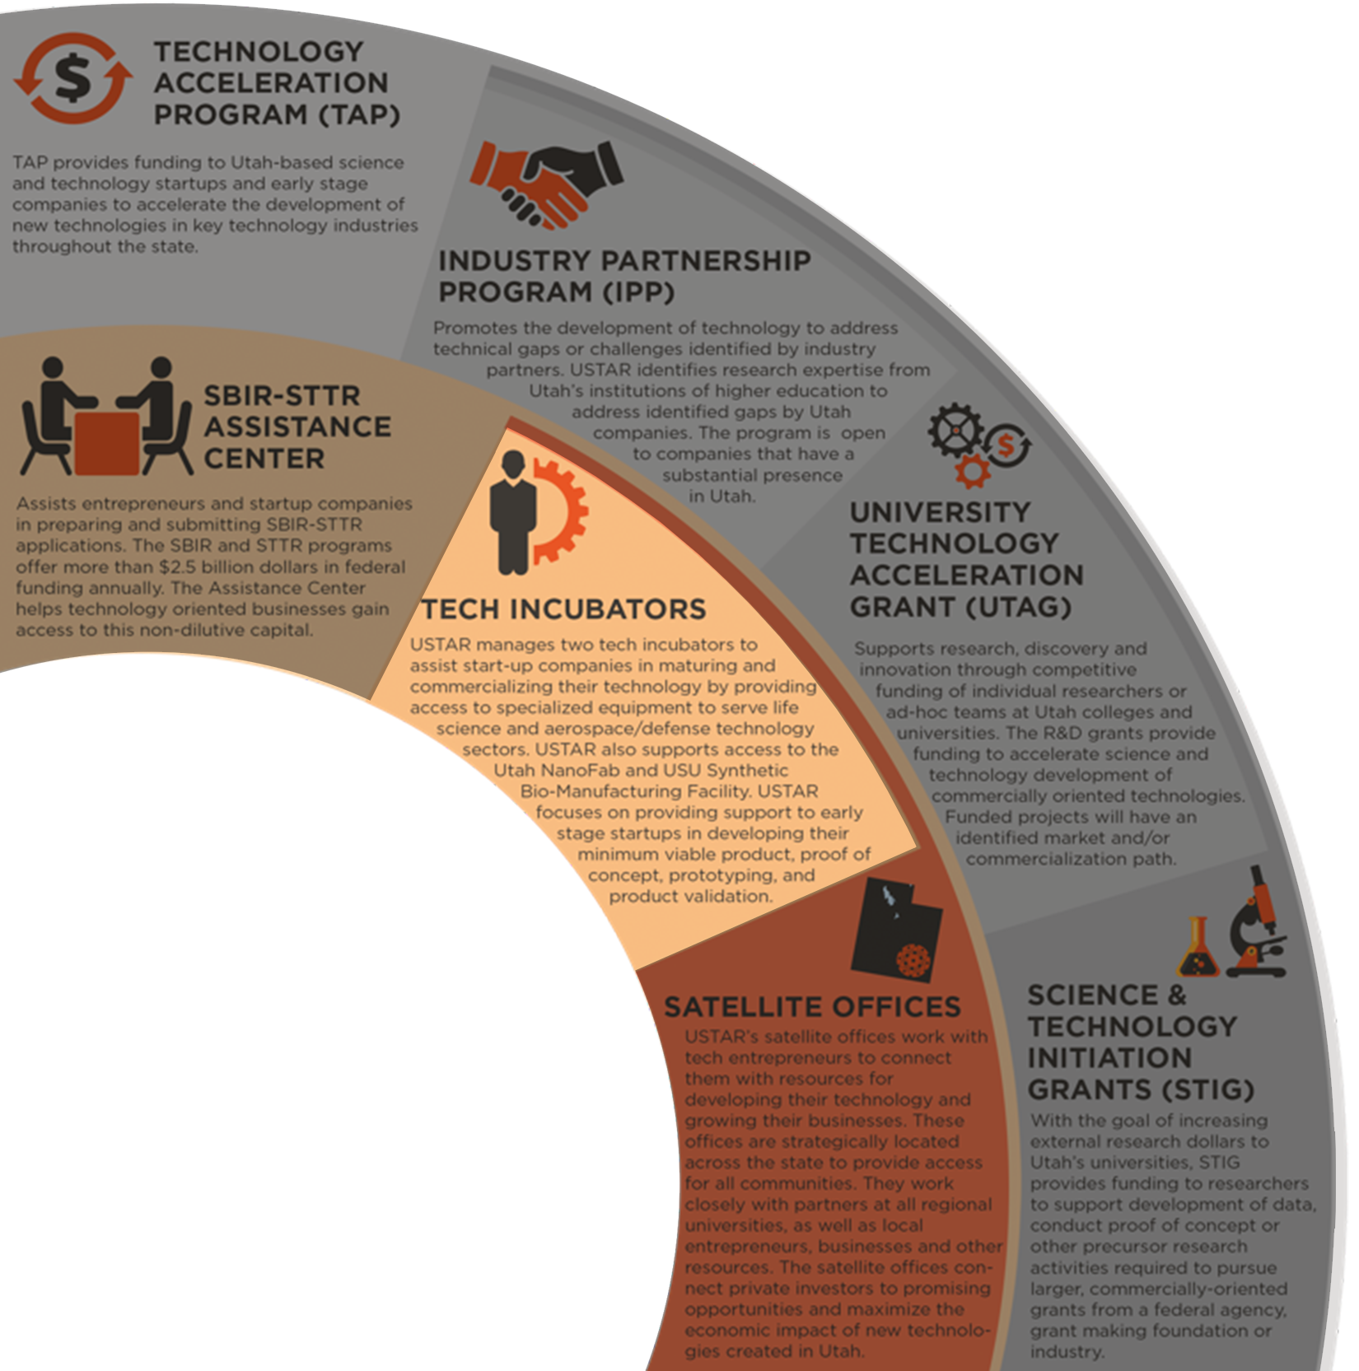

USTAR INCUBATION ENTERPRISE
Tech Incubators:
As part of the state-wide effort, USTAR manages two technology incubators to assist start-up companies in maturing and commercializing their technology by providing access to specialized equipment to serve life science and aerospace/defense technology sectors.
USTAR focuses on providing support to early stage startups in developing their minimum viable products, proof of concept, prototyping, product validation, product development, and connecting research with industry and funding.
Core Facilities:
USTAR established two state-of-the-art research buildings which provide research space, core facilities and specialized equipment for prototyping and fundamental research. These facilities are available to both university researchers and commercial partners.

Slide 18
JOIN US
UAMMI Industry – University Crosswalk
  November 1st 1- 5:30 PM
  1930 South State Street, Salt Lake City, UT 84115 (OC Tanner HQ)
Ribbon Cutting for the USTAR Innovation Center
  November 3rd 10 AM
  Falcon Hill Research Park

Slide 19
USTAR HQ Office
111 Main Street, Suite 550
Salt Lake City, Utah 84111
801.583.8622
CLEARFIELD
Falcon Hill
306 E. 650 North
Clearfield, UT 84015
385.226.8457
PROVO/OREM
815 W. 1250 South
Orem, Utah 84058
801.863.2720
ST. GEORGE
35 N Main Street,
St. George, Utah 84770
435.216.8364
SBIR-STTR Assistance Center
SLCC – Miller Campus
Corporate Partnership Center
9750 South 300 West Suite 214
Sandy, Utah 84070
801. 957.5249
USTAR BioInnovations Gateway
2500 S State St Rm. 224
South Salt Lake, Utah 84115
385.646.4625

Slide 20
ECONOMIC DEVELOPMENT
RESOURCES FOR TECH
USTAR PRINICPAL RESEARCHERS
SBIR/STTR
TECHNOLOGY
GRANT FUND
TECH INCUBATOR/ACCELERATOR
TAP
USTAR
GOED
Federal or
Federal/State
Private
Entities
UNIVERSITY/INDUSTRY PARTNERSHIPS
MEP
TVC/TCO
RESEARCH
PROOF OF CONCEPT
PROTOTYPE
PRODUCT
DEVELOPMENT
MANUFACTURING
MATURE TECHNOLOGY
MARKET
ANALYSIS
BUSINESS
FORMATION
SUPPLY CHAIN
GROWTH
MATURE COMPANY
BUSINESS
TCIP
SBDC/SBA
BRC’s
IAF
EDTIF
PTAC
ANGEL INVESTOR / VENTURE CAPITAL / COMPANIES
Notes:
There are several clear distinctions between USTAR and GOED that should be recognized, and a number of implications that fall from there:
USTAR has a narrow focus on technology development, whereas GOED is focused on Business. The development of technology and technology companies requires different services and expertise from other businesses and having a narrow focus allows USTAR to meet the needs of tech entrepreneurs. USTAR refers clients from our programs to GOED for the business services they require.
GOED’s expertise through that resides in their Business Resource Center’s (BRC’s) and/or SBDC/SBA is leveraged by small companies that USTAR works with who need assistance with business plans, government backed loans, or connecting with business resources across the State.
USTAR’s emphasis is on the development of technology through the product development stage. USTAR focuses on the industry clusters in the State that have market gaps. Areas, such as software, that are robustly supported by angel, VC and other funding mechanisms are not targeted as directly. Once a technology has reached the stage of manufacturing, USTAR support will end and there is a natural pathway to additional funding and support through GOED’s TCIP program. In fact, in the last round of TCIP funding – approximately 75% of the companies that received GOED funding had been supported in some way by USTAR programs.
GOED also is the sole recruiter of mature companies and supports companies of all types, including technology companies, once they have become mature, through growth mechanisms such as MEP, IAF, PTAC and EDTIF.

Slide 21
Project Focus Areas within Sectors
Automation and Robotics
  Cutting-edge machinery
  Design, construction and application of robots
  Computer systems to control, sensory feedback and information processing
  Advanced materials
  Transformative applications of automated processes
  3D printing processes
  Sensors and wireless transmission and visualization
Aerospace
  Aircraft and spacecraft
  Aerodynamics, engineering, advanced materials,
  Advanced computer systems for safety and security for manned and unmanned operation

Slide 22
Project Focus Areas within Sectors
Big Data and Cybersystems
  Large and complex data sets in business, crime, traffic, energy usage, genome, complex environmental or ecological systems, etc.
  Innovative systems for capture, curation, analyzing, sharing and reporting
  Innovative solutions to cyber crimes, prevention and resolution
Energy and Clean Technologies
  Products, advanced materials and processes
  Renewable and nonrenewable materials to alleviate impact on natural resources
  Cut emissions and waste
  Efficient energy storage
Life Science materials and devices
  Cellular, molecular or organismal subject matter
  Medical device detection and diagnostics, biotechnology, pharmaceuticals
  Horticulture, animals sciences, genetics, advanced material and therapeutic compositions

