Slide 1
Writing Persuasive Grant Proposals
October 10, 2017

Slide 2



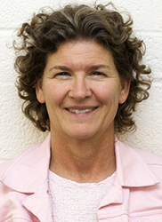
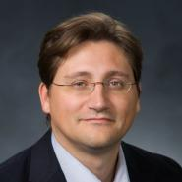
Research Development Support
Kristen Clarke Kellems
FHSS Research Development
934 SWKT
Tel: 801-422-8967
Email: fhssresdev@byu.edu
Conrad Monson
STEM Research Development
275 McDonald Building
Tel: 801-422-7722
Email: conrad_monson@byu.edu
Jaynie Mitchell
MSE Research Development
306C MCKB Tel: 801-422-3067
Email: Jaynie@byu.edu
Sarah Dorff
Research Development Administrator
269 McDonald Building
Tel: 801-422-0132
Email: resdev@byu.edu
Jon Balzotti
English Department Faculty College of Humanities
4127 JFSB
Tel: (801) 422-2440
jonathan_balzotti@byu.edu

Slide 3
Agenda
Persuasive Writing Techniques
Proposal Elements
Persuasive Titles and Abstracts
Summary

Slide 4
Proposal Development Process
Good Ideas
Fundable Idea
Find Funder(s)
Pre-Proposal
Preparation for Writing
Write the Proposal
Market the Proposal
Revise
Marketing
Reject
Accepted AND Funded
Funder
Draft
Submit (ORCA)
Peer Review
Edit

Slide 5
Persuasive Writing Techniques

Slide 6
Prewriting: Prepare a Proposal Development Timeline
Month | Activity
1 | Identify the problem. Analyze your ability to successfully pursue the idea.
2 | Identify a project director and others who will be involved in planning/writing the proposal. Conduct a needs assessment. Identify prior work/related activities of other universities. Develop a case for how your work differs from/compliments others. Identify funders and get administrative buy-in.
3 | Begin cultivating potential funding sources. Ensure university can meet compliance obligations.

Slide 7
Prewriting: Prepare a Proposal Development Timeline (cont.)
Month | Activity
4 | Develop the first draft of the proposal and seek feedback from colleagues who have previously received funds from this source
5 | Modify the proposal using input received during previous months. Complete the final version and translate it into the formats required by the funders. Submit the proposal for internal reviews. Submit the proposal to the funder.
6-9 | Verify receipt of the proposal by the funders and find out when a decision is likely to be made. Stand by while funders conduct their initial review and request more information.
10-11 | Receive approval or rejection. In either case, obtain reviewers comments.
12 | Receive authorization to expend funds. Start the project.

Slide 8
Prepare a Project Development Timeline
Tasks | Start Date | Duration (Days) | End Date | Cumulative (months) | Outcome
Create Stimulus | 02/01/14 | 15 | 02/16/14 | 0.5 | Create EVP and fMRI stimulus
Program Psycophysical Responses | 02/08/14 | 15 | 02/23/14 | 0.7 | Interface stimulus to computer
Program ERP data collection | 02/18/14 | 15 | 03/05/14 | 1.1 | Interface stimulus and data collection for ERP
Program fMRI data collection | 03/01/14 | 30 | 03/31/14 | 1.9 | Interface stimulus and data collection for fMRI
Prepare MSE Mentoring Poster | 03/05/14 | 5 | 03/10/14 | 1.2 | Prepare a poster for MSE Mentoring conference on technical
Interface ERP and MRI | 03/20/14 | 30 | 04/19/14 | 2.5 | Beta test interface of all previous tasks
Analysis of Beta testing | 04/20/14 | 30 | 05/20/14 | 3.6 | Final shake down for actual data collection including revisions
Pilot of 3 participants | 05/01/14 | 60 | 06/30/14 | 4.9 | 3 participants will be run and data analyzed and reviewed
Data collection of 7 participants | 09/05/14 | 70 | 11/14/14 | 9.4 | This includes training of new students and data collection
Analysis of first half of data collection | 11/01/14 | 30 | 12/01/14 | 10.0 | Analysis of first data set
Prepare MSE progress report | 01/01/15 | 30 | 01/31/15 | 12.0 | Report preparation etc
Submit abstract for presentation | 01/10/15 | 10 | 01/20/15 | 11.6 | Prepare professional presentation for IERASG
Complete data collection | 02/01/15 | 90 | 05/02/15 | 15.0 | Complete the final data collection
Prepare MSE Mentoring Poster | 03/01/15 | 10 | 03/11/15 | 13.3 | Prepare a poster for MSE Mentoring conference
Test-retest reliability | 04/01/15 | 45 | 05/16/15 | 15.5 | 3 participants re-tested
Data analysis | 05/02/15 | 90 | 07/31/15 | 18.0 | Data analysis and integration of results
Submit abstract for presentation | 08/01/15 | 20 | 08/21/15 | 18.7 | Prepare professional presentation for ICA
Draft paper 1 | 09/01/15 | 45 | 10/16/15 | 20.5 | Prepare draft for paper 1
Submission paper 1 | 10/20/15 | 3 | 10/23/15 | 20.8 | Submit paper 1 to EEG and Clin Neurophys
Draft paper 2 | 11/10/15 | 45 | 12/25/15 | 22.8 | Prepare draft for paper 2
Submission paper 2 | 01/10/16 | 3 | 01/13/16 | 23.5 | Submit paper 2 to IJA or JSHR
Final Report to MSE | 01/20/16 | 10 | 01/30/16 | 24.0 | Final report to MSE

Slide 9
Alternate Timeline Format

Slide 10
Academic vs Grant Proposal Writing
ACADEMIC
Scholarly pursuit: Individual passion
Past oriented Work that has been done
Theme centered: Theory and thesis
Expository rhetoric: Explaining to reader
GRANT PROPOSAL
Sponsor goals: Service attitude
Future oriented Work that should be done
Project centered: Objectives and activities
Persuasive rhetoric: “Selling” the reader

Slide 11




The Baseline Logic
Baseline Logic is the foundation understanding of a proposal
…we will develop and implement a compre-hensive strategy for integrating current institutional initiatives into Engineering & Technology Division’s educational offerings.
Because of the mis-alignment between (a) the college’s operating and delivery systems and (b) the needs of the college’s students and employers and community it serves…
Current Situation
Desired Result
S₂
S₁
As a result, BYU will be more responsive to the rapidly changing requirements of students, employers, and the community, offering higher quality educational services in less time and at a lower cost.
B
Benefits
90% of proposals have serious flaws in their baseline logic
(Baseline logic and generic slots descriptions adapted from Jon Balzotti’s presentations)

Slide 12
The Needs Statement Creates the Basis of Your Proposal
Component
1. Story (Problem)/S₁ | Describe the problem: (1) context of the problem, (2) justification for addressing the problem, (3) specific aspect of problem being addressed. (Causes and Effects) Statistics: -Your own data -Info from external sources Examples: -Anecdotes -Real-life examples -Quotes
2. Plan for solving (Problem) S₁ | What questions must be answered to solve the problem or realize the opportunity? (Derived from deliverables and from themes)
3. Request for support | State the actions you want the sponsor to take immediately and resources you want the sponsor to commit.

Slide 13


Proposal Elements are Created From the Needs Statement
The Needs Statement thoroughly develops and describes the problem you are addressing including context and justification … develops the Situation Slot, S₁
Describes Methods at a high level; informs Qualifications and Benefits
Provides the basis for the Budget you need
Needs Statement Components
1. Story (Problem)/S₁
2. Plan for solving (Problem)/S₁
3. Request for support
The 6 Generic Proposal Slots (tied to baseline logic)
Achieved Objective(s)
S
Methods
2
S
Situation
1
B
Qualifications
Benefits
Budget

Slide 14
S1 Situation for the Needs Statement: Describe the problem
Describe the context of the problem
Define the problem so that other people can understand it, identify with it, and recognize it’s important
Be specific about what larger societal problem your proposed project contributes to solving
Describe the scope of the problem and the justification for solving it
Scope: How large is the problem? How many people affected by it?
Justification: Why do we need to spend the money and resources to solve this problem now? (Urgency)
Describe the aspect of the problem you’re trying to solve
If you are working on trying to solve a complex societal problem, you will not try and solve the entire problem, but rather an aspect of the problem

Slide 15
Describe the Problem: Rhetorical Appeals
Aristotle wrote that there are three types of rhetorical appeals. They are:
A rational appeal (logos), citing facts, figures, and statistics to build your case; using deductive reasoning and inductive examples to support your claims
An emotional appeal (pathos), using case studies or examples which arouse the readers’ emotions and stimulate their desire to help
An appeal to the character and credibility (ethos) of you and your research team
The type of appeal you will use in your proposal depends on what type of sponsor you are writing for
If you are writing to a federal funding agency, you will concentrate on appeals to logos (facts, figures, and statistics) and ethos (the credibility and experience of your PI and research team members)
Smaller foundations prefer pathos (emotions)

Slide 16
Describe the Problem: Example
According to the Children’s Report card, approximately 10,753 were physically, mentally, or sexually abused. Children of color, especially Hispanics, are at considerably greater risk of being abused. According to the Department of Health and Human Services, Hispanic children are four times more likely to become victims of child abuse than Caucasian children.
This appeal to logos incorporates the context of the problem, the justification and scope
Certain aspects of Hispanic culture may create risk factors. Many Hispanic people leave their home countries to improve their quality of life, yet in the United States encounter poor education, unemployment and lack of affordable housing. While parents are working, relatives or friends who also live in the household often care for the children. Circumstances like these often leave Hispanic children more prone to abuse. Therefore, programs and interventions tailored specifically for Hispanics are needed to help prevent child abuse and successfully identify and refer victims to treatment.
This paragraph gives the aspect of the problem being solved
CENTRO believes that there is a need to educate the Hispanic community about child abuse in order to prevent abuse and identify and treat victims. CENTRO understands the cultural needs of the Hispanic community and has been serving the twin cities for 28 years.
This is an appeal to ethos—why this organization is qualified to solve this problem

Slide 17
The Needs Statement Creates the Basis of Your Proposal
Component
1. Story (Problem)/S₁ | Describe the problem: (1) context of the problem, (2) justification for addressing the problem, (3) specific aspect of problem being addressed. (Causes and Effects) Statistics: -Your own data -Info from external sources Examples: -Anecdotes -Real-life examples -Quotes
2. Plan for solving (Problem) S₁ | Method section contains the approach taken to solve the problem and list of activities/tasks.
3. Request for support | The instrumental purpose statement contains actions you want the sponsor to take immediately and resources you want the sponsor to commit.

Slide 18
Needs Statement: Plan for Solving the Problem and Request for Support
Plan for solving the problem (S1)
Convince your reader that the problem is solvable
Show how one consequence will lead to another until your solution is effected, or you can use analogies or precedent (i.e. how other similar research proposals have been successful elsewhere)
Justifying your solution
Actions you want the sponsor to immediately take and resources you want it to commit
Be specific about what the money will be used for and why it is necessary.
State what will happen if the project isn’t funded; what happens after funding ends

Slide 19
Plan for Solving the Problem and Requesting Support: Example
CENTRO seeks to empower and support the Hispanic community by eliminating barriers to self-suffiency. CENTRO believes that cultivating strong and healthy children who are free of abuse is one step to cultural self-sufficiency. For these reasons, we are undertaking a program to train parents and teachers to recognize the signs of abuse and refer abused children to treatment.
This training program will involve developing training materials and training trainers in the community to conduct free training sessions. We are seeking funding to train these trainers and develop a training video. Therefore, we are requesting $6,700 in support from your organization.

Slide 20
Practice Identifying the 3 Components of a Needs Statement
The Minneapolis Police Department Community Crime Prevention/SAFE (CCP/SAFE) Unit works with the community on teaching crime prevention. Because of the ethnic and racial diversity in Minneapolis, CCP/SAFE has made resources materials in seven different languages. The deaf community is also defined by language and culture, but it has not had the attention directed at bridging the communication gap that exists between the police and the deaf community that other groups have had.
We believe that information and education will result in safety awareness and empowerment within the deaf community. By providing 12 workshops that present material suggested by the deaf community, we will effectively begin to narrow the gap between the police and the deaf community.

Slide 21
Proposal Slots Map to Typical Proposal Sections
The generic slots map directly to proposal sections or provide content to support proposal sections identified by a funder
The Generic Proposal Slots
Typical Proposal Sections
Introduction/Background/Justification and Scope
Situation: This is our understanding of the problem.
Objectives: Given that problem, these are our objectives for solving (or realizing) it.
Introduction/Background/Justification and Scope/Specific Aims
Methods: Given those objectives, these are the methods we will use to achieve them.
Work Plan/Methods/Approach/Data Management Plans
Qualifications: Given those methods, these are our qualifications for performing them.
Qualifications
Budget: Given those qualifications and methods, this is how much the project will cost.
Budget/Budget Justification/Project Costs
Benefits: Given our efforts and funders support, these are the benefits or value you will receive.
Benefits/Significance
Content Supports
Titles/Abstract/Summary/Intellectual Merit/Broader Impacts/Previous Work/Biosketches
CVs/Other Resources and Support

Slide 22
Tips for methodology/approach section
Be very specific, right down to the weeks and days. What will you do first? How long will each step take?
How will you: investigate/quantify/collect/research/read/integrate/write about/represent/control for variables/reveal/illustrate/make accessible/organize?
Remember to tie the approach to the problem and benefits using PIP
Does this sentence effectively explain the methodology (and use PIP)?
“First, I will go to New Jersey to find out information about the polling system there. I will then review the results and write a paper to show the effect of re-districting.”
“I will spend three weeks in August performing a statistical analysis of polling data from the state archives in Trenton, New Jersey. Using the integrative approach suggested in Wyles and Geyser (2000), I will spend two months correlating voter turnout trends and controlling for mitigating circumstances such as the June 2003 Motor Voter legislation.”

Slide 23
Create Persuasive Titles
First thing the reviewer should read is an “eye-catching” title
Title should emphasize the payoff/benefit
Title must be understood by a broad spectrum of audiences, including the general public
Select words which accent the main category of the study, describe its distinctive features
State the major idea as quickly as possible, with the modifiers following, rather than preceding, the main category

Slide 24
Persuasive Titles (cont.)
Avoid fillers and non-communicating devices such as
“A Study of... ”, “An Exploratory Study to Determine...”, “An Examination of...”, “A Method to Explore...” (unless the focus of your project is the methodology itself, rather than the results of using the methodology)
Study titles of other funded projects in your field to
Get a sense of the type of research currently funded
See how specifically other researchers describe their projects
See the extent of precise technical language in your discipline
Avoid jargon or vogue words

Slide 25
Persuasive Titles (cont.)
List candidate words and standard abbreviations
Create approximately ten titles using combinations and permutations of the words and abbreviations
Ask colleagues and “laypersons” to identify the most informative and evocative of interest
Refine until you have an eye catching title
Example
Rather than "Studies on the Development of Objective Techniques for Monitoring the Development of Visual Acuity in Infants“ how about "Visual Acuity in Infants” or "Visual Acuity in Infants: Objective Monitoring of its Development"

Slide 26
Create Persuasive Summaries and Abstracts
After the title, the next and perhaps only thing a reviewer reads is the abstract or summary
Written last, but read first by reviewers
Provides first impression of your project but may also be the last impression for reviewers wanting to refresh their understanding after reading your proposal
Must be an intriguing “first advertisement”
Compelling, interesting, exciting
Should reflect entire scope of project

Slide 27
Persuasive Summaries and Abstracts (cont.)
Summarizes project purpose, goals, research design, methods, significance
Must convey:
What researcher intends to do
Why it’s important
Expected outcome(s)
How work will be accomplished
Should be explicit (e.g., “The objective of this study is to …”)
Has to be well crafted and thoughtful, CONCISE and COMPLETE
“If I had more time, I would have written you a shorter letter (Mark Twain’s correspondence with a friend)”

Slide 28
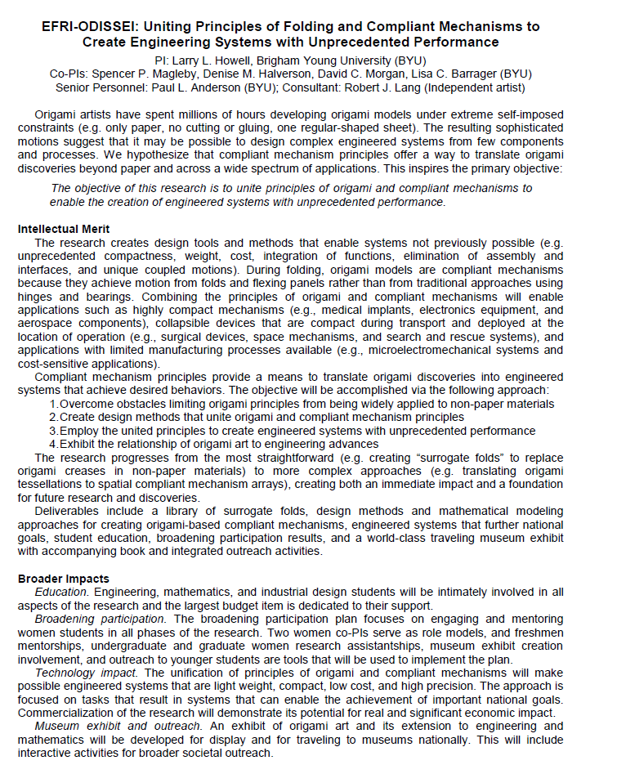
Project Summary from Larry Howell’s NSF Origami Proposal
Received highest possible scores from NSF review panel
Good example of PIP

Slide 29
Conclusion - Proposal Success
Pay attention to details
Prepare before writing
Write persuasively

Slide 30
Upcoming Research Development Events
Oct 12, 2017 2:00 PM 270 McDonald
Big changes coming in Grants.gov! ORCA will be here to answer your questions about your role as a PI on a grants.gov federal grant application.
Oct 17, 2017 12:00 Noon 270 McDonald
Editing, Rewriting, and Marketing
Research Development with discuss common proposal mistakes and will provide instruction on best practices and successful strategies for approaching program Officers

Slide 31
References

Slide 32
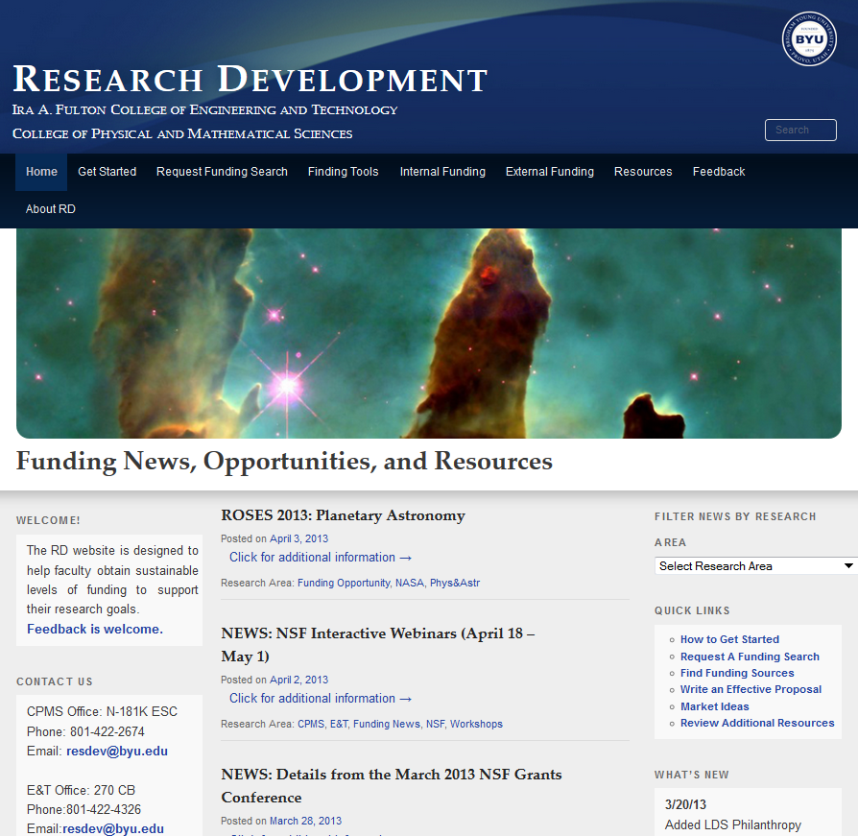
STEM Research Development Website (FHSS Website in Development)
Design
Information “dense”
Information accessible < 3 clicks
Checklists and guides
Pages
Home page
Orient reader to website
Funding news
Quick links to other pages
Getting Started page
Planning, finding, securing funding steps
Request a funding search
Tools funding searches
Internal and external funding sources
Resources
Proposal planning/management
Proposal preparation
Sample proposals
Marketing
http://researchdevelopment.byu.edu/

