Slide 1

DECEMBER 10, 2021
Grant Proposal Writing Workshop
APRIL
28, 2021
Research Development
Faculty Center

Slide 2
AGENDA
RDCC and participant introductions
Research Funding Environment Kahoot Game
Develop a Fundable Idea Instruction and Peer Share
Identify Funders Escape Room Game
Contacting Program Officers
Prewriting
Review Process
Baseline Logic
RAO—Susie Quartey

Slide 3
“
Research Development supports faculty and graduate student efforts to procure and secure funding for research and scholarly activities.

Slide 4
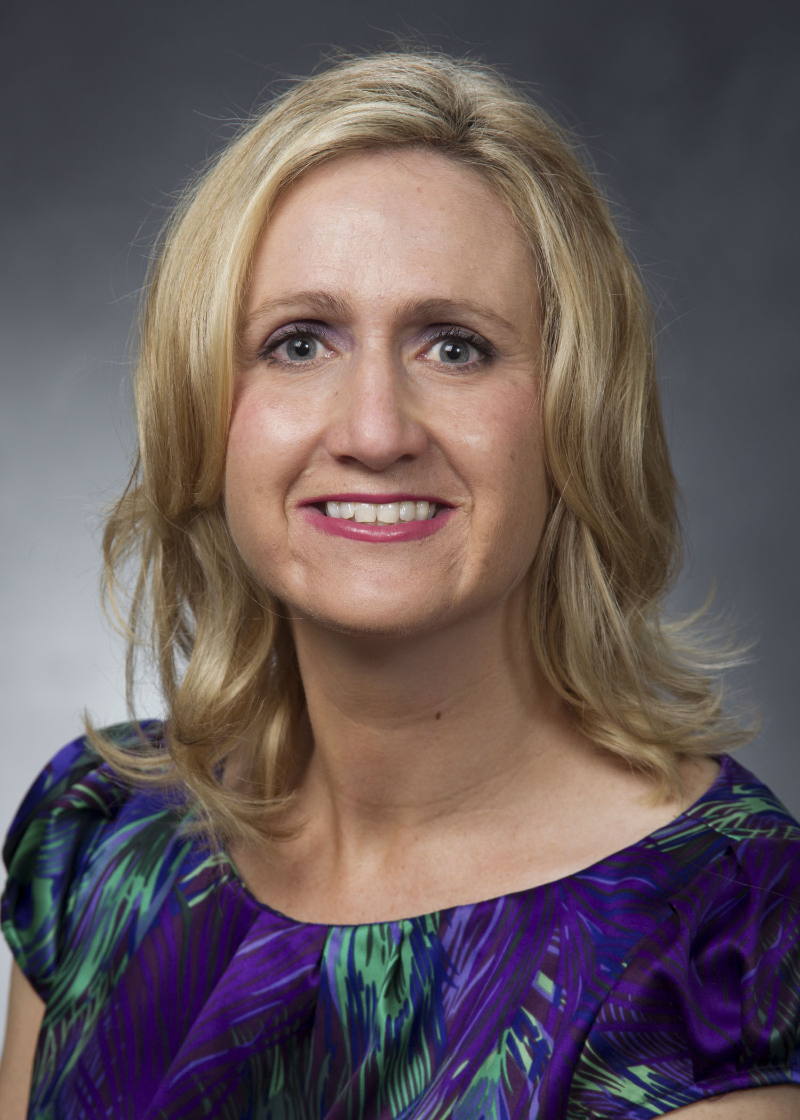
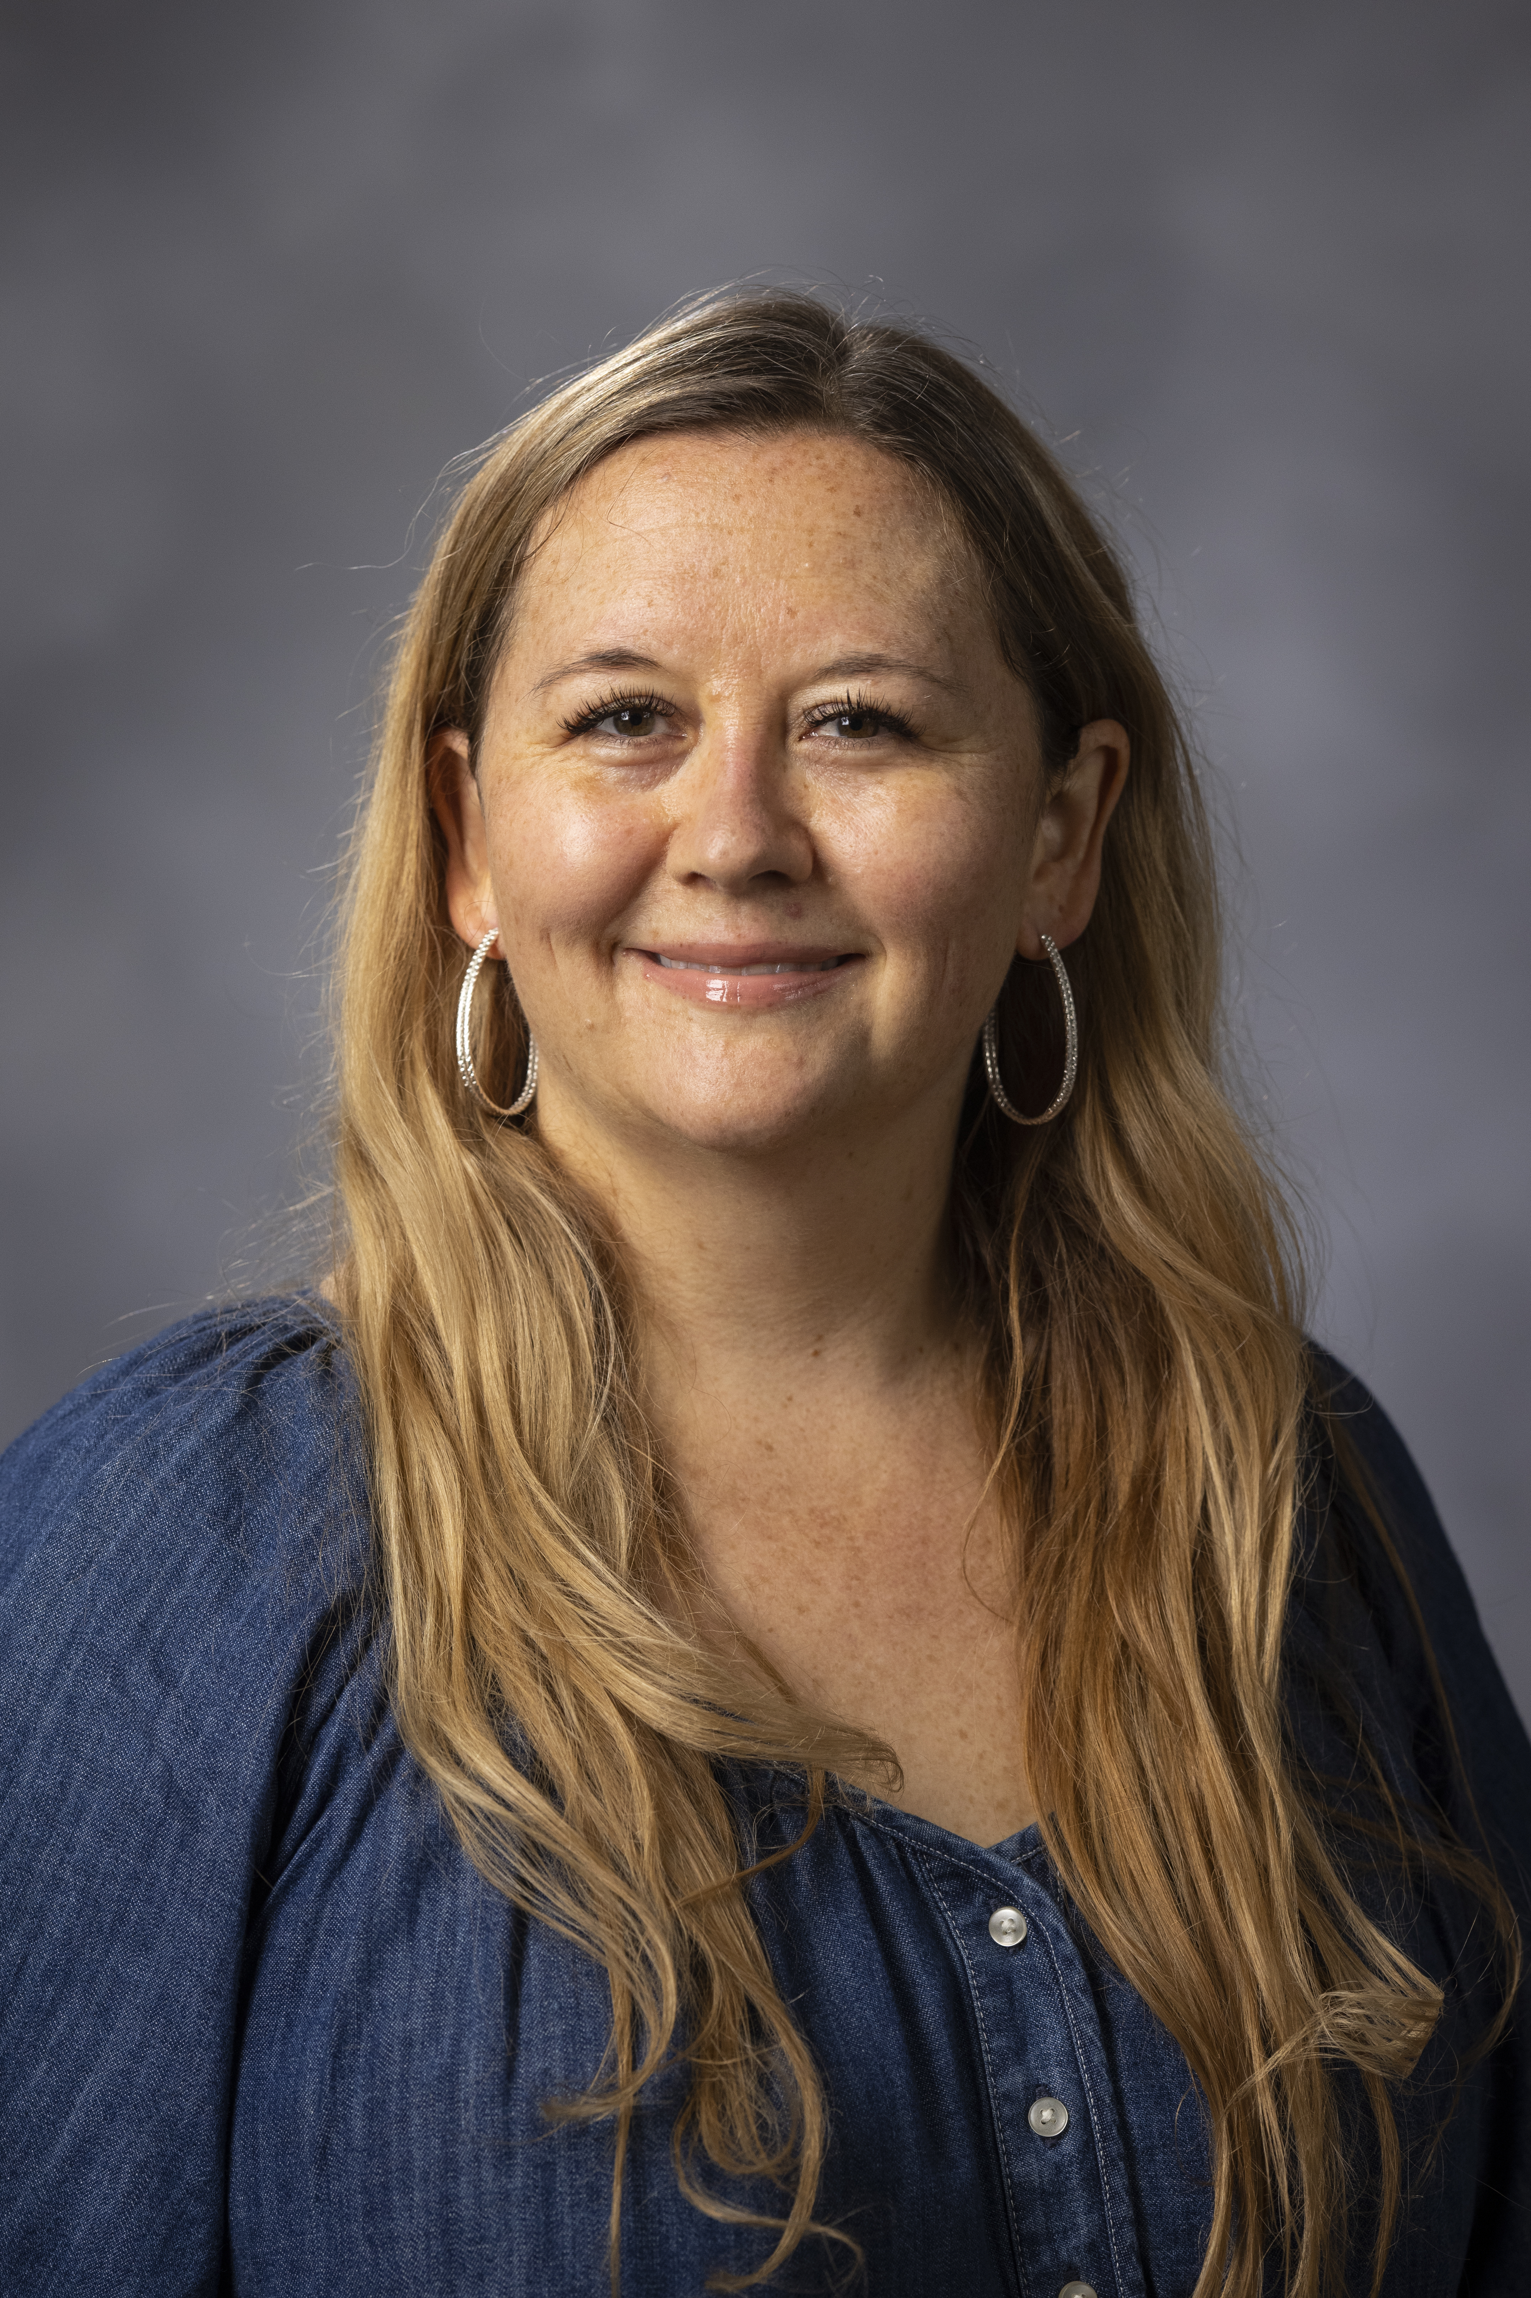
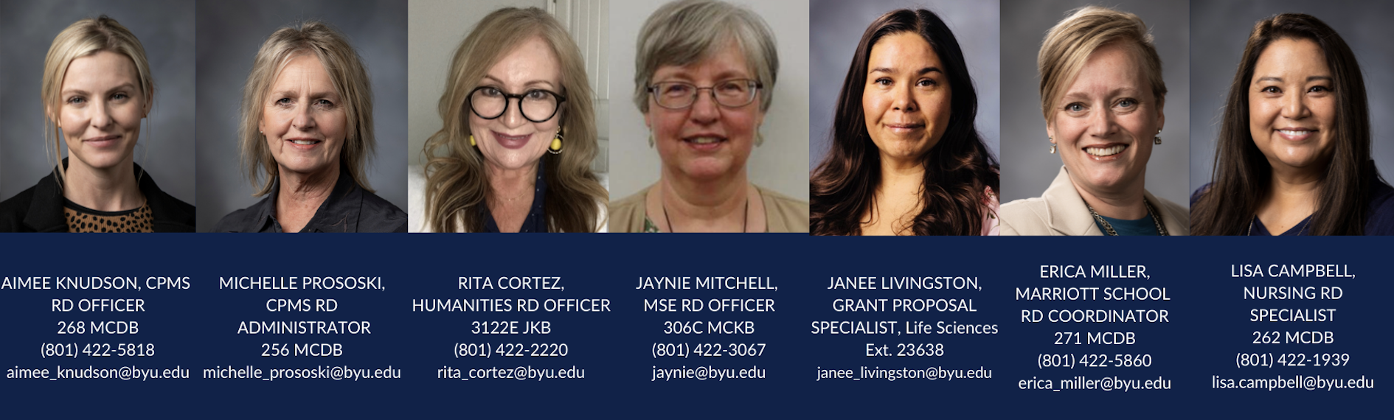
Research Development at BYU: The Research Development Coordinating Council
University Research Development Office
Kristen Clarke Kellems
Research Development Director
275 MCDB
Tel: 801-422-8967
Email: kckellems@byu.edu
Mandi Rolfe
Research Development Administrator
269 MCDB
801-422-0132
mandi_rolfe@byu.edu
In-College Research Development Specialists

Slide 5
Functions of the Research Development Coordinating Council
Facilitate interdisciplinary collaborations and connections
Council and support research development officers across campus
Share information and training on funding opportunities and funder priorities
Strengthen campus research culture

Slide 6

Other University-level Resources for Academic Research
  Research Administration Office
    Sponsored Projects
    Research Compliance
    Lab Animal Resource Center
    https://rao.byu.edu/
  Research Accounting
    Research funds management
    https://finserve.byu.edu/grants-contracts
  Faculty Center
    Career training and development
    https://facultycenter.byu.edu/
  Technology Transfer Office
    Licensing, patents, intellectual property
    https://techtransfer.byu.edu/
BYU Copyright Office
Establishing patents and trademarks
    https://copyright.byu.edu/
  Creative Works Office
    Prepares research for commercial use
    https://cwo.byu.edu/
  Kennedy Center
  International travel and research
  https://kennedy.byu.edu/
  Graduate Studies Office
    Graduate student support
    https://gradstudies.byu.edu/
  Harold B. Lee Library (HBLL)
    Data management storage and publication databases
    https://lib.byu.edu/about/faculty-guide/

Slide 7
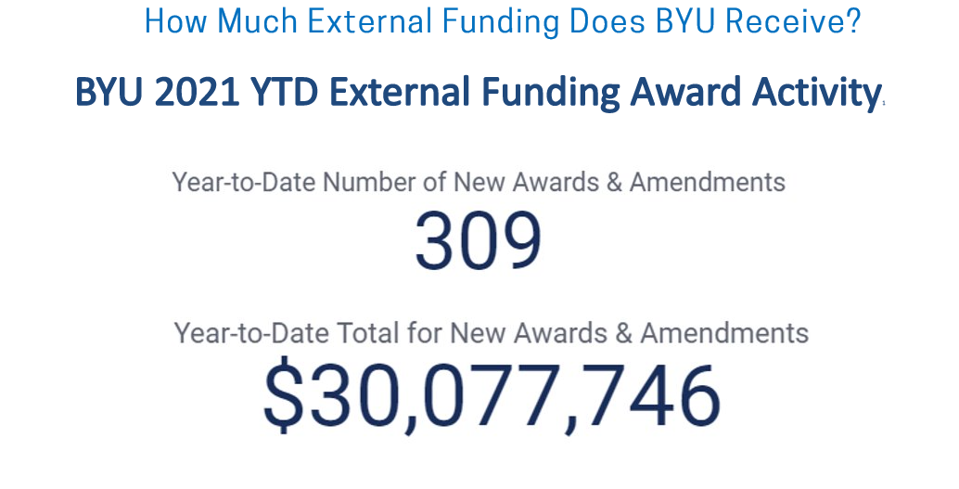
Funding Picture at BYU
¹ From RAO Kuali data 11/30/2021; includes subawards

Slide 8
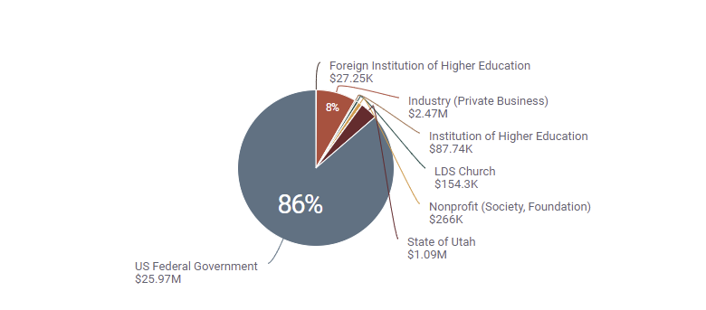
BYU External Funding Sources 2021¹
¹ From RAO Kuali data 11/30/3021; includes subawards

Slide 9
Bootcamp Results
Proposal Reviews
59 faculty participating in the two intensive grant writing bootcamps had a 54% success rate.
24 faculty participating in the NIH proposal reviews had a 54% success rate.
Working with Research Development
Attending Workshops
Fulbright Scholar Program
Faculty who participated in RD events received 33-40% more awards than those who didn’t participate.
Fulbright proposal success rate over 70% up from 23% ten years ago

Slide 10
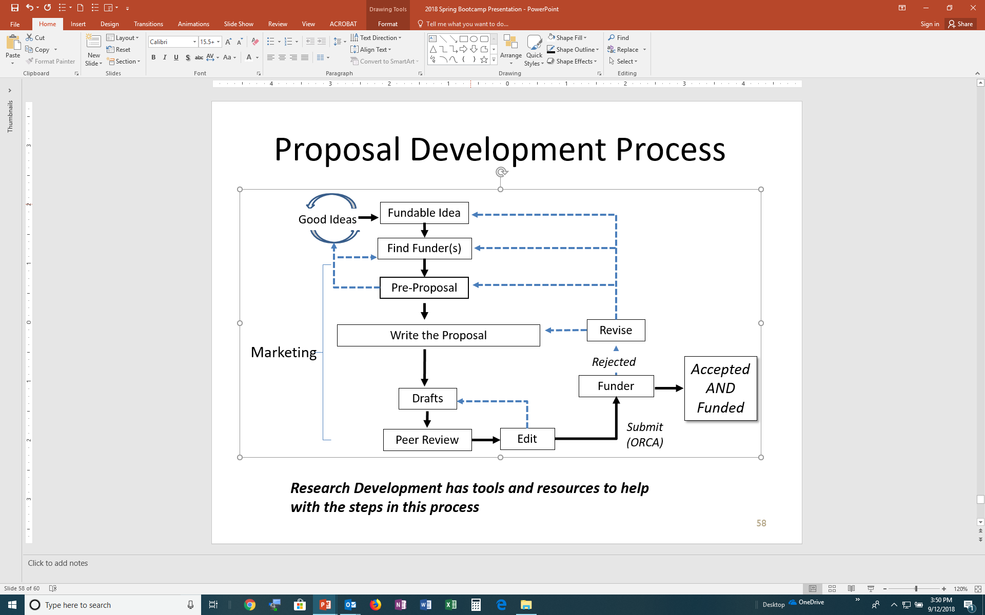
Proposal Development Process
Facilitate interdisciplinary collaborations and connections
Council and support research development officers across campus
Share information and training on funding opportunities and funder priorities
Strengthen campus research culture
Research Development has tools and resources to help with the steps in this process

Slide 11


Team Exercise
Objective: As a team, use Pivot and the funder’s website to find clues embedded in a funding opportunity.
Your team will need access to the internet. Each team has a set of tasks to complete.
First team to create the correct code opens the Escape Box.
Identify Potential Funders

Slide 12
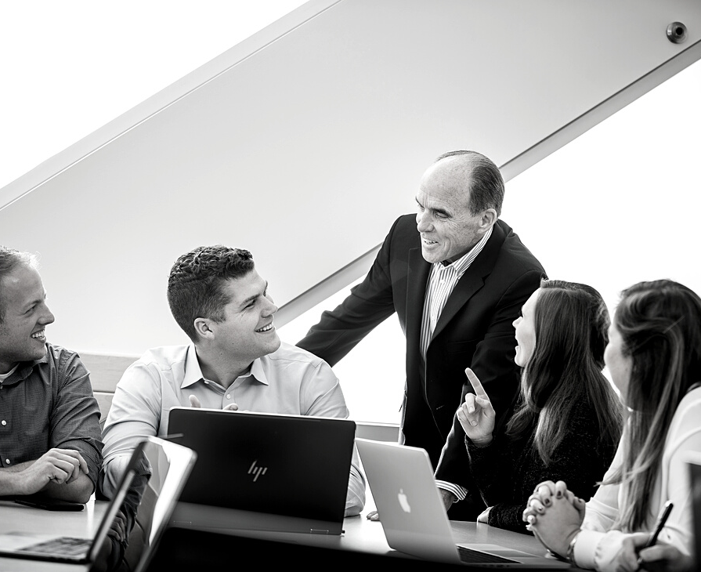
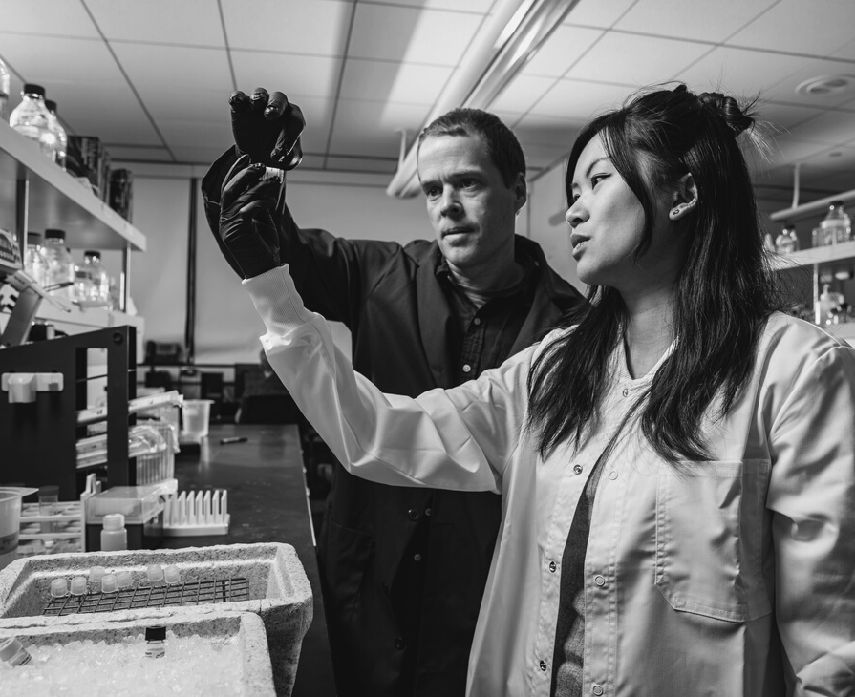

Funding search tools like Pivot
Online Resources to Find Potential Funders
Government agency, foundations, and company webpages
Publications in professional journals
Association conferences and webpages
Emails from RD, RAO, and colleagues

Slide 13

TRACK 1
Tenure-track faculty from 3+ departments and 2+ colleges
Three awards of $60k each year for 2 years
Internal Resources Aimed at Capturing External Funding: IDR Origination Awards
TRACK 2
Tenure-track faculty from 3+ departments and one college
Three awards of $20k each year for two years
Letter of Intent is due January 2022; Proposal deadline is February 2022.

Slide 14
In-depth trainings on funding search tools like Pivot
Conduct comprehensive individual and group funding searches
Research DevelopmentSupport
Complete an analysis of current funding trends and competitors in your field
Provide targeted information about specific funders

Slide 15

Fundable Ideas
Grant seekers must fully understand and appreciate that their ideas must help a funding agency ACHIEVE ITS MISSION.

Slide 16
National Science Foundation
Engineering Directorate Mission
The National Science Foundation promotes the progress of engineering in the United States in order to enable the Nation’s capacity to perform. Its investments in engineering research and education aim to build and strengthen a national capacity for innovation that can lead over time to the creation of new shared wealth and a better quality of life.

Slide 17
Aligning Your Idea With the Funder’s Mission
Origami artists have spent millions of hours developing origami models under extreme self-imposed constraints (e.g. only paper, no cutting or gluing, one regular-shaped sheet). The resulting sophisticated motions suggest that it may be possible to design complex engineered systems from few components and processes.
We hypothesize that compliant mechanism principles can translate origami discoveries beyond paper and across a wide spectrum of applications.
This inspires the primary research objective: The objective of this research is to unite principles of origami and compliant mechanisms to enable the creation of engineered systems with unprecedented performance.
Promote engineering
Innovation
Wealth, quality of life

Slide 18
Summarize and Share your Fundable Idea
What is the problem?
What are you going to do?
Why is it important?
What is the potential impact of your project?

Slide 19
Example
The problem or issue is that many engineered systems are expensive and require complex components and processes to produce.
We will perform preliminary research on the principles of origami techniques and how those principles can be utilized in a myriad of engineering fields.
This problem is important to address because a solution will reduce expense and complexity of engineered systems and will open doors to innovative uses of origami techniques.
Our project has the potential to impact any engineered product that uses interface parts. Our research has already led to designs in surgical devices, airbag folding, telescope lenses, spinal implants, contact lens cases, police shields, backpack design, and space mechanisms.

Slide 20
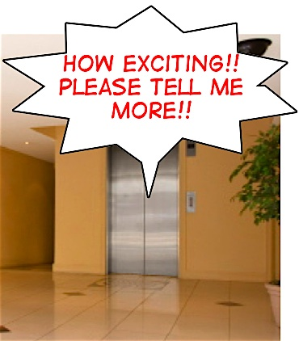
Peer Share:
Answer these questions about your project and share with a partner
What is the problem your project addresses?
What are you going to do?
Why is your project important to your field or a particular population?
What is the impact of your project? So what?
International Funding
In-depth Funding Seminars
Facilitate contacts with funding officers

Slide 21
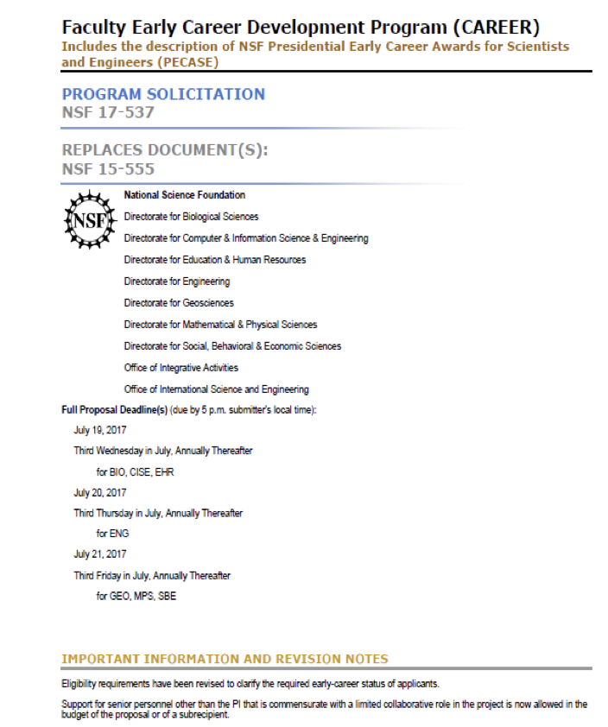
Thoroughly Decompose the Solicitation
Deadlines
Proposal format (fonts, etc.)
Proposal components (budgets, data management plan, project summary)
Unusual requirements
Procedures for submittal (including BYU ROA procedures)
Review Criteria
Research Development can help you understand the funder's solicitation!

Slide 22
Align your idea with the funder’s mission
Identify faculty that can review your idea or create a panel to review your project
Research DevelopmentSupport
Provide templates, examples and seminars on white papers and other marketing materials
Research funder’s award histories and identifying directorates with higher acceptance rates

Slide 23

Engaging with Potential Funders
Remember this is like a courtship
There is the initial contact
Then the interactive time period where interest grows
Next the commitment stage
With demonstration of commitment
Finally courtship where you have wooed them sufficiently where you enter into a partnership

Slide 24

Engaging with Potential Funders
Like any partnership there is always the gatekeeper
Any great courtship has a mother in law or in the grant world known as a program officer
Program Officers vary across the board with every organization
How to interact with Program Officers

Slide 25
Make initial contact and help prepare for program officer conversations
Help write tailored and compelling ”white papers”
Research DevelopmentSupport
Connect you with BYU faculty resources (faculty who have been program officers)
Arrange for program officer visits to campus and schedule individual visits

Slide 26
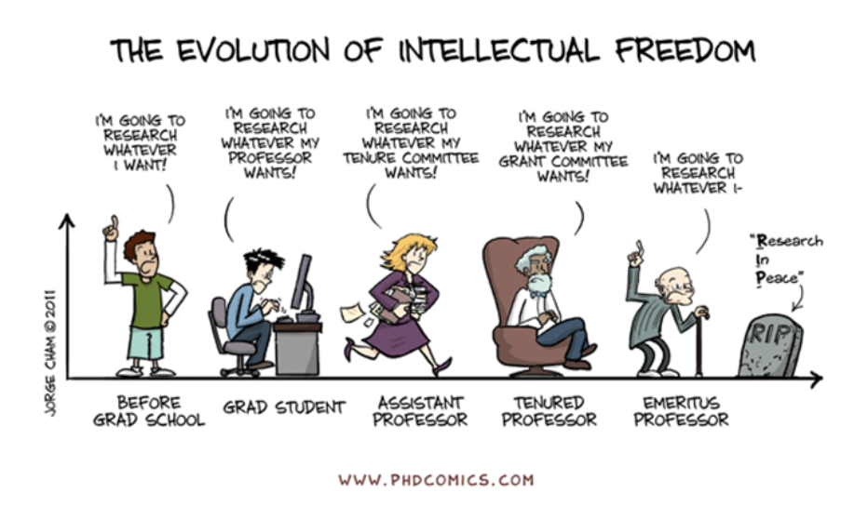
Basic Review Criteria
Remember back to the day of your thesis defense
There is a lot from that experience that correlates with your proposal
Review Criteria and the Review Process

Slide 27
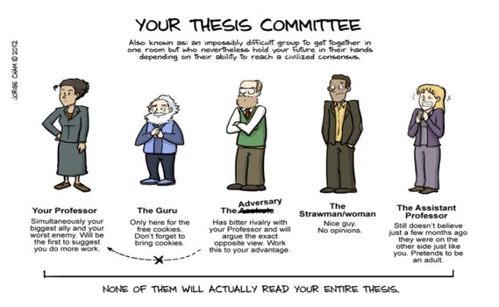
The reviewers’ objective is to:
Assess strengths and weaknesses
Determine if budget and budget justification are within reason
Critique research methodology
Remember think defense of your thesis

Slide 28
Organize faculty panels to review proposals according to funder's review criteria
Consult with program officers to ensure that review criteria is adequately met
Research Development Support
Help arrange a faculty member to serve on a review panel
Arrange for funding seminars that discuss how to meet review criteria (NSF, NIH, Broader Impact seminars)

Slide 29
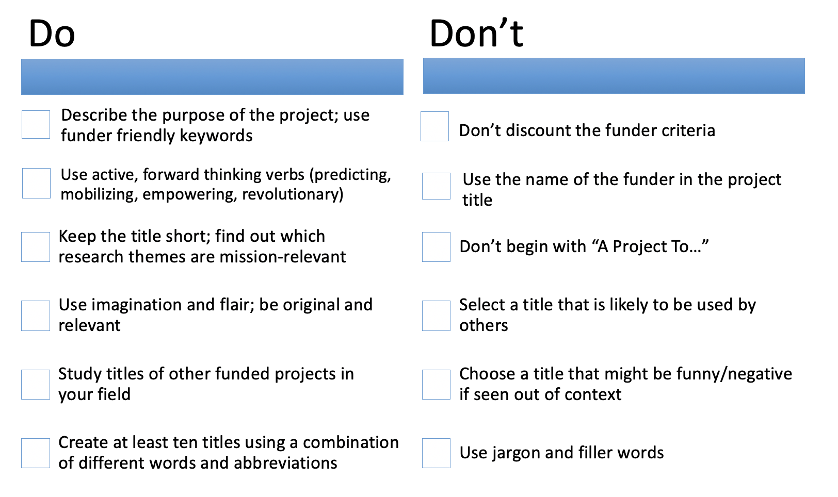
Grant Writing: Titles
Activity: Write and workshop 5 titles

Slide 30
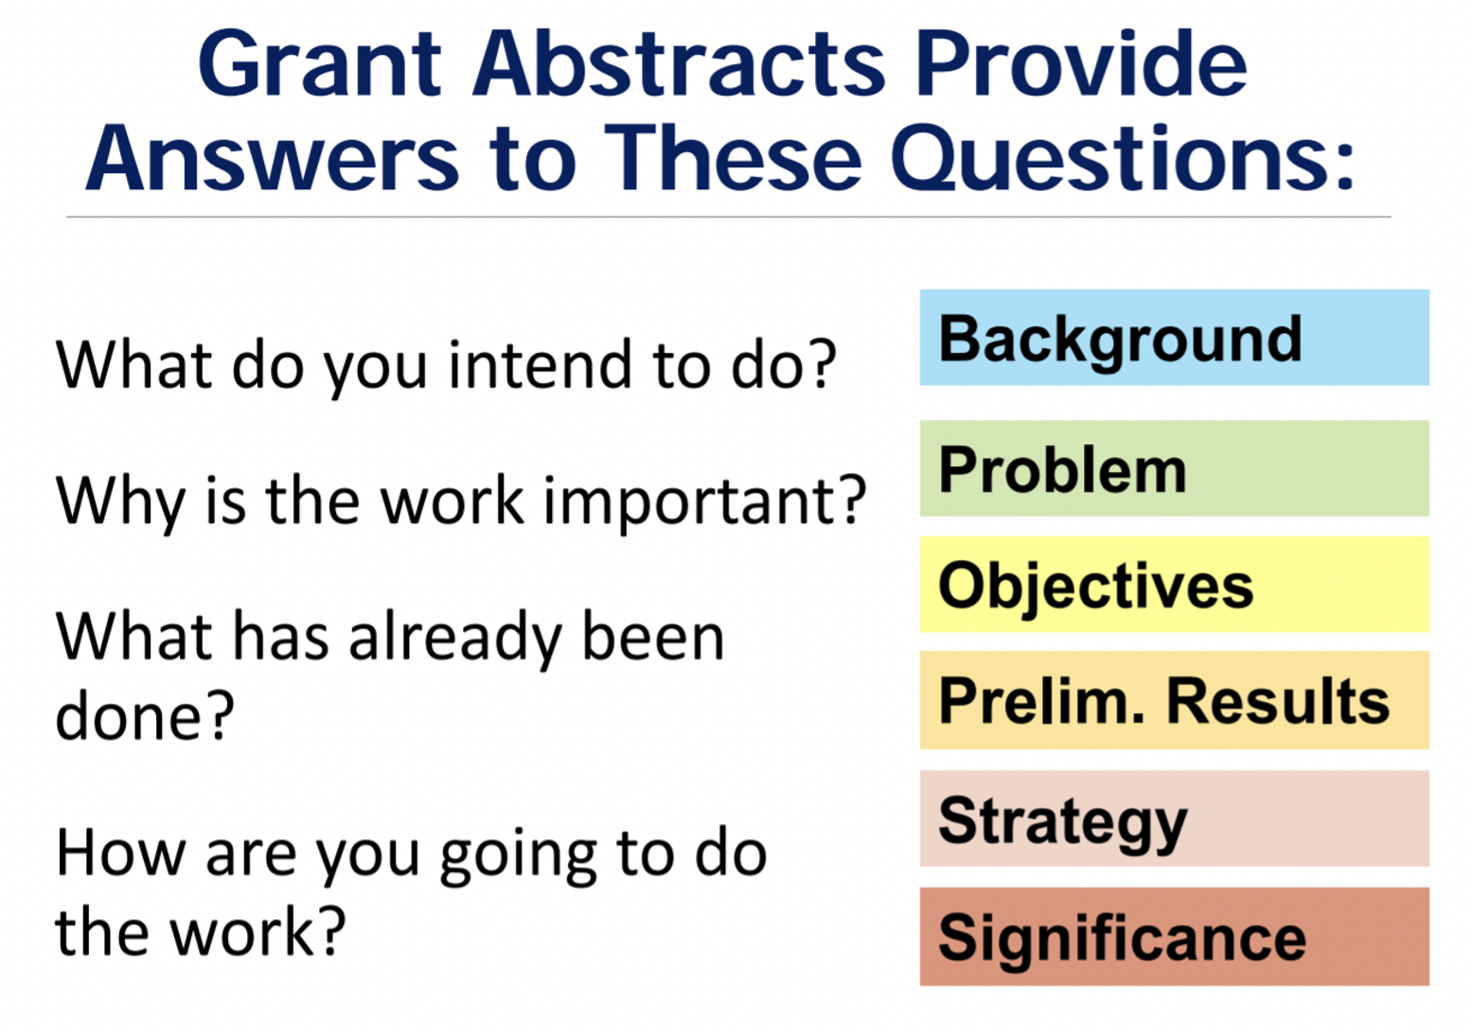
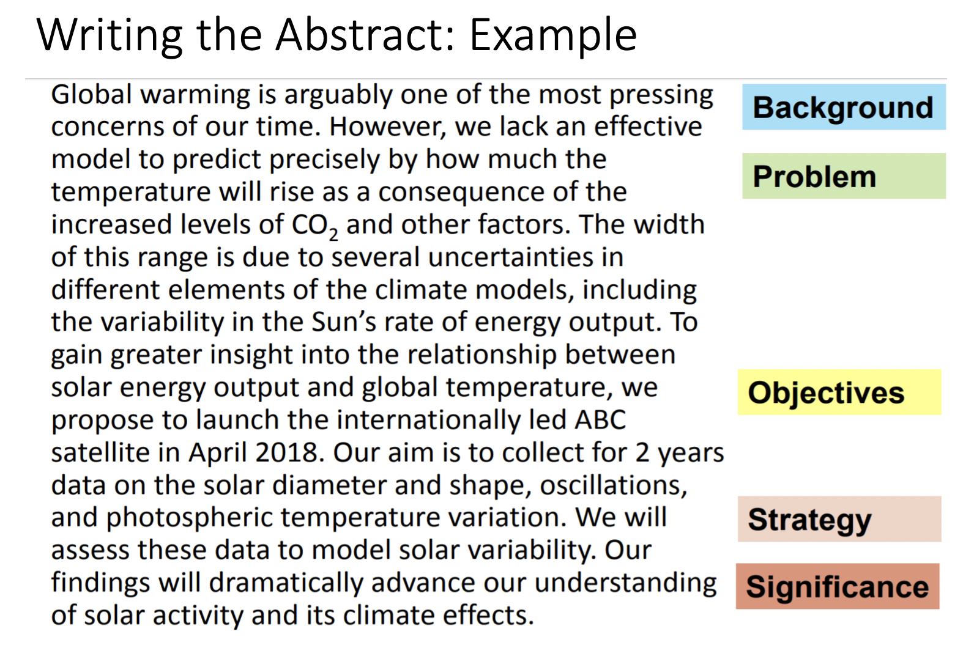
Grant Writing: Abstracts
Activity: Write a 200 word abstract

Slide 31
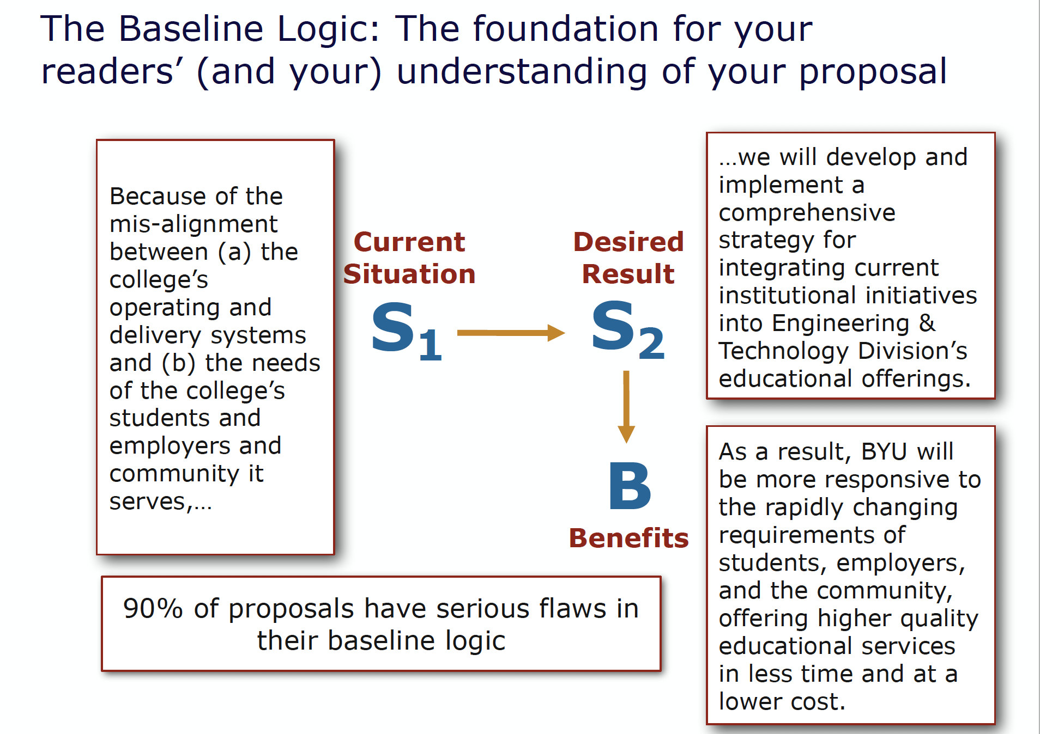
Grant Writing: Baseline Logic

Slide 32
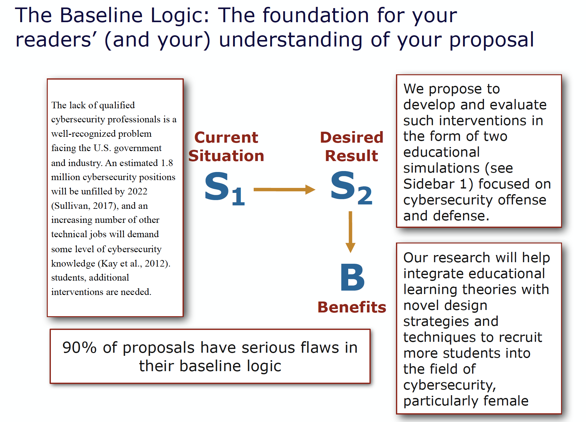
Baseline Logic

Slide 33
Baseline Logic Activity
S1-Current Situation
  Make a list of what you know about the current situation.
S2-Desired Result
  Make a list of the desired results of your project.
Deliverables–What will you do?
  Make a list of the project activities.
Benefits
  Make a list of the benefits resulting from your project.

Slide 34
Research Administration Office Proposal Preparation & Submission Processes
December 2021

Slide 35
RAO Sponsored Projects Personnel
Gene Larson, Director
Business, Education, Fine Arts, Lee Library,
Law School, Religion, Nursing
Debbie Silversmith, Associate Director-Sponsored Projects
      Humanities; Life Sciences
Susie Quartey, Research Administrator
      Physical & Mathematical Sciences; Family, Home, & Social Sciences
Maren Redd, Research Administrator
    Engineering

Slide 36
RAO Compliance Personnel
Jason Jay – IBC & IACUC Administrator
Regina McCarthy – IBC & IACUC Secretary
Sandee Aina – Human Research Protection Program Manager (HRPP)
Wayne Larson – IRB Administrator
Stephanie Coyne & Emily Gneiting – IRB Secretaries

Slide 37
Compliance Committees
IBC – Institutional Biosafety Committee, Biohazardous Chemical Research
  Every other month: ibc@byu.edu
IRB – Institutional Review Board, Human Subjects Research
  Monthly: irb@byu.edu
IACUC – Institutional Animal Care and Use Committee, Animal Research
  Monthly, iacuc@byu.edu
Notes:
Many federal changes; check website frequently and pay close attention to email messages related to IRB
Approval from federally mandated compliance committees is required for ALL research on campus, not just those with federal funding
Approved protocols must be in place before research can begin
External research funding unavailable to spend until approved protocol is in place; no R# issued

Slide 38
Sponsored Projects Functions
Proposal Approvals and Submission
Letters of Commitment
Contract Negotiations
MTAs
Misc. required forms
Award Processing / Issuing Subcontracts
Federal Compliance
Notes:
Certifications, Subrecipient Commitment Forms
Non-disclosure Agreements / Confidentiality Agreements / Material Transfer Agreements
MISC: Proof of insurance, worker’s comp, etc.)
Contractual support throughout the life of an award
Sponsored Projects Handbook to be updated in 2019

Slide 39
Proposal Submissions
All proposals routing to Research Administration should be completed 5 business days before due date: via Kuali Research - https://byures.kuali.co/
All internal approvals are now online via Kuali Research
  Go to https://rao.byu.edu/ for resources.
Notes:
Proposals commit the University
Terms and conditions need review & authorization; fac do not have authorization to sign documents
Cost sharing/matching needs approval
Problems are much easier to fix at the proposal stage than after submission or an award is received

Slide 40
System to System (S2S) Proposals
All NIH, NSF (non-collaborative) and other grants.gov submitted proposals (i.e. DOE, USGS, EPA) are submitted System to System (S2S), meaning directly to the sponsor from Kuali Research.
All S2S proposals will be submitted 2 days before the sponsor due date.
NOTE: If there is a funding opportunity listed in grants.gov, the proposal can be submitted via S2S.
In case of complex proposals (i.e. subawardees, required cost sharing, faculty are not requesting summer salary, or many Co-PIs) RAO may choose to submit via the agency specific electronic system, which would require separate entry of proposal info.
Notes:
Fringe rate changes every year
Full salary, 8 month base, regardless of whether they have an 8 month, 10 month, etc., contract

Slide 41
Non-System to System Proposals
All other proposals to sponsors that do not use grants.gov (i.e. Industry, Foundations, NASA, State/Local Government), are Non-System to System (Non-S2S) and will be submitted as directed by the sponsor.
NOTE: These proposals still go through Kuali for approvals.
Minimum Non-S2S Requirements
  Statement Of Work (SOW)
  Budget entered in Kuali Research
  Budget Justification
  Facilities/Equipment description (if required by the sponsor – this info is helpful to department chairs/associate deans, to know what resources are being committed)
Notes:
Facilities & Administration/Overhead/Indirect Costs: Operations and Maintenance, phones, copying, ILL, etc.
Building and Equipment Depreciation
General Administration (HR, payroll)
Department Administration
Sponsored Projects Administration
Library
Student Services
Matching/Cost Sharing: Only include if required by sponsor
If it is proposed, we are obligated to track and report it

Slide 42
Resources for Developing Budgets
Budget Helps
  Online Tutorial – How to create a proposal
  Budget Guide
  Uploading Subaward Budget
  How to See Total Cost Sharing and Breakdown

Slide 43
Your Formula for Success
Write Thorough Proposal
Utilize Available Resources
Obtain University Approval
Submit Proposal Early

Slide 44
Contact us Early & Often!
RAO http://RAO.byu.edu
Questions?

Slide 45

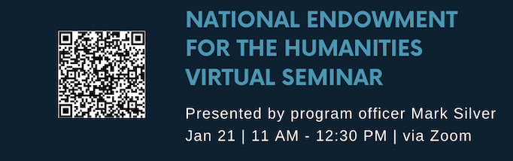
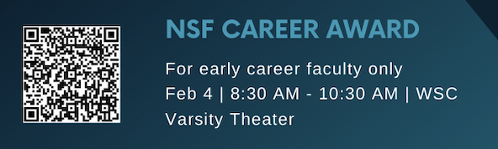
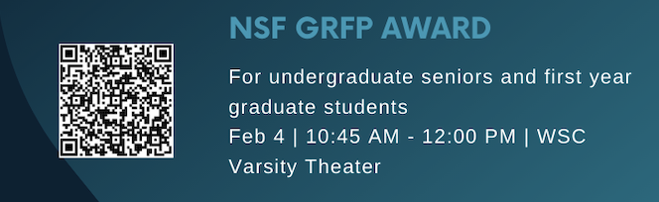
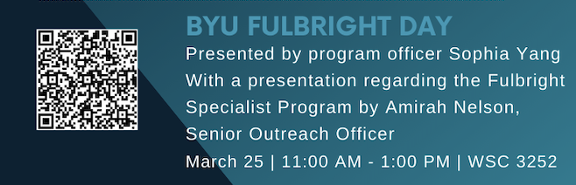
Upcoming Events

Slide 46
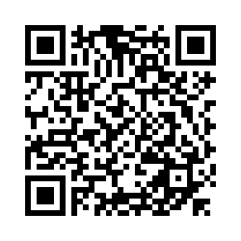
Feedback Survey

