Slide 1
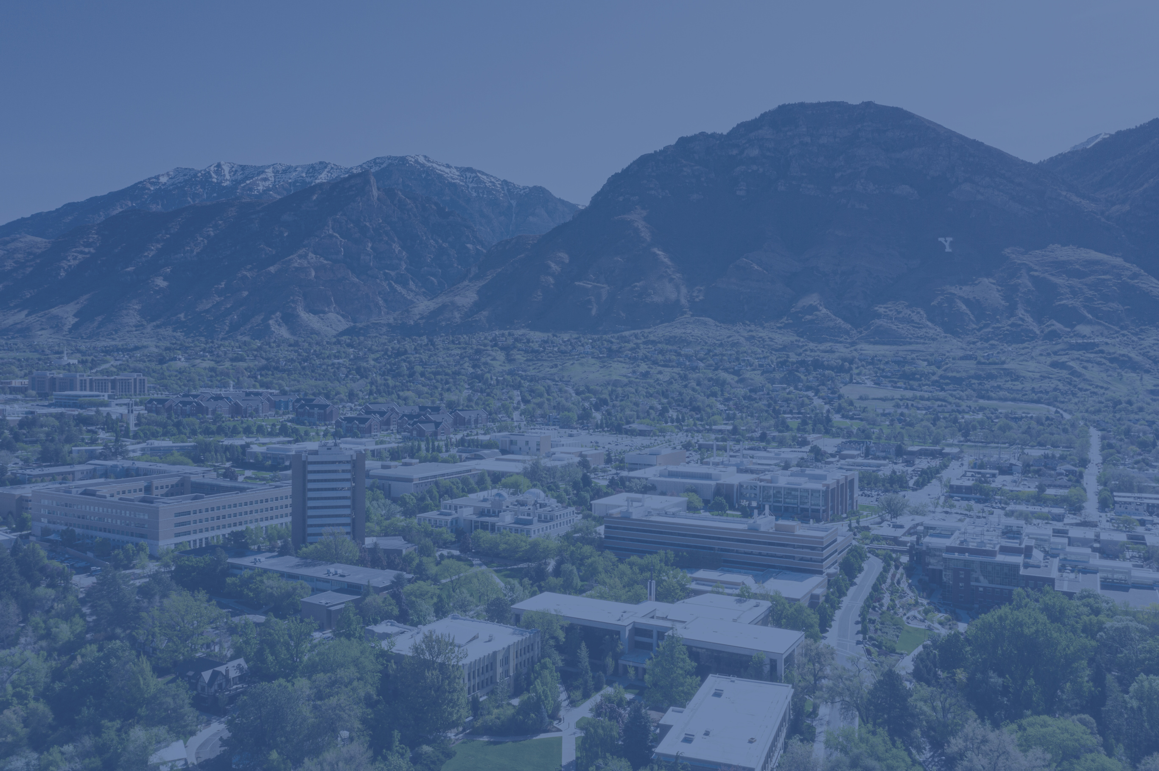
APRIL 20, 2021
The 2022 Intensive Grant Writing Bootcamp
APRIL
28, 2021
Research Development
Faculty Center
College of Humanities

Slide 2
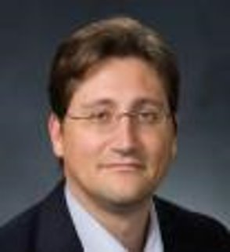
What to Expect
Day 1, May 9th
Overview of RD
Overview of Bootcamp
Baseline Logic and Six Generic Slots
Break from 10:30-10:45
Description of Needs Statement
Write the Needs Statement
Lunch from Faculty Center
Day 2, May 10th​
Recap of Day 1​
Description of Methods/Qualifications Sections​
Break from 10:30-10:45
Write Methods/Qualification Sections​
Lunch​
Day 3, May 11th​
Recap of Day 2​
Creating a Value Proposition​
Break from 10:30-10:45
Rewrite Methods/Qualifications Sections​
Description of Budget/Benefits Sections
Write Budget/Benefits Sections
Lunch​
Contact Mandi (rdadmin@byu.edu) for questions about attendance or the agenda.
Contact Jon for questions about content.
Jon Balzotti
College of Humanities, 4127 JFSB Tel: (801) 422-2440
jonathan_balzotti@byu.edu

Slide 3
“
Research Development supports faculty and graduate student efforts to procure and secure funding for research activities.

Slide 4
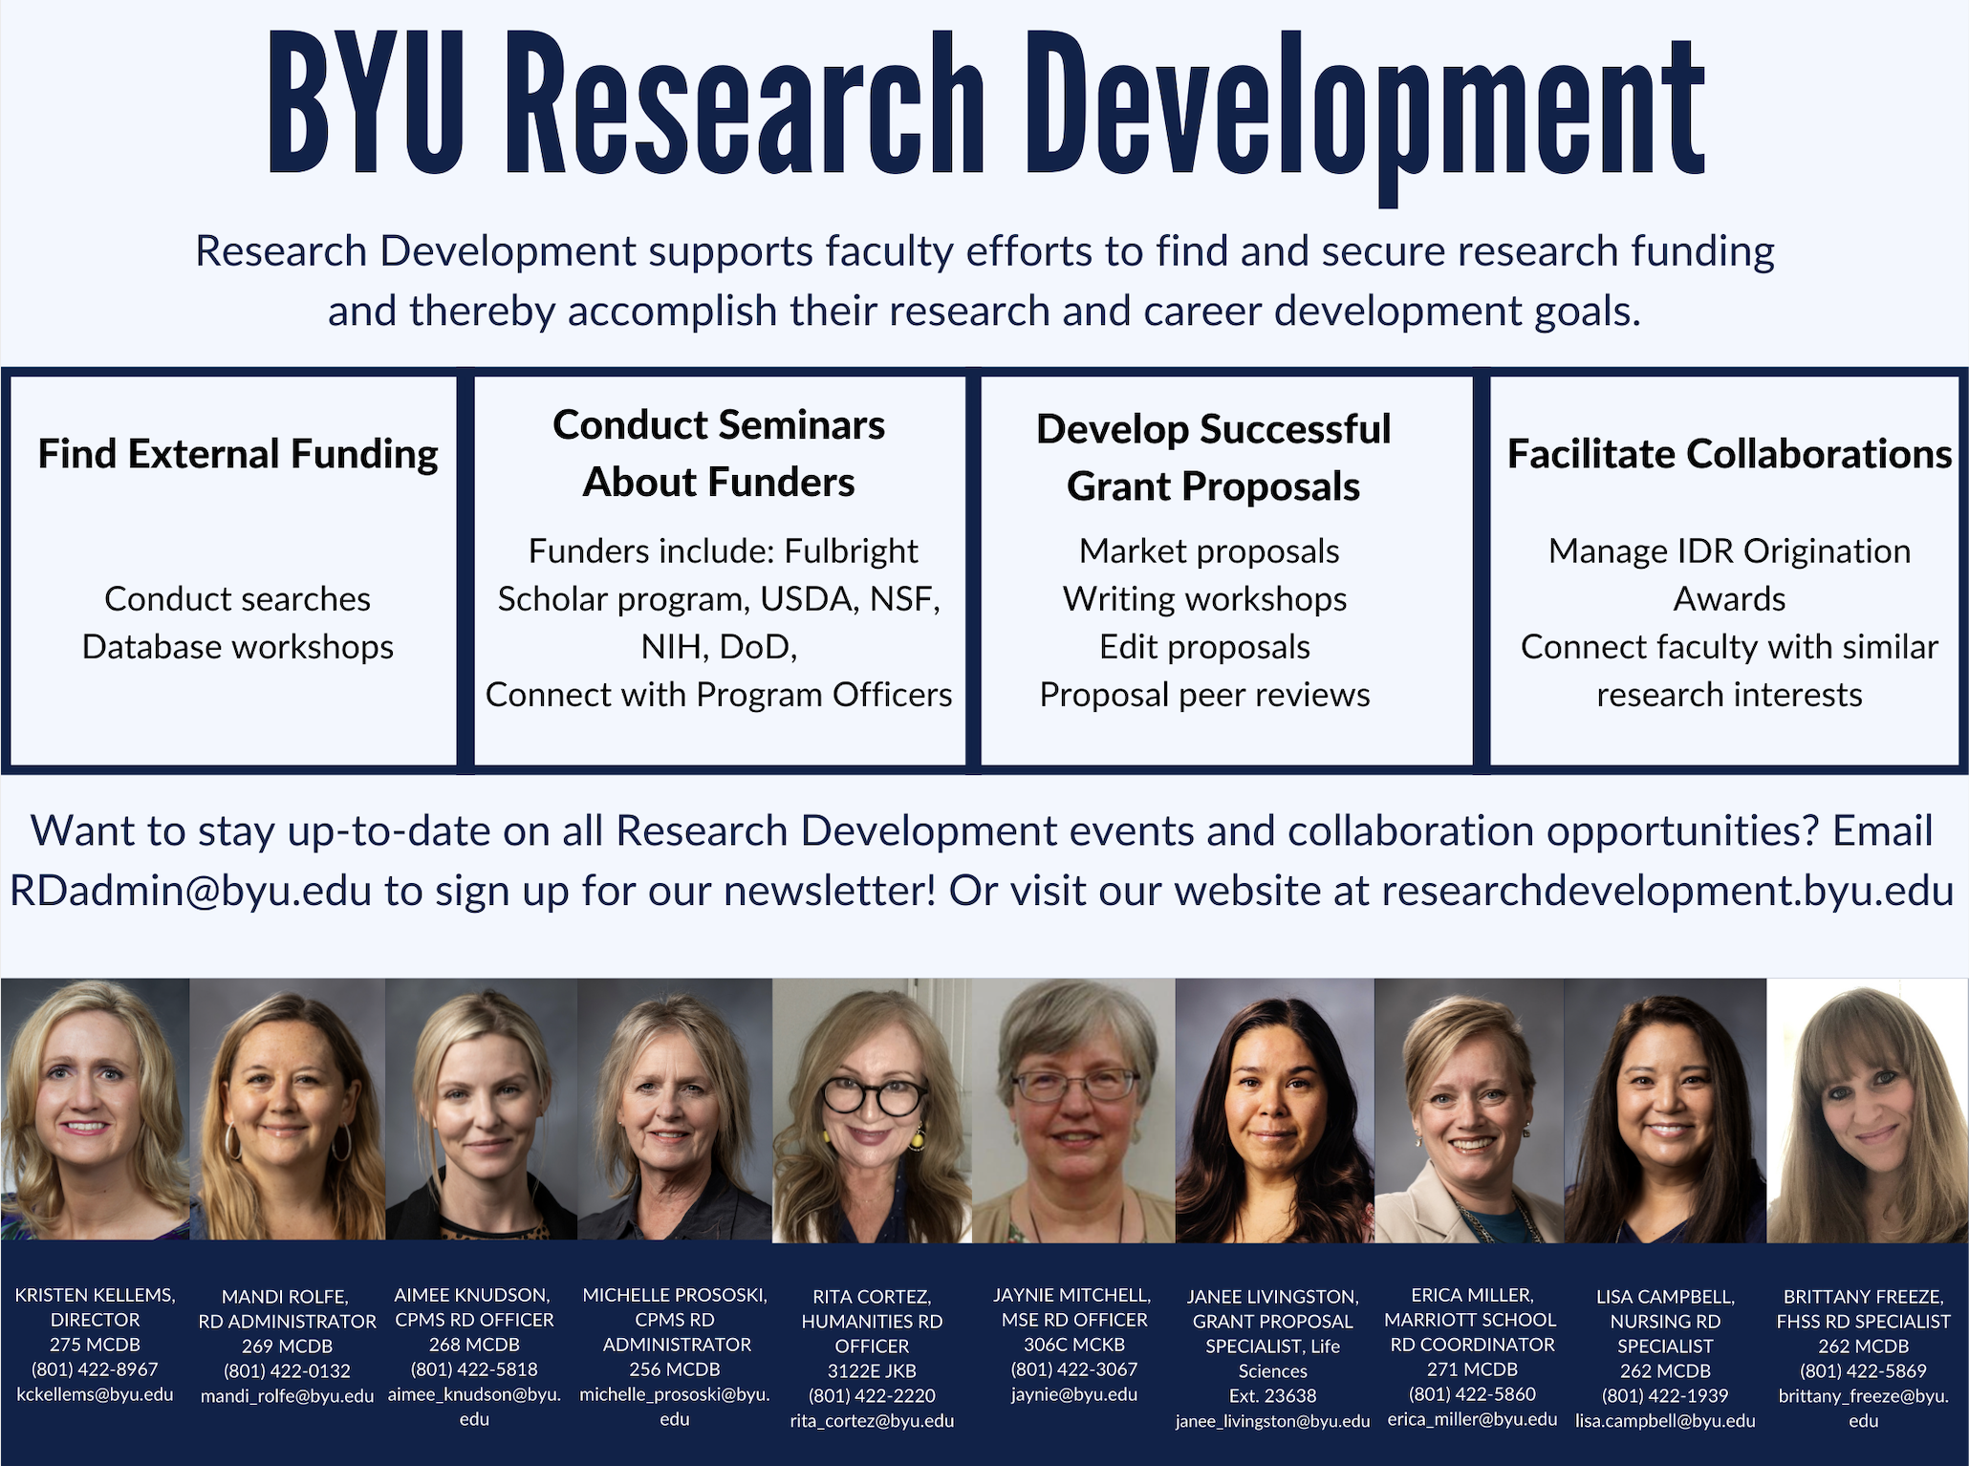

Slide 5
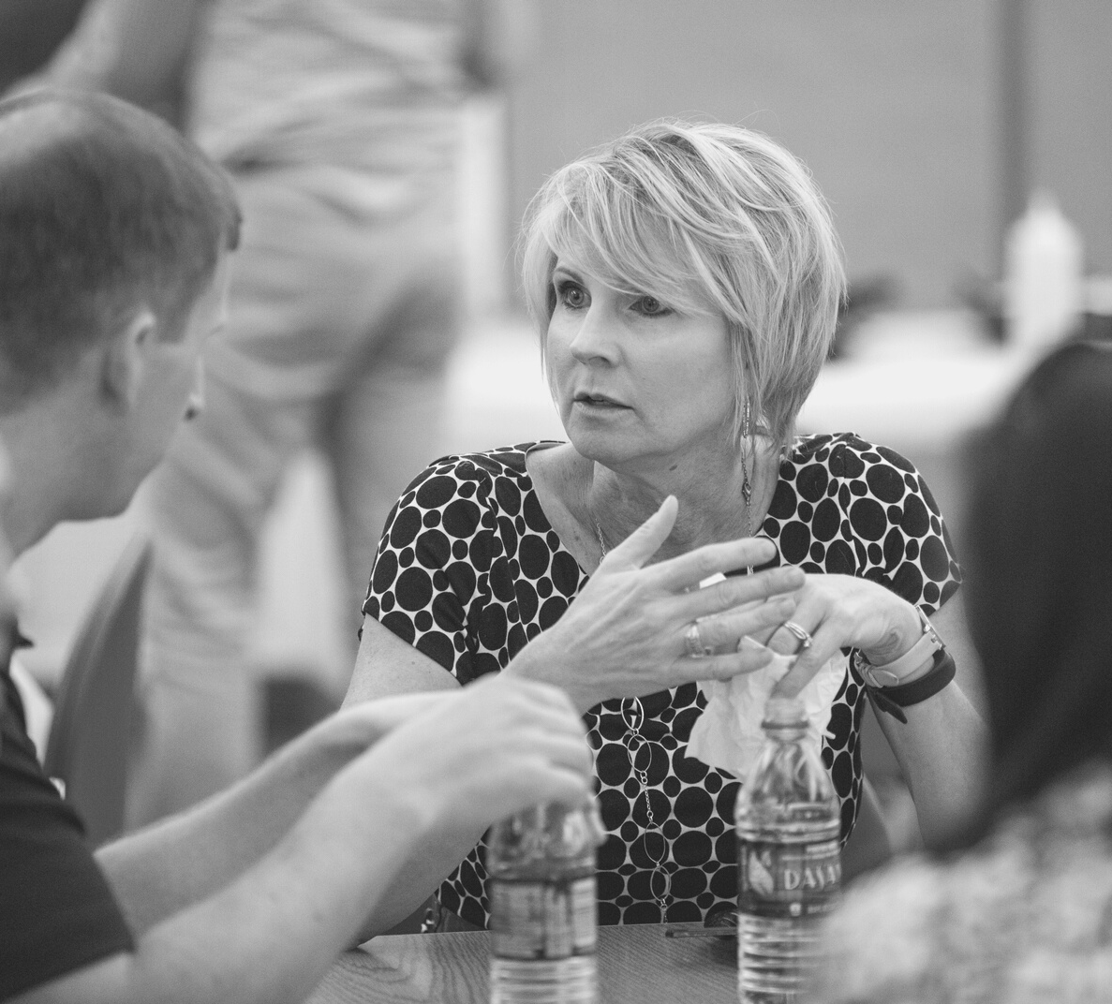
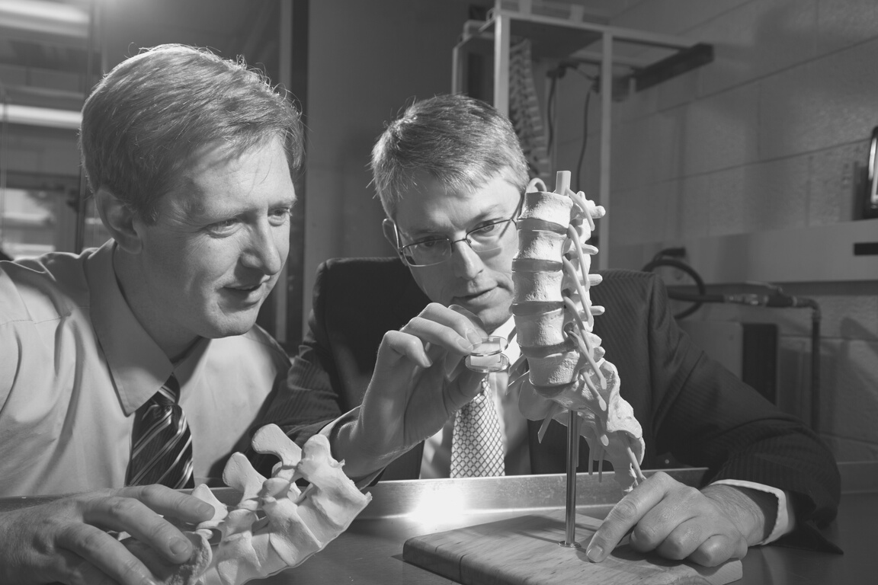

Find Funding
Online database training
Online database training
Funding newsletters and RD website
Individualized searches
Research Development Proposal Assistance
Proposal Writing
Topical seminars (budgets, data management plans, etc.)
RD website has templates and broader impacts page
Proposal reviews and edits

Slide 6
Bootcamp Results
NIH Proposal Reviews
59 faculty participating in the two intensive grant writing bootcamps had a 54% success rate.
24 faculty participating in the NIH proposal reviews had a 54% success rate.
RD Proposal Support Outcomes
Engaging with RD
Kulai Support
Faculty who participated in RD events received 33-40% more awards than those who didn’t participate.
Assistance with proposal entry into Kuali creates time to focus on proposal writing and research outcomes.

Slide 7
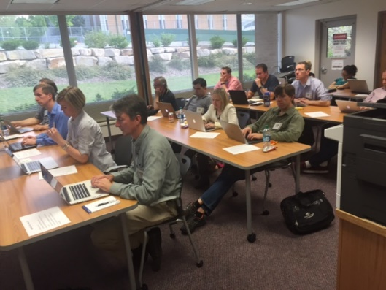
Intensive Grant Writing Bootcamp with Dr. Jon Balzotti
TOPICS
Develop proposal logic
Develop a need statement
Write proposal elements
Write persuasively
Market a proposal
Edit and re-write
WRITING FEEDBACK FROM INSTRUCTOR AND PEERS
WORKSHOP PROPOSAL COMPONENTS
COMPLETE A PROPOSAL DRAFT
98%

Slide 8
Attend the May grant writing bootcamp and write a short proposal
Receive proposal feedback from bootcamp peers
Develop the bootcamp proposal into a full proposal to an external funder
Participate in informal proposal status and progress checks
Participate in a peer review of a complete proposal prior to submission
Submit the proposal to an external funder
Intensive Grant Writing Bootcamp Participant Tasks

Slide 9
Better quality proposals with higher success rate
Expanded network of faculty colleagues for proposal review
Anticipated Program Outcomes
Better understanding of persuasive proposal writing
Beneficial relationships between mentors and participants

