Slide 1
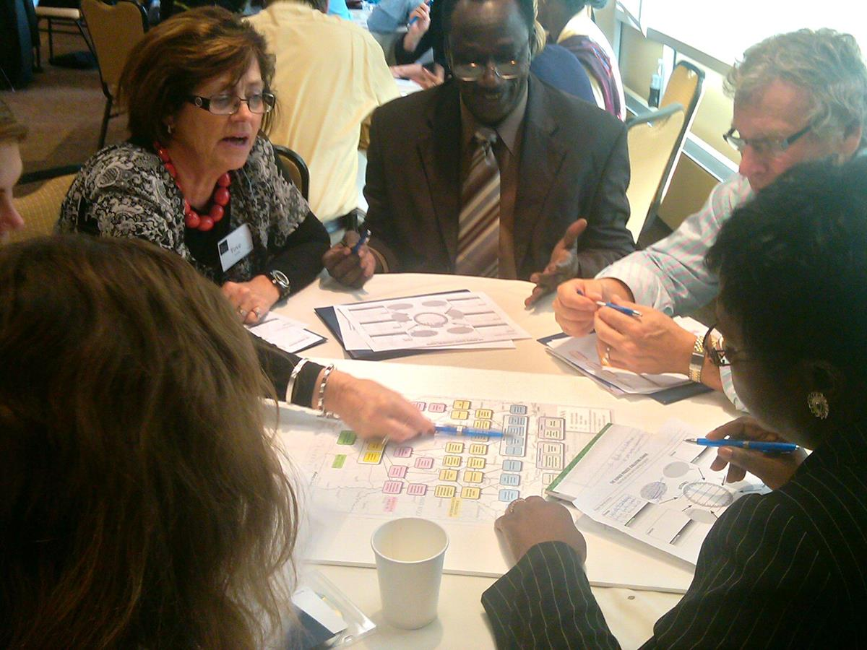
Logic Models
BYU Research Development Workshop
March 11, 2021

Slide 2


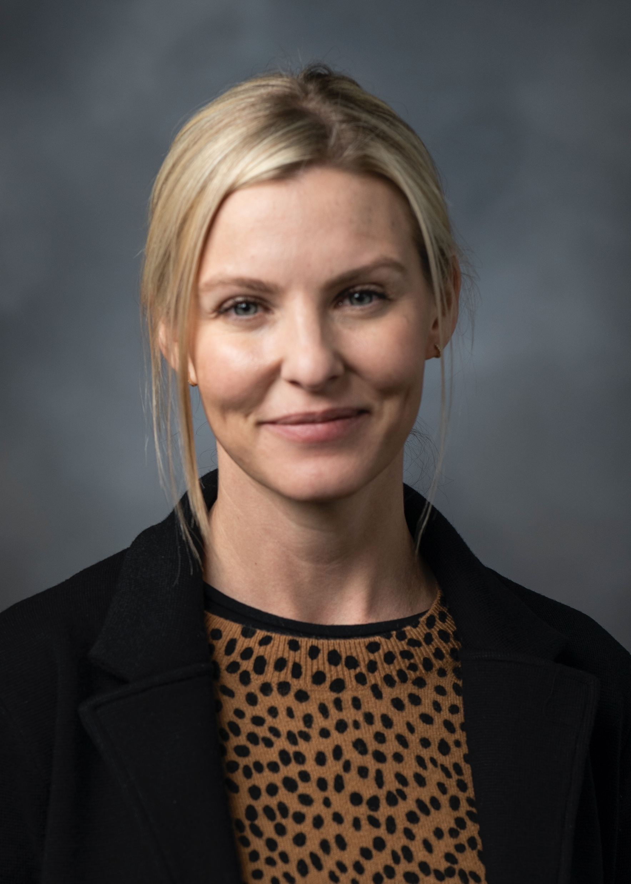


Research Development Coordinating Council
Kristen Clarke Kellems
Director of Research
Development
275 MB
Tel: 801-422-7722
kckellems@byu.edu
Kaylie Winterton
Research Development
Administrator
269 McDonald Building
Tel: 801-422-0132
rdadmin@byu.edu
Aimee Kirlew
CPMS Research
Development Officer
268 MCDB
Tel: 801-422-5818
aimee_kirlew@byu.edu
Jaynie Mitchell
MSE Research
Development Officer
306C MCKB
Tel: 801-422-3067
Jaynie@byu.edu
Michelle Prososki
CPMS Research
Development Administrator
256 MCDB
michelle_prososki@byu.edu
Jon Balzotti
English Department Faculty
4127 JFSB
Tel: (801) 422-2440
jonathan_balzotti@byu.edu
  RDCC partners with the Research Administration Office

Slide 3
who are you?
Please introduce yourself by telling us your name, position, and any of the following that describe you.
I am new to logic models.
I’ve created logic models before.
I’ve attended other logic model trainings.
My research would benefit from clear outcomes that my team all know and agree to.
My funder requires me to create logic models.
Taylor-Powell, E., & Henert, E. (2008).

Slide 4
agenda
Logic Models and Research Funding
What and Why
Components
How to Develop a Logic Model
Uses of a Logic Model
Logic Model Resources

Slide 5
Logic Models and Research Funding
Logic models (also known as theories of change or action) are required by the Department of Education, Department of Justice, CDC, and many national foundations in their proposal requests.
Even if not required, a logic model is an excellent way to organize and explain your key project components

Slide 6
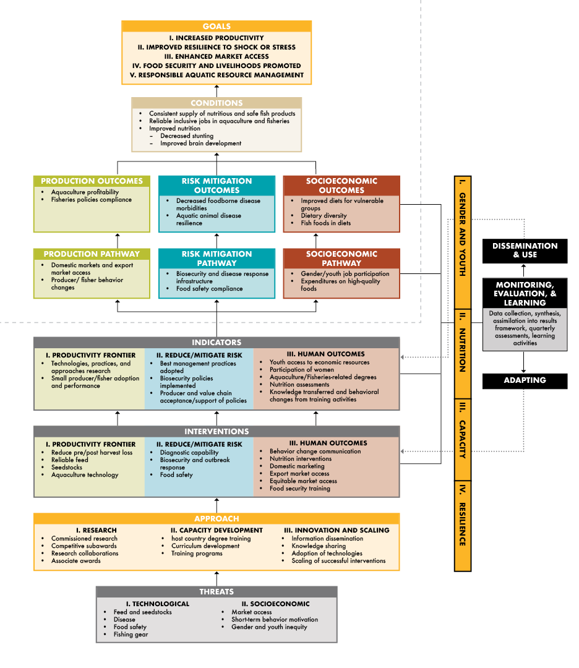
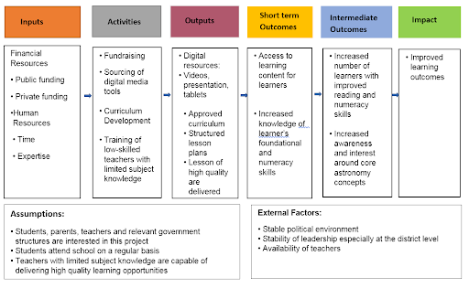
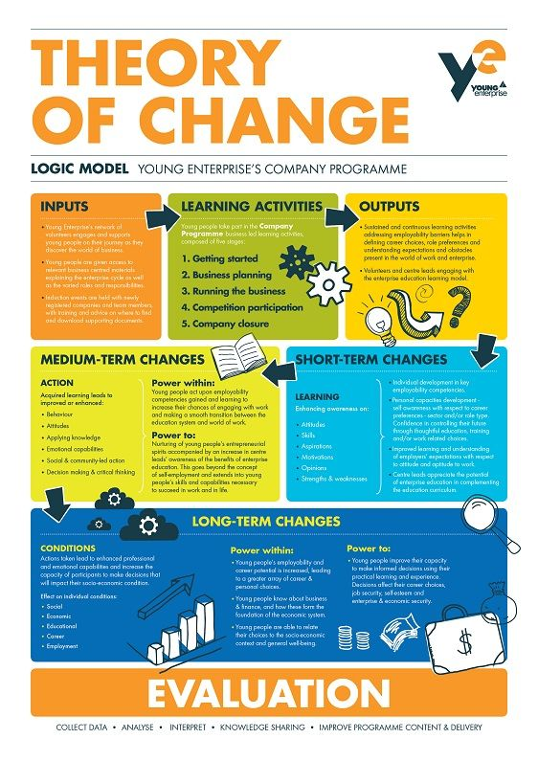
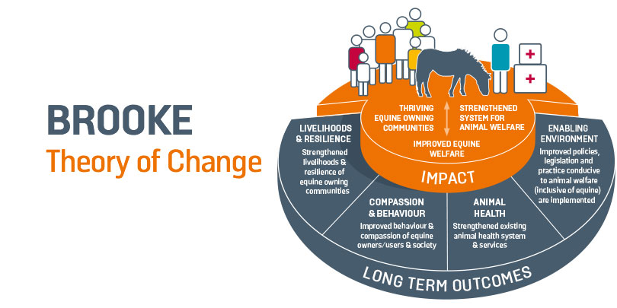
Examples
Logic Models or Theories of Change come in all shapes, sizes, and complexities

Slide 7
Best practices for logic models
Simple, legible image
Straight-forward approach that can be quickly understood
Reflects group thinking and shared understanding
Like programs, Logic Models can change over time and should reflect reality

Slide 8
What and Why
Activities
Outputs
Resources
Inputs
Outcomes
Short and Long Range
Impact
1
2
3
4
5
Your Planned Work
Your Intended Results
The What: Logic Model Definition
A logic model is a systematic and visual way to present and share your understanding of the relationships among the resources you have to operate your program, the activities you plan, and the changes or results you hope to achieve.
The most basic logic model uses words and/or pictures to describe the sequence of activities you will use to bring about change.
The Why: Creating a logic model as a “thought experiment” clarifies thinking, encourages collaboration, and centers mutual understanding.
(Kellogg Foundation 2004)

Slide 9
Components and their Definitions
Resources/Inputs: What you bring to the project
Activities: Actions you will take during the project
Outputs: What happens in the project that you will count or measure
Outcomes: Changes that you observe
Impact: What will happen now and in the future because of these changes

Slide 10
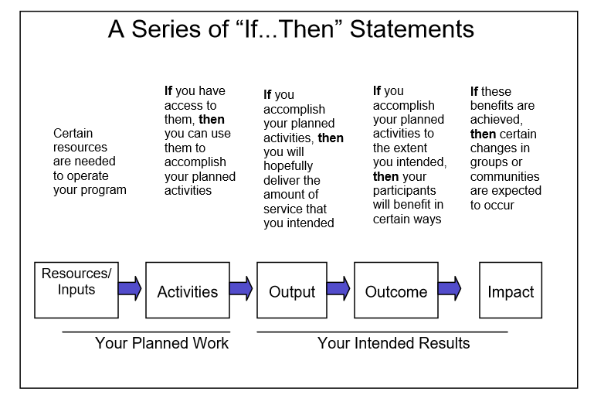
How to develop a logic model
Notes:
Group effort – should be a conversation starter for your team. Set SMART goals: simple, meaningful, achievable, realistic, tangible Focus on difference between outputs and outcomes and why both are necessary. Delivery (outputs – what your program provides) vs. Results (outcomes – participant benefits)

Slide 11
steps for developing a logic model
1. Determine the purpose of the logic model
2. Convene stakeholders
3. Determine a focus
4. Understand the situation - use the program objective as your anchor
5. Explore the research for best practices or approaches
6. Construct a series of activities linked to outputs, outcomes, and impacts. Stuck? Try working backwards
7. Connect the activities to other components with arrows to show the linkages
Notes:
CUR Template

Slide 12
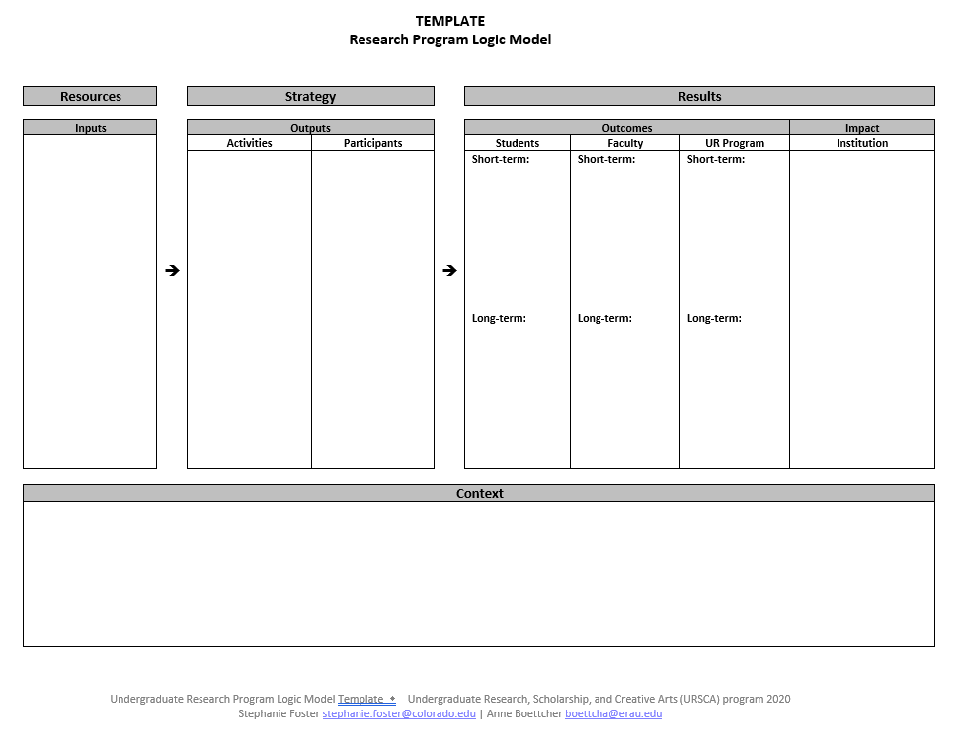
How to develop a logic model
Notes:
CUR Template - Activity

Slide 13
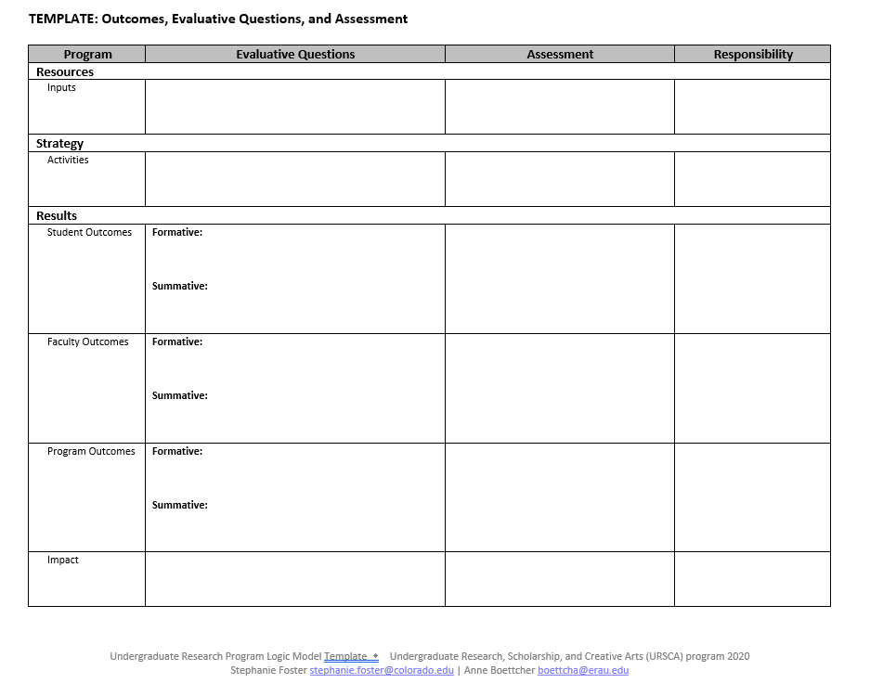
How to develop a logic model
Notes:
Activity

Slide 14
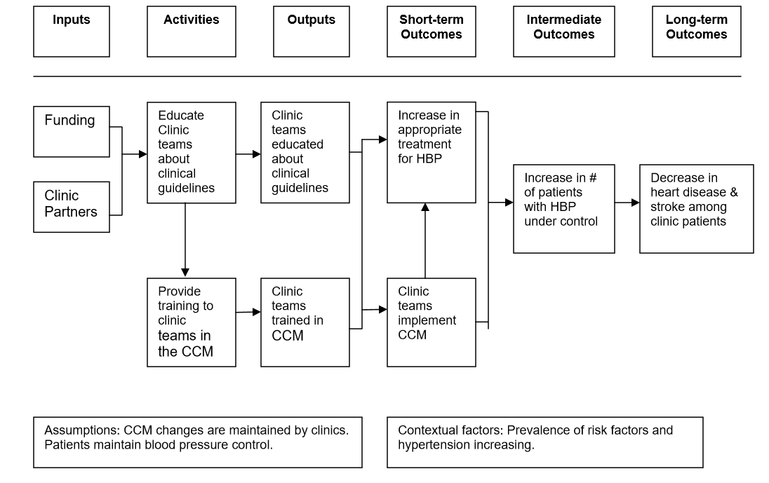
Uses of a logic model
Notes:
Discuss uses – planning and evaluation. Ask for comments on how this model could be useful in their work. If you were a reviewer, how would this inform your review of a proposal?

Slide 15
Logic model resources
CDC Logic Model Tools https://www.cdc.gov/eval/tools/logic_models/index.html
Developing and Using a Logic Model (DHDSP) https://www.cdc.gov/dhdsp/docs/logic_model.pdf
Foster, S., & Boettcher, A. (2020). Undergraduate Research Program Logic Model Template. Undergraduate Research Scholarship, and Creative Arts (URSCA) program, Logic Model Template.docx
IES-REL Regional Educational Laboratory Program
https://ies.ed.gov/ncee/edlabs/regions/pacific/elm.asp
Kellogg Foundation Logic Model Guide
https://www.wkkf.org/resource-directory/resources/2004/01/logic-model-development-guide
Taylor-Powell, E., & Henert, E. (2008). Developing a logic model: Teaching and training guide. Benefits, 3(22), 1-118. https://ou-webserver01.alaska.edu/ianre/internal/reporting/logicmodel/logicmodeltrainingguide.pdf

