Slide 1

Department of Defense Funding Workshop
Brigham Young University
13 FEB 2018
UNCLASSIFIED
“Simply stated, the lesson of the last decade is that failing to understand the human dimension of conflict is too costly in lives, resources, and political will for the Nation to bear… The optimal condition is for our leaders to have the ability to influence budding conflicts ‘left of bang,’ that is, before tensions turn violent…”
  (LTG Michael Flynn, James Sisco, & David C. Ellis, 2012, “The Value of Sociocultural Analysis in Today’s Environment,” PRISM, 3(4))
“Let me be clear that the key principle of all components of the Minerva Consortia will be complete openness and rigid adherence to academic freedom and integrity. There will be no room for “sensitive but unclassified,” or other such restrictions in this project. We are interested in furthering our knowledge of these issues and in soliciting diverse points of view – regardless of whether those views are critical of the Department’s efforts. Too many mistakes have been made over the years because our government and military did not understand – or even seek to understand – the countries or cultures we were dealing with.”
  (Secretary of Defense, Robert M. Gates, 14-April 2008, Address to Association of American Universities)

Slide 2
Department of Defense Funding Workshop
Brigham Young University
13 FEB 2018
UNCLASSIFIED
Dr. Lisa Troyer
Program Manager, Social & Behavioral Sciences, Life Sciences Division
Army Research Laboratory/Army Research Office
Acting Director, Minerva Research Initiative
Basic Research Office, USD(R&E)
lisa.l.troyer.civ@mail.mil
(919) 549-4230

Slide 3

Department of Defense Funding for Basic Research
Why Does Department of Defense (DoD) Care about Basic (Social) Science?
Conflict is costly in terms of lives, resources, and future opportunities
  Staying “Left of Bang” is more socially, economically, and politically effective and humane
  Conflict is an inherently social problem
DoD is first-responder in humanitarian crises, with little advanced warning about where those crises will occur – cultural, normative, political, economic context
  Past mistakes due to lack of systematic understanding of situations/cultures
  Inefficiency in delivery of aid and protection of forces
Increasing evidence of severe potential of non-kinetic threats:
  Take out social institutions: Economic, Political, Religious, Kin
  BUT: We compete for engineering, tools, hands-on technology
Recognition that the world’s intellectual capital, largely residing in universities, is an inadequately tapped resource that can facilitate decisions and policymaking to improve security and humanitarian efforts.

Slide 4
Department of Defense Funding for Basic Research
Funding Opportunities – Partial List of DoD Agencies Supporting Extramural Research in Social & Behavioral Science
Army Research Office (ARO)/Army Research Laboratory (ARL)
  Social & Behavioral, Computational Sciences, Social Networks, Cyber, Intersection of Natural, Social, Physical Systems (Extramural)
Army Research Institute (ARI)
  Personnel Assessment, Skilling, Sexual Harassment/Assault Programming
Army Medical Research & Materiel Command
  Emphasizes health research – incl. mental health
Army Corps. of Engineers Basic Research Offices
  Terrain, Intersection of Natural, Social, Physical Systems
Office of Naval Research (ONR)
  Sociocultural, Social & Technical Systems Integrations, Cyber
Air Force Office of Scientific Research (AFOSR)
  Human Factors, Autonomous Systems, Sociocultural Systems
Defense Threat Reduction Agency (DTRA)
  Resilience to Weapons of Mass Destruction, Risk Forecasting
Defense Advanced Research Projects Agency (DARPA)
  Complex Systems, Challenging Social Science Theory, Method
*Agencies often collaborate on supporting projects (funding, reviewing, administering)*

Slide 5

Department of Defense Funding for Basic Research
Partial List DoD Funding Landscape
  Small Business Innovation Research (SBIR)
  Small Business Technology Transfer Research (STTR)
Grants (1-5 years, length & amount depend on the agency)
  Basic Research ($110K/yr, 3-yrs)
  Short-Term Innovative Research ($100K/yr, 9-mos)
  Young Investigator Programs ($110K/yr, 3-yrs)
    Presidential Early Career Award for Scientists & Engineers ($500K/yr, 3-yrs)
  Vannevar Bush Faculty Fellowship (formerly NSSEFF) ($3M over 5-yrs)
  AAAS Fellowships (post-doc)
  University Research Initiatives
    Minerva Research Initiative
    DESI (Academic-Industry Partnership)
    LUCI (Academic-Industry-Lab Partnership)
    Multidisciplinary University Research Initiative ($1-$2M/yr, 5-yrs)
  Research Instrumentation Grants
  Research & Educational Opportunities for HBCU/MI
  Army Educational Outreach Program (High School, Undergraduate)
  Conference/Symposia Grants ($10K-$15K, 9-mos)
  National Defense Science & Engineering Graduate Fellowship (full tuition & fees, institutional stipend rate, 3-yrs)

Slide 6
Department of Defense Funding for Basic Research
MINERVA RESEARCH INITIATIVE – BRINGING IN SOCIAL SCIENCE
What Kind of Projects Does Minerva Fund?
Varies with national security priorities with change annually (or more often)
New topics fielded each year, depending on change
Recent Examples:
  Radicalization/De-Radicalization Dynamics
  International Investments in Defense-Related R&D
  Post-ISIL Dynamics (at-risk areas as fighters exile)
  AI, Cyber, Autonomous Systems, Social Sensors, Visualization
    Basic social science advances are critical – we don’t want another duplicative data collection project, widget, or algorithm
  Global opinions toward international aid, investment, intervention
  Validated models of temporal/spatial effects on social dynamics
Stronger competitiveness of projects that demonstrate understanding of existing state-of-the art in basic social science research and theory
  You need a serious, experienced, proven social scientist
  Balanced multidisciplinary teams tend to be competitive

Slide 7
Department of Defense Funding for Basic Research
MINERVA RESEARCH INITIATIVE – BRINGING IN SOCIAL SCIENCE
Competition is Strong
  150-165 white papers
  Trimmed to 40-50 full proposal invites
  Awards to 10-12
But these are pretty good statistics (vis-à-vis NSF, NIH, and others)
What Makes for a Successful Proposal?
  Understand the Process
    THOUROGHLY Read Federal Opportunity Announcement (FOA)
    Investigate DoD Priorities
    Communicate with Program Managers (listed in the FOA)
  Look at what we already have funded
    We will NOT invest in:
      Projects that gather data that already exists
      “Yet another algorithm” – this is BASIC SOCIAL SCIENCE program
      Validation is a critical standard
    We want high-risk, potentially high pay-off research that advances BASIC Social Science Theory & Method
  Also, Program Managers must ANNUALLY rationalize Minerva investment
  What is their agency and DoD gaining – how are they improving overmatch?

Slide 8



Department of Defense Funding for Basic Research
How Do I Learn about Opportunities?
Office of Research & Creative Activities
Grants.gov
E-mail me
How Do I Apply?
Office of Research & Creative Activities
Details usually in the Broad Agency Announcement (BAA), Request for Proposals (RFP), Request for Information (RFI), Federal Opportunity Announcement (FOA)
E-mail me

Slide 9

Department of Defense Funding for Basic Research
What is the Process for Applying?
Communicate with the Program Manager
  Before the discussion, prepare the elevator speech:
    What is the research question/objective?
    How will the answering the question advance basic science?
    What is the theoretical or research foundation for the project
    (Briefly) what is the methodological approach?
    What is the anticipated budget (all-in, including indirect costs)?
    Discuss program requirements (timelines, next steps, review process)
    BE PREPARED TO DO THIS VIA E-MAIL – WE TRAVEL ALOT
2. White Paper (4-5 pages)
  Research objective
  Scientific innovation
  Brief theoretical/research review
  Data sources
  Analytic strategy
  Budget
  Value to the agency
In most cases, white papers are not peer-reviewed.

Slide 10
Department of Defense Funding for Basic Research
What is the Process for Applying? (cont.)
3. Full Proposal (usu. only if invited)
  Submitted via grants.gov by your institution
    Give them plenty of notice – they have a lot of proposals and deadlines
    The recipient of a grant is the institution, not the PI
  Content will vary, but expect:
    Research objective
    Scientific innovation
    Theoretical background
    Method/data sources
    Analytic strategy
    Project schedule
    Management plan
    Detailed budget & budget justification
    Other (e.g., broader impacts, student training, value to agency mission)
  Most agencies use grants.gov to audit for required forms and formats – proposal may not be accepted if it fails the audit
    It will not be accepted if it is late

Slide 11
Department of Defense Funding for Basic Research
What is the Process for Applying? (cont.)
4. Wait for the disposition
  Review process (varies by agency)
    Some program managers invite proposers to suggest reviewers (although those suggestions might not be followed)
    Usually 3-5 academic scientists, 1-2 DoD scientists
    Review Criteria
      Scientific/Technical Merit
      Potential Impact
      Investigator Qualifications
      Budget Reasonableness
      Overall Evaluation
    Some program managers invite proposers to suggest reviewers (although those suggestions might not be followed)
  Communication varies by agency & program manager
    E-mail vs. formal letter
  Note the timelines (avoid e-mailing before the expected feedback date, but do so after the deadline has passed)

Slide 12
Department of Defense Funding for Basic Research
What is the Process for Applying? (cont.)
5. Possible Outcomes after Review
  Fundable
    Final decision will depend on budget
    Projects are often “queued” or ranked
  Grey
    Reviewer concerns need to be addressed
    Discuss potential for revising and resubmitting with program manager or other possible funding mechanisms
  Not Fundable
    Request feedback/reviews
    Discuss potential for revising and resubmitting with program manager or other possible funding mechanisms
  Recommended for Funding
    Processing award may take several weeks
      Prepare groundwork while you’re waiting:
        IRB, IACUC
        Subawardee agreements
        Foreign permissions

Slide 13
Department of Defense Funding for Basic Research
Additional Information & Tips
Succinct, to-the-point, writing in a grant proposal is a plus
  It’s not a mystery novel
  Objectives, thrusts, tasks, hypotheses are helpful
  Don’t over-reference
Carefully consider submitting full proposal unless invited
  In most cases, DoD programs are required to have several peer-reviews of a full proposal, even if it is not one that the program manager will support
  You and your institution must put in A LOT of time for a full proposal
Communicate with the program manager as you’re developing your proposal (unless there are specific “silent” periods – sometimes for special programs):
  Questions about content (e.g., level of detail, organization)
  Questions about budget
Do not ask the program manager to read a draft proposal

Slide 14
Department of Defense Funding for Basic Research
Additional Information & Tips (cont.)
IRB – Start Early!
  (At least) two-levels
    Institutional
    Army Human Research Protections Office AHRPO
    (In-country IRB)
  All modifications must be approved by AHRPO before they are put into effect
  There is a mandatory annual continuing review
Spending
  You must spend, or the funds may be swept
  If you need to move funds between budget categories, check first with the program manager
Communicate with the program manager
  Interesting findings – new opportunities
  Accomplishments – publications, presentations, additional funding
  Contact from any federal agency, official interested in your research
  Contact from press

Slide 15
Department of Defense Funding for Basic Research
FAQs
Can I conduct classified research with the DoD?
  The programs discussed today require that the research be unclassified; if you have questions about your research classification, program managers can help you.
Does the DoD limit my ability to disseminate my research findings?
  For the programs we’ve been discussing, all reports, publications, and presentations must be made publicly available.
Do I need to tell research participants & publishers that DoD is funding my project?
  Yes – Transparency is critical for these research projects.
Can program managers provide access to military subjects?
  Only in a very limited circumstances – discuss this with program managers.
Can I submit a research proposal or white paper to more than one agency?
  Usually some programs that don’t accept duplicate submissions, but most do; but be sure to notify all program managers that you are submitting a proposal to another agency and keep them posted on the disposition at other agencies.
Do I have to be a US Citizen to receive a grant from a DoD agency?
  It depends on the program – each BAA/FOA/RFI/RFP will indicate citizenship requirements (several ARO programs encourage participation of non-US institutions/PIs).
Must I have a Ph.D. to apply?
  It depends on the program, although most do not specify education requirements.

Slide 16

Department of Defense Funding for Basic Research
Questions?
lisa.l.troyer.civ@mail.mil

Slide 17
Department of Defense Funding Workshop
Brigham Young University
13 FEB 2018
UNCLASSIFIED
Dr. Lisa Troyer
Program Manager, Social & Behavioral Sciences, Life Sciences Division
Army Research Laboratory/Army Research Office
Acting Director, Minerva Research Initiative
Basic Research Office, USD(R&E)
lisa.l.troyer.civ@mail.mil
(919) 549-4230

Slide 18



ARO Social & Behavioral Sciences
Vision
Discover basic mechanisms underlying social dynamics across micro & macro levels over multiplex systems
Thrusts
Interdependencies among Social, Natural, and Physical (SNP) Systems
Biophysiological Technologies to Measure Social Dynamics
Relevance
Basic Scientific Advances
Making Scientific Discovery Useful to the Army & Beyond through Transitions
  SBIR, STTR, & Other Private-Public Sector Collaborations
Warfighter Advantage

Slide 19
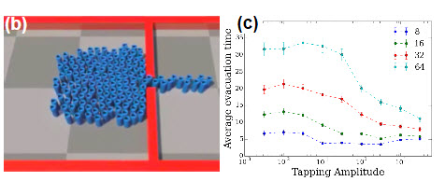
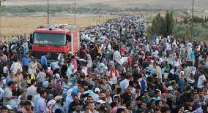
ARO Social & Behavioral Sciences
Modeling Interdependencies among SNP
Recent Breakthroughs
  New models of cascading effects across multiplex systems (Pratson, Maoz)
  New data & models of rebel financing (Walsh)
  Impact:
    Complex causes regional conflicts
    Insights on how rebels gain support
Next: Large-scale population dynamics — flocking, schooling, swarming, herding, stampeding
Possible Approaches
    Adapt models from physics, geoscience, biology, mathematics, demography
    Technologies to predict & visualize mass movement in human groups and human-environment dynamics at large scales

Slide 20
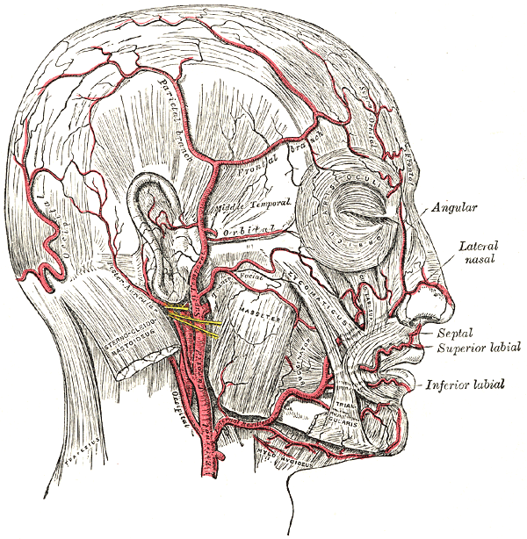
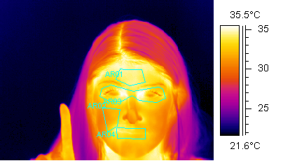
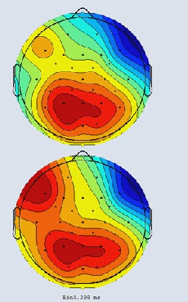
ARO Social & Behavioral Sciences
Measuring Social Dynamics
Recent Breakthroughs
  Biophysiological measures & models of human social dynamics (Kalkhoff, Melamed, Robinson, Simpson)
  Epigenetic predictors of social behavior (Reed)
  Impact:
    Basic scientific evidence that social dynamics are embodied in physiological and biological processes
    Measurement improvements in thermography, brain imaging, ocular measurement, acoustic patterning, (epi)genetic analyses
Next: Predict transitions across social states by tracking biophysiological changes (e.g., neutrality-aggression, cohesiveness-fragmentation, dominance-deference)
Possible Approaches
    Basic research on biophysiological models of social dynamics
    Basic research on epigenetics of social behavior
Identity Verification
Identity
Deception

Slide 21
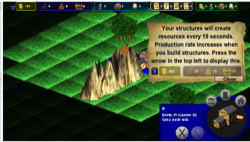


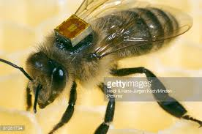
ARO Social & Behavioral Sciences
Transitioning Basic Social & Behavioral Science Research: Making Scientific Discovery Useful to the Army & Beyond through Transitions
Recent ARO SBIR/STTR Examples
  Gaming platforms to enable massive on-line experiments on social dilemmas
  Algorithms to rapidly infer social meaning from social media
  Ethnographic tool for field analysis of cross-cultural values
Recent Examples of Public-Private Partnerships from ARO-DARPA Collaborations
  Developing methods for replicability in social science research
  Modeling social intelligence for human-machine teaming
Recent ARO DURIP Example
  Radio Frequency Identification technologies to monitor social foraging behavior and environmental stress adaptation

Slide 22
Department of Defense Funding Workshop
Brigham Young University
13 FEB 2018
UNCLASSIFIED
Dr. Lisa Troyer
Program Manager, Social & Behavioral Sciences, Life Sciences Division
Army Research Laboratory/Army Research Office
Acting Director, Minerva Research Initiative
Basic Research Office, USD(R&E)
lisa.l.troyer.civ@mail.mil
(919) 549-4230

