Slide 1

Test Referee Branch Remote Sensing Capabilities.
Prepared by the DPG LIDAR Team
An ATEC operated proving ground with installation operations managed by IMCOM.

Slide 2
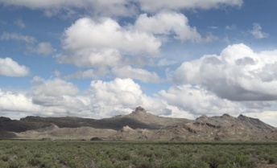
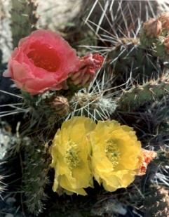
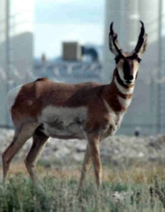
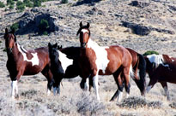
Introduction
1,300 sq. miles of remote desert
85 miles SW of Salt Lake City, Utah
Free of urban encroachment
Bordered on three sides by mountains and desert terrain
Chemical and Biological Defense Testing
250 sq. miles of test grid space
30 Miles
Salt Lake City
52 Miles
Notes:
Utah is located in the western US
Open air testing with simulants is done on our extensive test grids

Slide 3
Stand-off Detection
Lidar Systems
Scanning FTIR
Spectroscopy

Slide 4
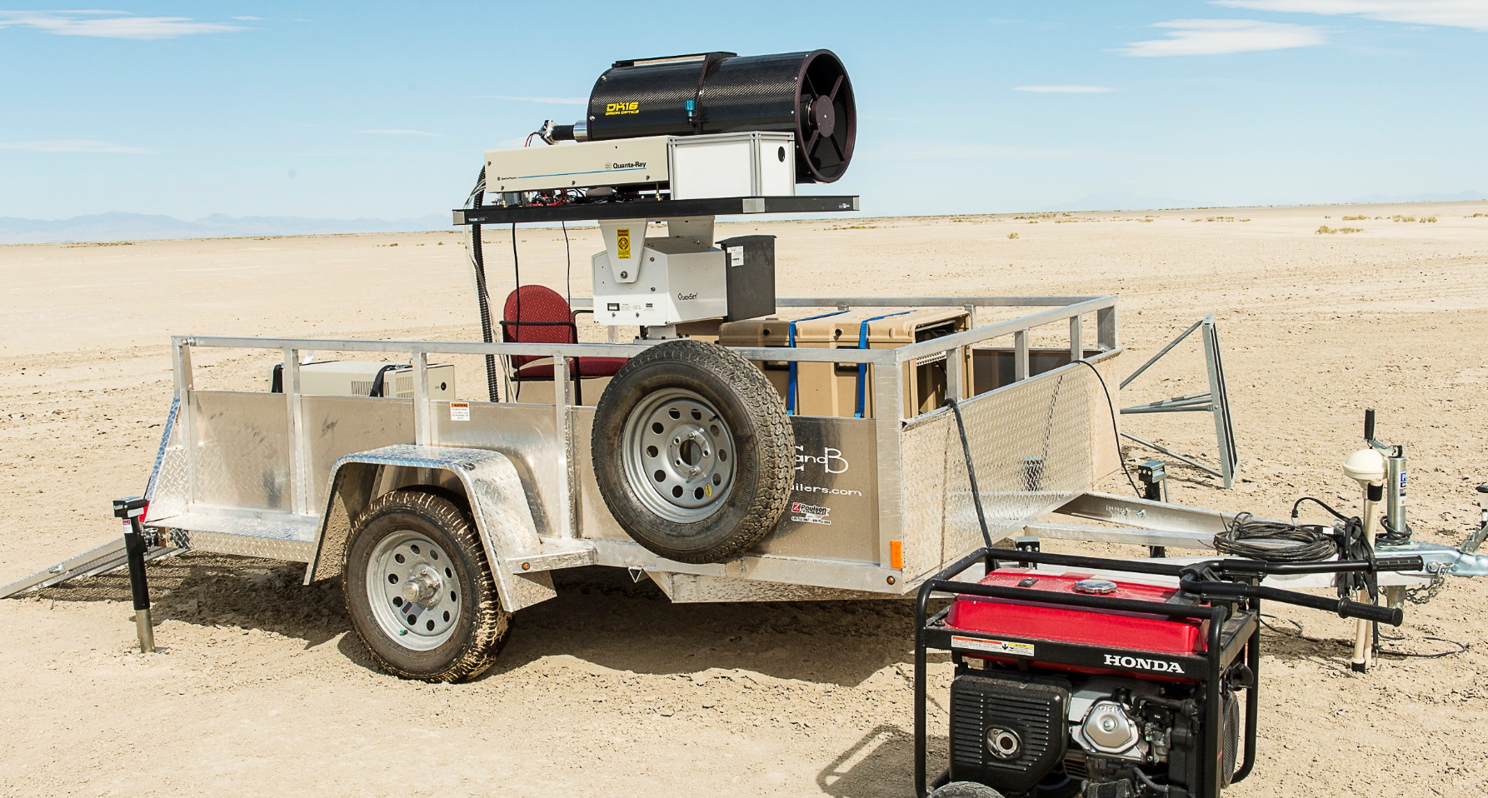
Lidar example system
Notes:
We developed these UV systems specifically for the Jack Rabbit II test as an experimental effort.
We are very pleased with the capability this technology provided.

Slide 5
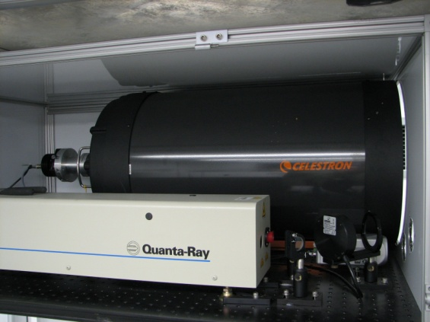
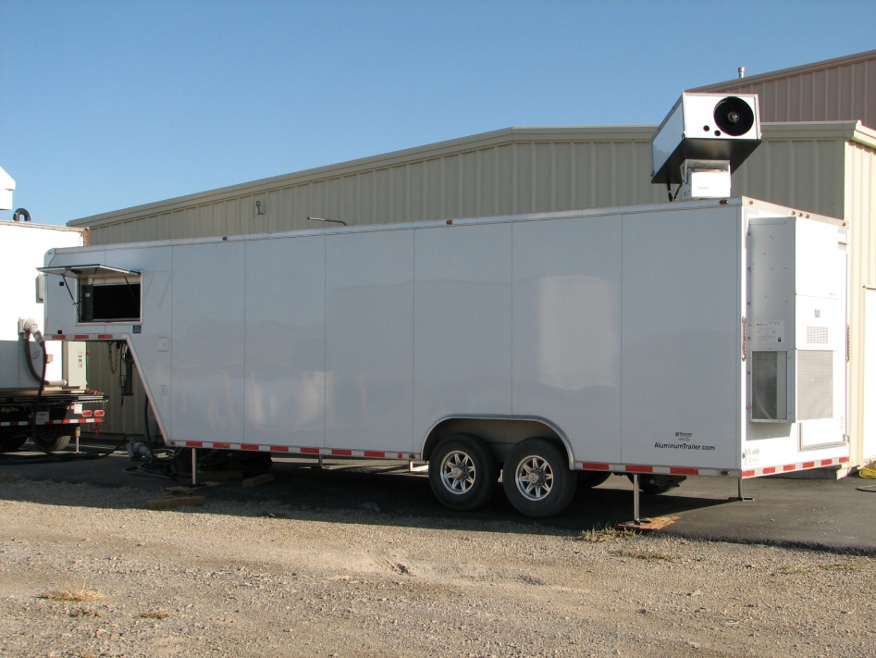
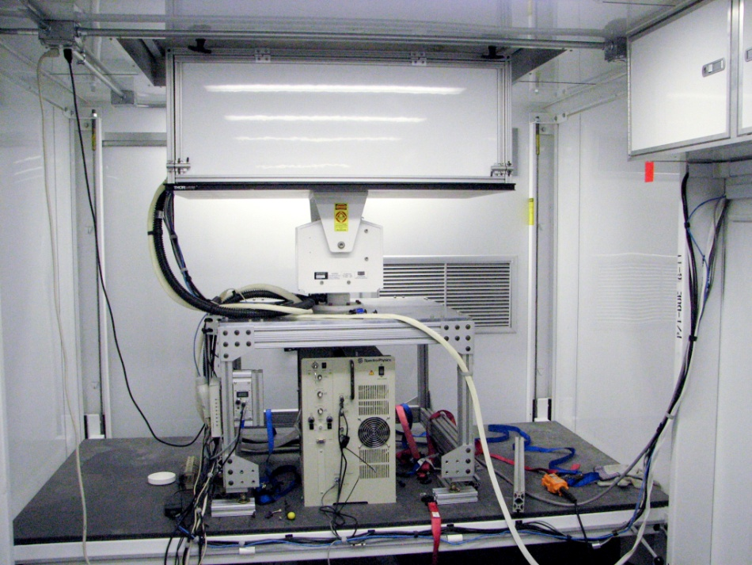
West Desert Lidar
Based on a Nd:YAG laser
High degree of reliability due to simple design
Continually upgrading and enhancing
Notes:
1064 nm laser at 8 watts average power
Side by side laser and telescope measure a typical cloud from 0.5km to 12km
Continually upgrading both software and hardware

Slide 6
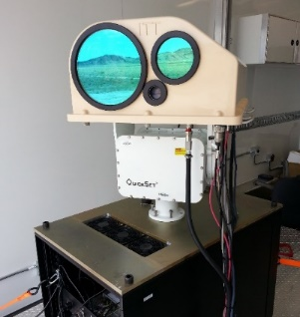
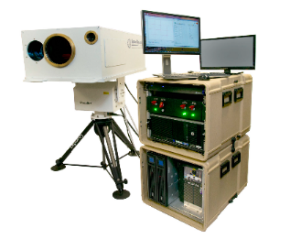
Operational LIDARs
West Desert LIDAR (2) – Non-eye safe system, Gold-standard of particle/aerosol test referees, integrated into Test Grid
Scanning Aerosol Multi-Pulse Lidar-(Eyesafe) (SAMPLE) (1) – Eye-safe system, poor daytime performance, integrated into Test Grid
CELiS (2) – Eye-safe System, more sensitive than SAMPLE, NOT integrated into Test Grid

Slide 7
LIDAR Work In Progress
Raman Enhanced Aerosol LIDAR (REAL) (2)-Too complex for mobile referee lidar, untapped capability, Proposed to be part of Full Field Wind Mapping capability for T&E Gaps
UV LIDAR (2)- One-off LIDAR developed for Jack Rabbit
LIF-primarily 1um; used UV on Jack Rabbit

Slide 8
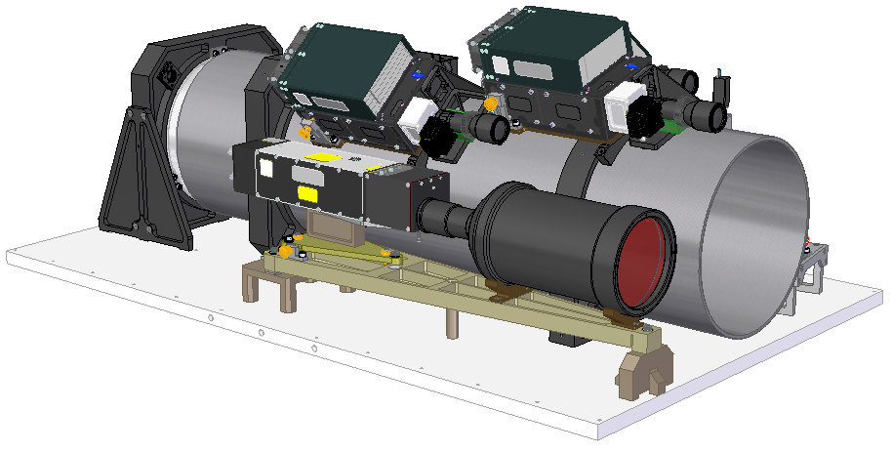
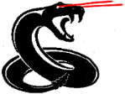
Near-term LIDAR Projects
Real-time Aerosol Test LIDAR (RATLR) (1) – Standoff Particle Size Distribution LIDAR
Currently being developed with an expected delivery in Q4 FY19
To be characterized in FY20
Four (4) wavelength LIDAR
Option of 4 additional wavelengths (greater size definition), if proven out
RATLR (Real-time Aerosol Test LidaR)

Slide 9
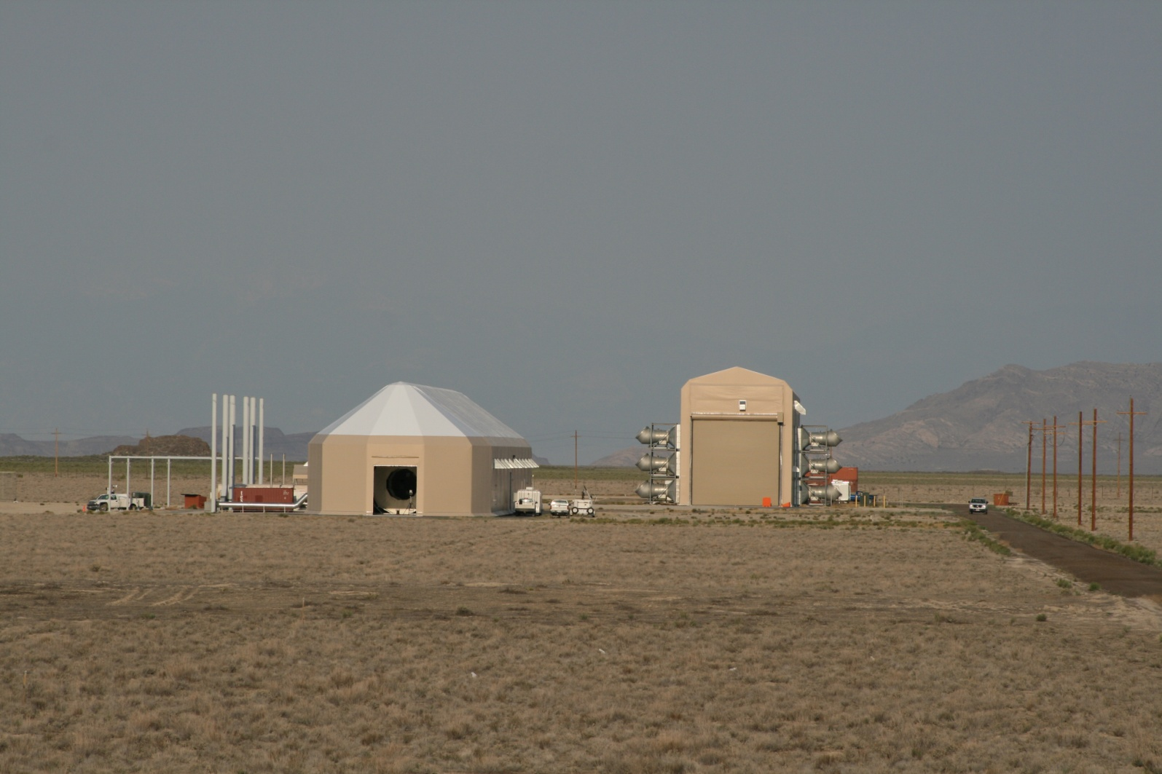
Lidar Calibration
ASC
JABT
Notes:
Provide a quasi-controlled environment where aerosol and environmental properties can be accurately monitored
These facilities are primarily used for calibration of lidar systems
They are the necessary step between the laboratory and open air testing
Allow the systems to be trusted to referee the “system under test” in the field

Slide 10
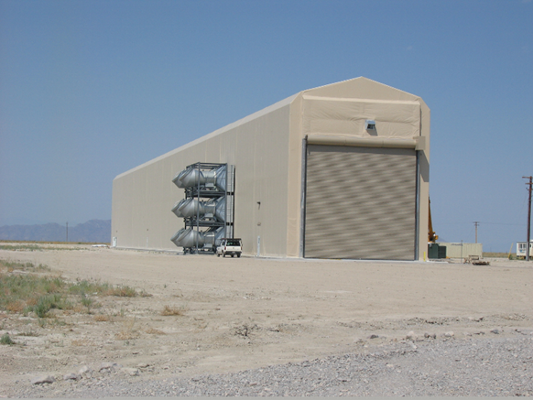
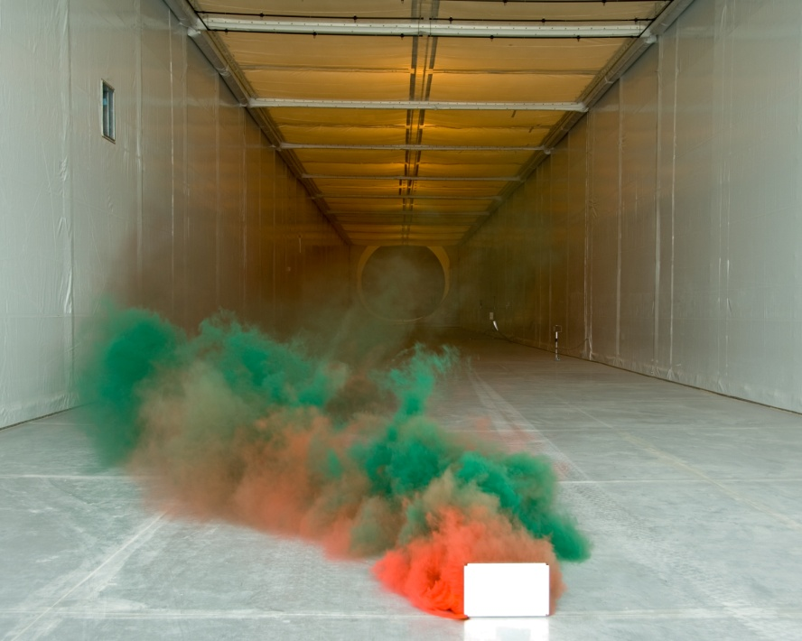
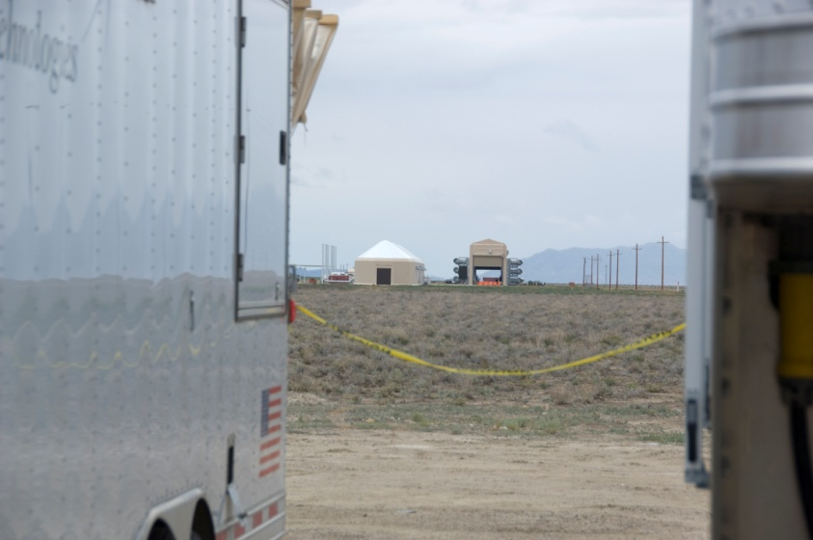
Joint Ambient Breeze Tunnel (JABT)
170 meter length
Volume, concentration control
User-selected Aerosols
Lidar placed at ~1km standoff
Instrumented with point samplers
Notes:
The purpose of this facility is to provide a real-life dynamic cloud
Tunnel air flow from 0.2 to 6 meters/second
Lidar beams are aligned directly over point samplers from a distance as seen in the photo
Many lidar systems may be calibrated at once
Multiple aerosols are tested to show lidar signal dependence on both concentration and type of aerosol

Slide 11
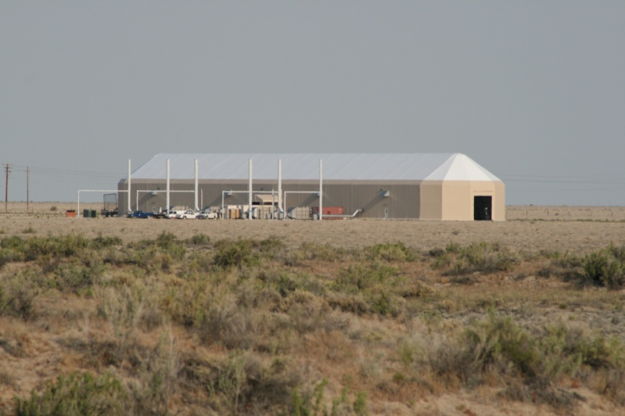
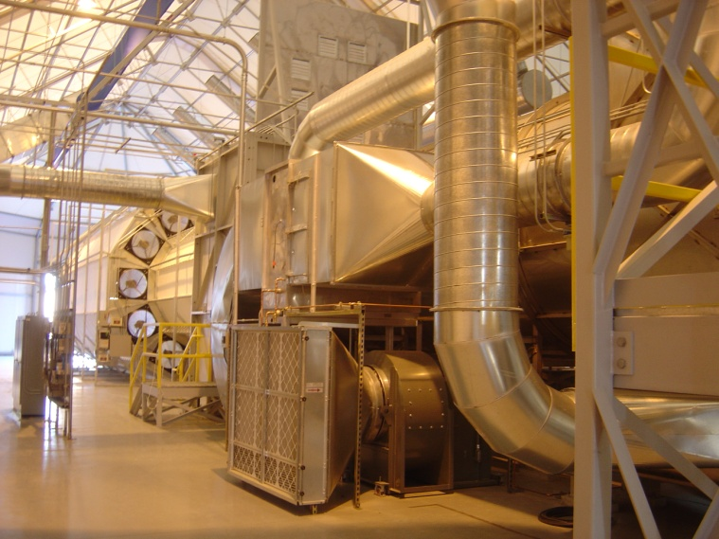
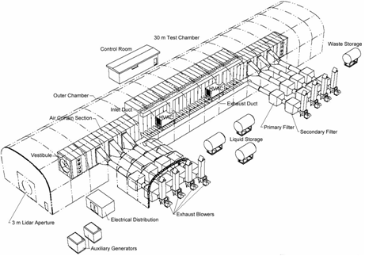
Active Standoff Chamber (ASC)
30 meter (98 ft) chamber. Static clouds with stable conditions
User-defined cloud characteristics (volume, concentration, etc.)
User-defined atmospheric conditions
Notes:
The purpose of the ASC is to provide a static / stable cloud for calibration
Aerosols are contained within the chamber using air curtains
Concentration stability of +/- 5% over 15 minutes
Facility was used recently for testing of a prototype DIAL system with Open path FTIR systems as a referee

Slide 12
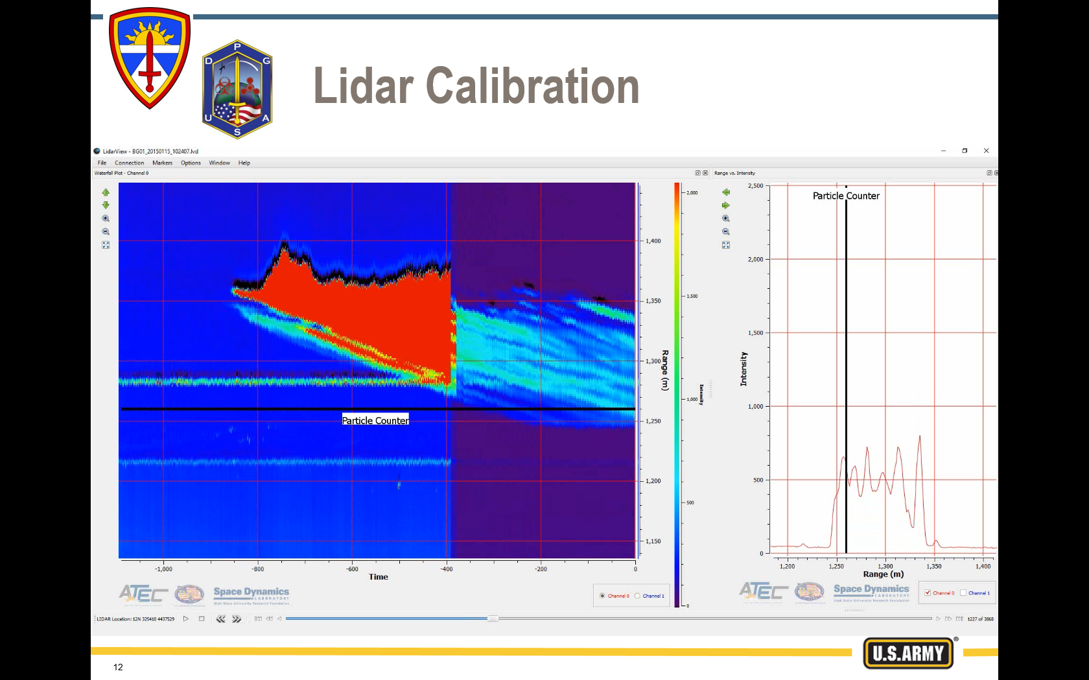
Lidar Calibration

Slide 13
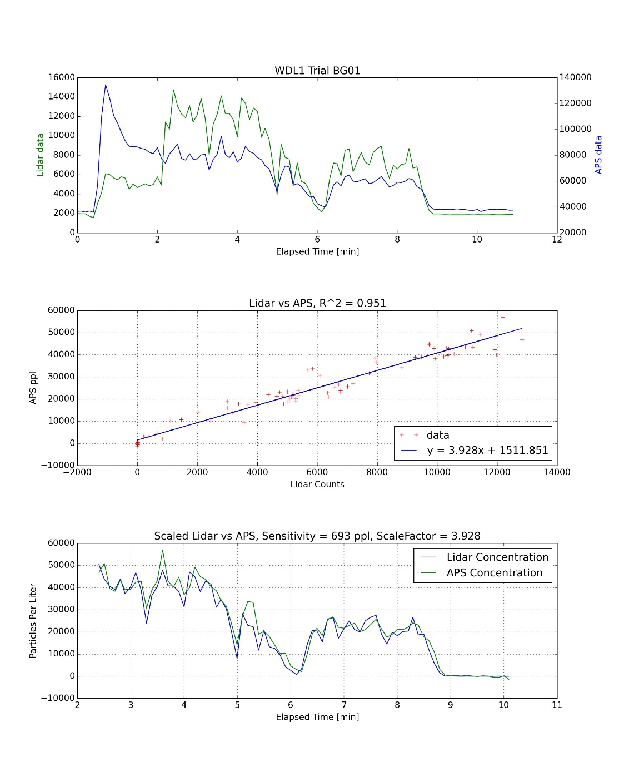
Lidar Calibration
Lidar vs Particle Counter
Plotted against each other, linear relationship determined =>
slope = scale factor
Scaled lidar and particle counter data now in the same concentration units

Slide 14
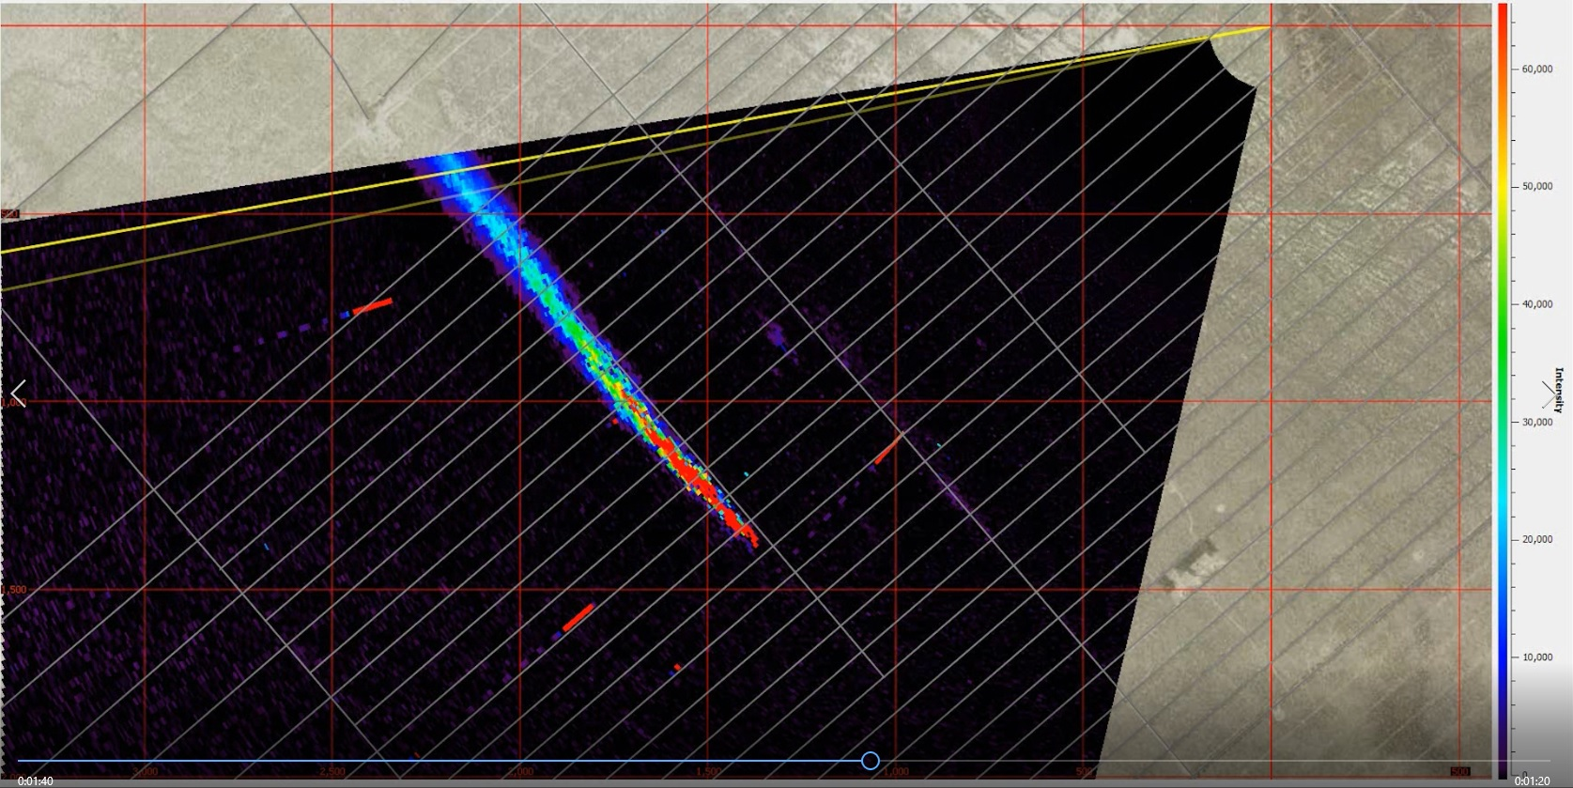
Backscatter Lidar Data

Slide 15
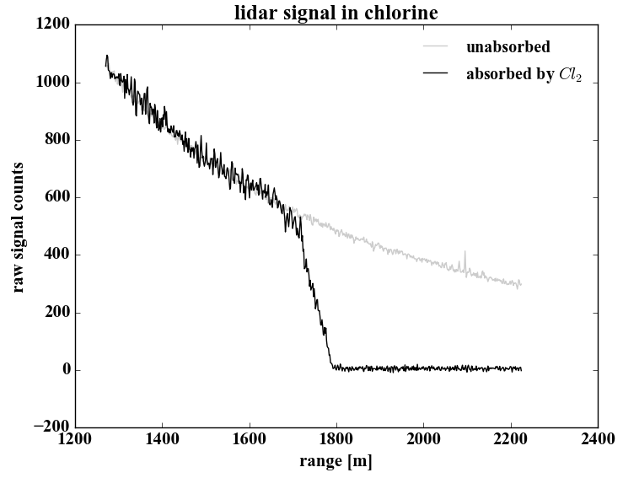
UV Lidar Data Example

Slide 16
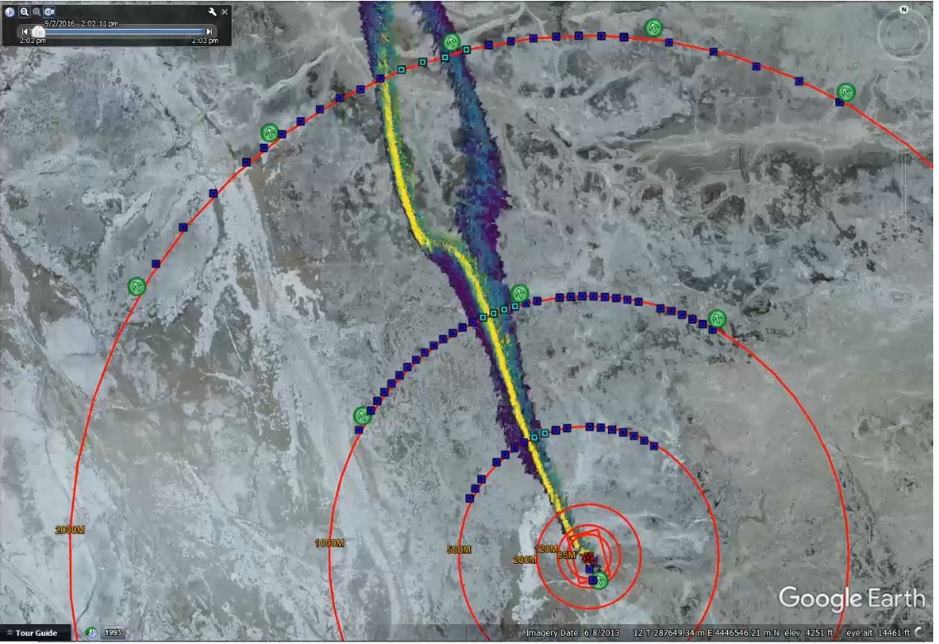
UV Lidar Data Example

Slide 17
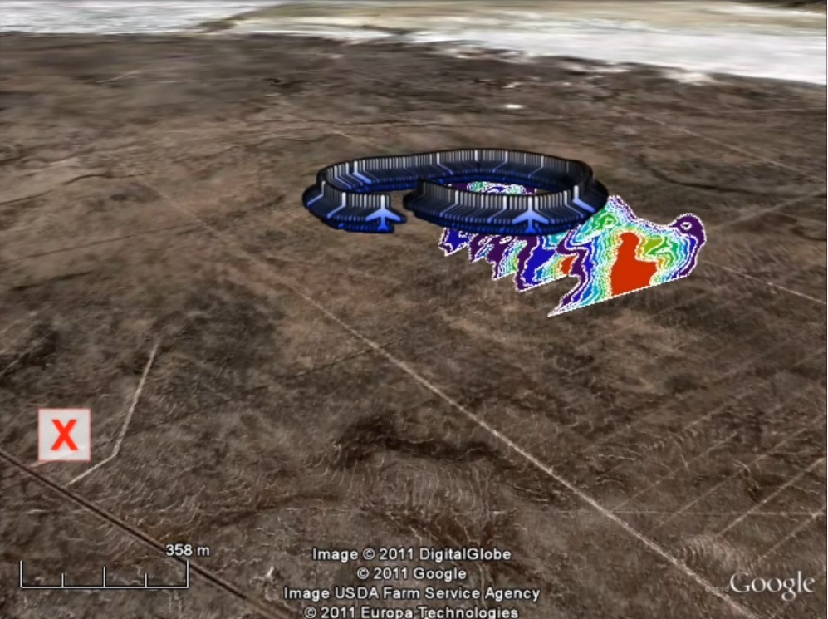
Processed Lidar Data Example

Slide 18
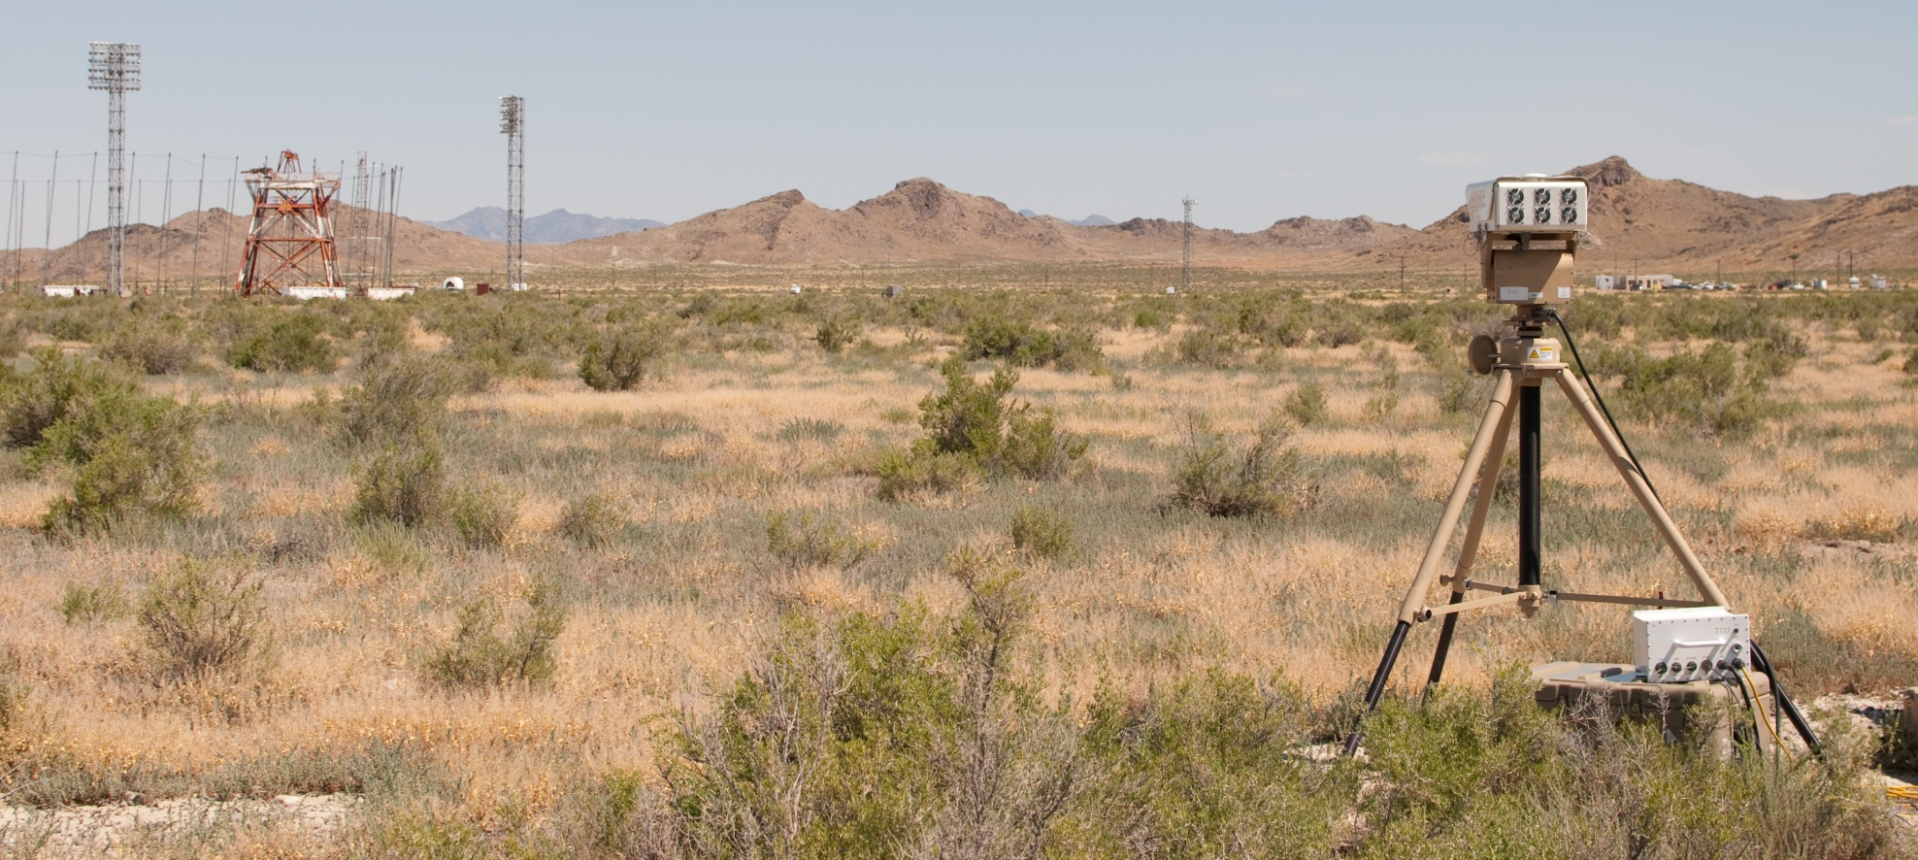
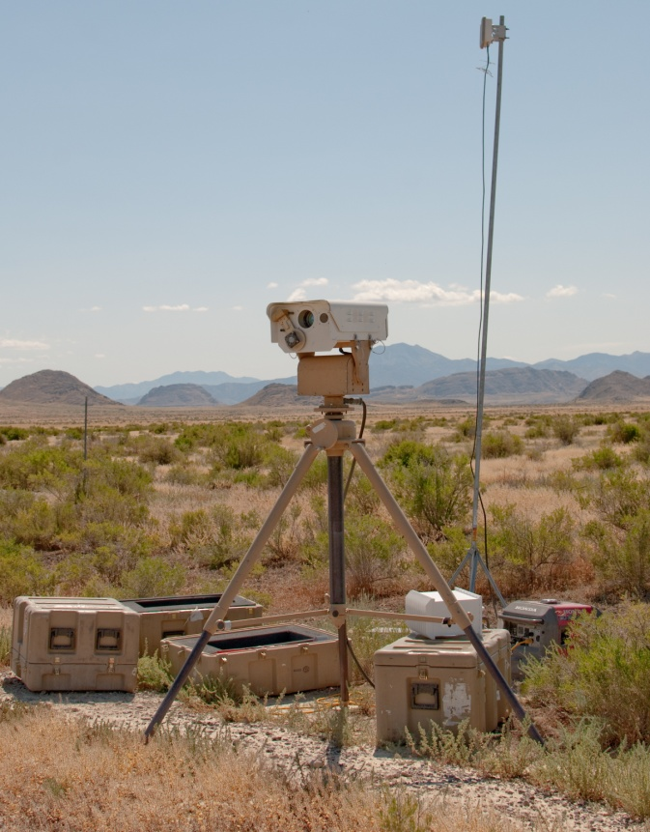
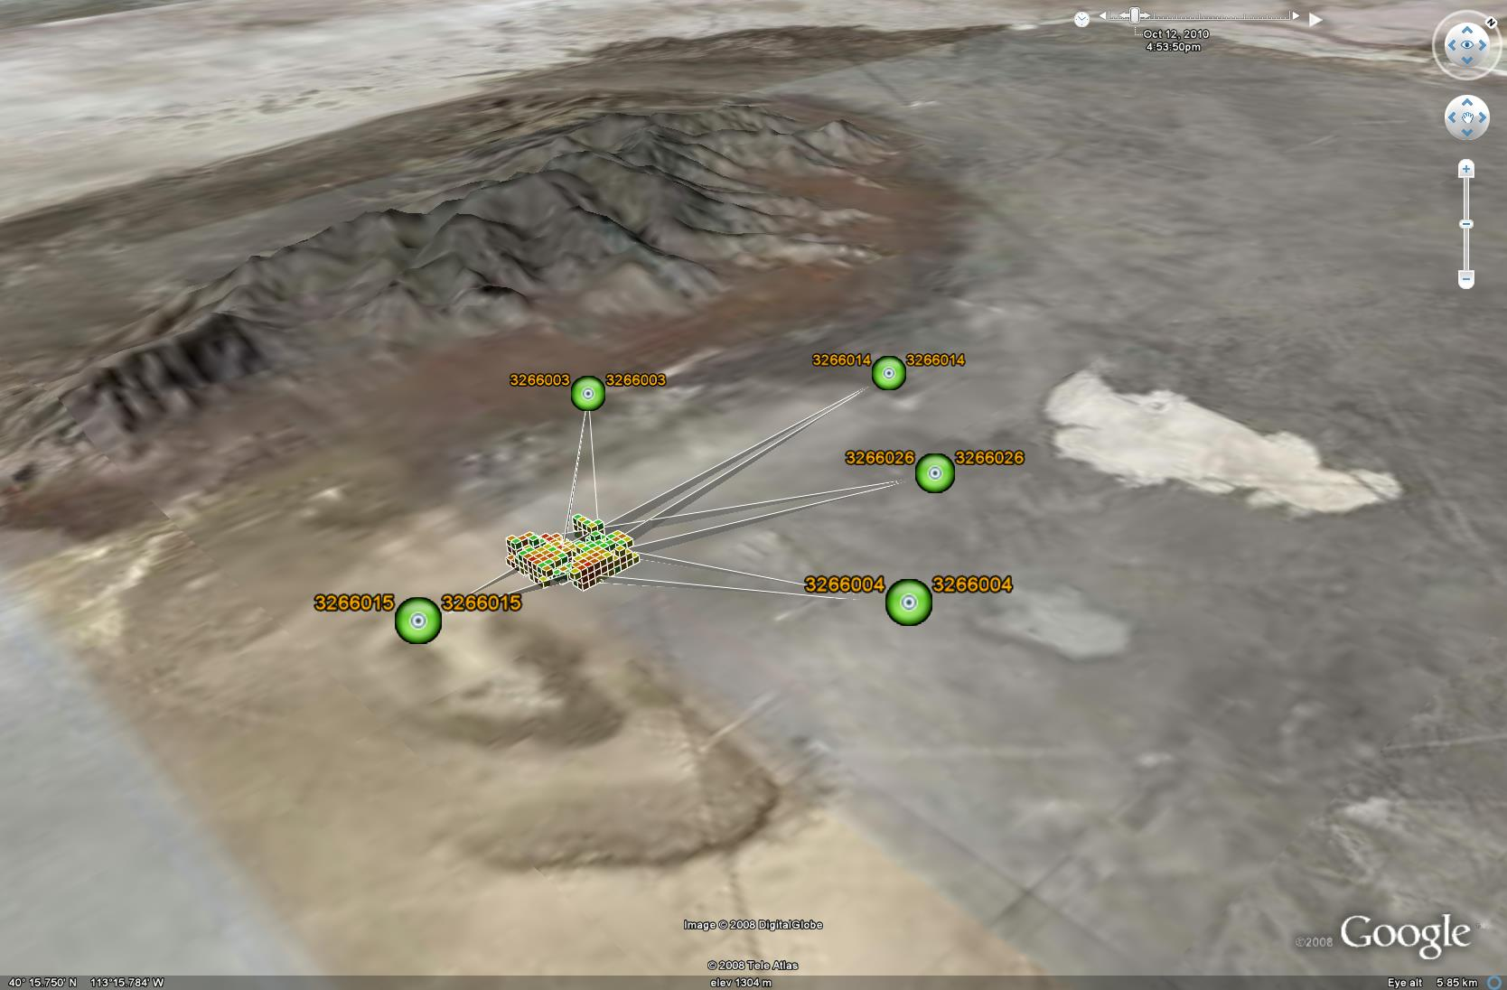
Chemical Cloud Tracking FTIR

Slide 19
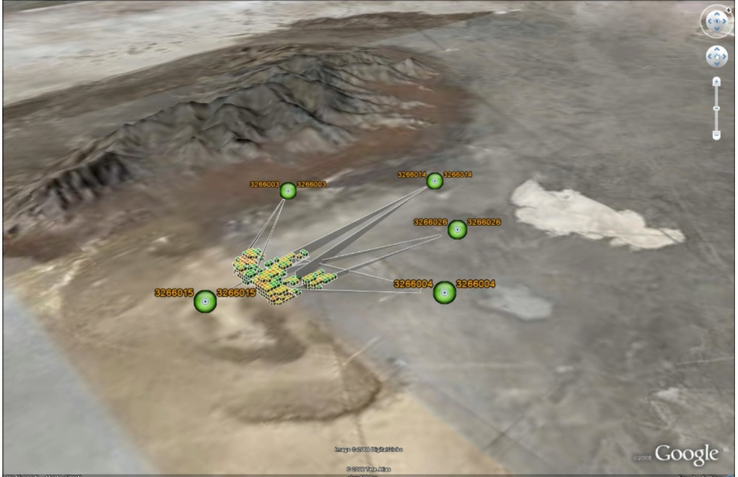
Chemical Cloud Tracking Data

Slide 20
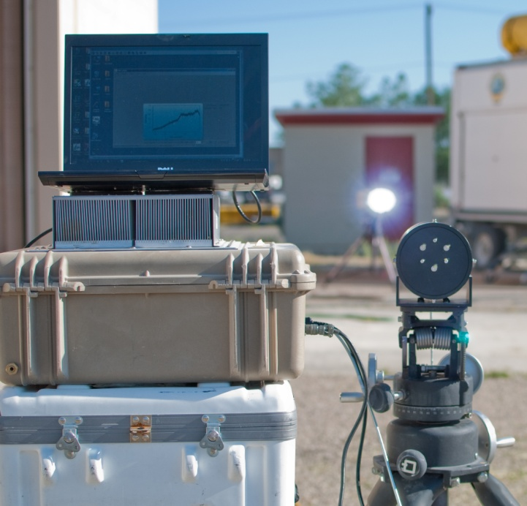
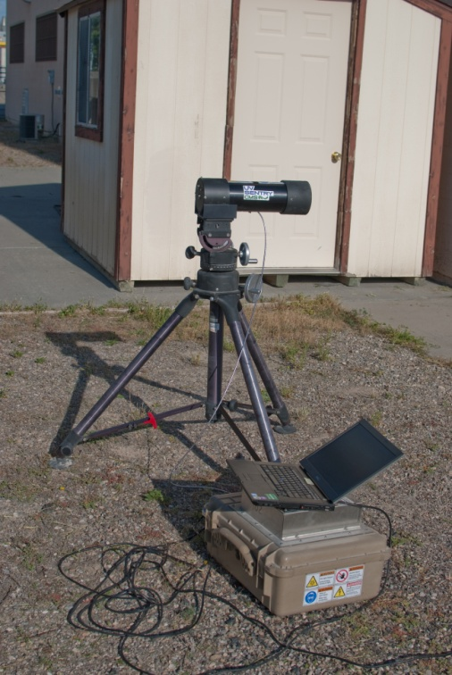
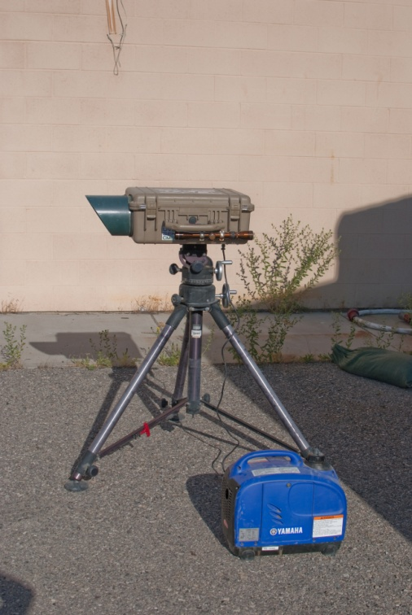
Active UV Spectroscopy
UV Sentry System
Detection of toxic industrial chemicals, where IR may be ineffective
Active source in an open-path arrangement
<1 km

Slide 21
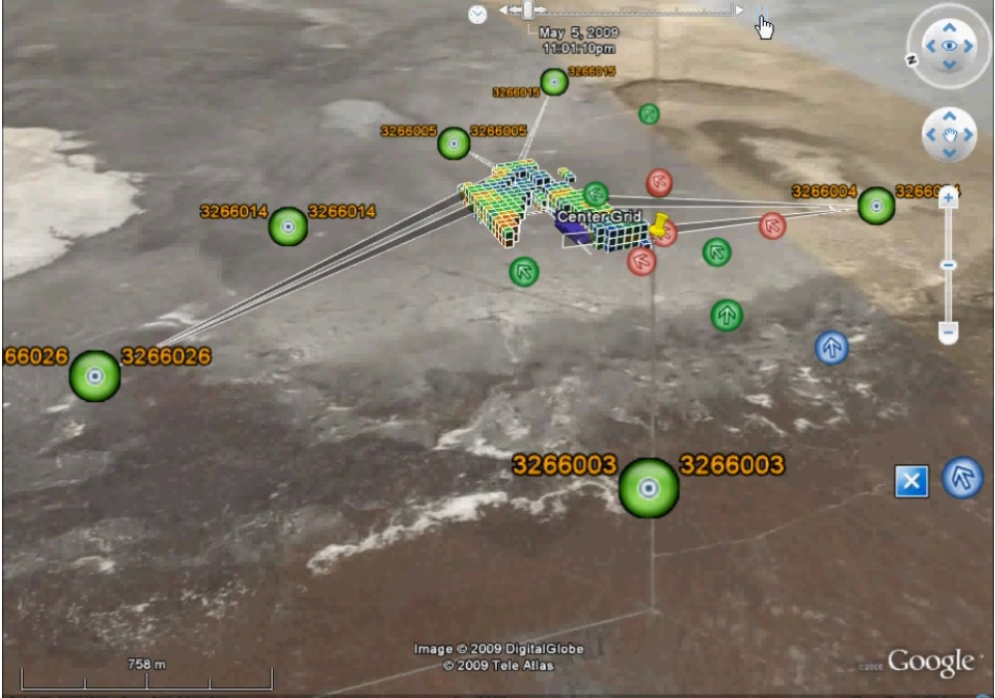
Test Data Visualization Example

Slide 22
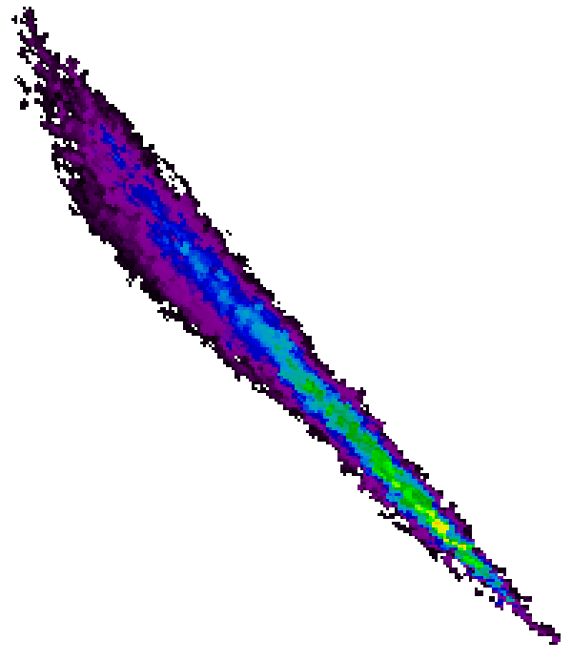
Future Work
3D-LIDAR – Combining data from multiple LIDARs (including wind maps and cloud modeling) to accurately recreate the plume release in three-dimensions, of particular interest to UAV and UGV testing
DISC/DIAL Re-design (based on future technology advancement)– Create an active standoff chemical sensor to referee chemical release
Full Field Wind Mapping (FFWM) – Develop ability to map wind fields over the grid, enhancing the data package given to the customer and feeding into dispersion/performance models

Slide 23
Future Work (cont)
Hyperspectral Imagers
One purchased in FY19
Two more units will be purchased in FY20
RATLR (Phase II)
Add four additional wavelengths
Additional particle size characterization

Slide 24
Past Relationship With BYU
SMART Scholarship Student
Student Interns (Electrical Engineering Dept)
Sponsored EE Senior Design Project
Dr. Brian Mazzeo
UV Canary Replacement

Slide 25
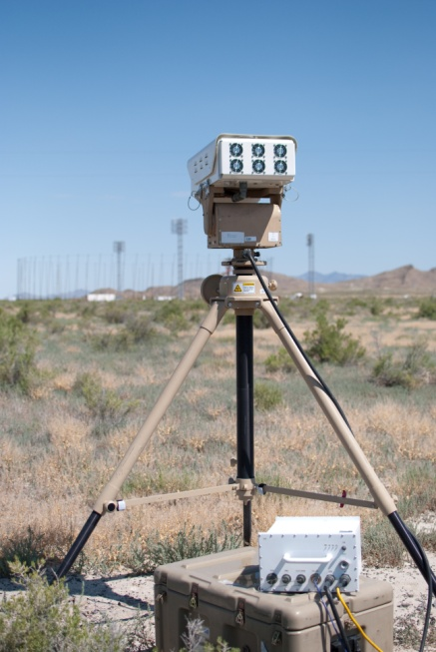
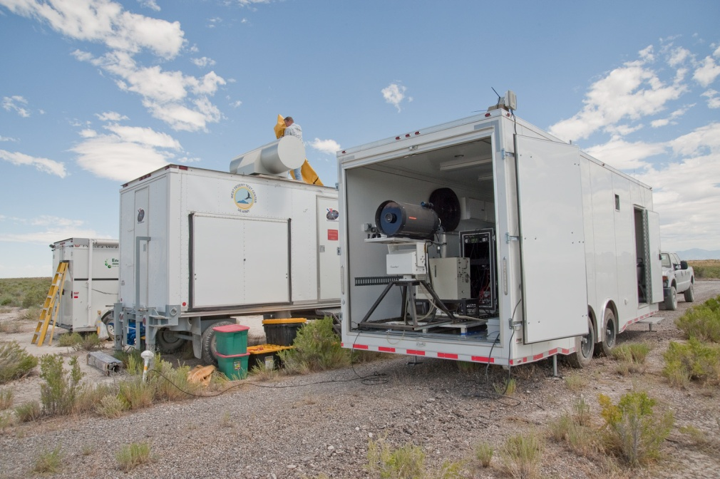
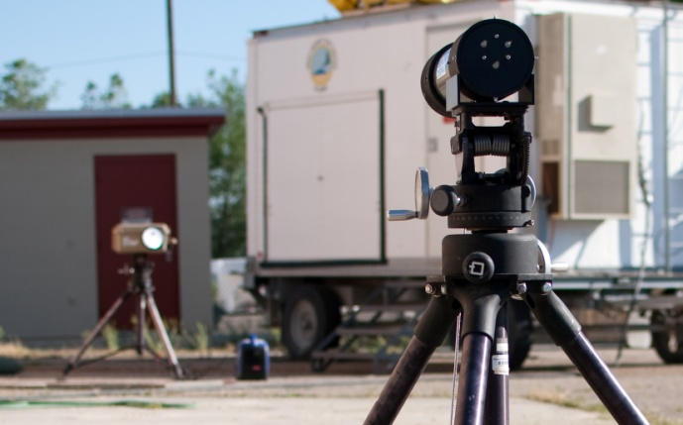
Questions??

