Slide 1
Food, Energy, Water Resources Interdisciplinary Group
November 20, 2015

Slide 2
Interdisciplinary/Collaborative Research Defined
“Interdisciplinary research (IDR) is a mode of research by teams or individuals that integrates information, data, techniques, tools, perspectives, concepts, and/or theories from two or more disciplines or bodies of specialized knowledge to advance fundamental understanding or to solve problems whose solutions are beyond the scope of a single discipline or area of research practice¹”
¹Facilitating Interdisciplinary Research Committee on Facilitating Interdisciplinary Research, National Academy of Sciences, National Academy of Engineering, Institute of Medicine, 2005.

Slide 3
Recap from last meeting and roundtable with NSF PEWs PO
The objective of our meeting was to kickoff a discussion about developing research project or projects related to the food, energy, water grand challenge
Across the colleges there is good interest, tools and expertise to develop projects
Faculty Center can provide funding support to teams with a faculty lead; colleges can come up with additional funds
RD will “manage” IDR proposal effort
With the research and tools at BYU, could address FEWs at several different levels, from the regional/global level to the local biome even to the microbial level
Need to get simulation/math, stats tools as part of the effort (clear from discussion with Jo Ann Lighty)
Could some of the BYU Global Water and other tools be used to monitor food, energy resources?
Dan Ames has a colleague who just landed a FEWs award; Dan will get a copy of the proposal
Brad, Neil and Bryan have extensive contacts at other universities with research interests related to the FEWs issues

Slide 4
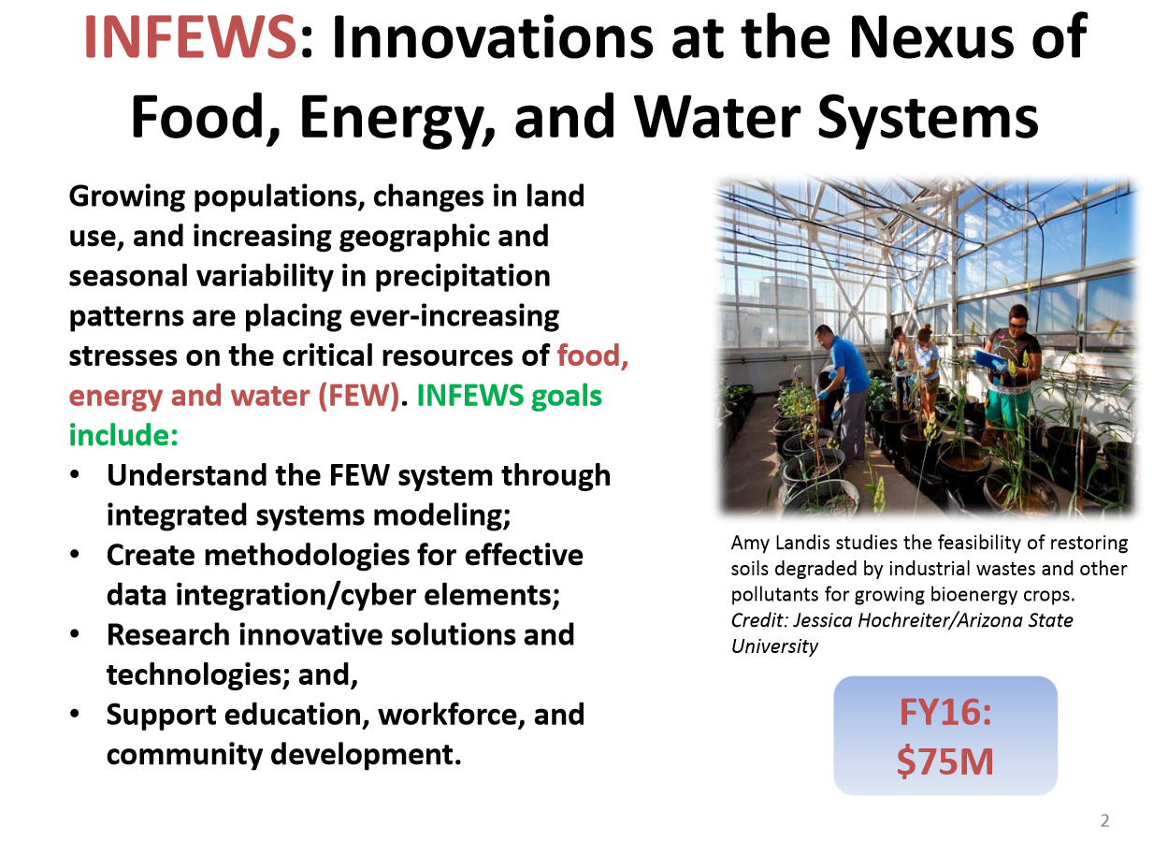

Slide 5
Potential Discussion Items for Today
What do you believe is the biggest FEW challenge related to your particular research interest?
What are the tools/approaches/methodologies to research those challenges?
What expertise/tools/approaches/methodologies are needed outside of your expertise to accomplish the research challenge

Slide 6
Participants and Potential Participants
Name | Department | General Research Interest | Food, Energy, Water Challenge Interests | Methods/Approaches/Tools
Dan Ames | Civil Engineering | Geospatial technologies; water resources | Water resources modeling | Environmental simulation and modeling; hydroinformatics
Jim Nelson | CEEn | Managing reservoir sedimentation; GIS; hydrology; water resources data dissemination tools | Water resources modeling and data collection; sophisticated water modeling | BYU global water and other tools to collect and disseminate water resources data
Norm Jones | CEEn | Ground water | Environmental water modeling; software development, sophisticated modeling of water run off, coastal environments; completed 4 year NSF EPSCOR project | BYU global water and other tools to collect and disseminate water resources data
Greg Carling | Geology | Hydrogeochemistry; hydrogeology; mercury and other trace metals in glacier meltwater; effects of groundwater surface water interactions | Water quality, nutrient and trace element cycling | Mercury analyzer, strontium isotopes, ICPS
Brad Geary | PWS | Soil microbes, plant health, genetic interactions | Soil microbes, plant health, genetic interactions | Genetic tools
Bryan Hopkins | PWS | Environmental implications of soil, nutrient, and water management of managed and wildland systems; nutrient pollution research; soil science, landscape management, environmental science | Agriculture, turf grass science, nutrient pollution issues, world wide water crises; working with church on water management; how to manage nitrogen and help plants recover from drought | Director of the Environmental Analytic Lab; tools include thermal conduction, gas chromatography analysis, phone acoustic
Neil Hansen | PWS | Transport of agricultural contaminants in overland flow; water use and conservation in agricultural and natural systems | Corn, soybeans, dry land agricultural systems; consumption of water by agriculture, | Systems level analyses; working with several companies; develop soil management practices; develop sensors, instrumentation
Matt Bekker | Geography | Tree-ring based reconstructions of hydroclimatic variables and associated atmospheric forcing mechanisms for water resources management | Tree-ring based reconstructions of hydroclimatic variables and associated | Tree ring analysis including impact of drought and historical information from tree ring data
Riley Nelson | Bio | Mongolian aquatic insect survey, aquatic invertebrate identification; freshwater ecology | Bioinformatics | Bioinformatics; lots of public and farmer outreach on environmental issues and broader impacts for NSF
Laura Bridgewater | MMB | Nuclear variant of BMP2. Gut microbiota and its effects on obesity, diabetes, heart disease, and cognitive function. | Microbiology in particular bodily systems like liver, gut, related to DNA sequencing | Bioninformatics, DNA sequencing to evaluate how water changes effect microbes causing diseases
Rollin Hotchkiss | CEEn | Hydraulics; water resources, managing reservoir sedimentation; U.S. sediment transport data; facilitating upstream fish passage
David Lignell | ChemE | One dimensional turbulence modeling (ODT), large-eddy simulation (LES), and a new technique under development, autonomous microstructure evolution (AME)
John Harb | Chem Eng | Wide range of topics of technological importance governed by electrochemical phenomena; micro- and nano-fabricated electrochemical devices
Randy Lewis | Chem Eng | Sustainable energy, biomaterials, biological interactions with nitric oxide; conversion of biomass to biofuels; biological conversion of syngas (hydrogen, carbon monoxide, and carbon dioxide) to biofuels
Jared Whitehead | Math | Applied Mathematics, Partial Differential Equations, Scientific Computing, Dynamical Systems

Slide 7
Additional Potential Participants
Name | Department | General Research Interest | Food, Energy, Water Challenge Interests | Methods/Approaches/Tools
Joseph Price | Economics | Family structure; field experiments in schools; healthy eating; habit formation; parental time investments
Eugene Cole | HS | Water and sanitation
Dennis Shiozawa | Bio | Freshwater Ecology; phylogeography of aquatic organisms in western North America
Robert Davis | Phys& Astr | We focus on nanoscale science, with an emphasis on carbon nanotubes and their respective uses
Roger Harrison | Chem & BioC | one dimensional turbulence modeling (ODT), large-eddy simulation (LES), and a new technique under development, autonomous microstructure evolution (AME)
Stephen Nelson | Geology | Response of arid groundwater systems to climate change, including structural and stratigraphic controls on interbasin flow; weathering rates of tropical islands to understand the relative importance of dissolve loads in ground water vs. dissolved and suspended loads in surface water

Slide 8
Next Steps
Site to store information?
Information about FEWs project Dan?
Information about colleagues from other universities working FEWs projects?
Detailed discussion on particular research project(s) to develop?
RD update funding opps with summaries?
White paper(s) to Jo Ann Lighty?
Tap FC for funding (needs faculty lead(s))

