Slide 1

APRIL 1, 2021
BYU
RESEARCH DEVELOPMENT
APRIL
28, 2021
Presented by Kristen Kellems

Slide 2
Today's Discussion
MAIN POINTS
Company Digest
Our Mission
How We Roll
Our Advantage
What We Offer
Top Promotions
Client Endorsements
Future Plans
Let's Talk

Slide 3

“
Networking is marketing. Marketing yourself, your uniqueness, marketing what you stand for.
THINK ABOUT IT
CHRISTINE COMAFORD-LYNCH

Slide 4


Our Mission
EXPANDING OPPORTUNITIES WHEREVER YOU ARE
Presentations are communication tools that can be demonstrations.

Slide 5
About Valiax
COMPANY DIGEST
Presentations are communication tools that can be demonstrations, lectures, speeches, reports, and more. Most of the time, they’re presented before an audience.

Slide 6

How We Roll
CONSTANTLY INNOVATING AND CREATING IDEAS
Presentations are communication tools that can be demonstrations.

Slide 7

VALUE AND QUALITY AT THE RIGHT PRICE
Presentations are communication tools that can be demonstrations.
Our Advantage

Slide 8

VITAMINS
Presentations are communication tools.
BASIC SKIN CARE
Starter Kit
Presentations are communication tools.
BASIC GYM EQUIPMENT
Presentations are communication tools.

Slide 9
40
30
20
10
Our Advantage
0
Item 1
Item 2
Item 3
Item 4
Item 5
Item 6
Item 7
EXPANDING OPPORTUNITIES
WHEREVER YOU ARE
Presentations are communication tools that can be demonstrations.

Slide 10
Item 5
20%
Item 1
20%
Our Customers
1
Item 4
20%
Item 2
20%
Item 5
20%
Item 1
20%
Item 3
20%
2
1
GENDER
Item 4
20%
Item 2
20%
Item 5
20%
Item 1
20%
Item 3
20%
2
SOCIAL STATUS
3
Item 4
20%
Item 2
20%
3
AGE
Item 3
20%

Slide 11
ROI OF INVESTORS
98%
98%
FULFILLMENT OF CLIENTS WITH PRODUCTS
Presentations are communication tools that can be demonstrations.

Slide 12
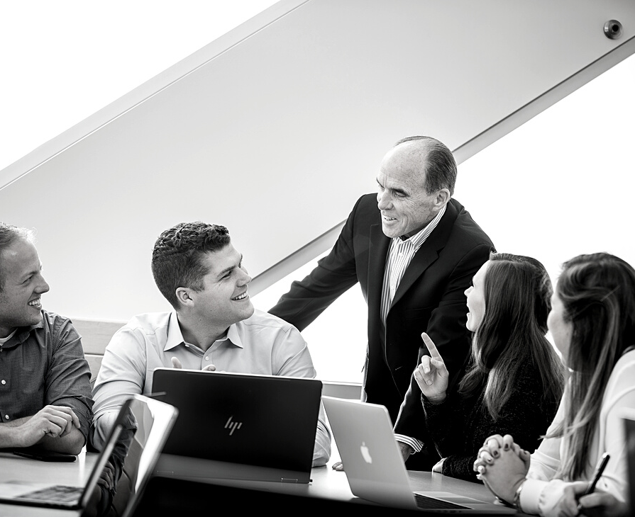
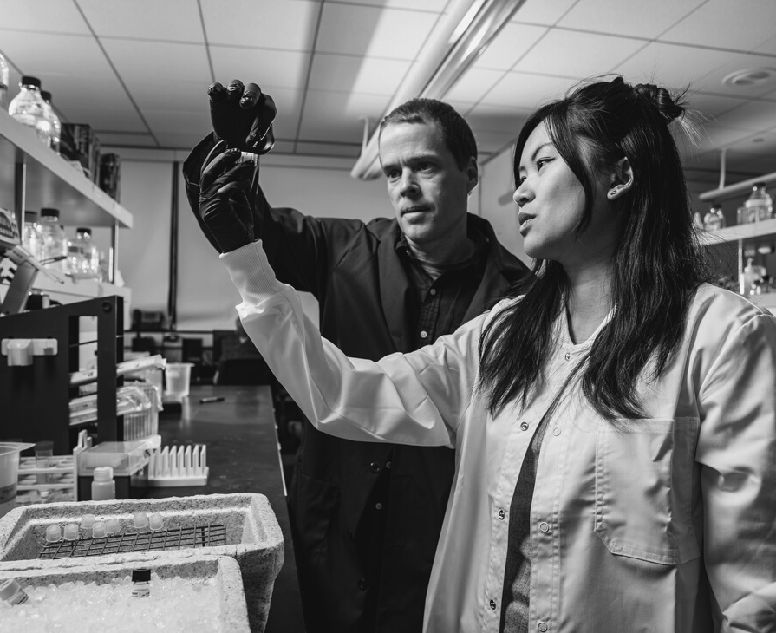
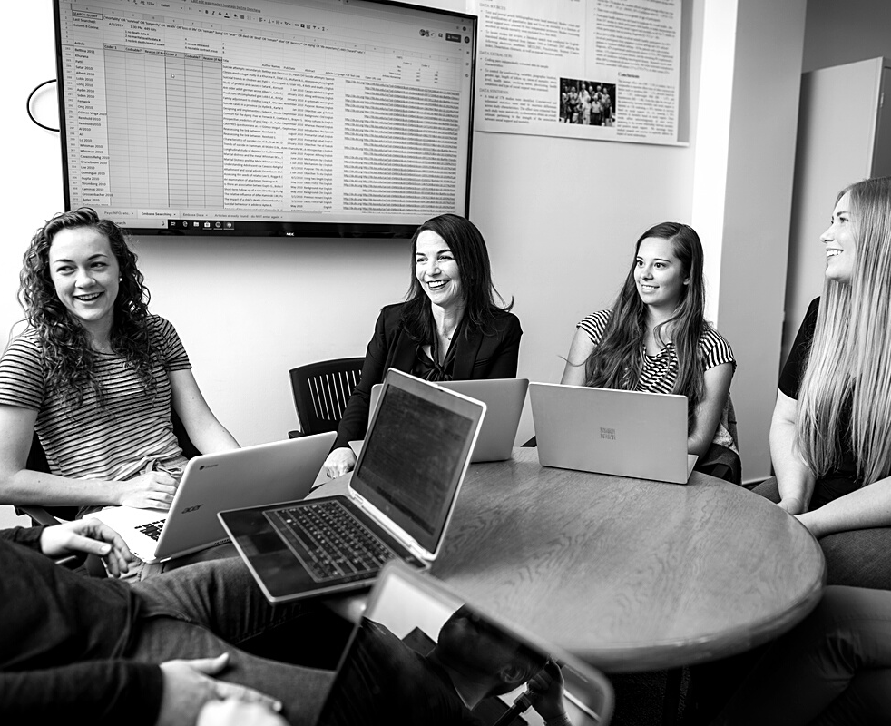
Process of Honoring Clients
STEP 1
Presentations are communication tools that can be lectures.
STEP 2
Presentations are communication tools that can be lectures.
STEP 3
Presentations are communication tools that can be lectures.

Slide 13

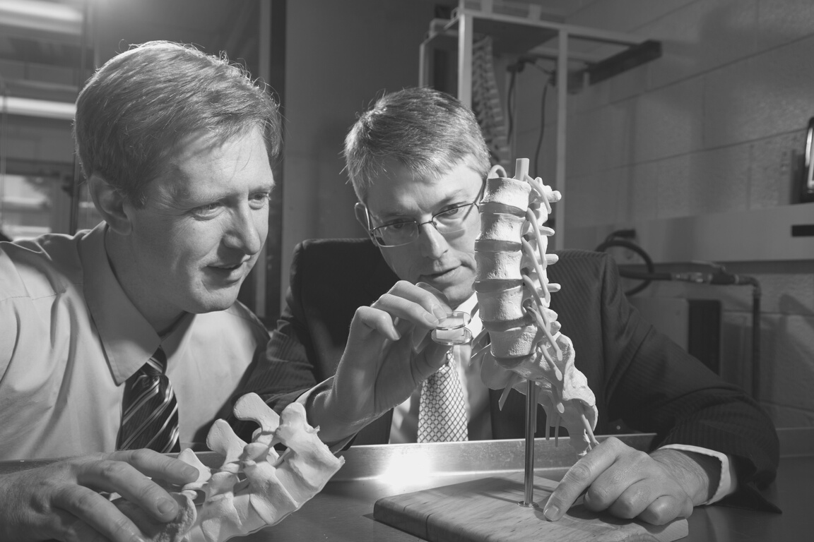


MINDY KAEPERNICK
Spinning Instructor
Presentations are communication tools.
DALE BUTTON
Client Endorsements
Dermatologist
Presentations are communication tools.
IRIS WOODROW
Athlete
Presentations are communication tools.

Slide 14
INNOVATIVE PRODUCTS
REGULAR BONUSES
Presentations are communication tools.
Presentations are communication tools.
What
Clients Can
Anticipate
LIFESTYLE CHANGES
NETWORK EXPANSION
Presentations are communication tools.
Presentations are communication tools.

Slide 15

Into the Future
WHAT'S IN STORE?

Slide 16
ONLINE SUPPORT
Presentations are communication tools.
DIGITAL REACH
Presentations are communication tools.
INTERNATIONAL PARTNERS
Presentations are communication tools.
Future Plans

Slide 17
VALIAX NETWORKING CO.
Presentations are communication tools
that can be lectures.
OTHER NETWORKING COMPANIES
Presentations are communication tools
that can be lectures.

Slide 18

Presentations are communication tools that can be lectures.

Slide 19

Proposed Timeline
NEXT STEPS
PHASE 1
PHASE 2
PHASE 3
PHASE 4
Presentations are communication tools that can be lectures.
Presentations are communication tools that can be lectures.
Presentations are communication tools that can be lectures.
Presentations are communication tools that can be lectures.

Slide 20

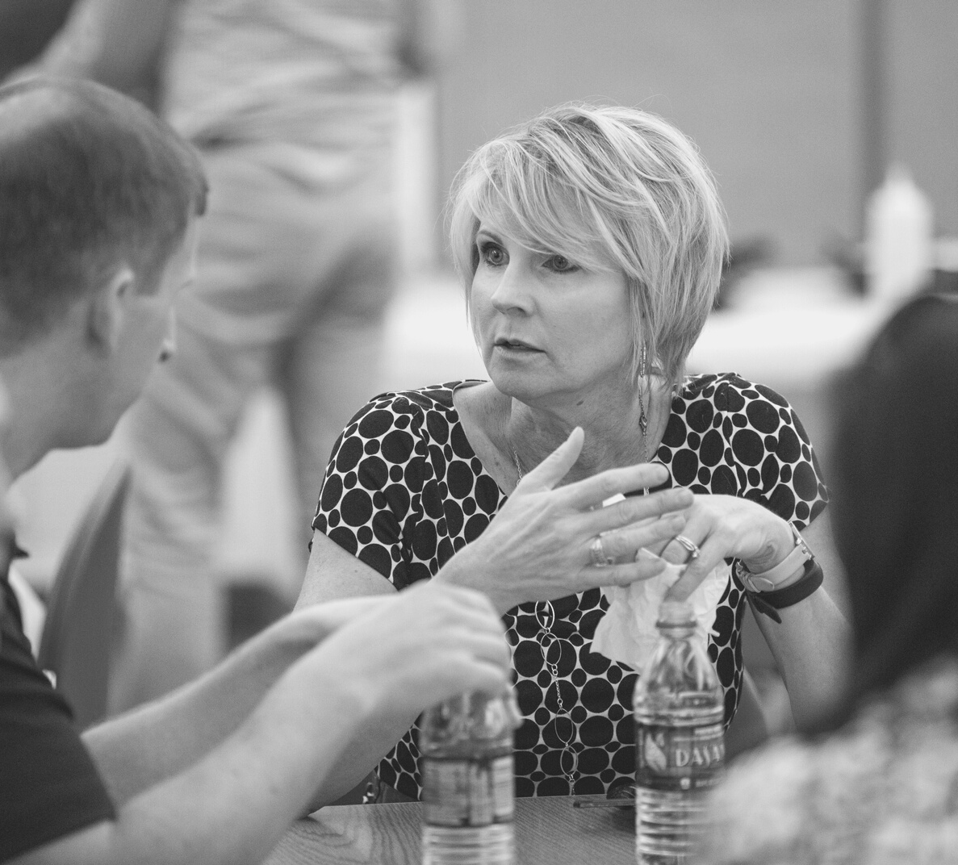
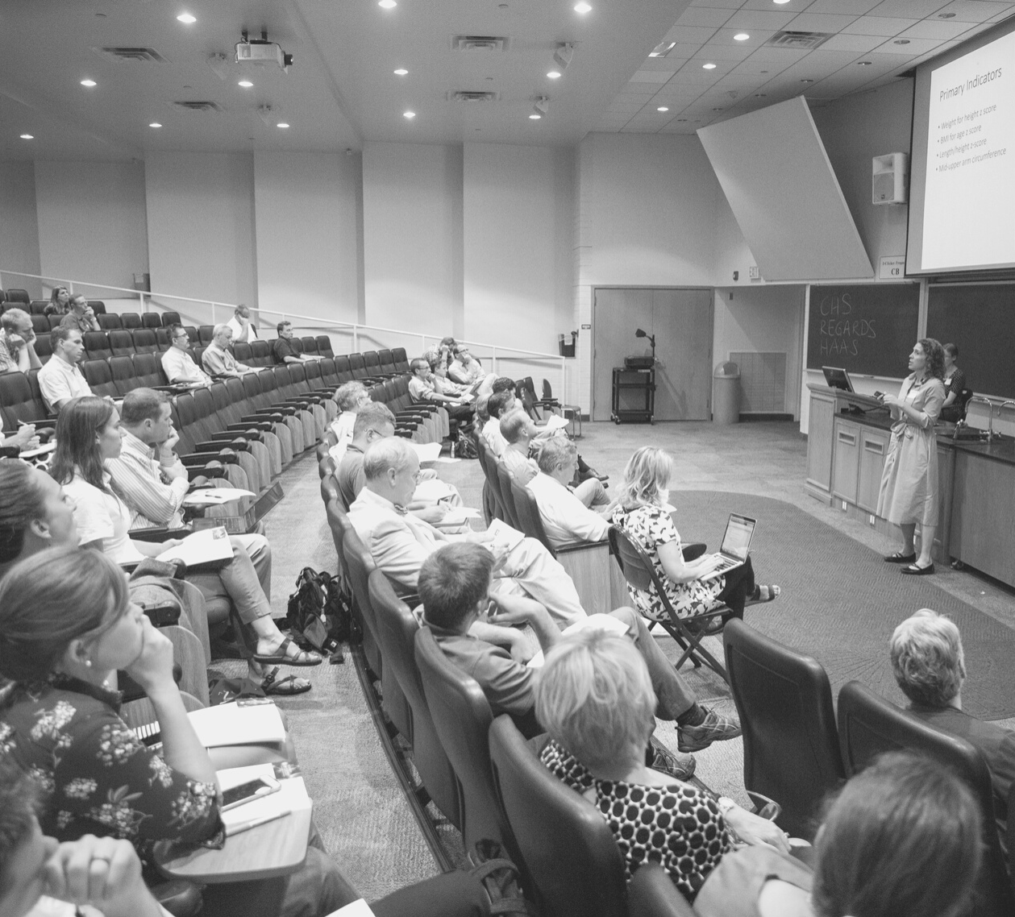
ANNUAL CONFERENCE 2019
Presentations are communication tools that can be lectures.

Slide 21
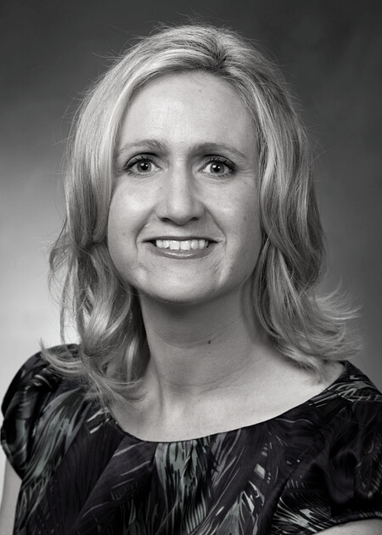
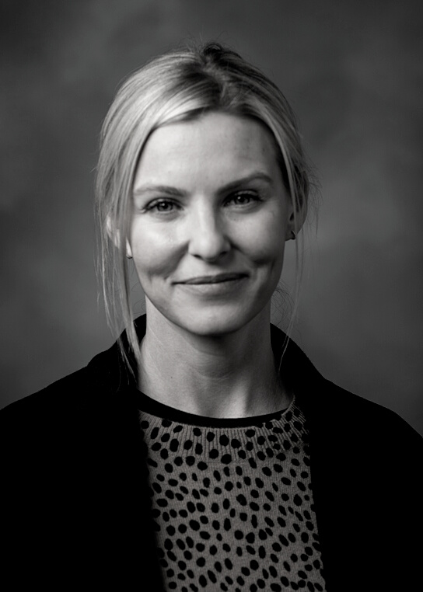
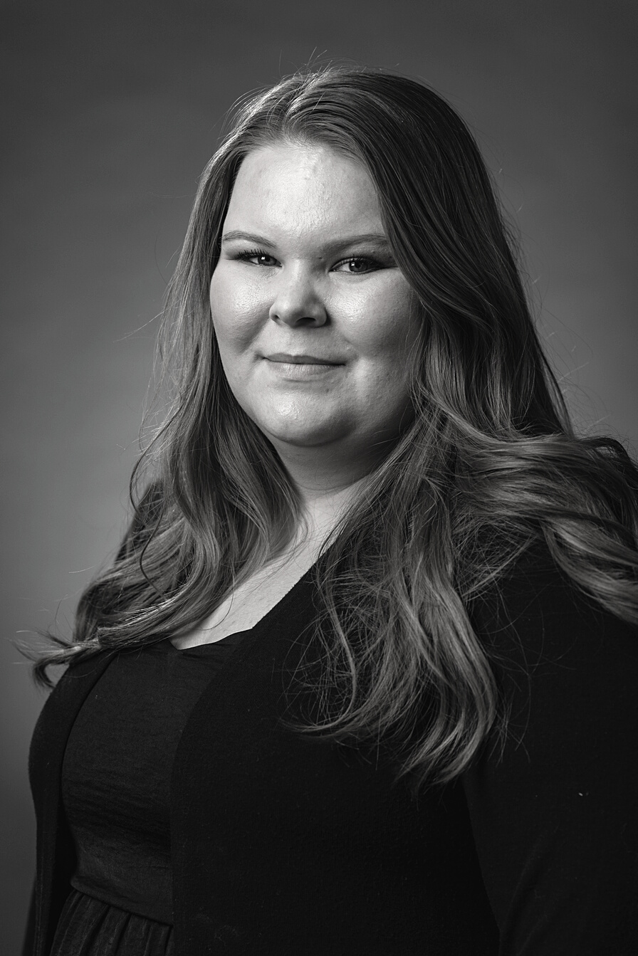
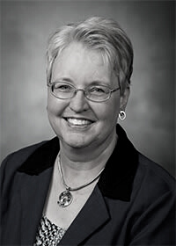

The Team
Kristen Kellems
RD Director
Info
Info
info
HEIDI JENSEN
RAMONA BISHOP
Operations Head
Marketing Manager

Slide 22
MAILING ADDRESS
PHONE NUMBER
EMAIL ADDRESS
123 Anywhere Street,
Any City
123-456-7890
hello@reallygreatsite.com
Let's Talk
CONTACT US

