Slide 1
Mentored Grant Writing Program November 6, 2019

Slide 2
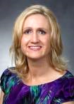

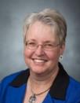
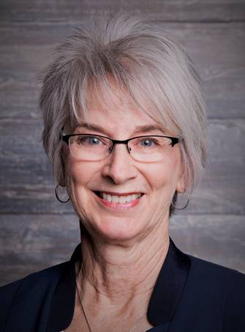
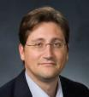
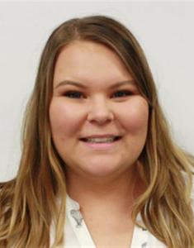
Research Development Support
Kristen Clarke Kellems
FHSS Research Development
934 SWKT
Tel: 801-422-8967
Email: fhssresdev@byu.edu
Conrad Monson
STEM Research Development
275 McDonald Building
Tel: 801-422-7722
Email: conrad_monson@byu.edu
Jaynie Mitchell
MSE Research Development
306C MCKB Tel: 801-422-3067
Email: Jaynie@byu.edu
Karen Hill
BYU Law Grants and Partnerships Manager 445 JRCB
Tel: 801-422-2684
Email: hillk@byu.edu
Jon Balzotti
English Department Faculty College of Humanities
4127 JFSB
Tel: (801) 422-2440
jonathan_balzotti@byu.edu
Kaylie Winterton
Research Development Administrator
269 McDonald Building
Tel: 801-422-0132
Email: rdadmin@byu.edu

Slide 3
Agenda
Introductions
Overview of Mentored Grant Writing Program
Proposal Writing Resources

Slide 4
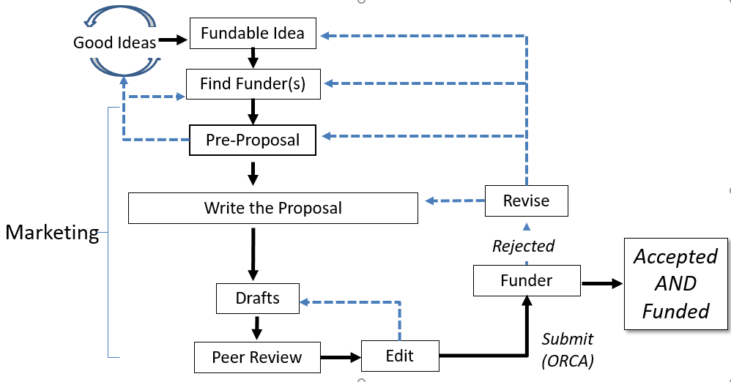
Proposal Development Process
Research Development has tools and resources to help with the steps in this process

Slide 5
Outcome of RD Proposal Support
From 2015-2018, the 59 faculty participating in 4-day proposal “bootcamps” had a 54% proposal success rate
From 2015-2018, the 24 faculty participating in RD-organized NIH intensive proposal reviews had a 54% success rate
From 2013-2014, faculty participating in RD events submitted 24-28% more proposals and received 33-40% more awards than those not participating

Slide 6
Objectives of the Mentored Grant Writing Program
Develop proposal writing skills through mentored guidance
Develop a complete proposal for submittal at the end of the program

Slide 7
Approach
From November, 2019 through September, 2020:
Provide mentors (including “at large” mentors) to faculty participants
Conduct seminars/provide information related to proposal development
Conduct proposal writing “Bootcamp”
Conduct informal proposal status and progress checks
Conclude with a complete proposal ready for submittal that has been carefully reviewed by a faculty panel

Slide 8
Resources for Finding Funding
Newsletters and website
Online funding database training
Individualized funding searches
Interdisciplinary teaming and collaborations
In-depth funding seminars

Slide 9

Proposal Writing Support
Seminars/information about proposal writing topics
Developing a fundable idea
Writing white papers
Seminars/information about specific funders
NSF, NIH, DOE, Education
DoD, DARPA, NEH
Foundations, Private Funders
Proposal review and editing

Slide 10
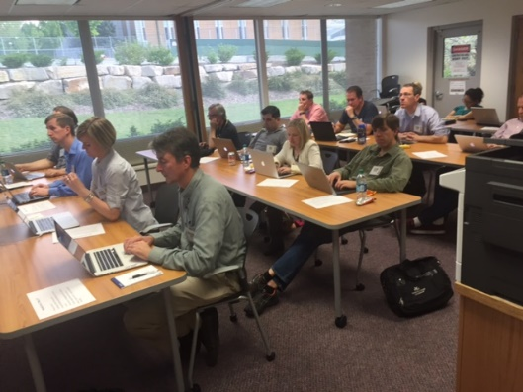
Proposal Writing “Bootcamp”
Topics
Develop proposal logic
Develop a need statement
Write proposal elements
Write persuasively
Market a proposal
Edit and re-write
Critiques on proposal progress throughout the development process
Complete a proposal draft

Slide 11
Baseline Logic
Baseline Logic is the foundation for a clear understanding of a proposal developed from a fundable idea
What is the problem you are addressing?
Current Situation
Desired Result
S₂
What does the project produce - insight, a product, and/or new knowledge - that address the problem?
S₁
B
Benefits
Benefits are the good outcomes after the desired result is achieved
90% of proposals have serious flaws in their baseline logic

Slide 12
Need Statement is Developed from Baseline Logic
Component
1. Story (Problem)/S₁ | Describe the problem: (1) context of the problem, (2) justification for addressing the problem, (3) specific aspect of problem being addressed. (Causes and Effects) Statistics: -Your own data -Info from external sources Examples: -Anecdotes -Real-life examples -Quotes
2. Plan for solving (Problem) S₁ | What questions must be answered to solve the problem or realize the opportunity? (Derived from deliverables and from themes)
3. Request for support | State the actions you want the sponsor to take immediately and resources you want the sponsor to commit

Slide 13


The Need Statement Content is Incorporated into Proposal Elements
The Need Statement thoroughly develops and describes the problem you are addressing including context and justification … develops the Situation description of a proposal
Describes Methods at a high level; informs Qualifications and Benefits
Provides the basis for the Budget you need
Need Statement Components
1. Story (Problem)
2. Plan for solving (Problem)
3. Benefits 4. Request for support
S
S
Methods
Objective(s)
2
1
Situation
B
Qualifications
Benefits
Budget

Slide 14
Develop a Final Proposal for Submittal
Develop the bootcamp proposal draft into a complete proposal for submittal
Participate in status checks and mentor reviews
Submit proposal to a panel review prior to submitting it

Slide 15
Anticipated Outcomes
Greater numbers of better quality proposals with higher proposal success rates
Expanded network of faculty colleagues for proposal review, possible research collaborations
Proposal development resources are available to more faculty

