Slide 1

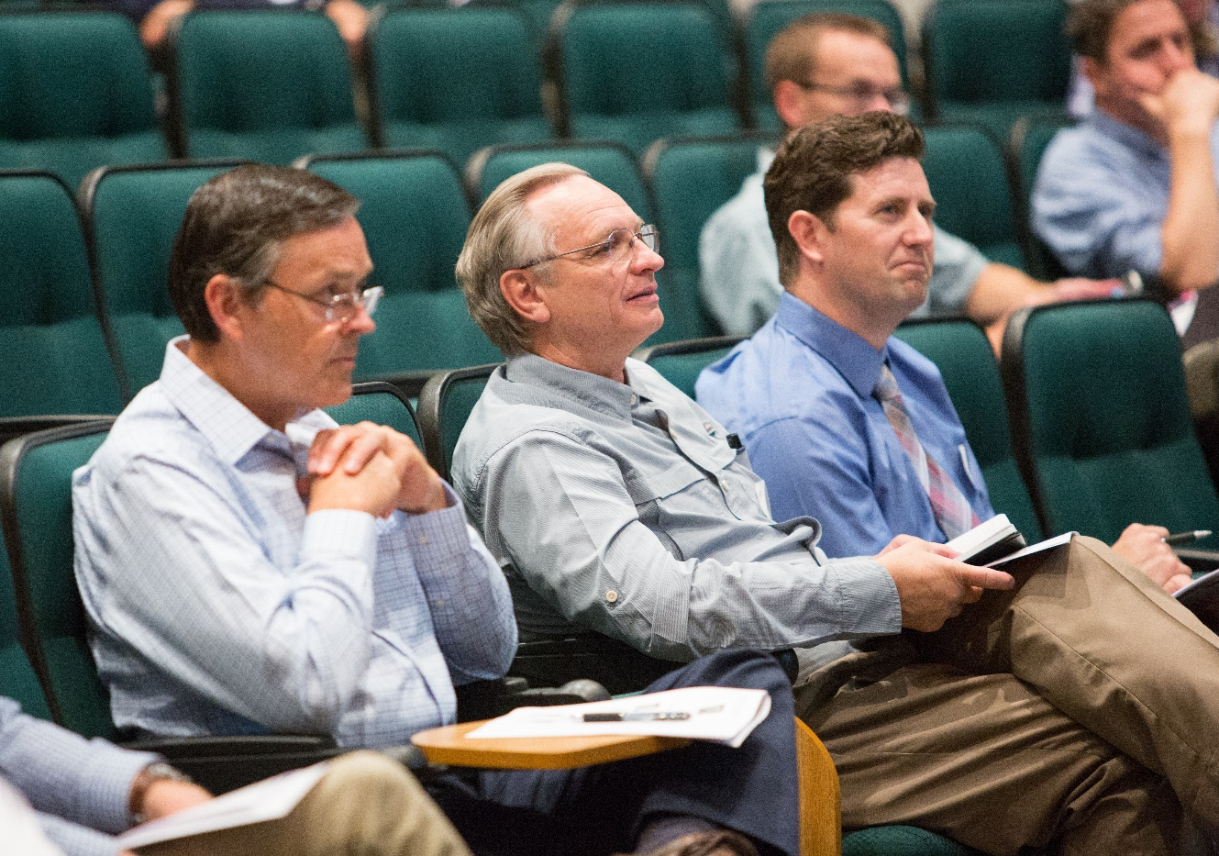
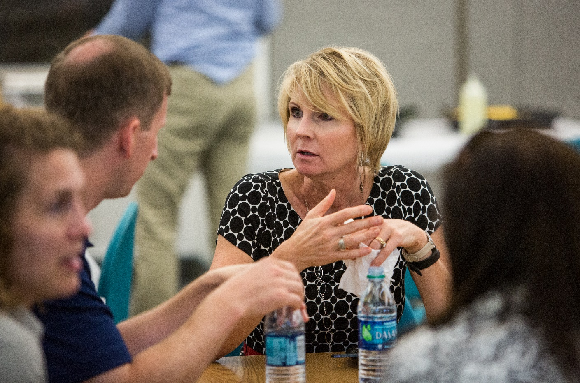
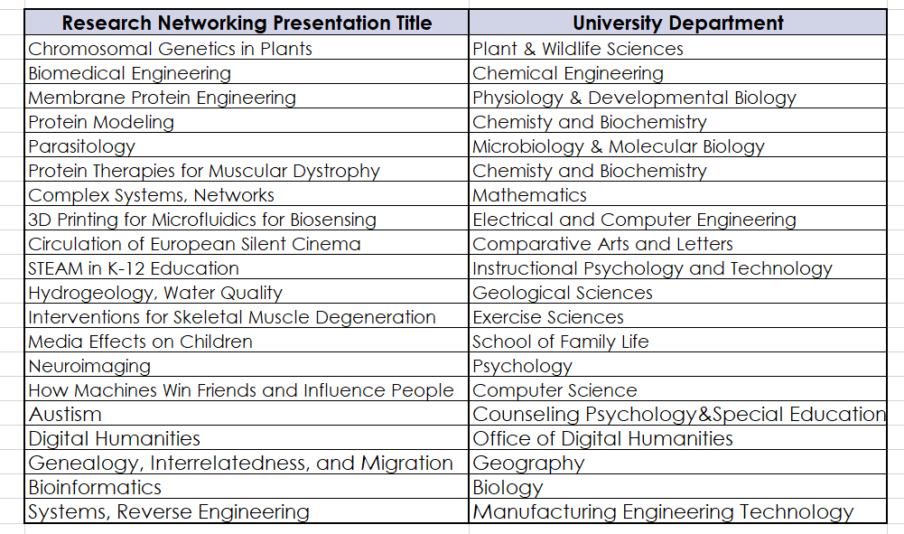

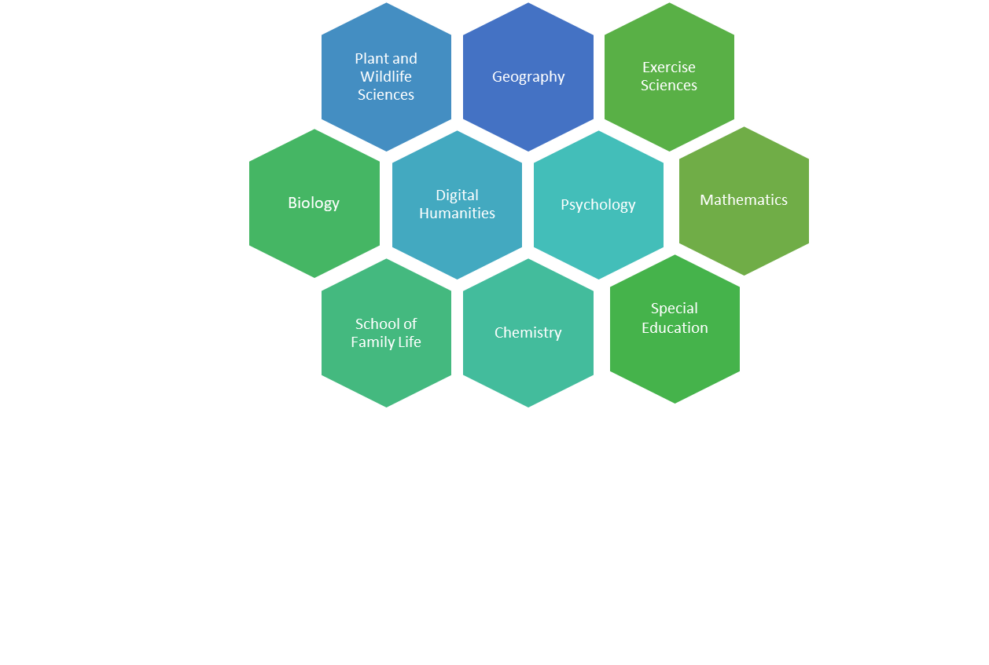
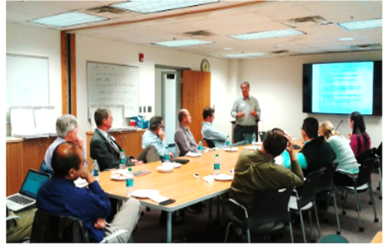



Shifting the Siloed Research Paradigm:
Facilitating Interdisciplinary Research (IDR) Teams
Jaynie Mitchell, Conrad Monson, Kristen Kellems, Karen Hill
Brigham Young University
Why IDR?
Research Networking
Seed Funding
Interdisciplinary research (IDR) is part of the new funding reality, and university faculty need research support to develop effective, innovative IDR teams, particularly at institutions like BYU which focus on undergraduate teaching and mentoring.
Utilizing these strategies, RD professionals at BYU have facilitated interdisciplinary research, resulting in increased collaboration across the university
Annual Research Networking Event
# of participants, # of colleges and # of departments represented to date
Stimulate IDR Team Formation
1st year of our competitive IDR Origination Award program resulted in 38 IDR teams. Lessons learned include:
Significant seed funding catalyzes IDR team efforts
  AAVP dedicated $720,000 ($120,000 per project over two years) in seed funding.
  After seed funding was announced, IDR activity expanded to 38 teams with over 100 participants from 36 departments in 8 colleges.
Make it easy to apply (short proposal) but require
sufficient detail to support review by non-experts
Ensure all colleges have equal chance for an award
Build an IDR future
Following the IDR competition, BYU research developers
    will continue to support teams in preparing quality external grant applications,
    work with all IDR groups to find other sources of funding and prepare for next round of seed funding, and
    facilitate the formation of new IDR teams.
Creative Space
Allocate a dedicated space that can be used by Interdisciplinary Research Teams to convene collaborative discussions.
RD Support identifies potential team members and funding opportunities, schedule and conduct meetings, manage and support proposal writing, and make facilities readily available to any IRD teams.
IDR Origination Award projects at BYU provide opportunities for student mentoring across the disciplines
Alzheimer’s Research Water Conservation
Second Language
Acquisition
Center for
Language
Studies
Statistics
Linguistics
Psychology
Digital Humanities
Faculty provide 3-minute research
presentations to other faculty
from across the university,
followed by a networking luncheon.
Research Development facilitates follow-up discussions.
Plant and Wildlife Sciences
Statistics
Agri-
Business
International Collaboration
Geography
Sociology
Psychology
Biology
BYU Research Development Team

