Slide 1

How Faculty Influencers can strategically grow your campus research culture
NORDP 2020
This Photo by Unknown Author is licensed under CC BY-ND

Slide 2
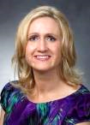

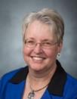
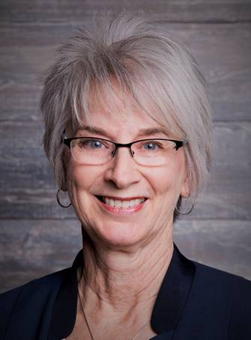
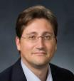
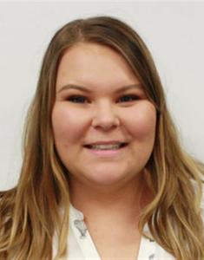
Research Development Support
Kristen Clarke Kellems
FHSS Research
Development
934 SWKT
Tel: 801-422-8967
Email: fhssresdev@byu.edu
Conrad Monson
STEM Research
Development
275 McDonald Building
Tel: 801-422-7722
Email: conrad_monson@byu.edu
Jaynie Mitchell
MSE Research
Development
306C MCKB
Tel: 801-422-3067
Email: Jaynie@byu.edu
Karen Hill
BYU Law Grants and Partnerships
Manager
445 JRCB
Tel: 801-422-2684
Email: hillk@byu.edu
Jon Balzotti
English Department Faculty
College of Humanities
4127 JFSB
Tel: (801) 422-2440
jonathan_balzotti@byu.edu
Kaylie Winterton
Research Development
Administrator
269 McDonald Building
Tel: 801-422-0132
Email: rdadmin@byu.edu

Slide 3
Agenda
Introductions
Who are faculty influencers and why are they important?
  Demonstrate best proposal writing practices
  Mentor new and early career faculty
  Actively participate in peer reviews and interdisciplinary teaming
How do you find and cultivate them?
How can they help grow your research culture?
Overview of Mentored Grant Writing Program
Proposal Writing Resources

Slide 4
The Role of Research Development on Campus
Encourage faculty to write quality grant proposals through the following:
1) Find and disseminating funding opportunities
2) Teach faculty to understand how funders think and operate
3) Master Sponsored Research Office approval processes
4) Cultivate a successful research culture on campus

Slide 5
The Age of the Networker
Since the beginning of the 21st Century, it is perceived that faculty are on the cusp, or are entering, another new time period called the “Age of the Networker.” This is a time to “preserve, clarify, and enhance the purposes of faculty development, and to network with faculty and institutional leaders to respond to institutional problems and propose constructive solution (Sorcinelli, Austin, Eddy, & Beach, 2005, p.28).

Slide 6
Objectives of the Mentored Grant Writing Program
Develop proposal writing skills through mentored guidance
Develop a complete proposal for submittal at
the end of the program

Slide 7
Why Mentorship?
Research indicates that mentorship is one of the key ways that faculty grow professionally (Cawthorne, 2016)
Our program takes informal grant mentoring and moves it into the intentional intervention
1) select and pair mentors to participants

Slide 8
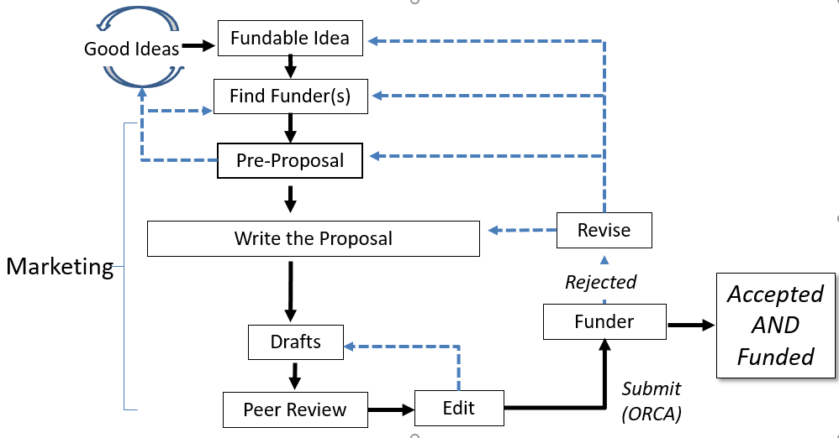
Proposal Development Process
Research Development has tools and resources to help with the steps in this process

Slide 9
Outcome of RD Proposal Support
From 2015-2018, the 59 faculty participating in 4-day proposal “bootcamps” had a 54% proposal success rate
From 2015-2018, the 24 faculty participating in RD-organized NIH intensive proposal reviews had a 54% success rate
From 2013-2014, faculty participating in RD events submitted 24-28% more proposals and received 33-40% more awards than those not participating

Slide 10
Resources for Finding Funding
  Newsletters and website
  Online funding database training
  Individualized funding searches
  Interdisciplinary teaming and collaborations
  In-depth funding seminars

Slide 11
Approach
From November, 2019 through September, 2020:
  Provide mentors (including “at large” mentors) to faculty participants
  Conduct seminars/provide information related to proposal development
  Conduct proposal writing “Bootcamp”
  Conduct informal proposal status and progress checks
  Conclude with a complete proposal ready for submittal that has been carefully reviewed by a faculty panel

Slide 12

Proposal Writing Support
Seminars/information about proposal writing topics
  Developing a fundable idea
  Writing white papers
Seminars/information about specific funders
  NSF, NIH, DOE, Education
  DoD, DARPA, NEH
  Foundations, Private Funders
Proposal review and editing

Slide 13
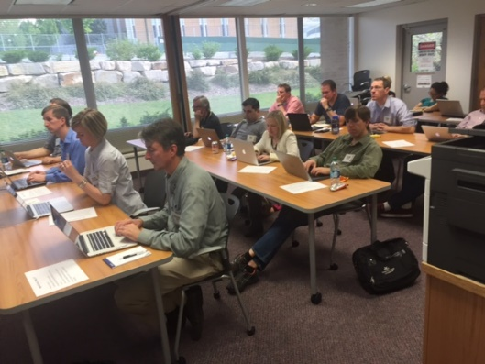
Proposal Writing “Bootcamp”
Topics
  Develop proposal logic
  Develop a need statement
  Write proposal elements
  Write persuasively
  Market a proposal
  Edit and re-write
Critiques on proposal progress throughout the development process
Complete a proposal draft

Slide 14
Baseline Logic
Baseline Logic is the foundation for a clear understanding of a proposal developed from a fundable idea
What is the problem you are addressing?
Current Situation
Desired Result
S₂
What does the project produce - insight, a product, and/or new knowledge - that address the problem?
S₁
B
Benefits
Benefits are the good outcomes after the desired result is achieved
90% of proposals have serious flaws in their baseline logic

Slide 15
Need Statement is Developed from Baseline Logic
Component
1. Story (Problem)/S₁ | Describe the problem: (1) context of the problem, (2) justification for addressing the problem, (3) specific aspect of problem being addressed. (Causes and Effects) Statistics: -Your own data -Info from external sources Examples: -Anecdotes -Real-life examples -Quotes
2. Plan for solving (Problem) S₁ | What questions must be answered to solve the problem or realize the opportunity? (Derived from deliverables and from themes)
3. Request for support | State the actions you want the sponsor to take immediately and resources you want the sponsor to commit

Slide 16


The Need Statement Content is Incorporated into Proposal Elements
The Need Statement thoroughly develops and describes the problem you are addressing including context and justification … develops the Situation description of a proposal
Describes Methods at a high level; informs Qualifications and Benefits
Provides the basis for the Budget you need
Need Statement Components
1. Story (Problem)
2. Plan for solving (Problem)
3. Benefits 4. Request for support
S
S
Methods
Objective(s)
2
1
Situation
B
Qualifications
Benefits
Budget

Slide 17
Develop a Final Proposal for Submittal
Develop the bootcamp proposal draft into a complete proposal for submittal
Participate in status checks and mentor reviews
Submit proposal to a panel review prior to submitting it

Slide 18
Anticipated Outcomes
Greater numbers of better quality proposals with higher proposal success rates
Expanded network of faculty colleagues for proposal review, possible research collaborations
Proposal development resources are available to more faculty

