Slide 1


How Faculty Influencers can strategically grow your campus research culture
BYU Research Development Coordinating Council
Notes:
Welcome – Kristen Kellems

Slide 2

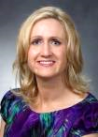
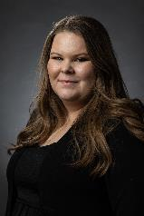
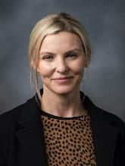
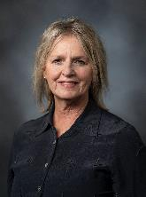
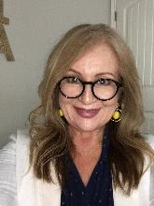
Research Development Coordinating Council
Kristen Clarke Kellems
Director of Research
Development
275 MB
Tel: 801-422-7722
kckellems@byu.edu
Kaylie Winterton
Research Development
Administrator
269 McDonald Building
Tel: 801-422-0132
rdadmin@byu.edu
Aimee Kirlew
CPMS Research
Development Officer
268 MCDB
Tel: 801-422-5818
aimee_kirlew@byu.edu
Jaynie Mitchell
MSE Research
Development Officer
306C MCKB
Tel: 801-422-3067
Jaynie@byu.edu
Michelle Prososki
CPMS Research
Development Administrator
256 MCDB
michelle_prososki@byu.edu
Rita Cortez
Humanities Research Development
3122 JKB
Tel: (801) 422-2200
Rita_cortez@byu.edu
NORDP 2021
Notes:
Team will introduce themselves

Slide 3
Research Development at BYU
Brigham Young University (BYU) is a large private faith-based R2 institution with a mission to promote
mentored research opportunities for its students
Research Development has a centralized office focused on pre-proposal/pre-award development that
  functions independently from the Research Administration (Sponsored Projects) office
  collaborates with Research Developers who support individual colleges
  fosters faculty and graduate student researcher skill sets
  promotes a campus-wide research culture
NORDP 2021
Notes:
Kristen talks about the recent transition from all decentralized to current centralized and college based model.

Slide 4
BYU Research Development Coordinating Council (RDCC)
RDCC seeks to support over 1200 faculty across campus through
research networking
interdisciplinary research team support including seed funding
faculty research mentoring
targeted funding opportunity searches
proposal writing workshop series
proposal submission support
funder-specific trainings
NORDP 2021
Notes:
Kristen – review poll results

Slide 5

Faculty
Campus
Resources
Funders
Creating a positive research culture requires RD to bring together many influencers
SPO
Innovation
RD
Champions
Mentored
Students
B&I
Partners
NORDP 2021
Notes:
Kristen - importance of culture, overview of how research culture can develop on campus. Faculty influencers are only one part of the circle of influence.

Slide 6

Faculty Influencers can help build a collaborative research culture on your campus
NORDP 2021
Notes:
Kristen - Why this topic is important – genesis of subject

Slide 7
Case Study
How can Research Development help this faculty member?
I am a relatively new Computer Engineering faculty. My area of research is on the Internet of Things (IoT). IoT is the idea of connecting everything to the Internet to collect data and control things. Doing so allows for a lot of exciting innovations.
One of the reasons I wanted to introduce myself is because I feel that my research is collaborative in nature. A lot of my work is on how to connect "things"—the more interesting the "things" that I am connecting, the better. Much value from my research comes from challenging contexts and applications. For example, I have researched air quality sensors in Mongolia. Also, I am currently working on a collaboration with the Plant and Wildlife Sciences Department and Geography Department, looking at turfgrass watering and monitoring the soil's moisture level.
My research often can supplement other fields such as environmental impact research, public health, personal monitoring, etc. I need people with exciting problems where data collection is hard to do. I wanted you to know that I am out here if someone is looking to deploy sensors and collect data.
NORDP 2021
Notes:
Kristen reviews case study and talks about how RD services should be faculty-centered.

Slide 8
Faculty Influencers extend RD’s reach and resources
received significant funding awards.
Faculty Influencers are experienced research faculty who have…av
served as PI or co-PI on large projects.
served as a proposal reviewer or project officer.
shown a willingness to share their expertise.
NORDP 2021
Notes:
Jaynie – definition of an influencer

Slide 9

Faculty Influencers are…
Networkers
Early Career Mentors
RD Networking events give faculty an opportunity to share their research and ask for collaborators
Pre-tenure faculty are paired with experienced faculty who provide support and encouragement during the proposal development process
Peer Reviewers
Research Proposal Exemplars
Experienced faculty provide a robust internal review prior to proposal submission
Faculty who have won awards are exemplars to the next cycle of proposers
NORDP 2021
Notes:
Jaynie - Where we see influencers in key roles at BYU, how RD can expand their limited resources through their influence.

Slide 10

Let’s Discuss!
How RD encourages participation in interdisciplinary projects
How RD facilitates new and early career faculty mentoring
Interactive break out rooms
How RD contributes to a culture of excellence
NORDP 2021
Notes:
Review topics for discussion, remind attendees to access the handout with the next three slides. Breakout rooms – 10-12 in each on how these areas are addressed at other institutions. Kristen and Jaynie will facilitate two rooms, Kaylie and Aimee will facilitate if needed, Michelle and Rita will attend as participants, take notes, and be prepared to share in the recap.

Slide 11
RD Encourages Participation in Interdisciplinary Projects
Hold research-focused networking events for faculty
Compile faculty research interests to help faculty find collaborators for certain topics
Provide physical space for collaboration meetings if possible
Provide seed funding or other incentives for faculty to form interdisciplinary research teams
Follow-up with teams with funding searches, peer-review panels, and skill development
NORDP 2021
Notes:
For handout – break out room topic 1 debrief

Slide 12
RD Facilitates New and Early Career Faculty Mentoring
Collaborate with institutional on-boarding efforts to include research mentoring programs
Hold intro to RD seminar for newer faculty
Hold seminars about early career opportunities
Invite new faculty to research networking events and skill development workshops
Encourage experienced faculty to include early career faculty on research teams
NORDP 2021
Notes:
For Handout – breakout room topic 2 debrief

Slide 13
RD Contributes to a Culture of Excellence
Create a repository of exemplar proposals as examples of excellence
Set up peer-review panels for specific funding opportunities or pending proposals
Highlight faculty research and awards in visible ways
Invite faculty influencers as panelists and presenters for skill building and funding opportunity seminars
NORDP 2021
Notes:
Break out room topic 3 debrief

Slide 14
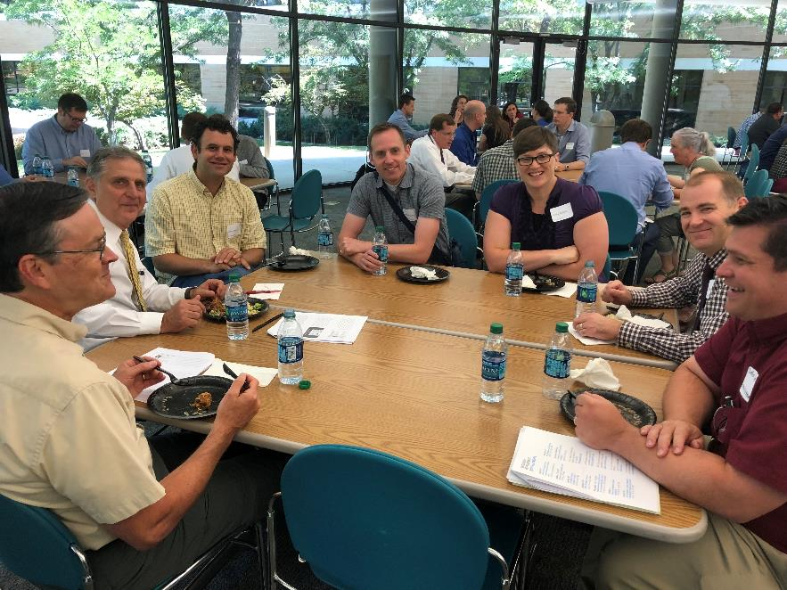
Identify
Support
Know your faculty and their research
Expand RD touchpoints throughout the research cycle
Connect
Energize
Provide robust opportunities for faculty to network and mentor
Encourage and celebrate research efforts at all levels
NORDP 2021
Notes:
Summary – Jaynie
What can you do to add faculty influencers to your resource list?
Review each of these areas – ask for input and suggestions

Slide 15

Questions?
Contact us at RDAdmin@byu.edu>
NORDP 2021
Notes:
Q & A

Slide 16


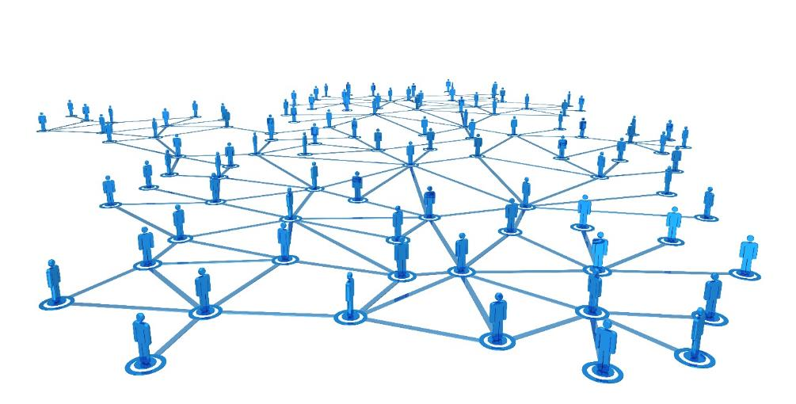

_{NORDP 2021}

