Slide 1

Establishing RD Networks To Foster
Cross-university Collaboration
13th Annual Research Development Conference ● May 3-6
Notes:
Katie leads us into our presentation!
Point to the first poll in NORDP conference system: “Do you have an RD network at your institution?”

Slide 2

How We’ll Spend This Time Together
Introductions to the Panel
Panelists Tell Their RD Network Stories
Prepared Panelist Questions
Open Discussion & Audience Participation
NORDP 2021

Slide 3

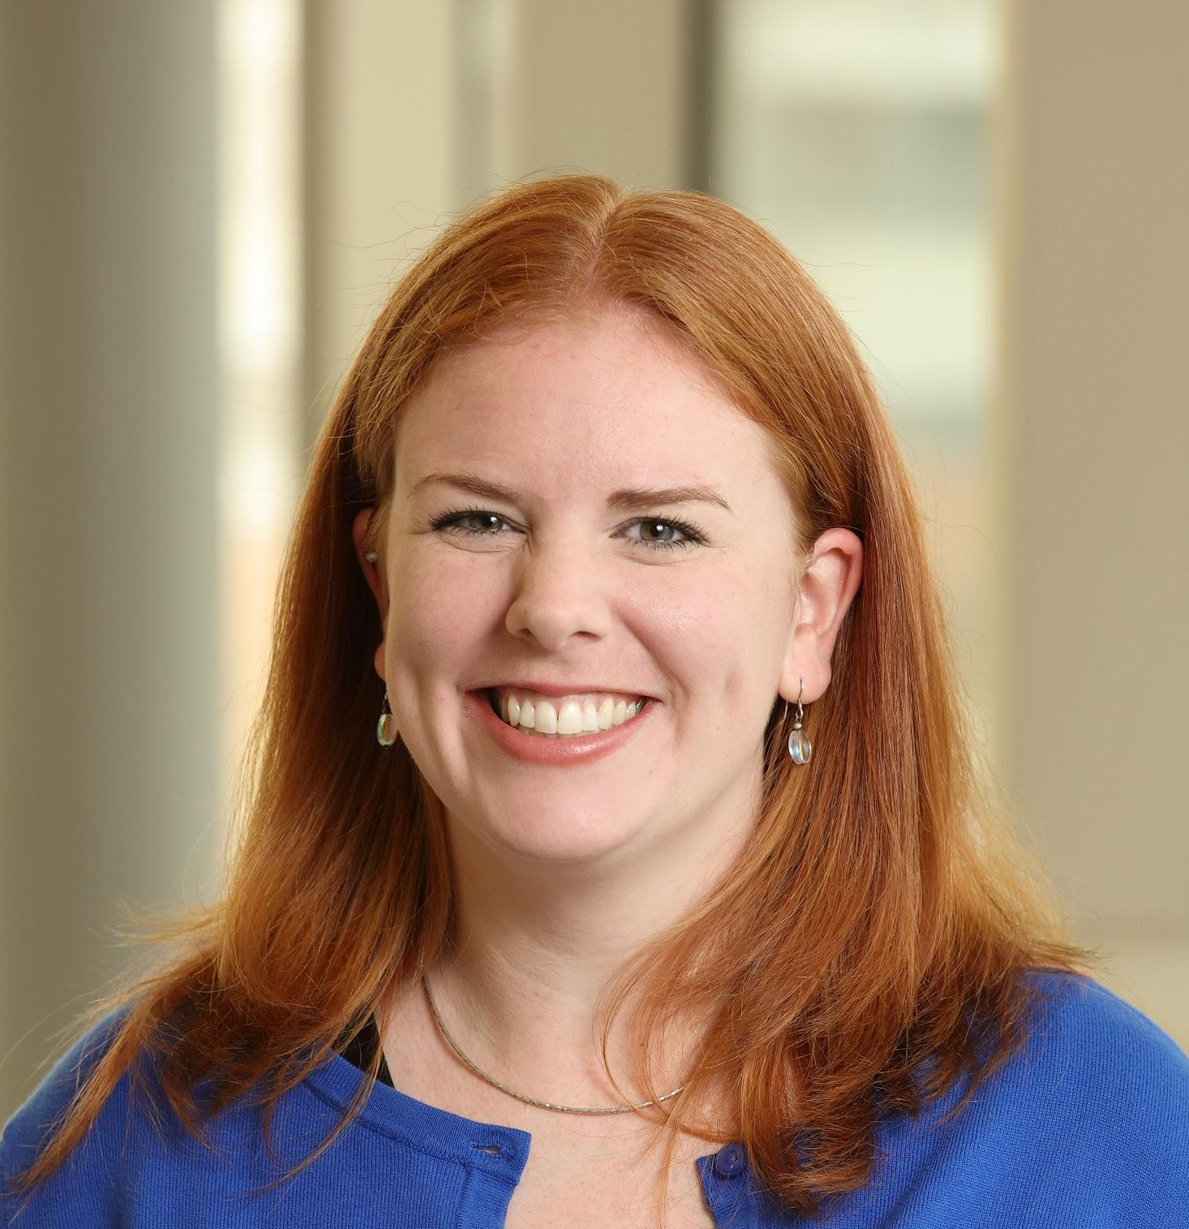
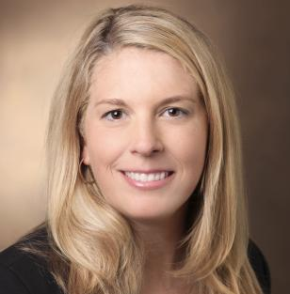
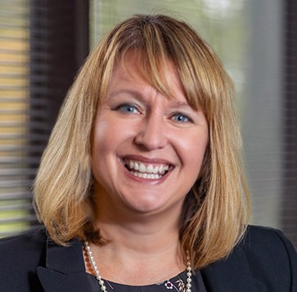
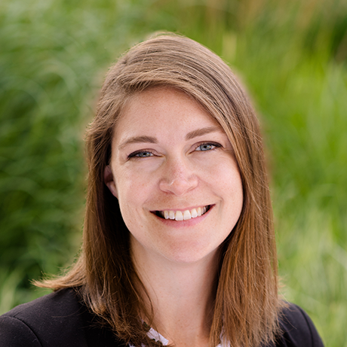
Speakers
Katie Pelland
University of Virginia
Becca Latimer
University of Virginia
Jill Jividen
University of Michigan
Jessica Brassard
Michigan Technological University
NORDP 2021
Notes:
Name, position, university, how long in RD, how long in NORDP

Slide 4

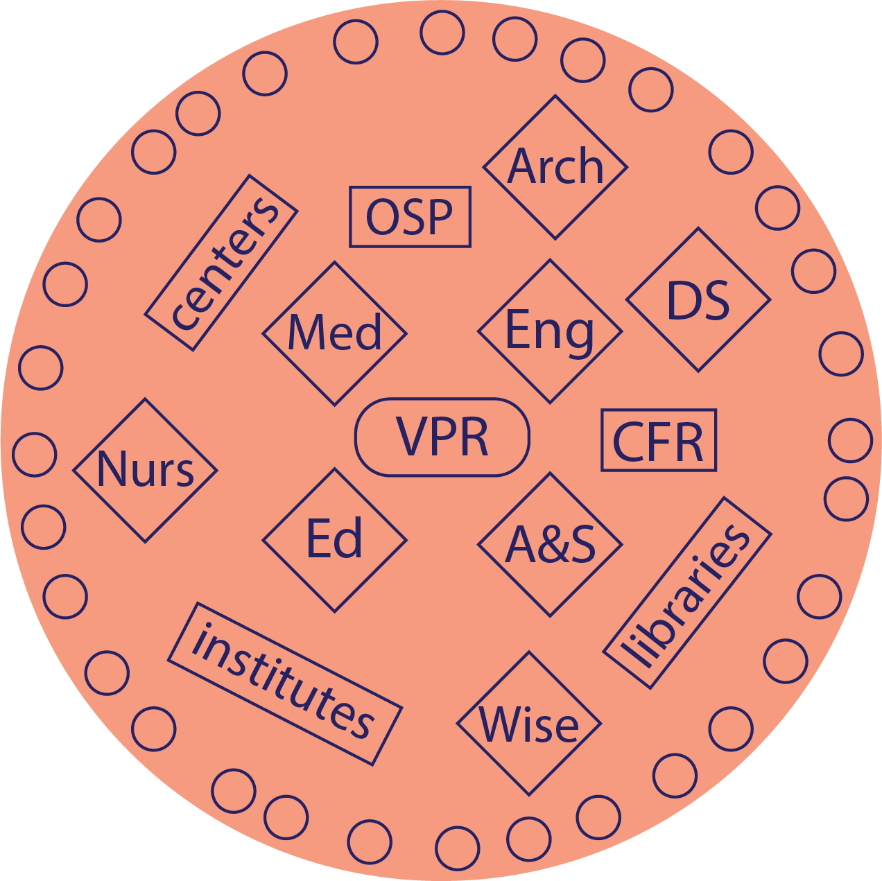
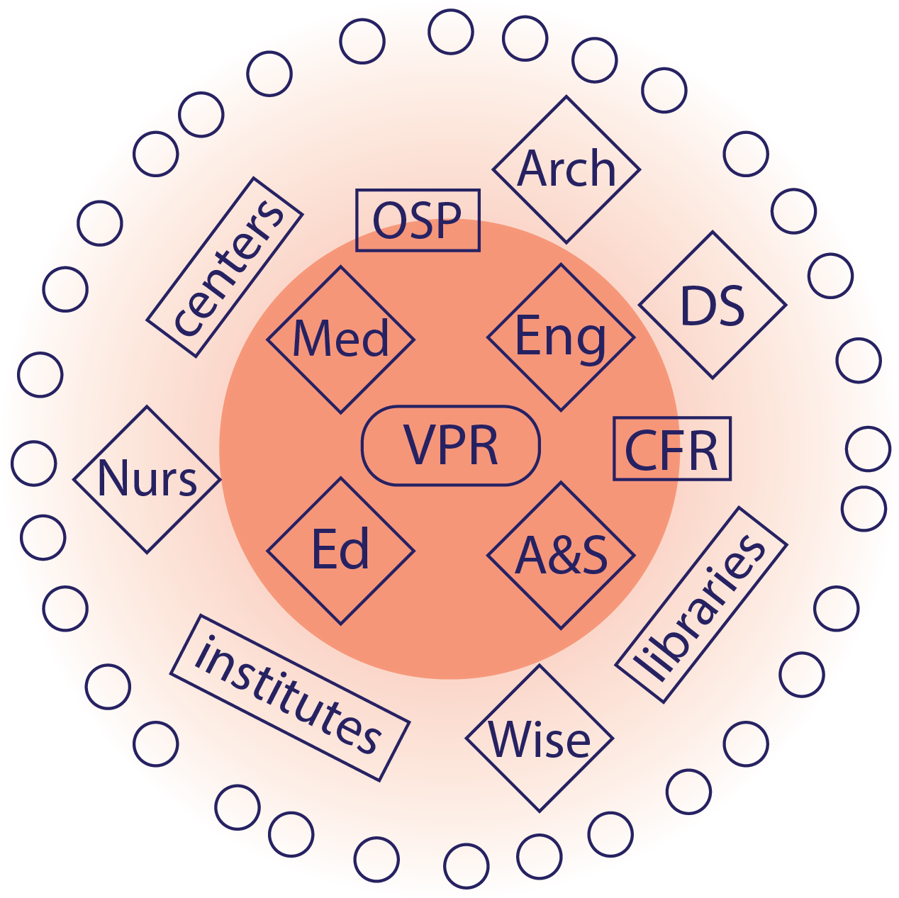
University of Virginia
2016: Research Net established
1–2 reps from each research school
October 2018: Community of practice for RD
Open to anyone working to advance RD
Includes RD professionals and others in research
April 2019: CoRD Charter adopted
September 2020: Reassessment of CoRD priorities and goals
Highlights:
2-person planning team rotates every 6 months (pre-pandemic)
Responsible for monthly meeting agenda
NORDP 2021

Slide 5
University of Michigan
RD listserv
(140 ppl)
Highlights:
Started building network in 2014 (4-6 people)
  Decentralized campus
2016: first RD half-day conference (~50 people)
  2017 & 2018: annual conferences attract 150-180 attendees
2019: OVPR invests in central RD team; move to hybrid model
  U-M hosts NORDP Great Lakes Regional Conf (180 attendees)
2020: Move to incorporate more formal structure with bylaws
  RD Community of Practice (RDCP), rep of schools/colleges/large units
  Information sharing, increase communication & collaboration
2021: RDCP Executive Committee (long-term goals, training, events)
RDCP
(30-35 ppl)
RDCP Exec Cmte
(12 ppl)
NORDP 2021
Notes:
Origin story--no one knew who was doing RD, if anyone; RA infrastructure, but no RD presence in a central office
Found each other via NORDP: 4-6 ppl to 10-15 ppl, began planning half-day events (mini-NORDPs)--to help define RD in an RA-heavy institution--resources, shoestring budget
now 30-35 RDCP, larger community listserv
In 2019, RD established in central office; RD group more formalized now with; EC: establish subcommittee for long-term plans for developing training for RDers, and for faculty

Slide 6
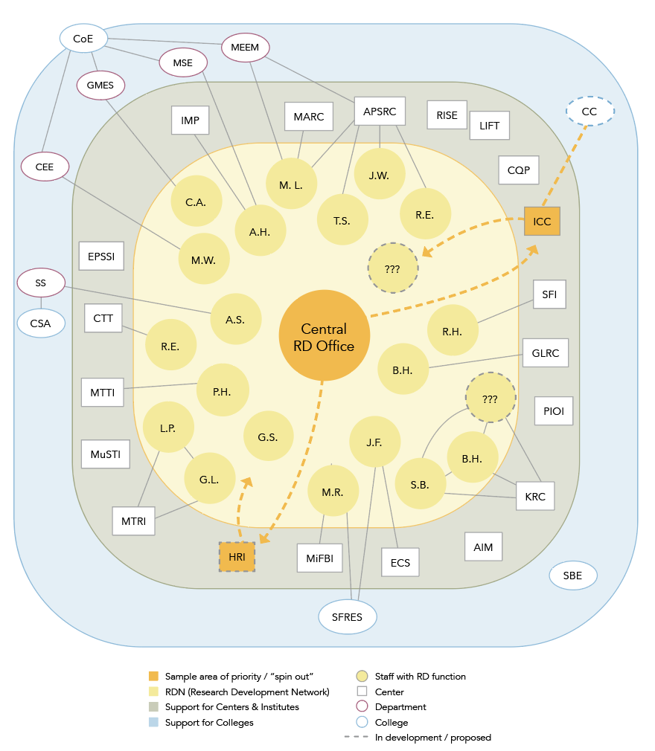
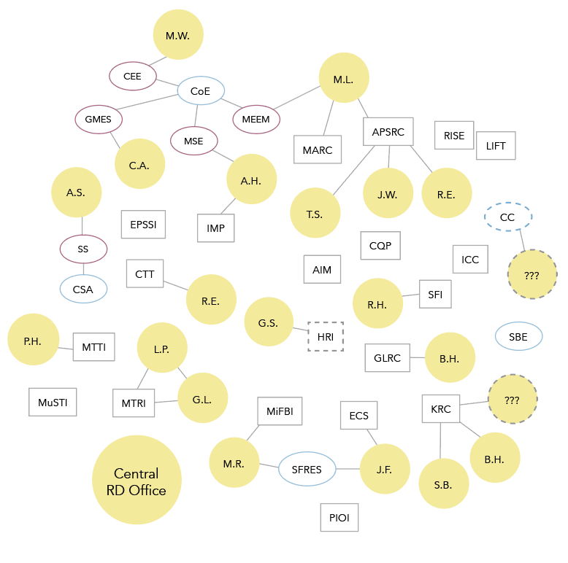
Michigan Technological University
Highlights:
Informal network existed. You had to know the right people for the right questions. Newcomers struggled.
2019: Semi-formalized as we formed a central RD unit strategy.
Continues to be a forum for discussions around:
  Process improvement
  Strategic proposals
  RD Toolkit development (boilerplate, templates, pre-award resources)
Use Slack to ask questions, share resources
NORDP 2021
Notes:
Pre-post graphics first, with bullet #1

Slide 7



Three University Perspectives
RD Model | Hybrid | Decentralized → Hybrid | Centralized
Year RD Network Established | 2016 (network) 2018 (CoRD) | 2014 (RD “group”) 2020 (RDCP) | 2019 (RD Network)
Size-ish | 80 on listserv 20 at monthly meeting | 140 on listserv 35 at quarterly meeting 12 at monthly EC meeting | 30 on listserv 10 at monthly meeting
CoP Leadership | Formal | Grassroots→Central Office | Central RD (2 people) + grassroots
NORDP 2021
Notes:
Apples to apples comparisons.

Slide 8
Panel Q1:
What are some challenges you’d like to address with the network on your campus?
NORDP 2021
Notes:
Jill
Becca/Katie
UM--improved communication/collaboration; metrics; sharing best practices
UVA - breaking down silo barriers, connecting interdisciplinary researchers, information sharing
MTU —

Slide 9
Panel Q2:
What resources are needed to build/sustain a community of practice?
NORDP 2021
Notes:
Katie/Becca
Jess
Leader/champion, Potential member input, Small budget (meeting location, snacks, member incentives, etc.), Dedicated time (organizing, meeting content development, etc.)
COP awards (not yet implemented, discussed pre-pandemic), developing recognition (to leaders) for COP members (takes manpower),

Slide 10
Panel Q3:
What has the network catalyzed?
NORDP 2021
Notes:
Jess
Jill
U-M: events have improved understanding of RD; begun to build leadership buy-in (centralized RD office); spin-off groups (team science, proposal development)

Slide 11
Panel Q4:
What could NORDP do to help local communities of practice grow?
NORDP 2021
Notes:
Pose to attendees! Point to the poll in the NORDP Conference system: “What could NORDP do to support your institutional network?”
Katie to lead discussion while the poll is being conducted.
COP meetings (regional or national meetings), COP starter kit

Slide 12
Resources
U-M Research Development
“Growing Research Development at a Decentralized University,” J. Jividen & B. LaPensee, NORDP GL Regional Meeting, OSU, 2018.
UVA Community of Research Development
NORDP 2021
Notes:
Origin story--no one knew who was doing RD, if anyone
After this slide, turn-off sharing and spur discussion. Onward!

