Slide 1

New Approaches in Research Development Programs: A Proposal Development Academy to Improve Early-Career Faculty Development and Grant Readiness

Slide 2

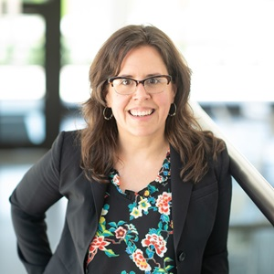
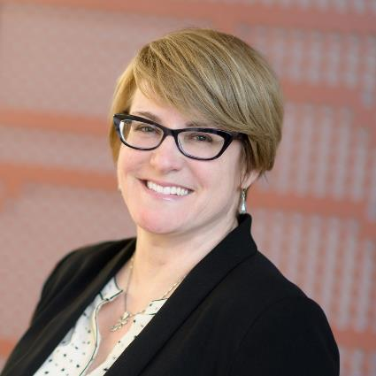
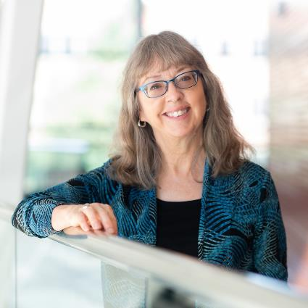
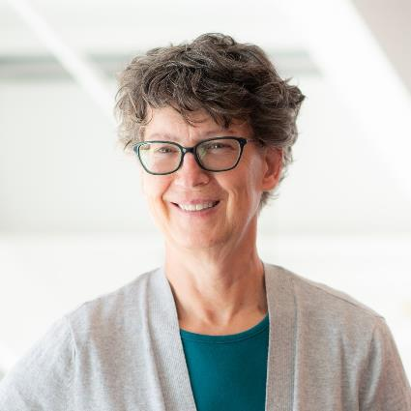
Presenters / Coauthors
University of Idaho Office of Research and Faculty Development
Carly Cummings
RFD Director
Kendra Mingo
Senior Proposal Development Specialist
Nancy Holmes
Proposal Development Specialist
Wendy Hessler
Proposal Development Specialist
NORDP 2021

Slide 3

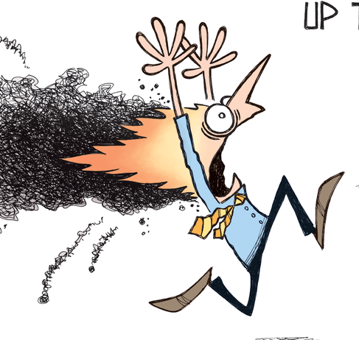
Why are we here?
Problem: “Hair on fire” proposal strategy
More proposals ≠ more success
Better proposals = more success
We want to equip early-career faculty to be more strategic and proactive in their proposal development, submit more competitive proposals
Reviewed enablers and strategies that promote proposal success
e.g., Wiebe et al., 2017; Wisdom et al., 2015; Preuss, 2015
Organized these into new workshop design focused on grant readiness
NORDP 2021

Slide 4
Our Approach – How it differs
Traditional Proposal Writing Workshops
Proposal Development Academy: What You Need to Know Before You Write
Focus on proposal writing skills
Participants often receive feedback on proposals in development
May include supplemental activities (e.g., peer mentoring, external review)
Focus on assessing and enhancing individual grant readiness
“Upstream” approach - strategies to implement before proposal writing
Commonly missed best practices
NORDP 2021

Slide 5
Grant Readiness defined
Having the necessary preparation, qualifications, training, expertise, networks, resources, infrastructure, organization, time, attitude, and perspective to develop a competitive grant proposal and carry out a proposed research project.
Cronan, Mike, and Lucy Deckard. New Faculty Guide to Competing for Research Funding. Second edition. College Station, TX: Academic Research Funding Strategies, LLC; c2016

Slide 6


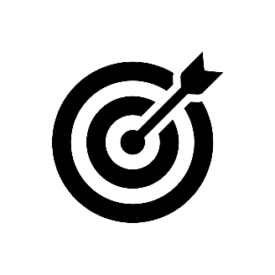


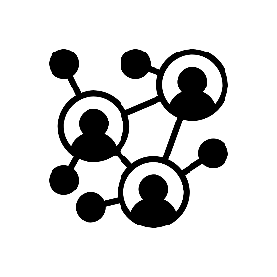





Grant Readiness – Ten categories:
Research Agenda
Finding Funding
Know Your Funder
Research Positioning
Proposal Development
Institutional Resources
PI Qualifications
Colleagues and Connections
Proposal Timing
Attitude and Resolve
NORDP 2021
Notes:
How do we operationalize that definition?
As Carly mentioned we went back to the literature to identify enablers and strategies that are thought to promote proposal success.
We then organized strategies in to 10 categories listed here centered that we think are key to grant readiness.

Slide 7
Grant Readiness – 50 items, 5 questions per category
Has a five-year research plan
Passionate about research topic/agenda
Research area is exciting, high-impact
Can explain knowledge gap and importance of your research
Knows Department/College expectations for external research funding
Research Agenda
Finding Funding
Know Your Funder
Research Positioning
Proposal Development
Institutional Resources
PI Qualifications
Colleagues and Connections
Proposal Timing
Attitude and Resolve
Knows how your research contributes to the field
Has discussed research ideas with funded colleagues
Completed one-page research summary
Identified and contacted program officer
Improved research ideas based on program officer feedback
NORDP 2021
Notes:
Identified and organized strategies in to 10 categories.
For each category we developed 5 questions resulting in a 50-item assessment and formative evaluation tool.
We implement the grant readiness pre-/post- assessment as one of the key workshop activities.

Slide 8
Workshop Model
Resources
Activities
Outputs
Outcomes
UI Research and Faculty Development (RFD) Team Budget for consultants, speakers, materials Resources Cronan, M. & L. Deckard. (2016). New Faculty Guide to Competing for Research Funding. Robertson, J. D. et al. (2019). The Grant Application Writer’s Workbook – NSF & NIH versions. | Small cohort model (Deans nominate faculty to participate) 8-week workshop w/ mandatory attendance Hybrid course delivery Weekly readings, presentations, homework 50-item grant readiness assessment tool RFD feedback & proposal development support Formative & summative evaluation | Faculty create five-year research plans Proposal resources & materials tailored to PI research Pivot funding profile Proposal production team Research support networks Requests for RFD proposal services Longitudinal reporting: # PDA faculty submitted # PDA faculty as PI, co-PI Timing of RFD services Early career awards New external sources | Short-term: Improved perception of grant readiness Short-term: Faculty are more proactive & strategic in their proposal development Long-term: Faculty submit more competitive proposals Other metrics: Improved fund rate More awarded resubmissions Increase in R&D expenditures Change in Carnegie Classification metrics
NORDP 2021

Slide 9

Optimizing Funding Searches
Crafting a Research Profile Using Pivot
Solicitation Requirements
Dissecting Proposal Solicitation for Effective Proposal Writing
Know Your Funder
Uncovering Sponsor Grant and Funding Data
Effective Proposal Structure
Review funded proposals to identify effective proposal architecture
Week
2
3
5
6
1
4
7
8
Research Positioning / Institutional Resources
Contacting Program Officers
Assembling Institutional Resources
Honing Proposal Materials and Timing
Create master proposal documents
Finalize 5-year Research Plan
Research Agenda Developing a 5-year Research Funding Plan
Colleagues & Connections / Resources & Support
Proposal Production Team
Grant Competitiveness Contact List
NORDP 2021

Slide 10
Optimizing Funding Searches
Crafting a Research Profile Using Pivot
Solicitation Requirements
Dissecting Proposal Solicitation for Effective Proposal Writing
Know Your Funder
Uncovering Sponsor Grant and Funding Data
Effective Proposal Structure
Review funded proposals to identify effective proposal architecture
Week
2
3
5
6
1
4
7
8
Research Positioning / Institutional Resources
Contacting Program Officers
Assembling Institutional Resources
Honing Proposal Materials and Timing
Create master proposal documents
Finalize 5-year Research Plan Grant Readiness Post-Survey
Research Agenda Developing a 5-year Research Funding Plan Grant Readiness Pre-Survey
Colleagues & Connections / Resources & Support
Proposal Production Team
Grant Competitiveness Contact List
NORDP 2021

Slide 11

Week | Workshop Activities / Faculty Products | Grant Readiness Category
1 | Create first draft of a 5-year research plan for proposal submissions | I, II, IV, VII
2 | Develop a research profile Use Pivot to create a targeted funding opportunity search | II
3 | Identify the culture, mission, interests, and program officer information Find funding data/history for one federal agency or private funder related to research area | III, IV, V
4 | Create a first draft of a facilities document for use in future grant applications | III, IV, VI
5 | Use a proposal solicitation to develop a proposal development checklist | V
6 | Review and score a funded proposal to identify effective proposal architecture | IV, V
7 | Develop a Proposal Production Team and Grant Competitiveness Contact List | IV, VIII, IX, X
8 | Investigate the rhetorical purpose of supplementary documents Finalize and submit a 5-year research plan | V
NORDP 2021

Slide 12
Preliminary Results

Slide 13
Preliminary Results
Notes:
We get better outcomes when we align our curriculum directly to grant readiness categories

Slide 14
Lessons Learned
Preserve prestige of small-cohort model
Accountability and feedback on homework assignments are key
Completion of a five-year research funding plan critical
We get better outcomes when we align our curriculum directly to grant readiness categories
In next iterations, we will convert grant readiness survey to likert scale
NORDP 2021

Slide 15
Takeaways
New approach that considers enablers and strategies that promote proposal success
Focused on assessing and enhancing individual grant readiness
Strategies to implement before proposal writing
Questions? Want to know more?
Attend our Pre-Conference Roundtable and Q&A Session on Tuesday 4/27/2021 from 2-3 p.m. EDT
NORDP 2021

Slide 16

CONTACTS:
Carly Cummings, PhD, CPRA
Director, Office of Research and Faculty Development
ccummings@uidaho.edu
208-885-1058
Kendra Mingo, MA, CRA
Senior Proposal Development Specialist
Office of Research and Faculty Development
kmingo@uidaho.edu
208-885-1178
NORDP 2021

