Slide 1
Extramural Research in the Era of COVID-19: an NIH Perspective
Michael Lauer, MD
Deputy Director for Extramural Research; Director, Office of Extramural Research
National Institutes of Health
National Organization of Research Development Professionals (NORDP)
Tuesday, May 4, 2021
Virtual Meeting
Disclosures: None

Slide 2
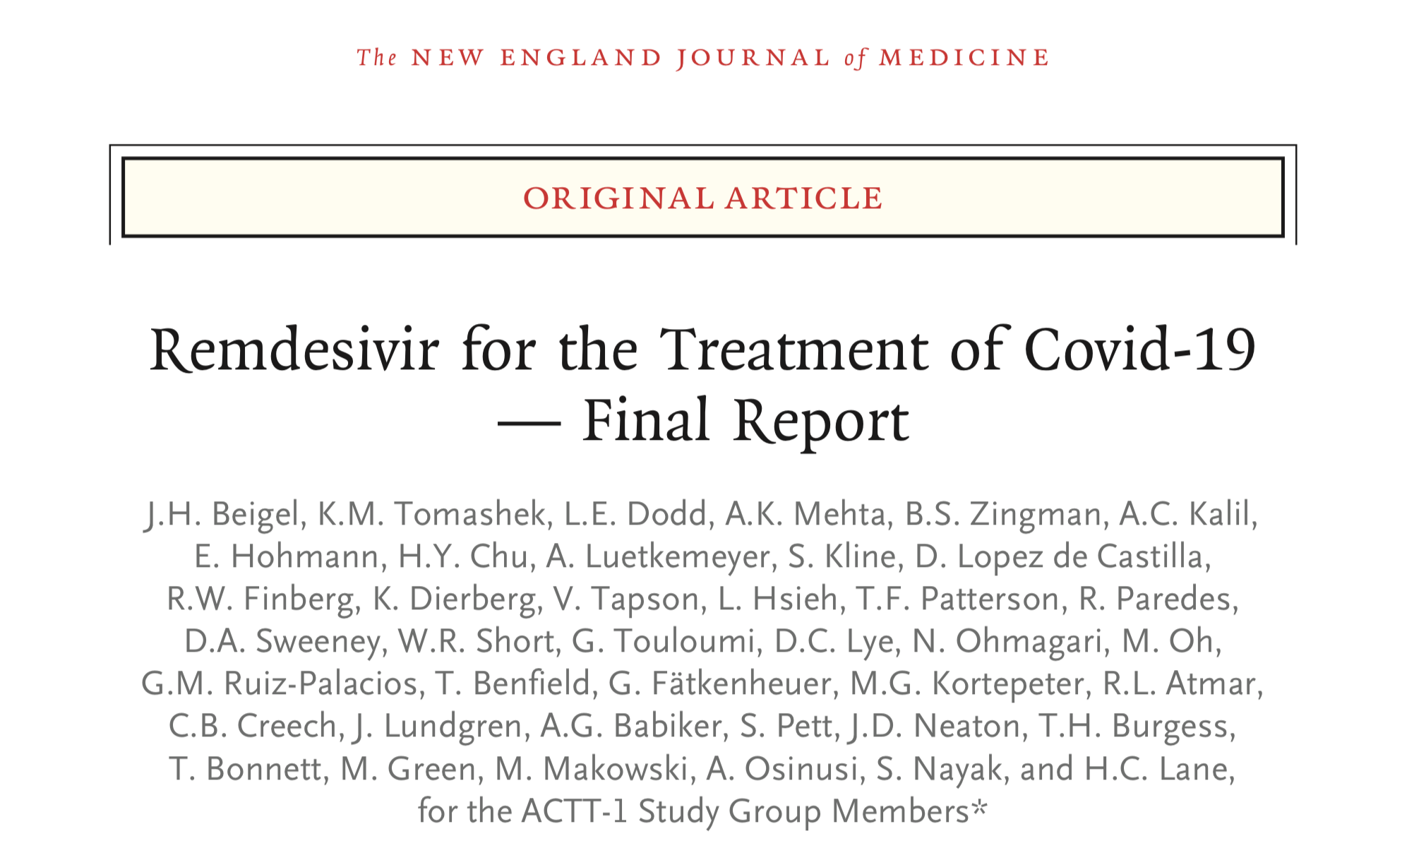
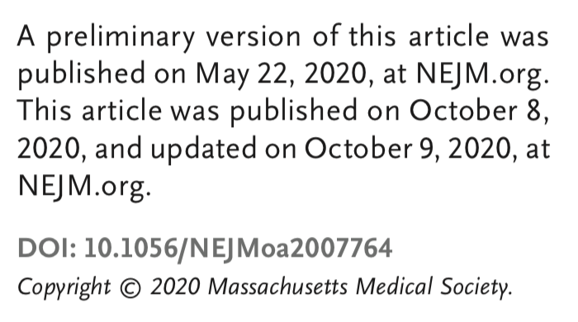
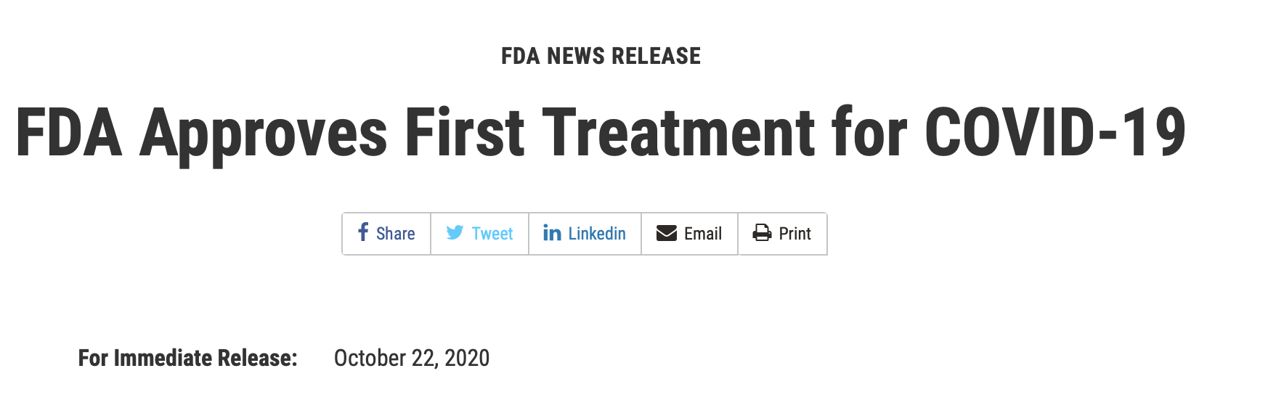
COVID-19: Acceleration!
https://www.nejm.org/doi/pdf/10.1056/NEJMoa2007764?articleTools=true
https://www.fda.gov/news-events/press-announcements/fda-approves-first-treatment-covid-19

Slide 3

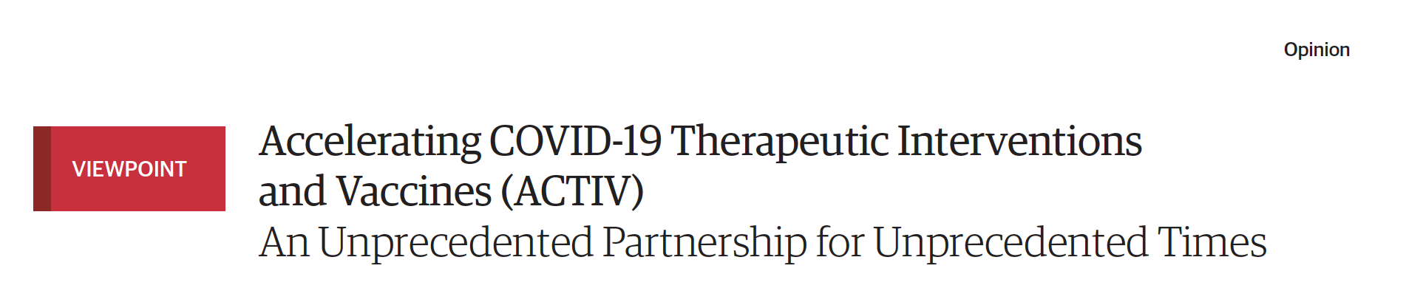
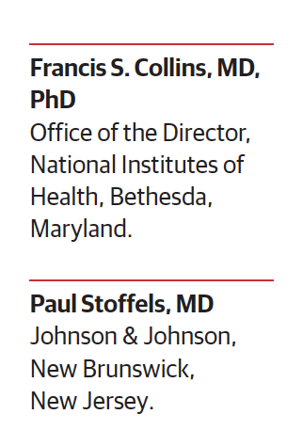
Accelerated Path to Therapeutics and Vaccines
Working Groups:
Preclinical: animal models, assays
Therapeutics clinical: prioritize agents, master protocol
Clinical trial capacity
Vaccines: evaluation, biomarkers, safety
https://jamanetwork.com/journals/jama/fullarticle/2766371

Slide 4
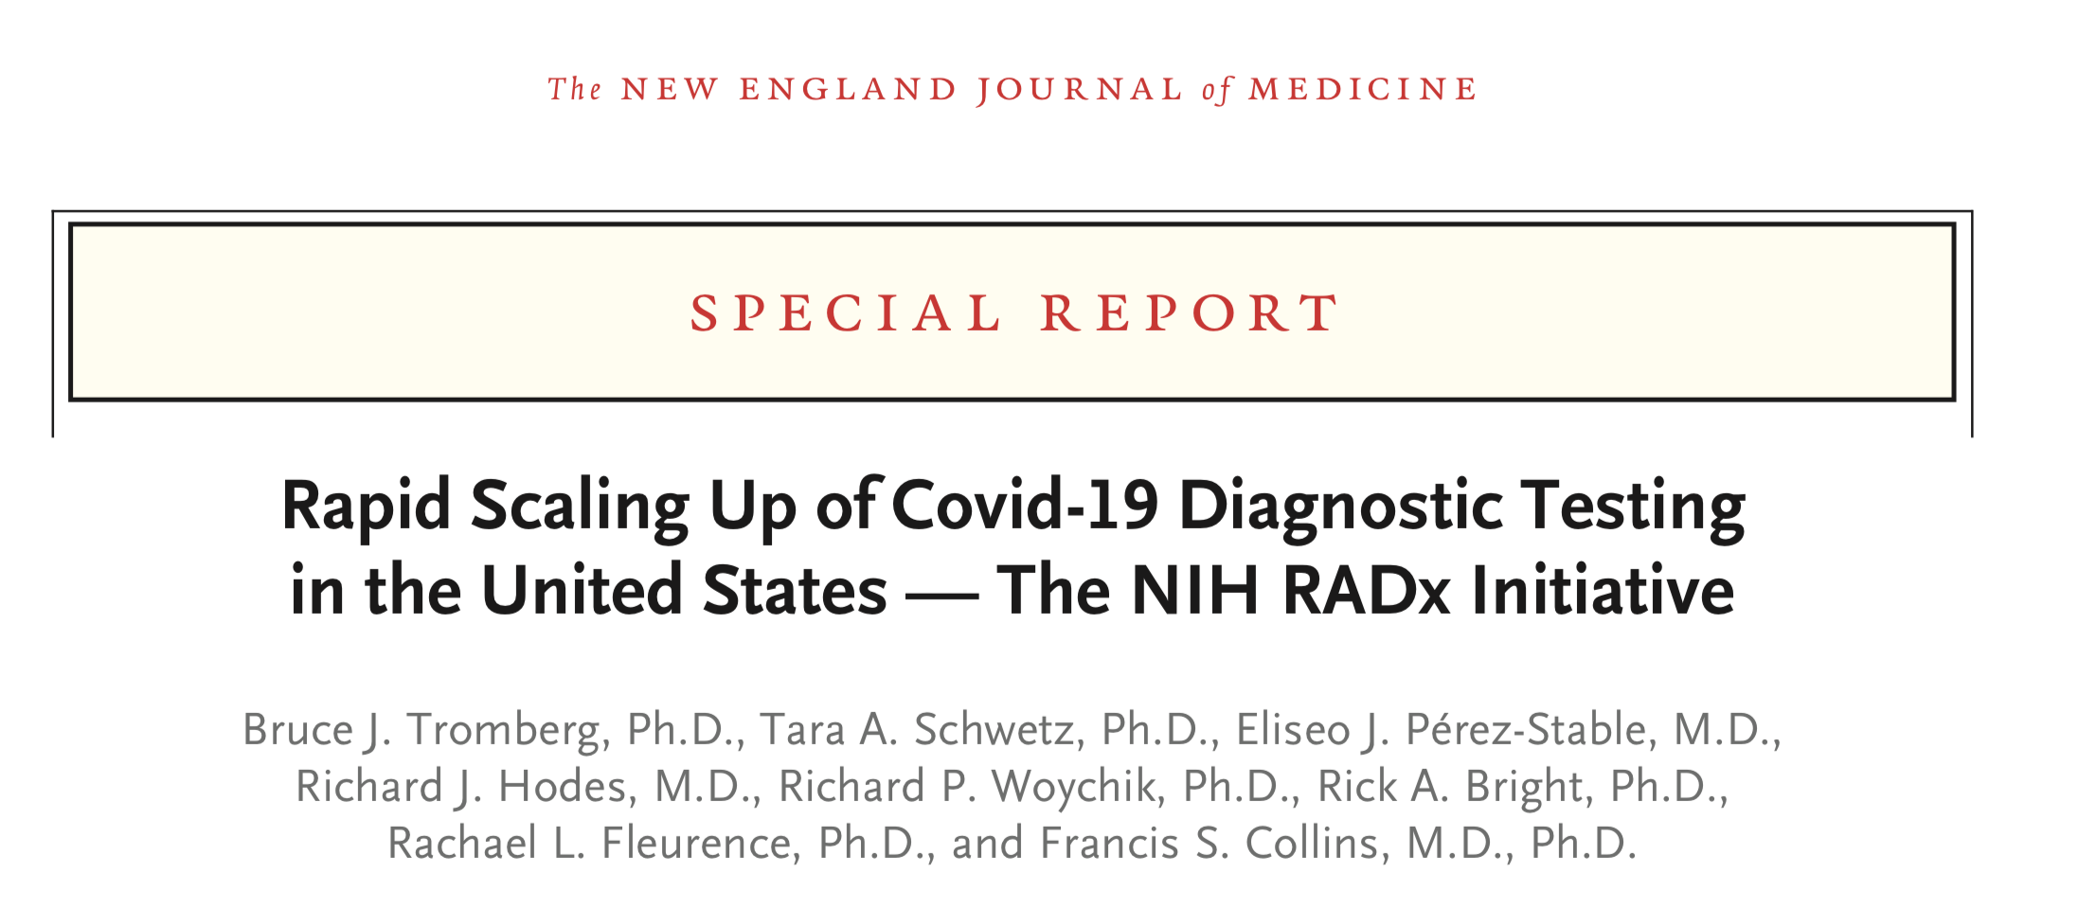
And Diagnostics …
https://www.nejm.org/doi/pdf/10.1056/NEJMsr2022263?articleTools=true

Slide 5
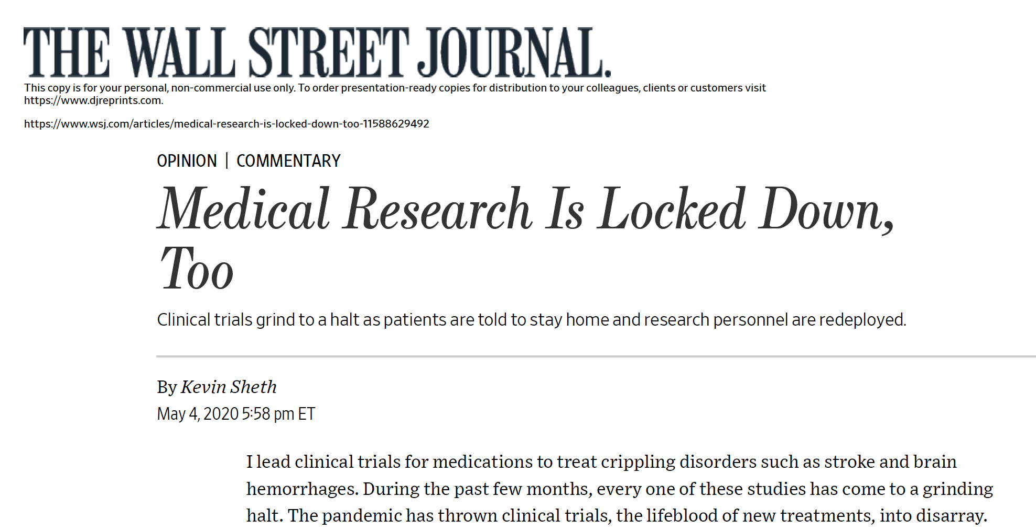
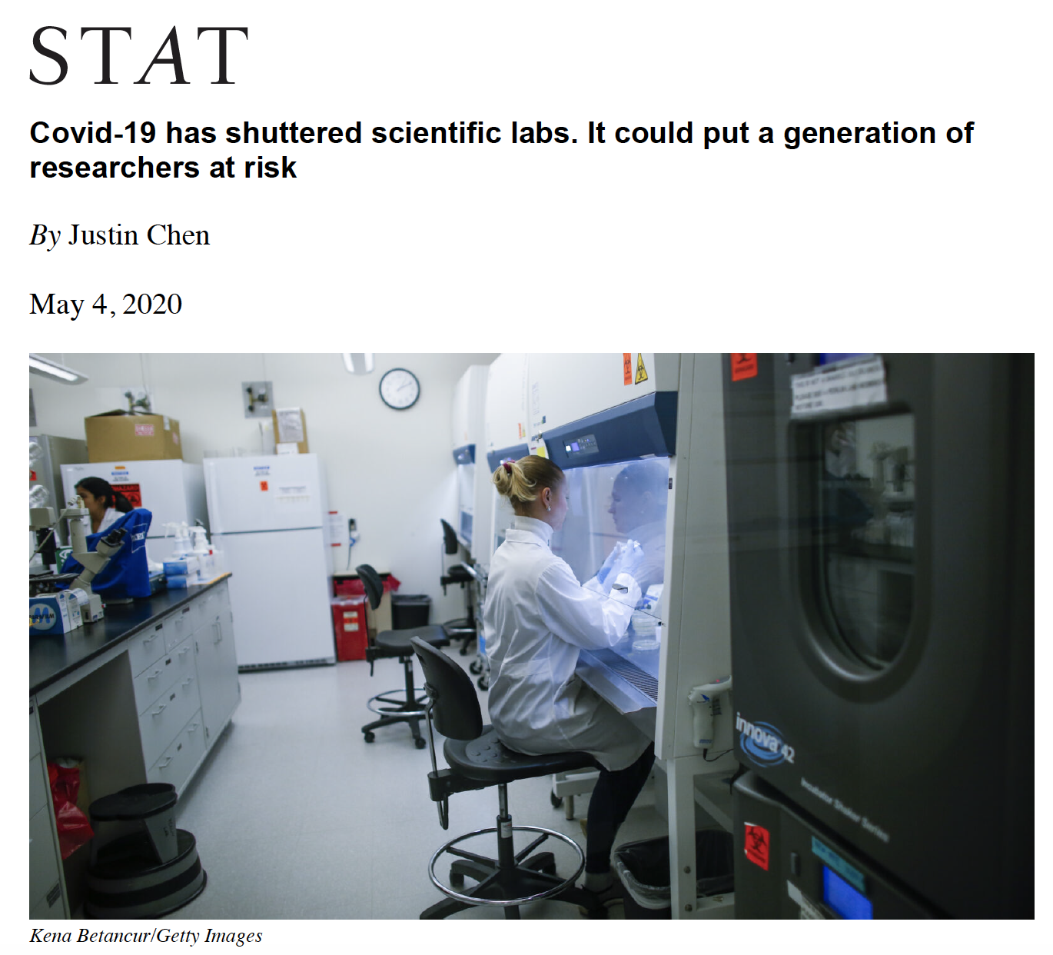
On the Other Hand …

Slide 6
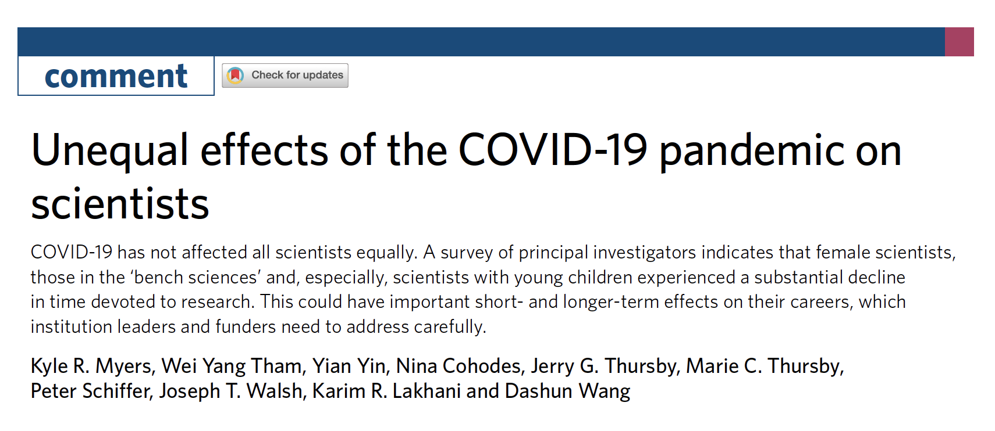
Disproportionate Effects
Nature Human Behavior, July 15, 2020
https://www.nature.com/articles/s41562-020-0921-y

Slide 7
Accommodations and Flexibilities
Application deadlines, post-submission data
All peer review remote – through Fall 2021
Salaries and stipends – until September 30, 2020
Human subject research, clinical trials
Animal research, guidance to IACUCs
Extensions on reporting; flexibility on expenditures
Accommodations for loss of time, ESI extension
https://grants.nih.gov/policy/natural-disasters/corona-virus.htm

Slide 8
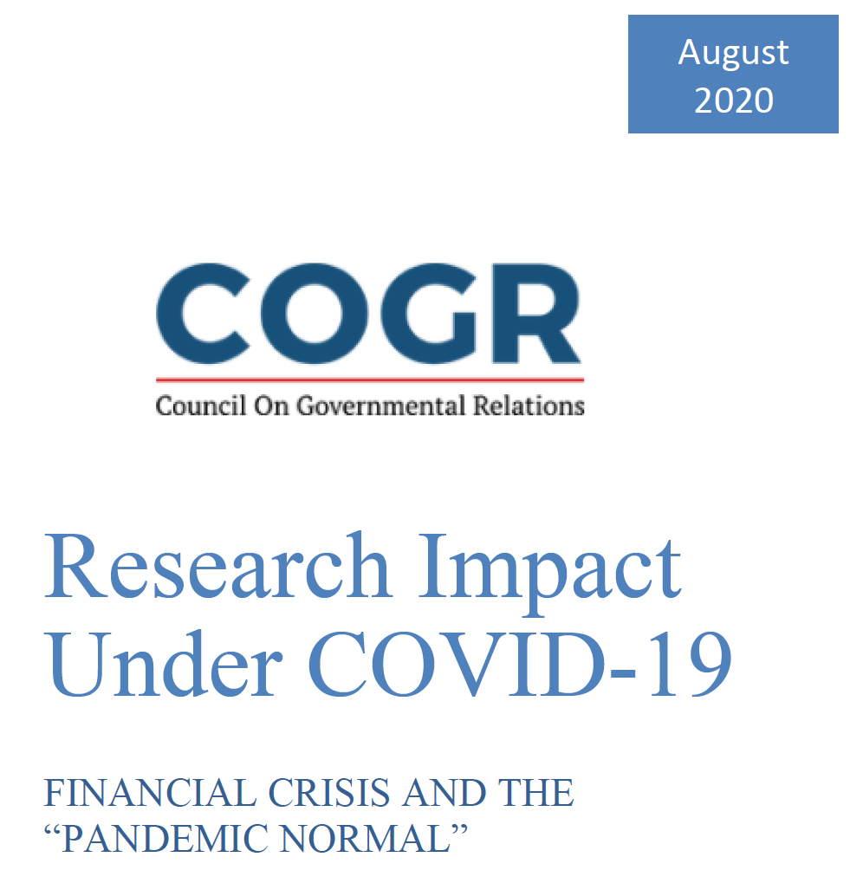
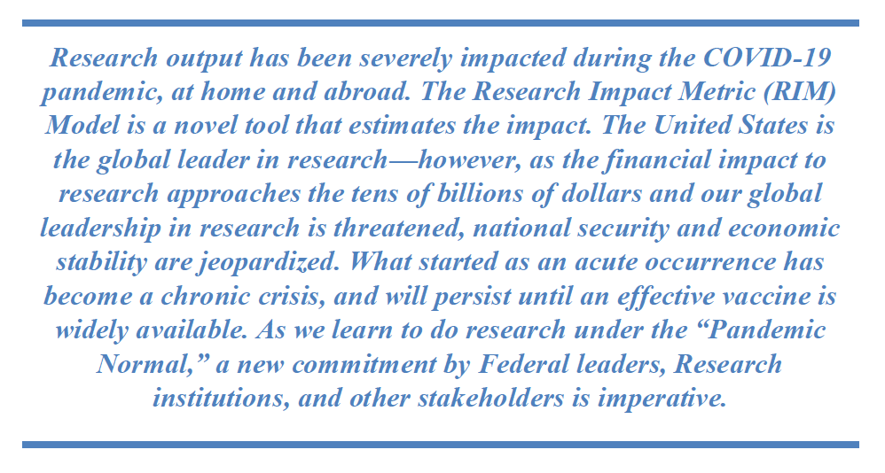
Intriguing Thought Exercise
https://www.cogr.edu/sites/default/files/Research_COVID_August2020_COGR_FINAL.pdf

Slide 9
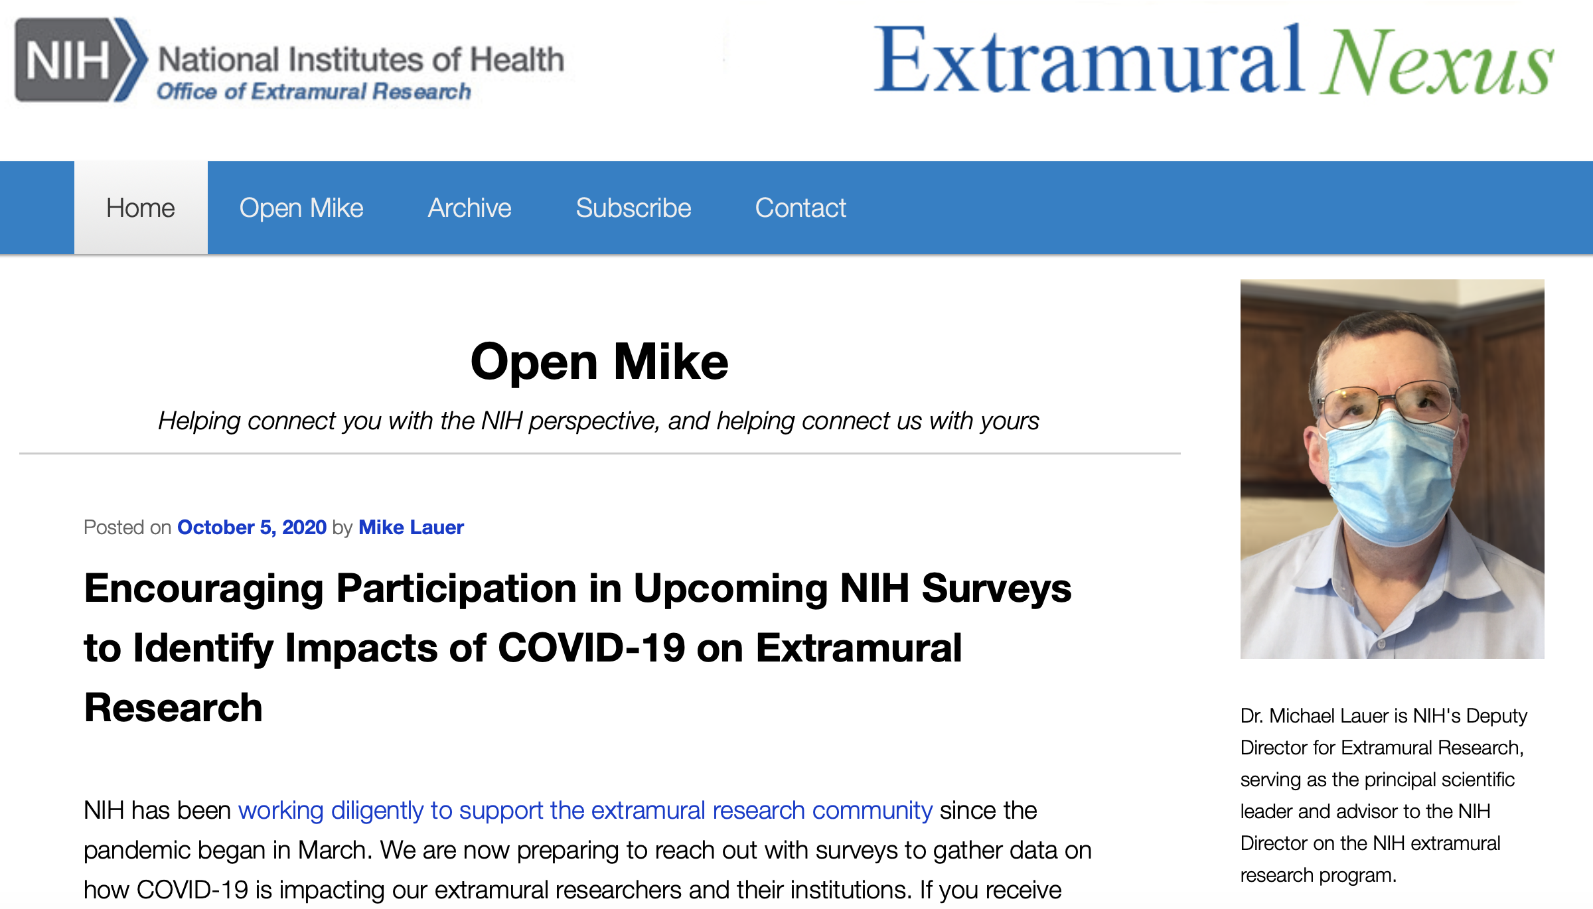
Learning From You!
https://nexus.od.nih.gov/all/2020/10/05/encouraging-participation-in-upcoming-nih-surveys-to-identify-impacts-of-covid-19-on-extramural-research/

Slide 10
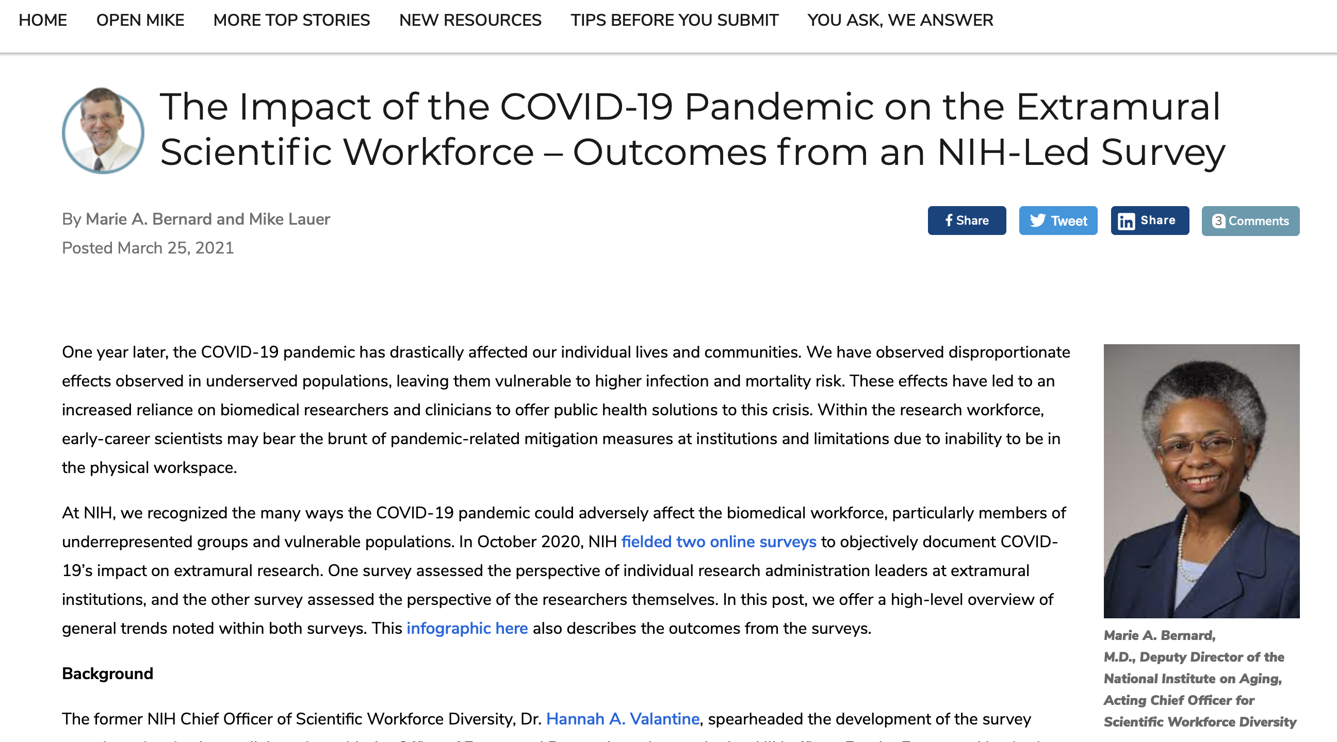
Thank You for Your Input
https://nexus.od.nih.gov/all/2021/03/25/the-impact-of-the-covid-19-pandemic-on-the-extramural-scientific-workforce-outcomes-from-an-nih-led-survey/

Slide 11
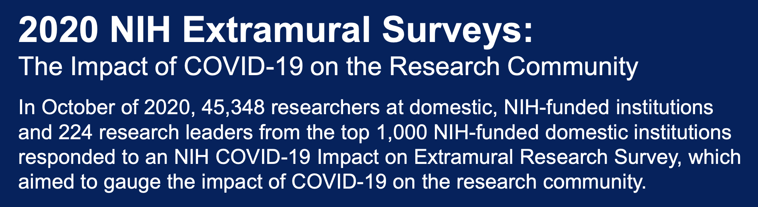
Input from Institutions and Researchers
https://grants.nih.gov/sites/default/files/NIH%20COSWD_COVID19%20Impact_Infographic_vF_Updated_3-19.pdf

Slide 12
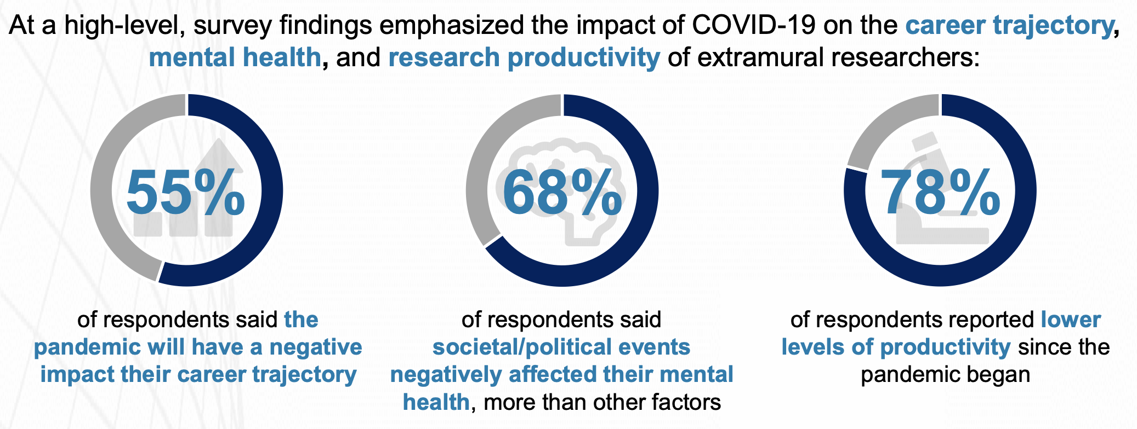
High-Level Findings
https://grants.nih.gov/sites/default/files/NIH%20COSWD_COVID19%20Impact_Infographic_vF_Updated_3-19.pdf

Slide 13
Impact on Career Trajectory by Career Stage
13
diversity.nih.gov

Slide 14
Impact on Career Trajectory by Type of Research
14
diversity.nih.gov

Slide 15
Impact on Career Trajectory by Race & Gender
Race by Gender | % Impacted
Asian, Men | 67%
Asian, Other Gender | 64%
Asian, Women | 62%
White, Other Gender | 61%
Two or More Races, All Genders | 59%
All Respondents | 55%
AIAN, Women | 41%
African American, Men | 40%
African American, Women | 39%
NHPI, Men | 31%
African American, Other Gender | 22%
15
diversity.nih.gov

Slide 16
Most Important Predictors of Career Trajectory Concerns
 | Top 10 Variables (Negative Class Predictors) | Importance
1 | Ability to apply for grants | 0.1634
2 | Progress towards promotion/tenure | 0.0627
3 | Reduced access to on-site laboratories | 0.0604
4 | Reduced access to core facilities | 0.0573
5 | Concern for the health of family and friends | 0.0510
6 | Reduced access to colleagues | 0.0479
7 | Caretaking responsibilities | 0.0402
8 | Lost access to expertise | 0.0321
9 | Timeline uncertainty for returning to work | 0.0277
10 | Personal mental/physical health has impacted productivity | 0.0258
AUC = 79.3
16
diversity.nih.gov

Slide 17
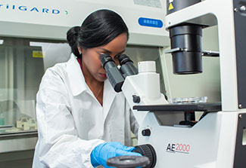
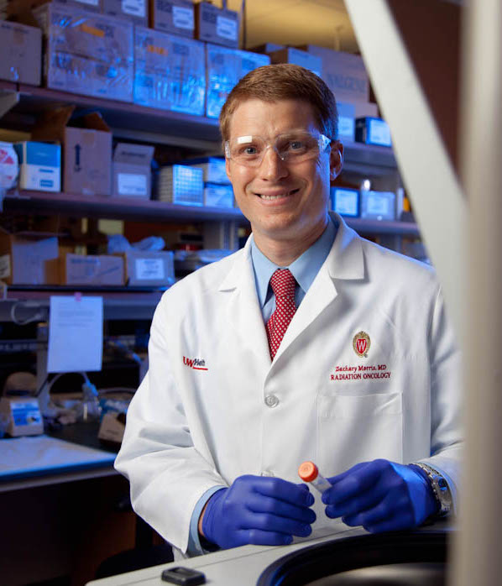
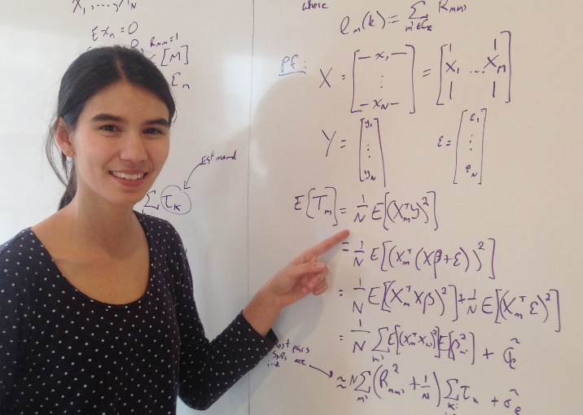
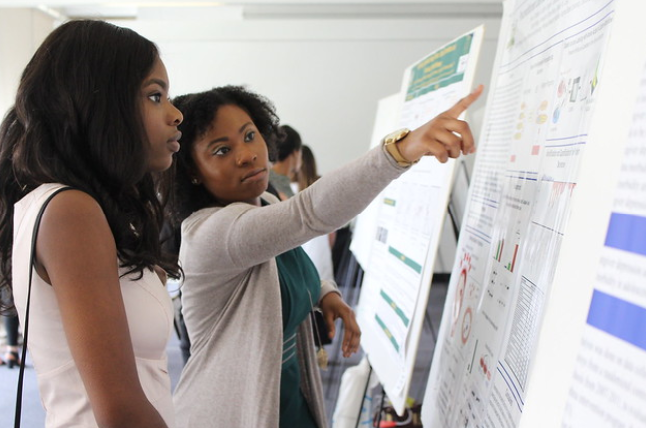
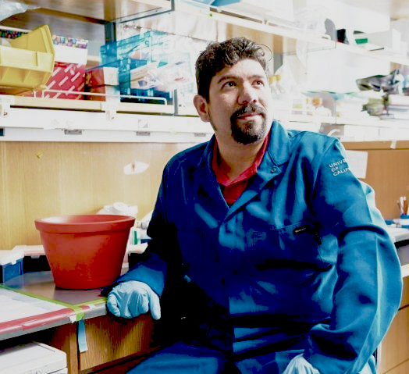
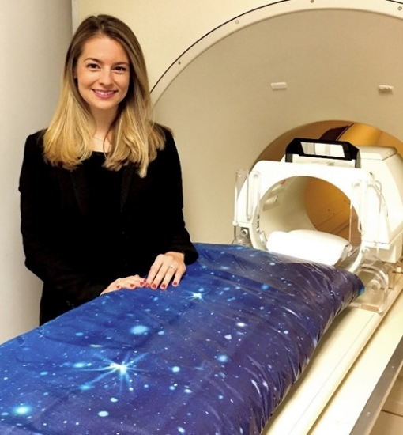
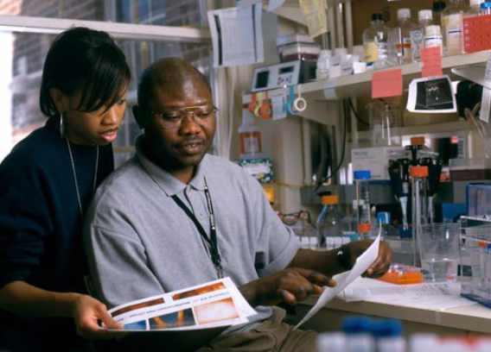
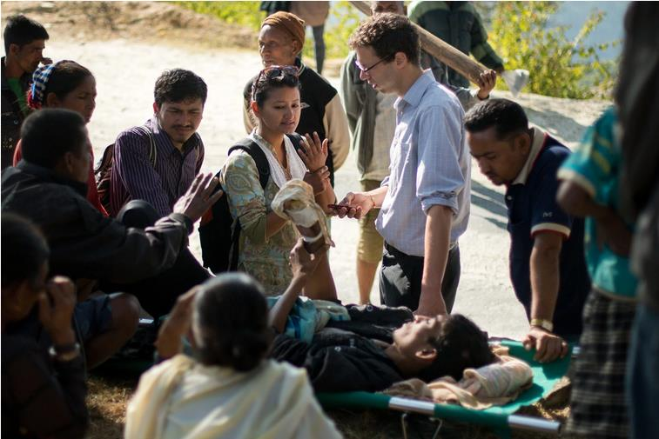
NIH’s Priorities for Early Career Investigators
Thanks to Francis Collins

Slide 18

Flexibilities
No-cost extensions (2nd no-cost extensions)
Funded extensions for select F and K awards
Eligibility extensions:
  Early Stage Investigator status
  K99/R00
Leniency on late applications
Preliminary data post-submission

Slide 19
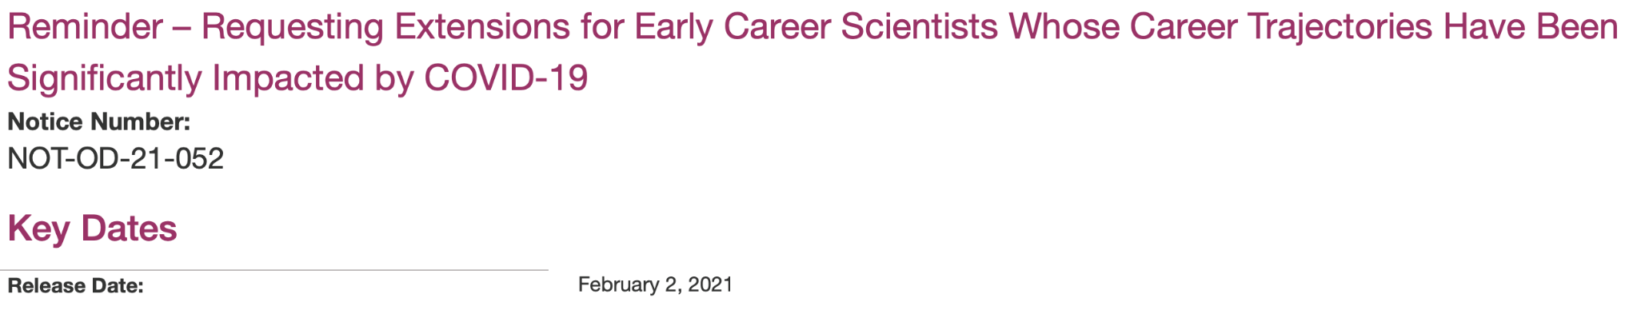

Funded Extensions
Select F and K awards, case-by-case basis
Decisions based on
  Availability of funds
  Activities hindered over and above lost research productivity that most individuals experienced because of COVID-19 related shutdowns

Slide 20
CY19 and CY20 ESI Extension Approvals

Slide 21
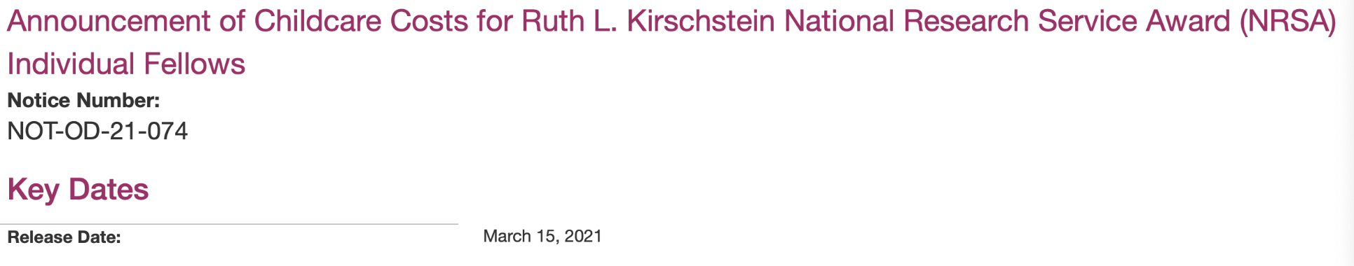

Childcare Allowance
$2500 / year / Fellow
Defray child-care costs
  Children < 13 years, disabled < 18 years
  Licensed childcare provider
  Recipient responsible for documentation
Plan for T awardees in FY2022

Slide 22
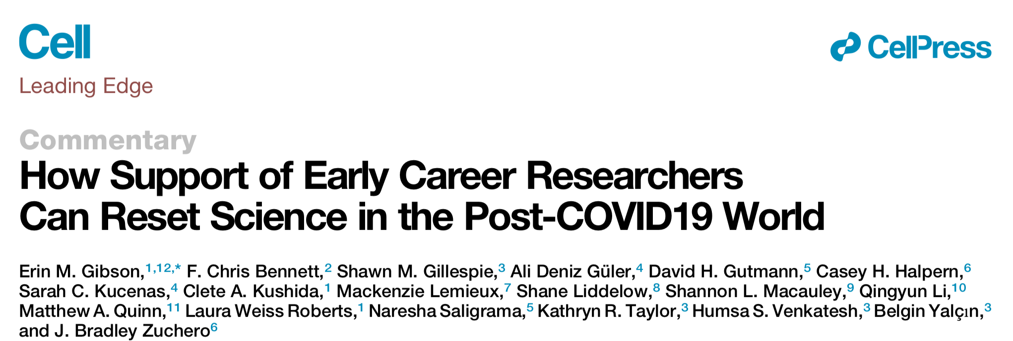
Perspectives For the Future
“The COVID19 crisis has magnified the systemic issues plaguing academic research … often-stifling excess requirements in publication, tenure, and grant processes; the reliance on funding from national agencies that is catered towards senior level researchers; and the lack of diversity in academic research due to the attrition of women and racial or ethnic minorities during early career stages … An unprecedented opportunity to reset … will require a concerted effort between funding agencies, universities, and the public to rethink how we support scientists, with a special emphasis on early career researchers.”
https://doi.org/10.1016/j.cell.2020.05.045

Slide 23

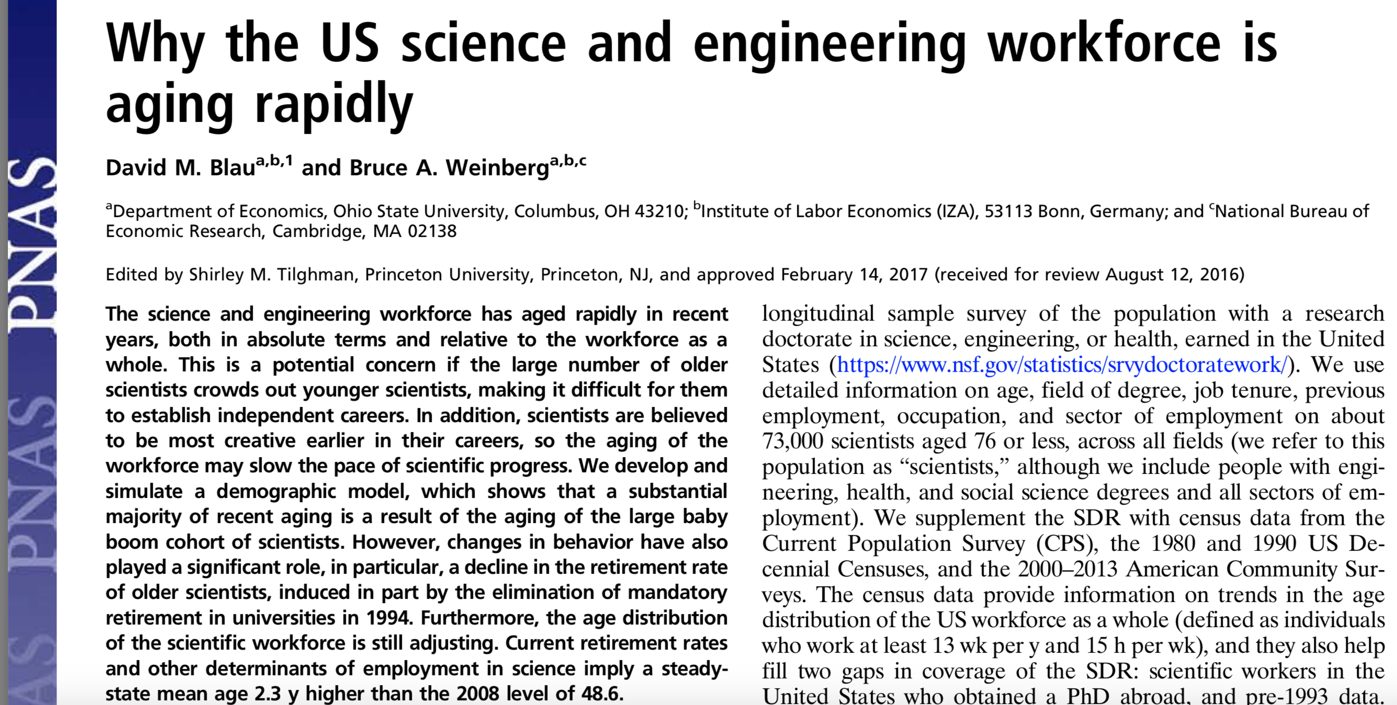
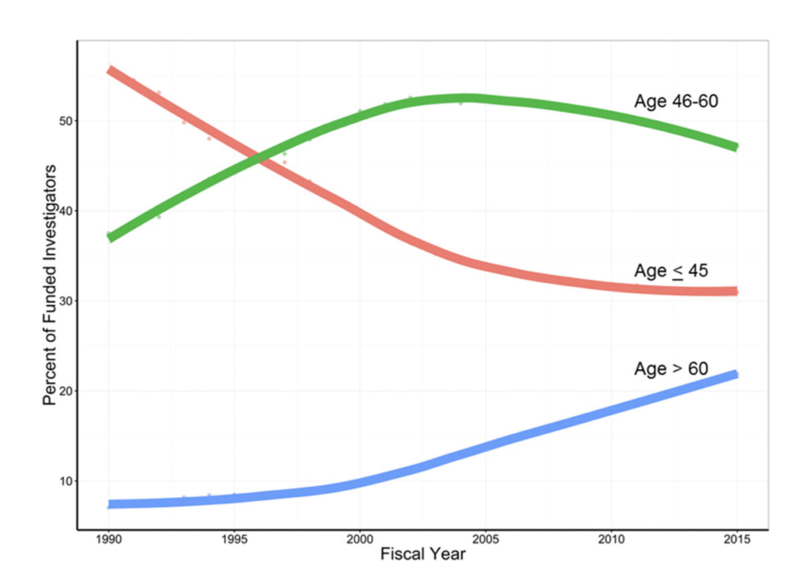
“Catered Towards Senior Level Researchers”
https://www.pnas.org/content/pnas/114/45/11801.full.pdf
https://www.pnas.org/content/pnas/early/2017/03/21/1611748114.full.pdf

Slide 24
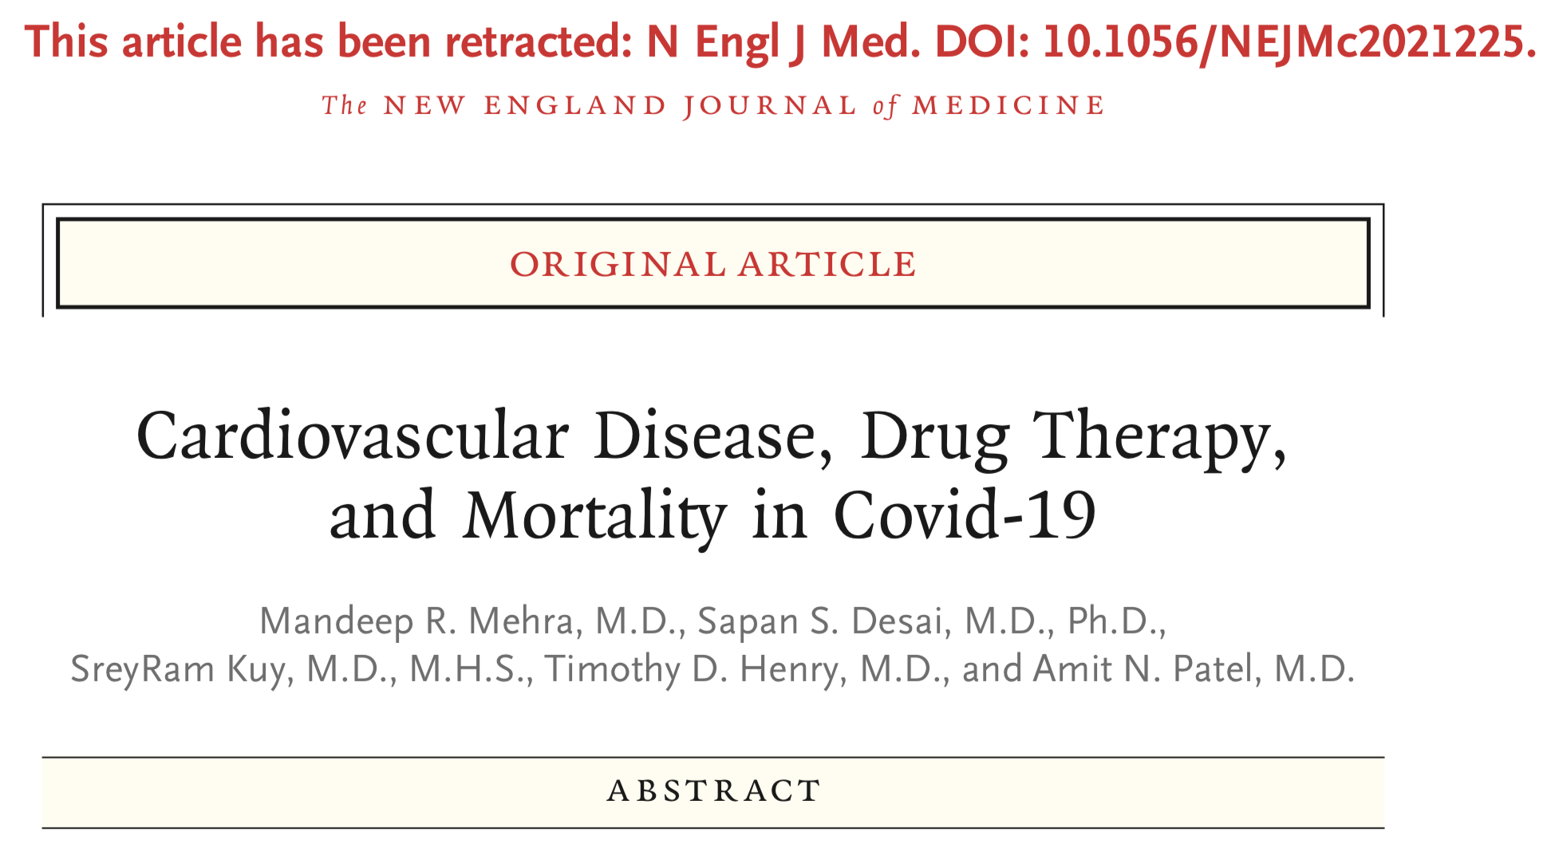
Concerns About Integrity

Slide 25
Responsible Conduct of Research
Conducting research
  “Classic” integrity: fabrication, falsification, plagiarism
  Other: peer review, harassment, non-disclosure
Responsibility to conduct the right research
  Focus on COVID-19

Slide 26
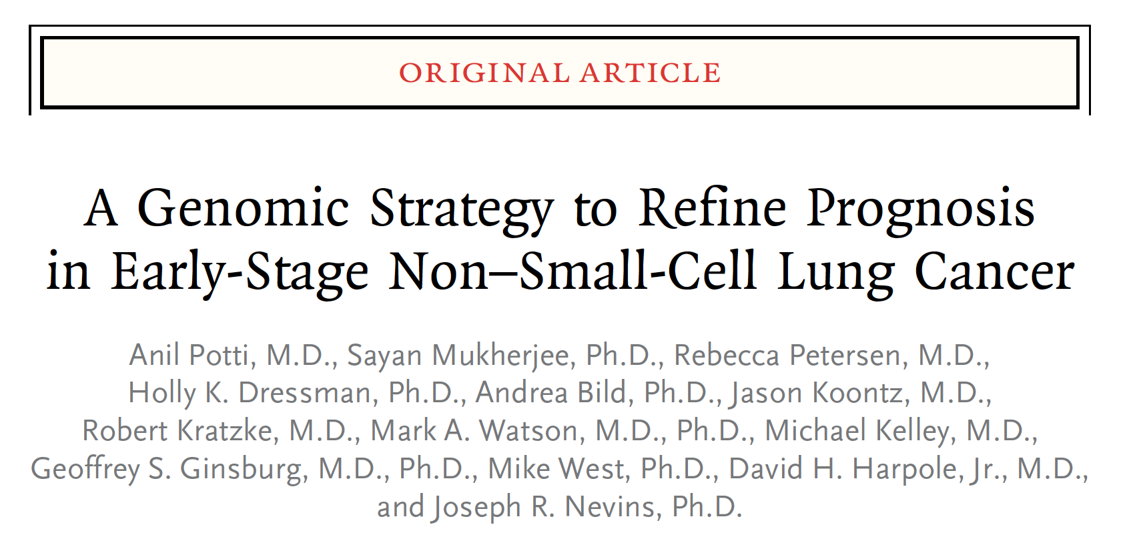

A Story …

Slide 27
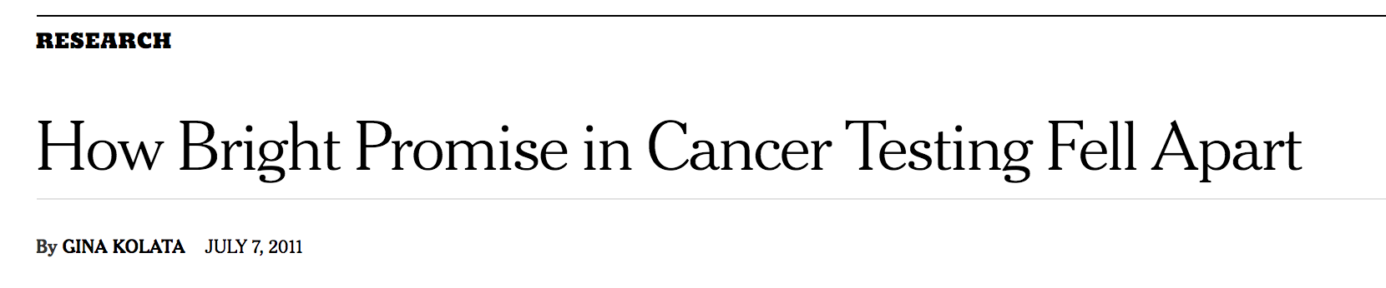

Collapse
In the end, four gene signature papers were retracted. Duke shut down three trials using the results. Dr. Potti resigned from Duke. He declined to be interviewed for this article. His collaborator and mentor, Dr. Nevins, no longer directs one of Duke’s genomics centers.
The cancer world is reeling.
The Duke researchers had even set up a company — now disbanded — and planned to sell their test to determine cancer treatments.

Slide 28
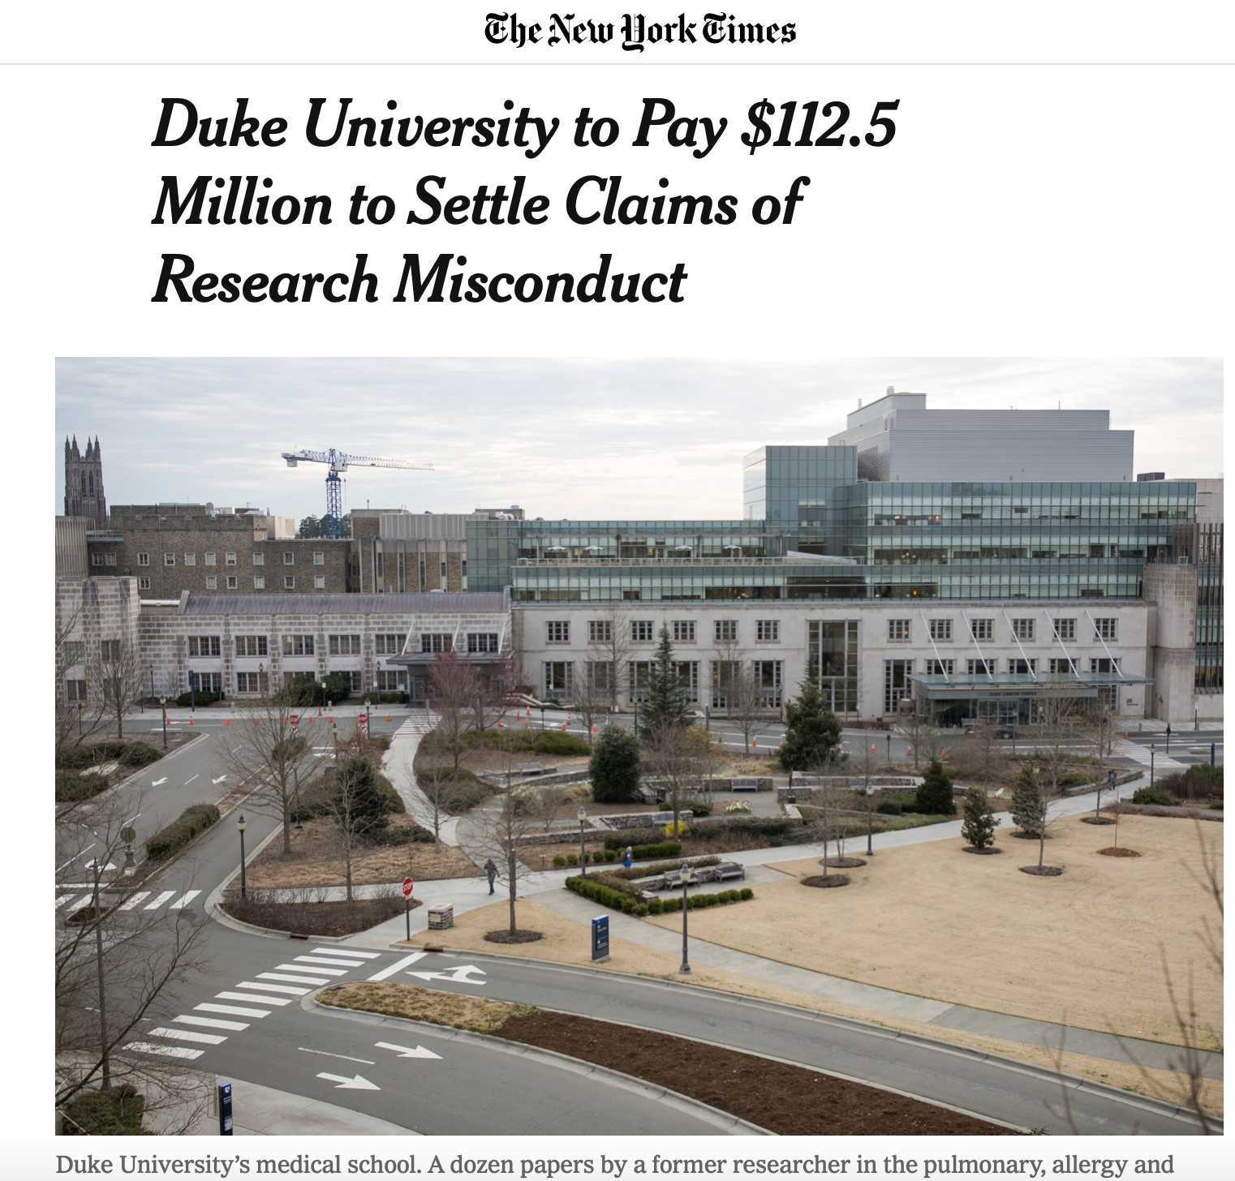
Shifting Focus …
“ Vincent E. Price, president of Duke University, said … ‘This is a difficult moment for Duke. This case demonstrates the devastating impact of research fraud and reinforces the need for all of us to have a focused commitment on promoting research integrity and accountability.’”
https://www.nytimes.com/2019/03/25/science/duke-settlement-research.html

Slide 29

US Government Worries
“Taxpayers expect and deserve that federal grant dollars will be used efficiently and honestly. Individuals and institutions that receive research funding from the federal government must be scrupulous in conducting research for the common good and rigorous in rooting out fraud,” said Matthew G.T. Martin, United States Attorney for the Middle District of North Carolina. “May this serve as a lesson that the use of false or fabricated data in grant applications or reports is completely unacceptable.”
https://www.justice.gov/opa/pr/duke-university-agrees-pay-us-1125-million-settle-false-claims-act-allegations-related

Slide 30
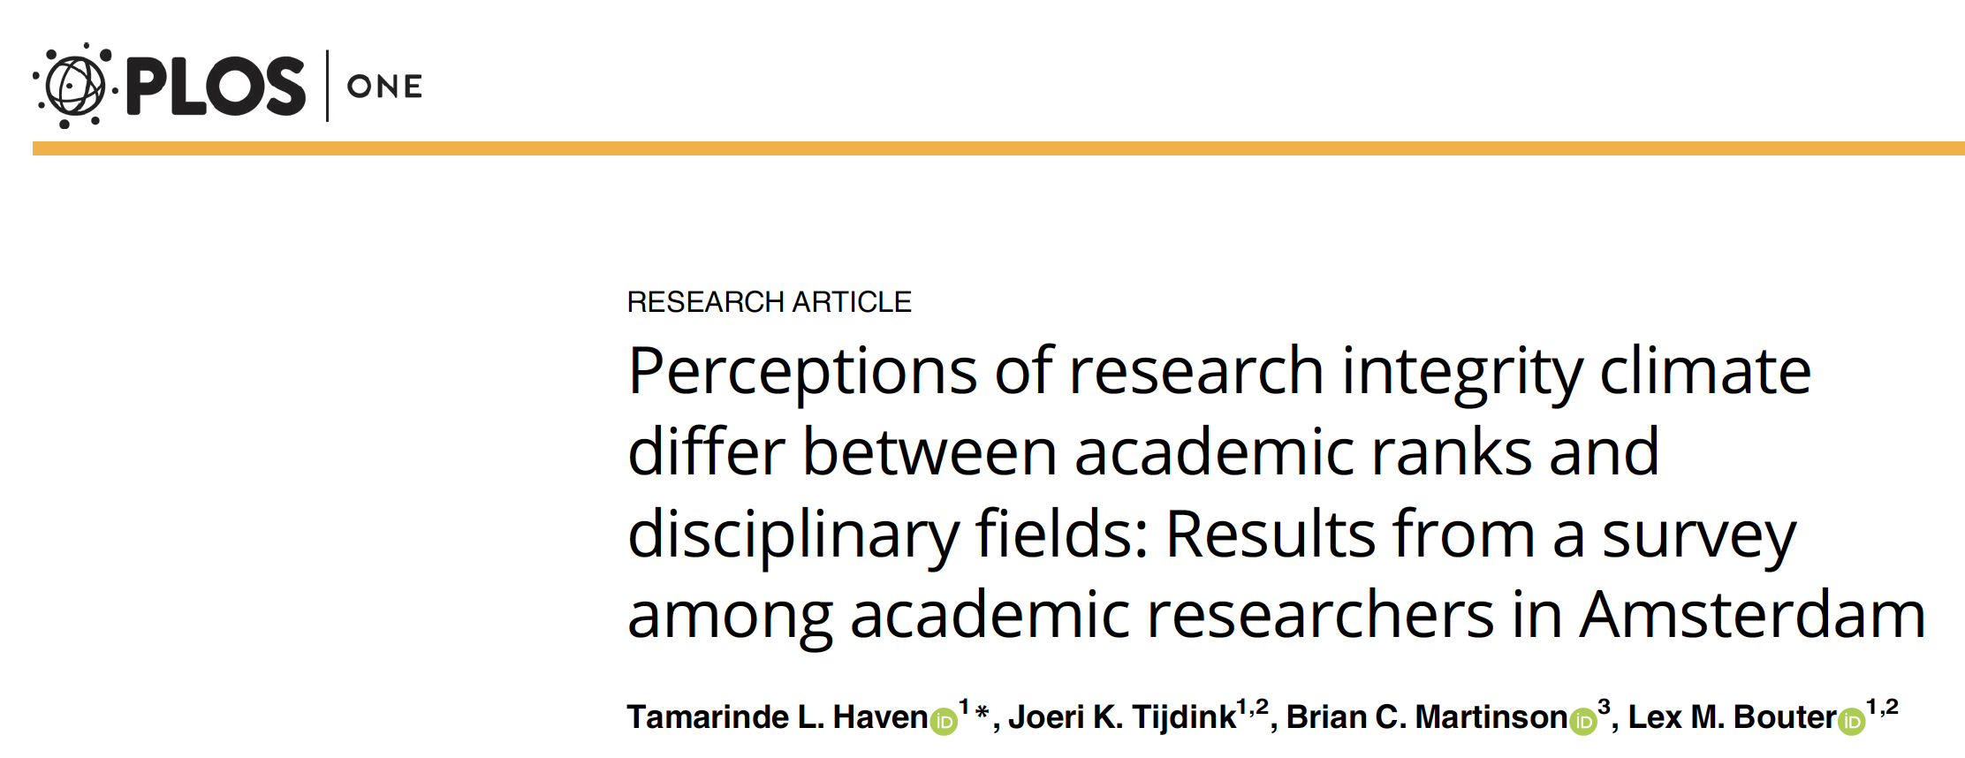
The Vocabulary Has Changed …
“Breaches of research integrity have shocked the academic community. Initially explanations were sought at the level of individual researchers but over time increased recognition emerged of the important role that the research integrity climate may play in influencing researchers’ (mis)behavior.”
PLoS ONE 14(1): e0210599. https://doi.org/10.1371/journal.pone.0210599

Slide 31
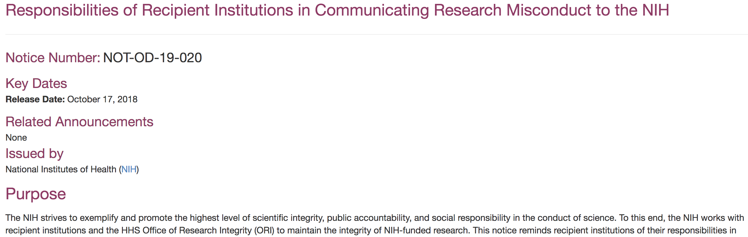
Leveraging Institutional Leadership
https://grants.nih.gov/grants/guide/notice-files/NOT-OD-19-020.html

Slide 32
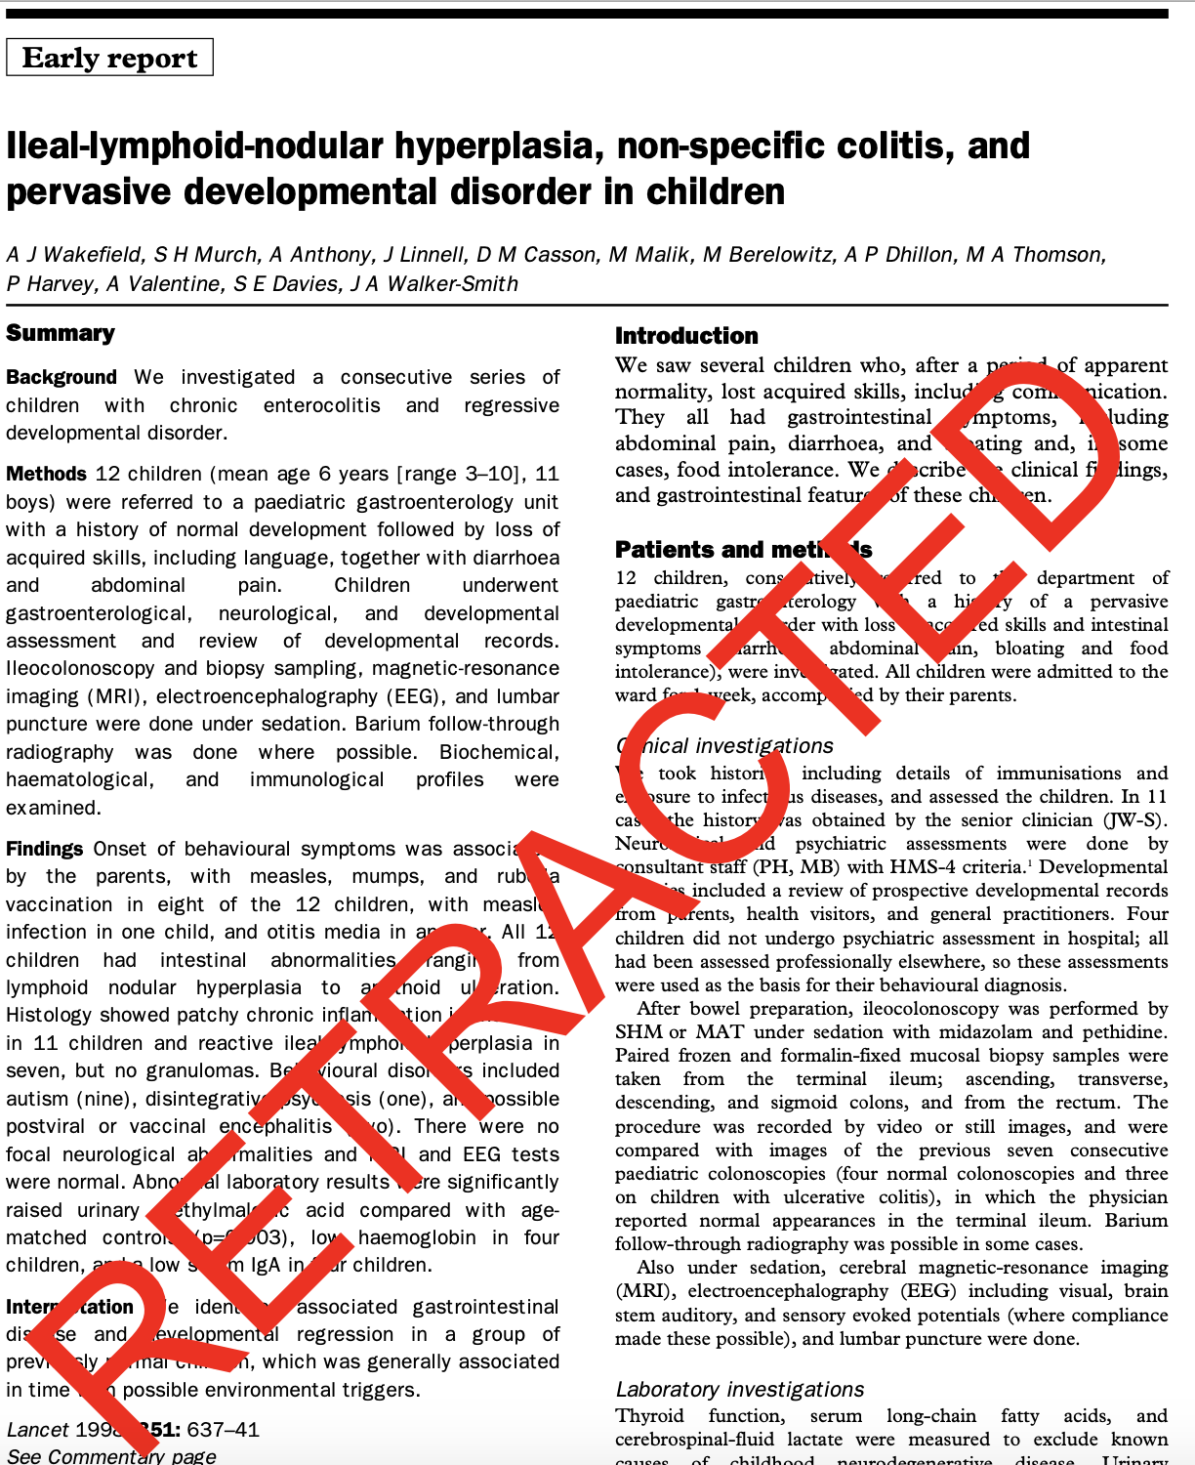
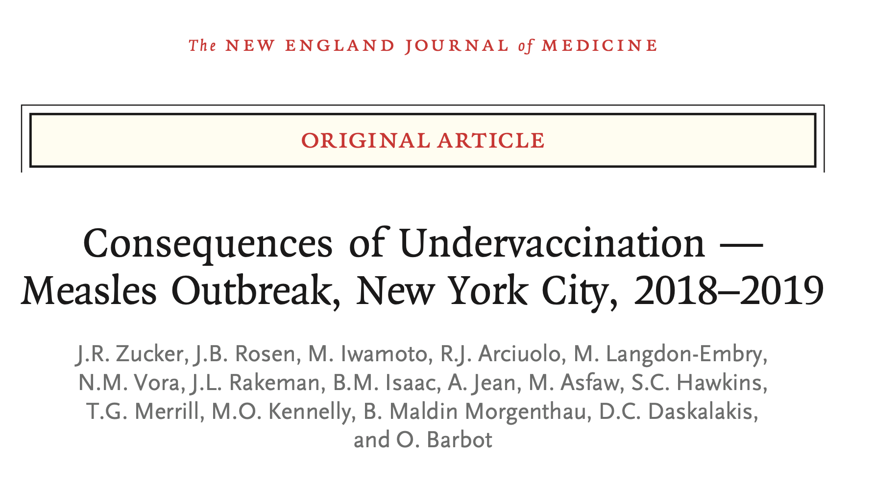
Pandemic – The Harms are Real
https://www.nejm.org/doi/pdf/10.1056/NEJMoa1912514?articleTools=true

Slide 33
Responsible Conduct of Research
Conducting research
  “Classic” integrity: fabrication, falsification, plagiarism
  Other: peer review, harassment, non-disclosure
Responsibility to conduct the right research
  Focus on COVID-19

Slide 34
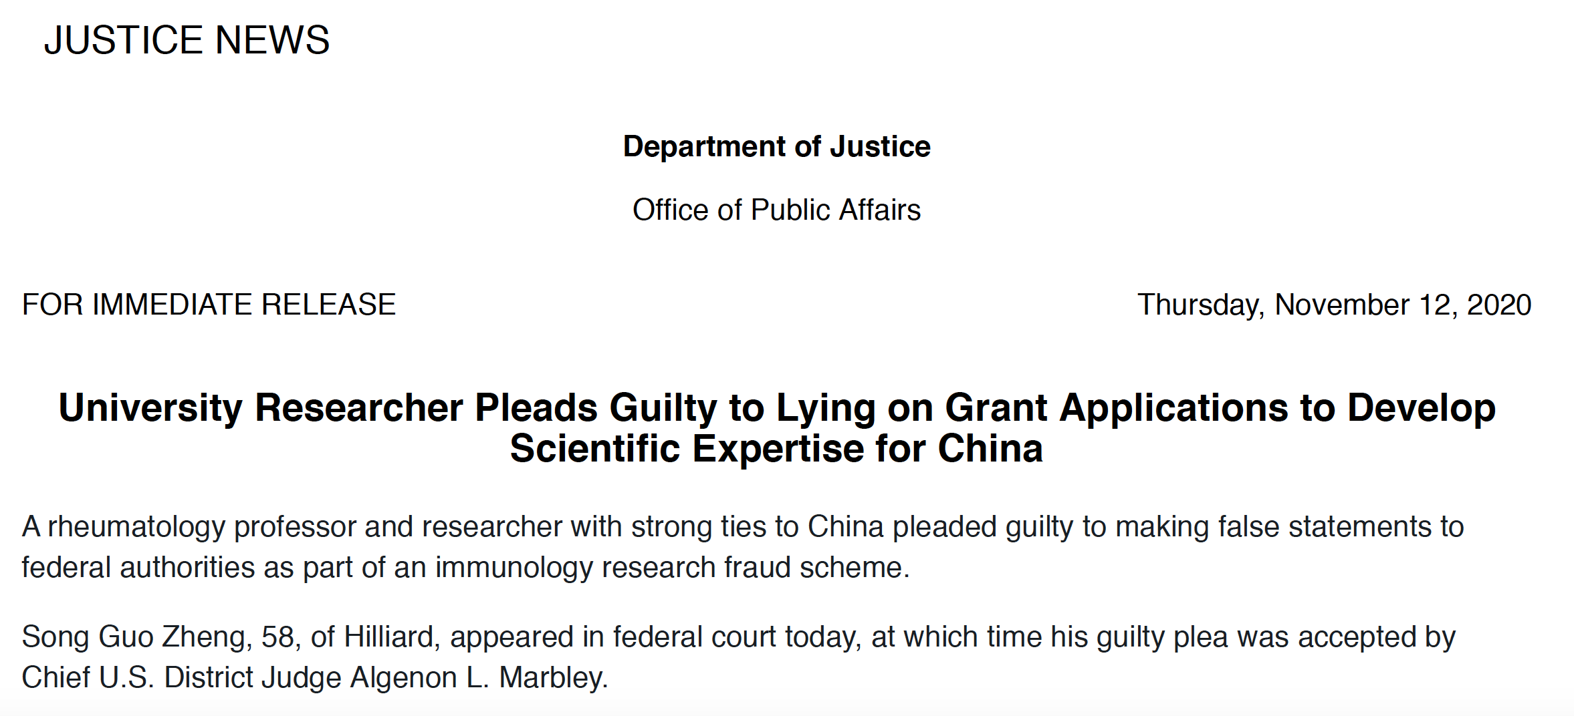
Lying on Grant Applications to Serve Foreign Interests

Slide 35
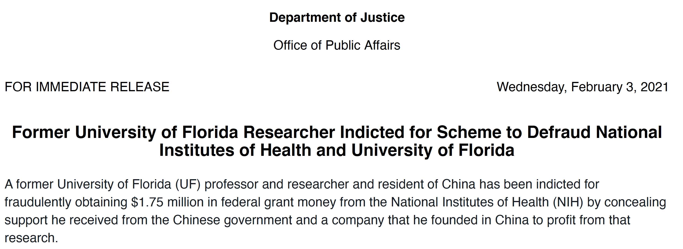
Lying to Serve Foreign and Personal Interests …

Slide 36
“Deep Informatics”
“During that same period, in 2016, Yang established a business in China known as ‘Deep Informatics.’ The indictment further alleges that Yang promoted his business in China by relating that its products were the result of years of research supported by millions of dollars of U.S. government funding. Simultaneously, Yang applied for and was accepted into the People’s Republic of China’s Thousand Talents Program (TTP) in connection with Northwestern Polytechnic University, located in Xi’an, China.”
https://www.justice.gov/opa/pr/former-university-florida-researcher-indicted-scheme-defraud-national-institutes-health-and

Slide 37
Responsible Conduct of Research
Conducting research
  “Classic” integrity: fabrication, falsification, plagiarism
  Other: peer review, harassment, non-disclosure
Responsibility to conduct the right research
  Focus on COVID-19

Slide 38
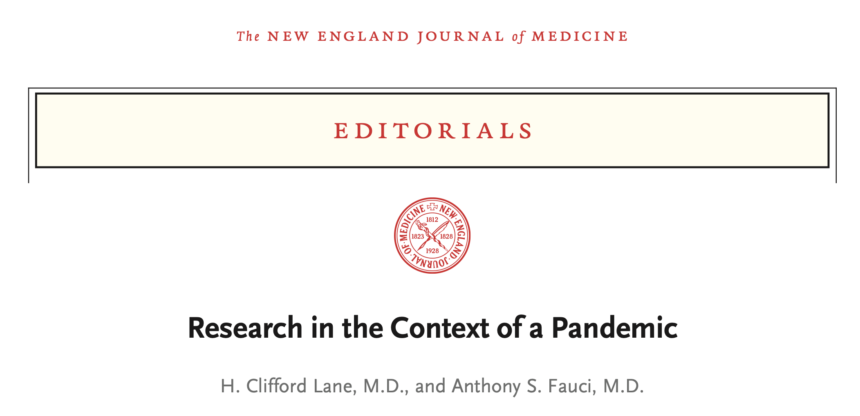
In the Context of Pandemic
“The current literature on the treatment of Covid-19 is filled with anecdotal reports of therapeutic successes in clinical trials with small numbers of patients and observational cohort studies claiming efficacy with little regard to the effect of unrecognized confounders. For the field to move forward and for patients’ outcomes to improve, there will need to be fewer small or inconclusive studies and more studies such as the dexamethasone trial now reported by the RECOVERY Collaborative Group.”
https://www.nejm.org/doi/pdf/10.1056/NEJMe2024638?articleTools=true

Slide 39
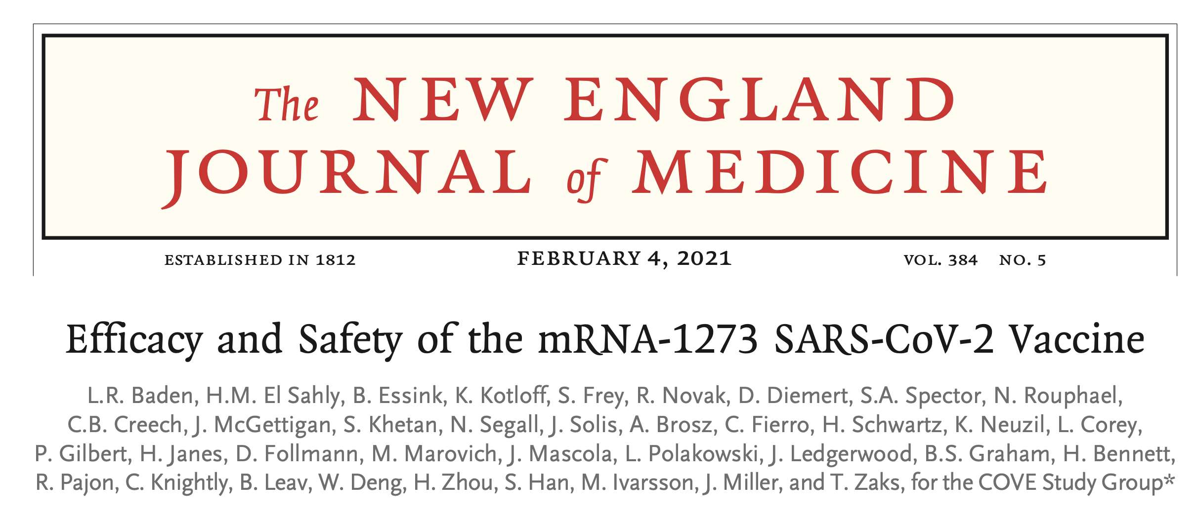
Large-Scale, Randomized
https://www.nejm.org/doi/pdf/10.1056/NEJMoa2035389?articleTools=true

Slide 40
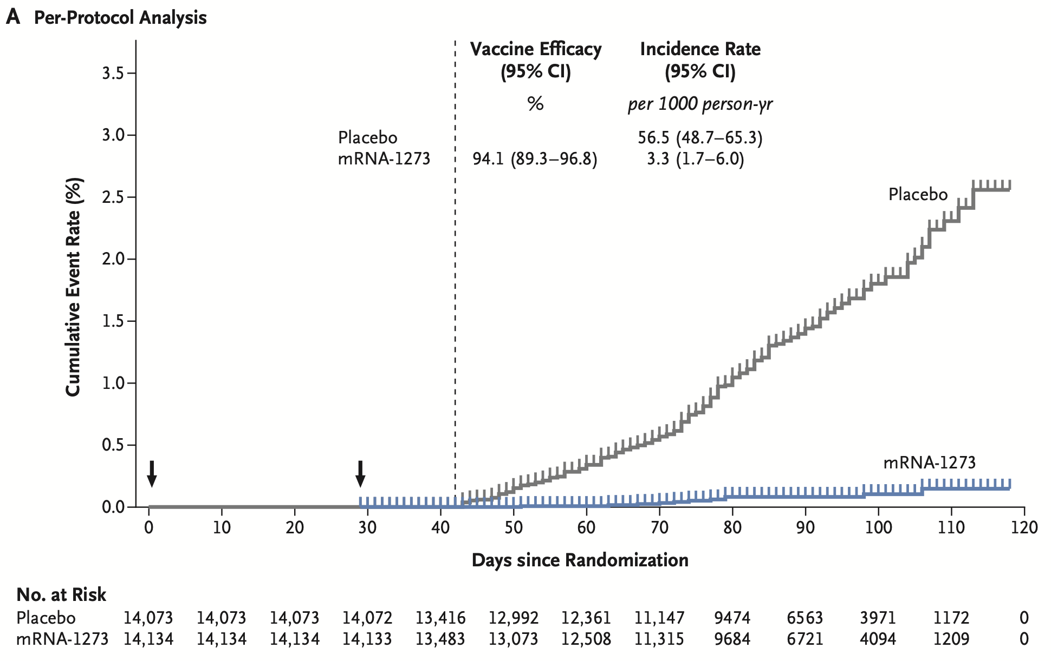
Large-Scale, Randomized, Definitive
https://www.nejm.org/doi/pdf/10.1056/NEJMoa2035389?articleTools=true

Slide 41

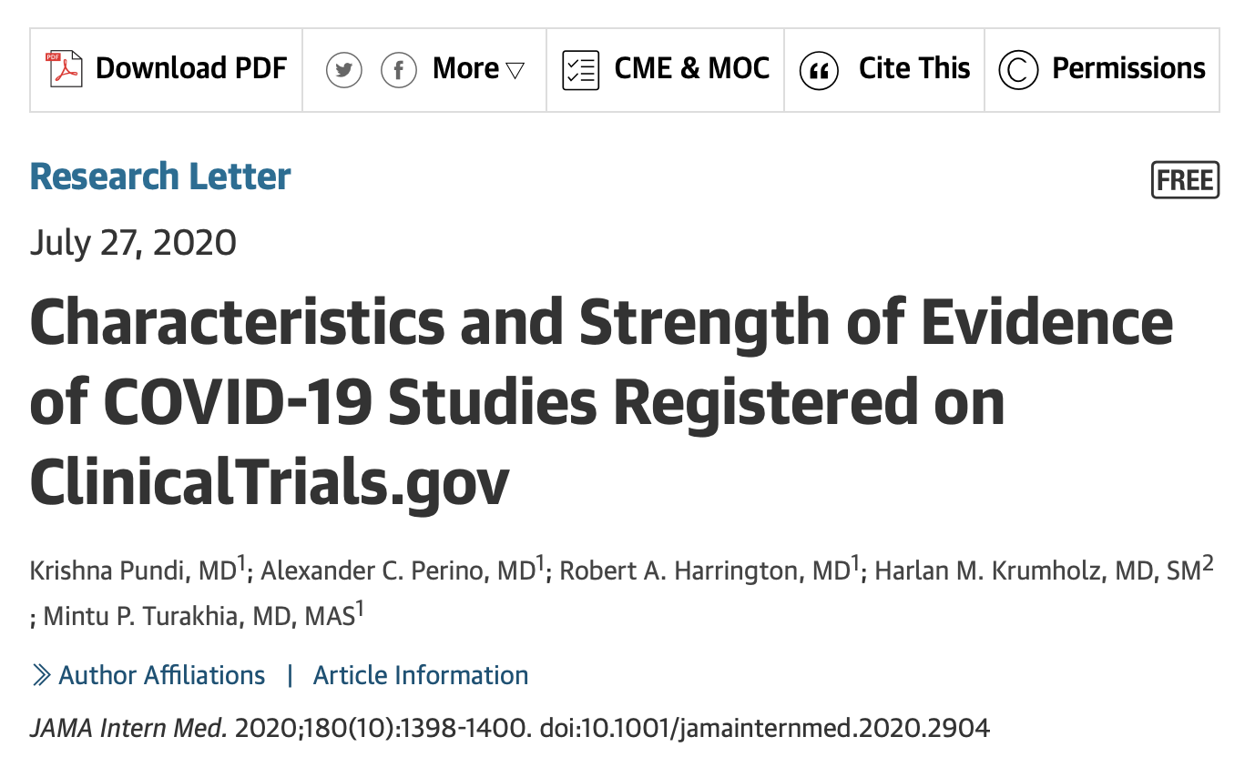
Concerns
https://jamanetwork.com/journals/jamainternalmedicine/fullarticle/2768882

Slide 42
Low Yield
“This cross-sectional study found that despite the marked rise in COVID-19 studies, only 29% of those registered in ClinicalTrials.gov have the potential to result in OCEBM level 2 evidence. Of the RCTs, only 29% are placebo-controlled, blinded studies … Even before results are known, most studies likely will not yield meaningful scientific evidence at a time when rapid generation of high-quality knowledge is critical.”
https://jamanetwork.com/journals/jamainternalmedicine/fullarticle/2768882

Slide 43

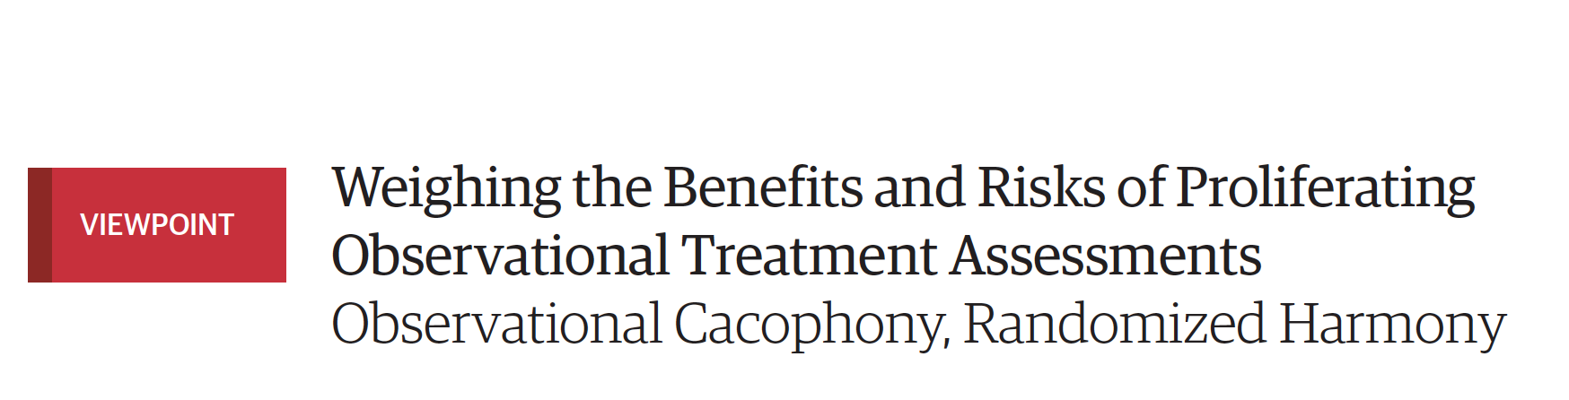
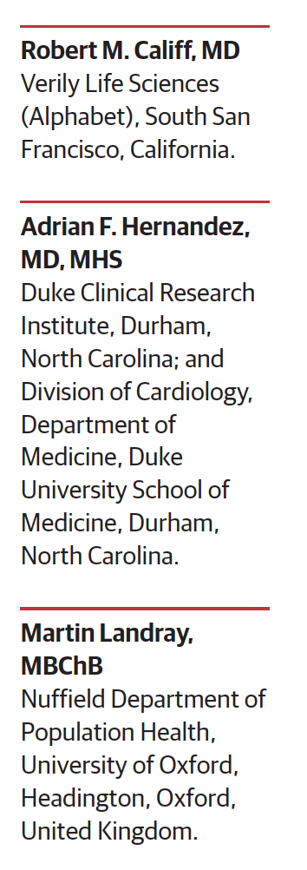
Cacophony vs Harmony
“Another recent study of 20,000 patients treated with plasma infusions from recovering COVID-19 patients claimed evidence of safety and. Expressed optimism for benefit based on low reported event rates, although there was no control group to anchor the observed event rates. If a fraction of these patients had been enrolled in RCTs, the answer for whether this intervention was effective would now be known.”
https://jamanetwork.com/journals/jama/fullarticle/2769139?utm_campaign=articlePDF&utm_medium=articlePDFlink&utm_source=articlePDF&utm_content=jama.2020.16238

Slide 44
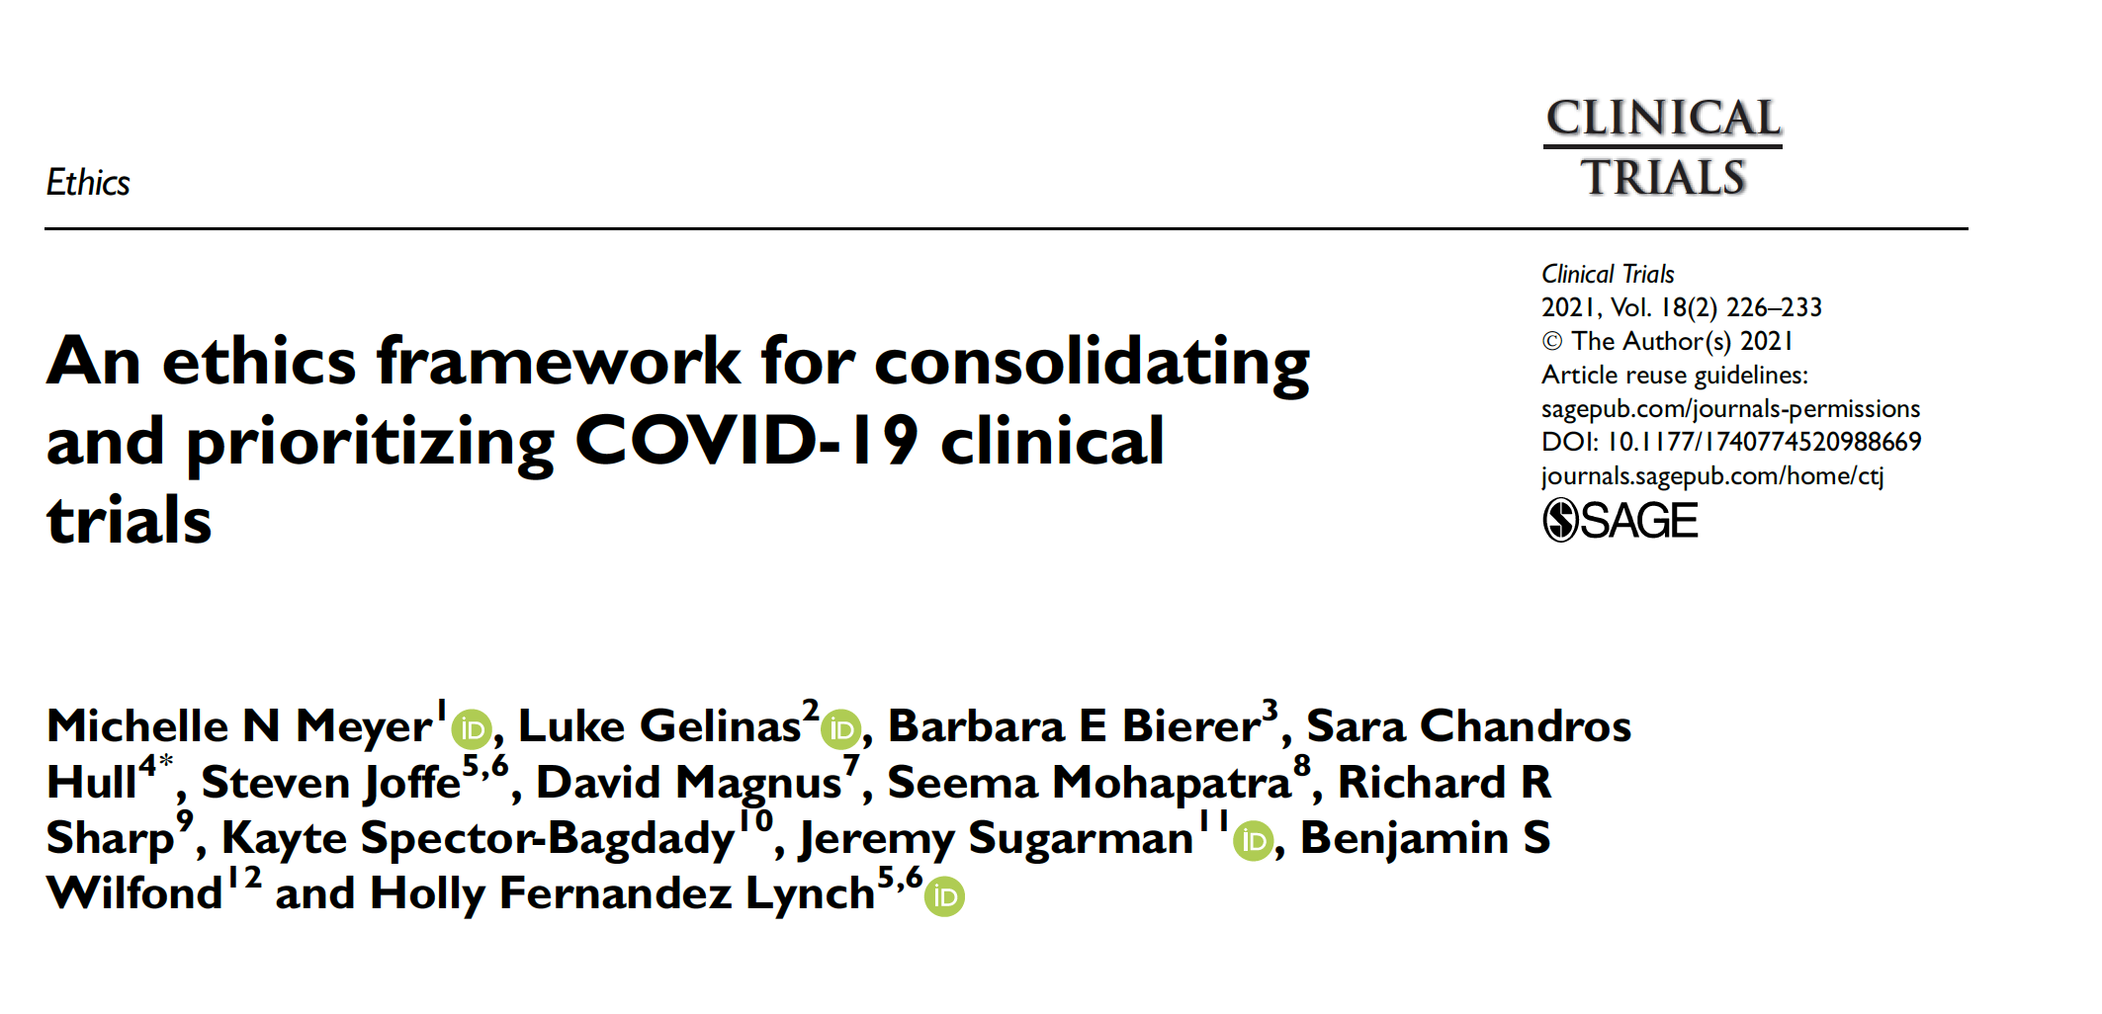
Being Addressed

Slide 45
Closing Thoughts
Impact on research “bipolar”
Extensive, and disproportionate, disruption
Long-term effects unclear
Opportunity for a future reset?
NIH priorities:
  Early career / at-risk investigators, certain trials
  Integrity above all (including peer review)

