Slide 1






Brokering Research-Practice Partnerships
Jaynie C. Mitchell, EdD
Brigham Young University Research Development
April 25, 2022
How RD Can Help Researchers Share the Power

Slide 2
Welcome!
Please put your name, where you are, and how long you have worked in RD in the chat.
How much do you know about Research-Practice Partnerships (RPPs)? Lots, little, never heard of it? That’s ok!

Slide 3
Research-Practice Partnerships (RPPs)
Research-Practice Partnerships are:
Long-term, collaborative (researcher-practitioner) research efforts based on the principles of mutualism and equity
Researchers and their community-based partners co-develop research questions, goals, and outcomes based on the partner’s needs and interests
Study findings have practical application and are broadly shared by the team in both the research and practice communities
Chat prompt: How does this model shift the power dynamics of traditional research?

Slide 4
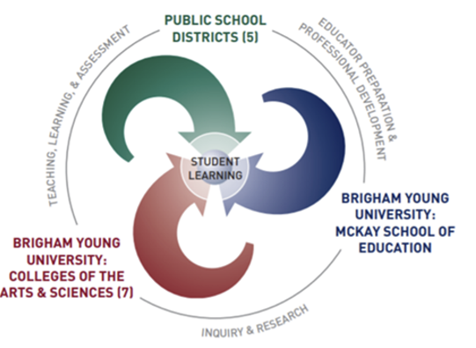

BYU’s McKay School of Education leads a
Research-Practice Partnership (RPP) that supports the development of research projects within our five
BYU-Public School Partnership (BYU-PSP) districts
Notes:
When conducting research, it is easy to go to one source: Wikipedia. However, you need to include a variety of sources in your research. Consider the following sources:
Who can I interview to get more information on the topic?
Is the topic current and will it be relevant to my audience?
What articles, blogs, and magazines may have something related to my topic?
Is there a YouTube video on the topic? If so, what is it about?
What images can I find related to the topic?

Slide 5

BYU is joining the national conversation
A program of the Kinder Institute for Urban Research at Rice University

Slide 6


According to NNERPP, here’s what makes the Research-Practice Partnership approach to mutualistic research design, development, and dissemination unique
Chat prompt: Why do you think RPPs could be challenging to create and difficult to maintain?

Slide 7
What is brokering?
Brokers are the professionals that serve as the bridge between the research and practice communities within partnerships
A broker helps members of research and practice organizations integrate into an RPP by cultivating and maintaining the relationships needed to effectively support research production and use
Brokers support “joint work” between researchers and practitioners by crossing the professional and organizational boundaries between their worlds (Wentworth, et al., 2021, p. 1, 4)

Slide 8
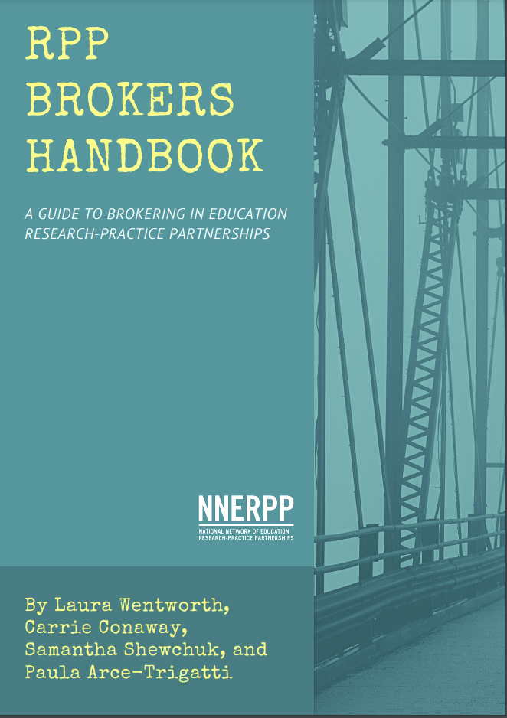
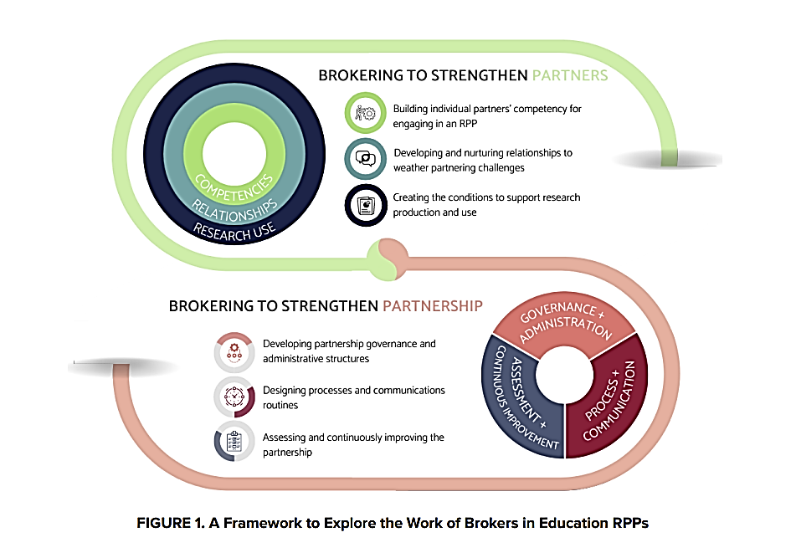
Brokering RPPs
http://nnerpp.rice.edu/rpp-brokers-handbook/

Slide 9
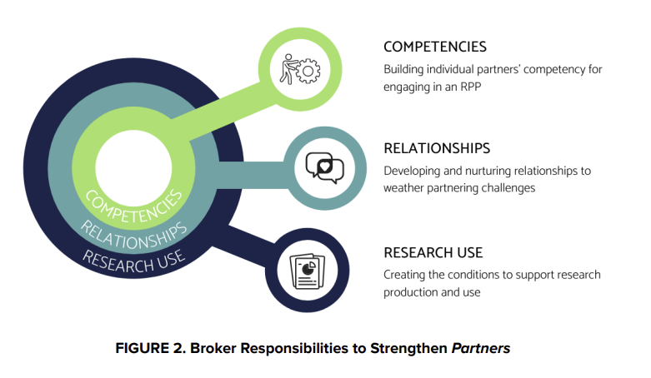
RD can build
Wentworth et al., (2021), p. 6-7

Slide 10
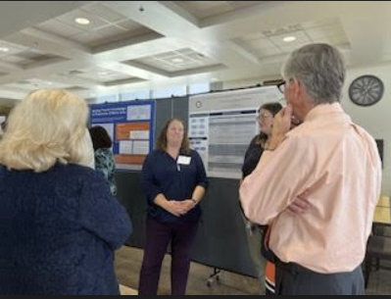
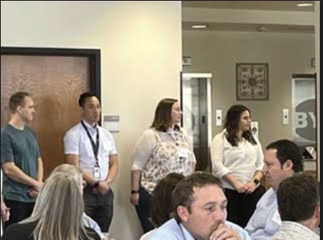
RPP
Research Project
Support
In 2020, BYU’s president funded a
pilot to support new RPP research projects –
In 2022, this pilot moved to ongoing status
Program Support
Project Development, Delivery, and Dissemination Support –
Design phase guidance and funding
RPP skill development workshops
Fall RPP Retreat (RPP Team presentations)
Spring RPP Showcase (RPP Team poster session)
Three years of funding for approved projects
One-stop “consent to conduct research” portal

Slide 11
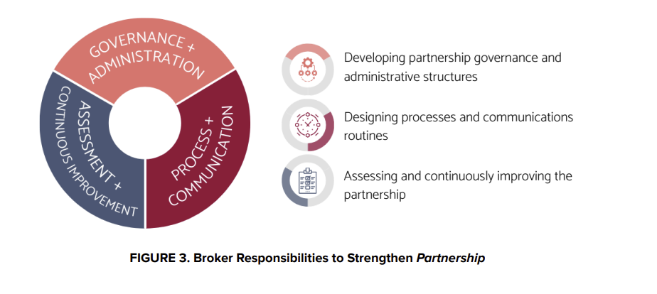
Lead institutions can build RPPs by

Slide 12
2022-2024
CITES Fellowship Grant
Heather Leary, PhD, IP&T
Jaynie Mitchell, EdD, MSE Dean’s Office
Qualitative, exploratory case study to investigate the supports offered to early-stage Research-Practice Partnership (RPP) projects and explore how up to eight (8) RPP project teams form and function over time.
Research Questions:
How do BYU-PSP RPP project teams form and progress through their lifecycle?
How does the institution provide support to BYU-PSP RPP projects?
How is this support received throughout a RPP project’s lifecycle?

Slide 13
Learn more about Research-Practice Partnerships
Recommended Resources
Penuel, W. R. & Gallagher, D. J. (2017). Creating Research-Practice Partnerships in Education, Harvard Education Press. ISBN 978-1-68253-047-4
National Network of Education Research-Practice Partnerships (NNERPP) http://nnerpp.rice.edu/
Coburn, C. E., & Penuel, W. R. (2016). Research–practice partnerships in education: Outcomes, dynamics, and open questions. Educational Researcher, 45(1), 48-54.
Assessing Research-Practice Partnerships Report – William T. Grant Foundation
Wentworth, et. al., (2021) RPP Broker’s Handbook
Research-Practice Partnerships: Power Dynamics

Slide 14

How can RD lead the work?
How can RD encourage equity in your research teams?
How does your institution collaborate to share power?
Where are you seeing progress in this work?

Slide 15
The NORDP Climate Survey is Coming!
NORDP is partnering with Kanarys to launch the 2022 NORDP climate survey next month! The results of this survey will drive decision-making, policies, and programming within NORDP, and we want to hear from you.
Be on the lookout for this survey to arrive in your inbox during the month of May. The first 30 respondents will be eligible for a variety of prizes!

Slide 16
Questions?
Contact Jaynie_Mitchell@byu.edu
Notes:
You can use this slide as your opening or closing slide. Should you choose to use it as a closing, make sure you review the main points of your presentation. One creative way to do that is by adding animations to the various graphics on a slide. This slide has 4 different graphics, and, when you view the slideshow, you will see that you can click to reveal the next graphic. Similarly, as you review the main topics in your presentation, you may want each point to show up when you are addressing that topic.
Add animation to images and graphics:
Select your image or graphic.
Click on the Animations tab.
Choose from the options. The animation for this slide is “Split”. The drop-down menu in the Animation section gives even more animations you can use.
If you have multiple graphics or images, you will see a number appear next to it that notes the order of the animations.
Note: You will want to choose the animations carefully. You do not want to make your audience dizzy from your presentation.

