Slide 1

NSF CAREER Mock Review Panels Strategies for Success
Beth Hodges, MSW Florida State University
Elizabeth Festa, Ph.D. Rice University
Missy Jenkins, MS, MPPA Texas Tech University
Jessica Venable, Ph.D. Thorn Run Partners
NORDP 2022 National Conference

Slide 2
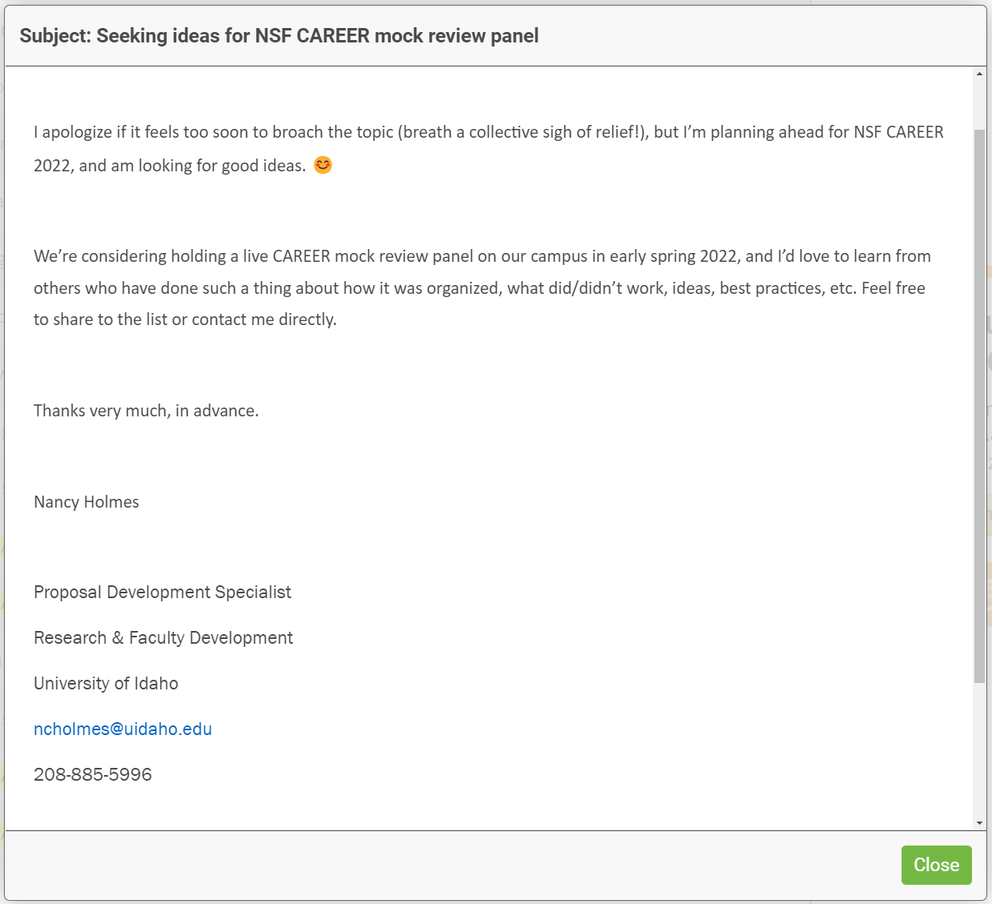
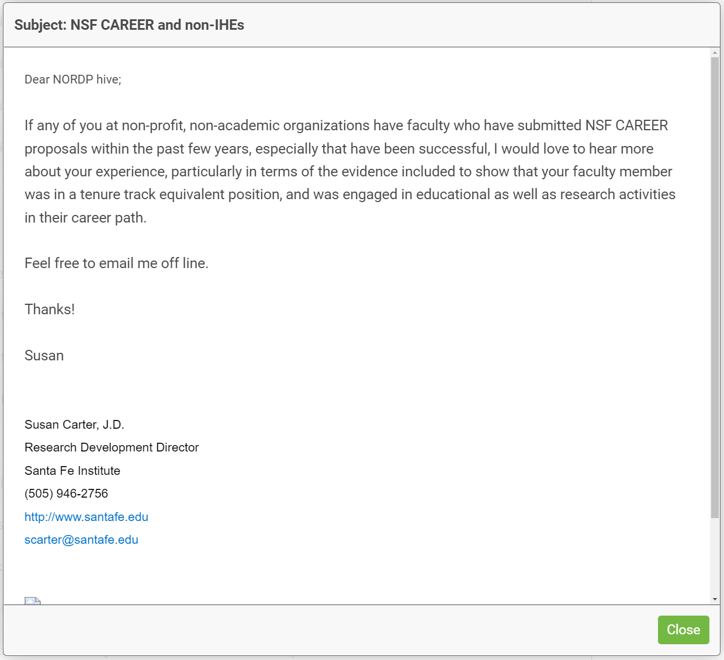
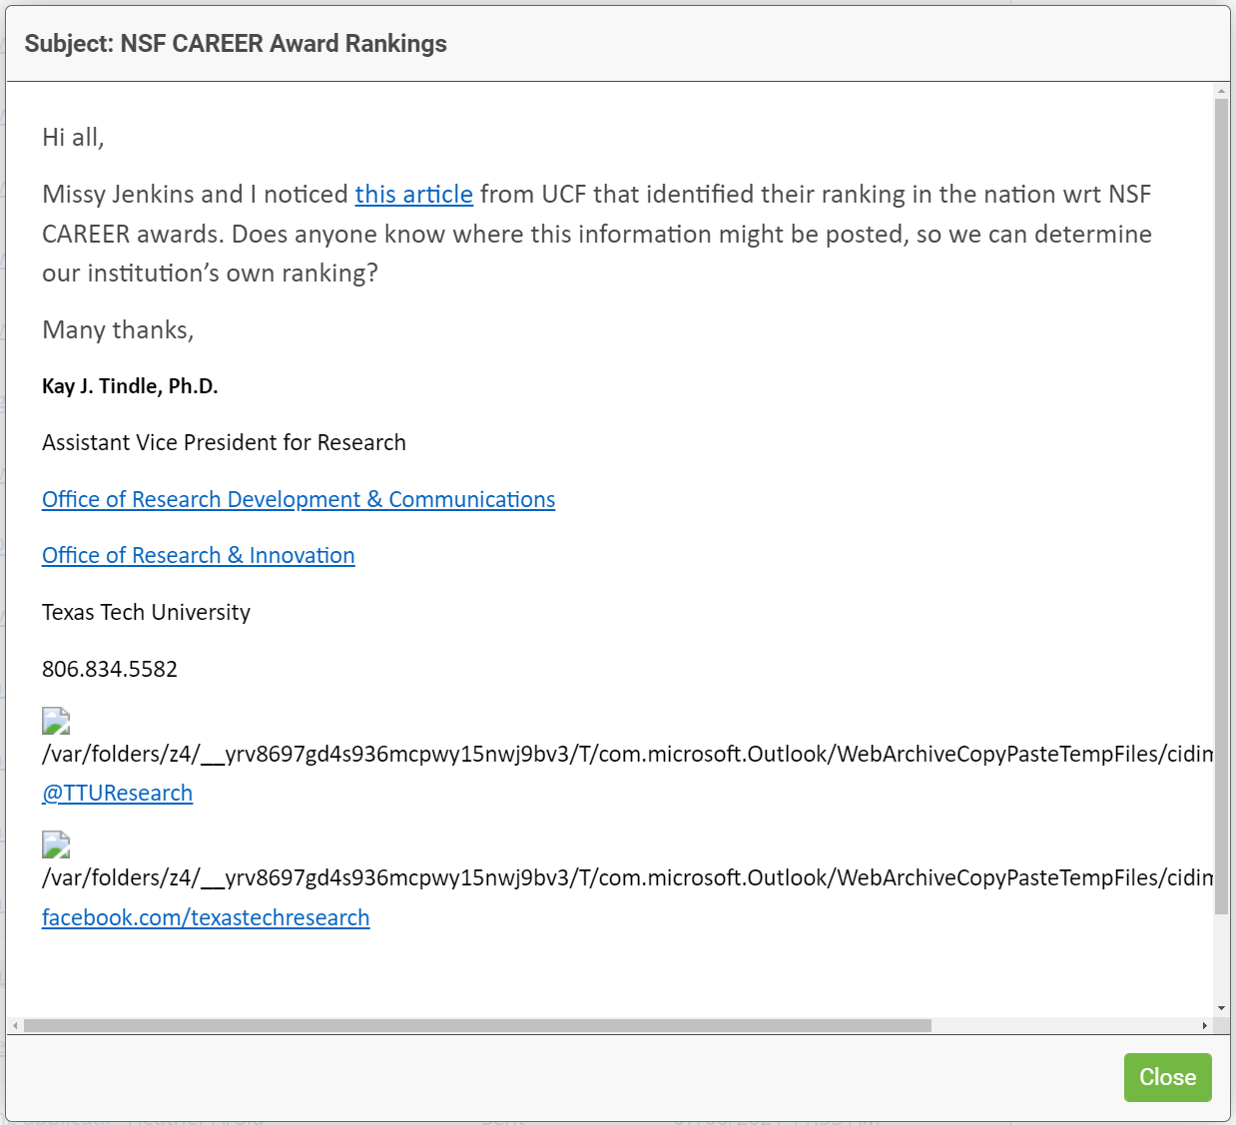
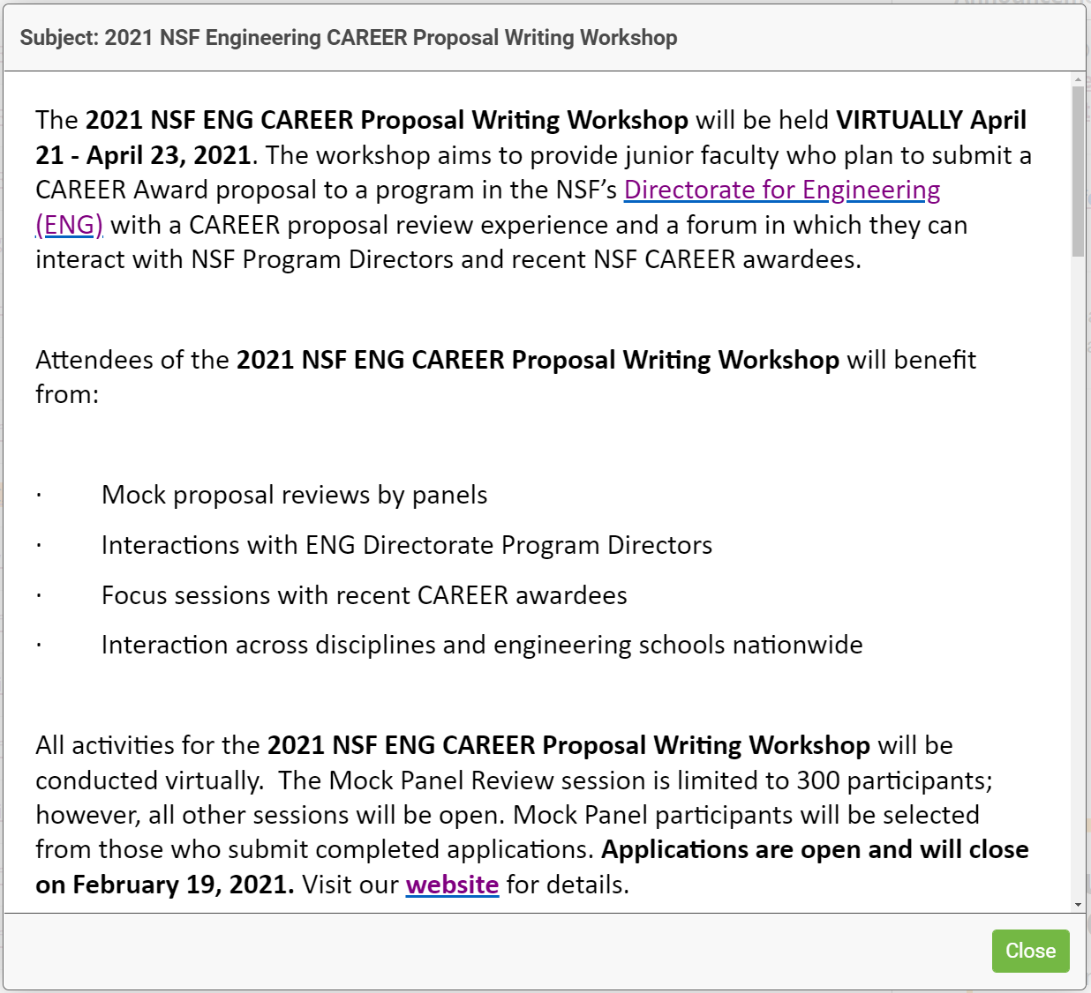
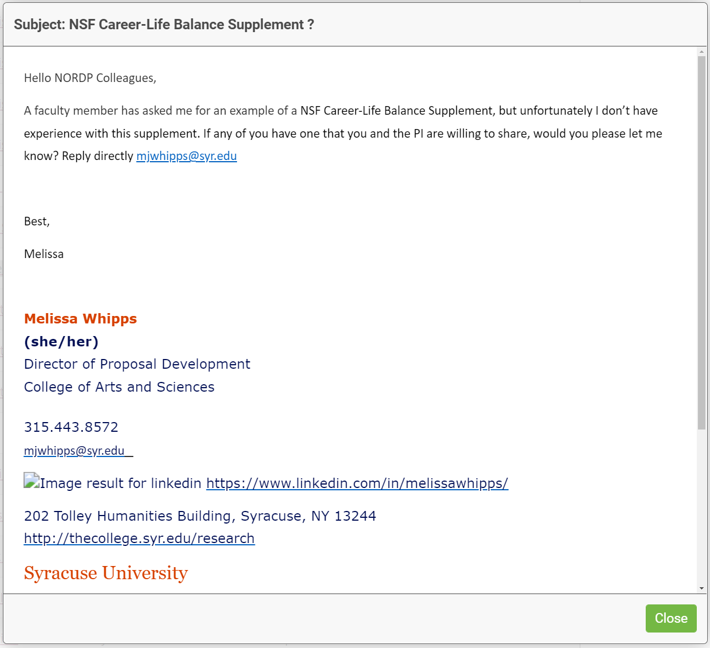
NSF Career has always been a hot topic of discussion among the NORDP community.

Slide 3
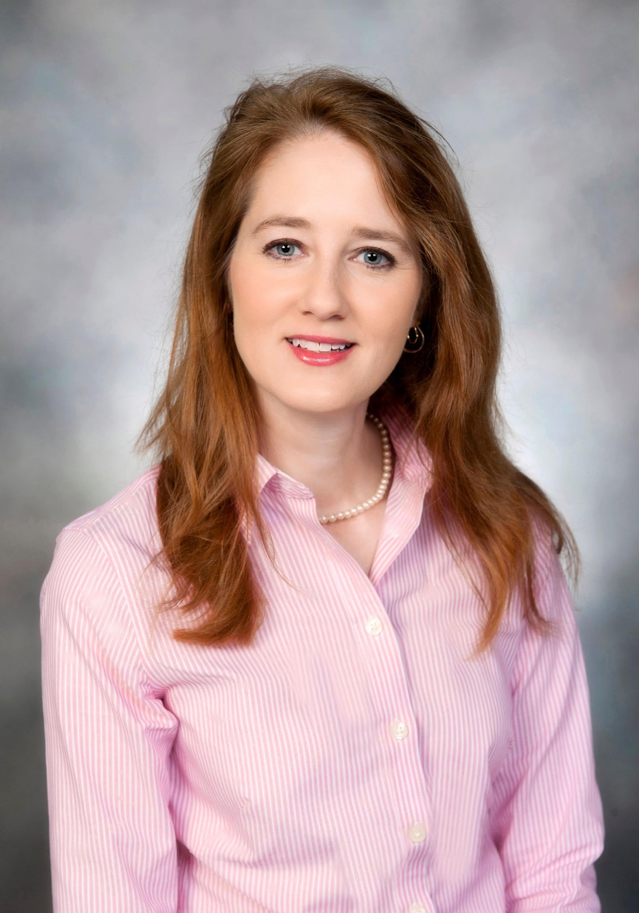
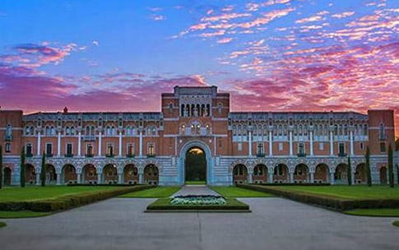
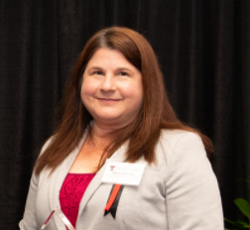
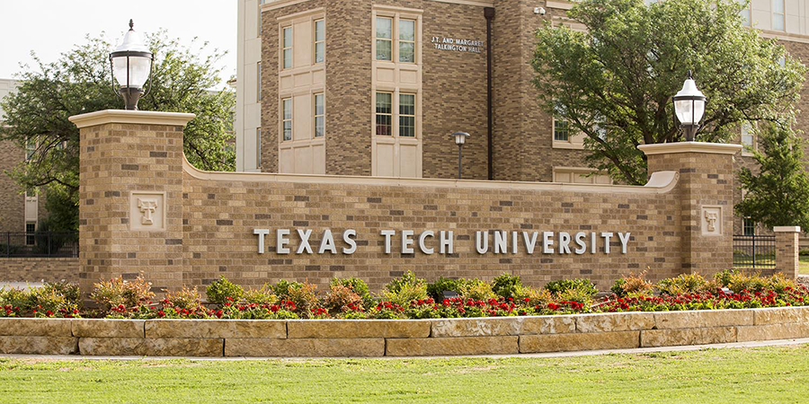
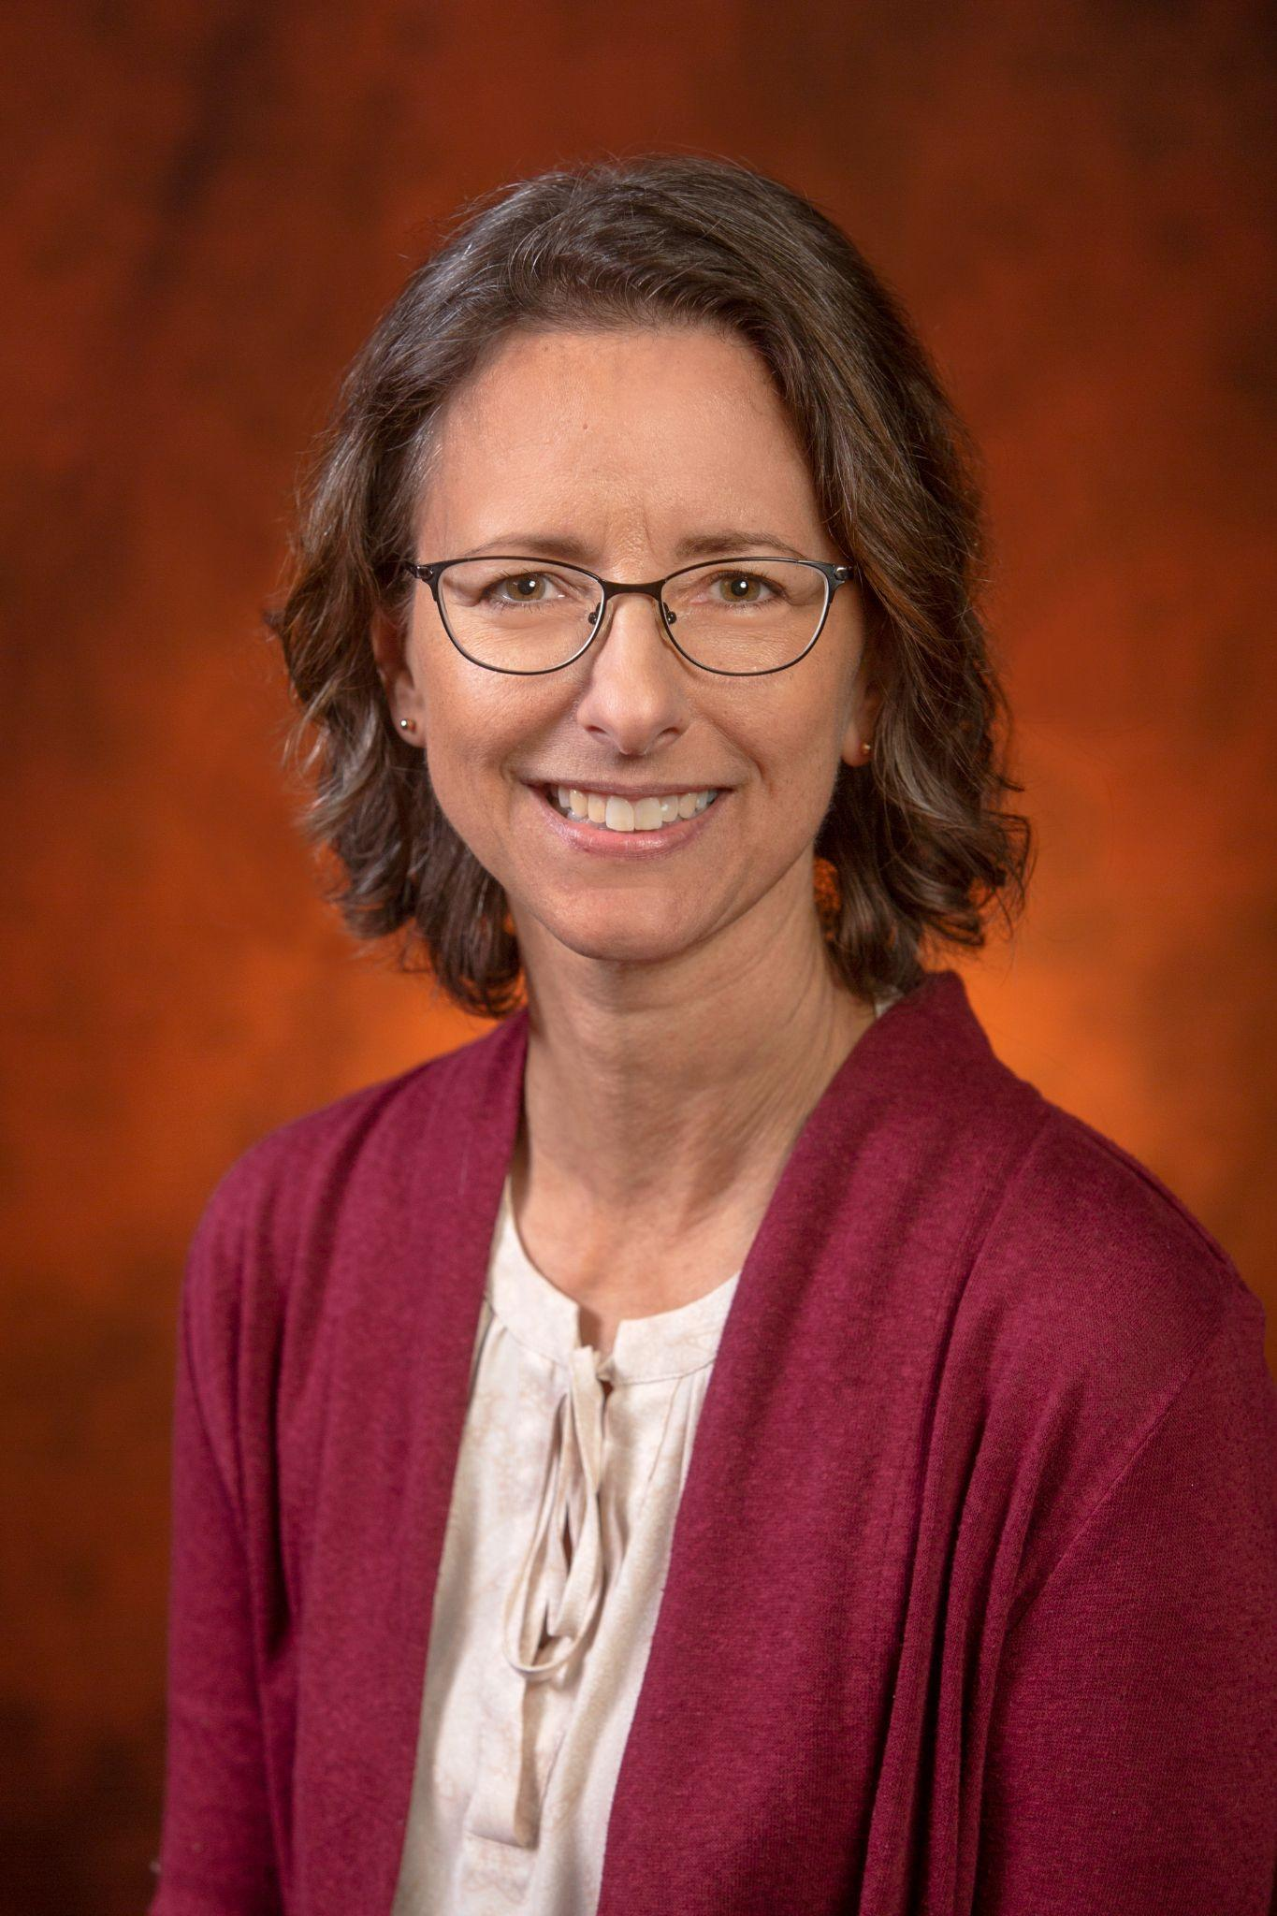
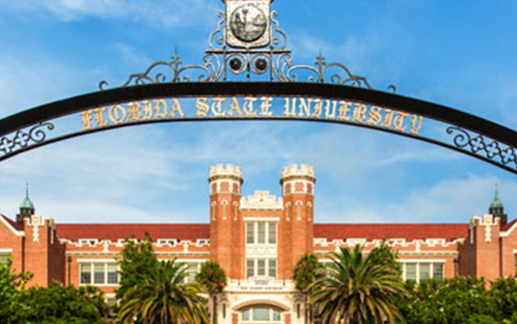
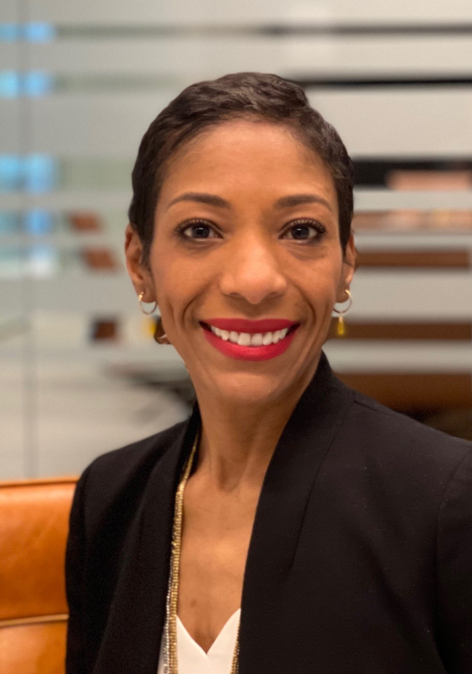

Elizabeth Festa, Ph.D.
Proposal Development Specialist
Rice University, eaf2@rice.edu
Missy Jenkins, MS, MPPA
Assistant Director
Texas Tech University, missy.jenkins@ttu.edu
Beth Hodges, MSW
Director, Office of Research Development
Florida State University, bhodges@fsu.edu
Jessica Venable, Ph.D.
Partner
Thorn Run Partners, jvenable@thornrun.com
Notes:
JESS: Open up introductions
Each will introduce selves; Jessica goes last to discuss role in presentation

Slide 4



Institution | Size (Students) | Total Full-time Faculty (all schools) | Research Priority | FY21 Research Expenditures | RD Office | RD/PD Staff | Schools Supported by RD | CAREER Applicant range per year | CAREER wins over past 4 years / Total Applied
 | 32, 520 UG 10,610 G | 1926 | R1 | $275 m. | Central RD | 6 | 11 colleges | 15-25 | 21 / 93 (23%)
 | 33,256 UG 7410 G | 1600 | R1 | $105 m. | Central RD | 6 | 12 schools | 15-20 | 14 / 81 (17%)
 | 4,096 UG 3484 G | 698 | R1 | $180 m. | Central PD under VP for Research | 4 | 6 schools | 10-20 | 25 / 55 (45%)
Institutional Profiles
COMPARISON
Notes:
Jess
Each institution presenting today is quite similar, except on a few key measures WE WERE CHANGING THE WORDING ON THIS CORRECT? MAYBE ADDING ANOTHER CATEGORY?
Maybe highlight the similarities really quickly (R1, central offices) and the big difference–size of school (and # of applicants over the past 4 years)

Slide 5






What is NSF CAREER?
NSF’s most prestigious award for early-career faculty.
Supports academic role models in research and education.
Fosters leaders who can advance the mission of their department or organization.
CAREER proposals must have an integrated research and education plan at their core.
Notes:
Jess
NSF is one of many early career awards (K99/R01; DOE);
Unlike other agencies, NSF CAREER is focused on create scholar-teachers (not just academic researchers) – education is an important component;
Considered to be one of the most prestigious awards for new investigators
you have the imprimatur of the NSF!
Gateway to an R1
social pressure (ease of pivoting to a standard grant from a CAREER);

Slide 6
The Peer Review Debate
QUALITY
BIAS
PREPARATION & PROCESS
OUTCOMES & BENEFITS
Reliability
Validity
Generalizability
Predictive power
History of the federal grant review process in the U.S.
Impact of the race, ethnicity, & gender of applicant
Impact of the race, ethnicity, & gender of reviewer
Institutional biases
Disciplinary cultures
Social dynamics
Power dynamics
Reviewer training & preparedness
Remote v. In-person panels
Incentives
Impact on future research productivity
Notes:
JESS:
Given the prestige of NSF CAREER, many have tried to “crack the code” around peer review to demystify how decisions are made around these awards
However CAREER review is just a small part of the overall debates around peer review
There are 4 major thrusts to this debate:
QUALITY: reliability of reviews; validity of reviews; generalizability of reviews; predictive power of reviews in the area of grant productivity
BIAS: impact of the race, ethnicity, and gender of applicant on reviews; institutional biases in the review process; the disadvantages of HBCUs in the grant review/research process; disciplinary cultures and how these manifest through the review process
PROCESS & DYNAMICS: social dynamics within grant review panels; the need for better training of reviewers and education on difference; remote v. in-person panels; incentivizing reviews
OUTCOMES: does being a reviewer make you a better grant-getter?

Slide 7

The Peer Review Debate
“Some academics have a propensity to assume that quality is intrinsic to the work and that some scholars have a natural talent for finding it.
But in fact the ‘cream’ does not rise naturally to the top, nor is it ‘dug out’ in unlikely places: it is produced through expert interaction, with the material provided by applicants. Neither the work nor the people are socially disembedded.
Panelists’ definitions of excellence are rooted and arise from their networks of colleagues and ideas. They aim for fairness, but the taken-for-granted aspects of social life—the cognitive structures they use routinely, the multiple networks of which they are a part—may lead them to assume that what appeals to them is simply best.”
~Michele Lamont, How Professors Think: Inside the Curious World of Academic Judgment, Cambridge and London: Harvard University Press, 2009, p.241
Notes:
JESS
We also cannot disregard the human context.
Reviewers and the peer review process ARE NOT OBJECTIVE, despite our belief in Cartesian ethics
Peer review is embedded in a social structure which can make “cracking the code” even more difficult for new investigators
Across all Rice, Texas Tech, and FSU, RD professionals strive to demystify the peer review process

Slide 8
How do you define “mock review”?
A structured process / activity to provide PIs with meaningful feedback on their grant proposals prior to submission.
External Peers
Internal / Cohort Peers
Technical / SME
Overall
Merit
Compliance
Panel
Individual
Paid
Volunteer
Live
Asynchronous
Lecture
Interactive
Constructive
Critical
Notes:
JESS
As we will discuss throughout this presentation, one of the approaches to these schools have taken is to incorporate a MOCK REVIEW element into NSF CAREER preparation.
But what do we mean by “Mock Review”?
Now we know what Peer review looks like at NSF as a way for panelists to make funding recommendations.
But we cannot duplicate (or mock) that exercise on campus. As a result, we “approximate” the peer review process – which can have a lot of variations:
Wo serves as reviewers? – Peers from outside the institution? Peers from inside the university but outside of the cohort? Fellow cohort members?
What is the focus of the review? -- On the technical / scientific merit or the overall grantsmanship?
Is it actually a PANEL, or is the review process a 1-1 exchange between PI and an eva\luator?
How are reviewers incentivized – Are they paid or is it volunteer?
To what extent does the PI and others participate in the review discussion?
And across the three campuses, “mock review” is not even a consistent term. For your institution, what is the definition of “mock review”
TEXAS TECH: What do you call your version of this activity?
RICE: What do you call your version of this activity? At Rice, a “mock review” is a session in which applicants have their full CAREER draft critiqued by a panel of experts external to the workshop cohort. These are previous winners and reviewers, and may include faculty external to the institution. We use the term “mock” review to distinguish this activity from “peer review” and “RD review” that are also a part of our workshop and are activities that are *internal* to our workshop. Like TTU, we do value peer-to-peer skill building.
FSU: What do you call your version of this activity?
In sum, for the purposes of this presentation, we will define MOCK REVIEW as “A structured process / activity to provide PIs with meaningful feedback on their grant proposals prior to submission.”

Slide 9
Similarities and differences
Our approaches
Why did you do it? | Motivation and drivers for the mock review
How did you do it? | Implementation and design of the mock review
What were the outcomes? | Feedback, results, and impacts of the mock review
What did you learn? | Lessons learned and recommendations
Resources | Literature, toolkits, models, and templates for adaptation
Notes:
JESS
Today’s discussion will answer 4 big questions:
Why did your institution offer NSF CAREER mock review?
How are the NSF CAREER mock reviews structured?
What were the outcomes of the NSF CAREER mock review activity?
If you knew then what you know now, what recommendations would you make to others hoping to design and deliver NSF CAREER mock review activities.
Finally we’ll offer some resources that you can pull from.

Slide 10

Created by Chanut is industries, the Noun Project
Motivation
WHY DID YOU DO IT?
Notes:
JESS
Let’s start with your motivation – Why offer mock review as part of preparing faculty to submit competitive NSF CAREER proposals?

Slide 11



Why include “mock review”?
Rice University
Provide technical review
Diversify participation
Have relied solely on small group peer review and RD staff review in past
Preference for RD staff review over peer review*
Certain departments / schools underrepresented in the workshop
  Increase participation but maintain cohort size
  Recruit mock reviewers to advertise RD services
Peer
RD
Expert
Credit: “Peer review” (Cody Foss) “Panel” (Adrien Coquet); “Develop” (Flatart). https://thenounproject.com/icon/develop-2933495/
Notes:
ELIZABETH
We want to be able to offer a technical review within the boundaries of our workshop (in addition to sending faculty back to their departments for review). Previous survey suggested that participants valued RD feedback slightly more than peer review—we wanted to increase the amount of “authoritative” feedback they receive.
We also wanted to use the mock review as a recruiting tool for our workshop to offer something that might entice departments that attend our workshops less frequently;We are small and can’t really increase our cohort size, but we are hoping to use MR for any faculty that cannot or aren’t interested in attending the workshop as a whole
Have relied solely on small group peer review and RD staff review in past. Evaluations showed surprising preference for RD staff review over peer review*
Certain departments/schools underrepresented in the workshop
Opportunity to increase participation without increasing total cohort size
Opportunity to recruit mock reviewers as a tool for advertising RD services

Slide 12
Why include “mock review”?
Florida State University
Improve proposals to increase success
Address preeminence
metric
Provide detailed feedback as a way of improving competitiveness
Increase NSF CAREER award numbers as a subset of activities metric for preeminence status
Notes:
BETH
We feel that this process provides an opportunity for faculty to receive feedback which can make their proposals more competitive. It also allows these junior faculty to see the benefits of pre-submission review and also the value of working on proposals early.
A carrot for wanting to increase the number of peer reviews-- although we would do this program anyway-- is that NSF career awards are part of a larger preeminent metric for the state of Florida. Florida currently has three universities designated as preeminent universities. Those are Florida State, the University of Florida, and the University of South Florida. This performance-based designation can provide millions of additional dollars from the State.

Slide 13
Why include “mock review”?
Texas Tech University
Support OR&I’s strategic focus
Support all NSF CAREER applicants
Increase number and quality of early career award applications, even beyond NSF CAREER
Complement and extend early career programming
  Research Career Mapping Exercise
  Writing Group
  Annual NSF CAREER Workshop
Reduce anxiety around review
Notes:
MISSY
Our Office of Research & Innovation has a major strategic focus on early career investigators. We want to get them early in their careers, so that as they begin to write grant proposals, including the CAREER, they can be more competitive. We start with our Research Mapping Initiative to help them understand their research agenda visualizing where they want their research to go/conceptual/defining interests/where they see themselves as a researcher in next 5 to 10 years; And then we ask them to do a calendar of their publications/conferences/ and grant proposals – including the NSF CAREER. So hopefully after that exercise they will have an understanding of the timeframe for submission to an early career opportunity.
We have Two program managers in our office who are specifically tasked to personally reach out to new faculty and we run 2 early career writing groups.
And, as NSF one of our largest funders – the Career is a natural fit for us.
Lastly, we’ve noticed that many of our early career faculty are hesitant to share their work, so one of our goals is to reduce that anxiety and help them feel more comfortable receiving feedback.

Slide 14

What was the history of mock review at your institution?
Have motivations evolved over time?
Did you have personal motivations for including mock review exercises?
Created by Soremba, the Noun Project
Notes:
JESS
BETH: How does mock review sit within the history of your office, RD services? Actually, my work with a CAREER program began two years prior to the creation of our RD office. So we are in the 11th year of CAREER efforts, but in our third year of holding our mock reviews. In the first year of doing the reviews, we offered them to just the College of Engineering faculty. This was a good start to see if they were helpful or if we needed to change anything. The following year we expanded to provide the service to all FSU faculty applying. This will be our third year this year.
MISSY: You “inherited” mock review. How has the motivation changed? – The CAREER mock review has been taking place since 2017 at TTU, but I didn’t join the office until 2020, so our motivations are still about helping faculty be more competitive and increase our numbers, but I will say we also have a more hand-holding approach now in order to really help them understand the review process overall and feel comfortable with it.
ELIZABETH: What were your personal motivations for including this component?
Our program is adding this component this year for the first time. We are in a good place our workshop series has been well-received. But we are always interested in providing the best experience possible. I have a research interest in how different types of feedback---peer, RD, and “expert” benefit faculty. I’m interested in studying this over the next few years and discovering how these different kinds of feedback work synergistically to improve faculty proposals.

Slide 15

Created by Icelloid, the Noun Project
Design and Implementation
HOW DID YOU DO IT?
Notes:
JESS
Let’s get into the nitty gritty of logistics.
(1) How does MOCK REVIEW fit into your overall NSF CAREER programming?
(2) What does Mock review “look like”

Slide 16
How does “mock review” fit in overall programming?
Texas Tech University
Research Building Blocks Series
Intermediate Early Career Faculty Writing Groups
NSF CAREER Workshop
“Mock Review”
Fall
Fall & Early Spring
March
May or Early June
Targeted to New & Early Career Faculty, teaching grant writing skills necessary for early career awards
Writing groups for faculty with at least 3 years experience in academia focused on writing a proposal to an early career award
A 2-hour workshop hosting a panel of previous awardees and practical advice for writing their NSF CAREER proposal
A Mock Review of PI proposals, open campus-wide, and participants review one another’s proposals
Notes:
MISSY
In our RD office we provide a number of various trainings and opportunities for feedback throughout the year. In the Fall we offer our RBB series to all faculty, but specifically target it to young/new faculty. In both Fall and Spring semesters, as well as often in the summer, we host writing groups for early career faculty. We currently have 2 separate groups: a “new novice” group, and the one I host is our “intermediate” group where the focus is on those faculty who are about 3 years in and ready to apply to an early career opportunity. Most often I have several in that group who are applying to the NSF CAREER and actively working on their proposals during this dedicated writing time. The writing groups typically start in late January/early February, then in March we host our annual NSF CAREER Workshop during which we have a panel of speakers who are recent past awardees, and we heavily promote the Mock Peer review during that workshop and the review actually takes place in late May/Early June. We ask faculty to send their half to mostly complete proposals to our RD office, then we “exchange papers” so-to-speak with about a week to week and half time for review, and we finish with a meeting to discuss the feedback.
Throughout the year we also offer services such as pre-submission and re-submission scans completed by RD staff – which is really a high level review of their proposal. We also offer and encourage them to send their proposals to our grant editors and make use of the graphic support we have at TTU.

Slide 17
How does “mock review” fit in overall programming?
Florida State University
NSF CAREER Kickoff
Deadline to Request Review
Draft Proposals due to ORD
“Mock Review”
ORD Editing Support
March
Early June
Mid-June
Late June/Early July
Early July
4-hour workshop targeted to all faculty interested in applying this year and in the future. Also open to FAMU / FSU Eng faculty on FAMU lines
All requests for reviews must be received by this date to allow for identification of reviewers
Submissions must be close to complete
1-hour Zoom sessions with each reviewer being given 15 minutes to critique proposal
Editing services for all applicants until 1 week prior to Sponsored Research deadline
Notes:
BETH: At FSU we hold a career kickoff in March which is a four-hour workshop that includes an overview of the CAREER program, a review of proposal elements, a session on integrating research and teaching, and sessions where faculty can hear from both reviewers and prior awardees and then finally a review of the different resources we provide.
After our kickoff, the cohort is established and I provide biweekly emails which include reminders and tips. I also notify them of deadlines which mostly centers around the peer review. Faculty must tell me that they are wanting a review by the first week in June. By mid-June all draft proposals are due to my office. The mock peer reviews themselves are held the last week of June and the very first week of July and then after that point my office will provide copy editing support as requested.

Slide 18
How does “mock review” fit in overall programming?
Rice University
Recruiting
Kickoff
Peer Review & Resources
Peer Review & Resources
“Mock Review”
RD Support
March
End April
May
June
Early July
Mid to late July
Coordinate with Office of Faculty Development
Modeling and instruction on PS; Presentations by Office of STEM Engagement; STEM evaluator; DEI rep; SPARC
Peer Review of Project Summary; discussion of model samples from past winners
Peer Review of Project Description and model samples
Panel of past winners/reviewers
Strategically positioned to allow for a minimum of 2 weeks to revise following feedback
Each applicant assigned to 1 RD specialist throughout the process; last 2 weeks are reserved for one-on-one editing
Notes:
ELIZABETH
Our mock review is part of a (typically) 10-11 week workshop, one session each week, 2 hours each, with typically 6-7 faculty members per cohort.
We begin with two weeks of kickoff meetings that is similar to what Beth and Missy offer during which we offer content on the solicitation and presentations by offices that provide support for the CAREER
We then move into sessions in which we do a “genre analysis” of the project summary and faculty participants peer review these in small groups within the workshop
Then in June we move into tips and strategies to peer review project descriptions and peer review these in small groups within the workshop
We also offer a panel of past winners and reviewers during these weeks
Similar to what BETH AND MISSY describe, the Mock Review is a culminating activity for us. We schedule it at the end of the worksop series just a few weeks before the due date for the CAREER; we invite expert who are external to our workshop to evaluate drafts of the faculty participant
I’d like to note that we our plan, while similar to FSU’s in some ways, incorporates an inner-cohort writing feedback that is not unlike what Texas Tech is providing–ours is specific to the CAREER, however.
We can afford to spend this much time on CAREER because we are a smaller institution.

Slide 19
Institution | Preceded by CAREER presentation? | Part of Extended Workshop? | Size of Panel | Technical Review? | Grantsmanship Review? | Expert or Peer? | Internal v. External Reviewers | Zoom or in person? | Length
 | Yes | No | 3 | Yes | Yes | Expert: past winners; senior scholars | External to Cohort | Zoom for all; recorded | 45 min. + 15 min. Q & A
 | Yes | Yes: CAREER specific | 3-4 | Yes | Yes | Expert: past winners; senior scholars | Both | Zoom (panel); In-person (participants) | 15 min. + 5 min. Q & A
 | Yes | Yes: not CAREER specific | 2 | No | Yes | Peer: other cohort members | Internal | In-person | ~1 hour
Design and Implementation
COMPARISON
Notes:
As we talk through this slide, we will compare and contrast to what the prior person(s) describes.
SIMILARITIES
Mock/panel review as one component that scaffolds production of the CAREER
Panels of 3-4 individuals
Participants submit full drafts for advanced review
DIFFERENCES– Jess, ask Beth and I about the length of our mock review sessions
Degree of emphasis on mock review within workshop
Composition of panels
Length of review session
Type of feedback received
Point in writing process

Slide 20
What were the downsides of the mock review exercise design?
What was the most important aspect of preparing reviewers?
Did “location dynamics” impact the event?
Created by Soremba, the Noun Project
Notes:
JESS
MISSY: What has been the most challenging aspect of your design and/or implementation? Because our Mock Peer Review is strictly made up of reviewers who are also applicants themselves, the faculty don’t always see the value in the feedback they receive. I’ve had faculty drop out after signing up to participate because they didn’t feel that someone outside of their discipline could provide quality feedback on their proposal. I try to mitigate this concern by reminding them that there are both educational as well as technical aspects to the NSF CAREER and that not all NSF reviewers will be experts in their field.
BETH: How do you prepare and incentivize reviewers to participate? To prepare our reviewers, I send each of them the guidance that is provided to the NSF career reviewers so that they can clearly address the same issues that a panelist would address. I also walk them through the process so they know what is being asked of them and what the deadlines are. We do not incentivize reviewers to participate. We do need a lot of receivers because of the format we have and so far, we have not had issues with recruiting volunteers. I think it does help that I have been here in the OVPR office for over 25 years and have worked with many of these senior faculty for years and have helped a good number of awardees with their proposals when they submitted, so getting them to say yes might be a little easier for that reason.
ELIZABETH: Peer review is also a social event. How do you expect factors like zoom and audience participation play a role? A: This is something that I’m really interested in. 1) Our review will go quite quickly and I don’t expect that there will be a lot of time for participation from other members of the workshop. But I expect that they will gain something from listening to all of the panels—watching different types of interactions and perceptions—and applying those to their own work. 2) Recording these on zoom also gives me the opportunity to review the sessions and to examine the kind of feedback that’s received. This is helpful for research purposes and for improving our own best practices as an office.

Slide 21

Created by Nithinan Tatal, the Noun Project
Feedback, Results, and Impact
WHAT WERE THE OUTCOMES?
Notes:
JESS
Of course, it’s also important to consider how the participants perceived the mock review exercise, and the impact on your driving motivations. Let’s take some time to look at the outcomes of each institution’s mock review exercise.

Slide 22
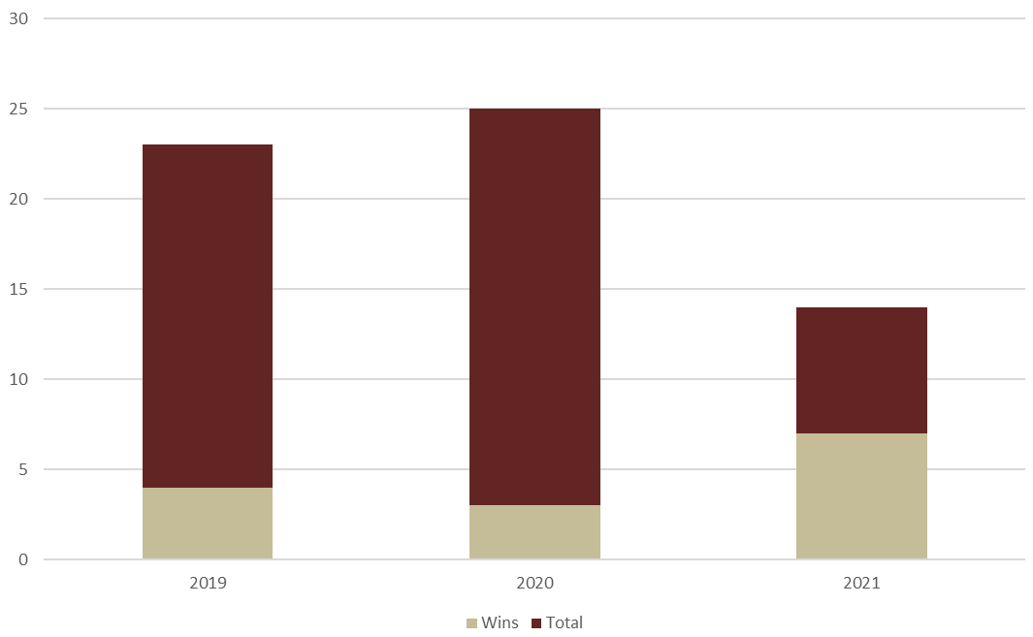
Is mock review associated with higher success rates?
Florida State University
ORD began peer reviews in 2019.
This year, 5 of the 7 faculty who were awarded participated in the ORD organized peer review.
Wins / Total Applicants
Notes:
BETH

Slide 23
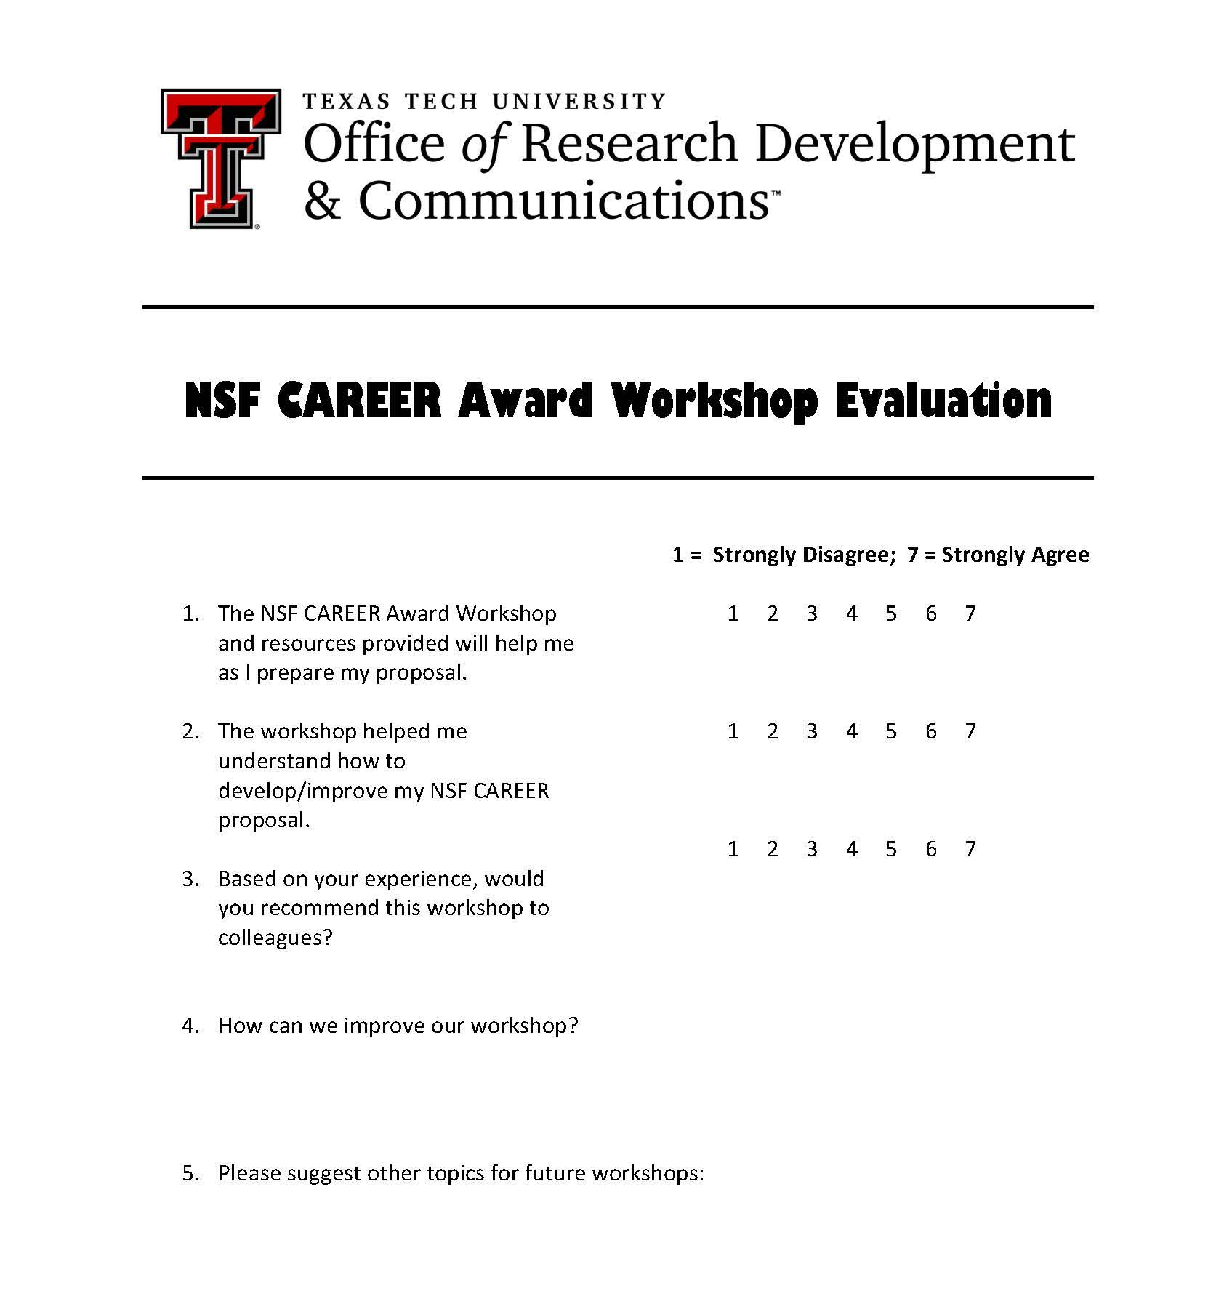
Is mock review associated with higher success rates?
Texas Tech University
Mock Peer Reviews have been taking place at TTU since at least 2017.
2020: Virtual, 3 participants. 1 participant was funded.
2021: Virtual, 4 participants.
2022: ~8 participants signed up.
Notes:
MISSY
Since I joined this effort in our RD Office in 2020, I am not aware that we have surveyed those who participate in the mock review, but we do track who submits and who is successful. Our cohorts have been small, as you can see on the slide, in 2020 we had three participants. One was funded, one was not, and we encouraged the third to apply to a standard NSF grant rather than the CAREER based on where his research was at the time. In 2021 we had four in our cohort, unfortunately, none were funded – three were first time applicants and the fourth chose not to re-submit last year.
Our 2022 review is planned for late May/early June with ~8 participants signed up so far.
I should say that we do have some data from the workshop we offer, and many of our faculty are both appreciative of it, and find it useful.

Slide 24
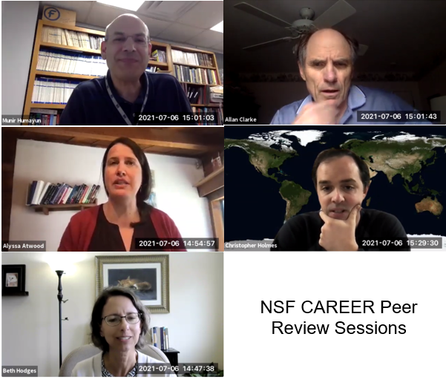
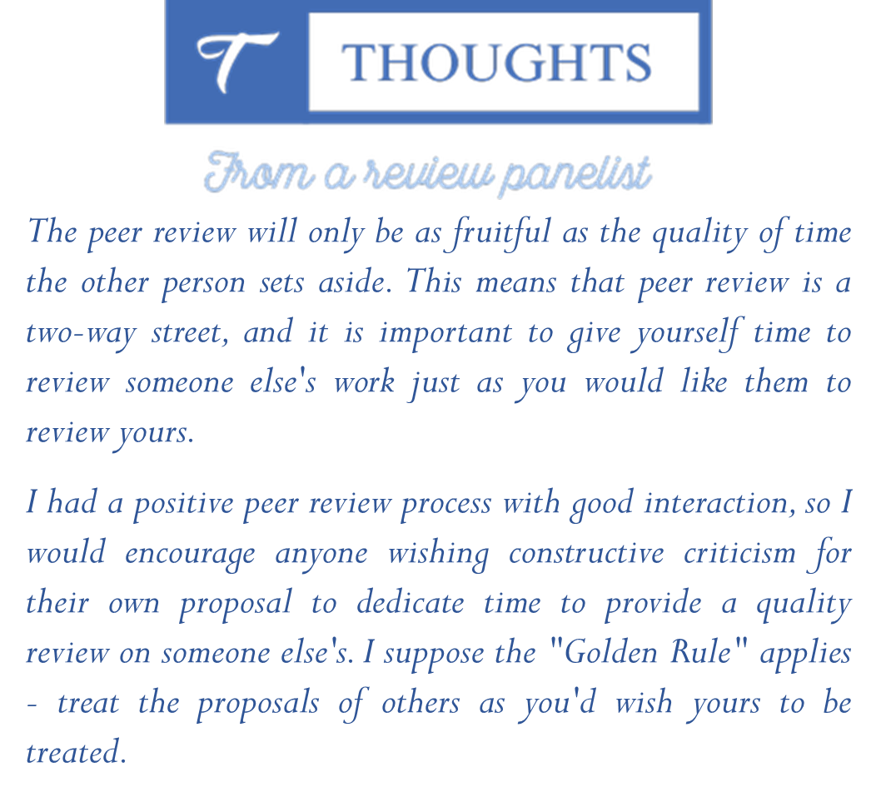
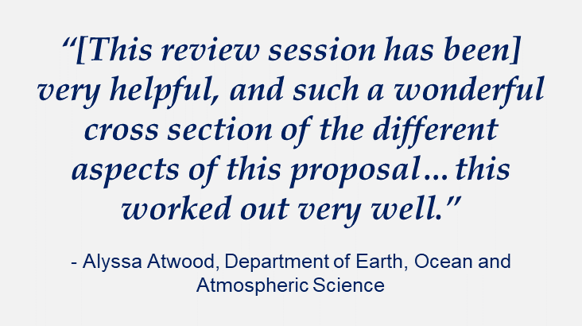
Notes:
JESS: What have the participants said about the mock review?
MISSY – You will get more out of it you are also willing to put more into it.

Slide 25
Does mock review enhance faculty skills and satisfaction?
Rice University
2012: CAREER presentations launched.
2019: Full workshops offered.
2021: 100% of NSF CAREER winners had participated in a OPD CAREER workshop.
    Highest number of applicants
    Record number of winners
**Evaluating new metrics as we add mock review
Notes:
ELIZABETH
Our stats are already excellent, so we aren’t addressing a weakness in wins as you can see from the graphic on the right. We had a record number of wins in our most recent cycle, during which 11 applicants were awarded out of 24 applicants. Of those 11, all had attended at least one of our CAREER workshops.
Faculty have been satisfied overall with our workshops, but we are hoping to enhance that even more as well as to work on early career investigator skill building in relationship to the mock review that Missy mentioned is so important at TTU.

Slide 26
Does mock review enable us to reach greater #s of departments?
Rice University
Using mock review to reach a larger number of applicants to CAREER
Advertising our unique services to faculty to establish relationships on the long-term
Notes:
ELIZABETH
As I mentioned earlier, we are also hoping that the mock review will enable us to entice faculty from departments and schools that we serve less often to take advantage of this opportunity.
Engineering has always been our mainstay, but our office has offered less support to the schools of natural sciences and social sciences for a variety of reasons. One of those is Rice’ s culture of decentralization which has led to more independence in some schools.

Slide 27
Pre-Workshop Evaluation
Rice University
Describe your confidence level in accomplishing the following tasks prior to the workshop:
Crafting a 1-page project summary
Crafting a project description
Understanding the NSF’s Intellectual Merit criteria
Understanding the NSF’s Broader Impacts criteria
Creating a viable educational plan with measurable goals
Researching educational scholarship in my discipline
Integrating educational and research goals
Giving substantive feedback to peers in my discipline/department
Giving substantive feedback to peers in my school of study
Giving substantive feedback to peers outside my school of study
Asking for specific feedback from peers
Engaging senior faculty/mentors in conversation about my research
Revising my work based on feedback
Notes:
We’ve developed pre- and post Qualtrics surveys to evaluate faculty skill development. I’m indebted to Crystal Botham inspiring the design of this particular question. Crystal published an article on Stanford’s NIH K99 workshop in PlosOne –her workshop focused on skill development in peer review. I’ve took inspiration from it as I developed these question for the CAREER award

Slide 28
Post-Workshop Evaluation
Rice University
How much did participating in, and observing, the mock review panels help you to achieve the following goals?:
Becoming familiar with the review process
Learning about how NSF criteria for evaluating the proposal may be applied
Discerning how reviewers may perceive your work
Discussing your proposal with peers
Understanding technical strengths and weaknesses of your research proposal
Understanding the non-technical (i.e. grantsmanship) strengths and weaknesses of your research
Understanding the strengths and weaknesses of your educational (broader impacts) plan
Prioritizing revisions in advance of submission
Notes:
We are really interested in honing in on what the mock review offers to the workshop; Some of these skills are taught in the workshop (such as understanding how to dovetail research and educational goals) so we are hoping the mock review will reinforce and “test” these to some extent. Others are more structural---for example, participating in a mock review will necessarily prompt participants to prepare a draft earlier than they might have. Assisting faculty in developing a productive writing process is a skill that we want to develop.

Slide 29
Post-Workshop Evaluation
Rice University
Please indicate how the following elements helped you to improve:
How much did your participation in the workshop as a whole improve your CAREER proposal?
How much did the peer review sessions help you to improve your proposal?
How much did the faculty mock review panel help you to improve your proposal?
How much did one-on-one editing with staff help you to improve your proposal?
*We are considering follow-on focus groups as well as analysis of video to determine the unique nature of feedback received in the mock review
Notes:
I am interested in comparing the kind of feedback that faculty receive from peers, experts, and our RD office and where this overlaps and departs. My interest stems in part from my previous career working in a multimodal communication center that served graduate and undergraduate students across the disciplines. I’m very interested in technical and non-technical feedback and how and where these actually intersect.
We may have follow-on focus groups to get at details about the nature of feedback that are difficult to assess quantitatively.

Slide 30
What was your most surprising finding?
What insights did you gain about RD / PD services overall?
Did you use the evaluation results to show value of your office?
Created by Soremba, the Noun Project
Notes:
JESS
Beth & Missy: What were the most surprising findings of your evaluation?
Beth: There has not been one critical bit of feedback about the sessions. Also, I was surprised that the reviewers enjoyed the process has well and have volunteered to do these in future years.
Missy: Perhaps not really surprising is that our faculty really do want to hear from past winners. They want the personal insight, and I think they also want to hear about the challenges so that they feel a little less alone as they continue on their CAREER journey.
ELIZABETH: How might this tie into evaluations for RD office?
In addition to total research dollars and awards conferred, I think most offices are concerned with user satisfaction—it’s a crucial metric for the services we provide.
But I’m becoming interested, though in a broader range of metrics.
For example, I think we should be taking the long-view and tracking faculty skill development over time, especially since CAREER is a gateway workshop .
I also think we need to look critically at our own development as an office and how we inform our own best practices. Thie entails looking more deeply at the kinds of activities and services we provide and why we provide them. What kind of feedback do faculty need? How can we facilitate their receipt of that feedback?
Finally, I’ve recently become interested in the idea of redressing misconceptions about what RD offices do and can do and measuring that through surveys. I am thinking of ways in which the mock review can help us with our mission of advertising our services and correcting the assumption that copyediting, compliance, and completing ancillary documents is the core of our efforts.

Slide 31

Created by Nithinan Tatal, the Noun Project
Lessons Learned and Recommendations
IF I KNEW THEN WHAT I KNOW NOW…
Notes:
JESS

Slide 32
Challenges
Tips
Participants dropping out of workshop before mock review
Participants not completing draft on time to allow for solid review
Participant concerns about sharing work
Lack of faculty incentives to serve as reviewers
Reliance on same volunteers for panels, reviews
Protecting faculty reviewer time
Reflect on the model that best fits your institutional needs and constraints
Scaffold the production of the draft (setting incremental due dates; offering reserved time for writing groups)
Set expectation that participants who win will serve as future reviewers/panelists
Remind faculty of deadlines throughout process
Recruit external reviewers (and offering honoraria)
Recruit emeriti faculty and offer honoraria
Offer lunch if in person
Notify reviewers when PIs they assisted are awarded
Notes:
Hi Jess–
CHALLENGES / BIGGEST CONCERNS
logistics,
privacy, and a
lack of incentives are the biggest concerns.
TIPS
1) spend time thinking about what model will work best for your school based on size, eligible faculty, staff availability and not to adapt accordingly
2) Help to develop your faculty’s sense of writing as a process; scaffold the development of the draft, check in periodically and remind them of due dates
3) Create a culture of sharing within each cohort.
4) Offer incentives where you are able to (honoraria for external reviewers, lunch for in-person events) Think creatively about how to reward reviewers–articles about your office and this mock review event, or even an email when a PI they assisted is awarded.

Slide 33

If you had 1 wish for NSF CAREER mock review, what would they be?
Notes:
JESS
Beth: That everyone applying would allow themselves to go through the review.
Missy: I think my wish would be that faculty would be more invested in the review process. One of our participants last year only submitted a summary, rather than a draft of his proposal, and so he didn’t receive good feedback, because there wasn’t much to comment on. I would like to see faculty see the value in having a draft that is ready to share, and being invested in the process.
Elizabeth: If I had three wishes I’d co-opt Beth and Missy’s wishes for faculty COURAGE AND ENGAGEMENT and add the wish that this mock review will be enjoyable for our faculty reviewers, too–that they will relish this MENTORSHIP experience.

Slide 34
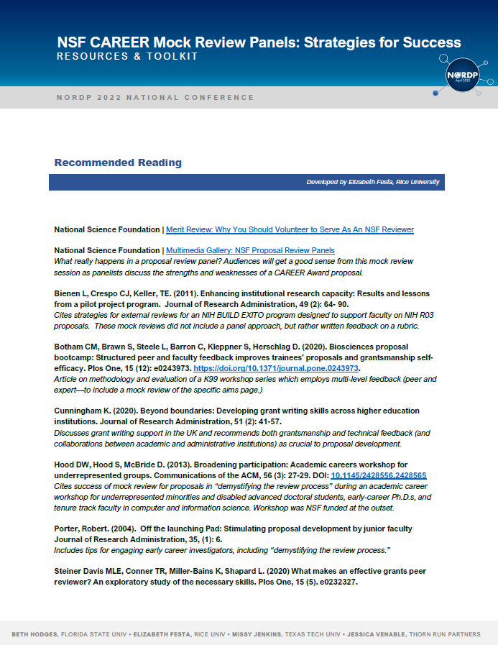
Resources and Toolkit

Slide 35
Questions?

Slide 36
Thank you!
As you implement or revise your own mock review panel, please share your insights and suggestions with us!

