Slide 1
Reducing Stress and Preventing Burnout for Research Development Professionals
11:00 am - 12:30 pm ET
April 26, 2022
NORDP Conference 2022
Joanna Downer, PhD
Associate Dean for Research Development,
Duke University School of Medicine

Slide 2
Let’s take a moment to breathe….
Close your eyes.
Take a deep breath and then exhale – repeat this deep breath three times.
You are HERE. This is your permission to focus on you. Put aside your other work and thoughts and obligations.
Take this time to do this for yourself.

Slide 3
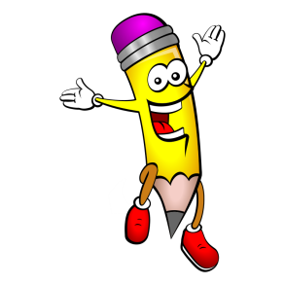

Learning Objectives
Explore a robust “tool-kit” for reducing stress, preventing burnout, and improving balance.
Begin developing your own specific plan of action – immediate, short-term, and long-term goals and steps.
Notes:
It might be harder and scarier before it gets better. Talk about a lot of contributors and approaches, try not to get overwhelmed, but just see if a few things jump out at you as being particularly relevant to your situation and perhaps represent things you might consider immediately.

Slide 4
"God grant me the serenity to accept the things I cannot change, the courage to change the things I can, and the wisdom to know the difference.“
–Reinhold Niebuhr

Slide 5
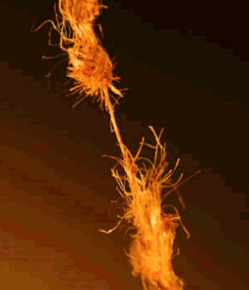

Stress
  A state of strain or tension resulting from adverse or very demanding circumstances that results in a predictable set of biochemical, physiological and behavioral changes.
  “Stress is not a function of events; it’s a function of the view you take of events.”
  “Burnout” is often “past the point of no return”.
  STRESS IS STRESS.
    http://www.apa.org/helpcenter/understanding-chronic-stress.aspx
    Mindfulness in the Age of Complexity (an interview with Ellen Langer), Harvard Business Review, March 2014. https://hbr.org/2014/03/mindfulness-in-the-age-of-complexity
Notes:
Untreated chronic stress → serious physical and psychological difficulties

Slide 6

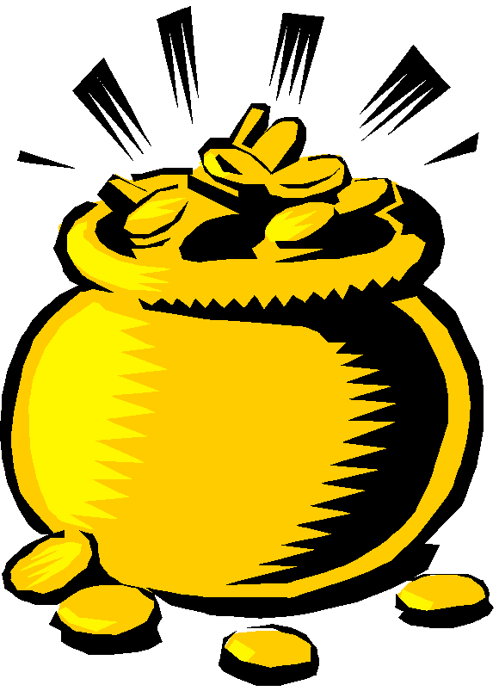

Where on the spectrum of stressed to burned-out are you?
  A validated measure: www.proqol.org
    The Professional Quality of Life Scale – Compassion Satisfaction and Compassion Fatigue ProQOL Version 5 (2009) © B. Hudnall Stamm, 2009 (In 2017, ownership transferred to the Center for Victims of Torture, which is continuing to offer the tool at no charge.)
    Scores “Compassion Satisfaction” and “Burnout”.

Slide 7
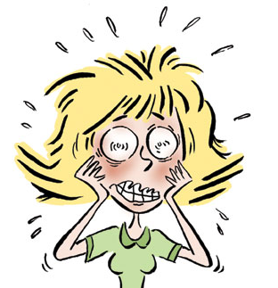

Contributing factors
External factors
Personal characteristics & tendencies:
  Are you a perfectionist?
  Do you set and stick to boundaries? Are you a natural helper?
  Do you effectively manage others’ expectations? Your own?
  Do you respond to stressors appropriately?
  Do you prioritize effectively? Do you ever prioritize yourself?
  Do you seek and thrive on challenge?
  Are you a procrastinator?
Burnout risks:
  Lack of control; Unclear job expectations
  Dysfunctional workplace dynamics; Mismatch in values; Poor job fit
  Extremes of activity
  Lack of social support (at work and/or home); Poor work-life balance

Slide 8
Figure out your goal
What is good “work-life balance” for YOU?
What do you have too little of?
What do you have too much of?

Slide 9

Figure out the (fixable) problem(s)
Toyota’s “Five Whys”
  Determine the root cause of an identified problem by asking “Why?” in response to each subsequent answer.
  May require >5 Whys or probing multiple identified problems.
  The final "why" should suggest a broken process or an alterable behavior, indicative of reaching the root-cause level and therefore actual potential solutions.
https://en.wikipedia.org/wiki/Five_whys

Slide 10
Many possible solutions
Learn and practice mindfulness-based stress reduction (MBSR)
Anticipate and plan for stressful periods
Manage interruptions
Set and maintain boundaries
Manage expectations
Create a better to-do list & prioritize effectively
Prioritize yourself:
  food, hydration
  exercise
  sleep
  recovery time
  connect (with nourishing friends, volunteer work, etc.)
  do something you love to do!
Get help (personal, professional, resources, coaching, counseling, etc.)
Re-evaluate and re-negotiate your responsibilities
In the Chat, identify topics of greatest interest.

Slide 11
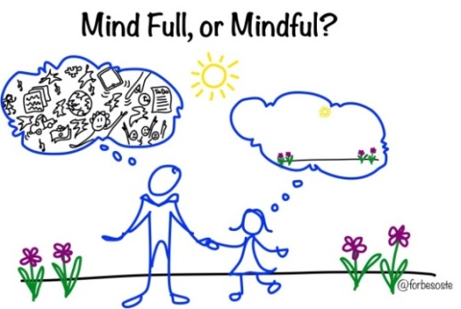
Mindfulness: A Few Practices
Moment-to-moment, non-judgmental awareness.
  Balances our logical brain and creative brain.
  Allows us to reset & recover each day or throughout the day.
“Mindfulness Based Stress Reduction” (MBSR)
  Awareness of Breath Practice
  20 Breaths Practice
  Body Scan Practice
  Walking Mindfulness
  Loving-Kindness
Find MBSR training.
Use an app like Calm.
Adapted in part from Benson, H. “The Relaxation Response”, 1975 ;
  Kabat-Zinn, J. “Full Catastrophe Living”, 2013.

Slide 12



Tools to control stressors
Anticipate and plan for stressful periods.
  Just because it’s “life” doesn’t mean it’s helpful.
  Consider your entire self.
  Take some time to recover.
Manage interruptions.
  Check emails on a set schedule; checking later allows you to focus first on your priorities.
  Schedule your calendar in a way that suits you; leave yourself breathing room.
Adapted in part from http://www.mayoclinic.org/healthy-lifestyle/adult-health/
in-depth/work-life-balance/art-20048134
Notes:
It takes double or triple the time to regain full concentration.

Slide 13

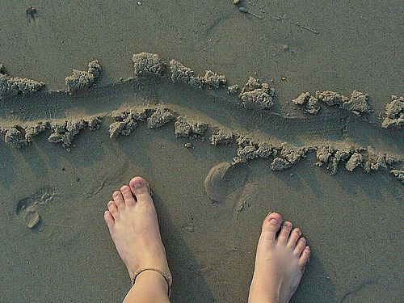
Tools to control stressors (cont.)
Leave work at work.
  Consciously separate work time from personal time.
  If working remotely, establish “beginning of work” and “end of work” routines.
Set boundaries (in writing!) and stick to them.
  Give yourself permission to say “no”, or to say “yes” under circumstances of your choosing.
Adapted in part from http://www.mayoclinic.org/healthy-lifestyle/adult-health/
in-depth/work-life-balance/art-20048134

Slide 14
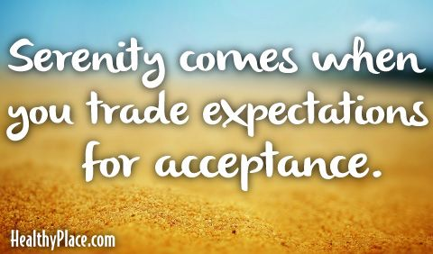
Tools to control stressors (cont.)
Manage others’ expectations, as well as your own.
  Keep your expectations as realistic as possible.
  Accept what you cannot change.
  Give the rationale and consequence, and then accept their decision.
  “It is what it is.”

Slide 15

Tools to control stressors (cont.)
Organize and plan.
  Stick to your own priorities!
  Rather than “big lists”, create effective project-specific “next step” to-do lists that gather ALL to-dos.
  PRIORITIZE AND USE THESE LISTS!

Slide 16
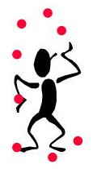
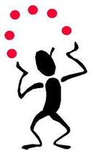
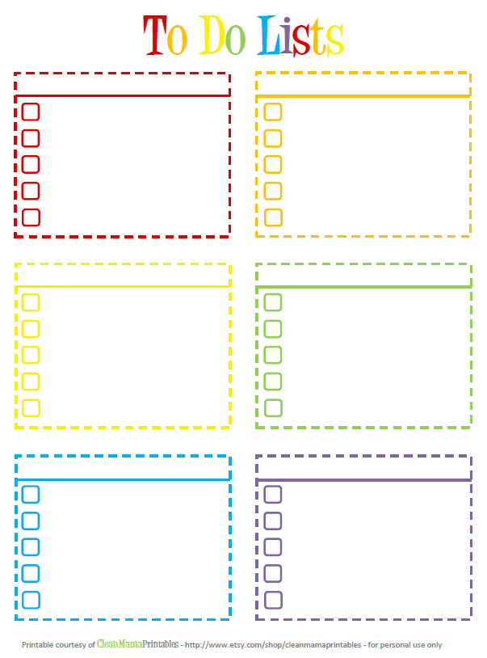
Make a better to-do list
David Allen’s five-stage process:
  Collect ALL of the things that are in your brain and put each on its own piece of paper;
  Process what they mean and what to do about them (the exact next step for each);
  Organize the results; and
  Review them as options for what you choose to
  Do.
A complete “to-do” list allows your brain to stop reminding you!
Get David Allen’s book or another of your choosing and implement it.
David Allen. Getting Things Done: The Art of Stress-Free Productivity. New York: Penguin Books, 2001.
Notes:
“Horizontal” to-dos catalog across all your projects or activities (finish this grant, visit family, celebrate a birthday…).
“Vertical” to-dos catalog steps or sub-activities necessary to each major project (talk with spouse about gift choices, send party invitations, go to store to buy gift and card, wrap present, get cake, clean house…).
“Next-step” is just the very next step in any activity or sub-activity, and provides the clearest and cleanest to-do list (sweep, vacuum, dust, clean half bath, clean guest bath…).

Slide 17
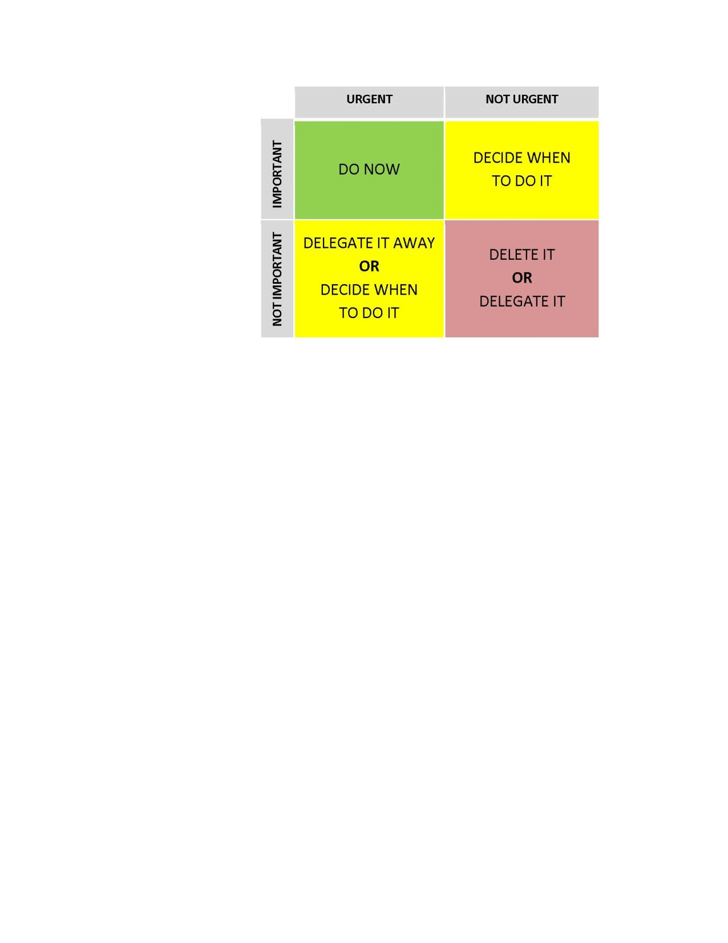
Tools to control stressors (cont.)
    Prioritize effectively.
      Use the “Eisenhower Matrix” to “do, decide when to do, delegate, or delete”.
      How much time are you really spending on various activities?
      Evaluate not just single requests, but ongoing efforts. (Don’t confuse “busy” with “productive”!)
      “Don’t waste 100% of your energy on a 5% issue.” http://pas.duke.edu/stress.php
The “Dark Playground”
(waitbutwhy blog)
Adapted in part from http://www.mayoclinic.org/healthy-lifestyle/adult-health/
in-depth/work-life-balance/art-20048134 and
http://waitbutwhy.com/2015/03/procrastination-matrix.html &
https://waitbutwhy.com/2013/10/why-procrastinators-procrastinate.html

Slide 18
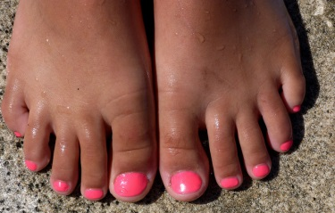


Tools to control YOU
Prioritize yourself.
  Prioritize your own needs sometimes.
  Be present.
  Take some time to recover.
Eat a healthy diet.
  Caffeine and alcohol in moderation.
  Stay hydrated (dehydrated = irritable!)
Adapted in part from http://www.mayoclinic.org/healthy-lifestyle/adult-health/
in-depth/work-life-balance/art-20048134
Notes:
Mention exercise with “time to recover”

Slide 19
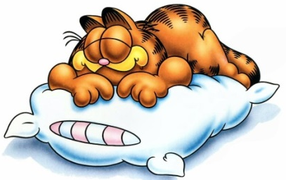
Tools to control YOU (cont.)
Get enough sleep.
  Brain running wild? Build that comprehensive to-do list; put a note pad and pen by your bed.
  Trouble falling asleep? Put away your phone; breathe slowly & count backwards; identify physical tension and relax it. Too cold or hot? Achy?
  Adjust your sleeping environment (bed, curtains, orientation, etc.).
  Exercise!

Slide 20
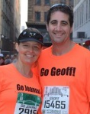
Exercise actually helps your brain rebuild
Endurance aerobic exercise leads to greater neurogeneration in the hippocampus than either strength training or high intensity interval training (in rodents).
Be (more) active.
  150 min/wk of moderate‐to‐vigorous physical activity
  Even segments of 2 minutes add up! (humans)
Get a sit-stand workstation or treadmill desk.
Nokia et al., J. Physiology 2016;594(7):1855-73 ;
Saint‐Maurice et al., J Amer Heart Assoc 2018;7:e007678

Slide 21
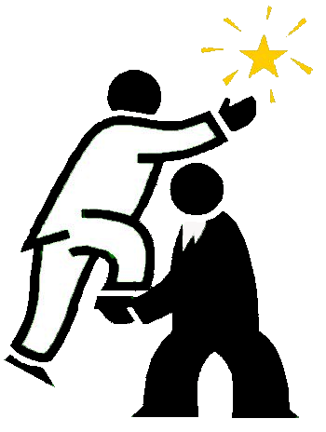


Tools to control YOU (cont.)
Seek professional help.
  Employer-provided counseling services? Career or Executive Coach?
Connect with other people.
  More time with “nourishing” friends.
  Vent your frustrations? Tread carefully!
Re-discover a favorite pastime or uncover a new one.
  Volunteering can boost sense of balance.
  Choose an activity that fills in what’s missing for you.
  Caution: Your activity may need to be as demanding as work.
  List five things you love to do and then do one of them!
Adapted in part from http://www.mayoclinic.org/healthy-lifestyle/adult-health/
in-depth/work-life-balance/art-20048134 and http://pas.duke.edu/stress.php

Slide 22
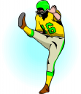

So what can you do?
Identify & evaluate work and personal responsibilities.
What is negotiable? What CAN you control?
  Drop (decide not to do them) and/or re-prioritize them.
  Seek reassignment of (punt!) draining responsibilities.
  Ask for and deploy additional resources at work and/or at home. Who do you need to talk to? What should you say?
Look for chances to add responsibilities that
  stimulate you. (Bolles, R.N., What Color Is Your Parachute?)
  Sign up for Mindfulness or other training
Adapted in part from http://www.mayoclinic.org/healthy-lifestyle/adult-health/
in-depth/work-life-balance/art-20048134

Slide 23
Let’s take a moment to rebuild….
You are enough.
You are worthy of compassion.
You are worthy of self-compassion.
Talk to yourself as you would to a friend.
Do the best you can, with what you have, when you can.

Slide 24
“Ultimately, the secret to working less is working less.”
–Joanna Downer

Slide 25
Reminder of the many possibilities
Learn and practice mindfulness
Anticipate and plan for stressful periods
Manage interruptions
Set and maintain boundaries
Manage expectations
Create a better to-do list & prioritize effectively
Prioritize yourself: food, hydration, exercise, sleep, recovery
Connect – with friends, with your purpose, with nature
Do something you love to do!
Get help (personal, professional, resources, coaching, counseling)
Re-evaluate your responsibilities at work and home

Slide 26
Questions? Tips?
Joanna Downer, PhD joanna.downer@duke.edu

Slide 27
Resources – Mindfulness Based Stress Reduction
http://www.helpguide.org/harvard/benefits-of-mindfulness.htm
Jon Kabat-Zinn. Full Catastrophe Living: Using the Wisdom of Your Body and Mind to Face Stress, Pain, and Illness. New York: Bantam Books Trade Paperbacks, 2013. (ISBN-13: 978-0345536938)
UCSD Center for Mindfulness website https://health.ucsd.edu/specialties/mindfulness/Pages/default.aspx
UCSD Center for Mindfulness online resources (including links to audio and video guidance) https://health.ucsd.edu/specialties/mindfulness/resources/Pages/default.aspx
Duke MBSR Program (10 weeks) https://www.dukeintegrativemedicine.org/programs-training/public/mindfulness-based-stress-reduction/
Duke Distance MBSR Program (8 weeks) https://www.dukeintegrativemedicine.org/programs-training/public/mindfulness-based-stressed-reduction-distance-learning/
Look at your own or nearby institutions for MBSR or mindfulness programs and offerings.

Slide 28
Online Resources – Stress and Burnout
http://waitbutwhy.com/2013/10/why-procrastinators-procrastinate.html
http://waitbutwhy.com/2013/11/how-to-beat-procrastination.html
http://waitbutwhy.com/2015/03/procrastination-matrix.html
https://www.psychologytoday.com/blog/high-octane-women/201104/overcoming-burnout
http://misplacedbrit.com/depression/recovering-from-burnout-or-depression-an-a-z/
http://www.helpguide.org/articles/stress/preventing-burnout.htm
http://www.helpguide.org/articles/stress/stress-symptoms-causes-and-effects.htm
http://www.health.harvard.edu/staying-healthy/understanding-the-stress-response
https://hbr.org/2016/06/steps-to-take-when-youre-starting-to-feel-burned-out
http://www.mayoclinic.org/healthy-lifestyle/adult-health/in-depth/art-20046642 (job burnout)
http://www.cnn.com/2017/01/18/health/no-worries-wisdom-project/index.html
http://pas.duke.edu/stress.php
https://www.nimh.nih.gov/health/publications/stress/index.shtml
Professional Quality of Life Elements Theory and Measurement: Compassion Satisfaction and Compassion Fatigue, Burnout, Secondary Traumatic Stress, Vicarious Traumatization and Vicarious Transformation
  Website: http://www.proqol.org/Home_Page.php
  Tool: http://www.proqol.org/uploads/ProQOL_5_English_Self-Score_3-2012.pdf

Slide 29
Resources – Effects of stress on the brain
Dias-Ferreira E, et al. Chronic stress causes frontostriatal reorganization and affects decision-making. Science 2009;325:621-625.
Lucassen PJ, et al. Regulation of adult neurogenesis by stress, sleep disruption, exercise and inflammation: Implications for depression and antidepressant action. European Neuropsychopharmacology 2010; 20:1-17.
Lucassen PJ, et al. Neuropathology of Stress. Acta Neuropathol 2014;127:109-135.
McEwen BS, Gray JD, Nasca C. Recognizing resilience: learning from effects of stress on the brain. Neurobiology of Stress 2015;1:1-11.
McEwen BS, McKittrick CR, Tamashiro KLK, Sakai, RR. The brain on stress: Insight from studies using the Visible Burrow System. Physiology & Behavior 2015;146:47-56.
Sandi C, Pinelo-Neva MT. Stress and memory: behavioral effects and neurobiological mechanisms. Neural Plasticity 2007;2007: Article ID 78970.
Schoenfeld TJ, Gould E. Stress, stress hormones, and adult neurogenesis. Experimental Neurology 2012;233:12-21.

Slide 30
Resources on mindfulness & work-life balance
Alexandra Michel, Christine Bosch, Miriam Rexroth. Mindfulness as a cognitive-emotional segmentation strategy: An intervention promoting work-life balance. J Occupational and Organizational Psychology. Dec 2014; 87(4):733–754. http://onlinelibrary.wiley.com/doi/10.1111/ joop.12072/full (Univ. Heidelberg study)
Kimberly Schaufenbuel. Bringing Mindfulness to the Workplace (a white paper). Executive Development, UNC Kenan-Flagler Business School, 2014. http://www.kenan-flagler.unc.edu/~/media/Files/documents/executive-development/unc-white-paper-bringing-mindfulness-to-the-workplace_final.pdf
Sonnentag S, Fritz C. Recovery from job stress: The stressor-detachment model as an integrative framework. J Organiz Behav 2015;36:S72-S103.

