Slide 1

Holistic Portfolio Management:
A New Way to Provide Oversight to Research Sponsored Awards
Lisa Preziosi, MFA / Research Development & Outreach Manager
preziosl@mskcc.org
Anindita Mukherjee, PhD/ Research Development & Outreach Manager
mukhera@mskcc.org
Memorial Sloan Kettering Cancer Center
NORDP 2022 National Conference
Notes:
Anindita 1-5
Lisa – 6 - 10

Slide 2

At MSK, a trio of individuals from the office of Research & Project Administration (RPA) assist investigators in developing, monitoring, and maintaining their research funding portfolios.
Trio Team:
Research Development & Outreach Managers (RDOM)
Grants Managers (GM)
Research Finance Managers (RFM)
In order to provide a more robust and multi-faceted view of a PI’s portfolio, RPA has introduced the concept of Holistic Portfolio Management Quarterly Meetings.
This initiative brings together the trio to discuss the status of their portfolios and share their distinct expertise, providing an all-encompassing perspective for the investigators.

Slide 3

GOALS:
Providing investigators with ongoing, proactive, holistic support and resources
Enhancing Institutional Funding
Strengthening PI research portfolios

Slide 4

During these quarterly meetings, each department’s assigned RDOM, GM, and RFM
provides different insight into a research portfolio.

Slide 5

Research Development & Outreach Managers (RDOM) are part of the Funding Development Team under the Monitoring and Outreach unit within RPA.
RDOMs assist PIs with Funding and Proposal Development and are considered “Pre-pre award”. They can provide guidance, support, tools, and resources to assist with finding and assessing funding opportunities, career development, and crafting competitive proposals.
During quarterly meetings, RDOMs can provide insight into the research goals of the department, their interest & understanding of sponsors, and their utilization of RTM’s resources.

Slide 6

Grants Managers (GMs) are part of the Grants and Contracts unit within RPA.
GMs are considered “Pre-award” and assist PIs with submitting grant applications. They help develop budgets, review submission materials, and are considered the Signing Official for NIH applications. In addition, they submit post application materials and assist with post-award non-financial reporting.
During quarterly meetings, GMs can discuss investigators’ current, pending, and planned grant applications.
They can also identify PIs that could benefit from RDOM support, including guidance for proposal development resources, targeted FOA searches, proposal review, or specific resources.

Slide 7

Research Finance Managers (RFMs) are part of the Research Financial Management unit within RPA.
RFMs are considered “Post-award" and assist investigators with Budgeting and Monitoring their awards. They help with reporting and play a crucial role in advising PIs regarding their spending and cost allocations.
During quarterly meetings, RFMs can discuss the fiscal health of their assigned research portfolios. They can indicate which investigators are well funded and which have potential budget shortfalls, providing insight into overspending, as well as indicate which lab members have and do not have research support.
They can suggest researchers that could benefit from RDOM support including funding development.

Slide 8



Results from RPA’s First Holistic Portfolio Meeting
77
Departments & Services were reviewed
313
PI portfolios were discussed
Suggestions for types of
Funding &/or Development Support were provided
PIs with projected shortfalls were tagged for additional support

Slide 9

CHALLENGES
Small RD Team with wide spectrum assignments coordinating the meetings & keeping/maintaining metrics
Scheduling between the required RDOM, GM, & RFM
How to track data and metrics
No dedicated Admin support for this initiative
PILOT
Meeting groups with overlapping assignments were created, lessening the need for multiple meetings.
Some portfolios needed less discussion than others, so timed agendas were utilized so individuals just needed to arrive 5 minutes before their slot and were able to leave once their discussion was complete.
A filterable, excel tracking document was created including categories for types of intervention and a priority ranking, and is housed in a shared drive.
LOOKING AHEAD
Minimizing the administrative burden on RD
Folding in Holistic Portfolio Management meetings into existing meetings, to lessen over-scheduling of staff
Creating a more robust tracking system that can cross reference information on other initiatives and be “one-stop shopping” for investigator information.

Slide 10
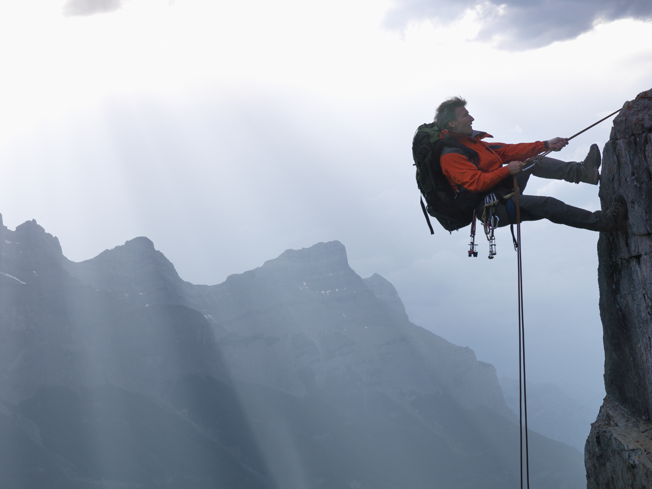
RPA’s first Holistic Portfolio Quarterly Meeting provided deep insights into researcher’s portfolios and was successful at assessing which investigators might benefit from different types of targeted support.
With an eye toward supporting MSK’s research community through proactive, multi-faceted administrative support, this initiative will continue to evolve, as additional tools, methodology, resources and metrics are developed
CONCLUSION

Slide 11



Thank You!
CONTACTS
Lisa Preziosi, MFA / Research Development & Outreach Manager/preziosl@mskcc.org
Anindita Mukherjee, PhD/ Research Development & Outreach Manager/mukhera@mskcc.org

