Slide 1
Developing NSF Proposals
March 13, 2019

Slide 2
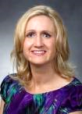
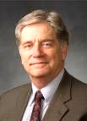
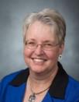
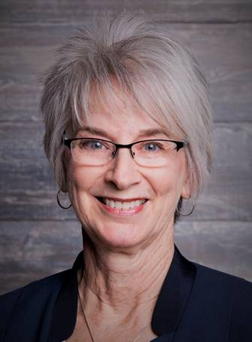
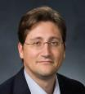
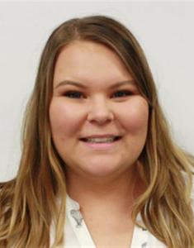
Research Development Support
Kristen Clarke Kellems
FHSS Research Development
934 SWKT
Tel: 801-422-8967
Email: fhssresdev@byu.edu
Conrad Monson
STEM Research Development
275 McDonald Building
Tel: 801-422-7722
Email: conrad_monson@byu.edu
Jaynie Mitchell
MSE Research Development
306C MCKB Tel: 801-422-3067
Email: Jaynie@byu.edu
Karen Hill
BYU Law Grants and Partnerships Manager 445 JRCB
Tel: 801-422-2684
Email: hillk@byu.edu
Jon Balzotti
English Department Faculty College of Humanities
4127 JFSB
Tel: (801) 422-2440
jonathan_balzotti@byu.edu
Kaylie Winterton
Research Development Administrator
269 McDonald Building
Tel: 801-422-0132
Email: rdadmin@byu.edu

Slide 3
Agenda
Introductions
Presentation by Michael Whiting
“Panel” discussion

Slide 4
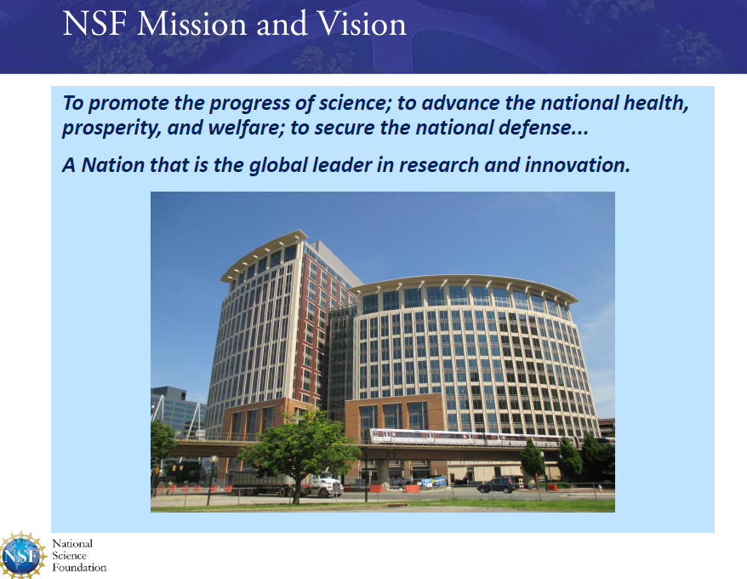

Slide 5
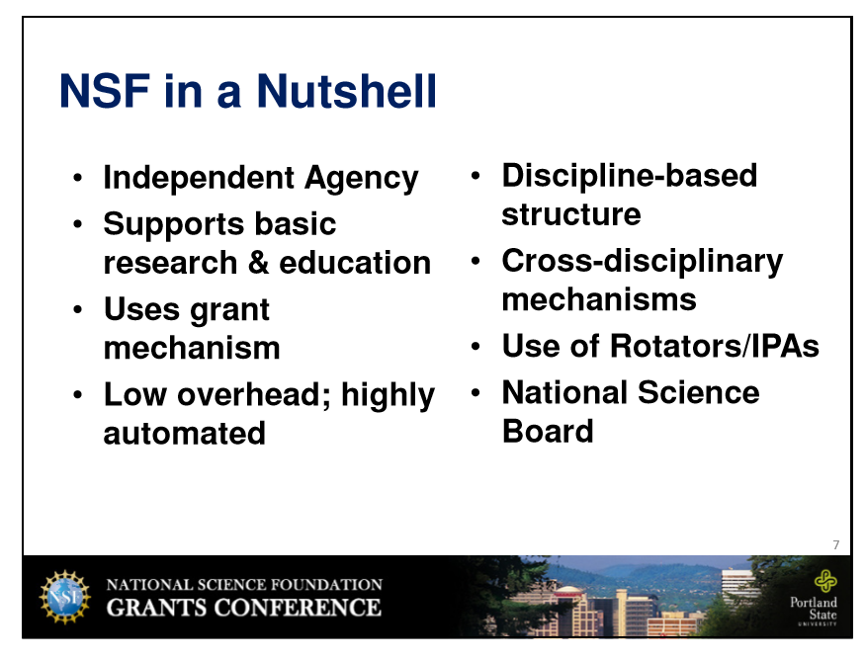

Slide 6
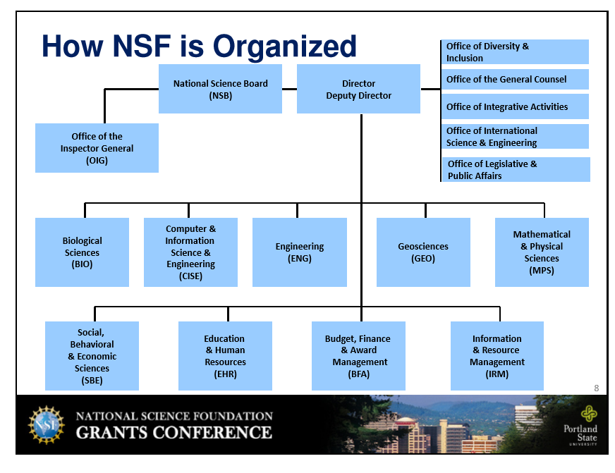

Slide 7
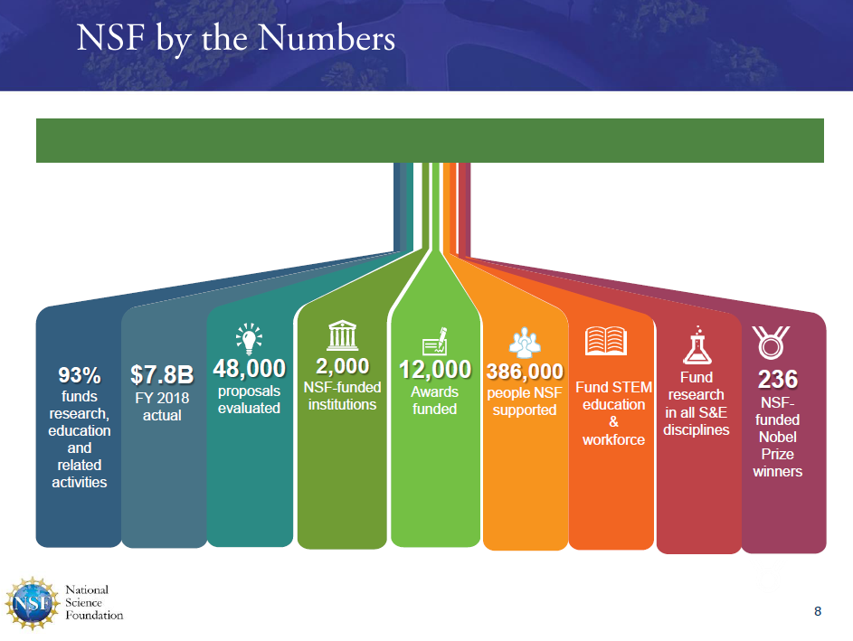
Budget for FY 2019 ~$8B

Slide 8
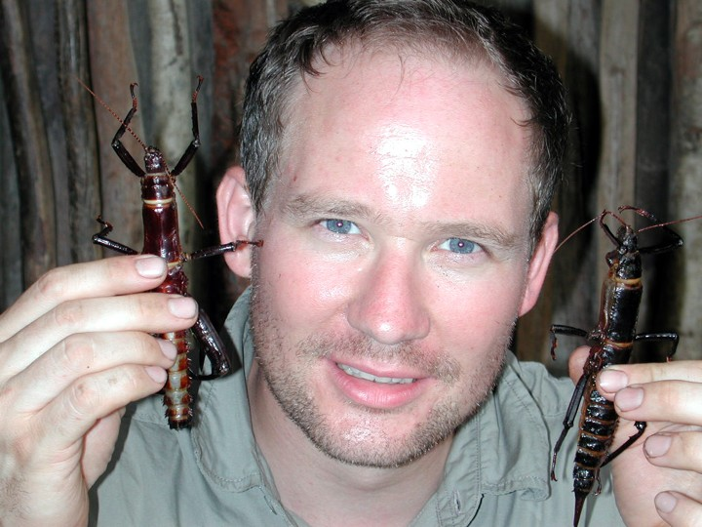
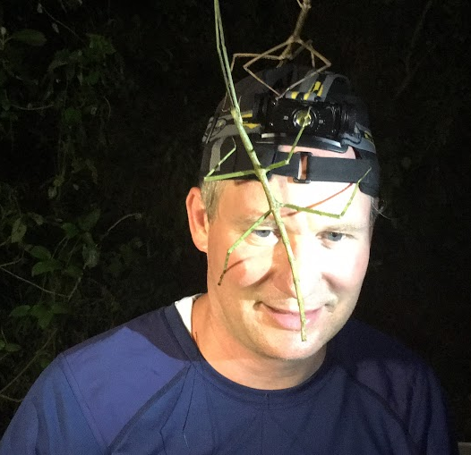
Michael Whiting is a Professor in Biological Sciences. His research uses genomic information to unravel patterns of insect diversification and evolution. Michael has received a National Science Foundation Career and other awards. He has been an NSF review panelist and an NSF Program Director in Systematics and Biodiversity Sciences.
Michael received a B.S. in Zoology with emphasis in Entomology, Cum Laude, Brigham Young University in 1990 and a Ph.D. in Entomology from Cornell University in 1995

Slide 9
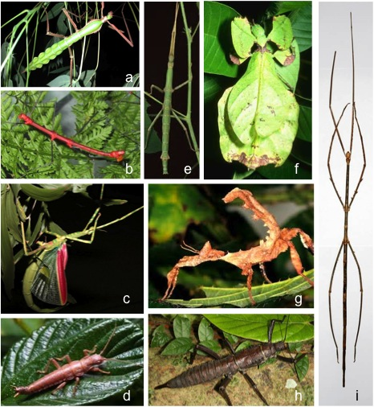
What Does a Program Officer Do?
Link between the PI and the Program (Funding agency).
Customer Service:
Meet with NSF visitors
Outreach at meetings, institutions, and other venues
Direct contact with PI: calls and emails.
Pre-panel Proposal Processing:
Read!
Solicit ad hoc reviews
Assemble panels
Run Panels
Post Panel Proposal Processing:
Write Panel Review Analysis
Justify decisions to superiors
Make Funding Recommendations
A Bunch of Other Stuff
Notes:
The best part of my day was talking to PI’s, usually in the early development stages.

Slide 10
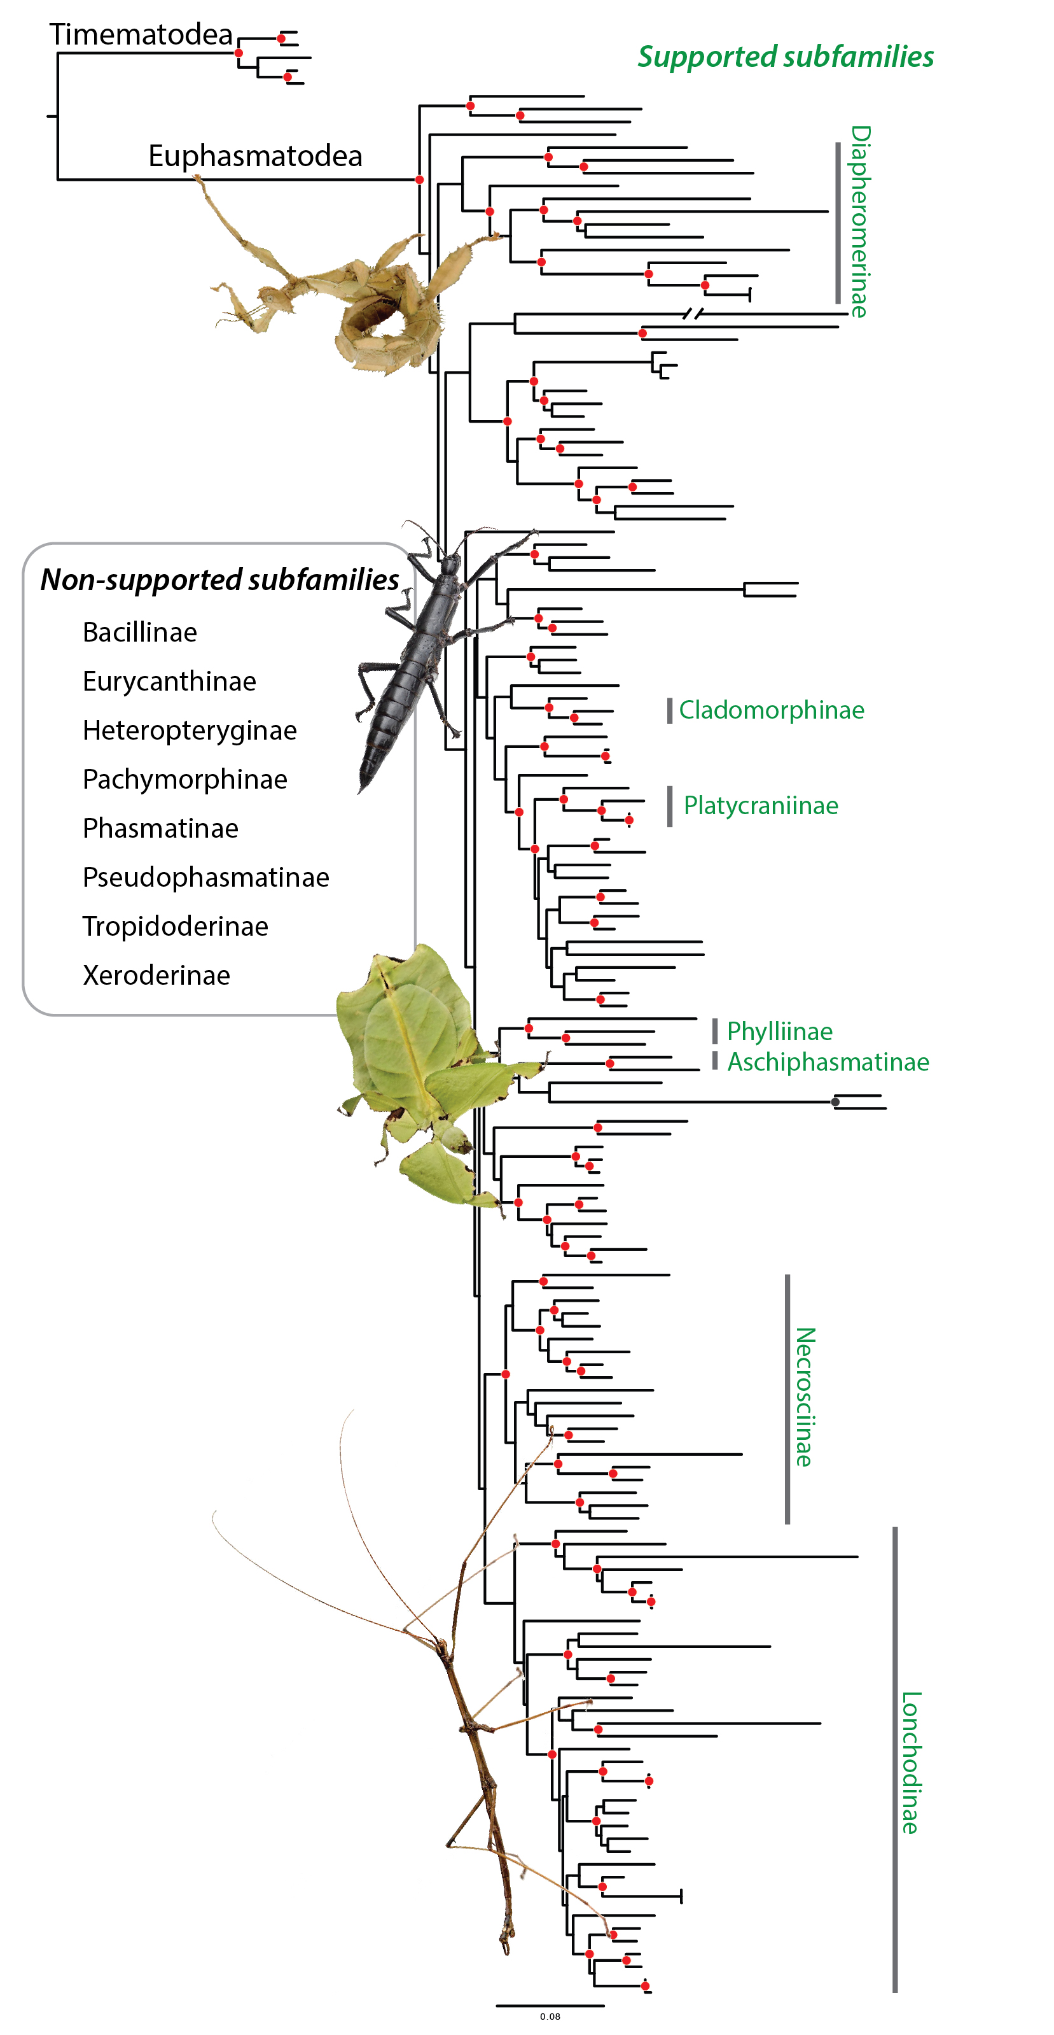
What Does a PO Look for in a Proposal?
“PO’s are tasked with creating a broad and diverse portfolio of funded proposals”
Diverse individuals participating in the sciences.
Career diversity, typically favoring new investigators.
Diverse institutions (Research 1 schools – Community Colleges).
Geographically diverse.
Diversity of sub disciplines.
Indicators of strong community support.
Diverse approaches that balance risk/success vs. originality.
Notes:
They are tasked with creating a broad and diverse portfolio of proposals:

Slide 11

Incredibly innovative.
“How exceedingly stupid not to have thought of that!” – Lord Huxley
Innovative but risky. Probably worth a go.
Innovative
Originality
Does the idea result in a fundamental shift in the field? Open new directions? Is it different? Is it exciting?
Relative Fitness
Nothing new here, and I don’t think the PI can actually complete the work anyway.
Incremental
Yes, the work will get done, it’s a solid proposal, but it is just like everything else we have funded. Do we really want to spend money here again?
Low
High
Risk
Will the PI be able to complete the work as proposed?
Notes:
Quoting Huxley on having read on The Origin of the Species: “How exceedingly stupid to not have thought of that”
Concept of relative fitness

Slide 12
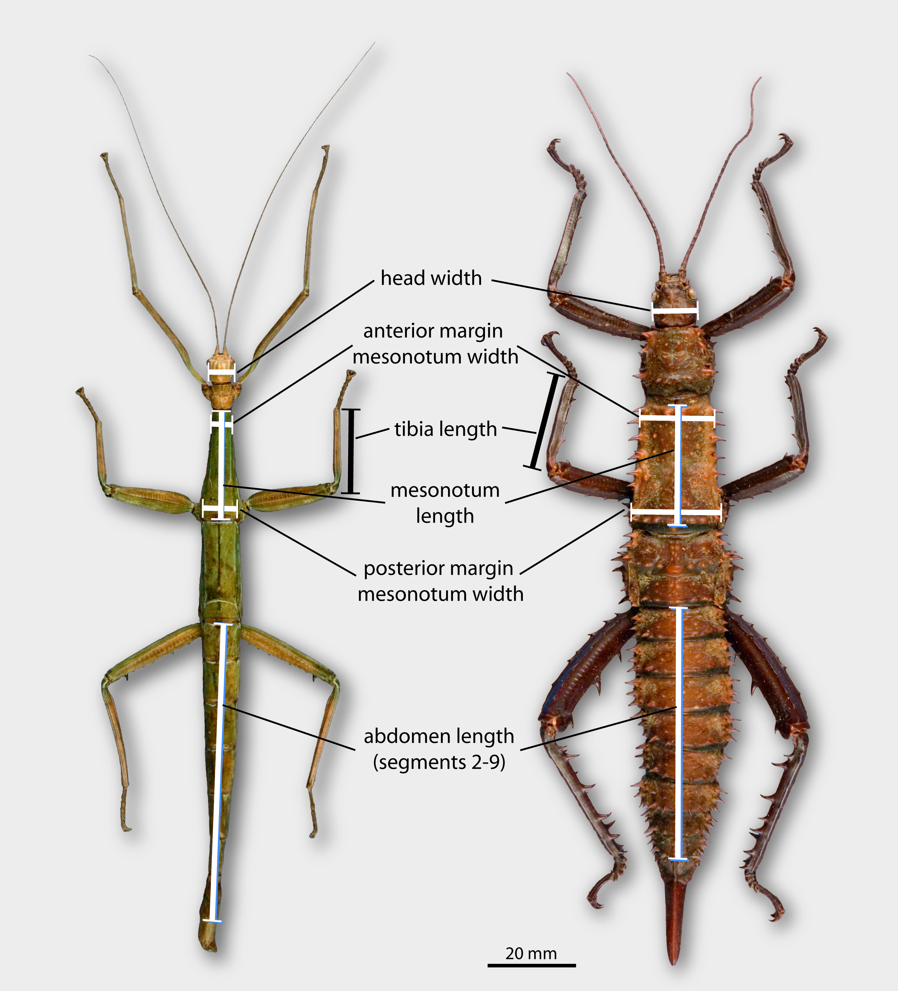
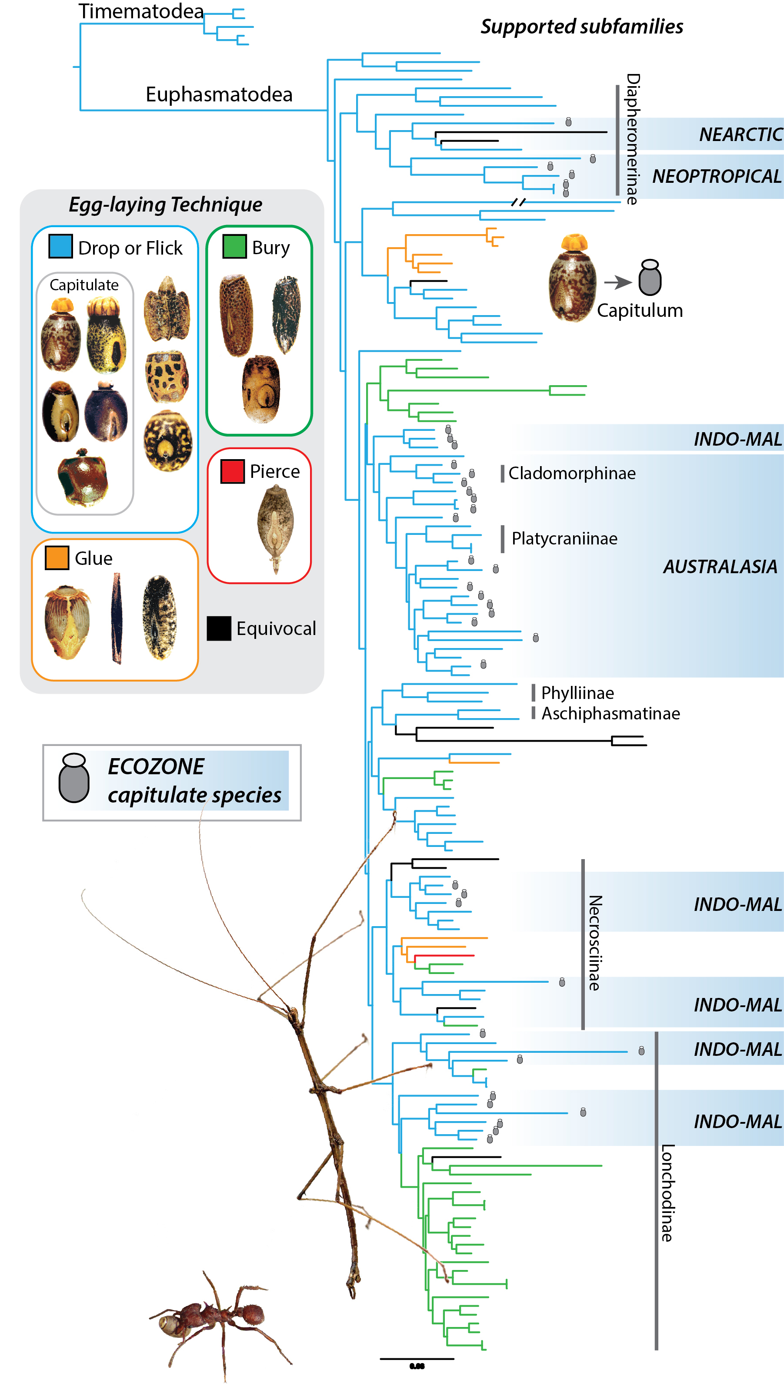
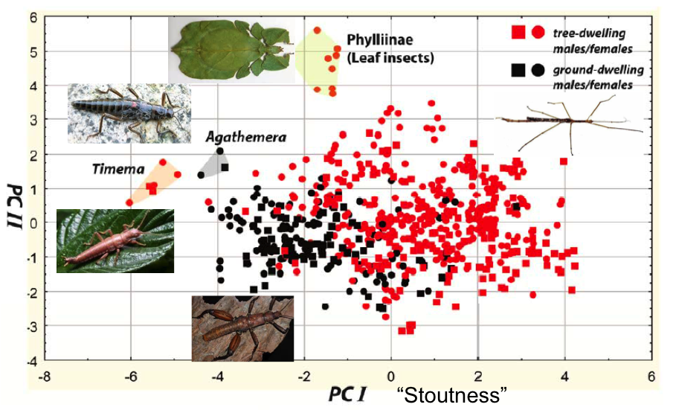
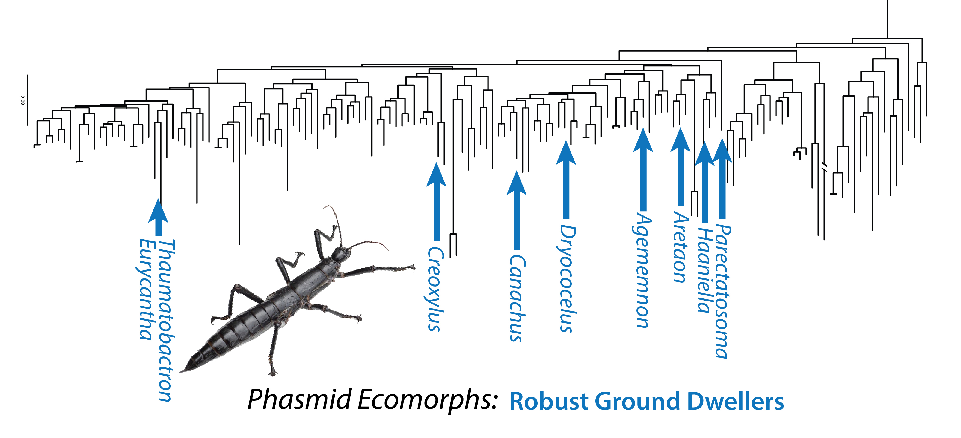
Review Analysis Boiler Plate
(See handout)
Notes:
Give the handout

Slide 13
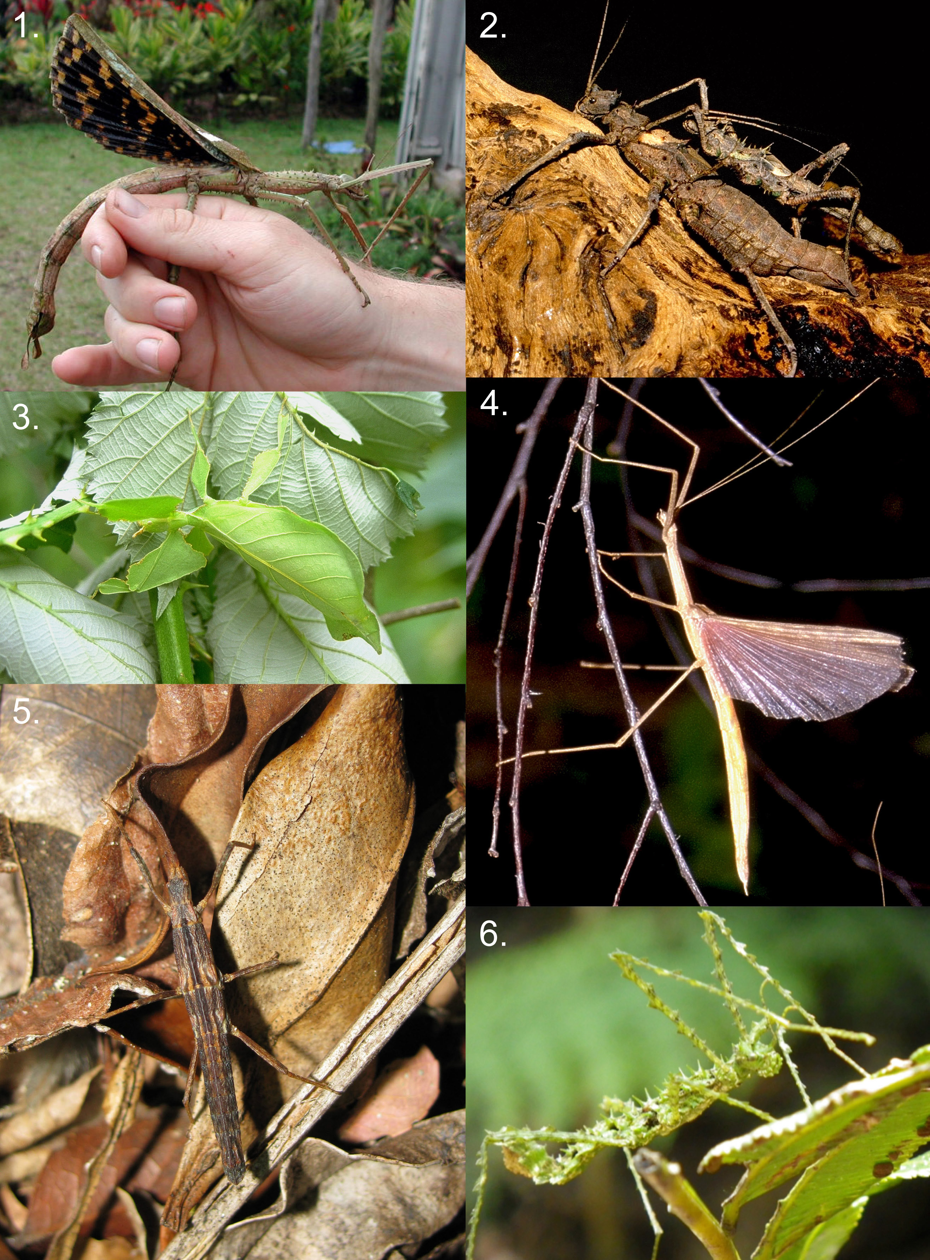
PI Perspective: Some General Tips
Contact the Program Officer!
Is this idea appropriate for this solicitation?
Are these sorts of broader impacts appropriate?
Give a quick overview of an idea, but recognize you are not likely to get feedback in terms of whether it is fundable.
Plant the seed!
Serve on a panel
Do your ad hoc reviews
Read recent successful proposals from colleagues
Read the GPG carefully before you begin writing and just prior to submission.
Avoid the RWR
Most proposals are funded on the second or third submission.
Be persistent and thick-skinned.
Notes:
1. We do not set the direction that a PI research goes; it is community driven.
2. Recognize that this is not just about getting money. It is about developing a research program that would be considered excellent at other institutions.

Slide 14
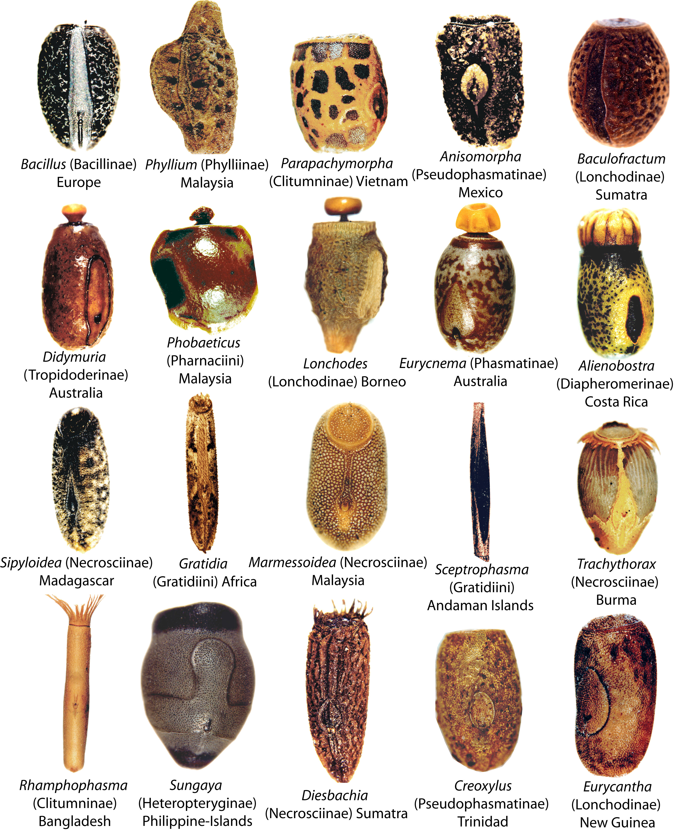
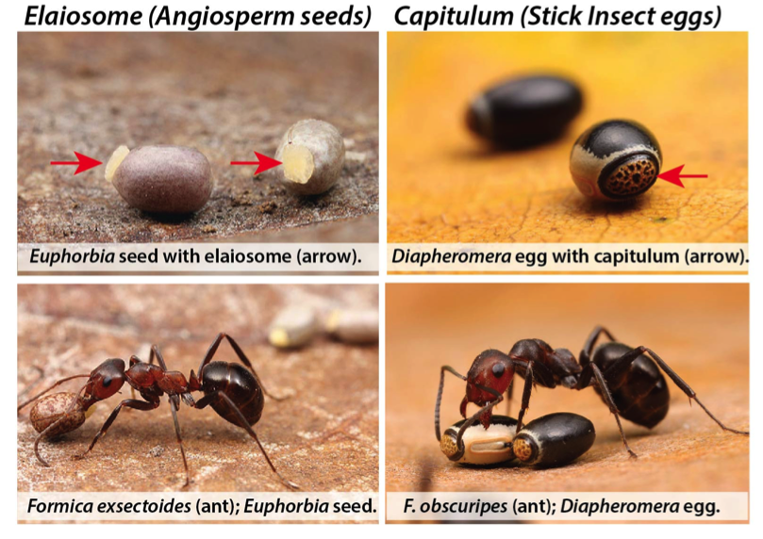
Intellectual Merit
PI’s spend most time thinking about this.
Be organized, clear, and concise.
Audience is reviewers and PO’s, often not specialists in your field.
Use illustrations effectively to make the proposal attractive and easier to read.
Label sections carefully and use bold type strategically.
Many reviewers just skim!
If a reviewer misunderstands a section or idea, it is your fault.
Notes:
Tell the story of the PI who basically yelled at the ad hocs to read his 10 papers before they even begin reviewing his proposal.

Slide 15

Broader Impacts
Critically important; not an afterthought
Leverage the use of undergrads; search for diversity.
Connect to other institutions, community colleges, high schools, etc.
Search for innovation with citizen science, new technologies, public outreach, etc.
Be creative.
Notes:
I included the 12 figures I used in my last proposal.

Slide 16
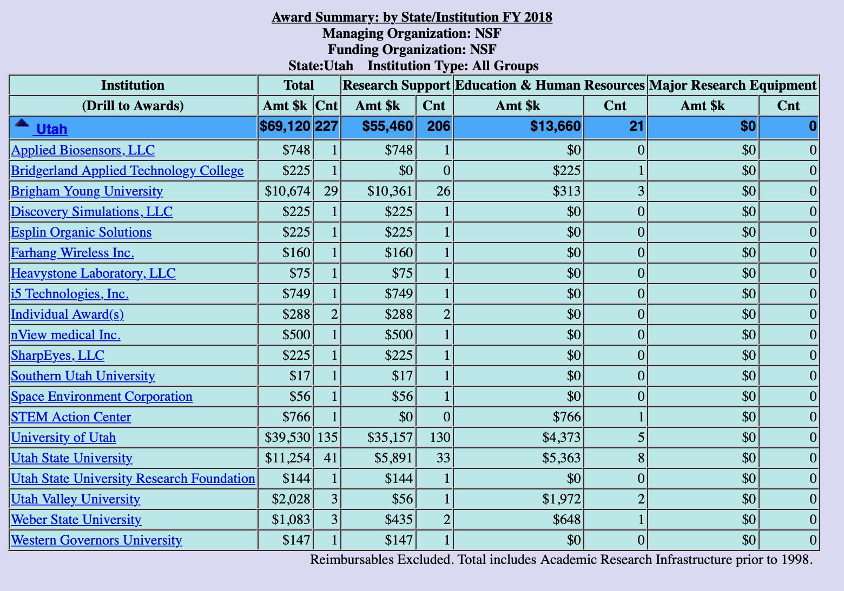

Slide 17
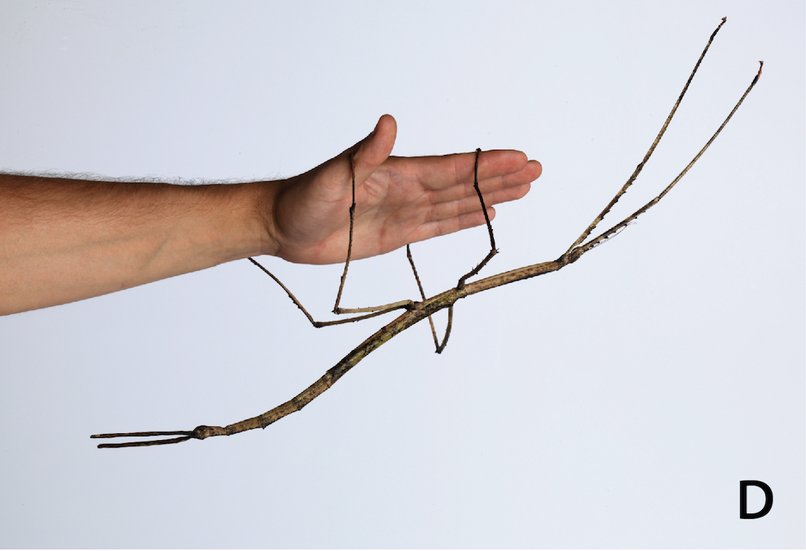
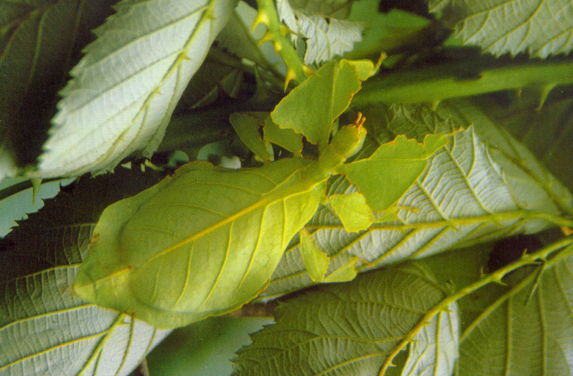
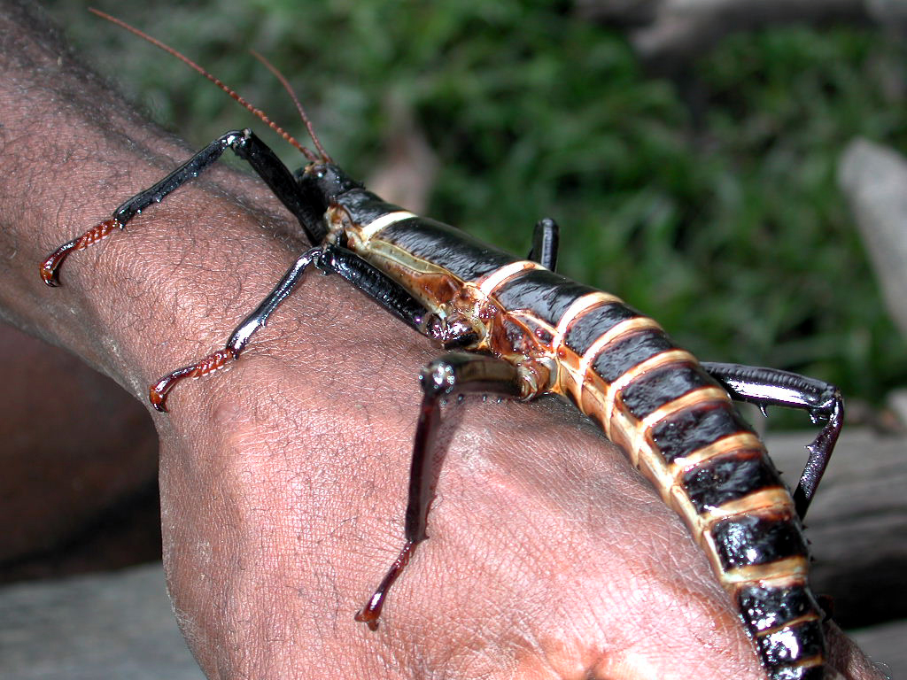
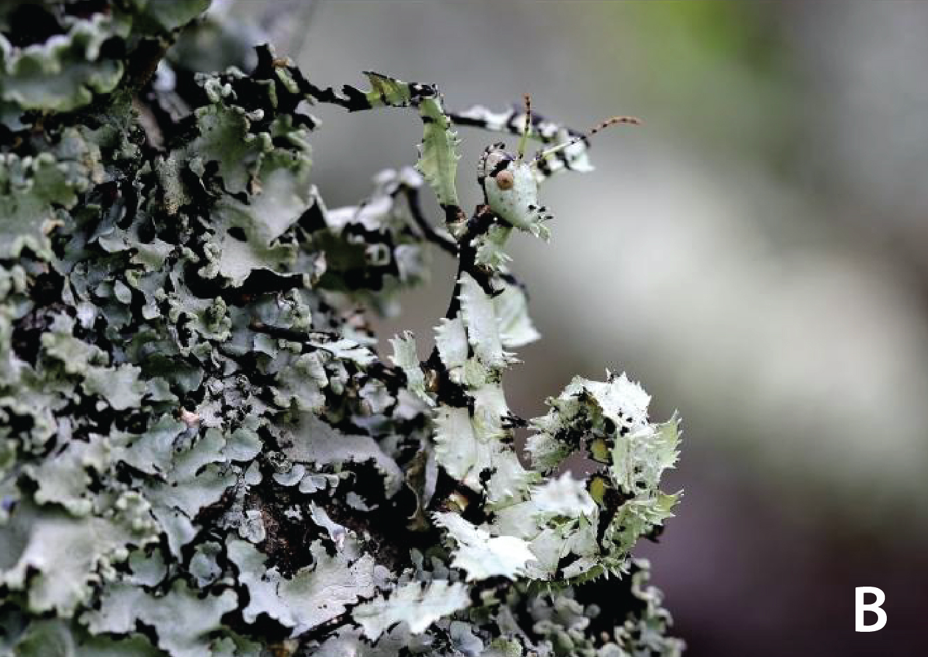
Questions?

Slide 18
Panel
Shane Reese is from the Department of Statistics and is the Dean of the College of Physical and Mathematical Sciences. His research interests include Bayesian Hierarchical Model, Bayesian Optimal Experimental Design and Sports Statistics. He has had funding from a variety of sources including several awards from the NSF.

Slide 19
2019 RD Events
January 31
Research Practice Partnerships Workshop– Bill Penuel (CU Boulder)
12:00-1:00 | 160-166 MCKB
February 4
Carter Cornwall– Writing NIH R01 Proposals
12:00-2:00 pm | 270 MB
March 13
NSF Seminar
12:00-1:00 pm | 270 MB
March 27
International Funding Seminar
12:00-1:00 pm | 270 MB
April 10
Outreach Seminar
12:00-1: 00 | 270 MB
May 6-7
Carter Cornwall Proposal Reviews
270 MB
May 9
Pivot training
12:00-1:00 pm | 2233 HBLL
May 13-16
Proposal Writing Bootcamp
9:00-2:00 | 270 MB
June 10-11
Grad Student Bootcamp
9:00-2:00 | 270 MB
*Dates may change - stay up to date at researchdevelopment.byu.edu

