Slide 1
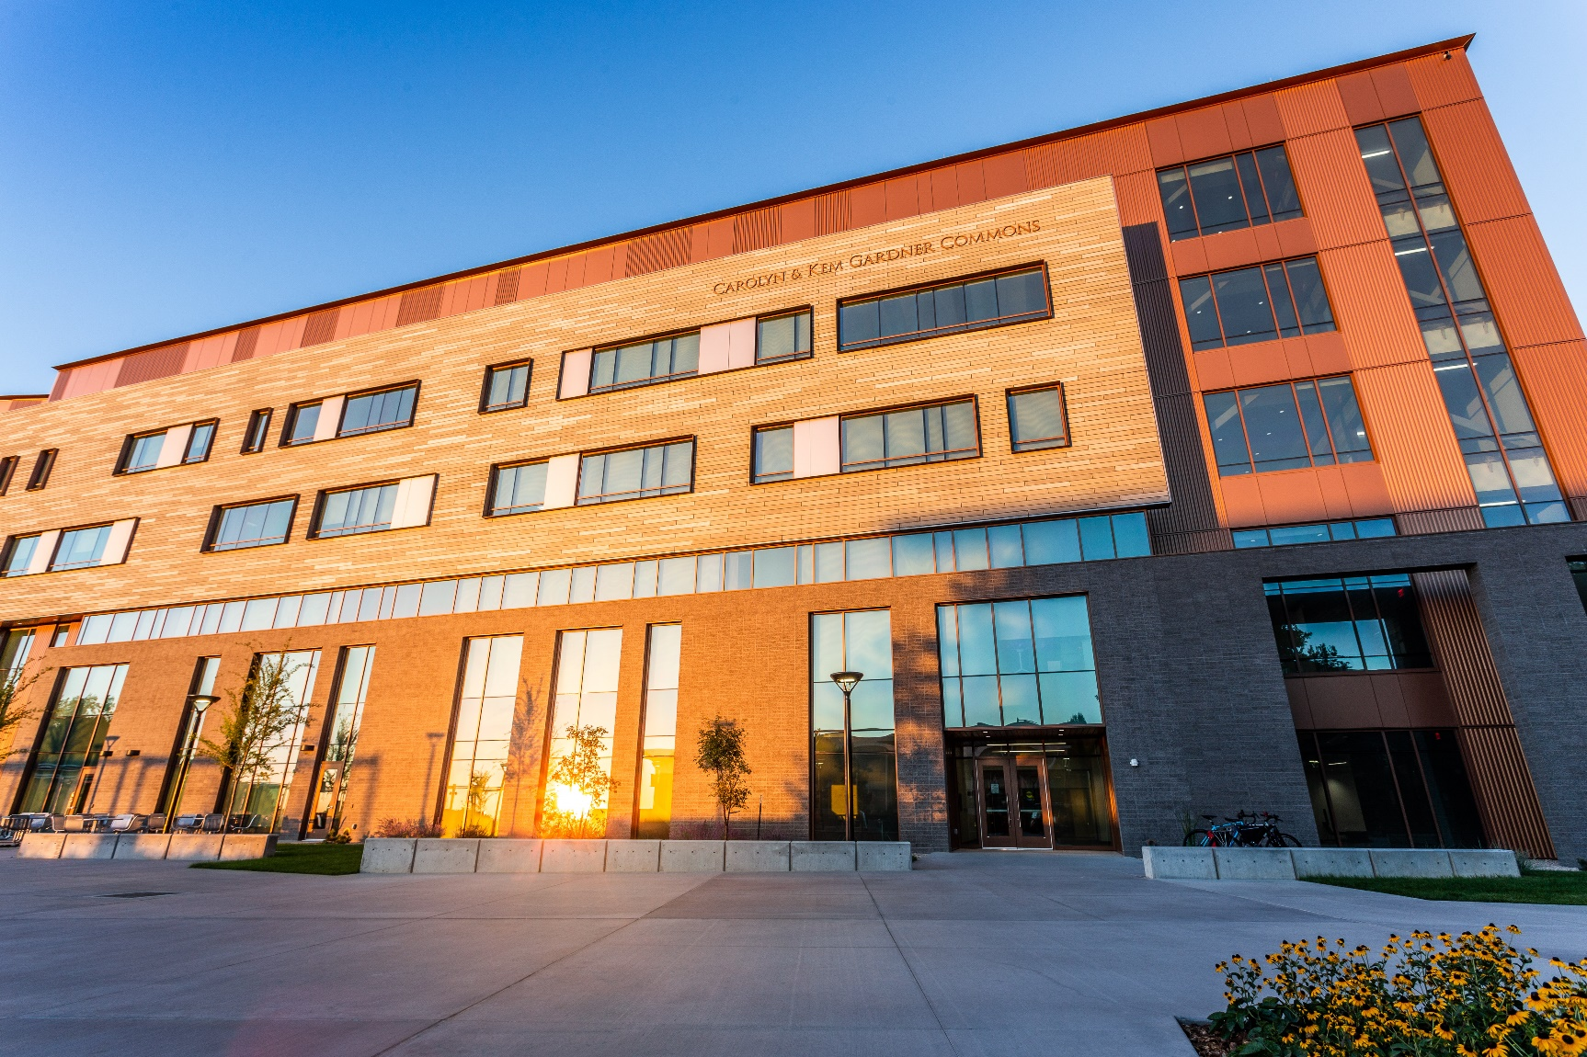
Wasatch Front Research Data Center
Funded by the National Science Foundation: Ken Smith, PI

Slide 2
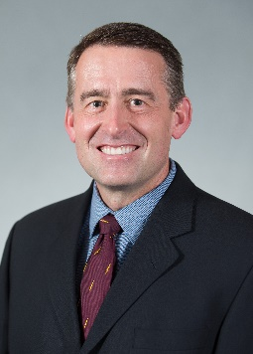
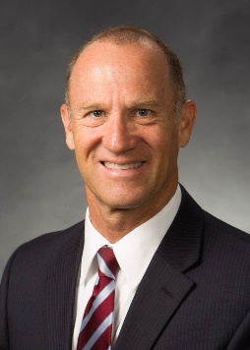
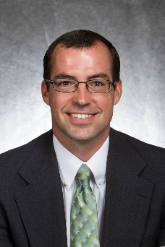
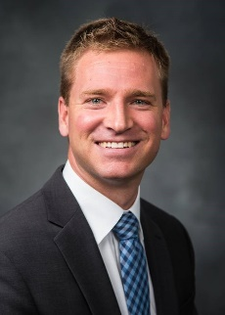
Acknowledgement
Mark Showalter
Eric Eide
Joe Price
Riley Wilson

Slide 3
What is a Federal Statistical Research Data Center
(FSRDC)?
Secure computing lab that is linked with the Census Bureau’s internal computing network
  Hrestricted-access data from multiple federal agencies for statistical purposes only
A contractual agreement between a leading research institution and the U.S. Census Bureau
FSRDCs are managed by an on-site Census employee—the administrator (RDCA)

Slide 4
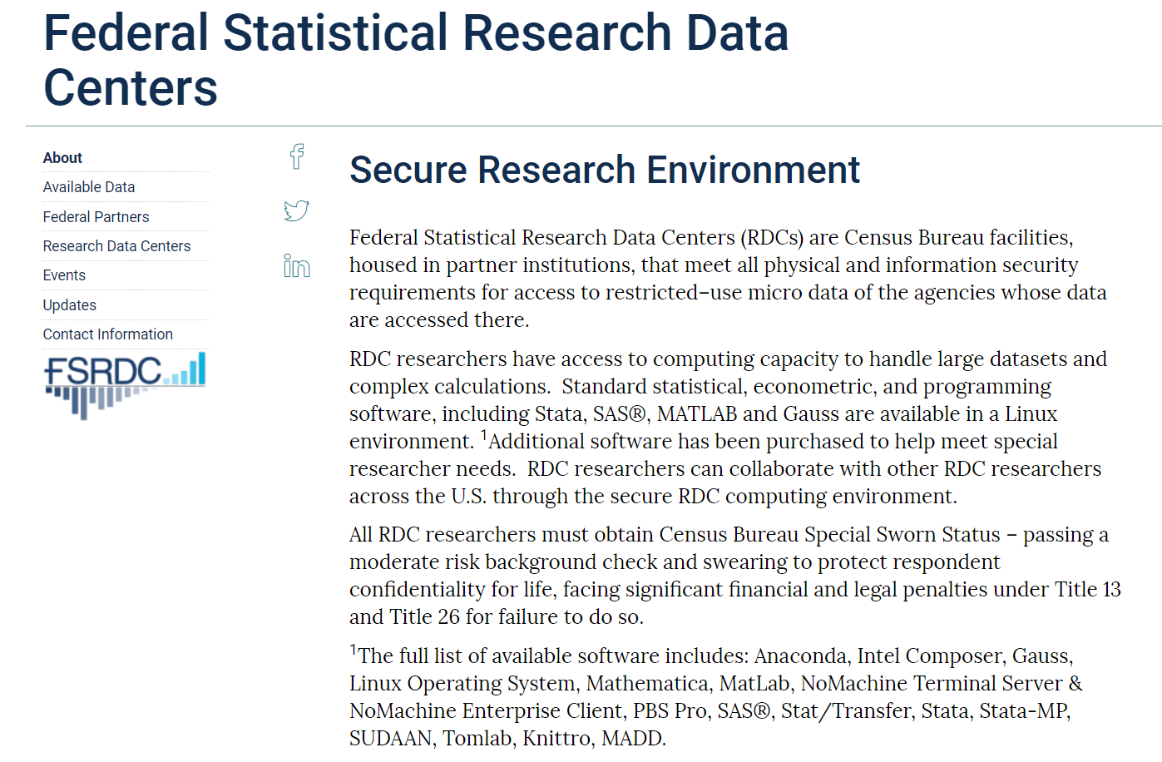

Slide 5

Wasatch Front Research Data Center
Most micro-level demographic and health data sets contain geographic detail and key measures unavailable in public use versions of the surveys.
Economic data include longitudinal data on firms, including detailed geographic information, and matched employee-employer data.
Many of the data sets can be linked across surveys or with external data sources providing a rich set of opportunities for researchers.

Slide 6
Providing Secure Access to Governmental Restricted Economic, Demographic and Health Data
U.S. Census Bureau (Decennial, ACS, Many Others)
National Center for Health Statistics
Agency for Healthcare Research and Quality
Bureau of Labor Statistics
IRS Statistics of Income (SOI)
Others are in the process (Dept of Justice)

Slide 7
Key Federal Agencies
Employment
Bureau of Labor Statistics (BLS)
US Bureau of the Census
Demographics
Economic
Longitudinal Employer–Household Dynamics (LEHD)
Research Using the Innovation Measurement Initiative's (IMI) UMETRICS Data
National Center for Health Statistics (NCHS)
Health Files
Geocodes
DHHS
Restricted Files
Agency for Health Research Quality (AHRQ)
(Medical Expenditure Panel Survey (MEPS)
https://www2.census.gov/about/linkage/data-file-inventory.pdf

Slide 8
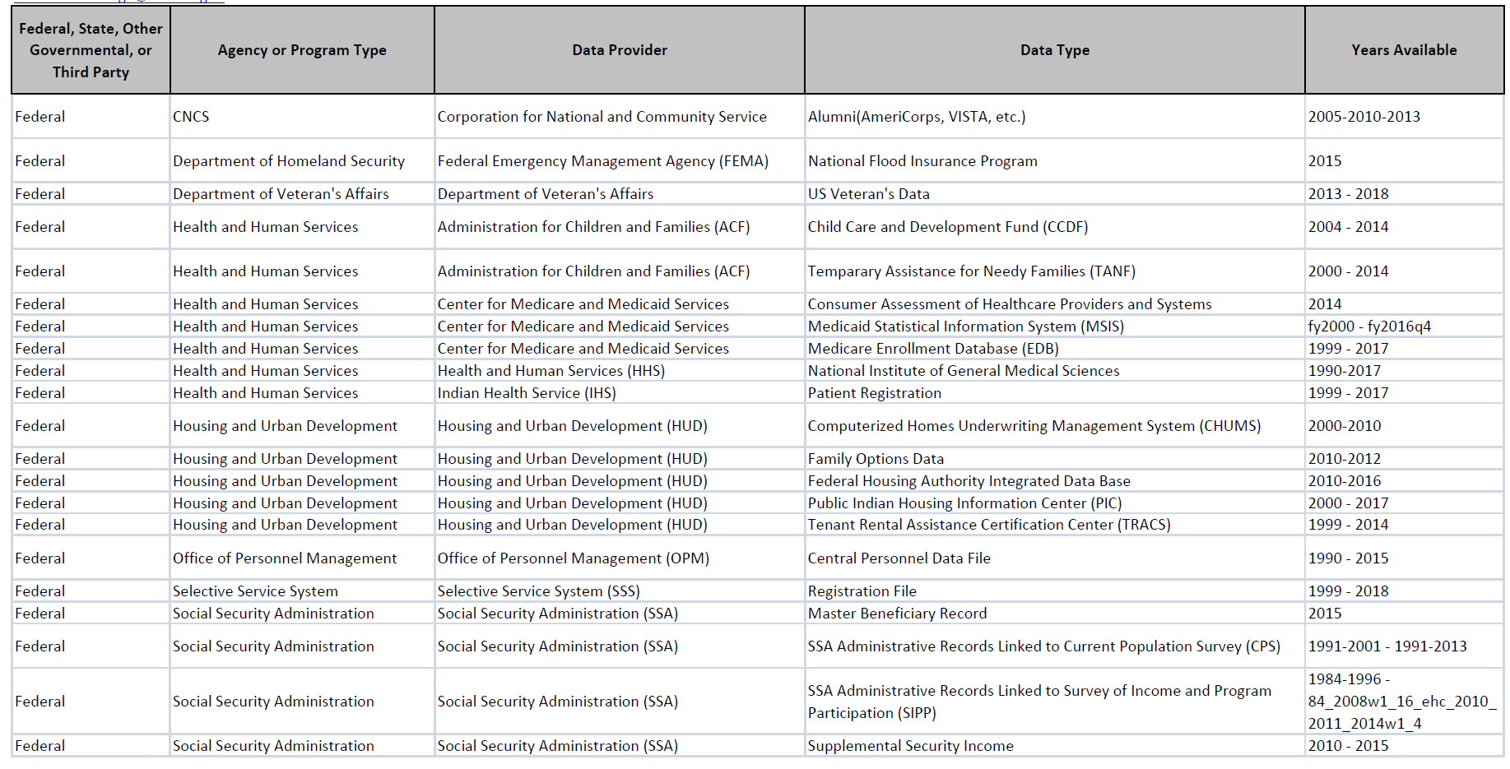

Slide 9
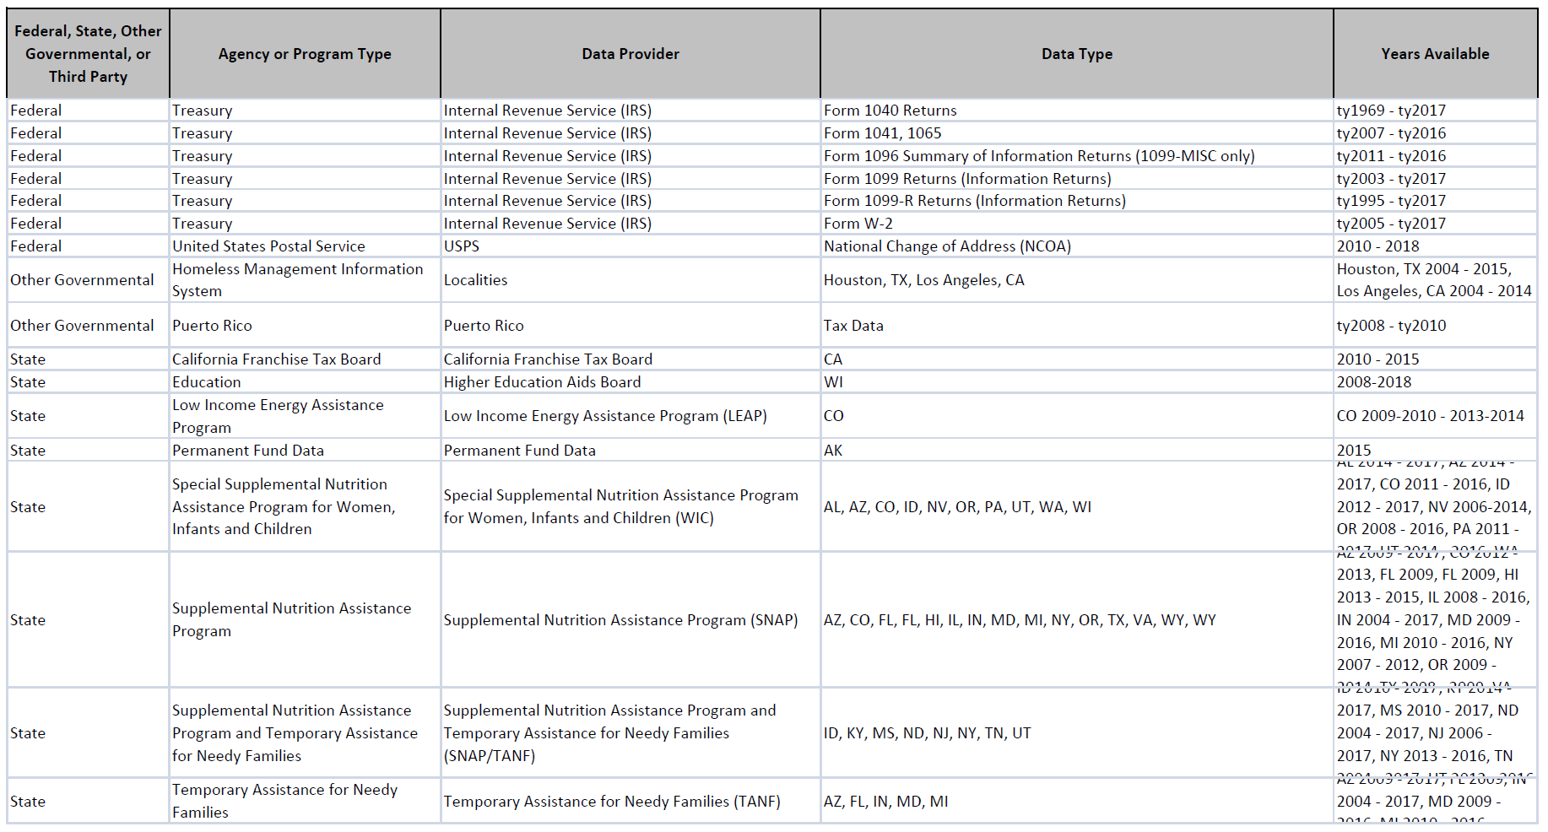

Slide 10
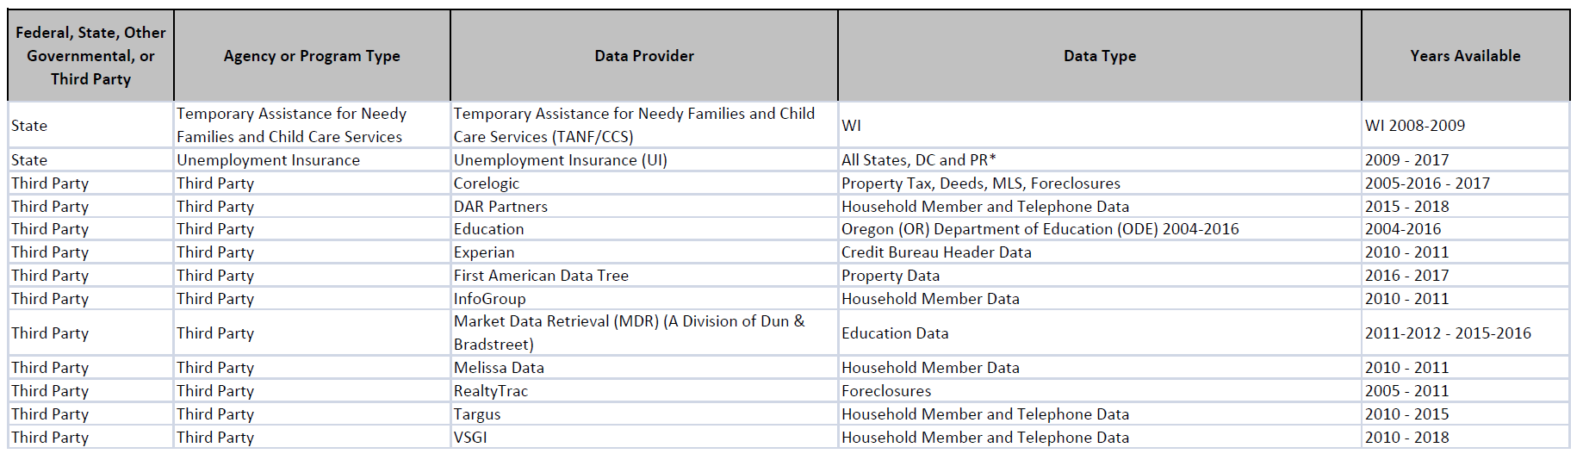

Slide 11
One of only 31 Federal Research Data Centers in the U.S.

Slide 12
Members
Faculty, Grad Students, and Affiliated Researchers:
Proposed free access to WFRDC services and secure laboratory for the first 2 years
FSRDC federal fees apply
Overtime, researchers are expected to write grant proposals and include WFRDC fees

Slide 13

Requirements
Projects must be approved by the agency that owns the data (e.g., Census, NCHS, BLS)
Researchers have a background investigation that qualifies them for “Special Sworn Status (SSS)”
Results are formally reviewed for disclosure violation before they leave the secure facility.

Slide 14

WFRDC Facility
Target Date: Summer 2019
Location: Gardner Commons on UU Campus
  10 thin client workstations to access FSRDC servers
  RDC Administrator’s office
  Badge Reader at Entrance
  Fulltime Security System
  No electronic devices allowed
  NOTHING leaves the secure lab without approval

Slide 15
Graduate Students Research Opportunities
Census Dissertation Mentorship Program
Census Dissertation Fellowship Program (up to $50,000)
(MAYBE) Cornell University Course by Videoconference

Slide 16

RDC – What Can’t It Do
Microdata that are not available publicly
  Firms
  Individuals/Households
Small geographic resolution
Population counts or large samples
All response items
  industry codes, occup codes, detailed race, income is not top-coded)
File Linkages
  with external data (e.g., via geocodes, establishment ID, etc.)
  between multiple internal data sets via non-public link keys

Slide 17
Utah Population Database
Birth & Death Records
University of Utah Hospitals
Inter-mountain Healthcare
Inpatient Visits
Ambulatory Surgery
Cancer Registries
Medicare
Genealogy
Driver Licenses
Medical Insurance Claims (APCD)
US Census (Individual level)
Marriage and Divorce
Dept of Human Services
Autism Registry
Birth Defects Network
Voter Registration
Emergency Dept
UPDB Data Sources
+ Geocodes
+ Option to link subjects in existing studies

Slide 18
FSRDC Active Projects by Type 2015-2018
450
400
1
350
300
201
1
250
200
129
142
150
110
148
100
98
103
50
79
15
29
31
45
0
Sept 2016 AHRQ NCHS
Sept 2015
Sept 2017
Sept 2018
CENSUS BLS

Slide 19
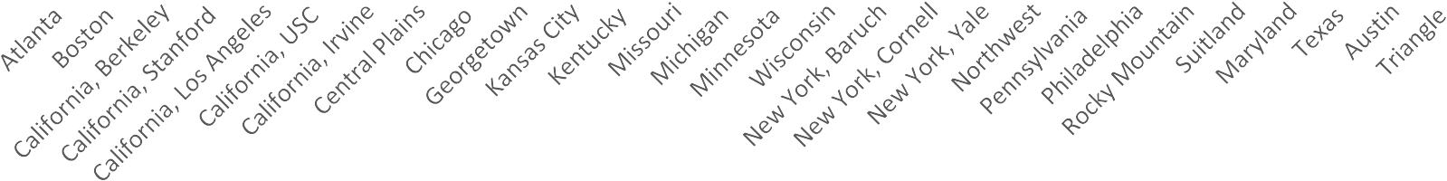
Active Projects by RDC 2017-2018
40
35
30
25
20
15
10
5
0
2017 Projects
2018 Projects

Slide 20
Projects by Type and RDC August 2018
Triangle Austin Texas Maryland Suitland
Rocky Mountain Philadelphia Pennsylvania Northwest New York, Yale
New York, Cornell New York, Baruch
Wisconsin Minnesota Michigan Missouri Kentucky Kansas City Georgetown
Chicago Central Plains California, Irvine California, USC California, Los Angeles California, Stanford California, Berkeley
Boston Atlanta
0
5
10
15
CENSUS ₇ BLS
20
HEALTH
25
30
35
40

Slide 21
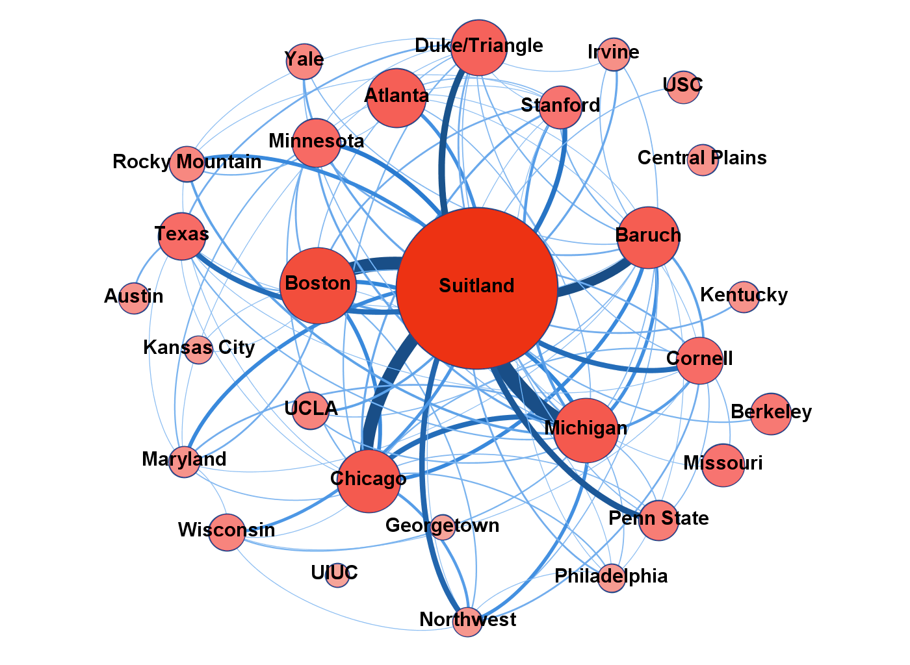
All Active Projects 2018
Note: Graph includes all projects. Node size and color proportional to the total number of projects. Line thickness and color are proportional to the number of collaborations between a given pair of FSRDCs. Does not display lines with 2 or fewer collaborations between nodes.

Slide 22
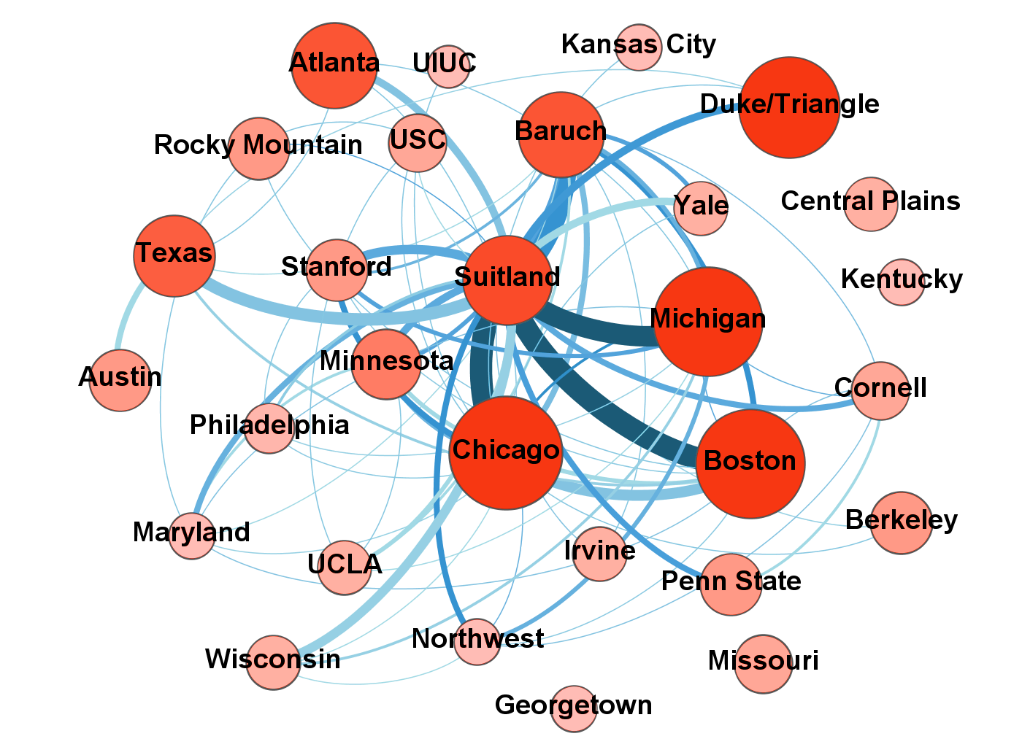
External Projects 2018
Note: Graph includes external projects. Node size and color proportional to the number of external projects. Line thickness and color are proportional to the number of external collaborations between a given pair of FSRDCs. Does not display lines with a single collaboration between nodes.

Slide 23
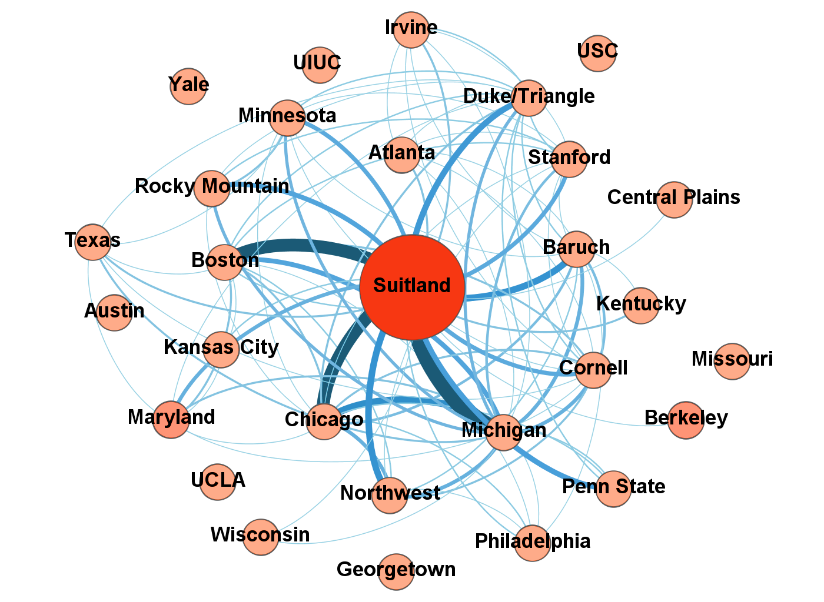
Internal Projects 2018
Note: Graph includes internal projects. Node size and color proportional to the number of internal projects. Line thickness and color are proportional to the number of internal collaborations between a given pair of FSRDCs. Does not display lines with a single collaboration between nodes.

Slide 24
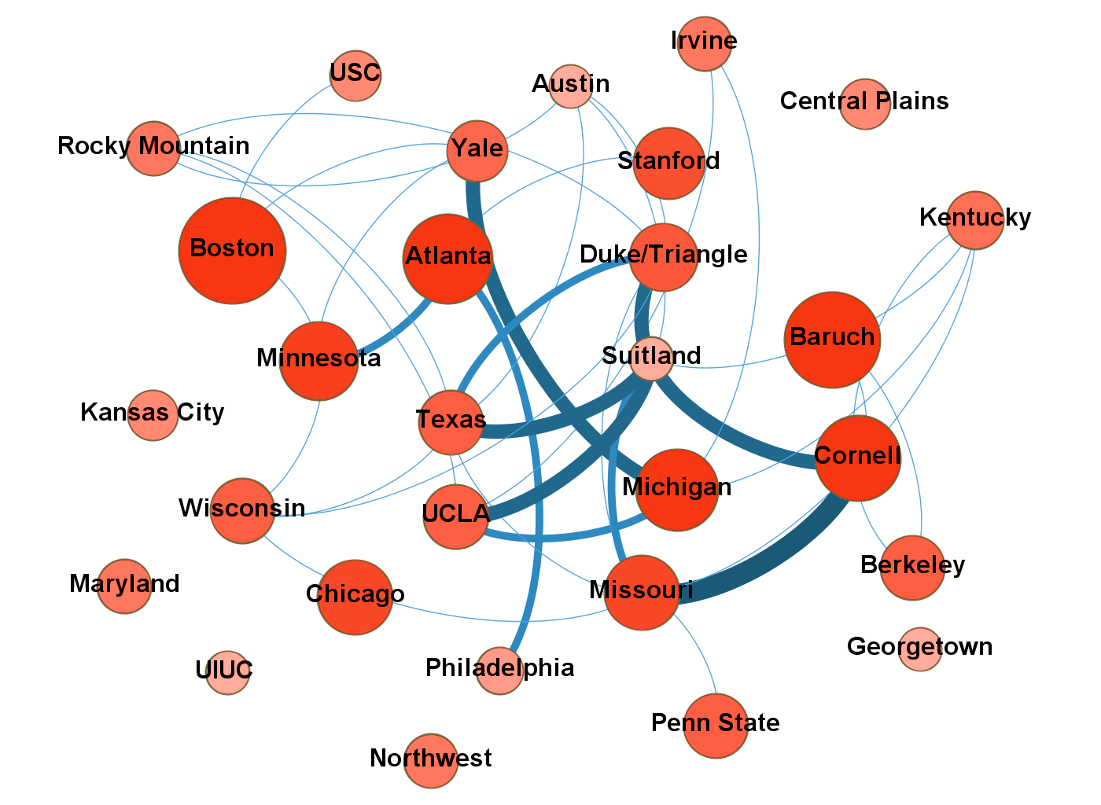
Health Projects 2018
Note: Graph includes NCHS projects. Node size and color proportional to the number of hosted NCHS projects. Line thickness and color are proportional to the number of NCHS collaborations between a given pair of FSRDCs. All collaborations displayed.

Slide 25
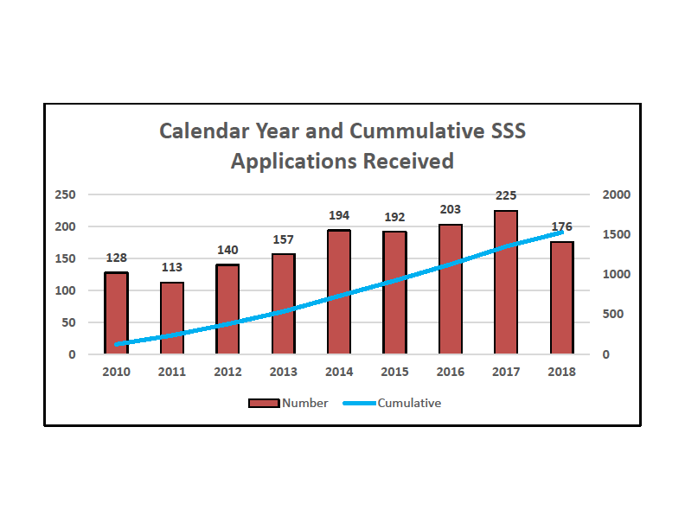
Special Sworn Status

Slide 26
Census Review Durations
2014-2018
350
309
300
250
202
200
189
150
144
100
90
68
56
64
53
51 51
62
55
51
50
47
0
2014
2015
2016
2017
2018
MEAN
MEDIAN MAX

Slide 27
Proposal Development (in Days) 2016-2018
140
124
120
104
100
85
80
66
60
52
55
40
20
0
2016
2017
2018
MEDIAN
MEAN

Slide 28
Census Approval Rates 2013-2018
90
80
70
60
50
40
30
20
10
0
78.9
74.7
67.3
70.0
63.6
64.1
75
80
49
55
38
39
2013
2014
2015
2016
Approval Rate (%)
2017
2018
Submissions

Slide 29
Projects Submitted
Aug 15, 2017 – Aug 14, 2018
9
Approved
Not Approved
14
Under Review
Resubmitted
48
N=87
Six of the 9 resubmitted projects have been approved.
25

Slide 30












Mean IRS Reviews (in Days) 2013-2018
External Projects ‐ Mean IRS Review in Days
140
127
120
109
100
93
80
70
72
61
65
60
58
57
57
57
45
40
20
0
2013
2014
2015
2016
2017
2018
IRS BOC

Slide 31












Median IRS Reviews (in Days) 2013-2018
External Projects ‐ Median IRS Review in Days
120
108
100
91
84
80
60
61
60
56
52
41
44
40
31
31
24
20
0
2013
2014
2015
2016
2017
2018
IRS BOC

Slide 32
WFRDC Advisory Committee
1. Ken Smith (Director) (PI)
2. Pam Perlich (Advisory Committee Chair) (co-I)
3. Lori Kowaleski-Jones (UU) (co-I)
4. Norman Waitzman (UU) (co-I)
5. Tom Cova (UU) (co-I)
6. Ming Wen (Sociology UU)
7. Mark Showalter (Economics BYU)
8. Mia Hashibe (Huntsman Cancer Institute UU, Epidemiology)
9. JoAnn Tschanz (Psychology USU)
10. Wu Xu (UDOH, Demography/Sociology)
11. Vikrant Deshmukh (UUHSC, Bioinformatics)
12. John Fairbanks (DLD)

Slide 33
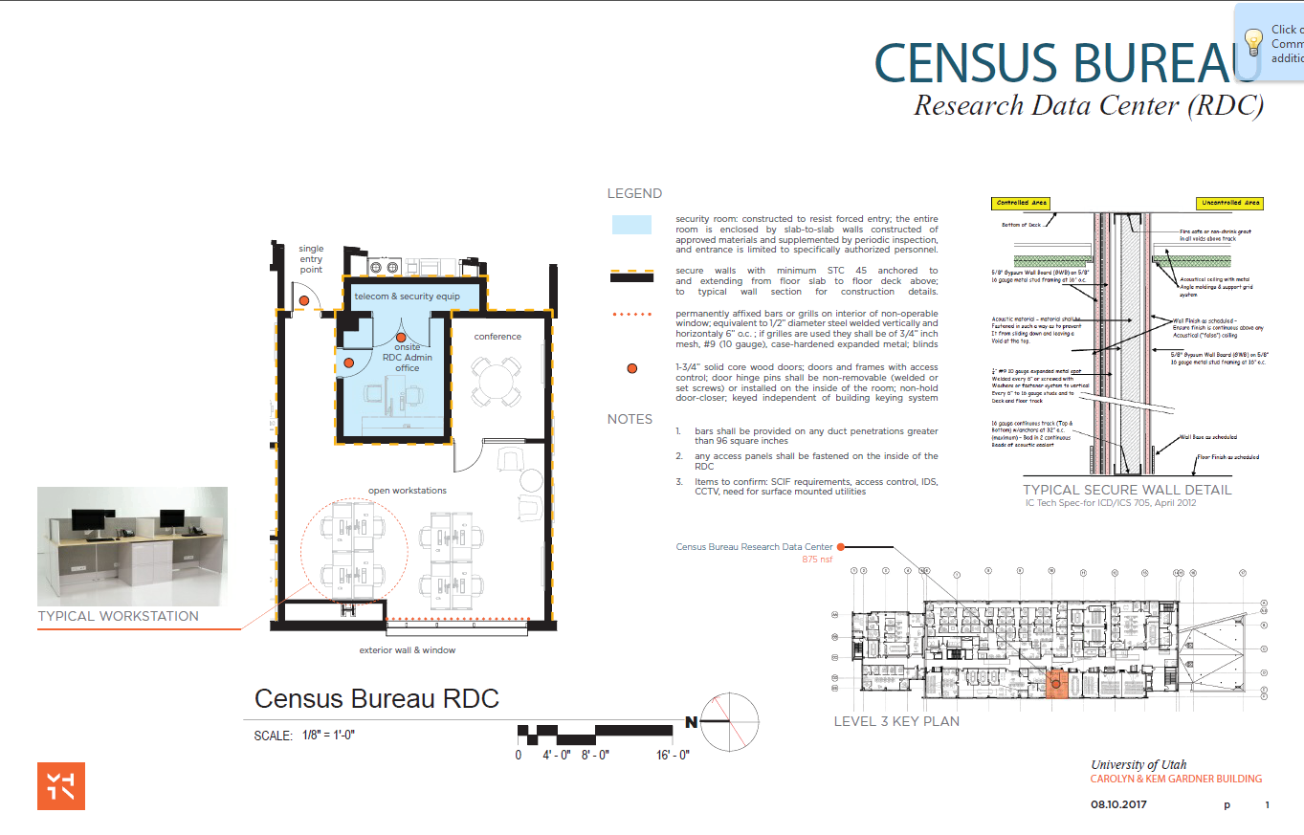
Opening Date: Late Spring or Early Summer 2019

Slide 34
Novel Projects
Domestic violence and help-seeking behavior
  Restricted National Crime Victimization Survey
    Report a range of crimes
  Uses geocodes to see county level data to observe police per capita and social service per capita
  Assesses how local resources affect help-seeking
Labor Force Participation after Childbirth
  Dates of birth are restricted because they are identifying
  Use DOBs of children linked to mother’s employment, income and program use
  Links Survey of Income and Program Participation (SIPP) with the Longitudinal Employer-Household Dynamics (LEHD) Survey

Slide 35
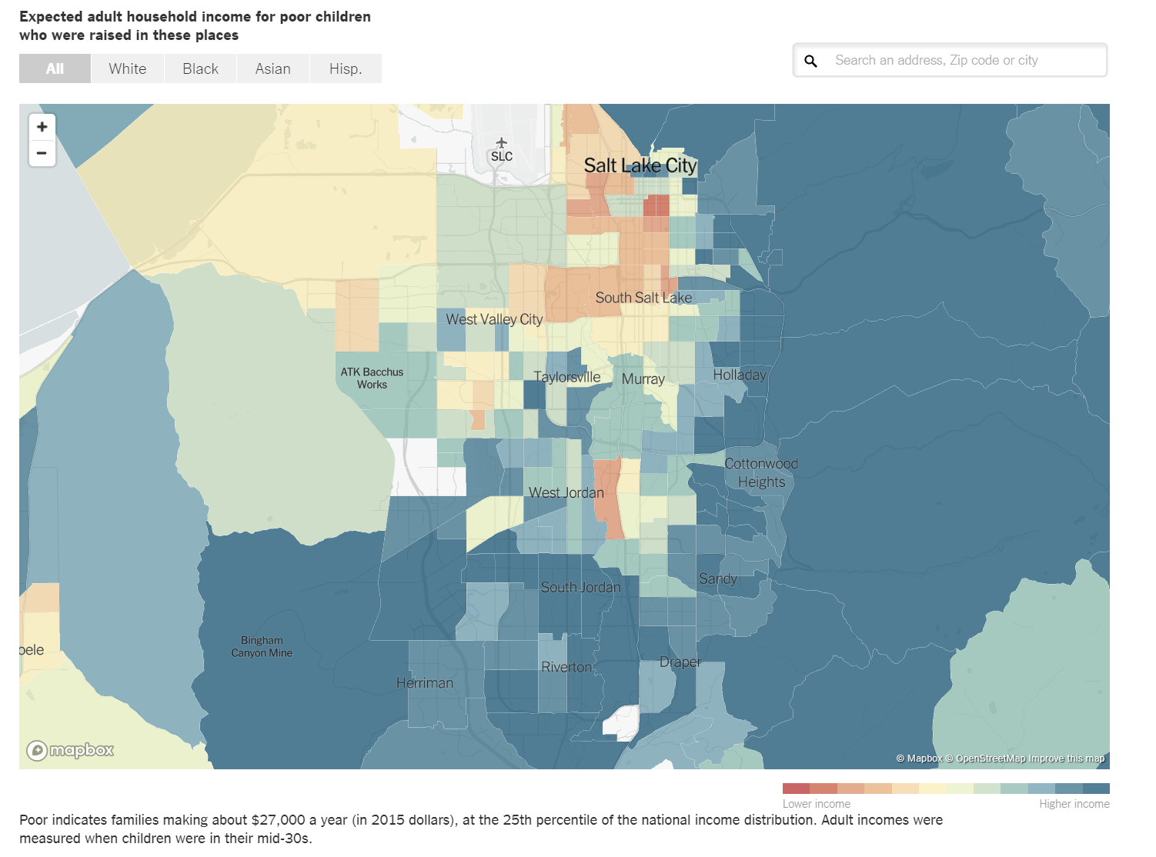
https://www.opportunityatlas.org/

Slide 36

RDC Rollout
Mid 2019 Opening
Security and architectural audit
Hiring RDC Administrator
Generating Proposals
Fee Structure in progress
Consortium with BYU and USU
  Branch?
Questions?

