Slide 1

The Interdisciplinary Research (IDR) Origination Awards Informational Seminar
The Office of Research Development
December 1, 2022

Slide 2
Research Development Office Mission
BYU Research Development supports faculty and graduate student efforts to procure and secure funding for research and scholarly activities.

Slide 3
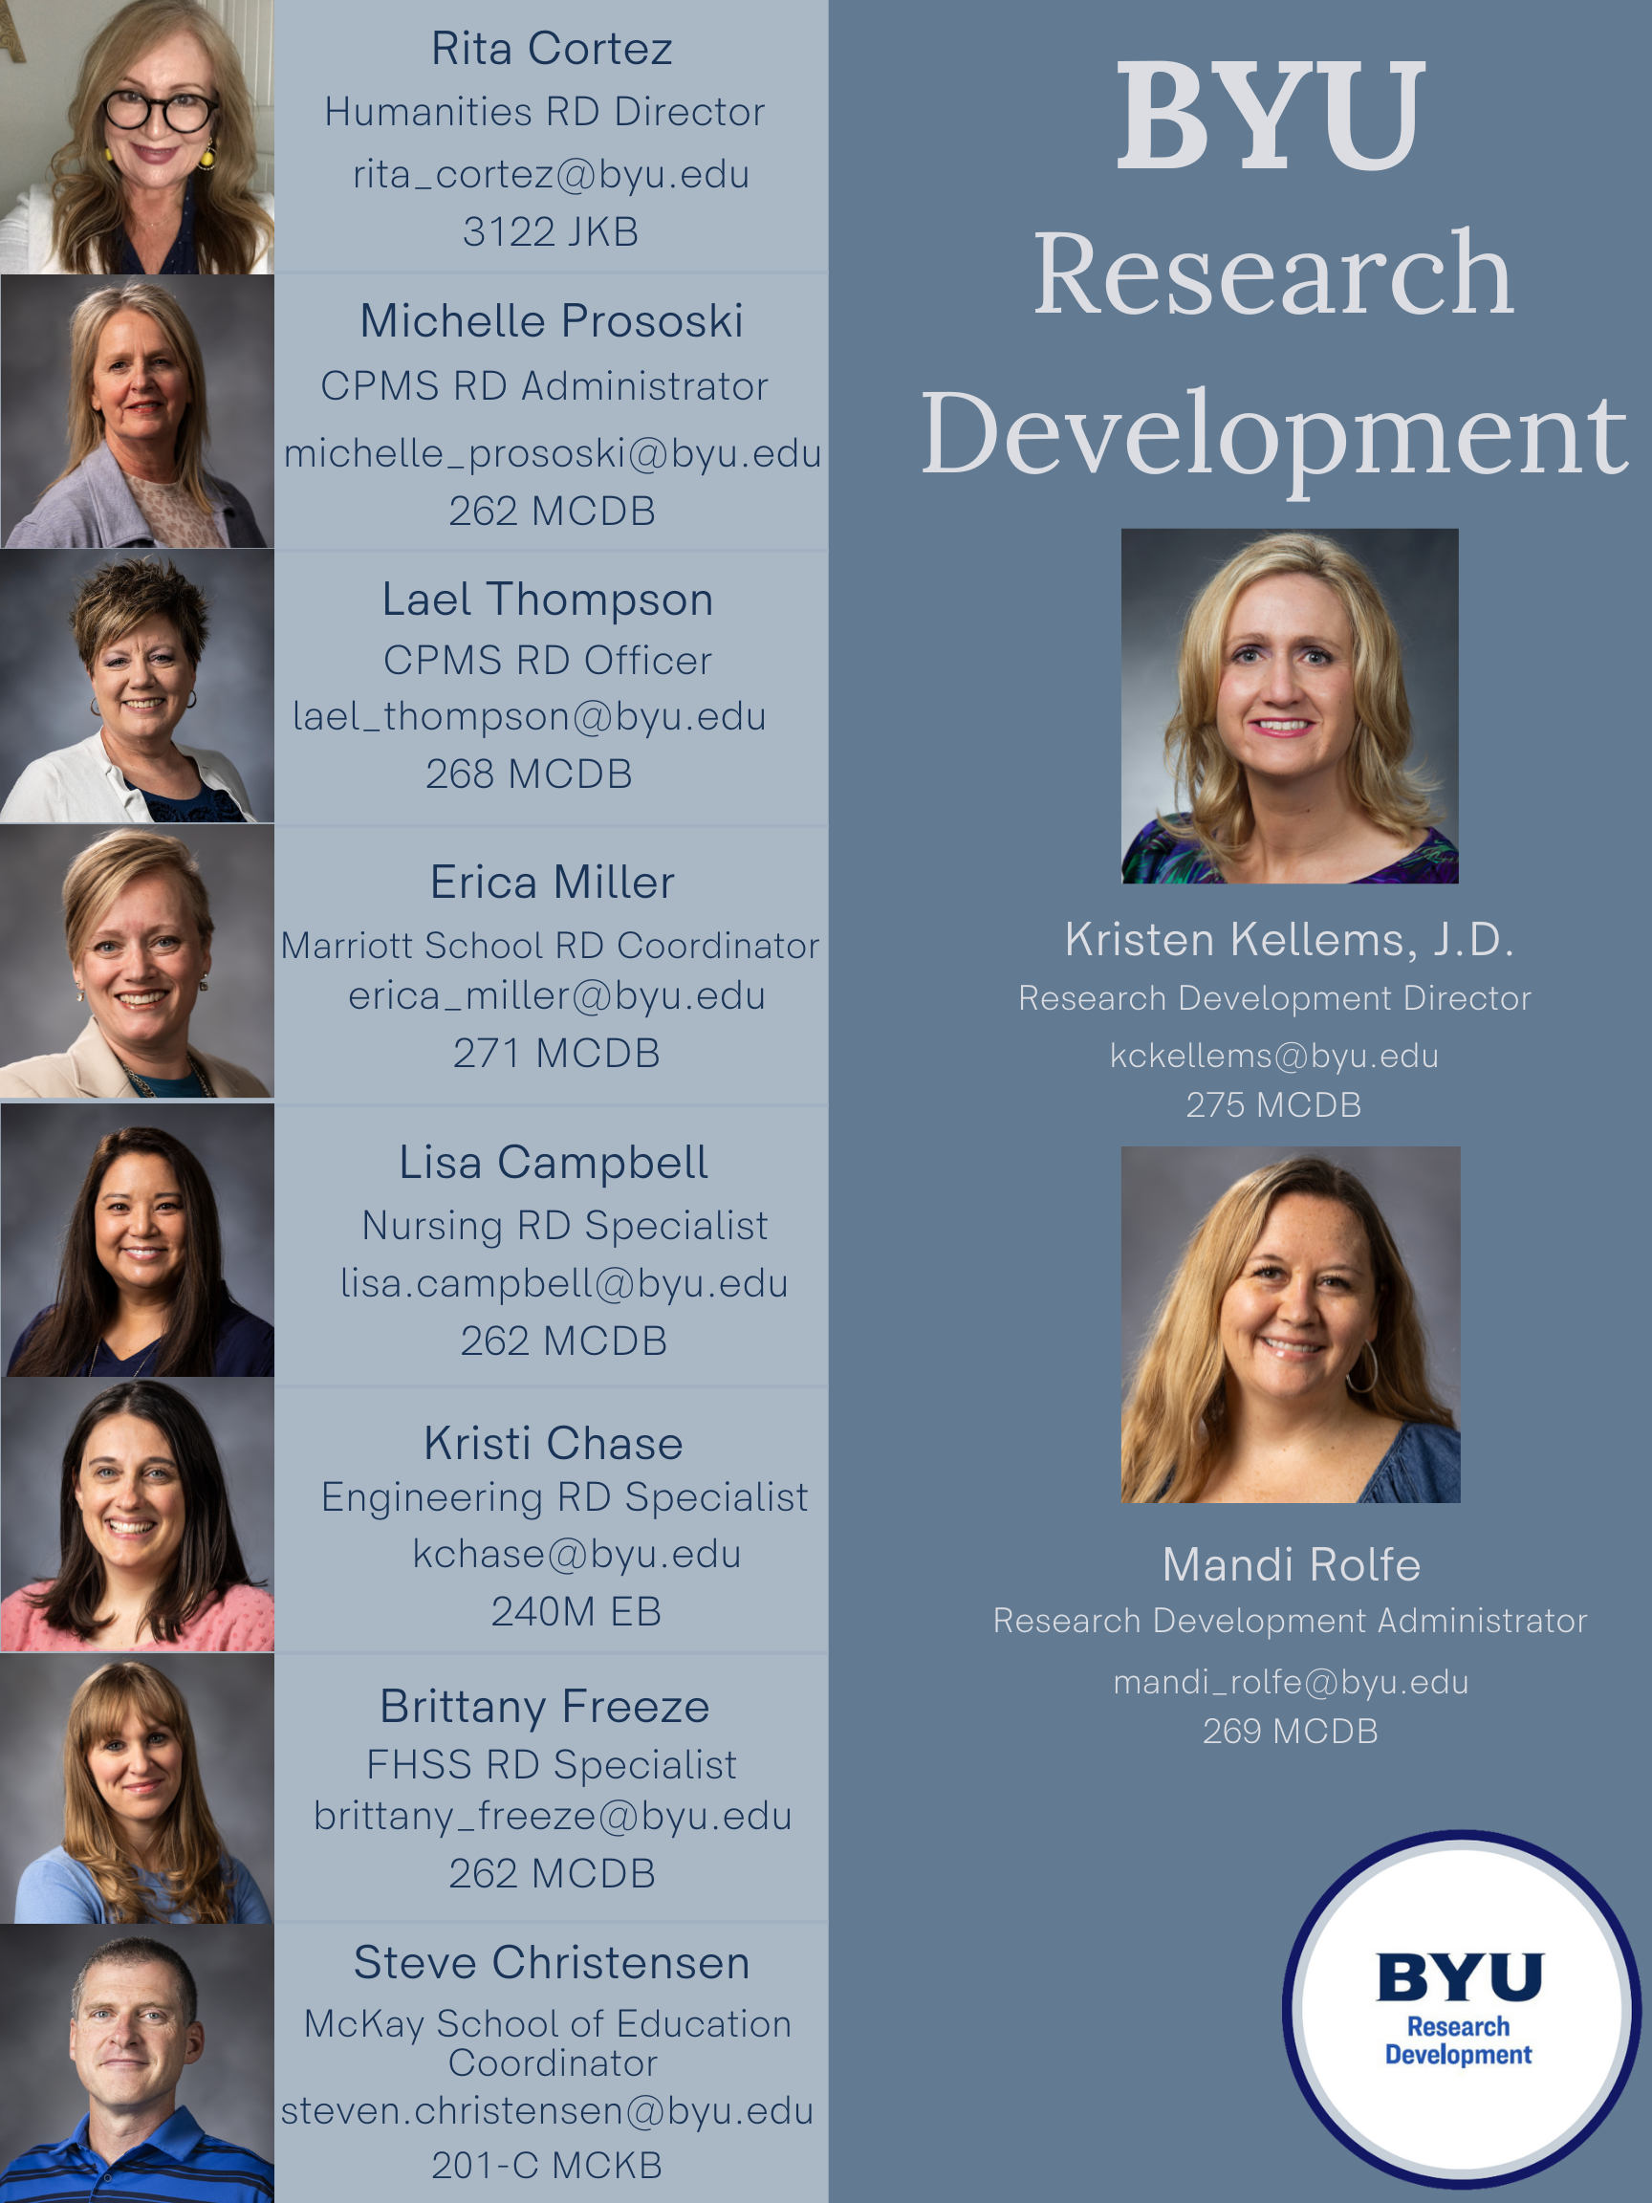
Find out more about the Office of Research Development and members of the Research Development Coordinating Council on our webpage: https://researchdevelopment.byu.edu/overview

Slide 4

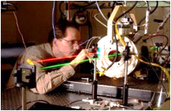
Aims of the Interdisciplinary Research Origination Awards
Catalyze the development of interdisciplinary projects at BYU
Develop preliminary data
Produce significant scientific, cultural, creative, and/or societal impacts
Capture larger amounts of external funding

Slide 5
Overview
Teams can apply for one of two tracks:
Track 1 teams consist of:
Faculty from two colleges and three different departments
$60,000 per year for two years
Three awards made
Track 2 teams consist of:
Faculty from one college and three different departments
$20,000 per year for two years
Two awards made
Discretionary award
Review committee determines an additional project to fund at an amount of their choosing

Slide 6
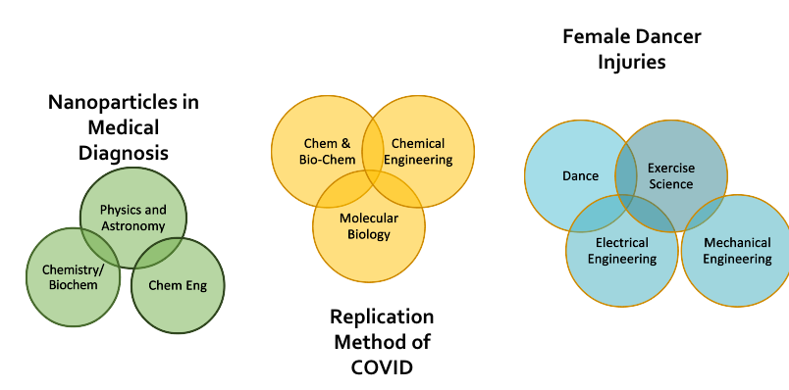
2022 Track 1 Winning Teams
Read winning applications here: https://researchdevelopment.byu.edu/idr-winners

Slide 7
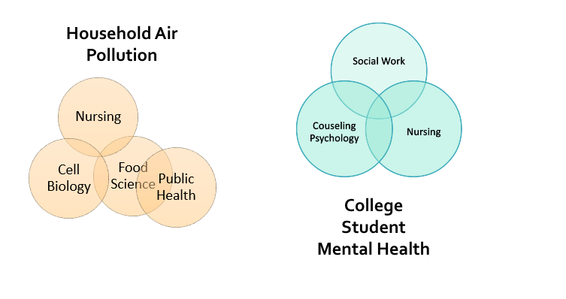
2022 Track 2 Winning Teams
Read winning applications here: https://researchdevelopment.byu.edu/idr-winners

Slide 8
Eligibility Requirements
Primary and Co-Investigators must be CFS-track faculty.*
The following university-level units are eligible to count as one department: ​
Academic departments​
CFS-track investigators in CAPS and the HBLL
The Center for Collaborative Research and Statistical Consulting
The MRI Research Facility
The Microscopy Lab
The following university-level centers with approval from the RD Director confirming that the research supports the center mission
Wheatley Institution
Maxwell Institute
Sorenson Center For Ethical and Moral Leadership
Museums and college-centers may also count as eligible department if necessary to the project. Consult with the RD Director about eligibility.

Slide 9

2023 Deadlines
Key Dates
Letter of Intent due January 17, 2023 by 11:59 p.m. Submitted via Qualtrics form found on the Research Development Office website.
Proposal is due on February 21, 2023 by 11:59 p.m. PDF of the application is submitted via email to rdadmin@byu.edu.
Awards will be announced before the end of Winter semester. Funding will be available during Spring term.

Slide 10
Proposal Components
•Cover page: 1 page that includes title, team members, abstract, summary of plans for external funding
•Project narrative: up to 5 pages, including expected outcomes
•Budget and budget narrative: up to 1 page
•References: limited to sources cited
•Plans for external funding: up to 1 page
•Biographical sketches: up to 2 pages for each faculty member
•Current and pending support no page limit; list all funding- not just funding related to your project- with title, source, and amount
All proposals not meeting the proposal component requirements will be ineligible for the technical review.

Slide 11


Proposal Components: Proceed with Care!!
OR
Cover page: Don't forget to include it! Found under "Proposal Components" on the webpage!
Budget and budget narrative: Talk about what you are using the money for and why that's a good use of funds
Plans for external funding: Talk about WHICH GRANTS YOU WILL APPLY FOR AND WHEN!! Reviewers love this information in a chart or table. The more specific you can be the happier you make the reviewers!
Biographical sketches: If you have never done one of these, RD can help!
Current and pending support no page limit; list all funding- not just funding related to your project- with title, source, and amount (yes, talk about start-up funds)

Slide 12
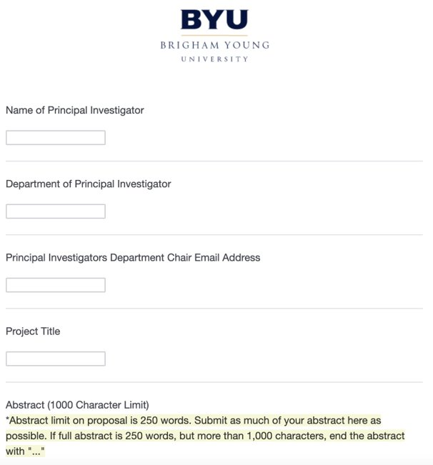
Letter of Intent
Purpose is to help the Associate Deans of Research plan the in-college review process
Department chair approval is required. The form sends an email to your department chair. Your chair needs to send a return email to rdadmin@byu.edu approving your project
Form found in the "submission" section of the IDR webpage: https://researchdevelopment.byu.edu/interdisciplinary-research-idr-origination-awards
Email rdadmin@byu.edu with issues.
​

Slide 13
Tips for Success
Funded Projects
Addressed an important problem with a global impact (water cycle, Alzheimer’s), or focused on a smaller targeted audience that appealed to reviewers (second language literacy in adults, mental health of college students), and/or made advancements in an academic field
Were clearly written and easily understood
Avoided a lot of technical details or jargon so the project descriptions, methodologies, and outcomes could be understood by non-experts
Described the outcomes well
Defined each team members’ critical role and expertise and how they were integrated and essential to the project success

Slide 14
Things to Avoid
Unfunded Projects
Omitted information on pending and current funding related to the project
Failed to adequately describe the critical role of each team member in the success of the project
Left out specific measures of success (measures of success are ore related to statistical measures and specific project outcomes, not just publications or external funding)
Were poorly modified versions of previously submitted proposals

Slide 15
Review Criteria
Proposals will be evaluated based on:
A strong potential for external funding following the IDR award
Potential to produce significant scientific, cultural, creative and/or societal impacts
A clearly articulated problem statement
Identified measures of success and achievable milestones
Diverse interdisciplinary research partnerships with clear team member contributions

Slide 16
Review Process
Compliance review by Research Development
Ensures each proposal has all components and complies with criteria
All proposals not meeting the proposal component requirements will be ineligible for the technical review.
If you have questions about proposal components or would like RD to review your proposals, please contact us after the LOI deadline but before the proposal deadline.
College level review
Associate Dean of Research from the college of the primary investigator conducts the review using the review criteria
University level review
Associate deans review the highest ranked proposals from the college reviews using review criteria
A pair-wise comparison of college-selected proposals is held
Each proposal is reviewed by at least 4 deans not from the PI’s college
Pair-wise comparisons result in the selection of proposals for funding by Associate Academic VP for Research, Larry Howell

Slide 17
FAQs
Funds may be used for external participants, international and domestic travel, student wages
Funds can't be used to buy out courses or to pay faculty salaries
External collaborators are allowed but a BYU faculty member must be the PI and there must be at least three BYU faculty members on the team
Faculty members may participate on more than one IDR team but can only be a PI on one team
Teams are able to change their PI with a signoff from the new PI's department chair and a short explanation for the change
Teams are not able to change from a Track 1 to a Track 2 proposal

Slide 18
Help from the Research Development Office
The Research Development Office can help with:
Identifying funding opportunities for your team
Reviewing proposal drafts
Maintains a database of campus researchers
Questions?? Email kckellems@byu.edu or rdadmin@byu.edu

