Slide 1

Disclaimer: The following slides were used to supplement a public oral presentation for potential NEH applicants. They are not intended to provide complete information about the NEH’s programs and they do not constitute an official statement of NEH policy. For current information about NEH programs, including eligibility requirements and the dates of deadlines, please consult the guidelines posted on the NEH website at www.neh.gov.

Slide 2
Applying for a Grant from the
National Endowment for the Humanities (NEH)
Brigham Young University
Virtual Workshop
January 21, 2022
Mark Silver
National Endowment for the Humanities

Slide 3
NEH is a taxpayer-funded government agency dedicated to the humanities.
We award grants through national competitions based on peer review.

Slide 4
Grant Program Divisions & Offices
7
Federal/State Partnership
Education Programs
Preservation and Access
Challenge Grants
Public Programs
Digital Humanities
Research Programs

Slide 5
Office of Federal/State Partnership
Serves as a liaison between NEH and the nonprofit network of 56 state and jurisdictional humanities councils

Slide 6


OFFICE OF
FEDERAL / STATE PARTNERSHIP
utahhumanities.org

Slide 7
Division of Education Programs
Funds projects that strengthen teaching and learning in the humanities through professional development and innovative curricular programs.
—Wikimedia

Slide 8
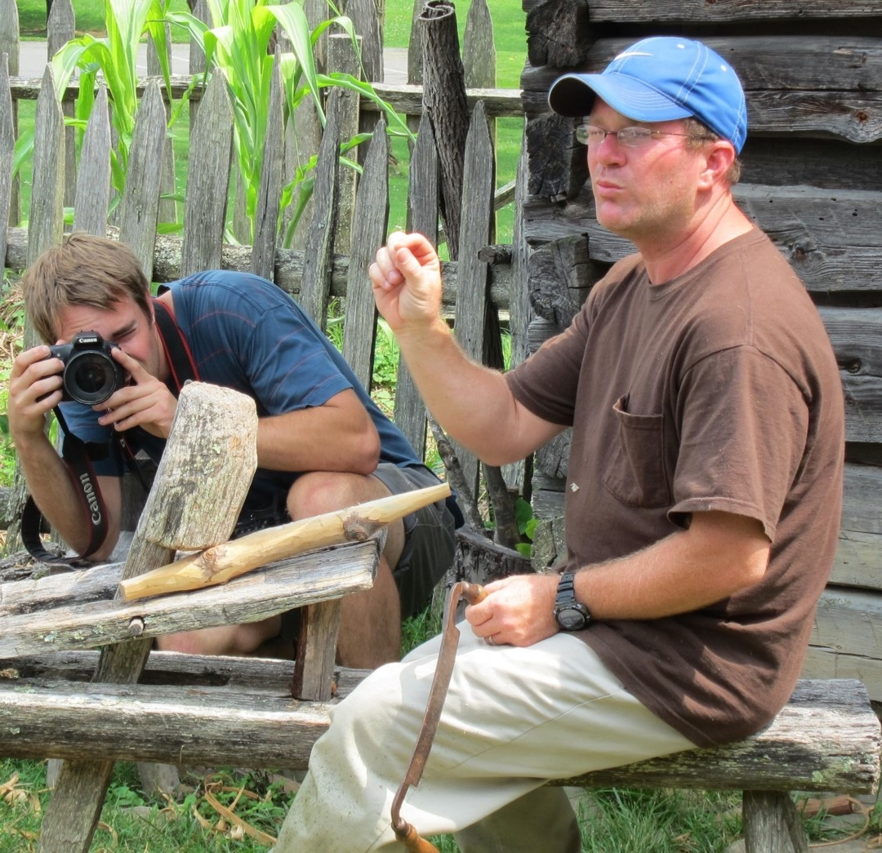
Division of
Education Programs
SUMMER INSTITUTES
Awards:
Up to $235,000
LANDMARKS OF AMERICAN HISTORY AND CULTURE
Awards: Up to $190,000
DEADLINES
Directors: February 22, 2022 (for summer 2023)
Participants: March 1, 2022 (for summer 2022)
Summer programs

Slide 9

Seeks to expand the role of the humanities in undergraduate education by linking humanities and non-humanities programs or departments
Division of
Education Programs
Humanities connections
Planning Grants:
Up to $35,000 for 12 months
Implementation Grants:
Up to $150,000 for 36 months
Deadline: September 1, 2022
—NEH

Slide 10
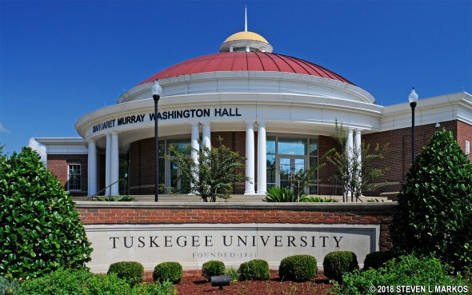
Helps strengthen the teaching and study of the humanities by developing new programs, courses, or resources, or enhancing existing ones
Includes special competitions for:
Historically Black Colleges and Universities
Hispanic-Serving Institutions
Tribal Colleges and Universities
Community Colleges
Deadline: May 9, 2022
Awards: Up to: $150,000
Division of
Education Programs
HUMANITIES INITIATIVES
Notes:
Humanities Initiatives helps strengthen the teaching and study of the humanities at Hispanic-Serving Institutions, HBCUs, and TCUs by developing new humanities programs, resources, or courses, or by enhancing existing ones.

Slide 11
DIVISION OF
PRESERVATION AND ACCESS
Funds projects that preserve and create intellectual access to collections and cultural heritage resources of importance for research, education, and public programming in the humanities.

Slide 12
Division of Preservation and Access
REPRESENTATIVE ACTIVITIES SUPPORTED
Cataloging library collections, archival records, or museum artifacts
Preserving collections through conservation treatment
Digitizing collections
Creating databases, digital tools, and reference resources
Developing or implementing plans for the sustainable care of collections
Conducting research to advance the field of preservation and access

Slide 13
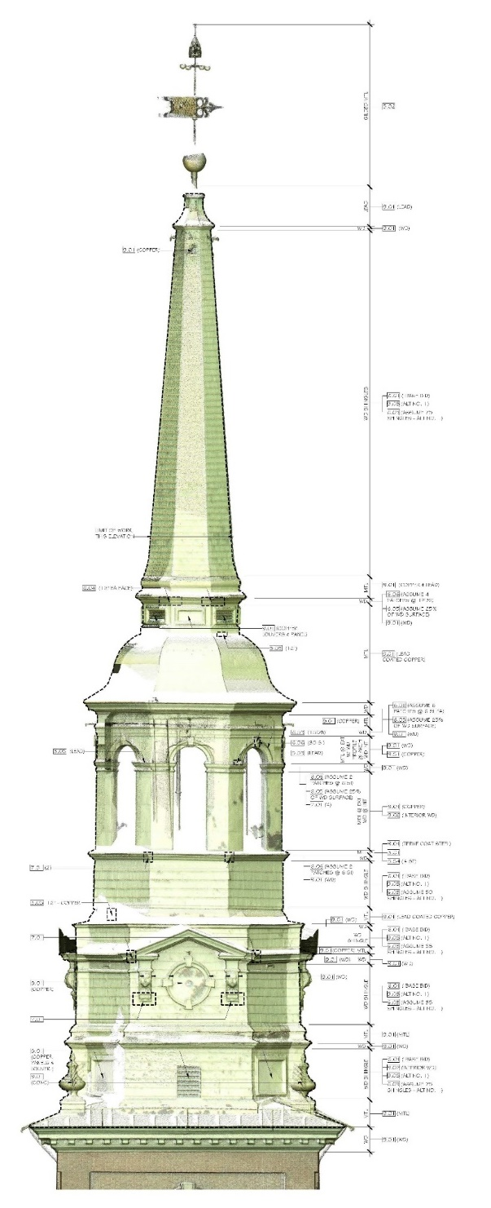
For the design, purchase, construction, restoration, or renovation of facilities; the purchase of equipment and software; or the development of digital infrastructure.
Maximum Award: $750,000
Deadline: May 17, 2022
Recipients must raise matching funds.
Office of
Challenge Grants
Infrastructure and Capacity Building Challenge Grants

Slide 14
Division of
Public Programs
Supports a wide range of public humanities projects that reach large and diverse public audiences and make use of a variety of formats including exhibits, public programs, film, radio, and digital media.

Slide 15

Division of
Public Programs
Supports the development and production of film, television, radio, and podcast projects.
Two levels of funding: Development and Production
Awards: Up to $75,000 for Development and up to $700,000 for Production
Next deadline: January, 2023
MEDIA PROJECTS

Slide 16

T
Division of
Public Programs
Supports permanent and travelling exhibitions, historic site interpretation, and discussion programs
Two levels of funding: Planning and Implementation
Awards: Up to $75,000 for Planning and Up to $400,000 for Implementation
Next deadline: January, 2023
PUBLIC HUMANITIES PROJECTS

Slide 17
OFFICE OF DIGITAL HUMANITIES
Offers grant programs that address cultural changes brought about by the introduction and spread of digital technology. This includes projects that explore how to harness new technology for humanities research as well as those that study digital culture from a humanistic perspective.

Slide 18

Office of
Digital Humanities
For development of new digital technology that contributes to the humanities
Funding: Up to $50,000 for Level I Funding: Up to $150,000 for Level II Funding: Up to $350,000 for Level III
Next Deadline: June 24, 2022
DIGITAL HUMANITIES ADVANCEMENT GRANTS

Slide 19

Office of
Digital Humanities
For national or regional training programs aimed at scholars, humanities professionals, and/or advanced graduate students
Funding: Up to $250,000
Deadline: March 2, 2022
INSTITUTES FOR ADVANCED TOPICS IN THE DIGITAL HUMANITIES

Slide 20
Division of Research Programs
Supports scholars—individuals and collaborative teams—working on research projects that advance knowledge and understanding of the humanities.

Slide 21
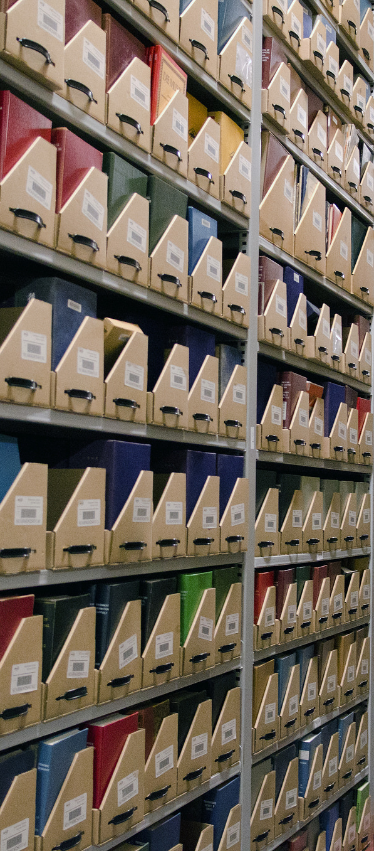
Division of Research Programs
Public Program Grants Division of Research Programs
WHAT WE FUND
Activities
Travel to archives
Research
Fieldwork
Writing
Scholarly editing
Collaboration
Convening
Print and Digital Products
Articles
Monographs
Multi-authored volumes
Archaeological reports
Translations
Editions
Other interpretive tools

Slide 22
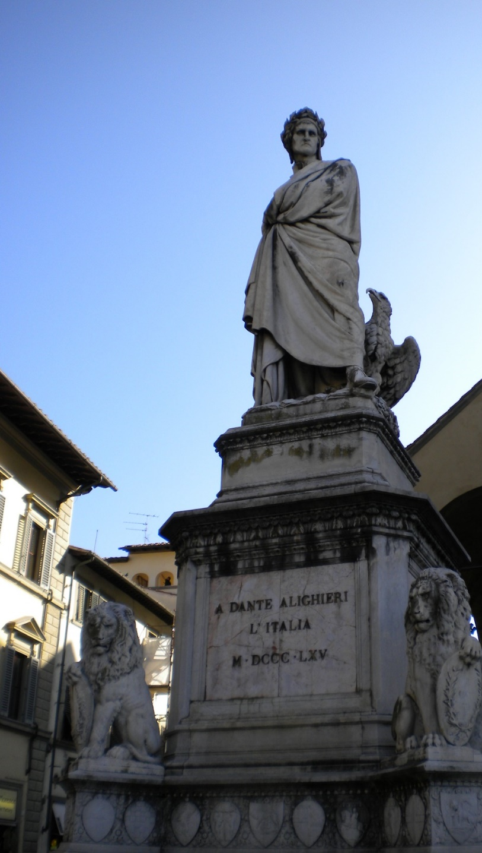
Division of Research Programs
SELECTED GRANT OFFERINGS
Grants for Institutions
Collaborative Research
Scholarly Editions &
Translations
Archaeological & Ethnographic Field Research
Grants for Individuals
Fellowships
NEH-Mellon Fellowships
Summer Stipends
Japan Fellowships
Public Scholars

Slide 23
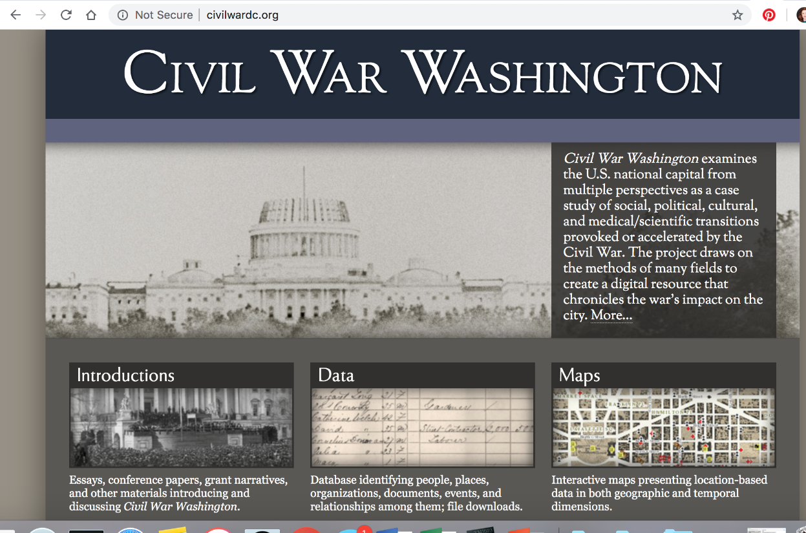
Division of Research Programs
Supports scholars working together on a project.
Collaboration must involve at least two scholars from the same or different institutions.
Awards: Up to $250,000 (depending on category)
Four categories: Planning International Collaborations, Conferences, Manuscript Preparation, and Scholarly Digital Projects
Deadline: December 2022
Staff will review drafts
Collaborative research

Slide 24

Division of Research Programs
For scholarly editions and scholarly translations of pre-existing texts that would otherwise be difficult to access or use
Projects must involve at least two scholars
Awards are made for one to three years and rarely exceed $100,000 per year
Deadline: December 2022
Staff will review drafts
Scholarly editions & translations

Slide 25

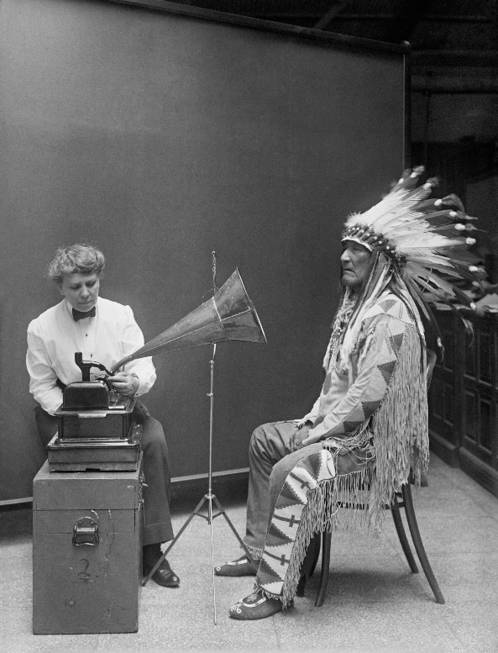
Division of Research Programs
For empirical field research using archaeological and/or ethnographic methods to answer questions in the humanities
Awards: 4 to 36 months, up to $150,000
Tenured faculty are required to raise $20,000 in matching funds
Deadline: September 28, 2022
Archaeological and Ethnographic field research

Slide 26
Division of Research Programs
SELECTED GRANT OFFERINGS
Grants for Institutions
Collaborative Research
Scholarly Editions &
Translations
Archaeological & Ethnographic Field Research
Grants for Individuals
Fellowships
NEH-Mellon Fellowships
Summer Stipends
Japan Fellowships
Public Scholars

Slide 27
Division of Research Programs
GRANTS FOR INDIVIDUALS: Features in Common
Eligibility: Limited to U.S. citizens and non-citizens who have resided in the U.S. for the three preceding years. Currently enrolled students are not eligible.
Allowable uses include: Living expenses for research and writing, course buyouts, salary replacement, travel, research assistants, equipment and materials, publication costs.
Mobility and flexibility: no requirement to be in residence at a particular place; may be combined with salary or other sources of funding.
Dollar value: determined by the number of months of support you seek (no budget required).

Slide 28


Division of Research Programs
For individual scholars pursuing research in the humanities
Awards are for periods of 6 to 12 months.
Award periods must be continuous and full-time.
Awards pay $5,000/month.
Maximum: $60,000
Next Deadline: April 13, 2022
FELLOWSHIPS

Slide 29

Division of Research Programs
For “born digital” research and publication in the humanities
NEH-Mellon Fellowships for Digital Publication
Awards are for periods of 6 to 12 months.
Award periods must be continuous and full-time.
Awards pay $5000 per month.
Maximum: $60,000
Deadline: April 20, 2022

Slide 30


Division of Research Programs
For continuous full-time work on a humanities project for a period of two consecutive months
All awards are for $6,000.
Award periods must be continuous and full-time.
May require nomination
Deadline: September 2022
SUMMER STIPENDS

Slide 31



Division of
Research Programs
FELLOWSHIPS FOR ADVANCED SOCIAL SCIENCE RESEARCH ON JAPAN
For social science research focused on Japan (may include comparison with other countries)
Awards are for periods of 6 to 12 months
Award periods must be continuous and full-time
Awards pay $5,000/month
Maximum: $60,000
Special encouragement for junior scholars
Deadline: April 27, 2022

Slide 32


Division of Research Programs
Supports well-researched books in the humanities intended to reach a broad readership
Awards are for periods of 6 to 12 months.
Award periods must be continuous, but may include part-time work.
Awards pay $5,000 per full-time month.
Maximum: $60,000
Next deadline: December 14, 2022
Eligibility: must meet the requirement for previous publication
Public scholarS

Slide 33
Division of Research Programs Average funding rates (last 5 years)
Fellowships:
received 1120 applications per year
funded 79 (7%)
NEH-Mellon Fellowships for Digital Publication:
received 52 applications per year
funded 8 (15%)
Public Scholars:
received 278 applications per year
funded 24 (9%)

Slide 34
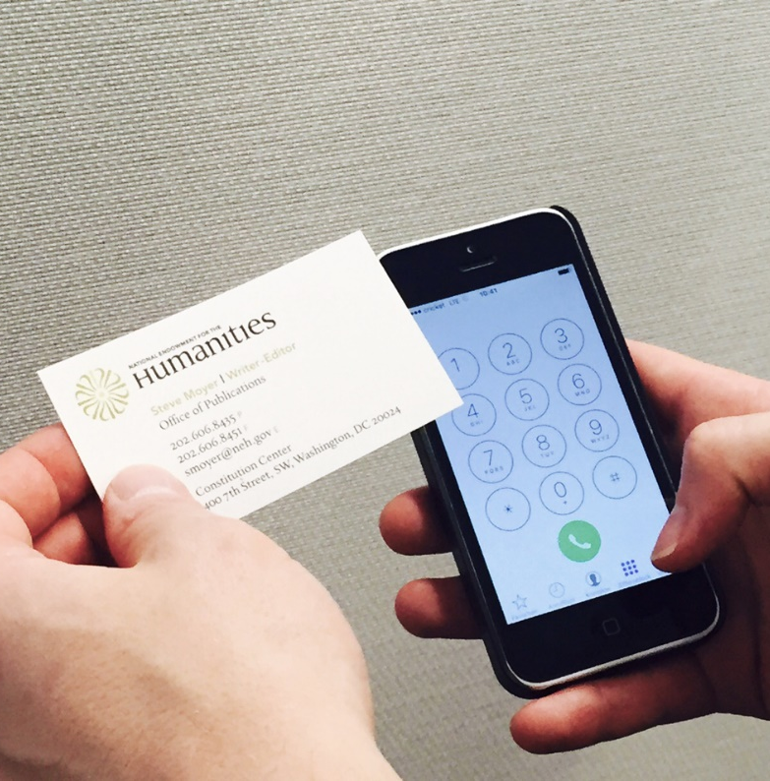

The Submission and Review Process

Slide 35
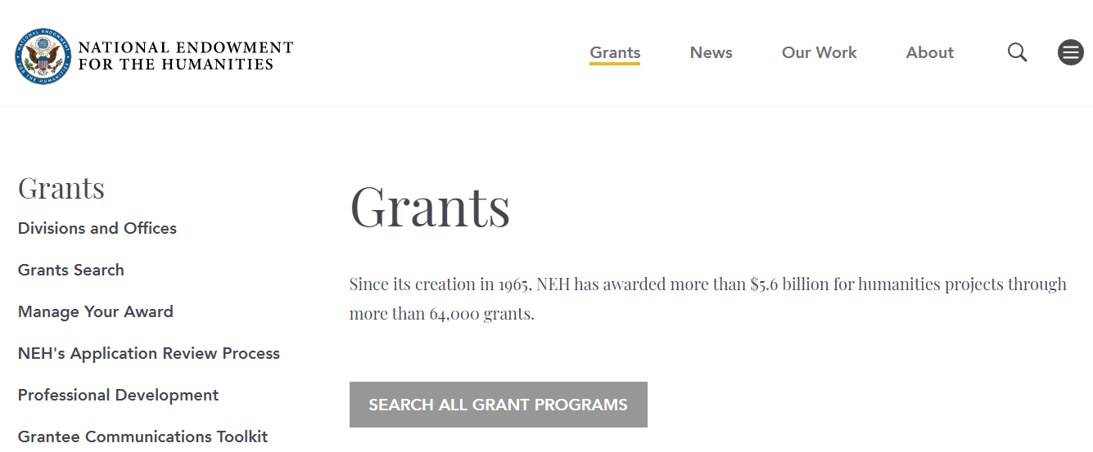
www.neh.gov

Slide 36
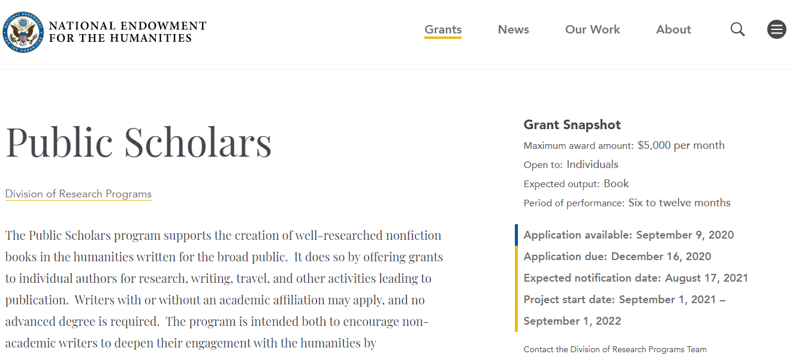
Program Resource Page (upper portion)
Describes the program and its purpose in detail
Explains how to prepare and submit your materials
Indicates whether staff will read a draft application
Lists prohibited project types and activities (section D6)
Lists the review criteria (i.e., how your application will be judged)

Slide 37
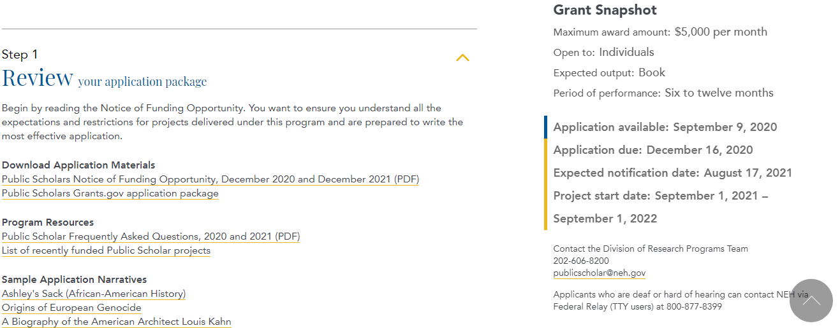
Program Resource Page (lower portion)
Describes the program and its purpose in detail
Explains how to prepare and submit your materials
Indicates whether staff will read a draft application
Lists prohibited project types and activities (section D6)
Lists the review criteria (i.e., how your application will be judged)

Slide 38
Program Resource Page (lower portion)
Describes the program and its purpose in detail
Explains how to prepare and submit your materials
Indicates whether staff will read a draft application
Lists prohibited project types and activities (section D6)
Lists the review criteria (i.e., how your application will be judged)

Slide 39
Notice of Funding Opportunity (NOFO)
Describes the program and its purpose in detail
Explains how to prepare and submit your materials
Indicates whether staff will read a draft application
Lists the review criteria (i.e., how your application will be judged)

Slide 40
Required materials and page limits are listed in the Notice of Funding Opportunity (NOFO)
For Fellowships
3-page narrative proposal (single-spaced)
1-page work plan
1-page bibliography
2-page C.V.
2 letters of reference
Additional forms listing your contact information, work sites, and letter writers.

Slide 41
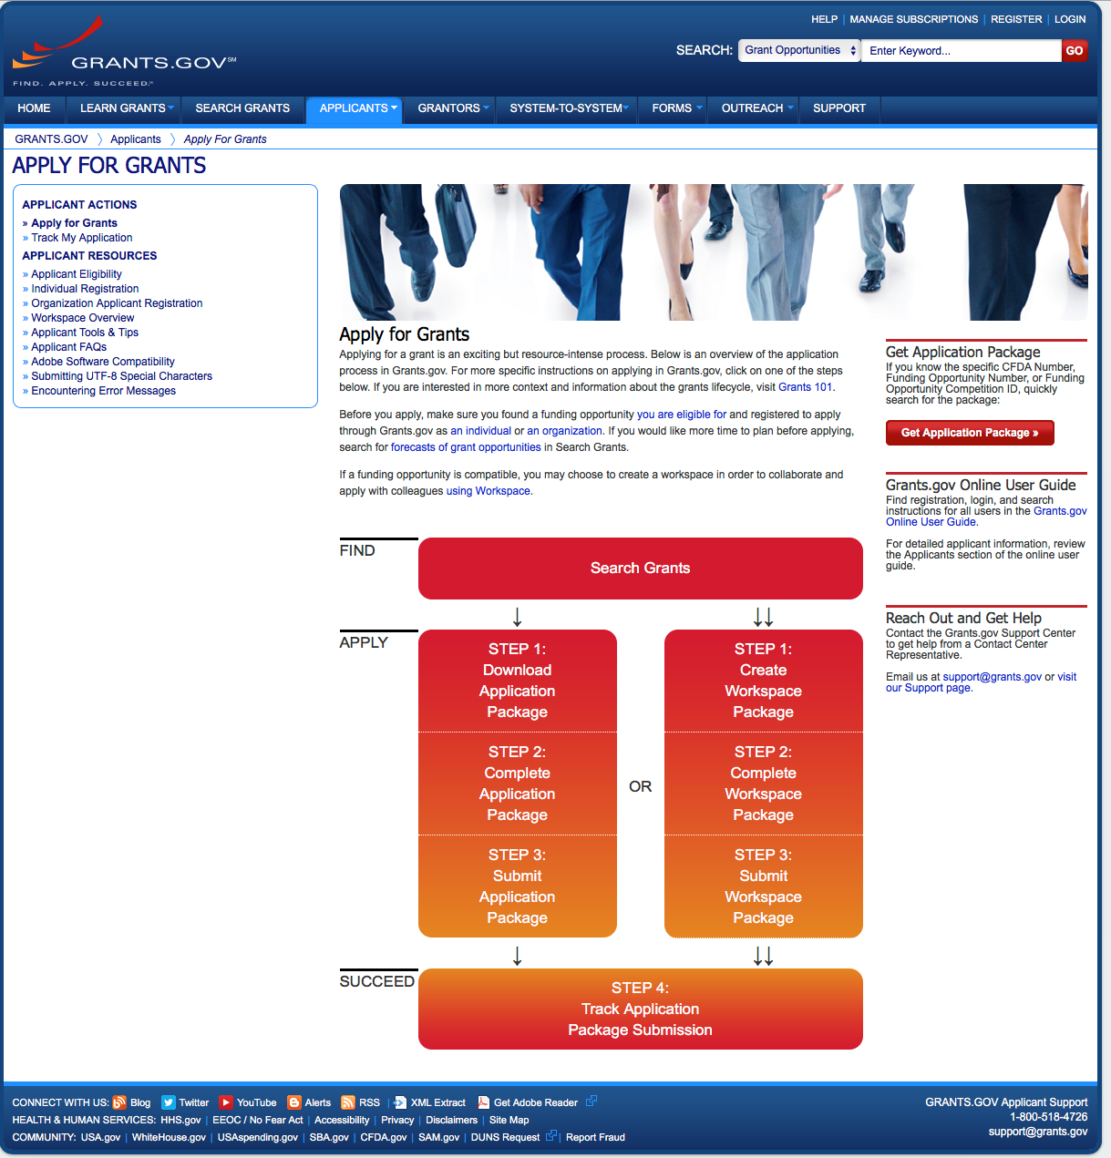
Applications to NEH must be submitted through grants.gov

Slide 42

Steps of Application Review
(more details at neh.gov/grants/application-process)application-process
Award notification
Chairman’s decision
National Council review
Staff recommendations
Peer review panels
Sorting by NEH staff
Submission

Slide 43
Steps of Application Review
(more details at neh.gov/grants/application-process)application-process
Award notification
Chairman’s decision
National Council review
Staff recommendations
Peer review panels
Sorting by NEH staff
Submission

Slide 44

NEH Fellowships: Peer Review
Tier 1
About 36
3-person non-convening panels
Top 33% of applications advance
Tier 2
About 12
4-person convening panels
Each panel evaluates about 25 to 30 applications

Slide 45
Example Scenario for Peer Review in the NEH Fellowships Program
Tier 1 Panel: “Asian Studies”
An historian of China
A literature scholar focused on Japan and Korea
A religion scholar focused on South or Southeast Asia
Tier 2 Panel: “African, Middle Eastern, and Asian Studies”
An historian of Africa
A specialist in film and media studies of the Middle East
An historian of East Asia
A specialist in literature of India

Slide 46

Tips for Applicants

Slide 47
Tips for Individual Research Grant Applications
Zero in on the evaluation criteria (section E1 of the Notice)

Slide 48
Evaluation Criteria NEH FELLOWSHIPS AND SUMMER STIPENDS
The intellectual significance of the proposed project, including its value to humanities scholars, general audiences, or both.
The quality of the conception, definition, organization, and description of the project and the applicant's clarity of expression.
The feasibility and appropriateness of the proposed plan of work.
The quality or promise of quality of the applicant as an interpreter of the humanities.
The likelihood that the applicant will complete the project, including, when relevant, the soundness of the dissemination and access plans.

Slide 49
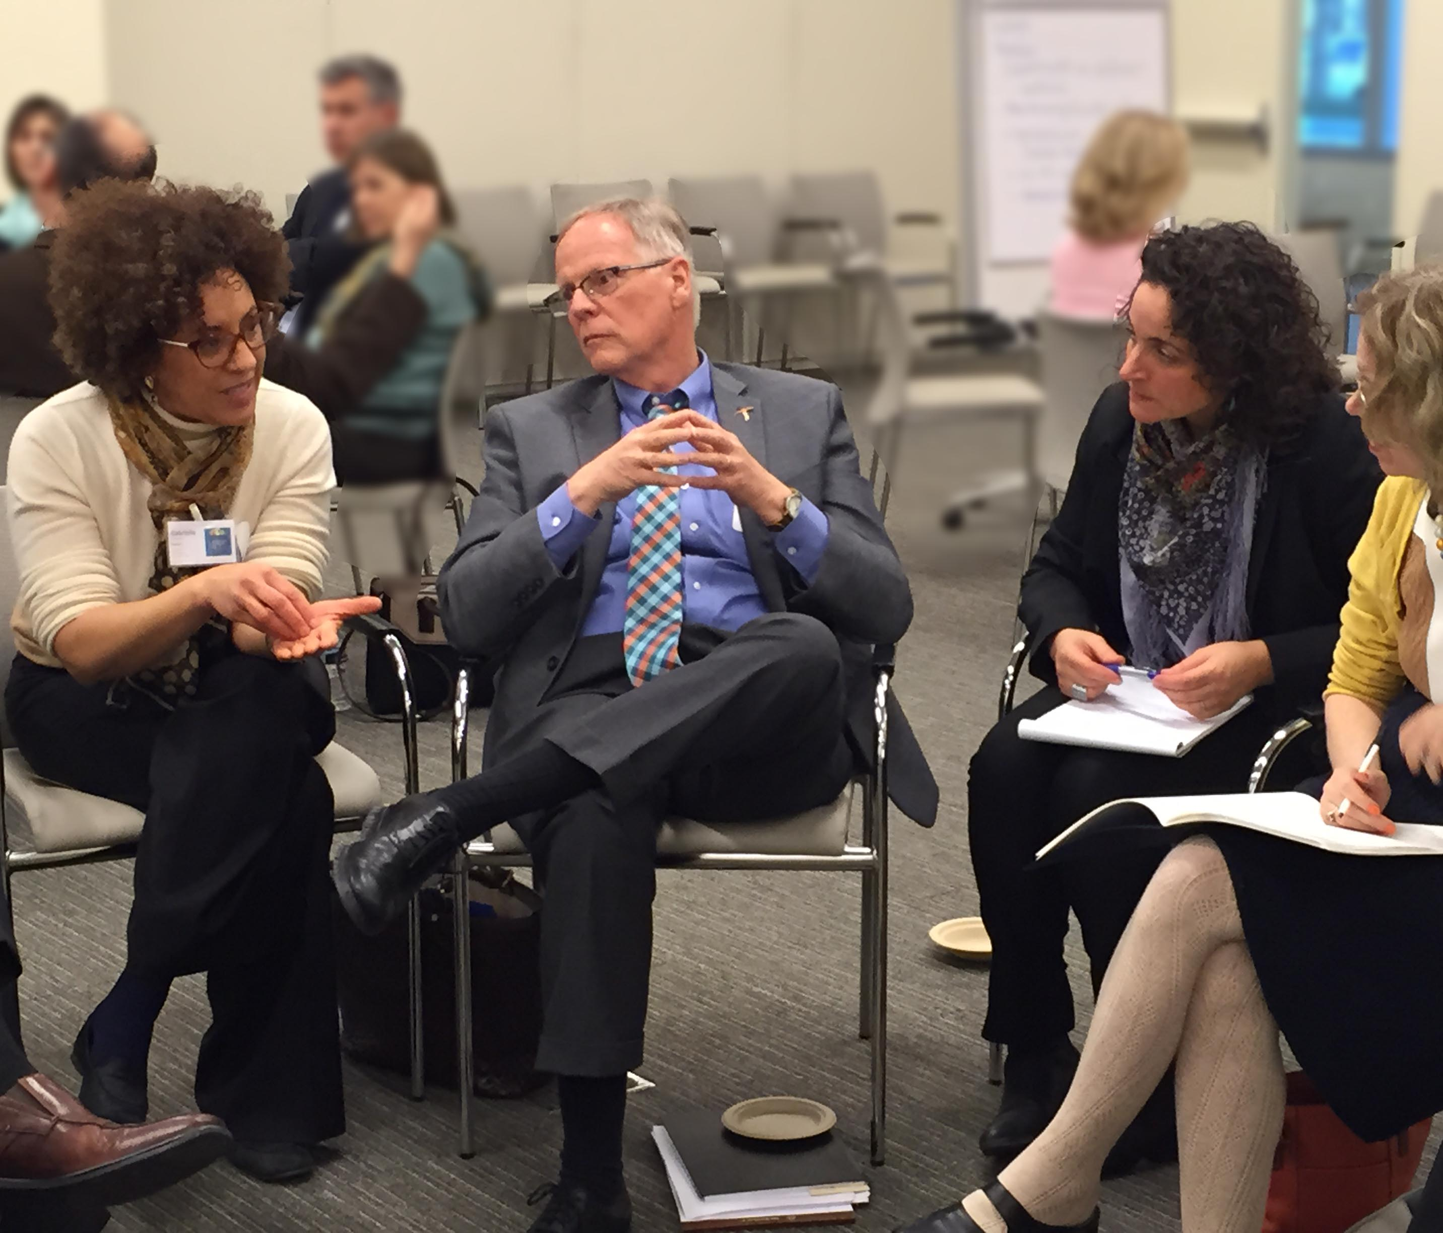
Making the Case for Significance
Explain what’s new and why it matters
Situate your work clearly
Identify connections to other areas
Avoid hype
Avoid over-reliance on “gap-filling”
Demonstrate with an example
In general, the broader the better
—Maria Biernik/NEH

Slide 50
Evaluation Criteria NEH FELLOWSHIPS AND SUMMER STIPENDS
The intellectual significance of the proposed project, including its value to humanities scholars, general audiences, or both.
The quality of the conception, definition, organization, and description of the project and the applicant's clarity of expression.
The feasibility and appropriateness of the proposed plan of work.
The quality or promise of quality of the applicant as an interpreter of the humanities.
The likelihood that the applicant will complete the project, including, when relevant, the soundness of the dissemination and access plans.

Slide 51
Tips for Individual Research Grant Applications
Zero in on the evaluation criteria (section E1)
Actively manage your letter writers
Don’t neglect the bibliography
For proposals involving dissertation revision, explain what’s new
List language competencies

Slide 52
Tips for All NEH Applicants
Study the samples of winning applications
Be aware of prohibited project types (see section D6 of the Notice).
Watch the online information session
Submit a draft application if allowed
Re-apply
Ask for the peer reviewers’ comments

Slide 53

Questions?
Mark Silver
Division of Research Programs
msilver@neh.gov
research@neh.gov (202) 606-8200
(If you call, please leave an email address.)

