Slide 1
Research Development Basics for Graduate Students
BYU Research Development Office
2/11/2022

Slide 2
Research Development Mission
The mission of the Research Development is to help faculty and graduate students find and secure funding for travel or research projects.

Slide 3
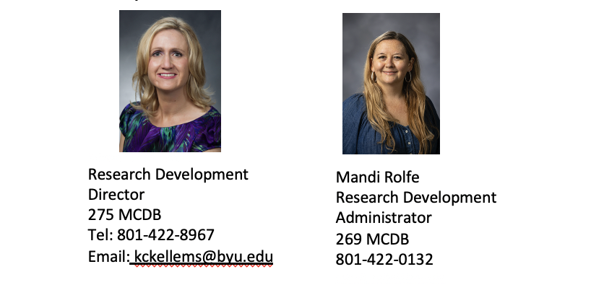
What Does the Research Development Office Do?
Facilitates interdisciplinary collaborations through research networking and the Interdisciplinary Research Origination Awards
Connects external funders with BYU faculty
Manages limited submission process
Manages international funding opportunities (Fulbright Program)
Strengthens grantsmanships skills through targeted workshops
Manages the Research Development Coordinating Council
Builds research culture across campus

Slide 4
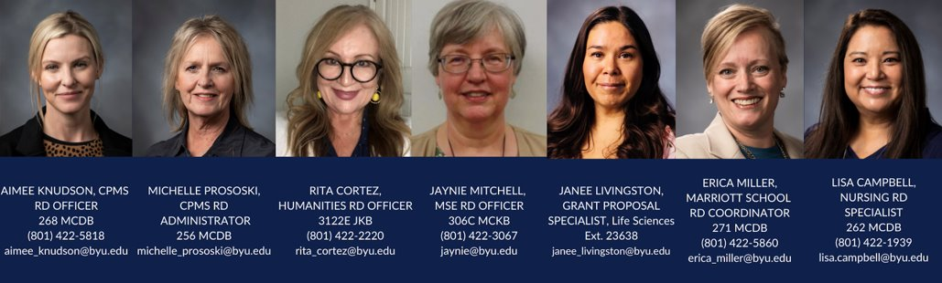
Who Can Help Me and How Can They Help Me?
Each RD Specialist in their unit helps individual faculty with:
Administrative support on proposals (Kuali submission assistance)
Identifying funding sources
Editing and revising proposals
Aligning proposal components with funder requirements
Assistance in drafting some proposal components (i.e. Biosketches, budget forms)
Administrative support on proposals (Kuali submission assistance)
Disseminating information on Research Development seminars and events

Slide 5
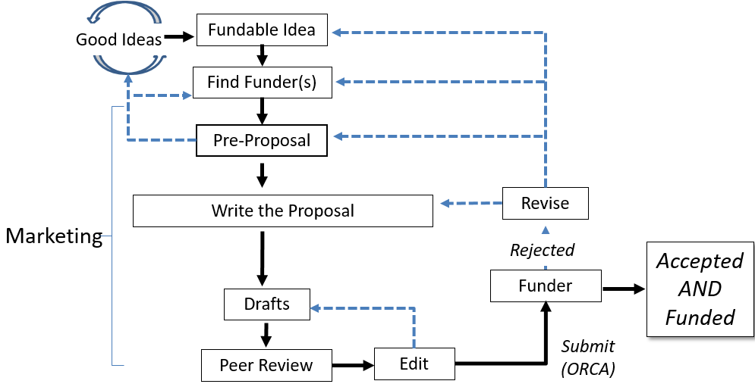
Proposal Development Process
Research Development has tools and resources to help with the steps in this process

Slide 6

First Steps
What do you care about?
Who is your research audience and what do they care about?
Where is the intersect?

Slide 7


Tell us why we should care
Exercise – Spend 5 minutes identifying your good idea and write it on a 3x5 card Divide into pairs and share
Notes:
Rework exercise into “Elevator Speech”

Slide 8
Find a Funder Interested in Your Idea
RD Has Resources for Finding Funding:
Grad Student Funding Newsletter
RD Website has list of internal funding opportunities: https://researchdevelopment.byu.edu/graduate-student-funding
In-depth funding seminars that graduate students can attend
Access to Pivot (online funding database): https://researchdevelopment.byu.edu/find-funding-sources
Proposal library
Individualized searches
College specialists will have college-specific information
Ask your college grant specialist for help!

Slide 9
External Funding

Slide 10

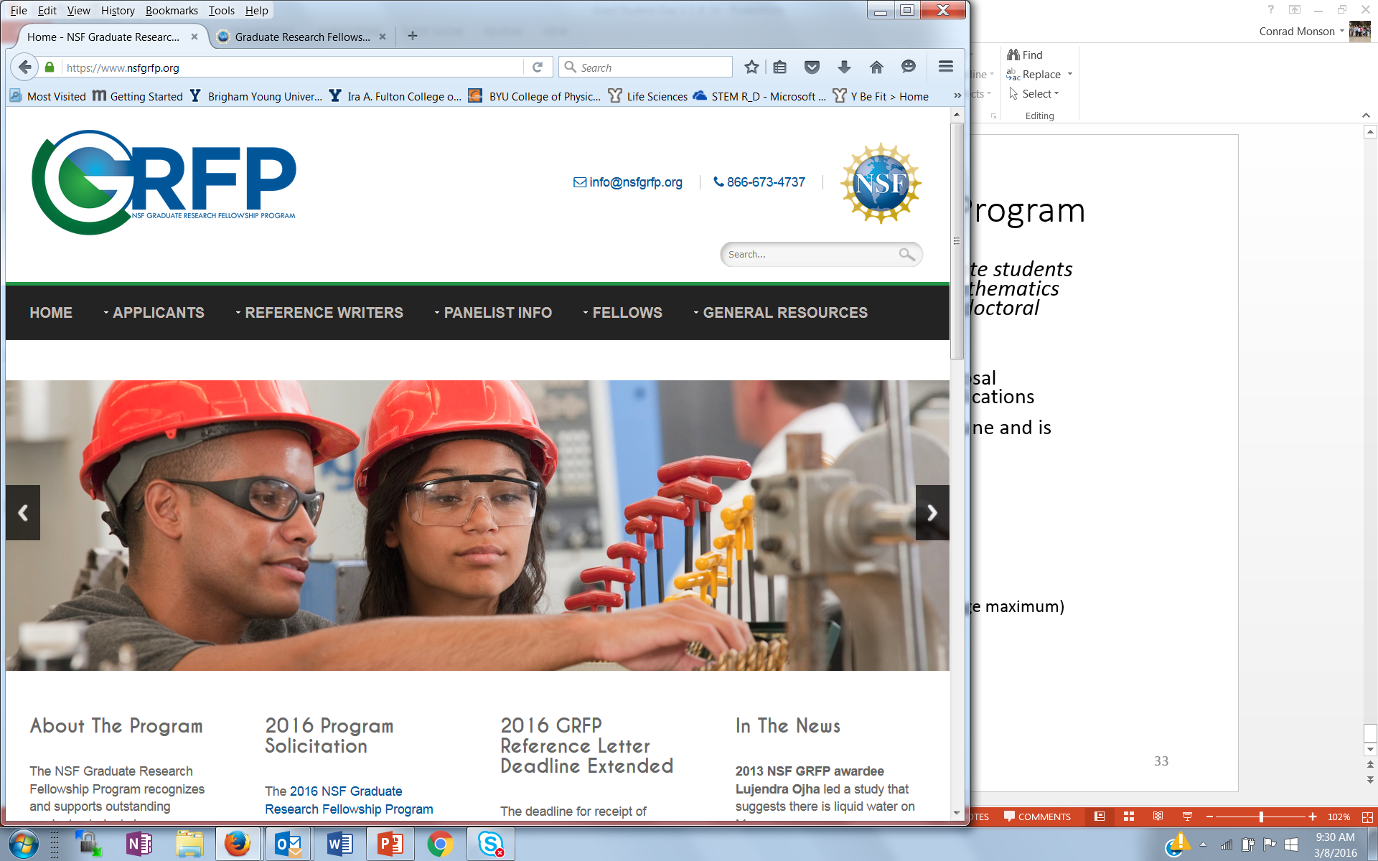
External Funding for Graduate Students
Department of Defense
National Defense Science and Engineering Graduate Fellowship: https://ndseg.asee.org/
National Institutes of Health: https://researchtraining.nih.gov/
Ruth L. Kirschstein Pre-doctoral Individual National Research Service Award
K-Awards
American Educational Research Association(AREA)
http://www.aera.net/Education-Research
NSF Graduate Student Fellowship
Information at https://www.nsfgrfp.org/
U.S. Student Fulbright Program
Website: https://us.fulbrightonline.org/
Contact: Kristen Kellems (fhssresdev@byu.edu)

Slide 11
You Have Found a Grant…Now What?
Start early! Leave time for feedback!
Things to do before you write!
Human subjects or animal research?
Complete IRB or lACUC process
Read funding announcement (solicitation) carefully!
Talk to a program officer!
Look at examples of grants the funder has awarded

Slide 12
Online Database Training
Learn to use Pivot to find funding!
Date: February 18th, 2022
Time: 11:00 a.m.
Location: 270 MCDB
Sign up: https://forms.gle/29xBe1MqFc2FjTRC7

Slide 13
Does your research involve Human Subjects?
International, federal, state and institutional policies regulate HOW researchers work with human subject participants.
BYU's Institutional Review Board (IRB) approves research plans involving human subjects and ensures researchers comply with regulations.
Apply for IRB approval BEFORE the study begins—(this might be AFTER you receive funding).

Slide 14

IRB Helpful Hint #1
IRB is like a video game—there are 16 base levels—with 5 *Bonus* levels. Keep leveling up. You cannot level up unless you complete the level you are on.

Slide 15

IRB Helpful Hint #2
Answer the IRB questions like you would a test response. Answer each piece. Make it easy for the reviewer to see that you answered the question completely.

Slide 16

IRB Helpful Hint #3
Copy and paste liberally!!! If your study design has been used in a previous study—copy and paste the method. If your research rationale is in your dissertation/thesis-- copy and paste it into the IRB application

Slide 17
Learn More about IRB
Want to learn more?
Visit IRB.byu.edu or
Email erica_miller@byu.edu for a link to an IRB Training.

Slide 18
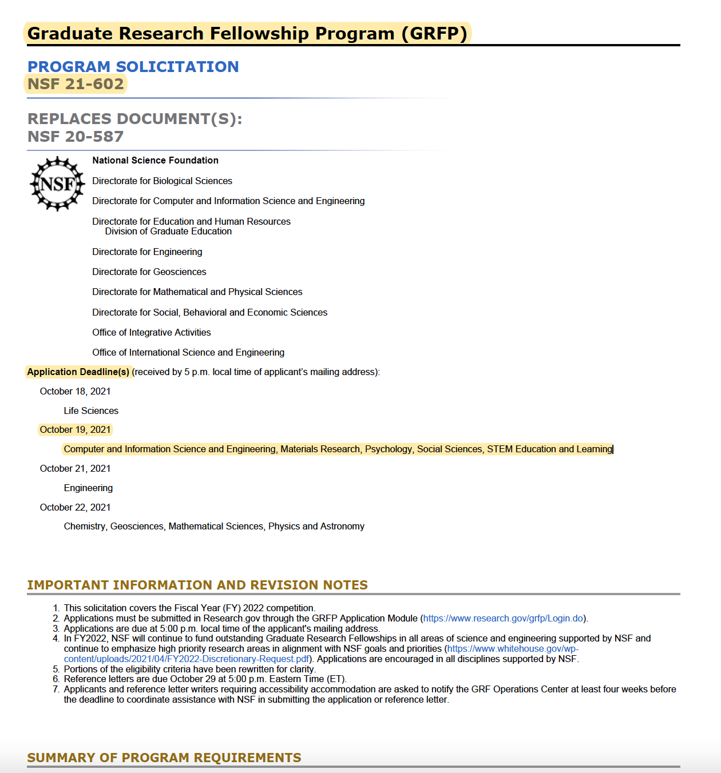
Read the Solicitation Carefully!
Deadlines
Eligibility
Directorate Information
Program Requirements
Proposal Components
Funding/Budget Limits
Application Preparation Instructions
Merit Review Criteria
Agency Contacts

Slide 19
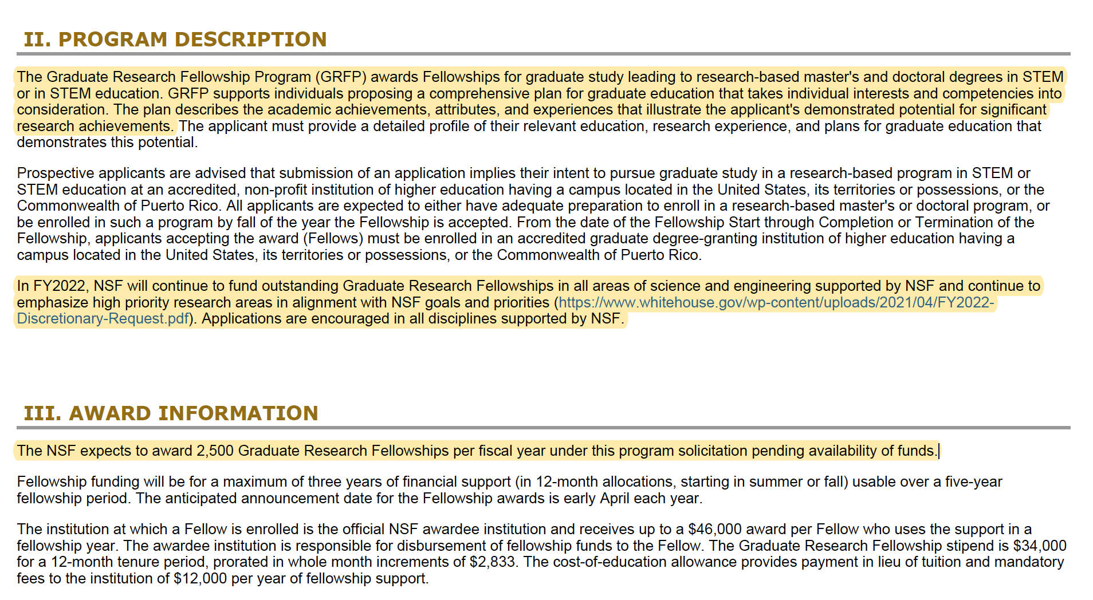
Learn about the program requirements
What is the funder looking for?
Students perusing master's and doctoral degrees in STEM
Highlighting the prioritization of the NSF's goals and priorities

Slide 20
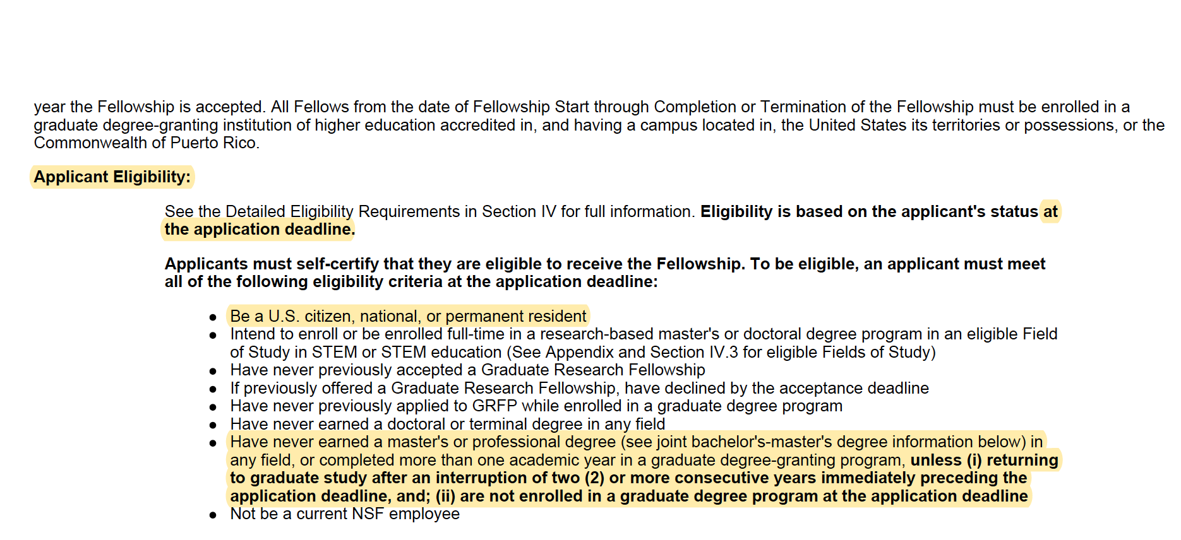

Eligibility Requirements
This is different for different sponsors and programs. Please read this carefully before you start preparing a proposal.

Slide 21
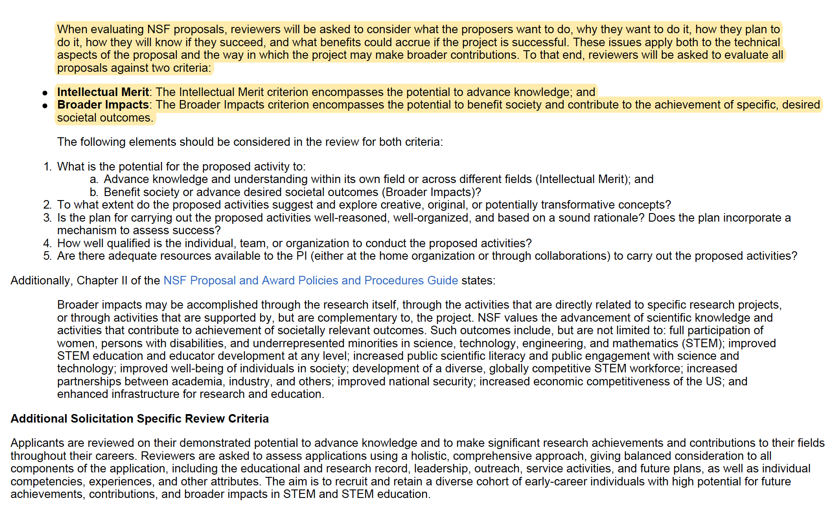
Merit Review Criteria
The sponsor tells you exactly how your proposal will be reviewed

Slide 22
Activity
Match some of what you wrote on your notecard with what the NSF Graduate Research Fellowship is asking for.

Slide 23
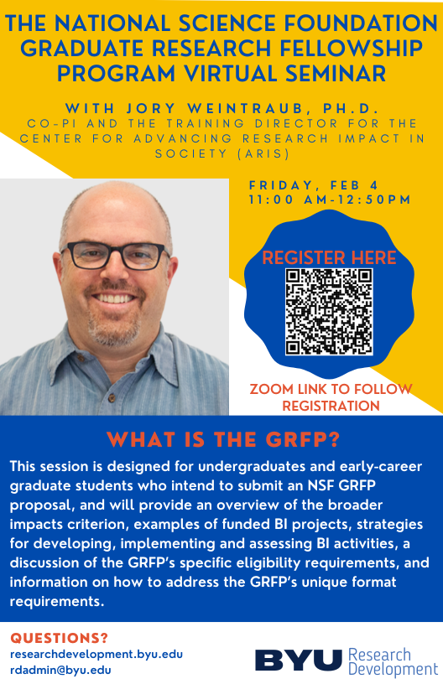
GRFP Seminar
Ask for access to the recording for the GRFP Seminar that was held with Jory Weintraub on 2/4/22.

Slide 24
Set Yourself Up for SUCCESS!!
Talk to the contact person about the funding opportunity!
That person can provide you with:
More in-depth eligibility information
Insight into the review process
Proposal editing services
Check out the competition!
Make sure to read essays from past winners, if available.
Get inspired and see what other winners wrote to win
Scholarship coordinator should be able to share these with you; there are also examples online for some scholarships

Slide 25
You Are Ready to Write…Now What?
RD Resources for Proposal Writing:
Bootcamps and writing workshops focused on graduate students
Learn how to frame your proposal with a logical structure
Learn how to write clearly and persuasively
Individualized proposal writing support
Sample proposals
Templates
Proposal editing services
Peer review or faculty review panels

Slide 26
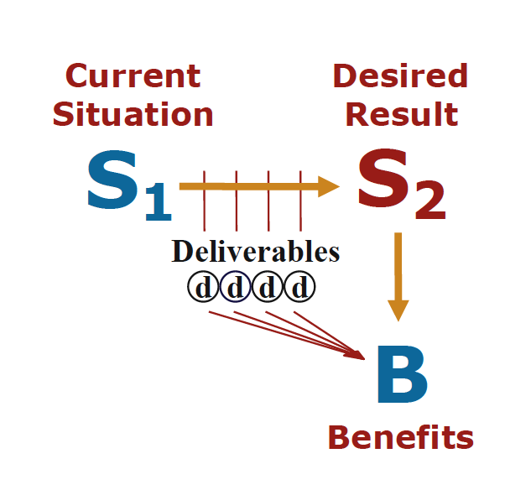
The Baseline Logic: How to Structure Your Proposal
90% of proposals have serious flaws in communicating their
baseline logic
(Baseline logic and generic slots descriptions adapted from Jon Balzotti’s presentations)
Notes:
Explain diagram
Have participants write S1, S2, B, on post-it notes and stick to their desktop in the above configuration

Slide 27
Baseline Logic Activity
S1-Current Situation
Make a list of what you know about the current situation.
S2-Desired Result
Make a list of the desired results of your project.
Deliverables/Project Activities
Make a list of the project activities.
Benefits
Make a list of the benefits resulting from your project.
Gap
(Short and Long Term)
Notes:
Give 1.5 minutes for each of the four steps. Have participants write answeWhat is the situation
Who does it impact
Why is it problem
Who is working on it
What is missing

Slide 28
Principles of Writing Clearly
Open sentences with short, concrete subjects
Get to the main verb quickly
Open your sentences with information familiar to your reader
Push new units of information to the end of the sentence
Begin sentences in a passage with consistent topic/subjects
Be concise
Cut meaningless and repeated words
Compress phrase into one or two words
Prefer affirmative sentences to negative ones
Use analogies

Slide 29
Take-away Message
Develop an idea that excites you. Make sure it’s achievable and has the potential to contribute new knowledge
Refine your idea - identify a faculty collaborator, solicit a LOT of feedback, and draft a need statement that you can share with project officers
Search for funders and get to know the funder’s funding priorities from their web site and funded projects list.
If contact information is listed, email the program officer directly to see if your project fits into the priorities
Attend the proposal writing workshops for a jump start!
Start the application early and get help and advice.
Gather preliminary data - use BYU grants to get seed money for pilot data
Practice your “elevator speech” i.e. the 3MT competition
Contact Research Development!

Slide 30

Upcoming Events
Pivot Database Training
Date: February 18th, 2022
Time: 11:00 a.m.
Location: 270 MCDB
Sign up: https://forms.gle/29xBe1MqFc2FjTRC7

