Slide 1

Fulbright Specialist Program
Information Session for U.S. Applicants
Keegan Scott
Fulbright U.S. Scholar Outreach and Recruitment Officer
Institute of International Education
Brigham Young University Fulbright Day
Friday, March 31, 2023
Notes:
[Customize this page with your name, title, organization, and presentation date and location.]

Slide 2
Today’s Presentation
Overview of the Fulbright Specialist Program
Benefits for Participating Specialists
Eligible Disciplines and Host Institutions
Sample Project Activities
Applicant Eligibility Criteria
Application Review and Matching Process
Q&A

Slide 3

About the Fulbright Program
A program of the U.S. Department of State with funding provided by the U.S. Government
Led by the United States government in partnership with more than 160 countries worldwide, the Fulbright Program offers international educational and cultural exchange programs for passionate and accomplished students, scholars, artists, teachers, and professionals of all backgrounds to study, teach, or pursue important research and professional projects.
Since 1946, the Fulbright Program has provided international exchange opportunities to more than 400,000 participants across 160 countries! Learn more about Fulbright at www.fulbrightprogram.org.

Slide 4
Diversity & Inclusion
The Fulbright Program strives to ensure that it reflects the diversity of U.S. society and societies abroad. We encourage the involvement of people from traditionally underrepresented audiences in all our grants, programs, and other initiatives
Fulbright Program opportunities are open to people regardless of their race, color, national origin, sex, age, religion, geographic location, socioeconomic status, disability, sexual orientation or gender identity.

Slide 5
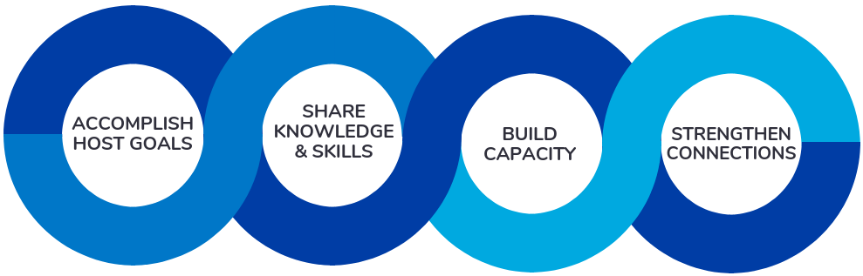
Fulbright Specialist Program Overview
Established in 2001; World Learning serves as the program’s implementing partner
Experienced U.S. academics and established professionals complete short-term (2-6 weeks) projects designed by institutions in 160 eligible countries and other areas
400+ projects are implemented annually; projects take place year-round

Slide 6
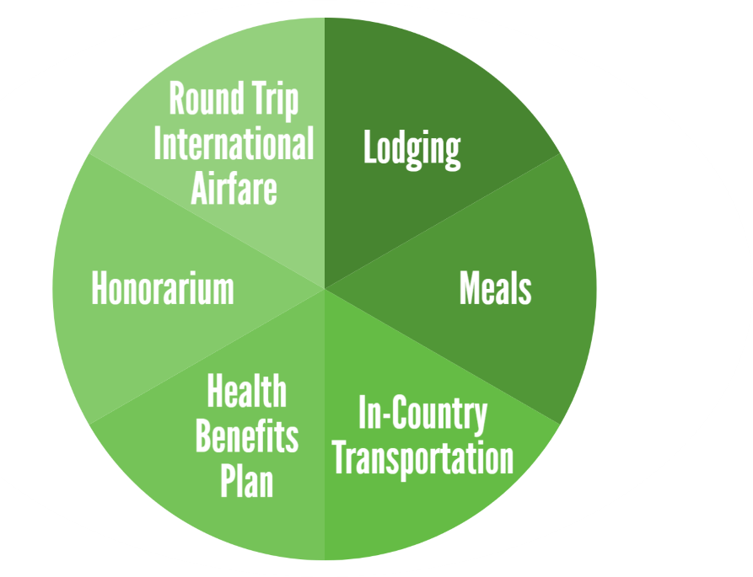
Benefits for Participating Specialists
The U.S. Department of State provides funding for round-trip economy class international airfare, a transit allowance ($100), daily honorarium ($200), applicable visa fees, and a limited health benefits plan
Host institutions provide lodging, meals, and in-country transportation for the duration of the grant period

Slide 7
Eligible Project Fields
Agriculture
American (U.S.) Studies
  Includes topics in the arts and humanities
Anthropology
Archaeology
Biology Education
Business Administration
Chemistry Education
Communications & Journalism
Computer Science & Information Technology
Economics
Education
Engineering Education
Environmental Science
Law
Library Science
Math Education
Peace & Conflict Resolution Studies
Physics Education
Political Science
Public Administration
Public/Global Health
Social Work
Sociology
Urban Planning

Slide 8





Eligible Host Institutions
Public or private universities
Community colleges
Ministries/agencies
Courts
Parliamentary or congressional bodies
Conservatories
Museums
Libraries
Non-partisan, issue centered organizations and think tanks
Public health organizations
Teaching hospitals

Slide 9

Sample Project Activities
Delivering seminars, training or workshops
Consulting on faculty or workforce development
Developing academic or training curricula and materials
Giving lectures at the graduate or undergraduate level
Conducting needs assessments or evaluations for a program or institution
Supporting accreditation process for a university program
Engaging in strategic planning activities

Slide 10
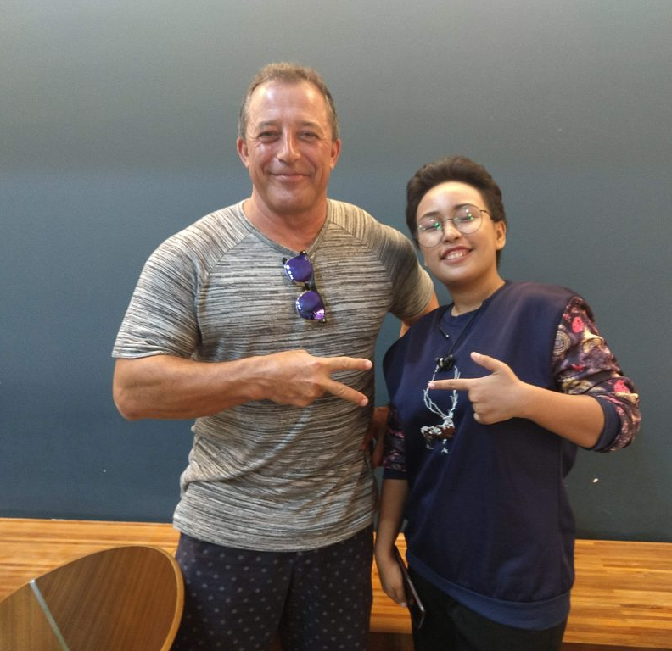
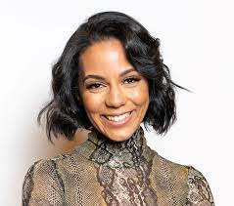
Dr. Gene Tsudik
Chancellor’s Professor and Vice Chair of Graduate Studies, Computer Studies at UC Irvine
Fulbright Specialist to Burma (University of Information Technology)
Spent one month in Burma working with UIT to create a new cybersecurity curriculum, including developing teaching modules and advising faculty on suggested course topics, hours, and textbooks.
Also provided a series of lectures on advanced topics in security, privacy and cryptography, including some of his own research in these areas, and promoted information about graduate study in computer science in the United States
Ashley Gabb
Director of Supplier Inclusion and Diversity at The Estee Lauder Companies Inc.
Fulbright Specialist to France (Institut Supérieur de Communication et Publicité - ISCOM)
Spent two weeks in France teaching a short course for first year communications students about authentic DEI communications in the corporate world.
Visited several ISCOM campuses throughout France to give lectures and workshops on topics such as DEI in corporate communications and career pathways in communications.
Consulted with faculty and international office staff about using corporate partnerships to internationalize curriculum and other opportunities for students.

Slide 11
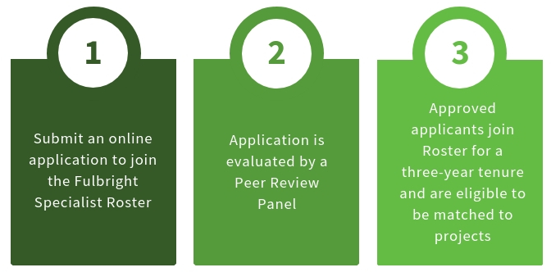
Fulbright Specialist Roster
The Fulbright Specialist Roster is a pre-vetted group of individuals who are eligible to be matched to Specialist projects designed by host institutions abroad

Slide 12
Key Eligibility Criteria
Online Application Components
Must be a U.S. citizen
Have significant experience in your respective field, as demonstrated by professional, academic, or artistic achievements
U.S. Alumni of other Fulbright programs are eligible to apply; 24-month waiting period applies to anyone previously admitted to the Fulbright Specialist Roster
Required:
Personal Information
Education
Employment
Resume/CV
Essays (2)
Reference Contacts (3)
Optional:
Geographic Preferences
Language Skills

Slide 13
Roster Application Essay Prompts
Maximum of 1500 words each
Essay One: Please describe why you are interested in serving as a Fulbright Specialist and how your participation would benefit a host institution abroad as well as your institution or employer in the U.S.
Please include specific examples of activities that you may be interested in leading or completing at your host institution abroad as part of your program.
Essay Two: Please describe any previous experience working in an international environment and why you believe that you would be effective serving as a Fulbright Specialist at a host institution abroad.
If you do not have prior experience in an international setting, please describe what strategies you would employ in order to be successful while serving as a Fulbright Specialist in a cross-cultural context.

Slide 14
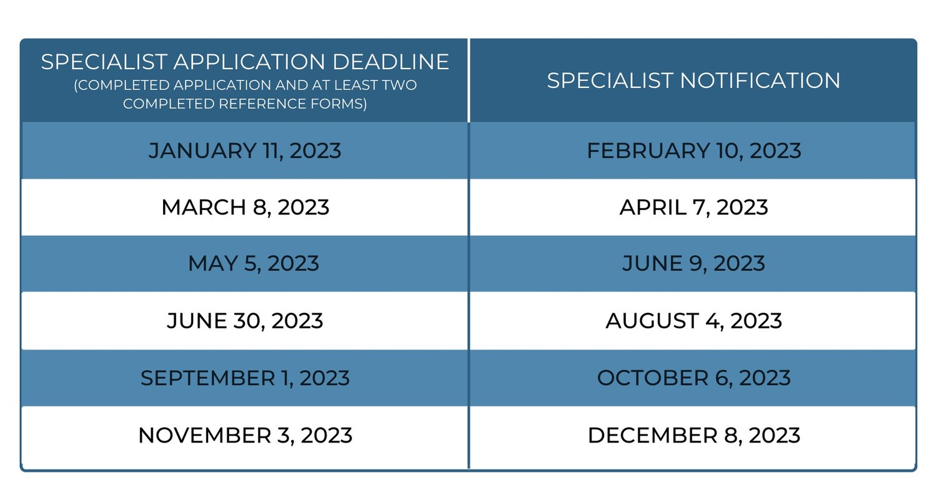
Application Review Process
Applications are accepted year-round and peer review panels are convened six times per year
Peer review panels are comprised of three individuals from the same general field as the applicant
Panels assess professional qualifications, cross-cultural skills and adaptability, potential for overall benefit to stakeholders, etc.
Visit fulbrightspecialist.worldlearning.org
for a full list of peer review panel criteria

Slide 15

The Matching Process
Individuals accepted to the Roster receive access to an online Portal for the duration of their tenure
Through the Portal, users can view and express interest in any available open projects by a set deadline
A list of qualified candidates is then sent to the host institution to review and select a finalist
Please note that host institutions may opt to request an individual to serve as the Specialist for a particular project, if they have a prior affiliation with the candidate or a candidate was recommended to them

Slide 16
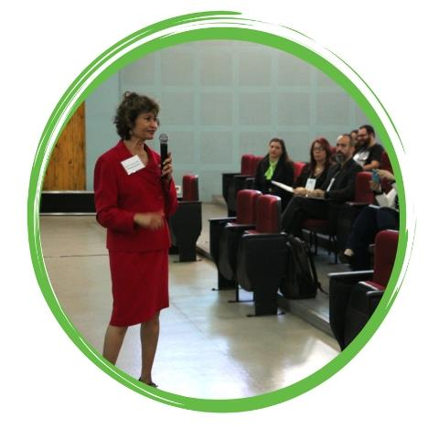
Grant Implementation
Once an individual on the Roster has been successfully matched to a project, World Learning staff will begin grant implementation including:
  Distributing and collecting program forms
  Arranging international travel
  Disbursing honorarium payment
  Conducting a mid-program call
  Serving as primary point of contact

Slide 17
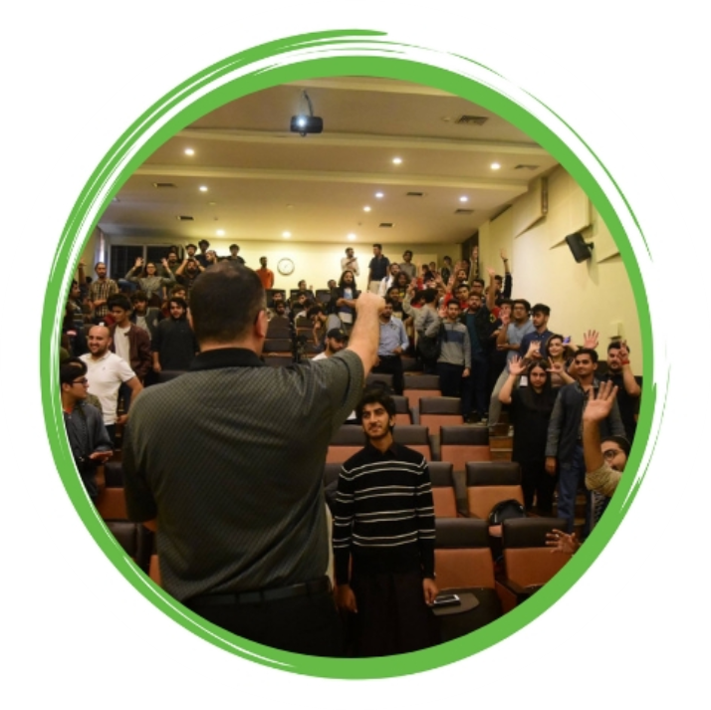
Questions? Contact us!
Fulbright Specialist Program: fulbrightspecialist@worldlearning.org
Visit fulbrightspecialist.worldlearning.org
to learn more and apply

