Slide 1
Fulbright Meet and Greet
September 1, 2023
Fulbright Program Opportunities
^{Kristen Clarke Kellems}
^{Research Development DIRECTOR}
BYU FuLBRIGHT U.S. Scholar Program Liaison
^{kckellems@byu.edu; 2-8967}
Notes:
Specify that you will focus on U.S. scholar awards for faculty and professionals (FYI for those interested in Student or Visiting Scholar Programs.)

Slide 2
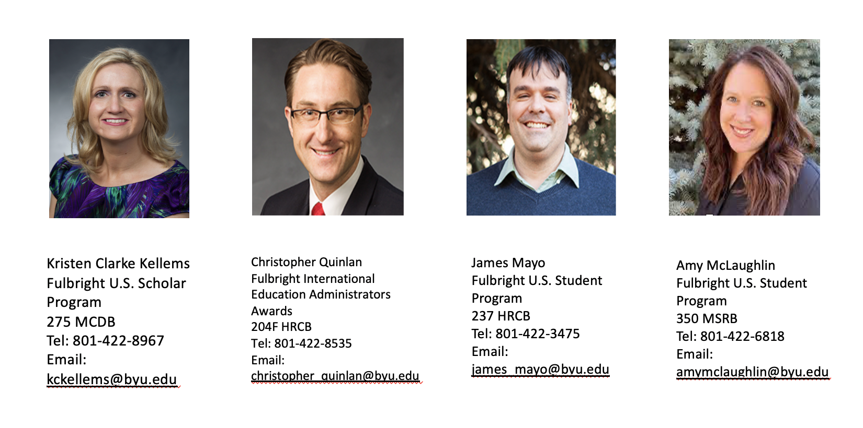
BYU Fulbright Contacts
Notes:
While US Scholar is the smallest piece of this puzzle, it is the most strategic. All other programs are possible through the development of relationships that faculty foster while abroad through programs like Fulbright.

Slide 3
Fulbright by the Numbers
The Fulbright Program funds over 8,000 awards annually:
900
900
2,200
4,000
400
U.S. scholars and administrators
Visiting
scholars
U.S.
students
foreign
students
language teaching assistants
Notes:
While US Scholar is the smallest piece of this puzzle, it is the most strategic. All other programs are possible through the development of relationships that faculty foster while abroad through programs like Fulbright.

Slide 4

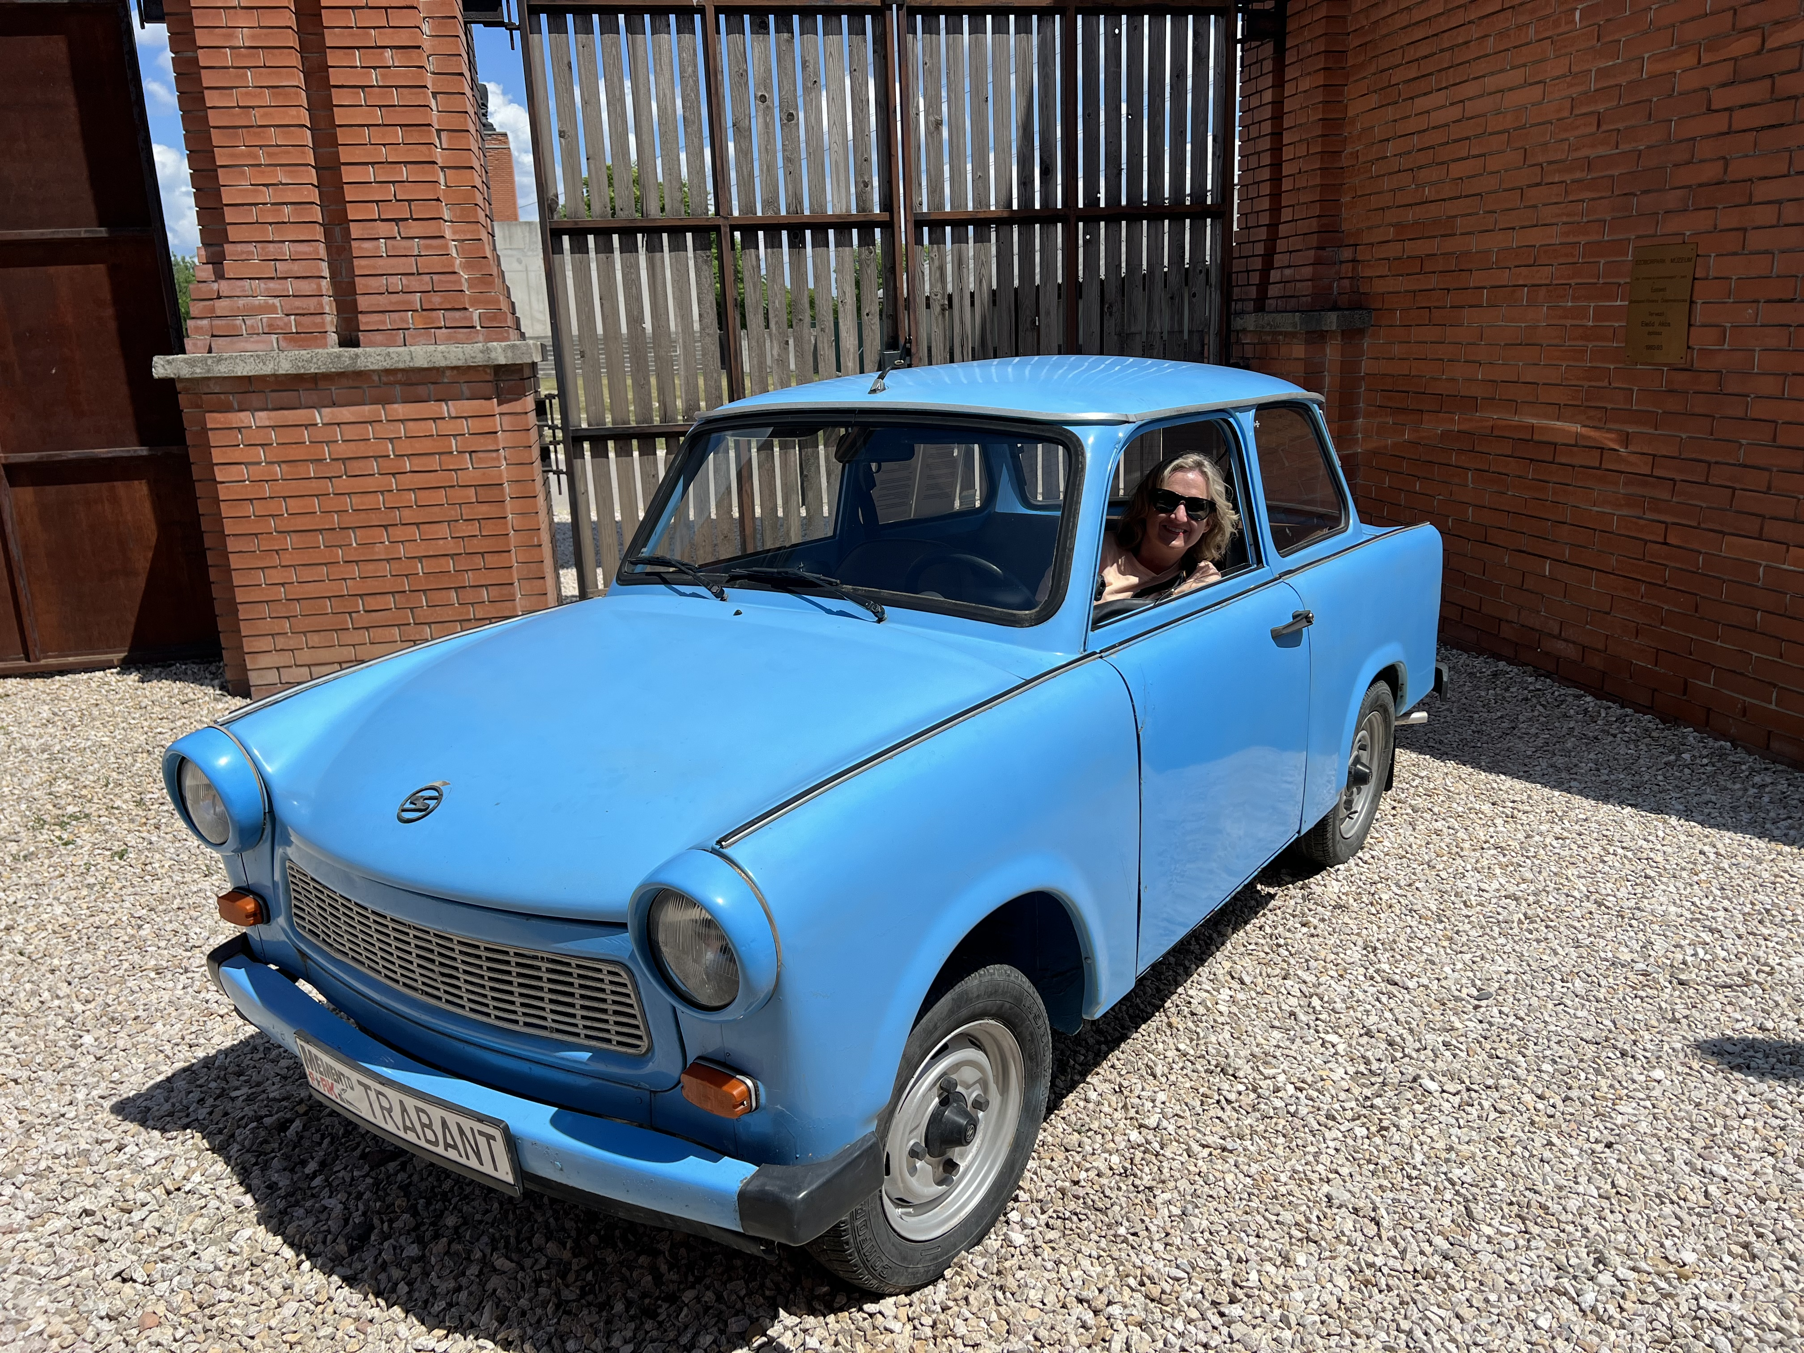
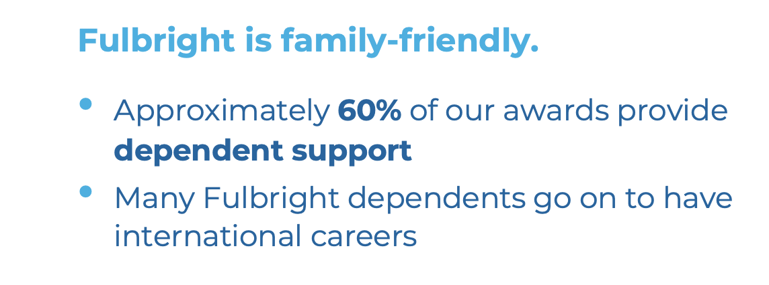
Why Fulbright?
Fulbright is transformational.
Foster relationships that are real and lasting
Expand your publishing network
Become more multicultural in the classroom
Serve as an ambassador for international exchange
Gain the professional recognition as being identified as a “Fulbright Scholar”
Join a vibrant alumni network

Slide 5

Which Award is for you?
Award Types:
1
Scholar Awards
2
Postdoctoral Awards
3
Distinguished Scholar Awards
4
International Education Administrator Awards
Notes:
Different award categories fall under the umbrella of the U.S. Scholar Program
Scholar awards are by far the largest category, ranging in grant length and professional profile. These can be for postdoctoral researchers to full professors and everyone in between.
Postdoctoral awards are specific to researchers who have completed their PhD within 5 years of the fellowship start date.
Distinguished Scholar awards are intended for more accomplished faculty. Some awards look for those at associate or full professor rank or above – always consult award description
IEA awards – for administrators at US campuses to participate in seminars abroad. These are not for faculty and do not support research or teaching, but are excellent opportunities for faculty with administrative responsibilities (such as a dean or chair) and university staff.

Slide 6

Tips for a strong application:
USE IIE RESOURCES
READ AWARD’S DESCRIPTION
START EARLY
Before you start, read your award’s description carefully to ensure you meet all requirements and your proposed project is possible.
Start application and enter referees’ information
as soon as possible.
Take advantage of IIE resources
Talk to Kristen
Talk to BYU Fulbright alumni
2024-2025 Application Deadline: September 15, 2023
Notes:
Read the description carefully: as obvious as this sounds, you want to make sure what you're proposing is appropriate and you are personally eligible for the award. Confirm all this before you begin!
Start as soon as possible: This will allow you to familiarize yourself with the application system and avoid any last minute panics at the deadline. Also remember that your references are due on the same day as your application (Sept 15), so you want to give your referees as much time as you can for them to submit their letters on your behalf.
We are here to help! We offer resources throughout the competition to guide you through the application process, plus office hours to ask your questions live to IIE staff.
Applicants who follow instructions are always the most competitive.

Slide 7

Application Components
Requirements:
Supplemental Materials:
Application Form
Course outlines or syllabi (for teaching)
Project Statement
Reference list (for research)
Curriculum Vitae or Resume
Portfolio submissions (for artists, architects, and journalists)
2 Letters of Recommendation
Language Proficiency Report (if required)
Letter of Invitation (if required)
Notes:
Note: IEA/FPPF application requirements are a bit different – In lieu of a project statement, applicants submit a series of essays.

Slide 8
Application Cycle
FEBRUARY
Competition Opens
SEPTEMBER 15
Application Deadline
SEPTEMBER
Program staff conducts technical reviews for completeness
OCTOBER – NOVEMBER
U.S. peer review
NOVEMBER – JANUARY
Applicants notified of status. Recommended applications are sent to host countries and to the Fulbright Foreign Scholarship Board.
JANUARY – JUNE
Final decisions are made
JUNE – ONWARD
Participants prepare for departure
Notes:
Note that the notification window for hearing final decisions is wide but also accurate. People can year as early as January and as late as the end of May.
**Note: Award timeline for IEA Seminars is different, depending on the award!

Slide 9
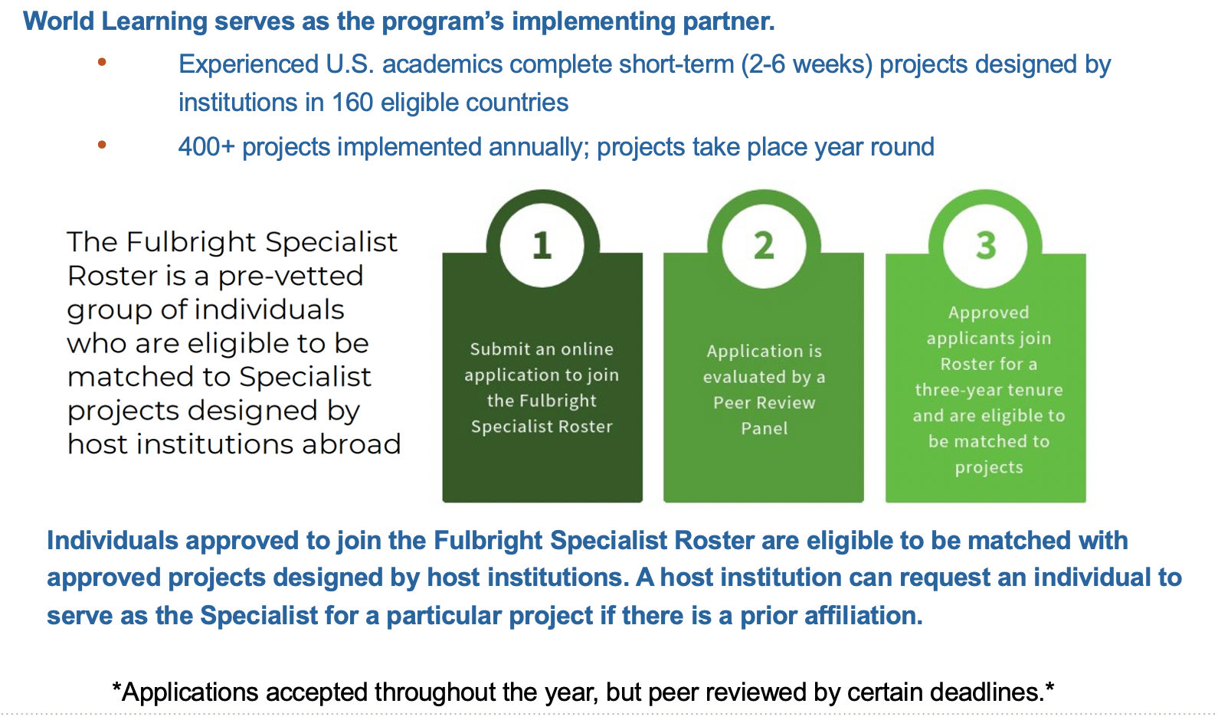
Fulbright Specialist Program
Notes:
Read the description carefully: as obvious as this sounds, you want to make sure what you're proposing is appropriate and you are personally eligible for the award. Confirm all this before you begin!
Start as soon as possible: This will allow you to familiarize yourself with the application system and avoid any last minute panics at the deadline. Also remember that your references are due on the same day as your application (Sept 15), so you want to give your referees as much time as you can for them to submit their letters on your behalf.
We are here to help! We offer resources throughout the competition to guide you through the application process, plus office hours to ask your questions live to IIE staff.
Applicants who follow instructions are always the most competitive.

Slide 10
International Education Administrator (IEA) Awards: Participate in a seminar!
fulbrightscholars.org/IEA
Fully-funded two week seminars for administrators (staff and faculty/leadership with responsibilities related to international education on U.S. campuses) to learn about a host country’s higher education system
Awards available for 2024-25 in:
India
Taiwan Japan
Korea
Germany France

Slide 11
Fulbright Scholar/Specialist Resources
CIES website – www.cies.org
Fulbright Scholar Program online Catalog of Awards and Application
Program Overview, Guidelines, Frequently Asked Questions and Tips for Applying
Specialist website – www.fulbrightspecialist.worldlearning.org
Email: kckellems@byu.edu
Overview of the Fulbright Specialist Roster and Application Process
Notes:
Read the description carefully: as obvious as this sounds, you want to make sure what you're proposing is appropriate and you are personally eligible for the award. Confirm all this before you begin!
Start as soon as possible: This will allow you to familiarize yourself with the application system and avoid any last minute panics at the deadline. Also remember that your references are due on the same day as your application (Sept 15), so you want to give your referees as much time as you can for them to submit their letters on your behalf.
We are here to help! We offer resources throughout the competition to guide you through the application process, plus office hours to ask your questions live to IIE staff.
Applicants who follow instructions are always the most competitive.

Slide 12


Slide 13




Program Award Types
Study/Research Grant
Independent research, study, or arts projects abroad
2,200+
Awards
__
140+
Countries Worldwide
950+
8-10
~140
Awards
Months
Countries
English Teaching Assistantship (ETA)
Help teach English and U.S. culture in the classroom
1,250+
8-10
~75
Awards
Months
Countries
Notes:
With over 2,200 awards to over 140 different countries, there are many opportunities to pursue your passion abroad
Fulbright U.S. Student Program grants fall into two categories: Open Study/Research awards and English Teaching Assistantships
Study/Research Awards: Opportunity to build your own adventure. Candidates for the Open Study/Research grant include those proposing independent study or research abroad; independent research while taking classes as a non-degree seeking student at a foreign university; or, to directly enroll in a graduate degree program abroad.
Independent research- Intellectually compelling and feasible project
Graduate Degree Enrollment- Applicant should specify the reasons for applying to proposed program at a particular institution in the host country. Applicants applying for graduate degree enrollment are traditionally responsible for securing admission to the university through the institution’s application process in addition to submitting a Fulbright application.
Hybrid b/w research and non-degree seeking
Creative & performing arts
English Teaching Assistantship: The ETA program places grantees in schools overseas to supplement local English language instruction and to provide a native English speaker presence in classrooms. Placements and experience vary by country so the first step, is to familiarize yourself with the country summary for the program to which you are applying.

Slide 14
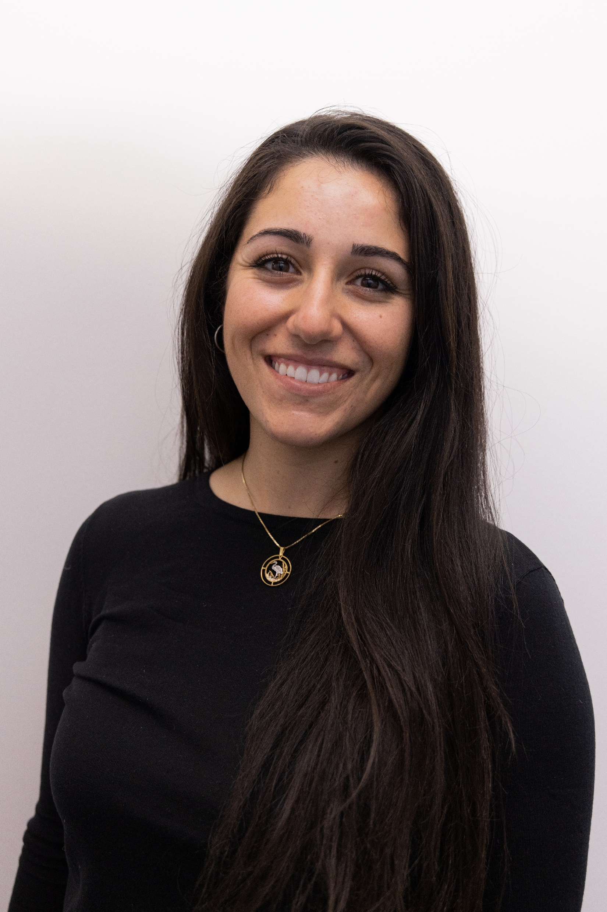
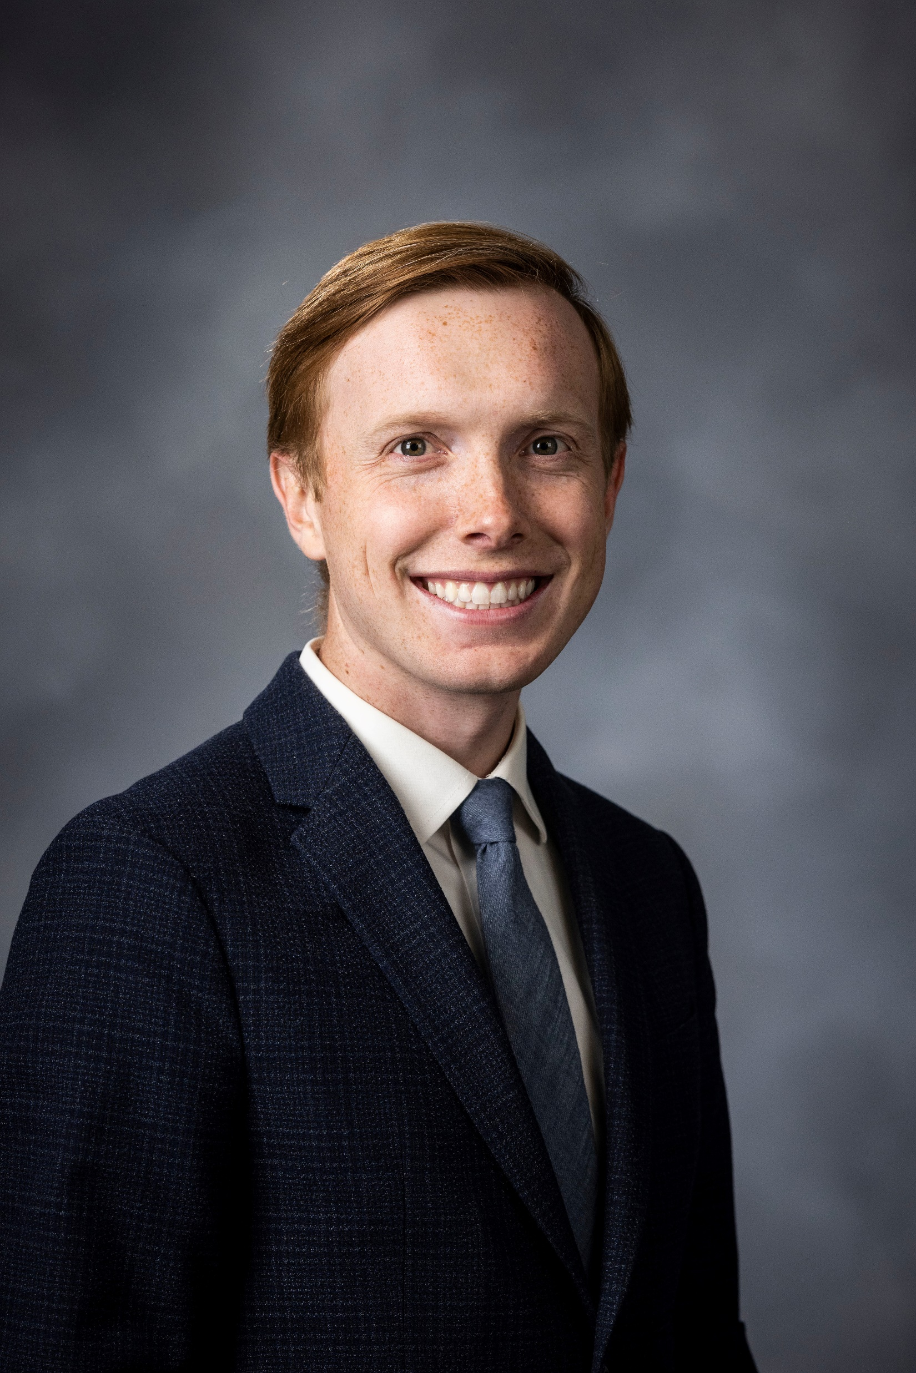
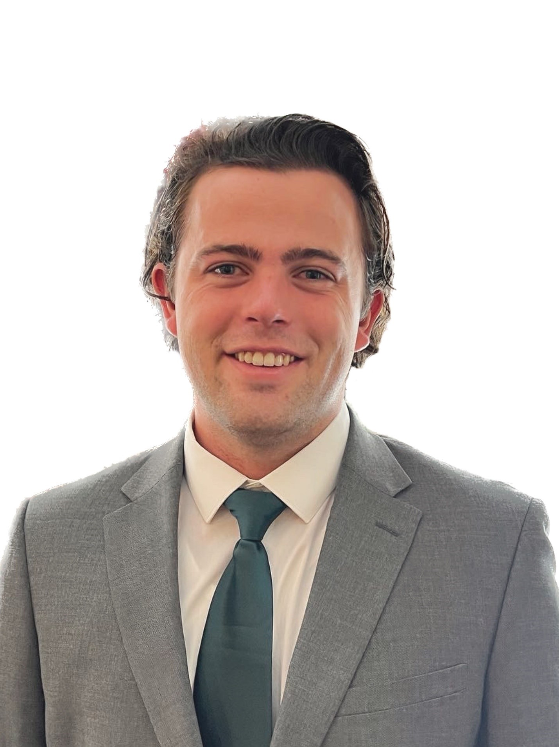

Recent BYU Fulbright Award Grantees
Ashlen Lemon
Cambodia
English Teaching Assistantship
Isabella Errigo
Ecuador
Research Award
Ben Stone
Estonia
Research Award
John McHenry
Tajikistan
English Teaching Assistantship

Slide 15


How Faculty Can Help:
Faculty referrals of qualified students
Help spread the word to students through newsletters/digital signage/fliers
In-class presentations or presentations to departments as a whole

